Slide 1
Example Module Ain’t Core
But it ain’t contrib neither

Slide 2

This here ‘con ain’t big enough for the both of our hats, crell!

Slide 3
This here ‘con ain’t big enough for the both of our hats, crell!

Slide 4

No core
No code
No Example

Slide 5
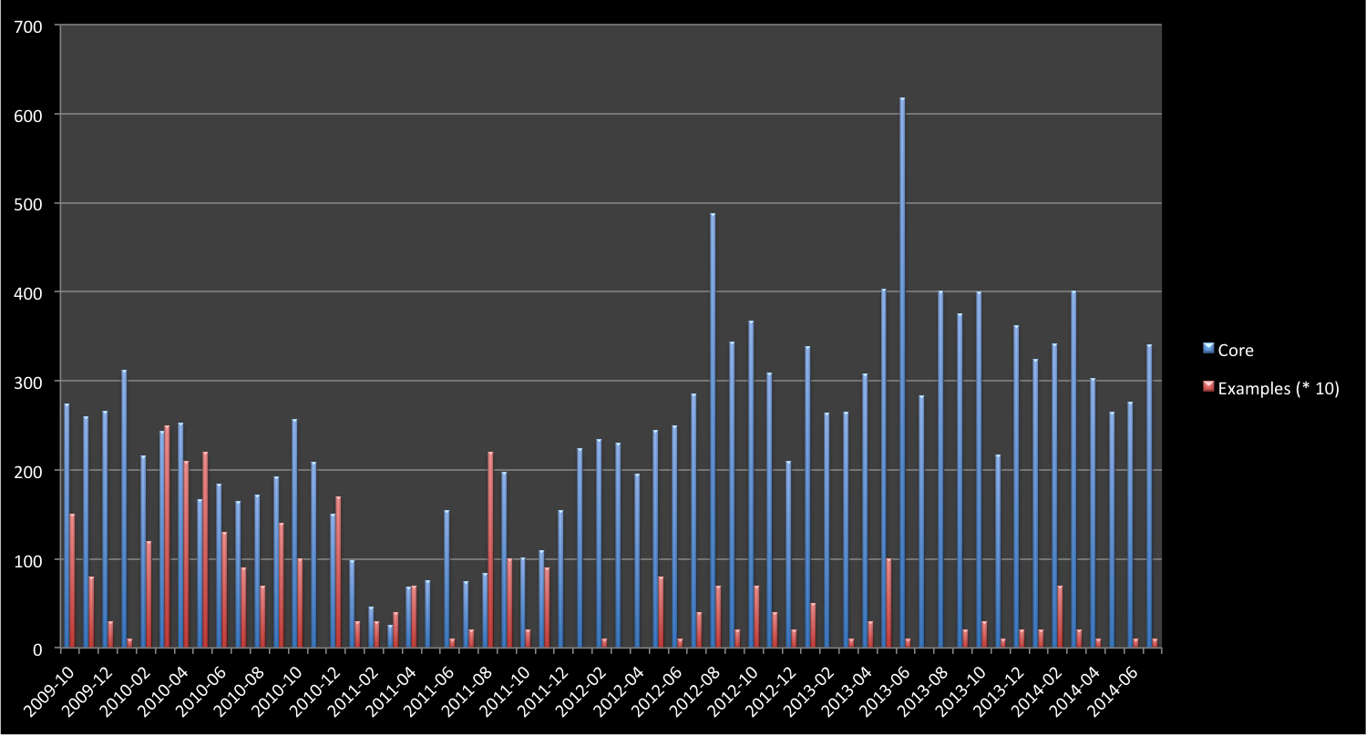
Drupal 8.0-Alpha-1
Drupal 7.0-alpha-1
Tablesort & Pager Example
Simpletest 8.x Example
Drupal 7.0-RC-1

Slide 6
Initial work
Drupal 7
Pre-release
Drupal 7
Post-release
Drupal 8
Example Modules Commits
Time

Slide 7
Initial work
Drupal 7
Pre-release
Drupal 7
Post-release
Drupal 8
Yikes!
Example Modules Commits
Time

Slide 8
Where do I even start?

Slide 9
Monetary investment
Paid Training
Educational prose
Community Documentation
Source code
Experience Required

Slide 10
Should I be fast?
Should I be easy to expand?
Should I be easy to understand?

Slide 11
Information
Knowledge

Slide 13
If you can’t port, then rewrite!

Slide 14
If you can’t port, then rewrite!
I canna do it, the core’s too diffn’t!

Slide 15
Field API
Entity System
Form API
DBTNG
Time to understand
Hooks
Core contributors
Example Contributors

Slide 16
Routing
Plugins
CMI
OOP
Symphony
Time to understand
Simpletest
YAML
Form API
Hooks?
Core contributors
Example Contributors

Slide 17
Routing
Shadow of Doubt
Plugins
CMI
OOP
Symphony
Time to understand
Simpletest
YAML
Form API
Hooks?
Core contributors
Example Contributors

Slide 18
…How it connects to everything has.
This API is “largely unchanged”, but..

Slide 19
What if it goes away in the next alpha?
Should I even be using this?
How can I make any decision here!?

Slide 20
Maybe core devs should do this?
Then at least Examples would keep up with core…

Slide 21
Example Modules Commits (Ideal)
Core Beta
Stable core
Core Alpha
Time

Slide 22
Critical examples updated/created
Example Modules Commits (Ideal)
Core Beta
Stable core
Core Alpha
Time

Slide 23
Critical examples updated/created
Critical examples Ready, non-criticals started
Example Modules Commits (Ideal)
Core Beta
Stable core
Core Alpha
Time

Slide 24
Critical examples updated/created
Critical examples Ready, non-criticals started
Non-critical examples ready
Example Modules Commits (Ideal)
Core Beta
Stable core
Core Alpha
Time

Slide 25
Critical examples updated/created
Critical examples Ready, non-criticals started
Non-critical examples ready
Minor fixes only!!!
Example Modules Commits (Ideal)
Core Beta
Stable core
Core Alpha
Time

Slide 26
New Developer

Slide 27
New Developer
Drupal.org

Slide 28

New Developer
Drupal.org
Download link

Slide 29
New Developer
Drupal.org
Download link
Install on Web server

Slide 30
New Developer
Drupal.org
Download link
?
Install on Web server
Find no examples

Slide 31
New Developer
Drupal.org
Download link
?
Install on Web server
Find no examples
Search for examples

Slide 32

New Developer
Drupal.org
Download link
?
Install on Web server
Find no examples
Search for examples
Download Examples!

Slide 33
New Developer
Drupal.org
Download link
?
Install on Web server
Find no examples
Search for examples
Download Examples!
What the heck is a module?

Slide 34
New Developer
Drupal.org
Download link
?
Install on Web server
Find no examples
Search for examples
*headdesk*
*headdesk*
Download Examples!
What the heck is a module?

Slide 35
New Developer
Drupal.org
Download link
Install on Web server
Enable Examples

Slide 36
New Developer
Drupal.org
Download link
Install on Web server
Enable Examples
{Happiness}

Slide 38
I’ve got some shiny new code for you.

Slide 39
I’ve got some shiny new code for you.
Cool, I’ll test it.

Slide 41
Dude, I think there’s a bug in here.

Slide 42
Dude, I think there’s a bug in here.
But…shiny?

Slide 43
Actual bugs

Slide 44
Actual bugs
Developer experience
(DX)

Slide 45
Actual bugs
Developer experience
(DX)
Feature gaps
(Entity API?)

Slide 46
Actual bugs
Developer experience
(DX)
Feature gaps
(Entity API?)
Unexpected use

Slide 47
Shouldn’t I live over there?
Routing
Plugins
CMI
OOP
Symphony
Time to understand
Simpletest
YAML
Form API
Hooks?
Core contributors
Example Contributors

Slide 48
New Developer

Slide 49
New Developer
Bug found in Core Examples

Slide 50
New Developer
Bug found in Core Examples
New issue on Drupal.org

Slide 51
New Developer
Bug found in Core Examples
New issue on Drupal.org
Submitted Patch

Slide 52
New Developer
Bug found in Core Examples
New issue on Drupal.org
Submitted Patch
New commit!

Slide 53
New Developer
Bug found in Core Examples
New issue on Drupal.org
Submitted Patch
New commit!
{Happiness}

Slide 55
This makes core better, easier, faster.

Slide 56
This makes core better, easier, faster.
But does it work for contrib?

Slide 58
I’m core isolated

Slide 59
I’m core isolated
I test DX {before} core is frozen.

Slide 60
Core Developer

Slide 61

New Core
Core Developer

Slide 62

New Core
In-core Examples
Core Developer

Slide 63
Dude,
everything’s
broken.
New Core
In-core Examples
Core Developer

Slide 64
Dude,
everything’s
broken.
Can’t you see I’m busy?
New Core
In-core Examples
Core Developer

Slide 65
Dude,
everything’s
broken.
Can’t you see I’m busy?
Fine! I fail
all your
tests.
New Core
In-core Examples
Core Developer

Slide 66
Dude,
everything’s
broken.
Can’t you see I’m busy?
Fine! I fail
all your
tests.
%#$!^%$
New Core
In-core Examples
Core Developer

Slide 67

Dude,
everything’s
broken.
New Core
In-core Examples
Core Developer

Slide 68

Dude,
everything’s
broken.
New Core
In-core Examples
Core Developer

Slide 69

Near alpha Core
In-core Examples
Core Developer

Slide 70
Dude,
everything’s
{still}
broken.
Near alpha Core
In-core Examples
Core Developer

Slide 71
Dude,
everything’s
{still}
broken.
Fine. Let’s fix you.
Near alpha Core
In-core Examples
Core Developer

Slide 72
Dude,
everything’s
{still}
broken.
Fine. Let’s fix you.
There goes our
release date.
Near alpha Core
In-core Examples
Core Developer

Slide 73
Why am I developing code not used by 90% of Drupal sites?
This should be contrib’s problem.
Core Developer

Slide 74
This is your fault!

Slide 75
New Core

Slide 76

New Core
Tests Disabled

Slide 77

Development Continues
New Core
Near alpha
Time gap
Tests Disabled

Slide 78

Development Continues
New Core
Near alpha
Time gap
Development {halted}
Tests Disabled

Slide 79

Development Continues
New Core
Near alpha
Time gap
Development {halted}
Tests Disabled
Update begins, Tests enabled

Slide 80
Development Continues
New Core
Near alpha
Time gap
Development {halted}
Tests Disabled
Update begins, Tests enabled
Completed Examples

Slide 81
Development Continues
New Core
Near alpha
Stable
Time gap
Development {halted}
Tests Disabled
Update begins, Tests enabled
Completed Examples

Slide 82
<drupal_root>
core
modules
Index.php

Slide 83
<drupal_root>
core
modules
Examples
Index.php

Slide 84
<drupal_root>
core
modules
examples
modules
Index.php

Slide 85
<drupal_root>
core
examples
modules
Index.php

Slide 86
<drupal_root>
core
modules
Examples
Index.php

Slide 87
Essential
Examples
Non-essential
examples
Example bug fixes only
8.x-dev
New Example window
8.0.x
8.1.x
Example Modules Commits (Ideal)
8.2.x
8.3.x (LTS)
9.X-dev
Years

Slide 88
This is your fault!

Slide 89
This is your fault!
Hey, That’s not fixing anything.

Slide 90
And you are!?

Slide 91
And you are!?
I’m the…
Contrib Champion

Slide 94
Raise Excitement

Slide 95
Raise Excitement
Mediate

Slide 96
Educate
Raise Excitement
Mediate

Slide 98

Examples
Flag
Rules

Slide 100
I have valid concerns
About core,

Slide 101
I have valid concerns
About core,
But I don’t feel
comfortable bringing
them to core devs
directly.

Slide 102
I have valid concerns
About core,
But I don’t feel
comfortable bringing
them to core devs
directly.
Okay, let’s document them.

Slide 103
Later…

Slide 104
Later…
We’ve had a lot
of concerns
about these issues.

Slide 105
Later…
We’ve had a lot
of concerns
about these issues.

Slide 106
Later…
We’ve had a lot
of concerns
about these issues.
Oh! Well…

Slide 107
Later…
We’ve had a lot
of concerns
about these issues.
Oh! Well…
Great! I’ll let Them
know!

Slide 108
Please remove me from Maintainers.txt
I no longer understand how core works.
Core no longer supports hobbyists.

Slide 109
I need to reduce my role in core
I have kids now, and I can’t keep up with the changes.
How to manage this transition?

Slide 111
I need to reduce my role in core

Slide 112
I need to reduce my role in core
I have kids now, and I can’t keep up with the changes.

Slide 113
I need to reduce my role in core
I have kids now, and I can’t keep up with the changes.
How to manage this transition?

Slide 114

I’m gonna get eaten.
New Developer

Slide 115
New Developer
Contrib Champion

Slide 116
It’s dangerous to drupal alone, take this!
New Developer
Contrib Champion

Slide 117
It’s dangerous to drupal alone, take this!
New Developer
Contrib Champion

Slide 118
Core Developer
Contrib Champion

Slide 119
I’m terrified of all these changes
Contrib Developer
Contrib Champion

Slide 120


Slide 121

/

Slide 122
(

Slide 123
(

