Slide 2
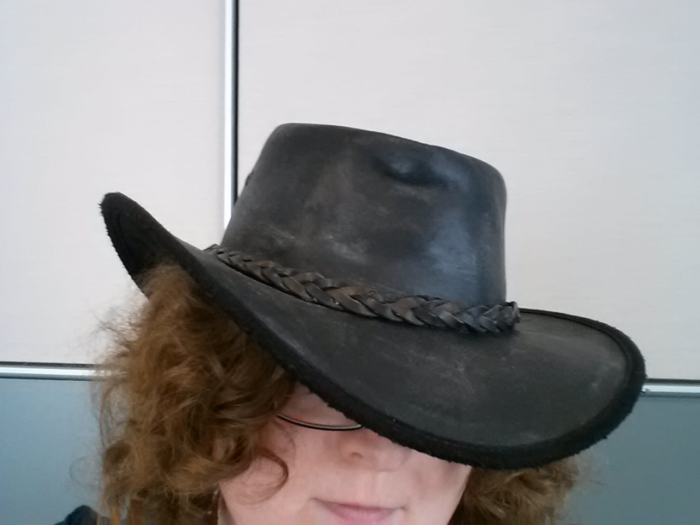
This here ‘con ain’t big enough for the both of our hats, crell!

Slide 3
This here ‘con ain’t big enough for the both of our hats, crell!

