Slide 1
Example Module Ain’t Core
But it ain’t contrib neither

Slide 2

This here ‘con ain’t big enough for the both of our hats, crell!

Slide 3
This here ‘con ain’t big enough for the both of our hats, crell!

Slide 4

No core
No code
No Example

Slide 5

/

Slide 6

/

Slide 7
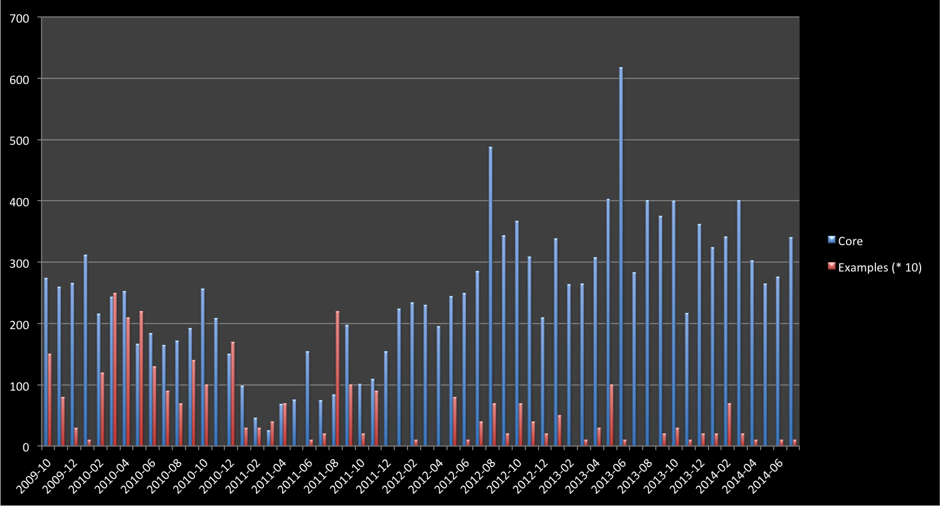
Drupal 8.0-Alpha-1
Drupal 7.0-alpha-1
Tablesort & Pager Example
Simpletest 8.x Example
Drupal 7.0-RC-1

Slide 8
Initial work
Drupal 7
Pre-release
Drupal 7
Post-release
Drupal 8
Example Modules Commits
Time

Slide 9
Initial work
Drupal 7
Pre-release
Drupal 7
Post-release
Drupal 8
Yikes!
Example Modules Commits
Time

Slide 10
Core Alpha
Core Beta
Stable core
Example Modules Commits (Ideal)
Time

Slide 11
Where do I even start?

Slide 12
Monetary investment
Paid Training
Educational prose
Community Documentation
Source code
Experience Required

Slide 13
Should I be fast?
Should I be easy to expand?
Should I be easy to understand?

Slide 14
Information
Knowledge

Slide 16
If you can’t port, then rewrite!

Slide 17
If you can’t port, then rewrite!
I canna do it, the core’s too diffn’t!

