Slide 1
Example Module Ain’t Core
But it ain’t contrib neither

Slide 2



Slide 3

This here ‘con ain’t big enough for the both of our hats, crell!

Slide 4
This here ‘con ain’t big enough for the both of our hats, crell!

Slide 5

No core
No code
No Example

Slide 6
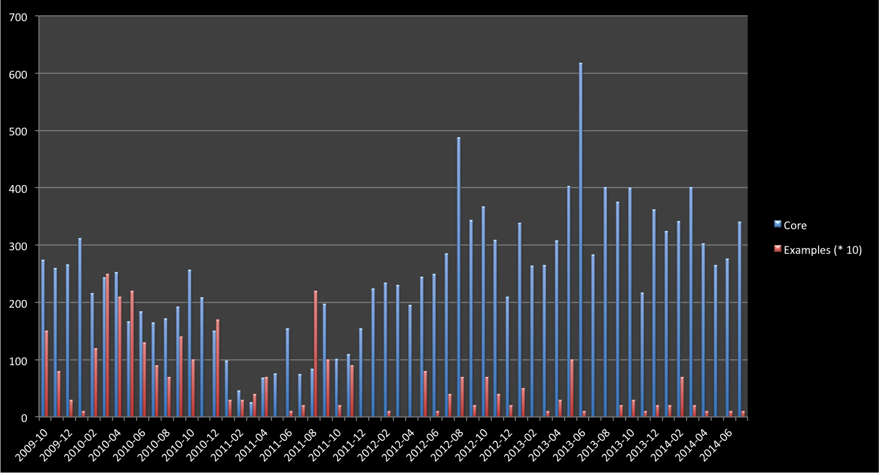
Drupal 8.0-Alpha-1
Drupal 7.0-alpha-1
Tablesort & Pager Example
Simpletest 8.x Example
Drupal 7.0-RC-1

Slide 7
Initial work
Drupal 7
Pre-release
Drupal 7
Post-release
Drupal 8
Example Modules Commits
Time

Slide 8
Initial work
Drupal 7
Pre-release
Drupal 7
Post-release
Drupal 8
Yikes!
Example Modules Commits
Time

Slide 9
Where do I even start?

Slide 10
Monetary investment
Paid Training
Educational prose
Community Documentation
Source code
Experience Required

Slide 11
Should I be fast?
Should I be easy to expand?
Should I be easy to understand?

Slide 12
Information
Knowledge

Slide 14
If you can’t port, then rewrite!

Slide 15
If you can’t port, then rewrite!
I canna do it, the core’s too diffn’t!

Slide 16
Field API
Entity System
Form API
DBTNG
Time to understand
Hooks
Core contributors
Example Contributors

Slide 17
Routing
Plugins
CMI
OOP
Symphony
Time to understand
Simpletest
YAML
Form API
Hooks?
Core contributors
Example Contributors

Slide 18
Routing
Shadow of Doubt
Plugins
CMI
OOP
Symphony
Time to understand
Simpletest
YAML
Form API
Hooks?
Core contributors
Example Contributors

Slide 19
…How it connects to everything has.
This API is “largely unchanged”, but..

Slide 20
What if it goes away in the next release?
Should I even be using this?
How can I make any decision here!?

Slide 21
Maybe core devs should do this?
Then at least Examples would keep up with core…

Slide 22
Example Modules Commits (Ideal)
Core Beta
Stable core
Core Alpha
Time

Slide 23
Critical examples updated/created
Example Modules Commits (Ideal)
Core Beta
Stable core
Core Alpha
Time

Slide 24
Critical examples updated/created
Critical examples Ready, non-criticals started
Example Modules Commits (Ideal)
Core Beta
Stable core
Core Alpha
Time

Slide 25
Critical examples updated/created
Critical examples Ready, non-criticals started
Non-critical examples ready
Example Modules Commits (Ideal)
Core Beta
Stable core
Core Alpha
Time

Slide 26
Critical examples updated/created
Critical examples Ready, non-criticals started
Non-critical examples ready
Minor fixes only!!!
Example Modules Commits (Ideal)
Core Beta
Stable core
Core Alpha
Time

Slide 27
New Developer

Slide 28
New Developer
Drupal.org

Slide 29

New Developer
Drupal.org
Download link

Slide 30
New Developer
Drupal.org
Download link
Install on Web server

Slide 31
New Developer
Drupal.org
Download link
?
Install on Web server
Find no examples

Slide 32
New Developer
Drupal.org
Download link
?
Install on Web server
Find no examples
Search for examples

Slide 33

New Developer
Drupal.org
Download link
?
Install on Web server
Find no examples
Search for examples
Download Examples!

Slide 34
New Developer
Drupal.org
Download link
?
Install on Web server
Find no examples
Search for examples
Download Examples!
What the heck is a module?

Slide 35
New Developer
Drupal.org
Download link
?
Install on Web server
Find no examples
Search for examples
*headdesk*
*headdesk*
Download Examples!
What the heck is a module?

Slide 36
New Developer
Drupal.org
Download link
Install on Web server
Enable Examples

Slide 37
New Developer
Drupal.org
Download link
Install on Web server
Enable Examples
{Happiness}

Slide 39
I’ve got some shiny new code for you.

Slide 40
I’ve got some shiny new code for you.
Cool, I’ll test it.

Slide 42
Dude, I think there’s a bug in here.

Slide 43
Dude, I think there’s a bug in here.
But…shiny?

Slide 44
Actual bugs

Slide 45
Actual bugs
Developer experience
(DX)

Slide 46
Actual bugs
Developer experience
(DX)
Feature gaps
(Entity API?)

Slide 47
Actual bugs
Developer experience
(DX)
Feature gaps
(Entity API?)
Unexpected use

Slide 48
Shouldn’t I live over there?
Routing
Plugins
CMI
OOP
Symphony
Time to understand
Simpletest
YAML
Form API
Hooks?
Core contributors
Example Contributors

Slide 49
New Developer

Slide 50
New Developer
Bug found in Core Examples

Slide 51
New Developer
Bug found in Core Examples
New issue on Drupal.org

Slide 52
New Developer
Bug found in Core Examples
New issue on Drupal.org
Submitted Patch

Slide 53
New Developer
Bug found in Core Examples
New issue on Drupal.org
Submitted Patch
New commit!

Slide 54
New Developer
Bug found in Core Examples
New issue on Drupal.org
Submitted Patch
New commit!
{Happiness}

Slide 56
This makes core better, easier, faster.

Slide 57
This makes core better, easier, faster.
But does it work for contrib?

Slide 59
I’m core isolated

Slide 60
I’m core isolated
I test DX {before} core is frozen.

Slide 61
Core Developer

Slide 62

New Core
Core Developer

Slide 63

New Core
In-core Examples
Core Developer

Slide 64
Dude,
everything’s
broken.
New Core
In-core Examples
Core Developer

Slide 65
Dude,
everything’s
broken.
Can’t you see I’m busy?
New Core
In-core Examples
Core Developer

Slide 66
Dude,
everything’s
broken.
Can’t you see I’m busy?
Fine! I fail
all your
tests.
New Core
In-core Examples
Core Developer

Slide 67
Dude,
everything’s
broken.
Can’t you see I’m busy?
Fine! I fail
all your
tests.
%#$!^%$
New Core
In-core Examples
Core Developer

Slide 68

Dude,
everything’s
broken.
New Core
In-core Examples
Core Developer

Slide 69

Dude,
everything’s
broken.
New Core
In-core Examples
Core Developer

Slide 70

Near release Core
In-core Examples
Core Developer

Slide 71
Dude,
everything’s
{still}
broken.
Near release Core
In-core Examples
Core Developer

Slide 72
Dude,
everything’s
{still}
broken.
Fine. Let’s fix you.
Near release Core
In-core Examples
Core Developer

Slide 73
Dude,
everything’s
{still}
broken.
Fine. Let’s fix you.
There goes our
release date.
Near release Core
In-core Examples
Core Developer

Slide 74
Why am I developing code not used by 90% of Drupal sites?
This should be contrib’s problem.
Core Developer

Slide 75
This is your fault!

Slide 76
New Core

Slide 77

New Core
Tests Disabled

Slide 78

Development Continues
New Core
Near alpha
Time gap
Tests Disabled

Slide 79

Development Continues
New Core
Near alpha
Time gap
Development {halted}
Tests Disabled

Slide 80

Development Continues
New Core
Near alpha
Time gap
Development {halted}
Tests Disabled
Update begins, Tests enabled

Slide 81
Development Continues
New Core
Near alpha
Time gap
Development {halted}
Tests Disabled
Update begins, Tests enabled
Completed Examples

Slide 82
Development Continues
New Core
Near alpha
Stable
Time gap
Development {halted}
Tests Disabled
Update begins, Tests enabled
Completed Examples

Slide 83
<drupal_root>
core
modules
Index.php

Slide 84
<drupal_root>
core
modules
Examples
Index.php

Slide 85
<drupal_root>
core
modules
examples
modules
Index.php

Slide 86
<drupal_root>
core
examples
modules
Index.php

Slide 87
<drupal_root>
core
modules
Examples
Index.php

Slide 88
Essential
Examples
Non-essential
examples
Example bug fixes only
8.x-dev
New Example window
8.0.x
8.1.x
Example Modules Commits (Ideal)
8.2.x
8.3.x (LTS)
9.X-dev
Years

Slide 89
This is your fault!

Slide 90
This is your fault!
Hey, That’s not fixing anything.

Slide 91
And you are!?

Slide 92
And you are!?
I’m the…
Contrib Champion

Slide 95
Raise Excitement

Slide 96
Raise Excitement
Mediate

Slide 97
Educate
Raise Excitement
Mediate

Slide 99

Examples
Flag
Rules

Slide 101
I have valid concerns
About core,

Slide 102
I have valid concerns
About core,
But I don’t feel
comfortable bringing
them to core devs
directly.

Slide 103
I have valid concerns
About core,
But I don’t feel
comfortable bringing
them to core devs
directly.
Okay, let’s document them.

Slide 104
Later…

Slide 105
Later…
We’ve had a lot
of concerns
about these issues.

Slide 106
Later…
We’ve had a lot
of concerns
about these issues.

Slide 107
Later…
We’ve had a lot
of concerns
about these issues.
Oh! Well…

Slide 108
Later…
We’ve had a lot
of concerns
about these issues.
Oh! Well…
Great! I’ll let Them
know!

Slide 109
Please remove me from Maintainers.txt
I no longer understand how core works.
Core no longer supports hobbyists.

Slide 110
I need to reduce my role in core
I have kids now, and I can’t keep up with the changes.
How to manage this transition?

Slide 112
I need to reduce my role in core

Slide 113
I need to reduce my role in core
I have kids now, and I can’t keep up with the changes.

Slide 114
I need to reduce my role in core
I have kids now, and I can’t keep up with the changes.
How to manage this transition?

Slide 115

I’m gonna get eaten.
New Developer

Slide 116
New Developer
Contrib Champion

Slide 117
It’s dangerous to drupal alone, take this!
New Developer
Contrib Champion

Slide 118
It’s dangerous to drupal alone, take this!
New Developer
Contrib Champion

Slide 119
Core Developer
Contrib Champion

Slide 120
I’m terrified of all these changes
Contrib Developer
Contrib Champion

Slide 121


Slide 122

/

Slide 123
(

Slide 124
(

