Slide 1


Slide 2
@socketwench
Tess Flynn

Slide 3
That’s wench, not wrench.
@socketwench
Tess Flynn

Slide 4
That’s wench, not wrench.
Flag
Module Maintainer
Flag Friend
Examples
@socketwench
Tess Flynn

Slide 5

That’s wench, not wrench.
Flag
Drupal Developer
Module Maintainer
Flag Friend
Examples
@socketwench
Tess Flynn

Slide 6
Page

Slide 7
Page
Page
Page
Page
Page
Page
Page

Slide 8
Page
Page
Page
Page
Page
Page
Page
Page
Page
Page
Page
Page
Page
Page
Page
Page
Page
Page
Page
Page
Page

Slide 9


Slide 10
content
content
content
Content

Slide 11
Blog
Forum
Picture
Page

Slide 12
Content Type

Slide 13
Title
Content Type

Slide 14
Title
Custom Fields
Content Type

Slide 15
Title
Custom Fields
Content Type
Permissions

Slide 16
Title
Custom Fields
Content Type
Permissions
Metadata

Slide 17
But what’s all this for? Why do we need it?

Slide 21
There it is!

Slide 23
Tools
Clothes
Games
Cooking

Slide 24
Now I can find what I need and work more effectively.
Tools
Clothes
Games
Cooking

Slide 25
“Lessons from the issue queue”
“Flag module recipes”
“Me by the lake”
“About US”

Slide 26
Blog
Forum
Picture
Page

Slide 27
Blog Type
Forum type
Picture type
Page Type

Slide 28
So, we’re done, right?

Slide 29

So, we’re done, right?
Right?

Slide 30
Unstructured content

Slide 31
Unstructured content
Desktop web

Slide 32
Unstructured content
Desktop web

Slide 33
Unstructured content
Editing Process
Desktop web

Slide 34
Unstructured content
Editing Process
Style Guides
Desktop web

Slide 35
Unstructured content
Editing Process
Style Guides
Desktop web

Slide 36
And then, mobile happened…
Unstructured content
Umm, where’s my site?
Desktop web
Mobile web

Slide 37
This sucks!

Slide 38
Separate sites isn’t enough.
We need separate channels.

Slide 39
Desktop content
MOBILE content
Desktop
Mobile

Slide 40
Desktop content
MOBILE content
developer
Desktop
developer
Mobile

Slide 41
WRITER
WRITER
Desktop content
MOBILE content
developer
Desktop
developer
Mobile

Slide 42
WRITER
WRITER
REVIEW
Desktop content
REVIEW
MOBILE content
developer
Desktop
developer
Mobile

Slide 43
Separate sites breaks sharing links!
And now I have two sites to maintain!

Slide 44
Desktop

Slide 45
Desktop
Mobile

Slide 46
Desktop
Mobile
Watch

Slide 47
Desktop
Mobile
Watch
Appliances

Slide 48
Desktop
Mobile
Watch
Appliances
There are too many channels to separate…

Slide 49
Maybe the problem isn’t the front-end…

Slide 50
Unstructured content
Maybe the problem isn’t the front-end…
What if it’s this?

Slide 51
UNSTRUCTURED content
Desktop
Mobile
Watch
Appliances

Slide 52
I determine my own format! Deal with it!
UNSTRUCTURED content
Desktop
Mobile
Watch
Appliances

Slide 53
I determine my own format! Deal with it!
UNSTRUCTURED content
Desktop
Mobile
Watch
Appliances

Slide 54
I determine my own format! Deal with it!
UNSTRUCTURED content
SPARE US, LORD CONTENT!
Desktop
Mobile
Watch
Appliances

Slide 55
Title:
Body:

Slide 56
Title:
Body:

Slide 57
Title:
Body:

Slide 58
Title:
Body:

Slide 59
Yesssss…
FEED me more WYSIWYG buttons!

Slide 60
Desktop
Smarter content
Mobile

Slide 61
Give me the full content.
I need a short title and Medium summary.
QUEURY
QUEURY
Desktop
Smarter content
Mobile

Slide 62
Give me the full content.
I need a short title and Medium summary.
QUEURY
QUEURY
RETRIEVE
RETRIEVE
Desktop
Smarter content
Mobile

Slide 63
Give me the full content.
I need a short title and Medium summary.
QUEURY
QUEURY
RETRIEVE
RETRIEVE
Desktop
Smarter content
Mobile

Slide 66
Good thing I only need one thing.

Slide 68
I’m never going to find all the pieces I need in this!

Slide 69
“ ”

Slide 70
title
Body
“ ”

Slide 71
title
Gallery
Bio
“ ”
Key quote
“Biggest lesson” section
Author Info

Slide 72
title
Gallery
Bio
Changing the one thing shouldn’t be hard
“ ”
Key quote
“Biggest lesson” section
Author Info

Slide 73
“ ”
“ ”
“ ”
“ ”
“ ”
“ ”
“ ”
“ ”
“ ”

Slide 74
“ ”
“ ”
“ ”
One down, 14567 to go…
“ ”
“ ”
“ ”
“ ”
“ ”
“ ”

Slide 75
“ ”

Slide 76
“ ”

Slide 77
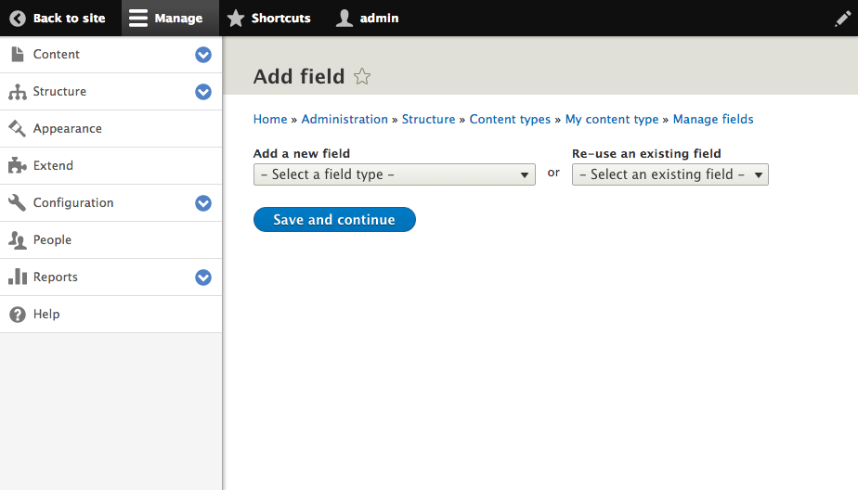
Click here

Slide 78
Files & Images
Numeric
Email*
Field Types
Text
Date*
Boolean
Link*
Reference

Slide 79
“ ”

Slide 80
Title

Slide 81
Title

Slide 82
Title
Fourth “Blob” Film is a hilarious campy romp
Fourth “Blob” Film is a…
Fourth “Blob”…

Slide 83
I’m here for your little fields too!
Crud.
The Blobs are {back}.

Slide 84
Title

Slide 85
Title
Full Title
Medium Title
Short Title

Slide 86
Title
Full Title
Medium Title
Short Title
Fourth “Blob” Film is a hilarious campy romp
“Blob” 4, this time in space.
“Blob” 4 Review

Slide 88
title
Gallery
Bio
“ ”
Key quote
“Biggest lesson” section
Author Info

Slide 89
“ ”

Slide 90
“ ”
Some of these aren’t just the same kind of data…
They {are} the same data.

Slide 93
This “field” is also multi-part.

Slide 94
“ ”

Slide 95
“ ”
Entity Reference

