Slide 1


@blink reaction

Slide 3
Flag Module
Handler Classes
Backend functions
Implemented Hooks and alters
Function-based API
Implemented Flag Hooks
Drupal

Slide 4
Flag_flag
Parent
Child
Flag_Entity
FLAG_BrOKEN
Flag_NODE
Flag_USER
Flag_Entity

Slide 5
We had to allow for X before, do we still need to?
Does it really have to work this way?
Can we do this better?
Can we do this simpler?

Slide 7
<<interface>> FlagInterface
ConfigEntityBundleBase
Parent
Flag
Child

Slide 8
<<interface>> FlagInterface

Slide 9
Node

Slide 10
Shiny!
Node

Slide 11
*POINK!*
Node

Slide 12
Node

Slide 13
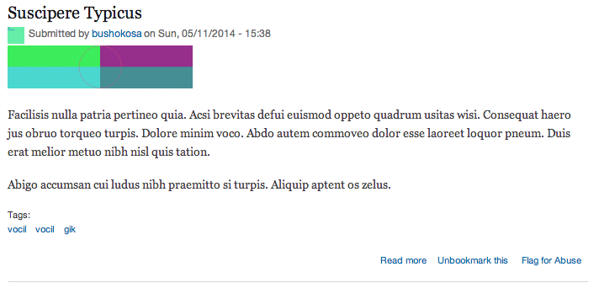
I’m a flag!
I am also a flag.

Slide 14
Flag
Flaggable (entity)
Flagging
Admin creates Flag
Flag Link attached
User flags the entity
Entity is flagged
Entity shown as flagged
User unflags the entity
Entity is Unflagged
Admin deletes Flag
Flag Link removed

Slide 15

It came from
OPEN SOURCE,,,
TO DEVOUR L.A. !!!

Slide 16

Flag

Slide 17
That’s just a class.
What am I supposed to do with that?
Flag
*sad and lonely*

Slide 18
Flag
Config entity assembly manual (For Flag)

Slide 19
Ooooh!
I get it now!
Flag
*builds stuff*
Config entity assembly manual (For Flag)

Slide 20
Parent
EntityForm
Child
FlagFormBase
EntityConfirmFormbase
FlagAddForm
FlagEditForm
FlagDeleteForm

Slide 21
Web Browser

Slide 22
flag_menu();
Web Browser

Slide 23
flag_menu();
Web Browser

Slide 24
flag_menu();
Web Browser
flag.routing.yml

Slide 25
flag_menu();
Web Browser
flag.routing.yml
Route Name | Path
flag.list | /admin/structure/flags
flag.add_page | /admin/structure/flags/add

Slide 26
Web Browser
I only cover *new* routes.
flag.routing.yml

Slide 27
I ADD TO existing routes!
Flag.links.menu.yml
Web Browser
I only cover *new* routes.
flag.routing.yml

Slide 28
Flag.links.menu.yml
Web Browser
flag.routing.yml
Route Name | Parent Route
flag.list | System.admin_structure

Slide 29
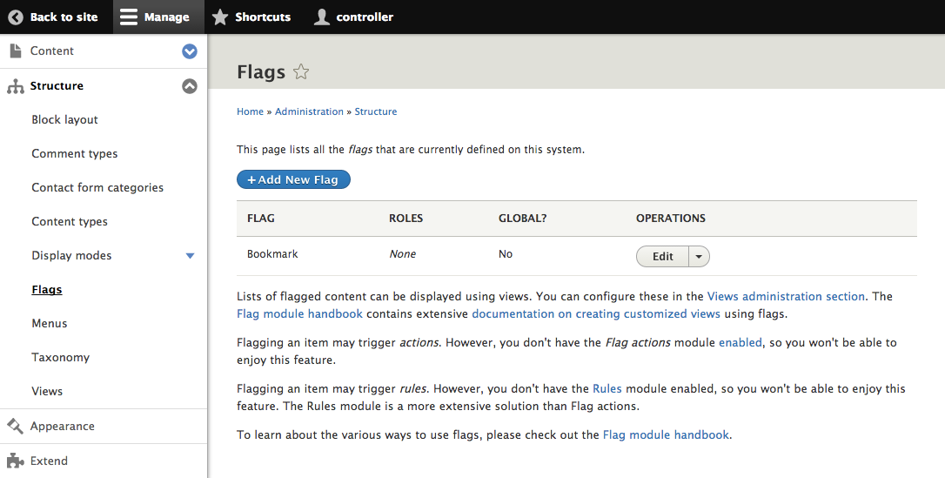
Local Action

Slide 30
Flag.links.menu.yml
Web Browser
flag.routing.yml
I ATTACH click-actions TO EXISTING ROUTES
Flag.links.ACTION.yml

Slide 31
Flag.links.menu.yml
Web Browser
flag.routing.yml
Route Name | Appears on
flag.add_page | Flag.list
Flag.links.ACTION.yml

Slide 32

Drupal console

Slide 33
<<interface>> FlaggingInterface
ContentEntityBase
Parent
Flagging
Child

Slide 34
Flagging
FID
Type
& ID
uid
Flag
Flaggable (entity)
User

Slide 35
Web Browser

Slide 36
Flag_Entity_view();
Web Browser

Slide 37
Flag_Entity_view();
Web Browser
Clicked flag Link

Slide 38
Flag_Entity_view();
Web Browser
Clicked flag Link
Some route

Slide 39
Flag_Entity_view();
Web Browser
Clicked flag Link
Something?
Some route

Slide 40
Flag_Entity_view();
Web Browser
Clicked flag Link
Something?
Entity::save();
Some route

Slide 41
Flag_Entity_view();
Web Browser
Clicked flag Link
Flag();
Entity::save();
Some route

Slide 42
Flag_Entity_view();
Web Browser
Clicked flag Link
Flag();
Entity::save();
I’m not a very Drupal 8 way of
doing things.
Some route

Slide 43
Flag_Entity_view();
Web Browser
Clicked flag Link
Flag();
Entity::save();
Some route

Slide 44
Flag_Entity_view();
Web Browser
Clicked flag Link
Entity::save();
Some route
Flag Service

Slide 45
Node
Flag
User
Entity?

Slide 46
FlagNode
Node
Parent
Child
Flag
FlagUser
User
Entity?

Slide 47
FlagNode
Node
Parent
Child
Flag
FlagUser
User
Flag…err?
Entity?

Slide 48
Node
Flag
User
Entity?

Slide 49
Node
Flag
UserFlagType
User
Entity?

Slide 50
Use an annotation to discover me!
Node
Flag
UserFlagType
User
Entity?

Slide 51
Flag
NodeFlagType
Node
Flag
UserFlagType
User
Entity?

Slide 52
Flag
NodeFlagType
Node
Flag
UserFlagType
User
Flag
EntityFlagType
(Derivative)
Entity

Slide 53
PluginBase
Parent
Child
FlagTypeBase
EntityFlagType
NodeFlagType
UserFlagType

Slide 54
Some route?
Clicked flag Link
Flag Service

Slide 55
LinktypePlugin
Clicked flag Link
Flag Service

Slide 56
Flag 7.X Hooks
Define FLAGS
Validate & grant access
React to Events
Provide Flag Types
Provide Link Types

Slide 57
CMI
Plugins
Events
Hooks?
Define FLAGS
Provide Flag Types
React to Events
Validate & grant access
Provide Link Types

Slide 58
Flag Service

Slide 59
Flag Service
Event Dispatcher

Slide 60
Event Subscriber
Event Subscriber
Flag Service
Event Dispatcher
Event Subscriber

Slide 61
Event Subscriber
Event Subscriber
Flag Service
Flag Event Class
Event Dispatcher
Event Subscriber

Slide 62
Event Subscriber
Event Subscriber
Flag Service
Flag Event Class
Event Dispatcher
Event Subscriber

Slide 63




Continued development
Major feature Iteration

Slide 64





Slide 65



Drupal.org Project
Public Repos
Drupal.org Sandbox

Slide 66
But is your module ready?
Drupal.org Project
Public Repos
Drupal.org Sandbox

Slide 67
But is your module ready?
Drupal.org Project
Easy, but few see me.
Public Repos
Drupal.org Sandbox

Slide 68
But is your module ready?
Maybe you need a clean break?
Drupal.org Project
Easy, but few see me.
Public Repos
Drupal.org Sandbox

Slide 69
Issue queue noise
Leverage Community
Git Log pollution
Visibility
Keep it in a sandbox
Start a Project branch

Slide 70
Issue queue noise
Leverage Community
Git Log pollution
Visibility
Keep it in a sandbox
Start a Project branch

Slide 71
Issue queue noise
Leverage Community
Git Log pollution
Visibility
Keep it in a sandbox
Start a Project branch

Slide 72

Example Module
for
Drupal 8.x
Drupal console

Slide 74


