Slide 1



Slide 2


Slide 4
Flag Module
Handler Classes
Backend functions
Implemented Hooks and alters
Function-based API
Implemented Flag Hooks
Drupal

Slide 5
Flag_flag
Parent
Child
Flag_Entity
FLAG_BrOKEN
Flag_NODE
Flag_USER
Flag_Entity

Slide 6
We had to allow for X before, do we still need to?
Does it really have to work this way?
Can we do this better?
Can we do this simpler?

Slide 8
<<interface>> FlagInterface
ConfigEntityBundleBase
Parent
Flag
Child

Slide 9
<<interface>> FlagInterface

Slide 10
Node

Slide 11
Shiny!
Node

Slide 12
*POINK!*
Node

Slide 13
Node

Slide 14
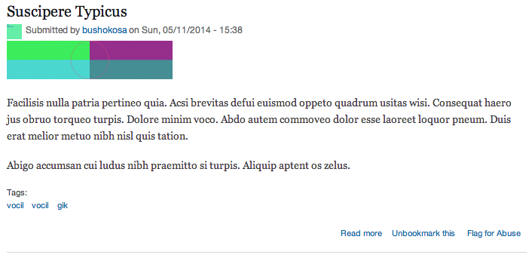
I’m a flag!
I am also a flag.

Slide 15
Flag
Flaggable (entity)
Flagging
Admin creates Flag
Flag Link attached
User flags the entity
Entity is flagged
Entity shown as flagged
User unflags the entity
Entity is Unflagged
Admin deletes Flag
Flag Link removed

Slide 16

It came from
OPEN SOURCE,,,
TO DEVOUR L.A. !!!

Slide 17

Flag

Slide 18
That’s just a class.
What am I supposed to do with that?
Flag
*sad and lonely*

Slide 19
Flag
Config entity assembly manual (For Flag)

Slide 20
Ooooh!
I get it now!
Flag
*builds stuff*
Config entity assembly manual (For Flag)

Slide 21
Parent
EntityForm
Child
FlagFormBase
EntityConfirmFormbase
FlagAddForm
FlagEditForm
FlagDeleteForm

Slide 22
Web Browser

Slide 23
flag_menu();
Web Browser

Slide 24
flag_menu();
Web Browser

Slide 25
flag_menu();
Web Browser
flag.routing.yml

Slide 26
flag_menu();
Web Browser
flag.routing.yml
Route Name | Path
flag.list | /admin/structure/flags
flag.add_page | /admin/structure/flags/add

Slide 27
Web Browser
I only cover *new* routes.
flag.routing.yml

Slide 28
I ADD TO existing routes!
Flag.links.menu.yml
Web Browser
I only cover *new* routes.
flag.routing.yml

Slide 29
Flag.links.menu.yml
Web Browser
flag.routing.yml
Route Name | Parent Route
flag.list | System.admin_structure

Slide 30
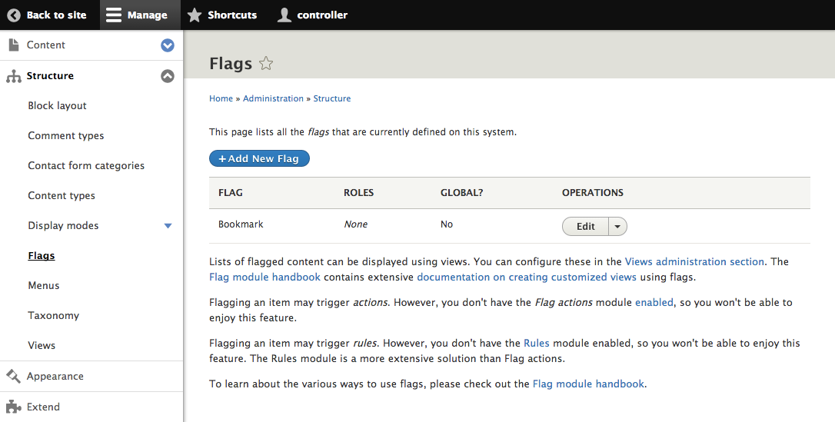
Local Action

Slide 31
Flag.links.menu.yml
Web Browser
flag.routing.yml
I ATTACH click-actions TO EXISTING ROUTES
Flag.links.ACTION.yml

Slide 32
Flag.links.menu.yml
Web Browser
flag.routing.yml
Route Name | Appears on
flag.add_page | Flag.list
Flag.links.ACTION.yml

Slide 33

Drupal console

Slide 34
<<interface>> FlaggingInterface
ContentEntityBase
Parent
Flagging
Child

Slide 35
Flagging
FID
Type
& ID
uid
Flag
Flaggable (entity)
User

Slide 36
Web Browser

Slide 37
Flag_Entity_view();
Web Browser

Slide 38
Flag_Entity_view();
Web Browser
Clicked flag Link

Slide 39
Flag_Entity_view();
Web Browser
Clicked flag Link
Some route

Slide 40
Flag_Entity_view();
Web Browser
Clicked flag Link
Something?
Some route

Slide 41
Flag_Entity_view();
Web Browser
Clicked flag Link
Something?
Entity::save();
Some route

Slide 42
Flag_Entity_view();
Web Browser
Clicked flag Link
Flag();
Entity::save();
Some route

Slide 43
Flag_Entity_view();
Web Browser
Clicked flag Link
Flag();
Entity::save();
I’m not a very Drupal 8 way of
doing things.
Some route

Slide 44
Flag_Entity_view();
Web Browser
Clicked flag Link
Flag();
Entity::save();
Some route

Slide 45
Flag_Entity_view();
Web Browser
Clicked flag Link
Entity::save();
Some route
Flag Service

Slide 46
Node
Flag
User
Entity?

Slide 47
FlagNode
Node
Parent
Child
Flag
FlagUser
User
Entity?

Slide 48
FlagNode
Node
Parent
Child
Flag
FlagUser
User
Flag…err?
Entity?

Slide 49
Node
Flag
User
Entity?

Slide 50
Node
Flag
UserFlagType
User
Entity?

Slide 51
Use an annotation to discover me!
Node
Flag
UserFlagType
User
Entity?

Slide 52
Flag
NodeFlagType
Node
Flag
UserFlagType
User
Entity?

Slide 53
Flag
NodeFlagType
Node
Flag
UserFlagType
User
Flag
EntityFlagType
(Derivative)
Entity

Slide 54
PluginBase
Parent
Child
FlagTypeBase
EntityFlagType
NodeFlagType
UserFlagType

Slide 55
Some route?
Clicked flag Link
Flag Service

Slide 56
LinktypePlugin
Clicked flag Link
Flag Service

Slide 57
Flag 7.X Hooks
Define FLAGS
Validate & grant access
React to Events
Provide Flag Types
Provide Link Types

Slide 58
CMI
Plugins
Events
Hooks?
Define FLAGS
Provide Flag Types
React to Events
Validate & grant access
Provide Link Types

Slide 59
Flag Service

Slide 60
Flag Service
Event Dispatcher

Slide 61
Event Subscriber
Event Subscriber
Flag Service
Event Dispatcher
Event Subscriber

Slide 62
Event Subscriber
Event Subscriber
Flag Service
Flag Event Class
Event Dispatcher
Event Subscriber

Slide 63
Event Subscriber
Event Subscriber
Flag Service
Flag Event Class
Event Dispatcher
Event Subscriber

Slide 64




Continued development
Major feature Iteration

Slide 65





Slide 66



Drupal.org Project
Public Repos
Drupal.org Sandbox

Slide 67
But is your module ready?
Drupal.org Project
Public Repos
Drupal.org Sandbox

Slide 68
But is your module ready?
Drupal.org Project
Easy, but few see me.
Public Repos
Drupal.org Sandbox

Slide 69
But is your module ready?
Maybe you need a clean break?
Drupal.org Project
Easy, but few see me.
Public Repos
Drupal.org Sandbox

Slide 70
Issue queue noise
Leverage Community
Git Log pollution
Visibility
Keep it in a sandbox
Start a Project branch

Slide 71
Issue queue noise
Leverage Community
Git Log pollution
Visibility
Keep it in a sandbox
Start a Project branch

Slide 72
Issue queue noise
Leverage Community
Git Log pollution
Visibility
Keep it in a sandbox
Start a Project branch

Slide 73

Example Module
for
Drupal 8.x
Drupal console

Slide 75


