Slide 1
GreenReg
Device & Register Framework v-2.0
API Overview
WARNING:
All image texts have not yet been renamed:
DRF → GreenReg
prefix dr_ → gr_

Slide 2
Key Topics
  Introduction
    What is GreenReg?
    Ambitious Goals
    What is missing?
  Concepts & Architecture behind GreenReg
    Bridging Model Complexity
    Registers as Stimuli
    Device Framework
    Register Framework
    Notification Rule Execution Path
  API Overview
    Device
    Register Container & Register
    Bit Range & Bit
    Notification Rules & DRF_Port<master>
    Attribute & Switch
  API Not Covered
    State Machine Support

Slide 3
Introduction

Slide 4
What is GreenReg?
GreenReg - GreenSocs (Device &) Register Framework
Refinement of Intel DRF
Developed to address several deficiencies in the OSCI language.
  Clear hierarchical accessibility of blocks and their elements
  Simplified communication over chosen bus
  Complete register implementation with simplified accessibility as apposed to current industry solutions
  Bit level decode
Intended for rapid development & maintainability of ESL models.
GreenReg has APIs for the following:
attribute
switch
device (may have registers)
sub-device (may not have registers)
registers
event C++ callback (bypass SC kernel)
bit ranges
bits
consistent accessibility
  (global, local, hierarchical)
analysis collection (for power, emi, or other)
simplified sockets

Slide 5
Ambitious Goals
Deficiencies in SystemC which GreenReg attempts to address
Re-use of code in PV, PVT & AV models
(methodology of implementation) - WIP
TLM independence with simplified transactions
(OSCI TLM, GSGPSocket, “XYZ”)
Intelligent Attributes & Highly Flexible Registers which model real, complex data scenarios
Key aspects to GreenReg
Simple User API
Access to Data
Manipulation of Data
Data Driven Changes (SC missing link to state machines)
Extensible “Contained Capabilities”

Slide 6
What is Missing?
Endianness
  Can be addressed on back end but…
  do not care, and IA target running on an IA host does not need said overhead.
Complete enhancement into the OSCI API
  SystemC is too tightly wrapped to inherit and make modifications, the only way to make real improvements is by either modifying the library or building an exoskeleton.
State machine kernel
  Still under investigation / development for a full prototype, and is not available for release in any form under any terms at this point in time.
  Positive progress has been made in taking Visio state machine diagrams and generating compiler compliant code.

Slide 7
Concepts & Architecture Behind GreenReg

Slide 8
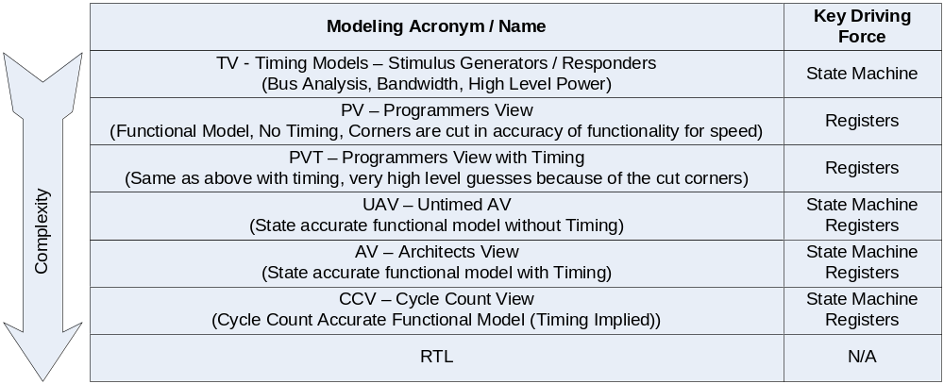
Bridging Model Complexity
This Table DOES NOT REFLECT Industry Terms

Slide 9







Bridging Model Complexity
XV - eXtended View
Support All ESL Views
Methodology, not just an API
The Vision
Reusable Engines
Flexible Combinations / Hooks
Logic Driven Implementation
TV
XV
PV
PVT
UAV
AV
CCV
RTL

Slide 10
Bridging Model Complexity
Taking a quick peek at accuracy:
  These statements are not based on “text book” terms, they are based on real use of ESL on prior projects. And what real world use model tells us is…
  PV is typically more “functionally accurate” from a bit/register level than AV
  AV is typically more “time accurate” from an internal state machine view than PV
  PVT is supposedly the reasonable re-use answer, problem is the user ends up re-coding.
Let’s take a step back from SystemC, and look at fundamental modeling blocks:
All ESL model techniques contain some elements of these blocks, with emphasis on specific areas.
State Machine Definition (execution roadmap)
Analysis ( Timing / Power )
Stimuli (which drives the model)
Functionality (manipulation of content & externals)

Slide 11
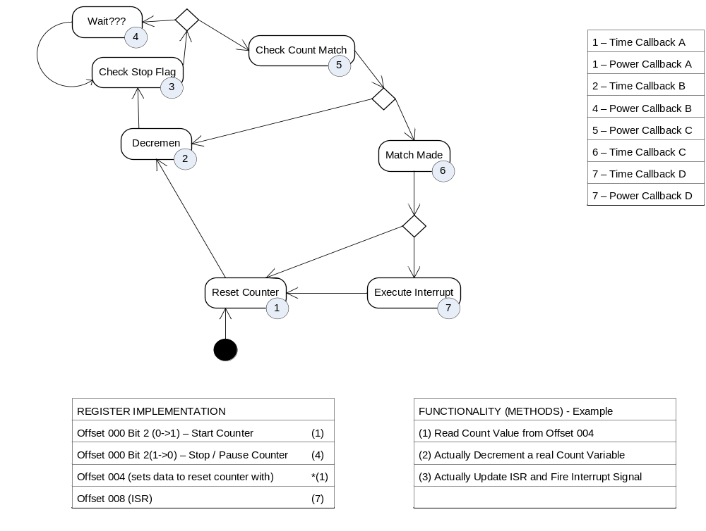
Bridging Model Complexity – IP Development
Analysis
State Machine
Stimuli
Functionality

Slide 12

Architects use ESL for Rough Timing Estimates
Analysis
State Machine
TV
Stimuli
Functionality

Slide 13
Firmware & Driver use ESL for sequencing
Analysis
State Machine
Stimuli
Functionality
PV

Slide 14

More complex driver use time sync (audio/video)
Analysis
State Machine
PVT
Stimuli
Functionality

Slide 15

SV begins using ESL for test development
Analysis
State Machine
UAV
Stimuli
Functionality

Slide 16
Full pre-silicon verification / next product study
Analysis
State Machine
AV
Stimuli
Functionality

Slide 17
Bridging Model Complexity – The Simple Trick
Fundamental Ingredients:
  State Machine which can either wait at a “gold” state, or cause delays between each state.
  Data must drive the state machine, and therefore be allowed to react to pre-defined rules.
  Calculations or “logic” must be encapsulated.
  Analysis calculations must occur specifically before or after logic execution. Separating logic from analysis adds more calls, but also provides the separation needed for re-use.
The Trick:
  By simply changing the binding one can change the model definition between AV/PV/PVT/etc.
  No, it is not all encompassing, the point is that a much larger code base is reusable.
The Bad:
  There is a performance hit, no way around it. (no numbers, but I would guess 30%)
  Focus on C++ direct callbacks over SystemC events should reduce the delta.

Slide 18
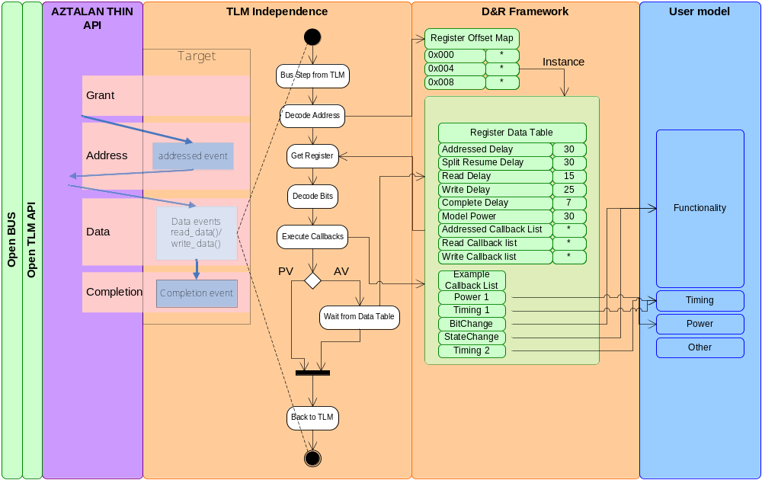
Registers as Stimuli (TLM Independence Slave)
PROTOCOL

Slide 19
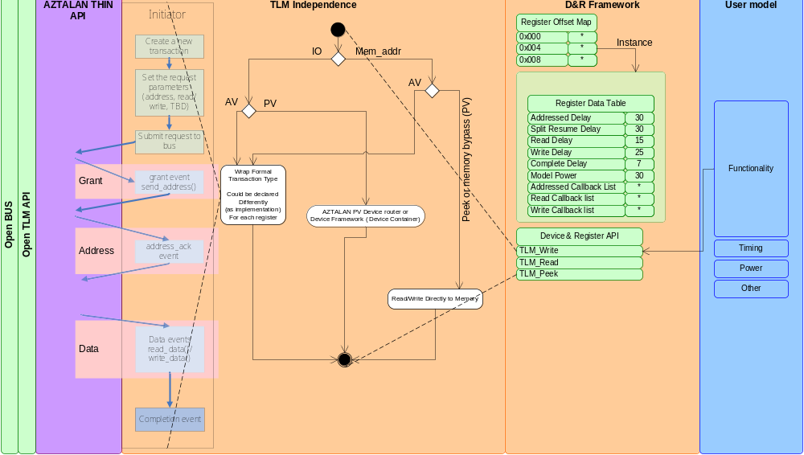
Registers as Stimuli (TLM Independence Master)
PROTOCOL

Slide 20
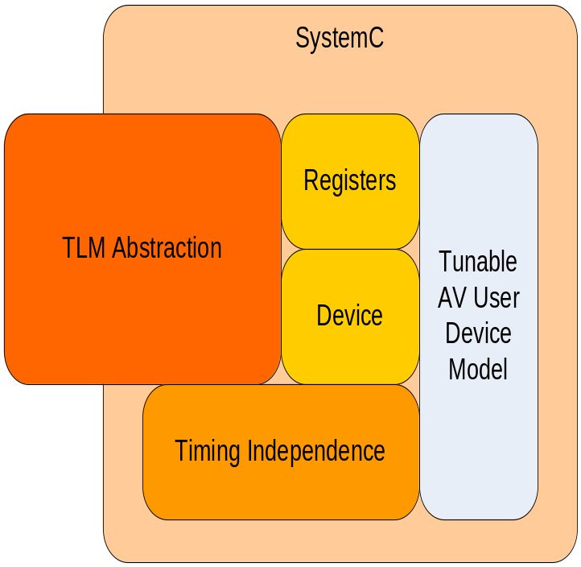
Device Framework
Enhance Development while achieving TLM & Timing Independence
  Support Complex Register Interfaces & Events
  Enable Reusable Models
    Provide a Device – Sub Device Model Code Base
  Improve Source Code Readability
  Code Faster

Slide 21
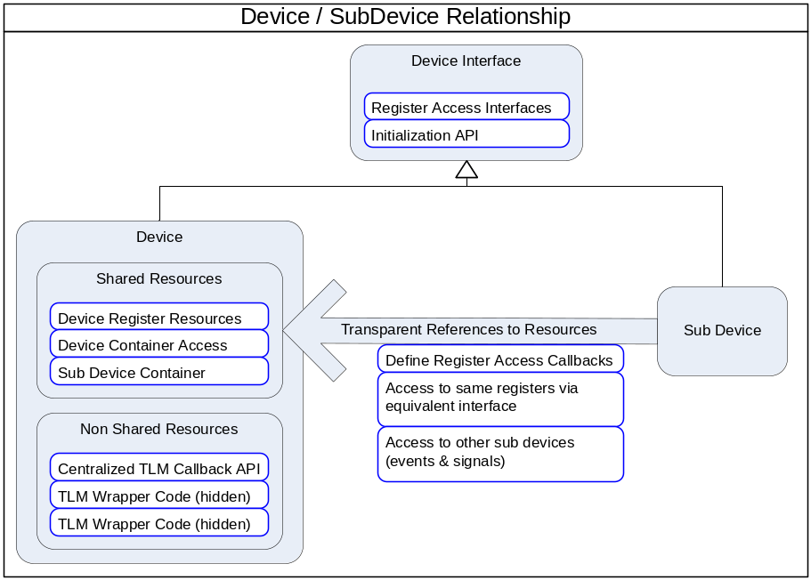
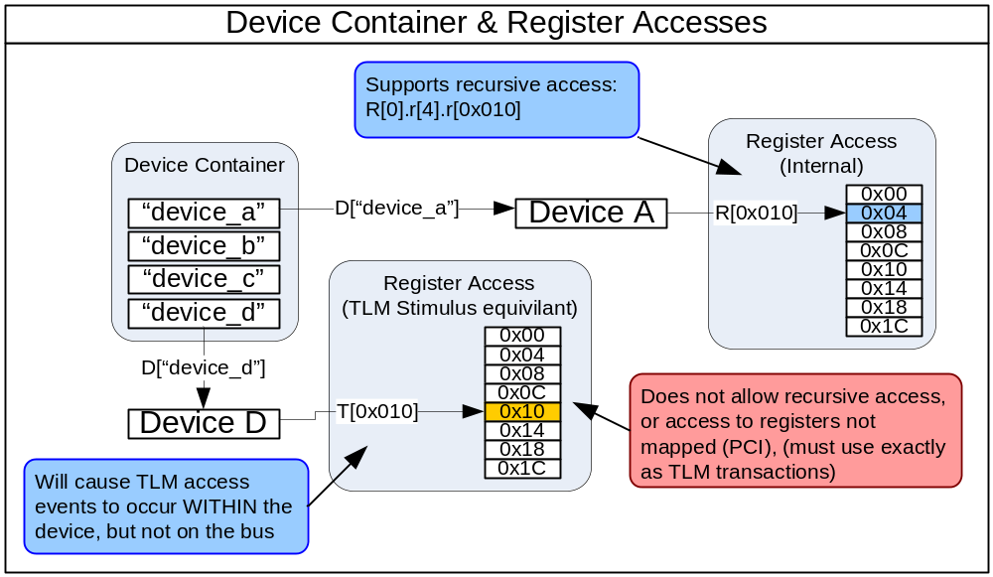
Device Framework
  Device class provides center point of access
  Sub-Device enables modular development of complex models
  Heavy weight ports allows TLM transactions between models w/o TLM access

Slide 22
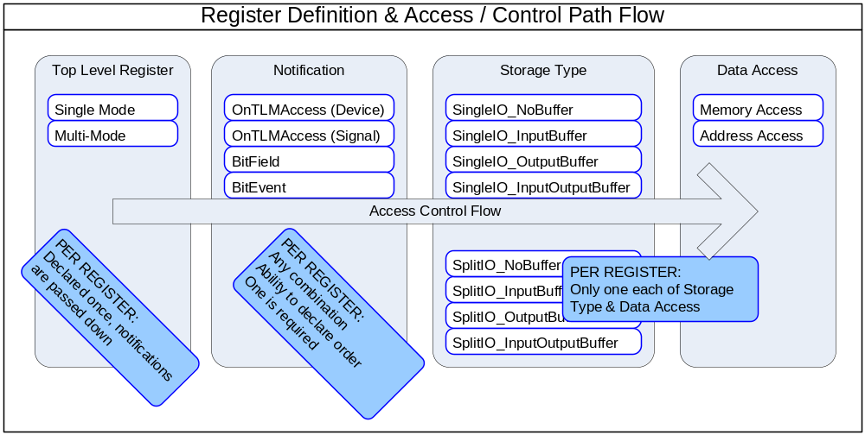
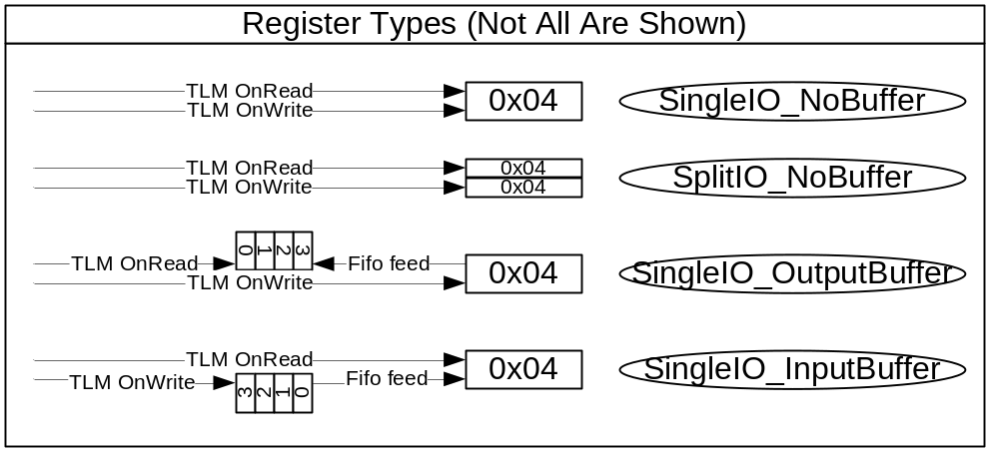
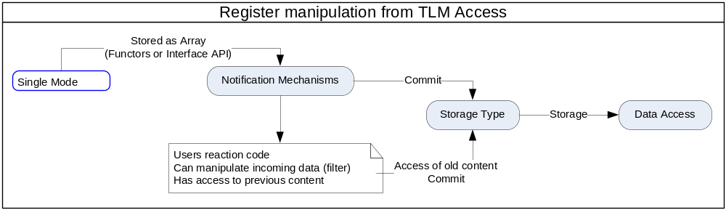
Register Framework (Register Types - concept)
    Multiple Change Notification Types
    Complex Input Output Chain (Fifo register)
    Only NoBuffer implementations are complete.

Slide 23
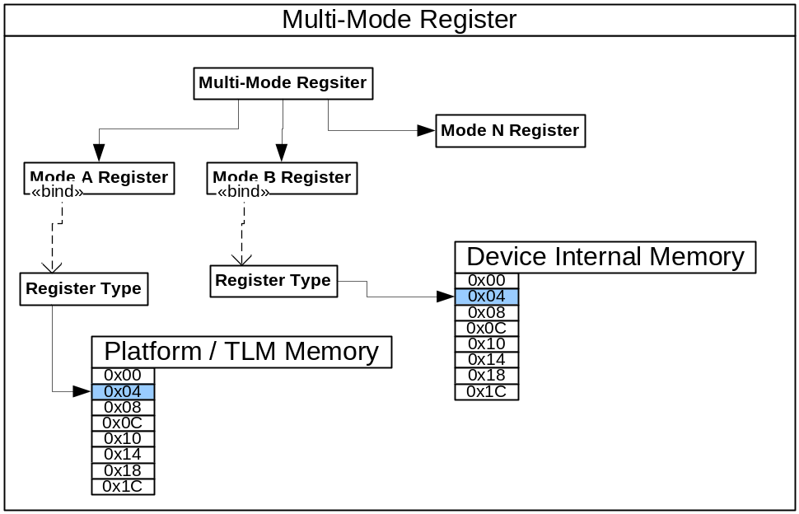
Register Framework (Multi-Mode) – Not Available
  Support mode change based on event (using a switch)
  Easily enable development of multi-memory devices (flash)

Slide 24
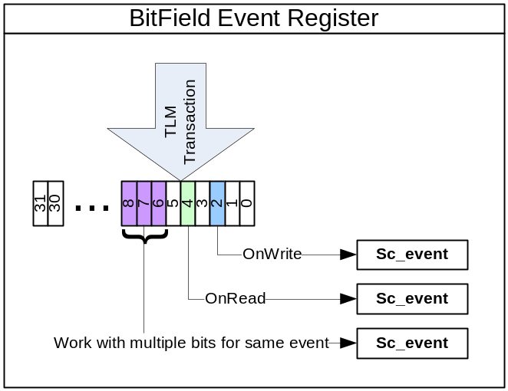
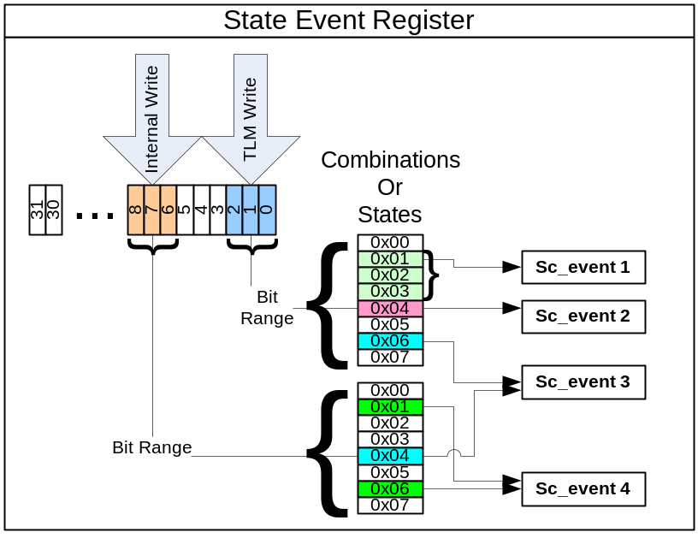
Register Framework (Notification Rules)
  Register Notification Event Rules
    TLM->Register Pre & Post Read Events
    TLM->Register Pre & Post Write Events
    Bit Change
    Pattern Match (on change)
  DRF Enables Second Level Decode through Notification Rules

Slide 25
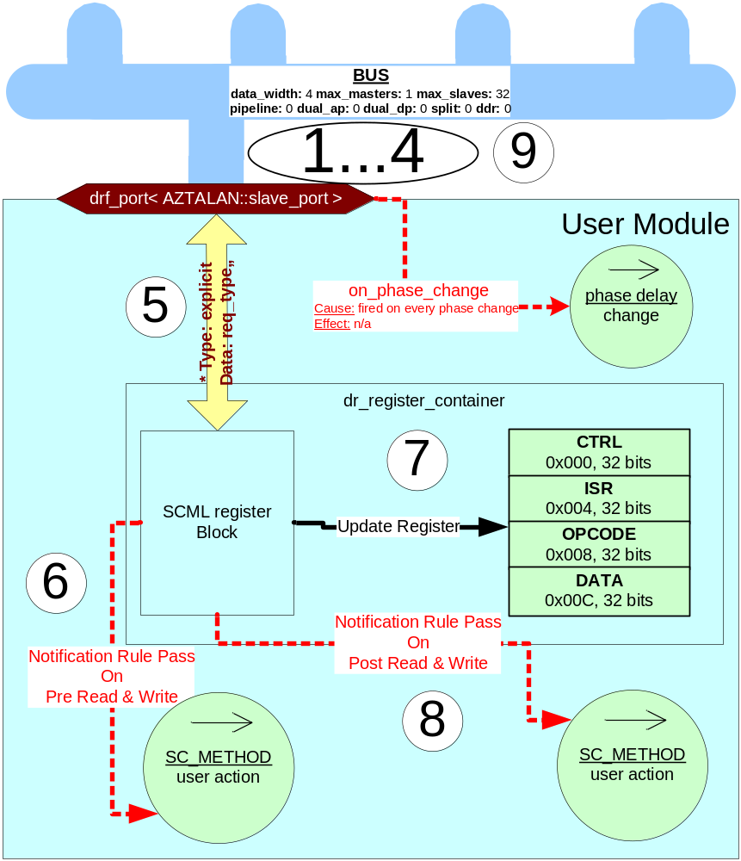
Notification Rule Execution Overview
  1-4: Bus phases based on port type
  5: Read or Write request at appropriate phase
  6: Pre – notification rules execute
    true evaluations stimulate model
    false evaluations do nothing
    Purpose:
      Reads which calculate register data
      Prep model for incoming writes
        enable / disable other notification rules in post-write
  7: Read register data or Write register data
  8: Post – notification rules execute
    true evaluations stimulate model
    false evaluations do nothing
    Purpose:
      Stimulate model based on write data change
      Stimulate model after bus has read current data (flush)
  9: drf_port completes transaction with bus

Slide 26
GreenReg API
(Device)

Slide 27
Device Package
Scope
  Provide separation, containment and traversal of specialized modeling elements that are not part of the Device Package.
  Enable a unified hierarchy that more logically represents a complete block of capability.
  Reduce overhead of instantiating an sc_module and provide room for future SystemC based automation.
Use Cases
  Any model representing a complete peripheral with 0 or more sub-logic blocks.
  Any model which will utilize other extended modeling features of GreenReg.

Slide 28
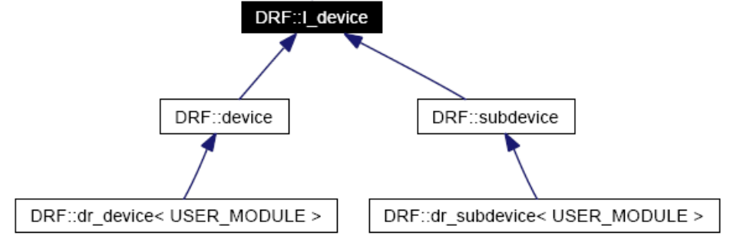
Device Classes
GreenReg Internal
  I_device
    Common Interface for device relationships
  device
    Responsible for feature implementation of device hierarchy functionality
  subdevice
    Responsible for feature implementation of subdevice hierarchy functionality
GreenReg User Interface
  gr_device
    Top level encapsulation of complete functional unit
    Abstracts device containment structure binding
  gr_subdevice
    Recursive logical block containment node.
    Abstracts device containment structure binding

Slide 29
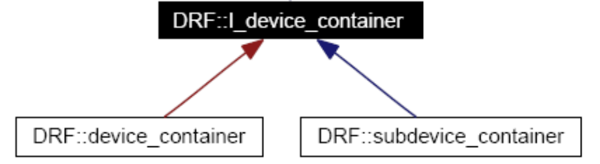
Device Container Classes
GreenReg Internal
  I_device_container
    Common Interface for device container features
  subdevice_container
    Responsible for feature implementation of device hierarchy functionality
    Instantiated in both the device & subdevice classes
  device_container
    May contain only devices
    Each device has one to enable hierarchical containment of devices with register blocks
    Global Device Container: gs::reg::g_gr_device_container

Slide 30
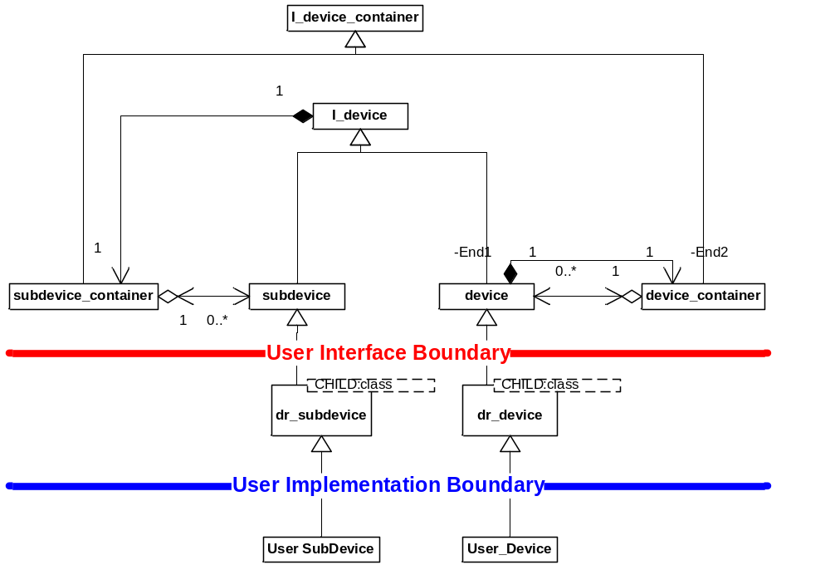
Device Inheritance & Containment

Slide 31
User Interface (gr_device)
Description
    Defines a top level encapsulation of reference for a complete functional unit
    Provides containment structures for other GreenReg elements
    Provides configuration accesses
Inheritance
    class my_device : public gr_device
Constructor
    Params: sc_module_name, address mode, dword size (ALIGNED) or # registers (INDEXED) of register block, parent
      parent is either the parent gr_device, or NULL if it is a top level device
    : gr_device( _name, ALIGNED_ADDRESS, 2, NULL)
Accessibility
    Attributes, components and sub-devices are accessed by [“name”]
    Registers are accessed by either [“name”] or [0xoffset]
    ‘a’ – attribute & switch container
    ‘c’ – component container
    ‘r’ – register container
    ‘rc’ – register container “containment”
    ‘sd’ – sub-device container
    ‘d’ – device container
    m_parent – pointer to parent device, this pointer CAN BE NULL, so check before use

Slide 32
User Interface (gr_device)
register_container_addressing_mode_e
    ALIGNED_ADDRESS – strict alignment forcing 32 bit registers to 32 bit boundaries, 16 to 16, 8 to 8
    INDEXED_ADDRESS – Allows non-aligned offsets to have any size register (32 bit max for now)

Slide 33
User Interface (dr_subdevice)
Description
    Defines a recursive encapsulation of sub-functional units
    Provides containment structures for other DRF elements
    Provides configuration accesses
Inheritance
    User sub-device must inherit from gr_subdevice as a type of itself
    class my_subdevice : public gr_subdevice
Constructor
    Params: sc_module_name from user device, parent node ( I_device )
    : gr_subdevice( _name, _parent)
Accessibility
    Attributes, components and sub-devices are accessed by [“name”]
    Registers are accessed by either [“name”] or [0xoffset]
    ‘a’ – attribute & switch container
    ‘da’ – attribute & switch container – top devices attribute container
    ‘c’ – component container
    ‘r’ – register container – reference to top devices register container, NOT LOCAL, may not be overwritten.
    ‘rc’ – register container “containment” – reference to top devices rc, NOT LOCAL, may not be overwritten.
    ‘sd’ – sub-device container
    m_parent – reference access to parent node (I_device)

Slide 34
Using the Device Package
Global or External Access
  gs::reg::g_gr_device_container[“device_name”].sd[“subdevice_name”].sd[“subdevice_name”].{Accessibility}
  gs::reg::g_gr_device_container[“device_name”].d[“encapsulated_device_name”].{Accessibility}
Internal Access
  sd[“subdevice_name”].{Accessibility}
  m_parent.sd[“subdevice_name”].{Accessibility}
Container API’s
  device_container & subdevice_container inherit from gs::reg_utils::access_data_container< DATA_TYPE>
    DATA_TYPE is either device or subdevice in these cases
  DATA_TYPE & operator [] ( id or “key”)
  bool has_data_elements()
  unsigned int number_of_data_elements()
  vector< unsigned int> get_all_data_ids()
  std::string get_data_key(id)
  DATA_TYPE * get_data ( id or “key”)

Slide 35
GreenReg API
(RegisterContainer & Register)

Slide 36
Register Package
Scope
  Provide containment, flexible register description, and intuitive access methodology not available in leading industry solutions.
  Enable an Industry First in 3rd tier register decoding
    1st tier encompasses identification of the owning device (BUS)
    2nd tier encompasses identification of a specific register, and applying write masks
    3rd tier encompasses rule based bit decoding and pattern matching
      Usually implemented in a giant switch
  Provide Industry with a Register API that can bolt to vendor API’s easily (under the hood).
    Excellent reusability potential
Use Cases
  Any logic block that needs registers
  Register use model where data changes will drive other logic blocks in the model

Slide 37
A Note on GreenReg Registers
Capabilities Enablement
  Focuses more heavily on accessibility and stimulus generation than any other Industry API.
  Size & Scope of the entire GreenReg Register API is too large to cover in a single training session.

Slide 38
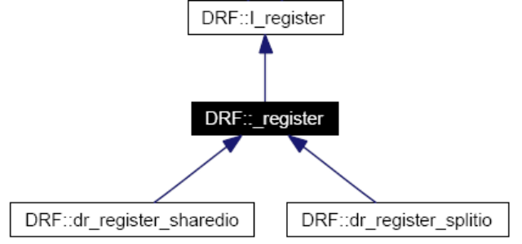
Register Classes
GreenReg Internal
  _register
    Implementation of common access methods.
  gr_register_sharedio
    Specialized implementation for shared data buffer.
    May not be created and bound by the user.
  gr_register_splitio
    Specialized implementation for separate input and output data buffers.
    May not be created and bound by the user.
GreenReg User Interface
  I_register
    Interface defining all public access methods.

Slide 39
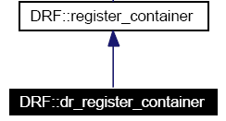
Register Container Classes
GreenReg Internal
  register_container
    Container of I_register *
GreenReg User Interface
  gr_register_container
    Provides only API to create registers
  I_register_container_bus_access
    Provides a simple interface for bus accesses to the registers
    Causes bus side stimulus to occur

Slide 40
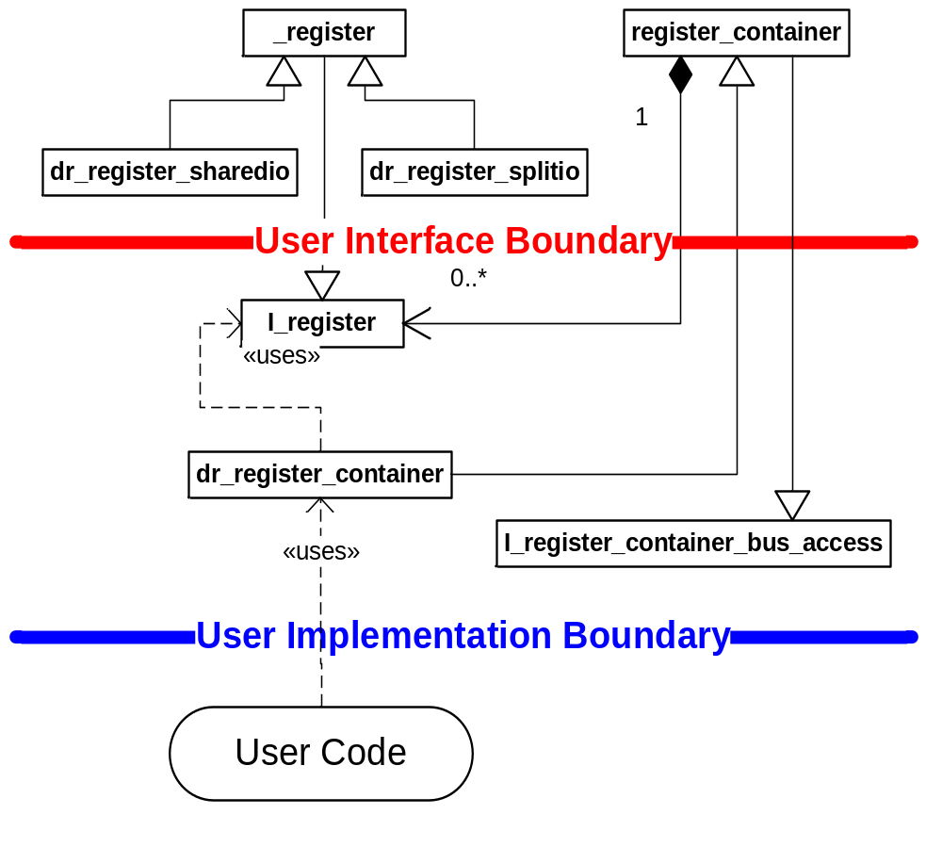
Register Inheritance & Containment

Slide 41
User Interface (gr_register_container)
Instantiation
  gs::reg::dr_register_container my_container;
    By default 1 register container already exists in gr_device, accessible by ‘r’
Constructor
  Params: sc_module_name, address mode, dword size (ALIGNED) or # registers (INDEXED) of reg. block
  my_container( “registers”, ALIGNED_ADDRESS, 2)
Methods of Interest
  create_register( “reg”, “desc”, 0x01, gs::reg::SPLIT_IO, 0xab, 0xff, 32, 0x0);
    creates a single register
    Params: name, description, offset, configuration, initial value, write mask, reg width, lock mask (ignore)
  create_register_block( “desc”, 0x02, 0x4c, gs::reg::SINGLE_IO, 0x00, 0xff, 32, 0x0);
    creates a block of registers
    Params: description, start offset, end offset, configuration, initial value, write mask, reg width, lock mask (ignore)
Container API’s
  register_container inherit from gs::reg_utils::addressable_owning_container< KEY, VALUE>
    KEY - an unsigned integer representing the offset of the register
    DATA_TYPE - I_register
  VALUE & operator [] ( id )

Slide 42
Configuration Enums (gr_register_container)
Configuration parameter in Create Register is a binary ‘or’ combination of the following:
  register_type_e (NOT YET AVAILABLE)
    STANDARD_REG – (default) describes a normal register
    MULTI_MODE_REG – describes a container of registers at specified offset
  register_io_e
    SINGLE_IO – (default) reads and writes access same buffer
    SPLIT_IO – reads and writes access separate buffers
  register_buffer_e (NOT YET AVAILABLE)
    SINGLE_BUFFER – (default) buffer is only 1 level deep, a read or write triggers logic immediately
    DOUBLE_BUFFER – buffer is 2 levels deep, a write pushes data to the second buffer, triggering logic
  register_data_e (NOT YET AVAILABLE, MAY BE REMOVED)
    FULL_WIDTH – (default) register uses code base for width optimized accesses
    BIT_ONLY – register uses code base for bit optimized accesses
    BIT_RANGE – register uses code base for bit_range optimized accesses

Slide 43
User Interface (I_register)
Methods of Interest
    get_register_type() - returns an unsigned int representing the configuration
      register_type_e, register_io_e, register_buffer_e, register_data_e
    get_width() – returns the width in bits of the register
    operator uint32 () – returns copy of register data
    operator = (uint32) – assigns value to register data
    get() – returns copy of register data
    set( uint32) & put( uint32) – assigns value to register data
    set_write_mask( uint32) – assigns value to write mask
    get_write_mask() – returns write mask
    bit_get( uint32 _bit) – returns boolean state of _bit
    bit_set( _bit, _data) & bit_put – assigns boolean _data to _bit
    bit_is_writable( _bit) – returns writemask state of _bit
    bit_set_writable( _bit, _writeable) – assigns _writeable to writemask state of _bit
Accessibility (Refer to Advanced Register Training)
    ‘i’ – input buffer
    ‘o’ – output buffer
    ‘b’ – bit container
    ‘br’ – bit range container

Slide 44
User Interface (I_register_container_bus_access)
Notes
  Inherited by register_container
  Documented separately because it is a fundamental access API
Methods of Interest
  bus_read( data, word aligned address, byte enable)
    stimulates a bus side read and returns true on success
  bus_write( data, word aligned address, byte enable)
    stimulates a bus side write and returns true on success

Slide 45
Using the Register Package (Register Allocation)
Word Alignment
  GreenReg registers support 8, 16, & 32 bit registers in the same block
  A tight (and logical) convention must be followed:
    32 bit registers can only be assigned to dword aligned addresses
    16 bit registers can only be assigned to word aligned addresses
    8 bit registers can only be assigned to byte aligned addresses

Slide 46
Using the Register Package
Global or External Access
    WARNING: This access description works with the registers from the module, not the bus perspective!
    gs::reg::g_gr_device_container[“device_name”].r[0x004] = 0x12345678;
    uint my_int = gs::reg::g_gr_device_container[“device_name”].r[0x004];
    gs::reg:: ::g_gr_device_container[“device_name”].r[0x004].method(…);
    gs::reg:: ::g_gr_device_container[“device_name”].r[0x004].{accessibility}
    gs::reg:: ::g_gr_device_container[“device_name”].bus_write( 0xa, 0x004, 0xf);
Internal Access
    NOTE: All accesses from a gr_device or gr_subdevice access the SAME register container without requiring the user to de-reference a pointer access.
    r[0x004] = 0x12345678;
    uint my_int = r[0x004];
    r[0x004].method(…);
    r[0x004].{accessibility}
    r.bus_write( 0xa, 0x004, 0xf);

Slide 47
GreenReg API
(BitRange & Bit)

Slide 48
Bit Package
Scope
  Intuitive bit level access to register data
  Dynamic on the fly allocation reduces memory impact without speed loss
Use Cases
  Any case where bit use is heavily required

Slide 49
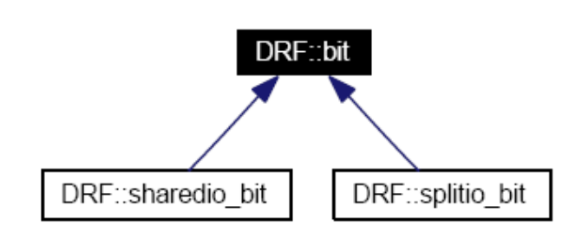
Bit Classes
GreenReg Internal
  sharedio_bit
    specialized implementation for shared data buffer
  splitio_bit
    specialized implementation for separate input and output data buffers
GreenReg User Interface
  bit
    class providing bit level method implementation

Slide 50

Bit Container Classes
GreenReg User Interface
  bit_accessor
    Container of bits
    API dynamically allocates bits that are used upon first access

Slide 51
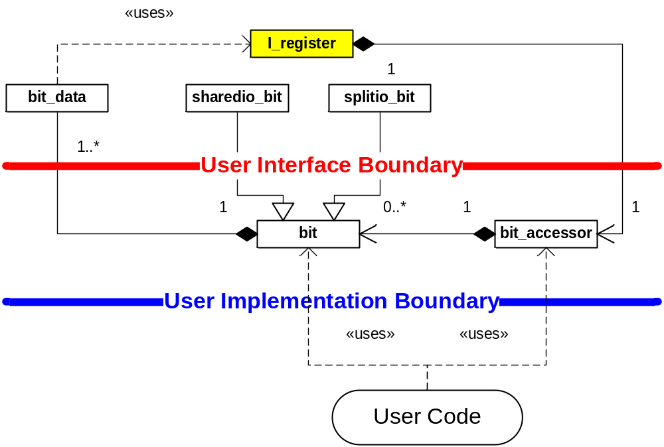
Bit Inheritance & Containment

Slide 52
User Interface (bit_accessor)
Instantiation
    bit_accessor has a symbiotic relationship with I_register, this is the only place of instantiation possible.
Methods of Interest
    bit & operator [] ( unsigned int) – returns a bit class at the specified bit index

Slide 53
User Interface (bit)
Methods of Interest
    operator bool () – returns the value of the bit location
    bit & operator = ( bool ) – applies the value to the bit location
    get() – returns the value of the bit location
    set( bool ) & get( bool) – applies the value to the bit location
    is_writable() – returns the write mask setting for the bit location
    set_writable( bool ) – applies the value to the write mask setting for the bit location
Accessibility
    m_register – pointer to the register which “owns” this bit
    ‘i’ – input data buffer
    ‘o’ – output data buffer

Slide 54
Using the Bit Package
Global or External Access
    WARNING: This access description works with the registers from the module, not the bus perspective!
    gs::reg::g_gr_device_container[“device_name”].r[0x004].b[3] = true;
    bool val = gs::reg::g_gr_device_container[“device_name”].r[0x004].b[3];
    gs::reg::g_gr_device_container[“device_name”].r[0x004].b[3].method(…);
Internal Access
    r[0x004].b[3] = true;
    bool val =r[0x004].b[3];
    r[0x004].b[3].method(…);

Slide 55
Bit Range Package
Scope
  Intuitive Bit Range access to data
  Intuitive Bit accesses relative to Bit Range starting offset
  Facilitate 3rd tier register decode with notification rule support in the bit ranges
  Support multiple overlapping bit ranges
Use Cases
  Control & Status Registers

Slide 56
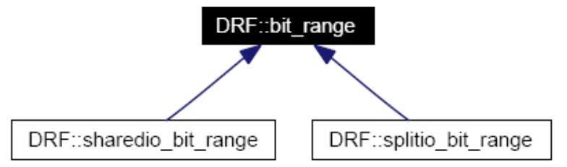
Bit Range Classes
GreenReg Internal
  sharedio_bit_range
    specialized implementation for shared data buffer
  splitio_bit_range
    specialized implementation for separate input and output data buffers
GreenReg User Interface
  bit_range
    class providing bit range method implementation

Slide 57

Bit Range Container Classes
GreenReg User Interface
  bit_range_accessor
    Container of bit_ranges
  bit_range_bit_accessor
    Container of bit references
    Accesses bits relative to bit_range starting offset

Slide 58
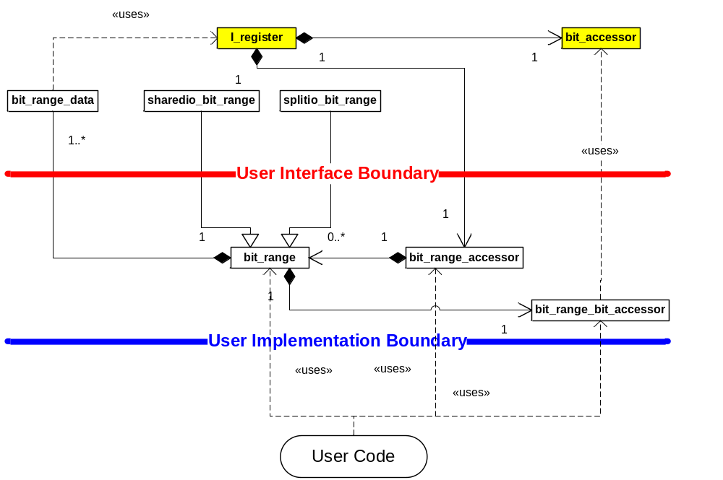
Bit Range Inheritance & Containment

Slide 59
User Interface (bit_range_accessor)
Instantiation
    bit_range_accessor has a symbiotic relationship with I_register, this is the only place of instantiation possible.
Methods of Interest
    bit_range & operator [] ( std::string) – returns a bit_range class for the specified string
    create( “name”, 3, 7);
      Params: “name”, starting bit, ending bit

Slide 60
User Interface (bit_range)
Methods of Interest
    operator unsigned int () – returns the value of the bit_range
    bit_range & operator = ( unsigned int ) – applies the value to the bit_range
    get() – returns the value of the bit_range
    set( unsigned int ) & get( unsigned int) – applies the value to the bit_range
Accessibility
    m_register – pointer to the register which “owns” this bit
    ‘i’ – input data buffer
    ‘o’ – output data buffer
    ‘b’ – bit_range_bit_accessor relative to bit range starting bit

Slide 61
User Interface (bit_range_bit_accessor)
Instantiation
    bit_range_bit_accessor has a sole relationship with bit_range, this is the only place of instantiation possible.
Methods of Interest
    bit & operator [] ( unsigned int) – returns a bit class at the specified bit index relative to the bit_range
      Implies the adjustment to the register is automatic

Slide 62
Using the Bit Range Package
Global or External Access
    gs::reg::g_gr_device_container[“device_name”].r[0x004].br.create(“ctrl”, 3, 7);
    gs::reg::g_gr_device_container[“device_name”].r[0x004].br[“ctrl”] = 0xF;
    gs::reg::g_gr_device_container[“device_name”].r[0x004].br[“ctrl”].b[3] = false;
Internal Access
    r[0x004].br.create(“ctrl”, 4, 8);
    r[0x004].br[“ctrl”] = 0xF; // yields register value 0xF0
    r[0x004].br[“ctrl”].b[3] = false; // yields register value 0xB0
    unsigned int var = r[0x004].br[“ctrl”];
    unsigned int boolean = r[0x004].br[“ctrl”].b[2];
    r[0x004].br[“ctrl”].method(…);
    r[0x004].br[“ctrl”].b[3] .method(…);

Slide 63
GreenReg API
(Functions)

Slide 64
GR_FUNCTIONs etc.
Instead of SC_METHOD, use
  GR_FUNCTION
    Called by immediate callback instead of event (more efficient!)
    or called delayed (see notification rule slides)
    Do not use SC_METHOD/SC_THREAD specific elements inside
    Does not need (cannot handle) dont_initialize()
  GR_FUNCTION_PARAMS
    Like GR_FUNCTION but gives parameters to called function:
    void function(gs::reg::transaction_type* &tr, const sc_core::sc_time& delay)
    TODO future: also give bool delayed to identify if delayed
  GR_METHOD (not recommended)
    Like GR_FUNCTION but is an SC_METHOD additionally
    Needs dont_initialize()
  SC_METHOD (not recommended)
    Possible with notification rule/register with enabled event witch
    (see slide event switch)

Slide 65
GreenReg API
(Notification Rules & greenreg_socket<master>)

Slide 66
Register Package ( notification rules )
Scope
  3rd tier decode encompasses rule based bit decoding and pattern matching
  Creation and use of pre-existing notification rules related to gr_register
  Does not cover creation of custom notification rules or details on internal mechanisms
    Refer to Notification Rule Training for more details
Use Cases
  Any registers that will stimulate model logic / activity

Slide 67
Using Notification Rules with I_register
Note:
    Not all features of I_register were covered in Register Training, please refer back if needed.
    These methods apply to GreenReg registers and bit ranges
Methods of Interest
  add_rule( POST_WRITE, “Post Write CWR”, NOTIFY, …)
    Creates a rule internally based on parameters and returns an event associated with the rule.
    Params: gr_reg_rule_container enum, unique name, gr_reg_rule_type, rule parameters.
    SHOULD BE DEFINED IN “end_of_elaboration”
  The following methods return the appropriate notification_rule_container
    Notification Rule Containers can be used to:
      enable/disable specific rules (by name)
      add new rules
    get_pre_write_rules() – returns container for rules executing before a write to register
    get_post_write_rules() – returns container for rules executing after a write to register
    get_pre_read_rules() – returns container for rules executing before a read from register
    get_post_read_rules() – returns container for rules executing after a read from register
    get_user_ibuf_write_rules() – returns container for rules executing after write to i buffer
    get_user_obuf_write_rules() – returns container for rules executing after write to o buffer

Slide 68
Configuration Enums (I_register::add_rule)
dr_reg_rule_container
PRE_READ – add rule to pre read notification rule container
POST_READ – add rule to post read notification rule container
PRE_WRITE – add rule to pre write notification rule container
POST_WRITE – add rule to post write notification rule container
USR_IN_WRITE – add rule to model stimulated input buffer write notification rule container
USR_OUT_WRITE – add rule to model stimulated output buffer write notification rule container
dr_reg_rule_type
NOTIFY – simplest rule, no parameters, simply notifies for every access
WRITE_PATTERN_EQUAL – notifies if the written data matches a specified pattern
READ_PATTERN_EQUAL – notifies if the data to be read matches a specified pattern
PATTERN_STATE_CHANGE – notifies if the old data to the new data matches a set of change patterns
BIT_STATE – notifies if a bit state is true (does not care if it was true prior to access)
BIT_STATE_CHANGE – notifies if bit state changed

Slide 69
Using Notification Rules with I_register
Global or External Access
    gs::reg::g_gr_device_container[“device_name”].r[0x000].get_post_write_rules().method(…);
Internal Access
  Declaring a pre-existing rule
    void my_module::end_of_elaboration()
    {
    // Pre-Write to the CWR (Control Word Register)
    GR_FUNCTION( pre_write_cwr );
    GR_SENSITIVE(r[0x000].add_rule( POST_WRITE, “pre_write_CWR", NOTIFY));
    }
  User Code
    r[0x000].get_post_write_rules().deactivate_rule( " pre_write_CWR ");
    …
    r[0x000].get_post_write_rules().activate_rule( " pre_write_CWR ");

Slide 70
Using Notification Rules with bit_range
Global or External Access
  gs::reg::g_gr_device_container[“device_name”].r[0x000].br[“test”].get_post_write_rules().method(…);
Internal Access
  Declaring a pre-existing rule
    void my_module::end_of_elaboration()
    {
    // Pre-Write to the CWR (Control Word Register)
    GR_FUNCTION( isr_bits );
    GR_SENSITIVE(r[0x000].br[“test”].add_rule( POST_WRITE, “isr_bits_CWR", BIT_STATE, 2, true));
    }
  User Code
    r[0x000].br[“test”].get_post_write_rules().deactivate_rule( "post_write_isr_bits_CWR ");
    …
    r[0x000].br[“test”].get_post_write_rules().activate_rule( “post_write_isr_bits_CWR ");

Slide 71
Delayed Notification Rules
Internal Access
  Declaring a delayed rule
    void my_module::end_of_elaboration()
    {
    // Pre-Write to the CWR (Control Word Register)
    GR_FUNCTION( pre_write_cwr );
    GR_DELAYED_SENSITIVE(r[0x000].add_rule( POST_WRITE, “pre_write_CWR", NOTIFY), sc_time(10, SC_NS));
    }
  Remark:
    Delayed only for bus accesses, only use for bus access notification rules
  Switch (enable/disable) delay
    Can be switched off per socket
    m_slave_socket.disable_delay();
    m_slave_socket.enable_delay();

Slide 72
Event Switch
Register-wide switch enables event notification of gr_event (fired by notification rules)
  Disabled by default (this means notification rules by default never fire their event but only make callbacks to GR_FUNCTIONs/GR_METHODs)
  Enabled register-wide
    r[0x01].enable_events();
    r[0x01].disable_events();
  With enabled switch SC_METHODs can be used
  (if needed for some reason)
  Enabled switch slows down simulation

Slide 73
greenreg_socket<master > Package
Scope
  Simplify the action of creating/completing read and write transaction across a bus
  Enable TLM Independence
Use Cases
  Any module using the bus to perform single block memory or io read/write transaction

Slide 74
drf_port<master > Classes
GreenReg User Interface
    greenreg_socket< *::master >
      Master port simplifies bus read(s) and write(s)

Slide 75
User Interface (greenreg_socket <master >
Instantiation
    greenreg_socket < master> my_master_port;
Constructor
    my_master_port( “my_port”)
      Params: name (sc_module_name)
Methods of Interest
    ->read( 0x4f003, 1); - returns data from offset for the specified size in bytes
      Pointer reference is using an operator overload, even though the port was not declared as a pointer
      Params: Absolute address, byte width (must align properly with target register expectations)
    ->write( 0x4f003, 0xc2, 1);
      Pointer reference is using an operator overload, even though the port was not declared as a pointer
      Params: Absolute address, byte width (must align properly with target register expectations)
    disable_delay() (only slave socket)
      Disables usage of delay for delayed notification rules (see GR_DELAYED_SENSITIVE)
    enable_delay() (only slave socket)
      Enables usage of delay for delayed notification rules (see GR_DELAYED_SENSITIVE)
    bool delay_enabled()
      If the delay for delayed notification rules is enabled

Slide 76
GreenReg API
(Attribute & Switch)

Slide 77
Attribute & Switch Package
Scope
  Enable data elements that are easily accessible and configurable.
  Facilitate GreenReg modeling methodology by enabling stimulus capabilities in data elements.
  Build upon and enhance sc_attribute with user friendly accessibility.
Use Cases
  Any data element that needs to be exposed.
  Exposed switches that will modify model configuration and/or operation.
  Any variable that will be used to drive stimulus of the model.
    As apposed to code that would pole a variable for various conditions
    This is a key step towards state machine driven models, as well as code automation

Slide 78
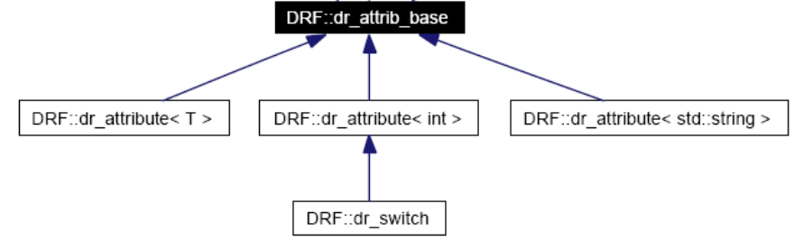
Attribute & Switch Classes
GreenReg Internal
    gr_attrib_base – many C++ operators to do some relatively tricky type resolution for the descending templated class.
GreenReg User Interface
    gr_attribute< T >
      T is int, unsigned int, string or user specific implementation
      Default event fires for every modification (disabled by default)
      Dumps to configuration file
      gr_attribute< unsigned int>
        SPECIAL: Only implementation that has Pre-Read & Post-Write notification rules
    gr_switch
      A specialized implementation of gr_attribute<int>
      A switch can have 2 or more pre-defined states
      Each state has an associated event that is fired when the state becomes active
      Dumps to configuration file (pre-defined switches will also dump possible options)

Slide 79

Attribute & Switch Container Classes
GreenReg User Interface
    gr_attribute_container
      storage container for gr_attrib_base objects (i.e gr_attribute<T> & gr_switch)
      gr_device & gr_subdevice have gr_attribute_container declared as ‘a’
      inherits from gs::reg_utils::access_data_container for accessibility
    gr_switch_container (DEPRICATED)

Slide 80
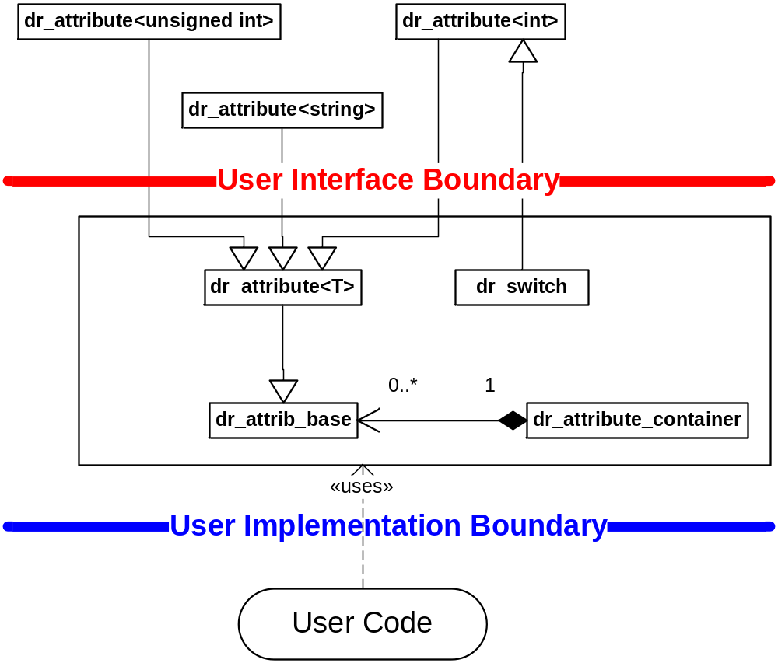
Attribute & Switch Inheritance & Containment

Slide 81
User Interface (gr_attribute)
Instantiation
    gr_attribute<int> my_int;
    gr_attribute<unsigned int> my_uint;
    gr_attribute<std::string> my_string;
    NOTE: other template types will require additional template specialization implementations.
Constructor
    my_uint( “counter”, “variable holding counter value”, a, 0x0);
    Params: name, description, attribute container, initial value
Methods of Interest
  Notification Rule Methods
    add_rule( ATTRIB_PRE_READ, “on_read_counter”, NOTIFY, …)
      Creates a rule internally based on parameters and returns an event associated with the rule.
      Params: gr_reg_rule_container enum, unique name, gr_reg_rule_type, rule parameters.
      SHOULD BE DEFINED IN “end_of_elaboration”
    get_pre_read_rules() – returns the pre-read rule container.
    get_post_write_rules() – returns the post-write rule container.
  Default Write Event Methods
    default_event() – returns the default write event (the event will not fire unless explicitly enabled, i.e. default disabled)
    enable_event() – enables the default write event if it were disabled
    disable_event() – disables the default write event if it were enabled
    has_event() – returns true if the default write event is enabled, false otherwise
  Access Methods
    dr_attrib_base & operator = ( _value) – write data operator (executes post_write notification rules if T=unsigned int)
    operator T () – read data operator (must be accessed via explicit <T> definition)
    (executes pre_read notification rules if T=unsigned int)
    set_value( _value) – writes value (executes post_write notification rules if T=unsigned int)
    get_value() – returns value (executes pre_read notification rules if T=unsigned int)

Slide 82
User Interface (gr_switch)
Instantiation
    gr_switch my_toggle_switch;
Constructor
    my_toggle_switch( “bypass_algorithm”, “bypasses decode algorithm to run faster when on”, a, gr_options_bool_toggle, gs::reg::OFF)
      NOTE: used for pre-defined switch types
      Params: name, description, dr_attribute_container, pre-defined switch, initial switch position.
    my_toggle_switch( “bypass_algorithm”, “description”, a, 0)
      NOTE: used for user-definable switches
Methods of Interest
    set_value(int id) – set the switch to the specified id, an event will be fired for this id (even if already set)
    operator = (int id) – same as set_value
    get_switch_event( int id) – returns the sc_event associated with the id
  Methods applicable only to the user-definable switch use case:
    add_entry( “confused”, 1) – creates a switch placement for the specified key at the specified id
    get_switch_event( “confused”) – returns the switch event from the string key
  Room for Improvement:
    switches do not have the ability to obtain their active state

Slide 83
Using the Attribute & Switch Package
Global or External Access
  gs::reg::g_gr_device_container[“device_name”].a[“my_uint”] = 32;
  unsigned int uint_a =
  gs::reg::g_gr_device_container[“device_name”].a[“my_uint”].attrib<unsigned int>();
Internal Access
  a[“my_uint”] = 32;
  unsigned int uint_a = a[“my_uint”].attrib<unsigned int>();
  a[“my_switch”].method(…)

Slide 84
Backup Material
WARNING:
NOT UPDATED AT ALL!

Slide 85
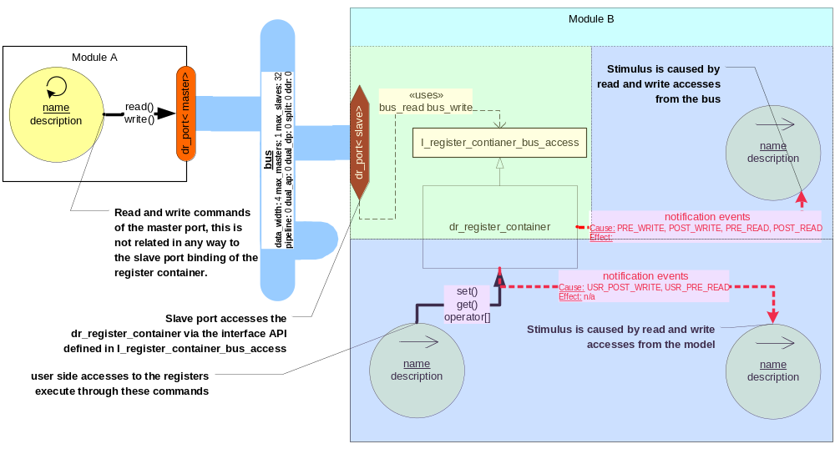
Port & Register Interface Relationships
Must View Foil in Slide Show View

Slide 86
Development API’s
  DRF Basics
  DR_REPORT
  dr_attribute & dr_switch
  dr_register & bit level access
  dr_notification_rule(s)
  dr_device & dr_subdevice
  drf ( platform configuration for model’s )

Slide 87
DRF Basics
  DRF is for peripheral models
    Capabilities may be useful in other areas
    Designed & Implemented in modular (contained) fashion
  Breaks the typical C++ Naming Convention Rules
    Uses very simple 1 or 2 letter keys for quick access to data (and cleaner code)
    ‘a’ – attributes
    ‘r’ – registers
    ‘b’ – bit
    ‘sd’ – sub-device
  Data Access & Manipulation are #1
    Use model is very simple, very powerful
    Instantiation is slightly more complicated, but will be reduced greatly in Alpha 3.0

Slide 88
DRF Basics
How Do I use in My Project?
    emd_module
    emd_test
    READ the readme.txt in these projects!!!
DRF is too big, where do I start?
    Talk to JP, others will become aware over time
    Class hierarchy and diagrams are available in help systems!!!

Slide 89
DR_REPORT
Never use in user code!

Slide 90
dr_attribute & dr_switch
Create a container (stand alone only)
    DRF::dr_attribute_container a;
Create an attribute or switch
    DRF::dr_attribute< int> m_int;
    DRF::dr_switch m_switch;
Constructor Initialization
    m_int( “int”, “description”, a, 1234567890),
    m_switch( “switch”, “description”, a, DRF::dr_options_bool_toggle, DRF::OFF)

Slide 91
dr_attribute & dr_switch
Reading
    i = m_int;
    i = a.attrib<int>(“int”);
    ui = m_switch;
    ui = a._switch(“switch”);
Writing
    m_int = 4;
    a[“int”] = 4;
    m_switch = DRF::OFF;
    a[“switch”] = DRF::ON;

Slide 92
dr_attribute & dr_switch
Determining Type
    If ( a[“m_int”].get_type() == IUTILS::INT ) printf(“Hello World”);
Events
    a[“m_int”].enable_event(); // must be called to enable, disabled by default
    a[“m_int”].disable_event(); // must be called to enable, disabled by default
    a[“m_switch”].get_switch_event( DRF::OFF); // each switch position has an “activate” event

Slide 93
dr_register & bit level access
Create a container (stand alone only)
    DRF::dr_register_container r;
Constructor Initialization (stand alone only)
    r( “registers”, 1, 32) // name, number of register, address width
Create a register (in constructor or end_of_elaboration)
    // name, description, offset, config options, default value, write mask, width, lock mask
    r.create_register( “reg”, “description”, 0x000, DRF::SPLIT_IO, 0xfeedf00d, 0xFFFFFFFF, 32, 0x0);
Read & Write
    ui = r[0x000];
    r[0x000] = (unsigned int) r[0x004];
    r[0x000] = 0x12300abc;

Slide 94
dr_register & bit level access
Bit Level Access
    r[0x000].b[3] = true;
    if( r[0x000].b[3] ) printf( “Hello World”);
Separate Input & Output Buffers (SPLIT_IO only!!!)
    // input is seen by the module as what the TLM wrote in
    // output is seen by the module as what the TLM will read
    r[0x000].i = 0x32323232;
    r[0x000].o = 0xfeedf00d;
    r[0x000].b[3].i = true;
    r[0x000].b[3].o = false;
DID YOU KNOW?
DRF bits are only access classes,
and created dynamically as needed

Slide 95
dr_notification_rule(s)
Second Level Automated Decode for Registers
External Rules (TLM->Register->Model)
    rule = new DRF::dr_reg_rule_pattern_state_change( “0x------01”, “0x------02”);
    r[0x000].get_post_write_rules().add_notification_rule( “simple_pattern_rule”, rule);
    // rules may be added to pre & post for both read & write operations
Internal Rules (Model->Register->Model)
    rule = new DRF::dr_reg_rule_bit_state_change( 3, true);
    r[0x000].get_user_ibuf_write_rules().add_notification_rule( “ibuf_rule”, rule);
    // rules exist for both input (ibuf) and output (obuf) for SPLIT_IO registers
Capabilities
    Enable & Disable rules at runtime
    Events fire at runtime just by changes to register variable…
    Most complicated rules are implemented (pattern matching)…
    Concept MIGHT be carried forward to attributes as well…

Slide 96
dr_analyzer
  Focused on data containment and manipulation
  Recording is possible through SVN (Zhu)
Definition
    Inherit from: public DRF::dr_analyzer< DRF::dr_energy_t>
Constructor
    DRF::dr_analyzer< DRF::dr_energy_t>( sc_module_name, parent)
Usage
    When inheriting from multiple analyzer API’s, you must be explicit:
      DRF::dr_analyzer< DRF::dr_energy_t>::method_name();
      Otherwise you can just use method_name();
Cached System (Push Methodology)
    Each “node” has a cache of all children
    Data is calculated as “cache + local”
    Change to data only touches current location and pushes up the 1 leg of the tree (very efficient)

Slide 97
dr_analyzer
Pull Methodology Support
    Available for specific use cases
Containment & Data are Separate Objects
    Inherit from Container
      set_local_data( _data);
      get_local_data( _data);
      get_cache_data( _data);
      get_on_cache_change_event();
      enable_on_cache_change_event();
      disable_on_cache_change_event();
      recalc_data_cache( _recurse_to_top);
    Data methods
      Operator () and =
      set & get
      increment & decrement

Slide 98
dr_device & dr_subdevice
Inheritance
    class my_device : public dr_device< my_device>
    class my_subdevice : public dr_subdevice< my_subdevice>
Constructor
    : dr_device< my_device>( _name, 2, 32)
    // sc_module_name, # registers, register width
    : dr_subdevice< my_subdevice>( _name, _parent)
    // sc_module_name, I_device (either a device or sub-device
Why Use?
    device & subdevice have attribute & subdevice containers
    device has one register container, all sub-devices have bounded reference to device registers
    Hierarchy is easy to walk:
      i = sd[“my_subdevice”].sd[“my_second_subdevice”].a.attrib<int>(“test_int”);
    Ability to save & load hierarchy configuration

Slide 99
drf ( platform configuration for model’s )
MUST BE DECLARED FIRST in SC_MAIN
    DRF::drf drf_framework_module( “drf”, “../modified_platform”);
    // sc_module_name, path to platform configuration (empty string will not try to load configuration)
Features
    Will load platform configuration on ”start_of_simulation” for dr_device & dr_subdevice models ONLY!
Saving a platform configuration
    Can be done at any time
    To be embedded in drf module, just not there yet
    DRF::dr_dumper::dump_platform( “test_path”, DRF::DR_CONFIG);
    // relative path, file format type (ONLY DR_CONFIG SUPPORTED AT THIS TIME)

Slide 100
OTHER
  Designed such that the code can be easily auto-generated from state machine XML description files

