Slide 1
Quarterly Review
Fiscal 2026
Notes:
Welcome everyone.

Slide 2
Highlights & <Risks>
Revenue up 12%
  Driven by renewals
See the report
Wow
Notes:
Mention renewals.

Slide 3
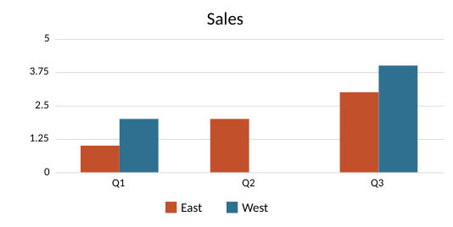
Numbers
Item | Cost
Pens | 2.5

