Slide 1
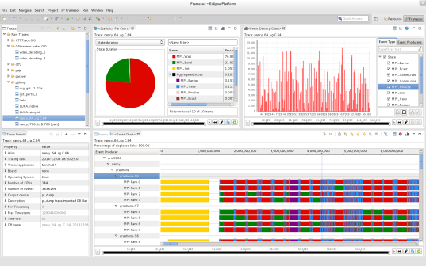
Framesoc Workbench
Software API
SoC-Trace Library
Generic Data-Model
Multiple-Trace DB
Traces – Tools – Analysis results

