Slide 1
이미지
학습
딥러닝
엔진
생성
모델
Rest
서비스
서버
유저
애플리케이션
서비스
학습 모델
모델 로드
/rest API
서비스 API
딥러닝 프레임워크 제공 영역
딥디텍트 제공 영역

Slide 2

Input
Convolution
ReLu
MaxPool
Output
[ -2.1986
-2.3380
-2.4327
-2.1802
-2.3331
-2.2747
-2.3658
-2.1936
-2.3564
-2.3890 ]
32x32
6x28x28
6x28x28
6x14x14
fully-connected
16x10x10
16x10x10
16x5x5

Slide 3










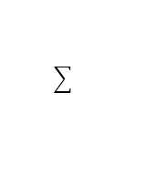
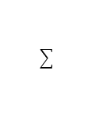



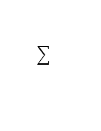











$$x_{1}$$
$$x_{1}$$
$$w_{1}$$
$$f_{}$$
$$z_{}$$
$$x_{2}$$
$$x_{2}$$
$$w_{2}$$
$$u_{}$$
$$z_{}$$
$$z_{}$$
$$x_{3}$$
$$= u=w_{1}x_{1}+ w_{2}x_{2}$$
$$x_{4}$$
$$z=f(u)$$
$$if z≻−b then 1 else 0$$
$$x_{0}=1$$
$$b_{}$$
$$x_{1}$$
$$w_{1}$$
$$f_{}$$
$$z_{}$$
$$x_{2}$$
$$w_{2}$$
$$= u=w_{1}x_{1}+ w_{2}x_{2}+b$$
$$z=f(u)$$
$$if z>b then 1 else 0$$

Slide 4

$$E^{1}\left(w_{1},w_{2}, b\right)= \left(h_x−y\right)=\left(w_{1}x_{1}+ w_{2}x_{2}+b−y\right)$$
$$W^{2}=W^{1} − ε∗X∗E^{1}$$

Slide 5








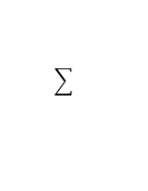


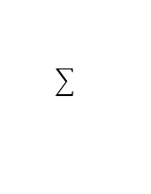

$$z_{}$$
$$x_{0}=1$$
$$b_{}$$
$$x_{1}$$
$$w_{1}$$
$$f_{}$$
$$x_{2}$$
$$w_{2}$$
layer
1
2
3
4
input layer
hidden ayer
hidden ayer
output layer
$$x_{0}=1$$
$$f_{}$$
$$x_{1}$$
$$f_{}$$
$$f_{}$$
$$x_{2}$$
$$f_{}$$
$$f_{}$$
$$z_{}$$
$$f_{}$$
$$x_{3}$$
$$f_{}$$
$$f_{}$$
$$x_{4}$$
parameter
$$W_{2}$$
$$W_{3}$$
$$W_{4}$$
output
$$Z_{1}$$
$$Z_{2}$$
$$W_{3}$$

Slide 6
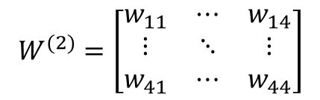

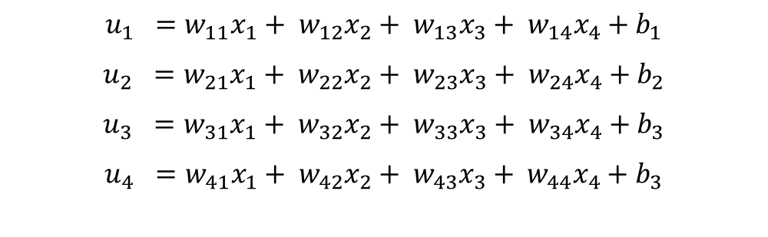

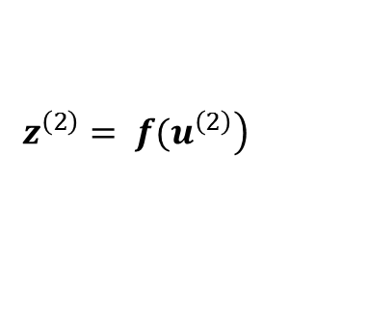


$$x_{} ={\left[x_{1}, x_{2}, x_{3}, x_{4}\right]}^{T}$$
$$u_{1} =w_{11}x_{1}+ w_{12}x_{2}+ w_{13}x_{3}+ w_{14}x_{4}+b_{1}$$
$$u_{2} =w_{21}x_{1}+ w_{22}x_{2}+ w_{23}x_{3}+ w_{24}x_{4}+b_{2}$$
$$u_{3} =w_{31}x_{1}+ w_{32}x_{2}+ w_{33}x_{3}+ w_{34}x_{4}+b_{3}$$
$$u_{4} =w_{41}x_{1}+ w_{42}x_{2}+ w_{43}x_{3}+ w_{44}x_{4}+b_{3}$$
$$W^{(2)}=\left[\begin{matrix}w_{11} & ⋯ & w_{14} \\ ⋮ & ⋱ & ⋮ \\ w_{41} & ⋯ & w_{44}\end{matrix}\right]$$
$$u^{\left(2\right)}= W^{\left(2\right)}x+ b^{\left(2\right)}$$
$$u^{(l+1)}= W^{(l+1)}x+ b^{(l)}$$
$$z^{\left(l+1\right)}= {f(u}^{\left(l+1\right)})$$
$$\left.z^{\left(2\right)}= {f(u}^{\left(2\right)}\right)$$
$$u^{(3)}= W^{(3)}x+ b^{(3)}$$
$$z^{\left(3\right)}= {f(u}^{\left(3\right)})$$

Slide 7


피드 포워드(Feed Forward)
$$x_{0}=1$$
$$f_{}$$
$$x_{1}$$
$$f_{}$$
$$f_{}$$
손실 함수 계산
$$x_{2}$$
$$f_{}$$
$$f_{}$$
$$z_{}$$
$$E\left(w\right)$$
$$f_{}$$
$$x_{3}$$
$$f_{}$$
$$f_{}$$
$$x_{4}$$
d
파라미터 업데이트
$$W^{2}=W^{1} − ε∗X∗E^{1}$$

Slide 8

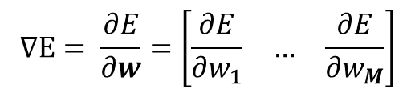
$$∇E= \frac{∂E}{∂w}=\left[\begin{matrix}\frac{∂E}{∂w_{1}} & … & \frac{∂E}{∂w_{M}}\end{matrix}\right]$$
$$w^{\left(t+1\right)}= w^{\left(t\right)}− ε∇E$$

Slide 9

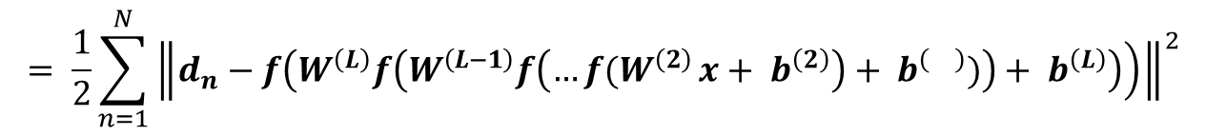
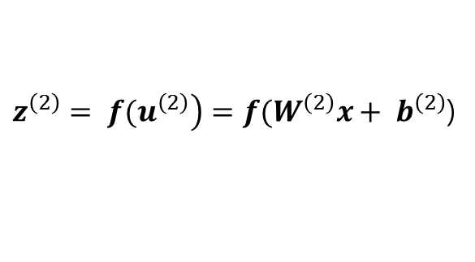
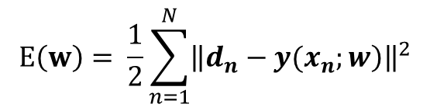


$\left.z^{\left(2\right)}= {f(u}^{\left(2\right)}\right)=f(W^{\left(2\right)}x+ b^{\left(2\right)}$)
$$z^{\left(3\right)}= {f(u}^{\left(3\right)})=f\left(W^{\left(3\right)}x+ b^{\left(3\right)}\right)$$
$$=f\left(W^{\left(3\right)}z^{\left(3\right)}+ b^{\left(3\right)}\right)$$
$$=f\left(W^{\left(3\right)}f\left(W^{\left(2\right)}x+ b^{\left(2\right)}\right)+ b^{\left(3\right)}\right)$$
$$E\left(w\right)= \frac{1}{2}\sum_{n=1}^{N}{{\left\|\left.d_{n}−y(x_{n};w\right)\right\|}^{2}}$$
$$= \frac{1}{2}\sum_{n=1}^{N}{{\left\|\left.d_{n}−f\left(W^{\left(L\right)}f\left(W^{\left(L−1\right)}f\left({…f(W}^{\left(2\right)}x+ b^{\left(2\right)}\right)+ b^{\left(\right)})\right)+ b^{\left(L\right)}\right)\right)\right\|}^{2}}$$

Slide 10
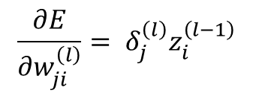
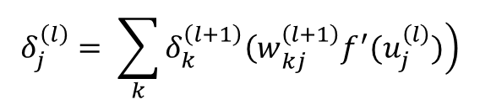



피드 포워드(Feed Forward)
$$x_{0}=1$$
$$f_{}$$
$$x_{1}$$
$$f_{}$$
$$f_{}$$
손실 함수 계산
$$x_{2}$$
$$f_{}$$
$$f_{}$$
$$z_{}$$
$$E\left(w\right)$$
$$δ_{j}^{\left(l\right)}= \sum_{k}{\left.δ_{k}^{\left(l+1\right)}{\left(w\right.}_{kj}^{\left(l+1\right)}f^{′}(u_{j}^{\left(l\right)})\right)}$$
$$f_{}$$
$$x_{3}$$
$$f_{}$$
$$\frac{∂E}{∂w_{ji}^{\left(l\right)}}= δ_{j}^{\left(l\right)}z_{i}^{\left(l−1\right)}$$
$$f_{}$$
$$x_{4}$$
$$δ^{\left(2\right)}$$
$$δ^{\left(3\right)}$$
$$δ^{\left(4\right)}$$
d
역 전파(Back Propagation)

Slide 11
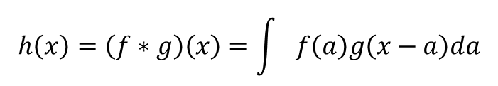
$$h\left(x\right)=\left(f∗g\right)\left(x\right)=\int{f\left(a\right)g\left(x−a\right)da}$$

Slide 12





Input
Convolution
3x32x32
6x28x28
ReLu
Output
6x28x28
MaxPool
6x14x14
another convolution layer … & fully-connected
Input
Convolution
3x32x32
6x28x28
ReLu
6x28x28
MaxPool

Slide 13



딥러닝 in Torch
엔지니어를 위한 딥러닝
송준이 지음

