Slide 1

Happy National Day

Slide 2
The Physical Layer
Transmission
04
Kai Bu
kaibu@zju.edu.cn
http://list.zju.edu.cn/kaibu/compnet2026
Notes:
In this chapter, we look at the lowest layer in our reference model, the physical
layer. It defines the electrical, timing, and other interfaces by which bits are sent as
signals over channels. The physical layer is the foundation on which the network
is built. The properties of different kinds of physical channels determine the performance (e.g., throughput, latency, and error rate) so it is a good place to start our
journey into network-land.

Slide 3
The Physical Layer
Transmission
transmission media
transmission theories

Slide 4
The Physical Layer
Transmission
transmission media
transmission theories

Slide 5
guided or wired
copper, coaxial cable, fiber optics
transmission media
wireless
terrestrial radio
satellite

Slide 6
Guided Transmission Media
Rely on a physical cable or wire
Feature with trade-offs in terms of frequency, bandwidth, delay, cost, and ease of installation and maintenance
Notes:
The purpose of the physical layer is to transport bits from one machine to an-
other. Various physical media can be used for the actual transmission. Transmis-
sion media that rely on a physical cable or wire are often called guided transmis-
sion media because the signal transmissions are guided along a path with a physi-
cal cable or wire. The most common guided transmission media are copper cable
(in the form of coaxial cable or twisted pair) and fiber optics. Each type of guided
transmission media has its own set of trade-offs in terms of frequency, bandwidth,
delay, cost, and ease of installation and maintenance. Bandwidth is a measure of
the carrying capacity of a medium. It is measured in Hz (or MHz or GHz). It is
named in honor of the German physicist Heinrich Hertz. We will discuss this in
detail later in this chapter.

Slide 7
Persistent Storage
For very large volumes of data: write data onto persistent storage (e.g., magnetic or solid-state storage); physically transport the tape or disks to the destination machine; read data back to the destination machine
Favor applications with a high data rate or a low cost per bit transported as the key factor
Notes:
One of the most common ways to transport data from one device to another is
to write them onto persistent storage, such as magnetic or solid-state storage (e.g.,
recordable DVDs), physically transport the tape or disks to the destination ma-
chine, and read them back in again. Although this method is not as sophisticated
as using a geosynchronous communication satellite, it is often more cost effective,
especially for applications where a high data rate or cost per bit transported is the
key factor.
A simple calculation will make this point clear. An industry-standard Ultrium
tape can hold 30 terabytes. A box 60 × 60 × 60 cm can hold about 1000 of these
tapes, for a total capacity of 800 terabytes, or 6400 terabits (6.4 petabits). A box of
tapes can be delivered anywhere in the United States in 24 hours by Federal
Express and other companies. The effective bandwidth of this transmission is
6400 terabits/86,400 sec, or a bit over 70 Gbps. If the destination is only an hour
aw ay by road, the bandwidth is increased to over 1700 Gbps. No computer net-
work can even approach this. Of course, networks are getting faster, but tape den-
sities are increasing, too.
If we now look at cost, we get a similar picture. The cost of an Ultrium tape is
around $40 when bought in bulk. A tape can be reused at least 10 times, so the
tape cost is maybe $4000 per box per usage. Add to this another $1000 for ship-
ping (probably much less), and we have a cost of roughly $5000 to ship 800 TB.
This amounts to shipping a gigabyte for a little over half a cent. No network can
beat that. The moral of the story is:
Never underestimate the bandwidth of a station wagon full of tapes hurtling
down the highway.
For moving very large amounts of data, this is often the best solution. Amazon
has what it calls the ‘‘Snowmobile,’’ which is a large truck filled with thousands of
hard disks, all connected to a high-speed network inside the truck. The total capac-
ity of the truck is 100 PB (100,000 TB or 100 million GB). When a company has
a huge amount of data to move, it can have the truck come to its premises and plug
into the company’s fiber-optic network, then suck out all the data into the truck.
Once that it is done, the truck drives to another location and disgorges all the data.
For example, a company wishing to replace its own massive datacenter with the
Amazon cloud might be interested in this service. For very large volumes of data,
no other method of data transport can even approach this.

Slide 8
Twisted Pair
Consist of two insulated copper wires, typically about 1 mm thick
Wires are twisted together in a helical form, similar to a DNA molecule
Waves from different twists cancel out, so the wire radiates less effectively
Notes:
Although the bandwidth characteristics of persistent storage are excellent, the
delay characteristics are poor: Transmission time is measured in hours or days, not
milliseconds. Many applications, including the Web, video conferencing, and
online gaming, rely on transmitting data with low delay. One of the oldest and still
most common transmission media is twisted pair. A twisted pair consists of two
insulated copper wires, typically about 1 mm thick. The wires are twisted together
in a helical form, similar to a DNA molecule. Two parallel wires constitute a fine
antenna; when the wires are twisted, the wav es from different twists cancel out, so
the wire radiates less effectively. A signal is usually carried as the difference in
voltage between the two wires in the pair. Transmitting the signal as the difference
between the two voltage levels, as opposed to an absolute voltage, provides better
immunity to external noise because the noise tends to affect the voltage traveling
through both wires in the same way, leaving the differential relatively unchanged.

Slide 9
Twisted Pair
Signal is usually carried as the difference in voltage between the two wires in the pair (as apposed to an absolute voltage)
Provide better immunity to external noise because the noise tends to affect the voltage traveling through both wires in the same way, leaving the differential relatively unchanged
Notes:
Although the bandwidth characteristics of persistent storage are excellent, the
delay characteristics are poor: Transmission time is measured in hours or days, not
milliseconds. Many applications, including the Web, video conferencing, and
online gaming, rely on transmitting data with low delay. One of the oldest and still
most common transmission media is twisted pair. A twisted pair consists of two
insulated copper wires, typically about 1 mm thick. The wires are twisted together
in a helical form, similar to a DNA molecule. Two parallel wires constitute a fine
antenna; when the wires are twisted, the wav es from different twists cancel out, so
the wire radiates less effectively. A signal is usually carried as the difference in
voltage between the two wires in the pair. Transmitting the signal as the difference
between the two voltage levels, as opposed to an absolute voltage, provides better
immunity to external noise because the noise tends to affect the voltage traveling
through both wires in the same way, leaving the differential relatively unchanged.

Slide 10
Twisted Pair
Transmit either analog or digital information
Bandwidth depends on thickness of the wire and distance traveled
Long distance makes signal too attenuated and thus repeaters needed
Notes:
The most common application of the twisted pair is the telephone system.
Nearly all telephones are connected to the telephone company (telco) office by a
twisted pair. Both telephone calls and ADSL Internet access run over these lines.
Twisted pairs can run several kilometers without amplification, but for longer dis-
tances the signal becomes too attenuated and repeaters are needed. When many
twisted pairs run in parallel for a substantial distance, such as all the wires coming
from an apartment building to the telephone company off ice, they are bundled to-
gether and encased in a protective sheath. The pairs in these bundles would inter-
fere with one another if it were not for the twisting. In parts of the world where
telephone lines run on poles above ground, it is common to see bundles several
centimeters in diameter.
Twisted pairs can be used for transmitting either analog or digital information.
The bandwidth depends on the thickness of the wire and the distance traveled, but
hundreds of megabits/sec can be achieved for a few kilometers, in many cases, and
more when various tricks are used. Due to their adequate performance, widespread
availability, and low cost, twisted pairs are widely used and are likely to remain so
for years to come.

Slide 11
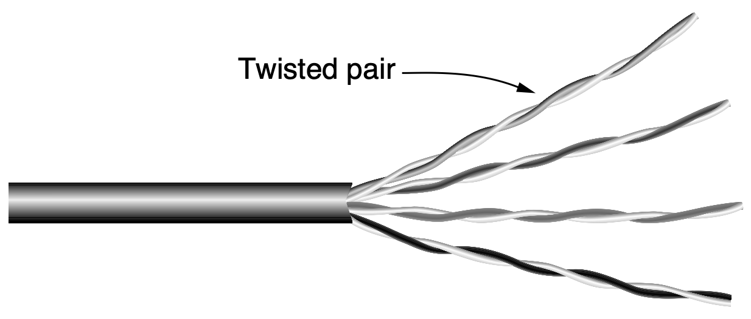
Twisted Pair
Example: Categorty 5e / Cat 5e
100-Mbps Ethernet uses two pairs, one for each direction
1-Gbps Ethernet uses all four pairs in both directions simultaneously
Notes:
Twisted-pair cabling comes in several varieties. One common variety of twist-
ed-pair cables now deployed in many buildings is called Category 5e cabling, or
‘‘Cat 5e.’’ A Category 5e twisted pair consists of two insulated wires gently twisted
together. Four such pairs are typically grouped in a plastic sheath to protect the
wires and keep them together. This arrangement is shown in Fig. 2-1.
Different LAN standards may use the twisted pairs differently. For example,
100-Mbps Ethernet uses two (out of the four) pairs, one pair for each direction. To
reach higher speeds, 1-Gbps Ethernet uses all four pairs in both directions simul-
taneously, which requires the receiver to factor out the signal that is transmitted.

Slide 12
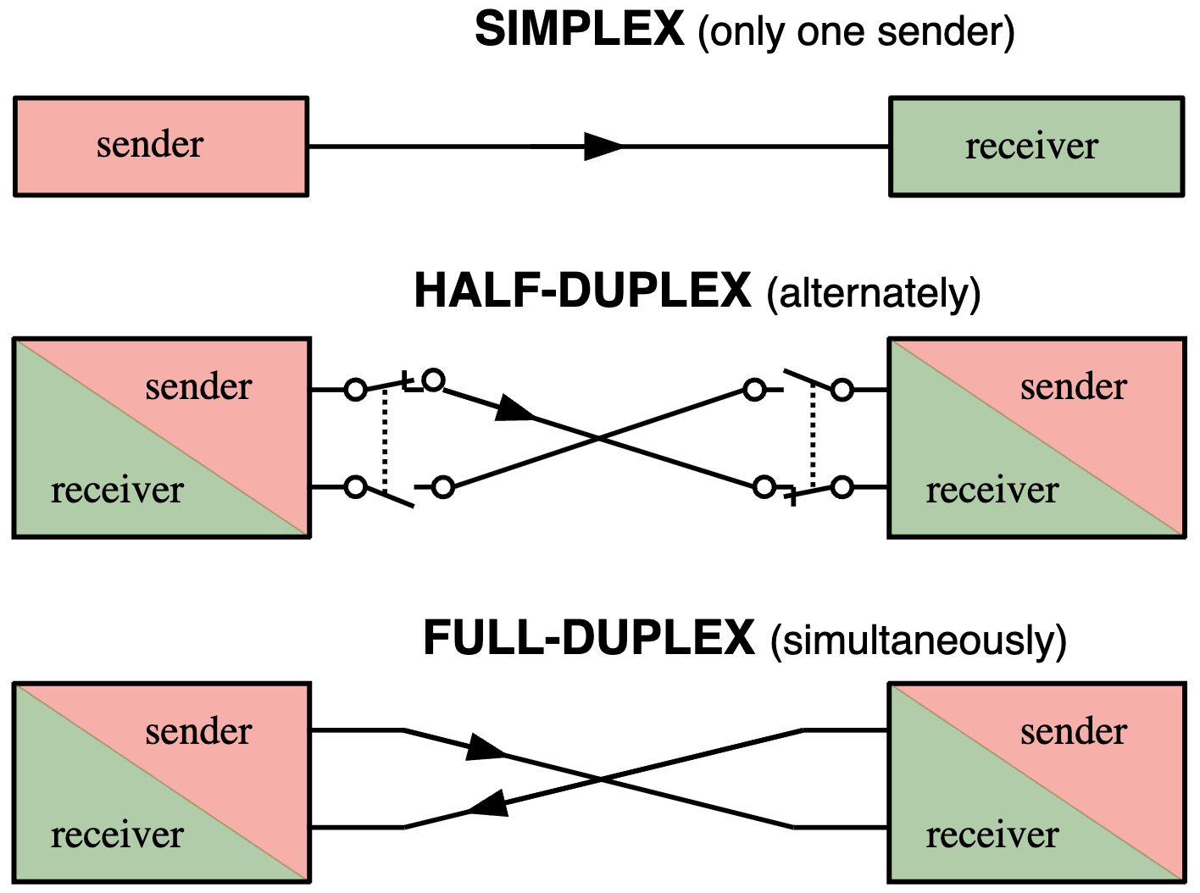
Twisted Pair
links can be used in only
one direction
links can be used in either
direction, but only one way at a time
links can be used in both
directions at the same time
https://www.weigu.lu/tutorials/sensors2bus/02_interfaces/index.html
Notes:
Some general terminology is now in order. Links that can be used in both di-
rections at the same time, like a two-lane road, are called full-duplex links. In
contrast, links that can be used in either direction, but only one way at a time, like
a single-track railroad line, are called half-duplex links. A third category consists
of links that allow traffic in only one direction, like a one-way street. They are call-
ed simplex links.

Slide 13
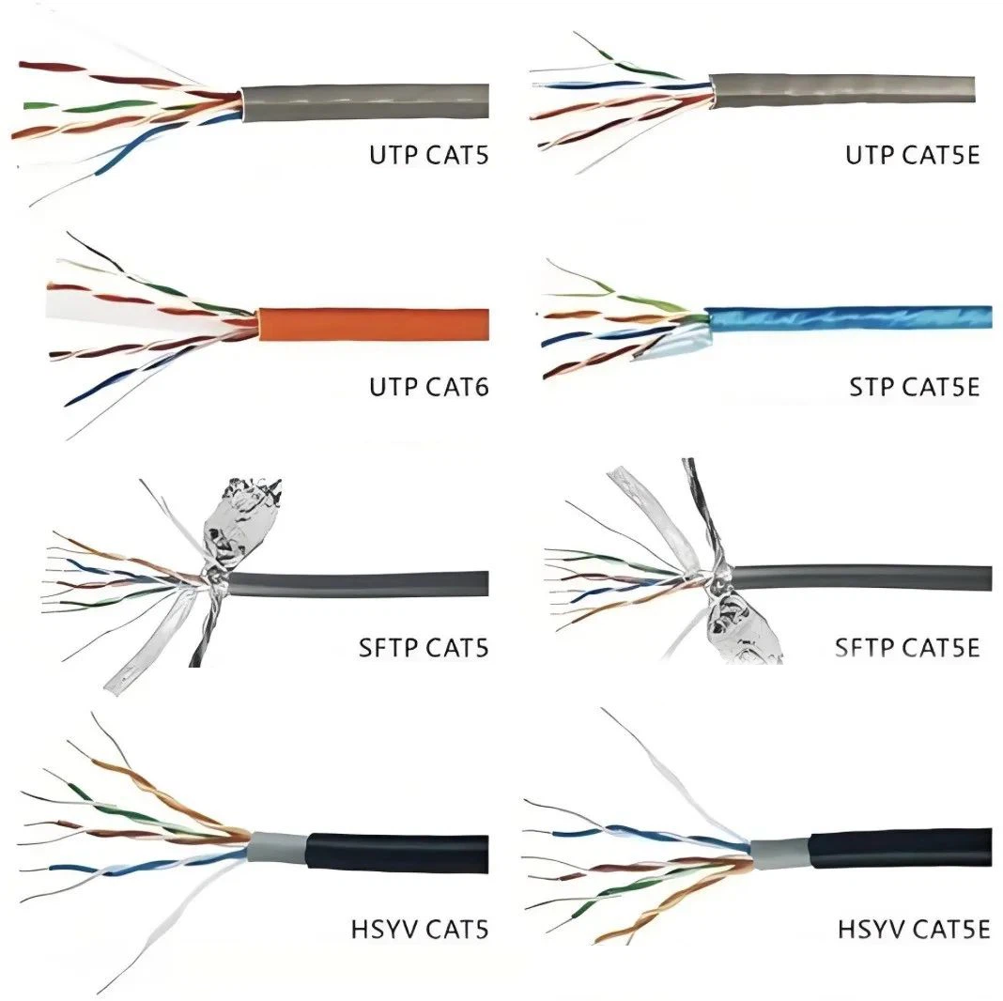
Twisted Pair
UTP: Unshielded Twisted Pair
STP: Shielded Twisted Pair
SFTP: Shielded Foiled Twisted Pair
https://www.cobtel.com/info/network-cables-types-from-cat5e-to-cat-102769292.html
Notes:
::HSYV, in the context of cables, stands for H-communication cable, Y-solid polyolefin insulation, V-indoor PVC flame retardant sheath. It is a specific type of copper core multi-core telephone cable used for communication.
Returning to twisted pair, Cat 5 replaced earlier Category 3 cables with a simi-
lar cable that uses the same connector, but has more twists per meter. More twists
result in less crosstalk and a better-quality signal over longer distances, making the
cables more suitable for high-speed computer communication, especially
100-Mbps and 1-Gbps Ethernet LANs.
New wiring is more likely to be Category 6 or even Category 7. These cate-
gories have more stringent specifications to handle signals with greater band-
widths. Some cables in Category 6 and above can support the 10-Gbps links that
are now commonly deployed in many networks, such as in new off ice buildings.
Category 8 wiring runs at higher speeds than the lower categories, but operates
only at short distances of around 30 meters and is thus only suitable in data cen-
ters. The Category 8 standard has two options: Class I, which is compatible with
Category 6A; and Class II, which is compatible with Category 7A.
Through Category 6, these wiring types are referred to as UTP (Unshielded
Twisted Pair) as they consist simply of wires and insulators. In contrast to these,
Category 7 cables have shielding on the individual twisted pairs, as well as around
the entire cable (but inside the plastic protective sheath). Shielding reduces the
susceptibility to external interference and crosstalk with other nearby cables to
meet demanding performance specifications. The cables are reminiscent of the
high-quality, but bulky and expensive shielded twisted pair cables that IBM intro-
duced in the early 1980s. However, these did not prove popular outside of IBM in-
stallations. Evidently, it is time to try again.

Slide 14
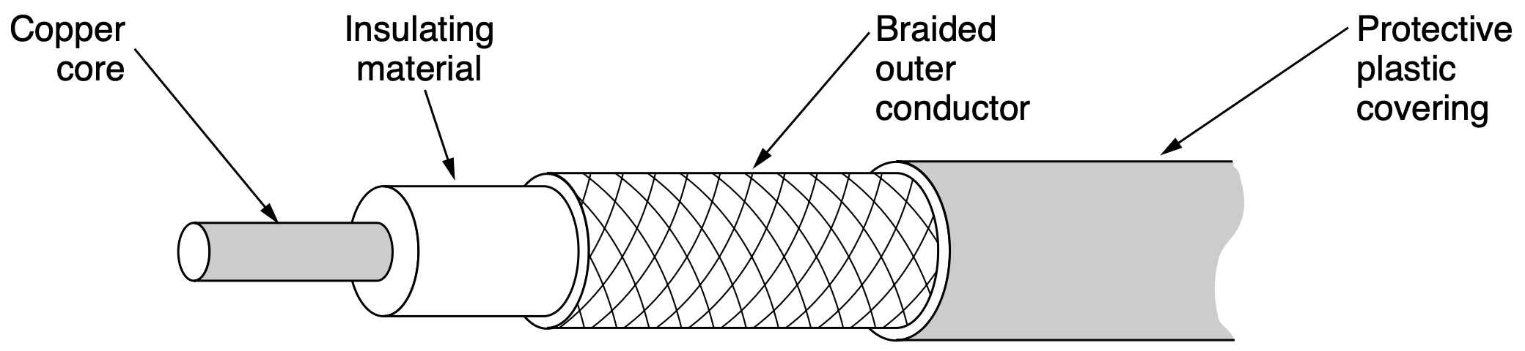
Coaxial Cable
Coax: better shielding and greater bandwidth than unshielded twisted pairs
Span longer distances at higher speeds
High bandwidth (up to 6 GHz) and excellent noise immunity
Notes:
Another common transmission medium is the coaxial cable (known to its
many friends as just ‘‘coax’’ and pronounced ‘‘co-ax’’). It has better shielding and
greater bandwidth than unshielded twisted pairs, so it can span longer distances at
higher speeds. Tw o kinds of coaxial cable are widely used. One kind, 50-ohm
cable, is commonly used when it is intended for digital transmission from the start.
The other kind, 75-ohm cable, is commonly used for analog transmission and cable
television. This distinction is based on historical, rather than technical, factors
(e.g., early dipole antennas had an impedance of 300 ohms, and it was easy to use
existing 4:1 impedance-matching transformers). Starting in the mid-1990s, cable
TV operators began to provide Internet access over cable, which has made 75-ohm
cable more important for data communication.
A coaxial cable consists of a stiff copper wire as the core, surrounded by an
insulating material. The insulator is encased by a cylindrical conductor, often as a
closely woven braided mesh. The outer conductor is covered in a protective plastic
sheath. A cutaway view of a coaxial cable is shown in Fig. 2-2.
The construction and shielding of the coaxial cable give it a good combination
of high bandwidth and excellent noise immunity (e.g., from garage door openers,
microwave ovens, and more). The bandwidth possible depends on the cable quali-
ty and length. Coaxial cable has extremely wide bandwidth; modern cables have a
bandwidth of up to 6 GHz, thus allowing many conversations to be simultaneously
transmitted over a single coaxial cable (a single television program might occupy
approximately 3.5 MHz). Coaxial cables were once widely used within the tele-
phone system for long-distance lines but have now largely been replaced by fiber
optics on long-haul routes. Coax is still widely used for cable television and met-
ropolitan area networks and is also used for delivering high-speed Internet con-
nectivity to homes in many parts of the world.

Slide 15
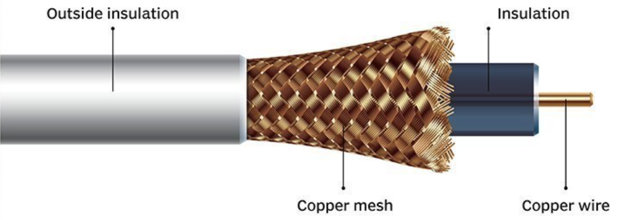
Coaxial Cable
Coax: better shielding and greater bandwidth than unshielded twisted pairs
Span longer distances at higher speeds
High bandwidth (up to 6 GHz) and excellent noise immunity
https://www.techtarget.com/searchnetworking/definition/coaxial-cable-illustrated
Notes:
Another common transmission medium is the coaxial cable (known to its
many friends as just ‘‘coax’’ and pronounced ‘‘co-ax’’). It has better shielding and
greater bandwidth than unshielded twisted pairs, so it can span longer distances at
higher speeds. Tw o kinds of coaxial cable are widely used. One kind, 50-ohm
cable, is commonly used when it is intended for digital transmission from the start.
The other kind, 75-ohm cable, is commonly used for analog transmission and cable
television. This distinction is based on historical, rather than technical, factors
(e.g., early dipole antennas had an impedance of 300 ohms, and it was easy to use
existing 4:1 impedance-matching transformers). Starting in the mid-1990s, cable
TV operators began to provide Internet access over cable, which has made 75-ohm
cable more important for data communication.
A coaxial cable consists of a stiff copper wire as the core, surrounded by an
insulating material. The insulator is encased by a cylindrical conductor, often as a
closely woven braided mesh. The outer conductor is covered in a protective plastic
sheath. A cutaway view of a coaxial cable is shown in Fig. 2-2.
The construction and shielding of the coaxial cable give it a good combination
of high bandwidth and excellent noise immunity (e.g., from garage door openers,
microwave ovens, and more). The bandwidth possible depends on the cable quali-
ty and length. Coaxial cable has extremely wide bandwidth; modern cables have a
bandwidth of up to 6 GHz, thus allowing many conversations to be simultaneously
transmitted over a single coaxial cable (a single television program might occupy
approximately 3.5 MHz). Coaxial cables were once widely used within the tele-
phone system for long-distance lines but have now largely been replaced by fiber
optics on long-haul routes. Coax is still widely used for cable television and met-
ropolitan area networks and is also used for delivering high-speed Internet con-
nectivity to homes in many parts of the world.

Slide 16
Power Lines
Deliver electrical power to houses
Eletrical wiring within houses distributes power to electrical outlets
Used for low-rate communication such as remote metering and device control in the home
Renewed interest in high-rate communication, both inside home as a LAN and outside the home for broadband Internet access
Notes:
The telephone and cable television networks are not the only sources of wiring
that can be reused for data communication. There is a yet more common kind of
wiring: electrical power lines. Power lines deliver electrical power to houses, and
electrical wiring within houses distributes the power to electrical outlets.
The use of power lines for data communication is an old idea. Power lines
have been used by electricity companies for low-rate communication such as re-
mote metering for many years, as well in the home to control devices (e.g., the X10
standard). In recent years there has been renewed interest in high-rate communica-
tion over these lines, both inside the home as a LAN and outside the home for
broadband Internet access. We will concentrate on the most common scenario:
using electrical wires inside the home.

Slide 17
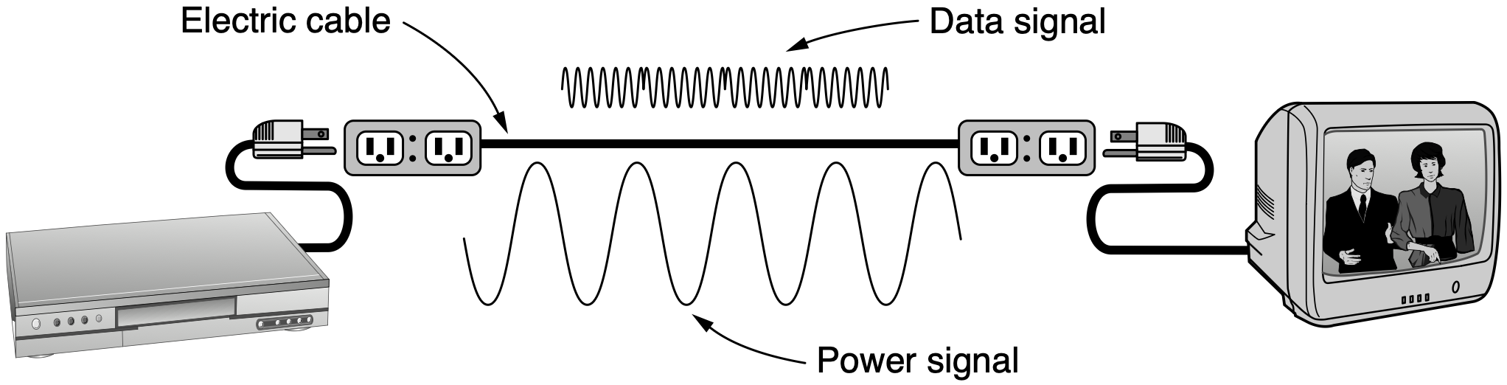
Power Lines
Example: send and receive movies over the electrical wiring
Data signal is superimposed on the low-frequency power signal
Notes:
The convenience of using power lines for networking should be clear. Simply
plug a TV and a receiver into the wall, which you must do anyway because they
need power, and they can send and receive movies over the electrical wiring. This
configuration is shown in Fig. 2-3. There is no other plug or radio. The data signal
is superimposed on the low-frequency power signal (on the active or ‘‘hot’’ wire)
as both signals use the wiring at the same time.
The difficulty with using household electrical wiring for a network is that it
was designed to distribute power signals. This task is quite distinct from distribut-
ing data signals, at which household wiring does a horrible job. Electrical signals
are sent at 50–60 Hz and the wiring attenuates the much higher frequency (MHz)
signals needed for high-rate data communication. The electrical properties of the
wiring vary from one house to the next and change as appliances are turned on and
off, which causes data signals to bounce around the wiring. Transient currents
when appliances switch on and off create electrical noise over a wide range of fre-
quencies. And without the careful twisting of twisted pairs, electrical wiring acts as
a fine antenna, picking up external signals and radiating signals of its own. This be-
havior means that to meet regulatory requirements, the data signal must avoid
licensed frequencies such as the amateur radio bands.
Despite these difficulties, it is practical to send at least 500 Mbps short dis-
tances over typical household electrical wiring by using communication schemes
that resist impaired frequencies and bursts of errors. Many products use proprietary
standards for power-line networking, but standards are being developed.

Slide 18
Fiber Optics
Used for long-haul transmission in network backbones, high-speed LANs, and high-speed Internet access
Optical transmission: 3 key components
light source
use pulse/absence of light to indicate bit 1/0
transmission medium
transmit light pulses through an ultra-thin fiber of glass
detector
generate electrical pulse when light falls on it
Notes:
Fiber optics are used for long-haul transmission in network backbones, high-
speed LANs (although so far, copper has often managed to catch up eventually),
and high-speed Internet access such as fiber to the home. An optical transmission
system has three key components: the light source, the transmission medium, and
the detector. Conventionally, a pulse of light indicates a 1 bit and the absence of
light indicates a 0 bit. The transmission medium is an ultra-thin fiber of glass. The
detector generates an electrical pulse when light falls on it. By attaching a light
source to one end of an optical fiber and a detector to the other, we hav e a unidirec-
tional (i.e., simplex) data transmission system that accepts an electrical signal, con-
verts and transmits it by light pulses, and then reconverts the output to an electrical
signal at the receiving end.

Slide 19
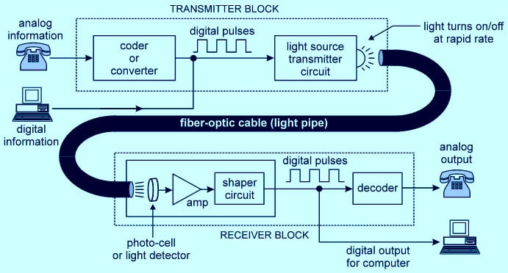
Fiber Optics
simplex
https://idstch.com/technology/photonics/fiber-optics-transmission-system-and-component-technologies-for-rising-internet-traffic/
Notes:
By attaching a light
source to one end of an optical fiber and a detector to the other, we hav e a unidirec-
tional (i.e., simplex) data transmission system that accepts an electrical signal, con-
verts and transmits it by light pulses, and then reconverts the output to an electrical
signal at the receiving end.

Slide 20
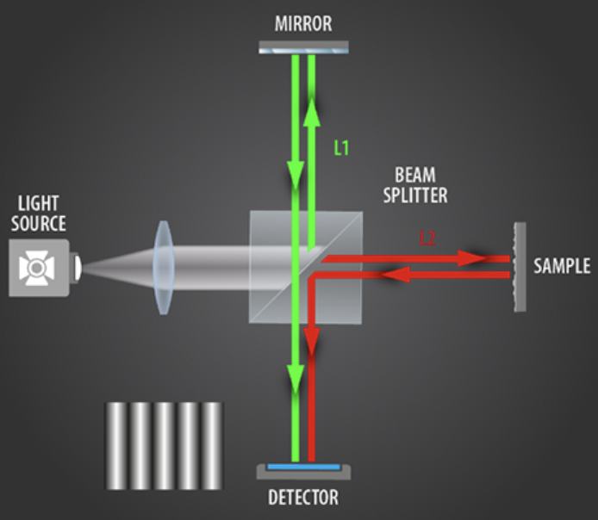
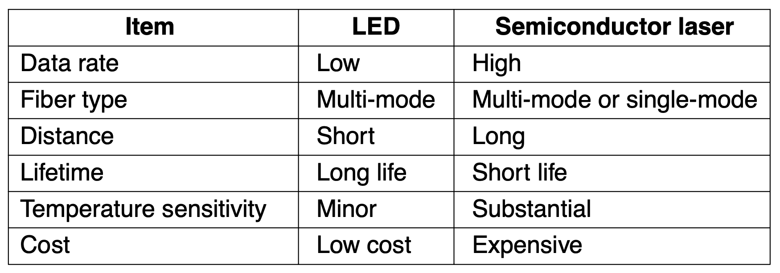
Fiber Optics
Light sources
Tune wavelength by inserting Fabry-Perot or Mach-Zehnder interferometers between source and fiber
https://www.sensofar.com/metrology/technology/measuring-principles/interferometry/
Notes:
https://www.ligo.caltech.edu/page/what-is-interferometer
Two kinds of light sources are typically used to do the signaling: LEDs (Light
Emitting Diodes) and semiconductor lasers. They hav e different properties, as
shown in Fig. 2-7. They can be tuned in wav elength by inserting Fabry-Perot or
Mach-Zehnder interferometers between the source and the fiber. Fabry-Perot inter-
ferometers are simple resonant cavities consisting of two parallel mirrors. The
light is incident perpendicular to the mirrors. The length of the cavity selects out
those wav elengths that fit inside an integral number of times. Mach-Zehnder inter-
ferometers separate the light into two beams. The two beams travel slightly dif-
ferent distances. They are recombined at the end and are in phase for only certain
wavelengths.

Slide 21
Fiber Optics
Light sources
Receiving end consists of a photodiode, which gives off an electrical pulse when struck by light (about 100 Gbps)
Notes:
The receiving end of an optical fiber consists of a photodiode, which gives off
an electrical pulse when struck by light. The response time of photodiodes, which
convert the signal from the optical to the electrical domain, limits data rates to
about 100 Gbps. Thermal noise is also an issue, so a pulse of light must carry
enough energy to be detected. By making the pulses powerful enough, the error
rate can be made arbitrarily small.

Slide 22
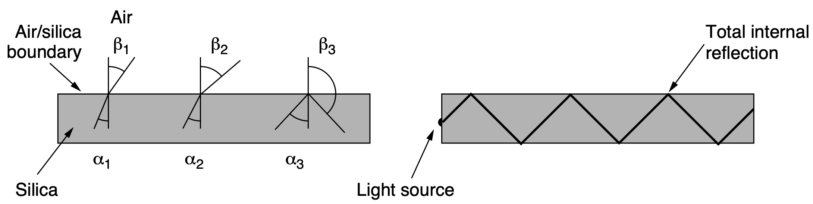
Fiber Optics
When a light passes from fused silica to air, the ray is refracted (bent) at the silica/air boundary
For angles of incidence above a certain critical value, the light is refracted back into the silica; none escapes into the air
Notes:
This transmission system would leak light and be useless in practice were it
not for an interesting principle of physics. When a light ray passes from one
medium to another—for example, from fused silica (glass) to air—the ray is
refracted (bent) at the silica/air boundary, as shown in Fig. 2-4(a). Here we see a
light ray incident on the boundary at an angle 1 emerging at an angle 1. The
amount of refraction depends on the properties of the two media (in particular,
their indices of refraction). For angles of incidence above a certain critical value,
the light is refracted back into the silica; none of it escapes into the air. Thus, a
light ray incident at or above the critical angle is trapped inside the fiber, as shown
in Fig. 2-4(b), and can propagate for many kilometers with virtually no loss.

Slide 23
Fiber Optics
When a light passes from fused silica to air, the ray is refracted (bent) at the silica/air boundary
For angles of incidence above a certain critical value, the light is refracted back into the silica; none escapes into the air
mode
Notes:
The sketch of Fig. 2-4(b) shows only one trapped ray, but since any light ray
incident on the boundary above the critical angle will be reflected internally, many
different rays will be bouncing around at different angles. Each ray is said to have
a different mode, so a fiber having this property is called a multimode fiber.

Slide 24
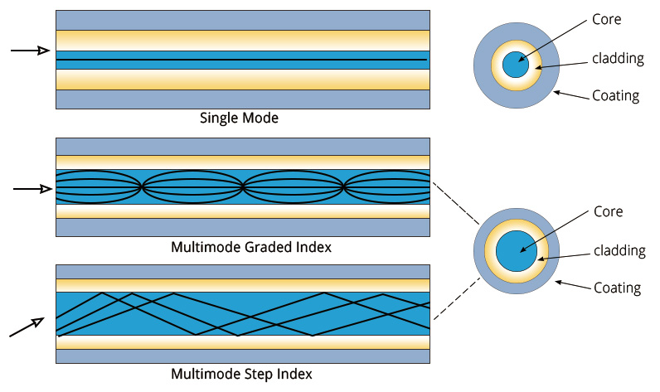
Fiber Optics
reflective index decreases gradually from the center towards the edge
uniform reflective index
https://www.qsfptek.com/qt-news/multimode-to-single-mode-fiber-conversion-tutorial.html
Notes:
::Multimode graded-index and step-index fibers differ primarily in how the refractive index changes within the fiber core, impacting their performance characteristics. Graded-index fibers, with a refractive index that decreases from the center to the edge of the core, offer lower modal dispersion and higher bandwidth compared to step-index fibers, which have a uniform refractive index throughout the core. This makes graded-index fibers generally preferred for higher-speed, longer-distance data transmission, while step-index fibers are often used for shorter distances and imaging applications.
::Modal dispersion, also known as intermodal dispersion, is a type of signal distortion that occurs in multimode optical fibers where different light paths (modes) travel at different speeds, causing the signal to spread out in time. This spreading can lead to pulse overlap and limits the data transmission rate over longer distances.
Each ray is said to have
a different mode, so a fiber having this property is called a multimode fiber. If the
fiber’s diameter is reduced to a few wav elengths of light (less than 10 microns, as
opposed to more than 50 microns for multimode fiber), the fiber acts like a
waveguide and the light can propagate only in a straight line, without bouncing,
yielding a single-mode fiber. Single-mode fibers are more expensive but are
widely used for longer distances; they can transmit signals approximately 50 times
farther than multimode fibers. Currently available single-mode fibers can transmit
data at 100 Gbps for 100 km without amplification. Even higher data rates have
been achieved in the laboratory for shorter distances. The choice between sin-
gle-mode or multimode fiber depends on the application. Multimode fiber can be
used for transmissions of up to about 15 km and can allow the use of relatively less
expensive fiber-optic equipment. On the other hand, the bandwidth of multimode
fiber becomes more limited as distance increases.

Slide 25
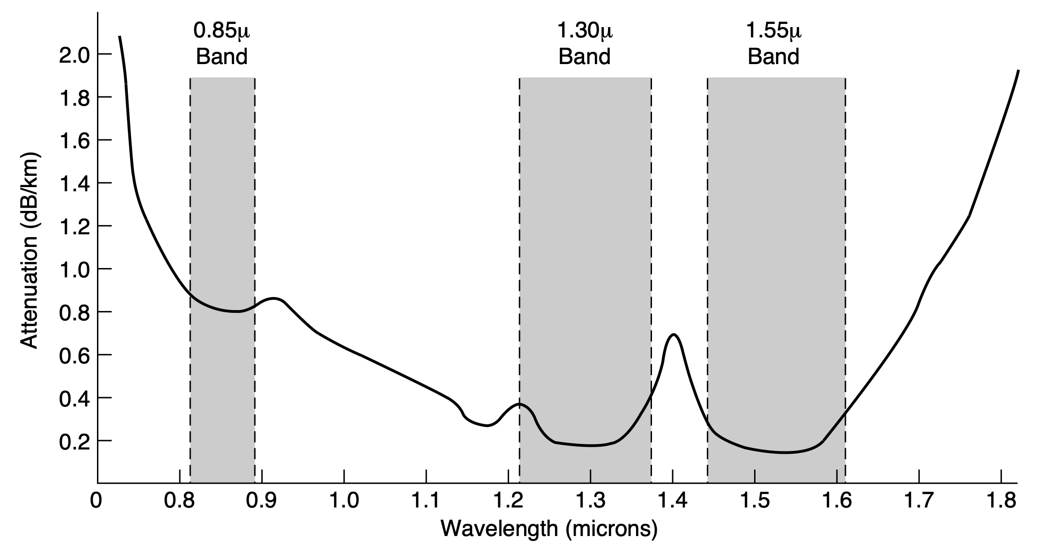
Light Attenuation
Ratio of input to output signal power
1 micron = 10⁻⁶ meters
Notes:
The attenuation of light through glass depends on the wav elength of the light
(as well as on some of the physical properties of the glass). It is defined as the
ratio of input to output signal power. For the kind of glass used in fibers, the atten-
uation is shown in Fig. 2-5 in units of decibels (dB) per linear kilometer of fiber.
As an example, a factor of two loss of signal power corresponds to an attenuation
of 10 log10 2= 3 dB. We will discuss decibels shortly. In brief, it is a logarithmic
way to measure power ratios, with 3 dB meaning a factor of two power ratio. The
figure shows the near-infrared part of the spectrum, which is what is used in prac-
tice. Visible light has slightly shorter wav elengths, from about 0.4 to 0.7 microns.
(1 micron is 10 6 meters.) The true metric purist would refer to these wav elengths
as 400 nm to 700 nm, but we will stick with traditional usage.

Slide 26
Light Attenuation
decibels (dB) per linear km of fiber dB=10xlog₁₀(final-power/initial-power)
1 micron = 10⁻⁶ meters
Notes:
The formula for power ratio in decibels is: dB = 10 * log10(P2/P1), where P1 is the initial power and P2 is the final power.
Three wav elength bands are most commonly used at present for optical com-
munication. They are centered at 0.85, 1.30, and 1.55 microns, respectively. All
three bands are 25,000 to 30,000 GHz wide. The 0.85-micron band was used first.
It has higher attenuation and so is used for shorter distances, but at that wav elength
the lasers and electronics could be made from the same material (gallium arsen-
ide). The last two bands have good attenuation properties (less than 5% loss per
kilometer). The 1.55-micron band is now widely used with erbium-doped ampli-
fiers that work directly in the optical domain.

Slide 27
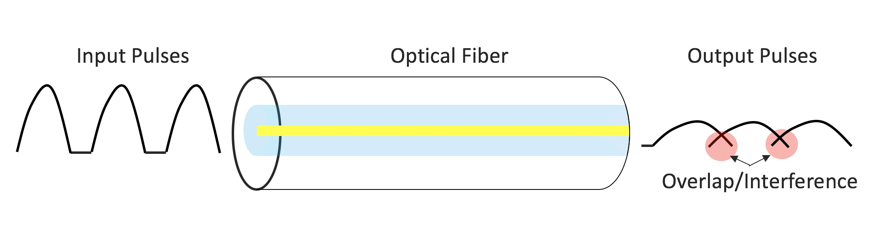
Chromatic Dispersion
Optical pulses broaden while they transmit through fibers
Broadening causes pulses to overlap and interfere with each other, resulting in bit errors
https://blogs.cisco.com/sp/fiber-optics-part-3-fiber-dispersion-will-change-the-way-you-see-your-links
Notes:
Light pulses sent down a fiber spread out in length as they propagate. This
spreading is called chromatic dispersion. The amount of it is wav elength depen-
dent. One way to keep these spread-out pulses from overlapping is to increase the
distance between them, but this can be done only by reducing the signaling rate.
Fortunately, it has been discovered that making the pulses in a special shape related
to the reciprocal of the hyperbolic cosine causes nearly all the dispersion effects to
cancel out, so it is now possible to send pulses for thousands of kilometers without
appreciable shape distortion. These pulses are called solitons. They are starting to
be widely used in practice.

Slide 28
Chromatic Dispersion
Could keep these broadened/spread-out pulses from overlapping by increasing the distance between input pulses
Yet have to reduce the signaling rate
https://blogs.cisco.com/sp/fiber-optics-part-3-fiber-dispersion-will-change-the-way-you-see-your-links
Notes:
Light pulses sent down a fiber spread out in length as they propagate. This
spreading is called chromatic dispersion. The amount of it is wav elength depen-
dent. One way to keep these spread-out pulses from overlapping is to increase the
distance between them, but this can be done only by reducing the signaling rate.
Fortunately, it has been discovered that making the pulses in a special shape related
to the reciprocal of the hyperbolic cosine causes nearly all the dispersion effects to
cancel out, so it is now possible to send pulses for thousands of kilometers without
appreciable shape distortion. These pulses are called solitons. They are starting to
be widely used in practice.

Slide 29
Chromatic Dispersion
Solitons: pulses that leverage self-phase modulation to cancel out dispersion
Modulate pulses in special shape related to reciprocal of hyperbolic cosine
https://blogs.cisco.com/sp/fiber-optics-part-3-fiber-dispersion-will-change-the-way-you-see-your-links
Notes:
Light pulses sent down a fiber spread out in length as they propagate. This
spreading is called chromatic dispersion. The amount of it is wav elength depen-
dent. One way to keep these spread-out pulses from overlapping is to increase the
distance between them, but this can be done only by reducing the signaling rate.
Fortunately, it has been discovered that making the pulses in a special shape related
to the reciprocal of the hyperbolic cosine causes nearly all the dispersion effects to
cancel out, so it is now possible to send pulses for thousands of kilometers without
appreciable shape distortion. These pulses are called solitons. They are starting to
be widely used in practice.

Slide 30
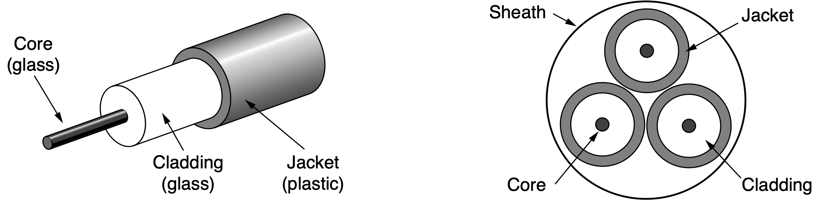
Fiber-Optic/Fiber Cables
Similar to coax, except without braid
Core diameter single-mode fiber: 8~10 microns multimode fiber: 50 microns
Notes:
Fiber-optic cables are similar to coax, except without the braid. Figure 2-6(a)
shows a single fiber viewed from the side. At the center is the glass core through
which the light propagates. In multimode fibers, the core is typically around 50
microns in diameter, about the thickness of a human hair. In single-mode fibers,
the core is 8 to 10 microns.
The core is surrounded by a glass cladding with a lower index of refraction
than the core, to keep all the light in the core. Next comes a thin plastic jacket to
protect the cladding. Fibers are typically grouped in bundles, protected by an outer
sheath. Figure 2-6(b) shows a sheath with three fibers.
Terrestrial fiber sheaths are normally laid in the ground within a meter of the
surface, where they are occasionally subject to attacks by backhoes or gophers.
Near the shore, transoceanic fiber sheaths are buried in trenches by a kind of sea-
plow. In deep water, they just lie on the bottom, where they can be snagged by
fishing trawlers or attacked by a giant squid.

Slide 31
Fiber-Optic/Fiber Cables
Similar to coax, except without braid
Core diameter single-mode fiber: 8~10 microns multimode fiber: 50 microns
How to connect fibers?
Notes:
Fiber-optic cables are similar to coax, except without the braid. Figure 2-6(a)
shows a single fiber viewed from the side. At the center is the glass core through
which the light propagates. In multimode fibers, the core is typically around 50
microns in diameter, about the thickness of a human hair. In single-mode fibers,
the core is 8 to 10 microns.
The core is surrounded by a glass cladding with a lower index of refraction
than the core, to keep all the light in the core. Next comes a thin plastic jacket to
protect the cladding. Fibers are typically grouped in bundles, protected by an outer
sheath. Figure 2-6(b) shows a sheath with three fibers.
Terrestrial fiber sheaths are normally laid in the ground within a meter of the
surface, where they are occasionally subject to attacks by backhoes or gophers.
Near the shore, transoceanic fiber sheaths are buried in trenches by a kind of sea-
plow. In deep water, they just lie on the bottom, where they can be snagged by
fishing trawlers or attacked by a giant squid.

Slide 32
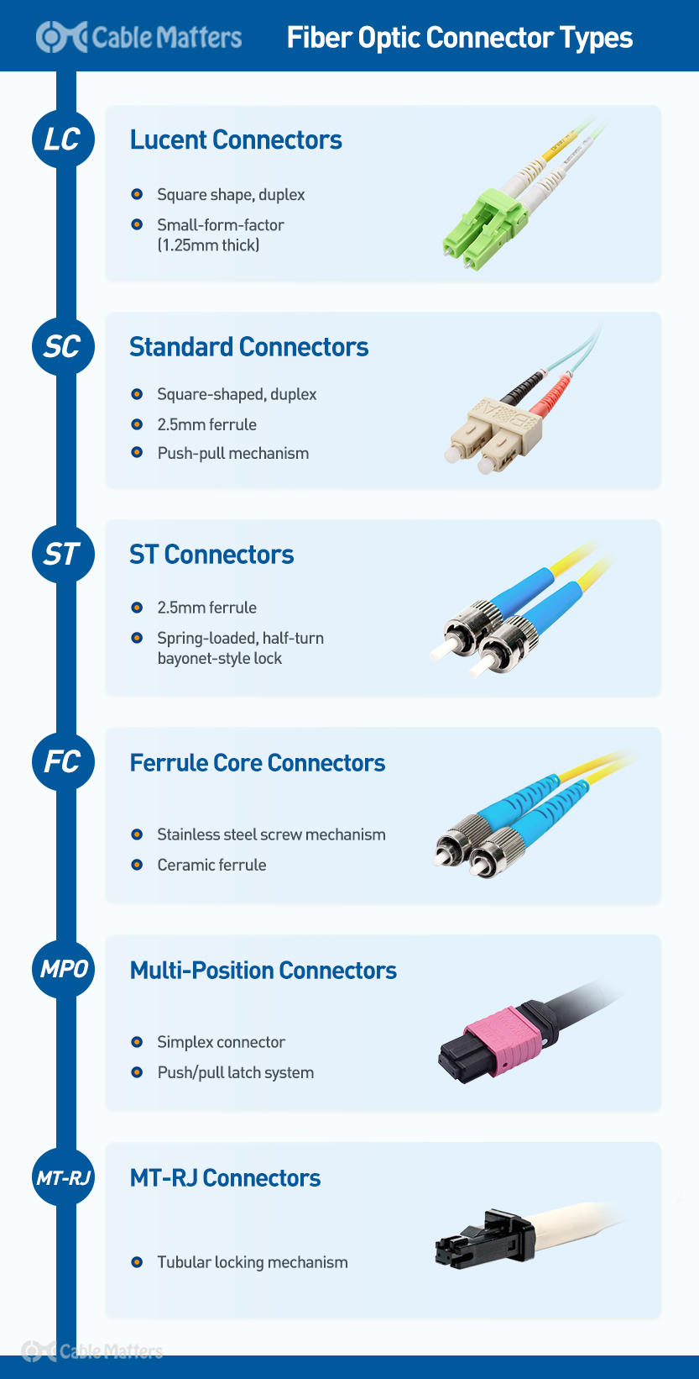
Fiber-Optic/Fiber Cables
Fibers terminate in connectors and be plugged into fiber sockets
Lose about 10% to 20% of the light
Easy to reconfigure systems
https://www.cablematters.com/Blog/Networking/fiber-optic-connector-types
Notes:
Fibers can be connected in three different ways. First, they can terminate in
connectors and be plugged into fiber sockets. Connectors lose about 10 to 20% of
the light, but they make it easy to reconfigure systems.

Slide 33
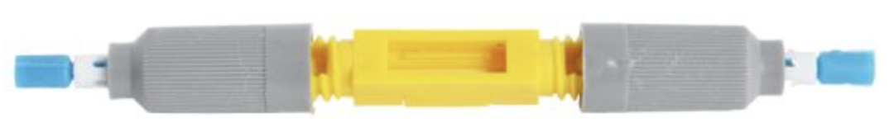
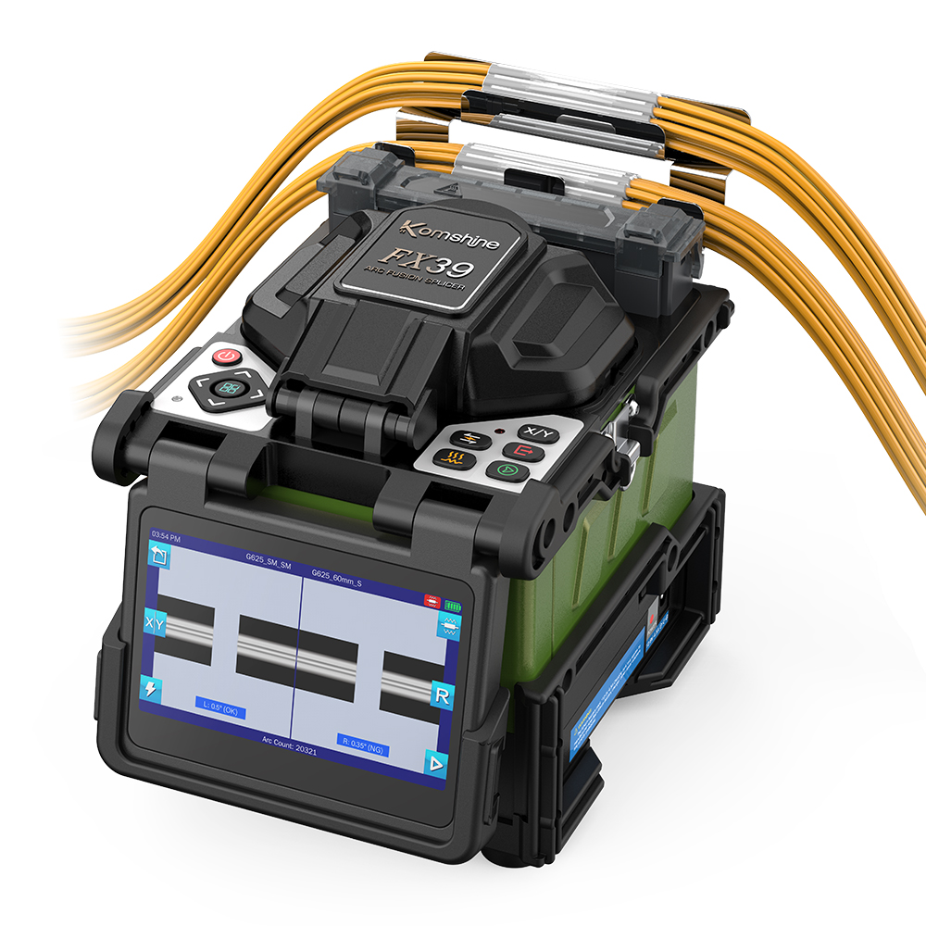
Fiber-Optic/Fiber Cables
Mechanical splices lay the two carefully cut ends next to each other in a special sleeve and clamp them in place (10% light loss)
Fusion splice fuses/melts two pieces of _____fiber to form a solid connection _____(only a small amount of _____attenuation)
https://www.fiberinstrumentsales.com/universal-mechanical-splice.html
https://www.komshine.com/products/fusion-splicer/fx39-fusion-splicer.html
Notes:
Second, they can be spliced
mechanically. Mechanical splices just lay the two carefully cut ends next to each
other in a special sleeve and clamp them in place. Alignment can be improved by
passing light through the junction and then making small adjustments to maximize
the signal. Mechanical splices take trained personnel about 5 minutes and result in
a 10% light loss. Third, two pieces of fiber can be fused (melted) to form a solid
connection. A fusion splice is almost as good as a single drawn fiber, but even
here, a small amount of attenuation occurs. For all three kinds of splices, reflec-
tions can occur at the point of the splice and the reflected energy can interfere with
the signal.

Slide 34
guided or wired
copper, coaxial cable, fiber optics
transmission media
wireless
terrestrial radio
satellite
Notes:
Many people now have wireless connectivity to many devices, from laptops
and smartphones, to smart watches and smart refrigerators. All of these devices
rely on wireless communication to transmit information to other devices and end-
points on the network.
In the following sections, we will look at wireless communication in general,
which has many other important applications besides providing connectivity to
users who want to surf the Web from the beach. Wireless has advantages for even
fixed devices in some circumstances. For example, if running a fiber to a building
is difficult due to the terrain (mountains, jungles, swamps, etc.), wireless may be
more appropriate. It is noteworthy that modern wireless digital communication
began as a research project of Prof. Norman Abramson of the University of Hawaii
in the 1970s where the Pacific Ocean separated the users from their computer cen-
ter, and the telephone system was inadequate. We will discuss this system,
ALOHA, in Chap. 4.

Slide 35
Electromagnetic Spectrum
Moving electrons create electromagnetic waves that can propagate through space (even in a vacuum)
Frequency 𝑓 in Hz: number of oscillators per second of a wave
Wavelength 𝜆 in meter: distance between two consecutive maxima (or minima) of a wave
Notes:
When electrons move, they create electromagnetic wav es that can propagate
through space (even in a vacuum). These waves were predicted by the British
physicist James Clerk Maxwell in 1865 and first observed by the German physicist
Heinrich Hertz in 1887. The number of oscillations per second of a wav e is called
its frequency, f, and is measured in Hz. The distance between two consecutive
maxima (or minima) is called the wavelength, which is universally designated by
the Greek letter (lambda).

Slide 36
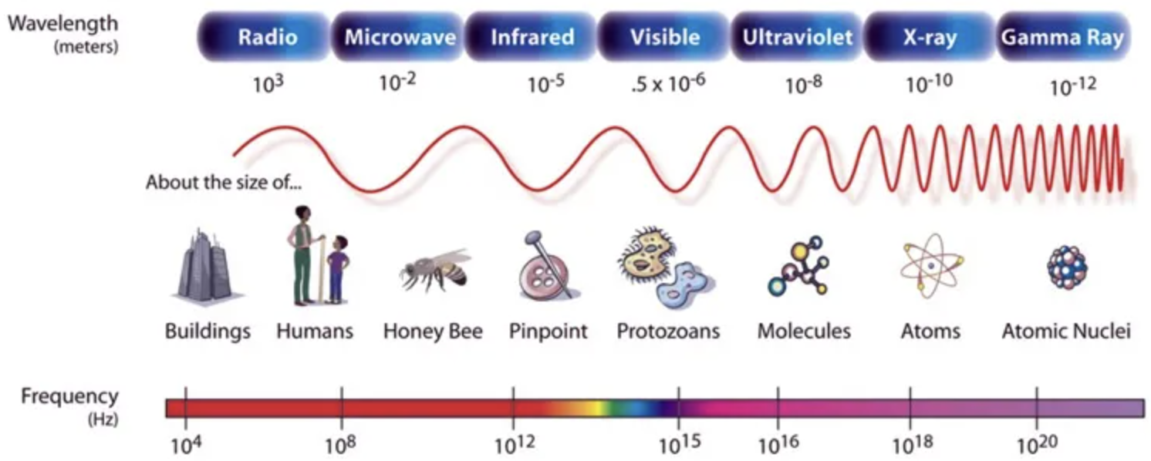
Electromagnetic Spectrum
Moving electrons create electromagnetic waves that can propagate through space (even in a vacuum)
https://scied.ucar.edu/learning-zone/earth-system/electromagnetic-spectrum
Notes:
When electrons move, they create electromagnetic wav es that can propagate
through space (even in a vacuum). These waves were predicted by the British
physicist James Clerk Maxwell in 1865 and first observed by the German physicist
Heinrich Hertz in 1887. The number of oscillations per second of a wav e is called
its frequency, f, and is measured in Hz. The distance between two consecutive
maxima (or minima) is called the wavelength, which is universally designated by
the Greek letter (lambda).

Slide 37
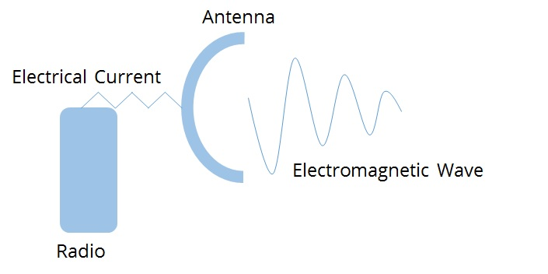
Electromagnetic Spectrum
Wireless-Communication Principle attach antenna to electrical circuit; antenna broadcasts electromagnetic waves to distant receiver
Notes:
When an antenna of the appropriate size is attached to an electrical circuit, the
electromagnetic waves can be broadcast efficiently and received by a receiver some
distance away. All wireless communication is based on this principle.

Slide 38
Electromagnetic Spectrum
Wireless-Communication Principle attach antenna to electrical circuit; antenna broadcasts electromagnetic waves to distant receiver
in a vacuum, all electromagnetic waves travel at the same speed of light 𝑐, regardless of frequency
𝑐 = 3 x 10⁸ m/sec
Notes:
When an antenna of the appropriate size is attached to an electrical circuit, the
electromagnetic waves can be broadcast efficiently and received by a receiver some
distance away. All wireless communication is based on this principle.

Slide 39
Electromagnetic Spectrum
Wireless-Communication Principle attach antenna to electrical circuit; antenna broadcasts electromagnetic waves to distant receiver
𝜆𝑓 =
in a vacuum, all electromagnetic waves travel at the same speed of light 𝑐, regardless of frequency
𝑐 = 3 x 10⁸ m/sec
Notes:
When an antenna of the appropriate size is attached to an electrical circuit, the
electromagnetic waves can be broadcast efficiently and received by a receiver some
distance away. All wireless communication is based on this principle.

Slide 40
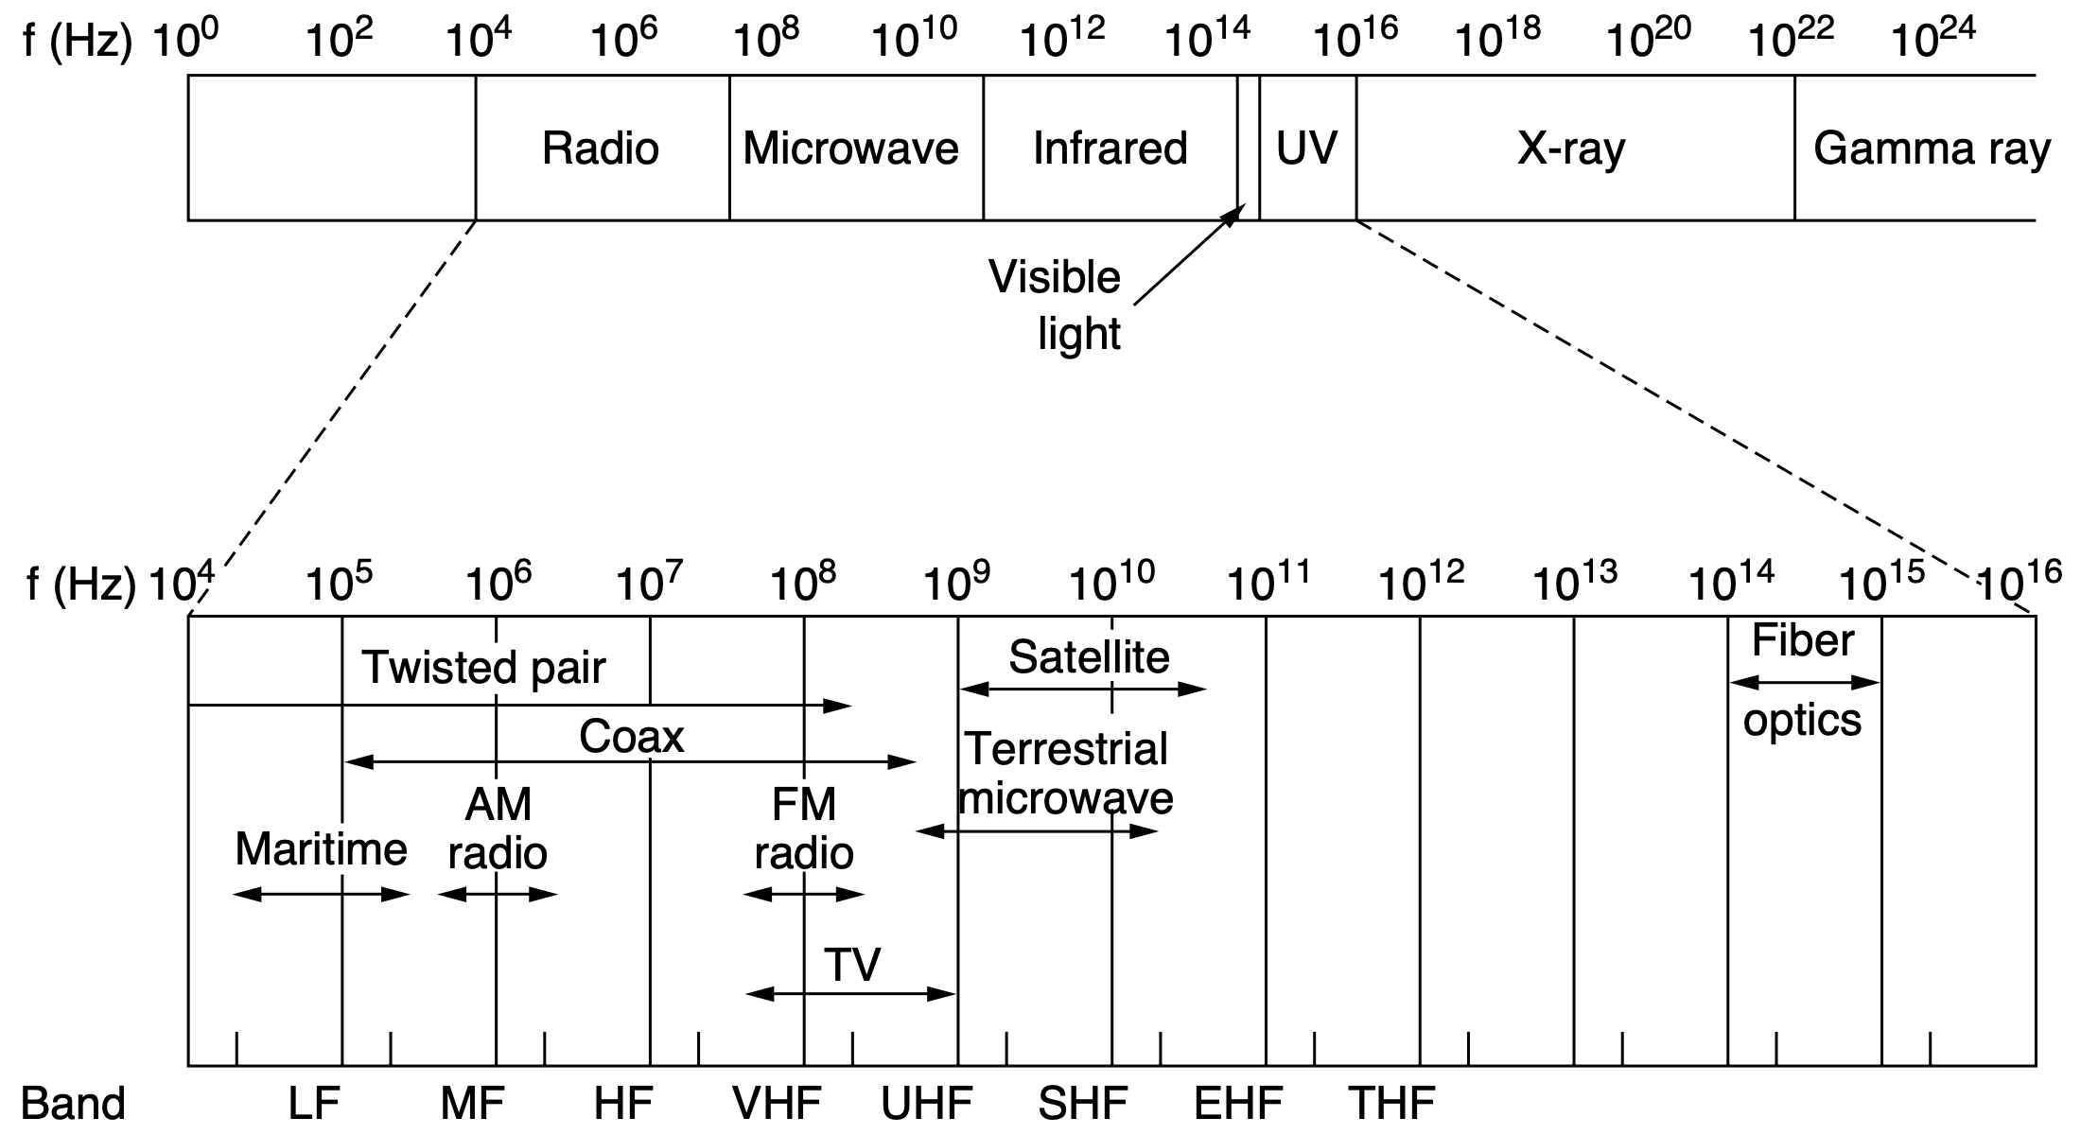
Electromagnetic Spectrum
Low Medium High Very Ultra Super Extremely Tremendously
Notes:
The electromagnetic spectrum is shown in Fig. 2-8. The radio, microwave, in-
frared, and visible light portions of the spectrum can all be used for transmitting
information by modulating the amplitude, frequency, or phase of the wav es. Ultra-
violet light, X-rays, and gamma rays would be even better, due to their higher fre-
quencies, but they are hard to produce and modulate, do not propagate well
through buildings, and are dangerous to living things.
The bands listed at the bottom of Fig. 2-8 are the official ITU (International
Telecommunication Union) names and are based on the wavelengths, so the LF
band goes from 1 km to 10 km (approximately 30 kHz to 300 kHz). The terms LF,
MF, and HF refer to Low, Medium, and High Frequency, respectively. Clearly,
when the names were assigned nobody expected to go above 10 MHz, so the high-
er bands were later named the Very, Ultra, Super, Extremely, and Tremendously
High Frequency bands. Beyond that, there are no names, but Incredibly, Astonish-
ingly, and Prodigiously High Frequency (IHF, AHF, and PHF) would sound nice.
Above 10¹² Hz, we get into the infrared, where the comparison is typically to light,
not radio.

Slide 41
Electromagnetic Spectrum
the amount of information that a signal can carry depends on the received power and is proportional to its bandwidth
Notes:
The theoretical basis for communication, which we will discuss later in this
chapter, tells us the amount of information that a signal such as an electromagnetic
wave can carry depends on the received power and is proportional to its bandwidth.
From Fig. 2-8, it should now be obvious why networking people like fiber optics
so much. Many GHz of bandwidth are available to tap for data transmission in the
microwave band, and even more bandwidth is available in fiber because it is further
to the right in our logarithmic scale. As an example, consider the 1.30-micron
band of Fig. 2-5, which has a width of 0.17 microns. If we use Eq. (2-1) to find the
start and end frequencies from the start and end wav elengths, we find the frequen-
cy range to be about 30,000 GHz. With a reasonable signal-to-noise ratio of 10 dB,
this is 300 Tbps.
Most transmissions use a relatively narrow frequency band, in other words,
delta-f /f << 1). They concentrate their signal power in this narrow band to use the
spectrum efficiently and obtain reasonable data rates by transmitting with enough
power. The rest of this section describes three different types of transmission that
make use of wider frequency bands.

Slide 42
Electromagnetic Spectrum
most transmissions use a narrow band and thus enough power to obtain reasonable data rates
Notes:
::analogy, speak frequency, voice volume, propagation distance for clear listening
The theoretical basis for communication, which we will discuss later in this
chapter, tells us the amount of information that a signal such as an electromagnetic
wave can carry depends on the received power and is proportional to its bandwidth.
From Fig. 2-8, it should now be obvious why networking people like fiber optics
so much. Many GHz of bandwidth are available to tap for data transmission in the
microwave band, and even more bandwidth is available in fiber because it is further
to the right in our logarithmic scale. As an example, consider the 1.30-micron
band of Fig. 2-5, which has a width of 0.17 microns. If we use Eq. (2-1) to find the
start and end frequencies from the start and end wav elengths, we find the frequen-
cy range to be about 30,000 GHz. With a reasonable signal-to-noise ratio of 10 dB,
this is 300 Tbps.
Most transmissions use a relatively narrow frequency band, in other words,
delta-f /f << 1). They concentrate their signal power in this narrow band to use the
spectrum efficiently and obtain reasonable data rates by transmitting with enough
power. The rest of this section describes three different types of transmission that
make use of wider frequency bands.

Slide 43
FHSS
Frequency Hopping Spread Spectrum transmitter hops from frequency to frequency hundreds of times per second
Popular for military communication because it makes transmissions hard to detect and jam
Resistent to fading and interference especially in crowded parts of the spectrum
Notes:
In frequency hopping spread spectrum, a transmitter hops from frequency to
frequency hundreds of times per second. It is popular for military communication
because it makes transmissions hard to detect and next to impossible to jam. It
also offers good resistance to fading due to signals taking different paths from
source to destination and interfering after recombining. It also offers resistance to
narrowband interference because the receiver will not be stuck on an impaired fre-
quency for long enough to shut down communication. This robustness makes it
useful for crowded parts of the spectrum, such as the ISM bands we will describe
shortly. This technique is used commercially, for example, in Bluetooth and older
versions of 802.11.

Slide 44
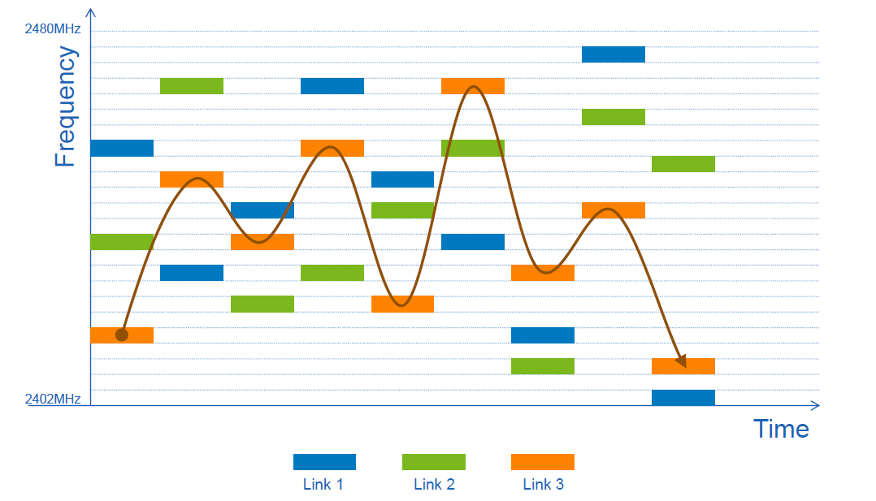
FHSS
https://news.sparkfun.com/6147
Notes:
In frequency hopping spread spectrum, a transmitter hops from frequency to
frequency hundreds of times per second. It is popular for military communication
because it makes transmissions hard to detect and next to impossible to jam. It
also offers good resistance to fading due to signals taking different paths from
source to destination and interfering after recombining. It also offers resistance to
narrowband interference because the receiver will not be stuck on an impaired fre-
quency for long enough to shut down communication. This robustness makes it
useful for crowded parts of the spectrum, such as the ISM bands we will describe
shortly. This technique is used commercially, for example, in Bluetooth and older
versions of 802.11.

Slide 45
DSSS
Direct Sequence Spread Spectrum use a code sequence to spread data signal over a wider freqeuncy band; allow multiple signals to share the same frequency band (different signals with different codes)
Notes:
A second form of spread spectrum, direct sequence spread spectrum, uses a
code sequence to spread the data signal over a wider frequency band. It is widely
used commercially as a spectrally efficient way to let multiple signals share the
same frequency band. These signals can be given different codes, a method called
code division multiple access that we will return to later in this chapter. This meth-
od is shown in contrast with frequency hopping in Fig. 2-9. It forms the basis of
3G mobile phone networks and is also used in GPS (Global Positioning System).
Even without different codes, direct sequence spread spectrum, like frequency hop-
ping spread spectrum, can tolerate interference and fading because only a fraction
of the desired signal is lost. It is used in this role in older versions of the 802.11b
wireless LANs protocol. For a fascinating and detailed history of spread spectrum
communication, see Walters (2013).

Slide 46
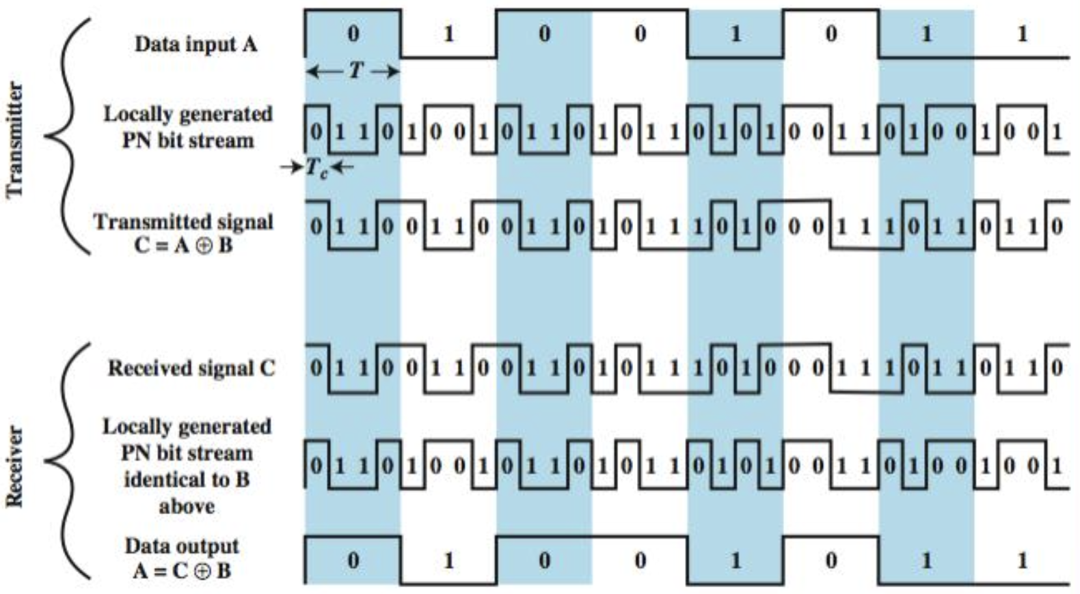
DSSS
Direct Sequence Spread Spectrum use a code sequence to spread data signal over a wider freqeuncy band
https://www.slideserve.com/Audrey/data-and-computer-communications
Notes:
A second form of spread spectrum, direct sequence spread spectrum, uses a
code sequence to spread the data signal over a wider frequency band. It is widely
used commercially as a spectrally efficient way to let multiple signals share the
same frequency band. These signals can be given different codes, a method called
code division multiple access that we will return to later in this chapter. This meth-
od is shown in contrast with frequency hopping in Fig. 2-9. It forms the basis of
3G mobile phone networks and is also used in GPS (Global Positioning System).
Even without different codes, direct sequence spread spectrum, like frequency hop-
ping spread spectrum, can tolerate interference and fading because only a fraction
of the desired signal is lost. It is used in this role in older versions of the 802.11b
wireless LANs protocol. For a fascinating and detailed history of spread spectrum
communication, see Walters (2013).

Slide 47
UWB
Ultra-WideBand communication send a series of low-energy rapid pulses, varying their carrier frequencies to communicate information
Rapid transitions lead to a signal that is spread thinly over a very wide frequency band
Notes:
UWB (Ultra-WideBand) communication sends a series of low-energy rapid
pulses, varying their carrier frequencies to communicate information. The rapid
transitions lead to a signal that is spread thinly over a very wide frequency band.
UWB is defined as signals that have a bandwidth of at least 500 MHz or at least
20% of the center frequency of their frequency band. UWB is also shown in
Fig. 2-9. With this much bandwidth, UWB has the potential to communicate at
several hundred megabits per second. Because it is spread across a wide band of
frequencies, it can tolerate a substantial amount of relatively strong interference
from other narrowband signals. Just as importantly, since UWB has very little en-
ergy at any giv en frequency when used for short-range transmission, it does not
cause harmful interference to those other narrowband radio signals. In contrast to
spread spectrum transmission, UWB transmits in ways that do not interfere with
the carrier signals in the same frequency band. It can also be used for imaging
through solid objects (ground, walls, and bodies) or as part of precise location sys-
tems. The technology is popular for short-distance indoor applications, as well as
precision radar imaging and location-tracking technologies.

Slide 48
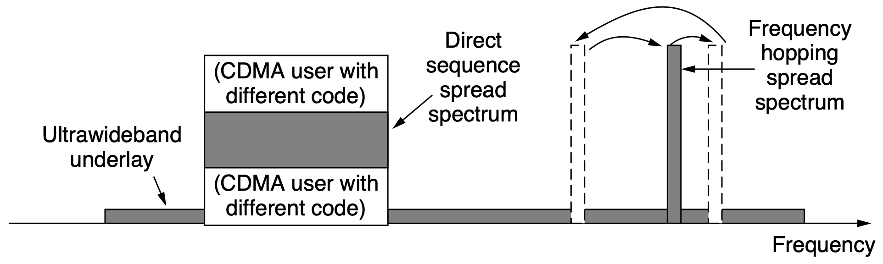
UWB
vs Spread Spectrum
Ultra-WideBand communication send a series of low-energy rapid pulses, varying their carrier frequencies to communicate information
Notes:
UWB (Ultra-WideBand) communication sends a series of low-energy rapid
pulses, varying their carrier frequencies to communicate information. The rapid
transitions lead to a signal that is spread thinly over a very wide frequency band.
UWB is defined as signals that have a bandwidth of at least 500 MHz or at least
20% of the center frequency of their frequency band. UWB is also shown in
Fig. 2-9. With this much bandwidth, UWB has the potential to communicate at
several hundred megabits per second. Because it is spread across a wide band of
frequencies, it can tolerate a substantial amount of relatively strong interference
from other narrowband signals. Just as importantly, since UWB has very little en-
ergy at any giv en frequency when used for short-range transmission, it does not
cause harmful interference to those other narrowband radio signals. In contrast to
spread spectrum transmission, UWB transmits in ways that do not interfere with
the carrier signals in the same frequency band. It can also be used for imaging
through solid objects (ground, walls, and bodies) or as part of precise location sys-
tems. The technology is popular for short-distance indoor applications, as well as
precision radar imaging and location-tracking technologies.

Slide 49
guided or wired
copper, coaxial cable, fiber optics
transmission media
wireless
terrestrial radio
satellite
to be covered in later subsection
Notes:
Many people now have wireless connectivity to many devices, from laptops
and smartphones, to smart watches and smart refrigerators. All of these devices
rely on wireless communication to transmit information to other devices and end-
points on the network.
In the following sections, we will look at wireless communication in general,
which has many other important applications besides providing connectivity to
users who want to surf the Web from the beach. Wireless has advantages for even
fixed devices in some circumstances. For example, if running a fiber to a building
is difficult due to the terrain (mountains, jungles, swamps, etc.), wireless may be
more appropriate. It is noteworthy that modern wireless digital communication
began as a research project of Prof. Norman Abramson of the University of Hawaii
in the 1970s where the Pacific Ocean separated the users from their computer cen-
ter, and the telephone system was inadequate. We will discuss this system,
ALOHA, in Chap. 4.

Slide 50
The Physical Layer
Transmission
transmission media
transmission theories

Slide 51
radio
transmission theories
microwave
infrared
light
Notes:
We will now discuss how the various parts of the electromagnetic spectrum of
Fig. 2-8 are used, starting with radio. We will assume that all transmissions use a
narrow frequency band unless otherwise stated.

Slide 52
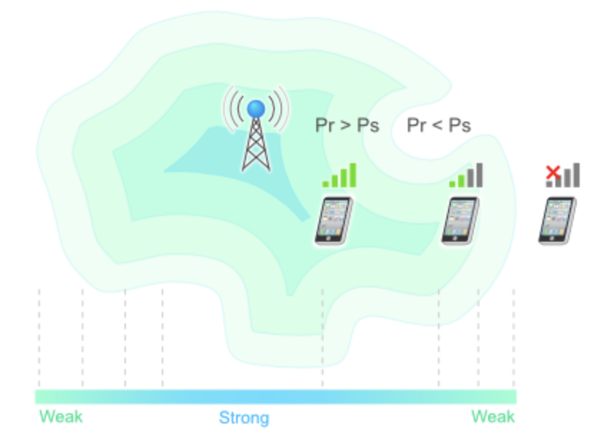
Radio Transmission
Radio Frequency (RF) waves are omnidirectional, travel long distances, penetrate buildings easily, yet are subject to interference
Pr: received power
Ps: receiver sensitity
https://yatebts.com/documentation/concepts/radio-propagation-concepts/
Notes:
::Receiver sensitivity is a measure of the minimum signal strength that a receiver can detect.
Radio frequency (RF) wav es are easy to generate, can travel long distances,
and can penetrate buildings easily, so they are widely used for communication,
both indoors and outdoors. Radio wav es also are omnidirectional, meaning that
they travel in all directions from the source, so the transmitter and receiver do not
have to be carefully aligned physically.

Slide 53
Radio Transmission
Path loss / Attenuation: power density of radio waves decrease with distance from the source 1/d² for low-frequency radio waves
Pr: received power
Ps: receiver sensitity
https://yatebts.com/documentation/concepts/radio-propagation-concepts/
Notes:
::Receiver sensitivity is a measure of the minimum signal strength that a receiver can detect.
The properties of radio wav es are frequency dependent. At low frequencies,
radio wav es pass through obstacles well, but the power falls off sharply with dis-
tance from the source—at least as fast as 1/r2 in air—as the signal energy is spread
more thinly over a larger surface. This attenuation is called path loss. At high fre-
quencies, radio wav es tend to travel in straight lines and bounce off obstacles. Path
loss still reduces power, though the received signal can depend strongly on reflec-
tions as well. High-frequency radio wav es are also absorbed by rain and other
obstacles to a larger extent than are low-frequency ones. At all frequencies, radio
waves are subject to interference from motors and other electrical equipment.
It is interesting to compare the attenuation of radio wav es to that of signals in
guided media. With fiber, coax, and twisted pair, the signal drops by the same frac-
tion per unit distance, for example, 20 dB per 100 m for twisted pair. With radio,
the signal drops by the same fraction as the distance doubles, for example 6 dB per
doubling in free space. This behavior means that radio wav es can travel long dis-
tances, and interference between users is a problem. For this reason, all govern-
ments tightly regulate the use of radio transmitters, with few notable exceptions,
which are discussed later in this chapter.

Slide 54
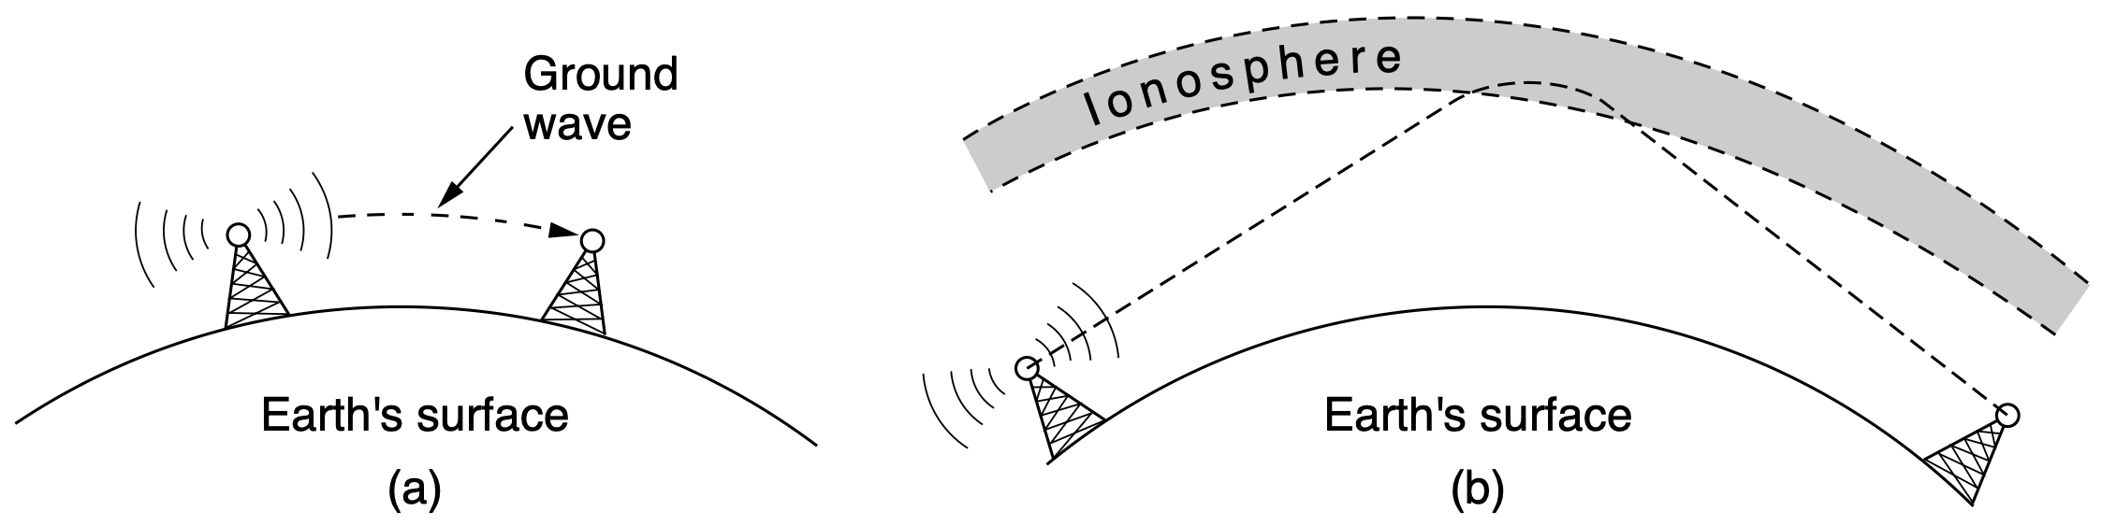
Radio Transmission
VLF, LF, and MF bands: radio waves follow the curvature of the earth
HF and VHF bands: ground waves tend to be absorbed by the earth, waves that reach the ionosphere are refracted by it and sent back to earth
Notes:
::AM radio broadcasting, short for Amplitude Modulation radio, is a method of transmitting audio signals by varying the amplitude of a radio wave. It was the first widely adopted technology for broadcasting, and while still used, it has largely been overtaken by FM radio for music due to FM's superior audio quality.
In the VLF, LF, and MF bands, radio wav es follow the ground, as illustrated in
Fig. 2-10(a). These wav es can be detected for perhaps 1000 km at the lower fre-
quencies, less at the higher ones. AM radio broadcasting uses the MF band, which
is why the ground wav es from Boston AM radio stations cannot be heard easily in
New York. Radio waves in these bands pass through buildings easily, which is
why radios work indoors. The main problem with using these bands for data com-
munication is their low bandwidth.
In the HF and VHF bands, the ground wav es tend to be absorbed by the earth.
However, the wav es that reach the ionosphere, a layer of charged particles circling
the earth at a height of 100 to 500 km, are refracted by it and sent back to earth, as
shown in Fig. 2-10(b). Under certain atmospheric conditions, the signals can
bounce several times. Amateur radio operators (hams) use these bands to talk long
distance. The military also uses the HF and VHF bands for communication.

Slide 55

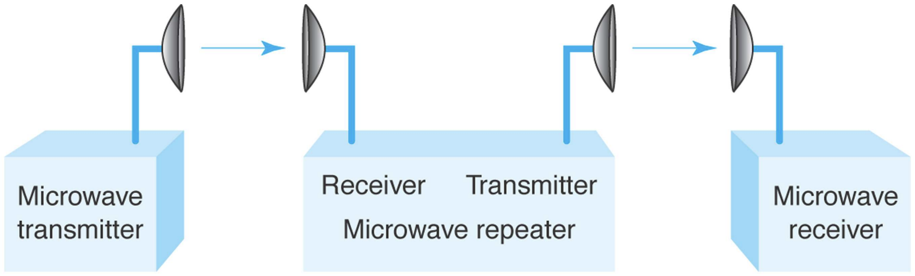
Microwave Transmission
Directional propagation (travel in a straight line)
Repeaters are needed to bridge communication between two far-apart towers
https://www.smithandfisher.com/what-the-5-types-of-microwave-antennas-are-used-for/
https://sites.itservices.cas.unt.edu/~hab/CH13.pdf
Notes:
Above 100 MHz, the wav es travel in nearly straight lines and can therefore be
narrowly focused. Concentrating all the energy into a small beam by means of a
parabolic antenna (like the familiar satellite TV dish) gives a much higher sig-
nal-to-noise ratio, but the transmitting and receiving antennas must be accurately
aligned with each other. In addition, this directionality allows multiple transmitters
lined up in a row to communicate with multiple receivers in a row without inter-
ference, provided some minimum spacing rules are observed. Before fiber optics,
for decades these microwaves formed the heart of the long-distance telephone
transmission system. In fact, MCI, one of AT&T’s first competitors after it was
deregulated, built its entire system with microwave communications passing be-
tween towers tens of kilometers apart. Even the company’s name reflected this
(MCI stood for Microwave Communications, Inc.). MCI has since gone over to
fiber and through a long series of corporate mergers and bankruptcies in the
telecommunications shuffle has become part of Verizon.
Microwaves are directional: they travel in a straight line, so if the towers are
too far apart, the earth will get in the way (think about a Seattle-to-Amsterdam
link). Thus, repeaters are needed periodically. The higher the towers are, the far-
ther apart they can be. The distance between repeaters goes up roughly with the
square root of the tower height. For 100-meter towers, repeaters can be 80 km
apart.

Slide 56
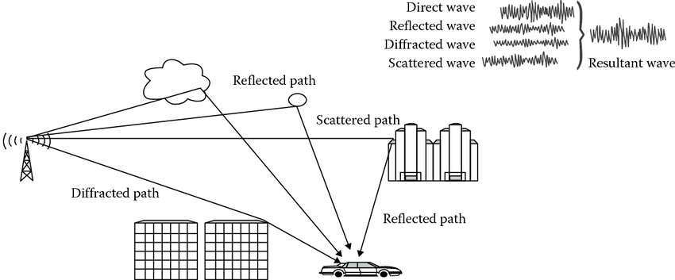
Microwave Transmission
Multipath fading: waves diverge in space, delayed waves may arrive out of phase with the direct wave and cancel the signal
https://www.researchgate.net/figure/Multipath-fading-environment_fig6_296549657
Notes:
Unlike radio waves at lower frequencies, microwaves do not pass through
buildings well. In addition, even though the beam may be well focused at the
transmitter, there is still some divergence in space. Some wav es may be refracted
off low-lying atmospheric layers and may take slightly longer to arrive than the
direct wav es. The delayed waves may arrive out of phase with the direct wave and
thus cancel the signal. This effect is called multipath fading and is often a serious
problem. It is weather and frequency dependent. Some operators keep 10% of
their channels idle as spares to switch on when multipath fading temporarily wipes
out a particular frequency band.

Slide 57
Microwave Transmission
Solution: keep 10% of channels idle as spares to switch on when multipath fading temporarily wipes out a particular frequency band
https://www.researchgate.net/figure/Multipath-fading-environment_fig6_296549657
Notes:
Unlike radio waves at lower frequencies, microwaves do not pass through
buildings well. In addition, even though the beam may be well focused at the
transmitter, there is still some divergence in space. Some wav es may be refracted
off low-lying atmospheric layers and may take slightly longer to arrive than the
direct wav es. The delayed waves may arrive out of phase with the direct wave and
thus cancel the signal. This effect is called multipath fading and is often a serious
problem. It is weather and frequency dependent. Some operators keep 10% of
their channels idle as spares to switch on when multipath fading temporarily wipes
out a particular frequency band.

Slide 58
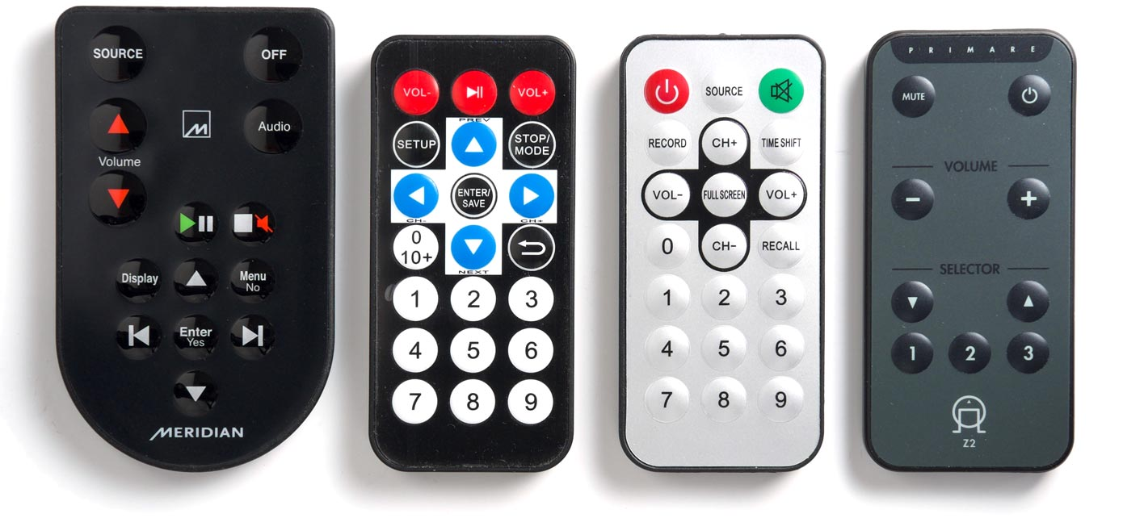
Infrared Transmission
Widely used for short-range communication e.g., remote controls for televisions, Blu-ray players, and stereos
Relatively directional, cheap, and easy to build
Do not pass through solid objects: less inference and eavesdropping
http://www.technoblogy.com/show?24A9
Notes:
Unguided infrared wav es are widely used for short-range communication. The
remote controls used for televisions, Blu-ray players, and stereos all use infrared
communication. They are relatively directional, cheap, and easy to build but have
a major drawback: they do not pass through solid objects. (Try standing between
your remote control and your television and see if it still works.) In general, as we
go from long-wav e radio toward visible light, the wav es behave more and more
like light and less and less like radio.
On the other hand, the fact that infrared wav es do not pass through solid walls
well is also a plus. It means that an infrared system in one room of a building will
not interfere with a similar system in adjacent rooms or buildings: you cannot con-
trol your neighbor’s television with your remote control. Furthermore, security of
infrared systems against eavesdropping is better than that of radio systems on
account of this reason. Therefore, no government license is needed to operate an
infrared system, in contrast to radio systems, which must be licensed outside the
ISM bands. Infrared communication has a limited use on the desktop, for example,
to connect notebook computers and printers with the IrDA (Infrared Data Associ-
ation) standard, but it is not a major player in the communication game.

Slide 59
Light Transmission
Free-space optics: unguided optical signaling, e.g., connect the LANs in two buildings via lasers mounted on their rooftops
Unidirectional, high bandwidth, low cost, relatively secure (difficult to tap a narrow laser beam)
Notes:
Unguided optical signaling or free-space optics has been in use for centuries.
Paul Revere used binary optical signaling from the Old North Church just prior to
his famous ride. A more modern application is to connect the LANs in two build-
ings via lasers mounted on their rooftops. Optical signaling using lasers is inher-
ently unidirectional, so each end needs its own laser and its own photodetector.
This scheme offers very high bandwidth at very low cost and is relatively secure
because it is difficult to tap a narrow laser beam. It is also relatively easy to install
and, unlike microwave transmission, does not require a license from the FCC
(Federal Communications Commission) in the United States and analogous gov-
ernment bodies in other countries.

Slide 60
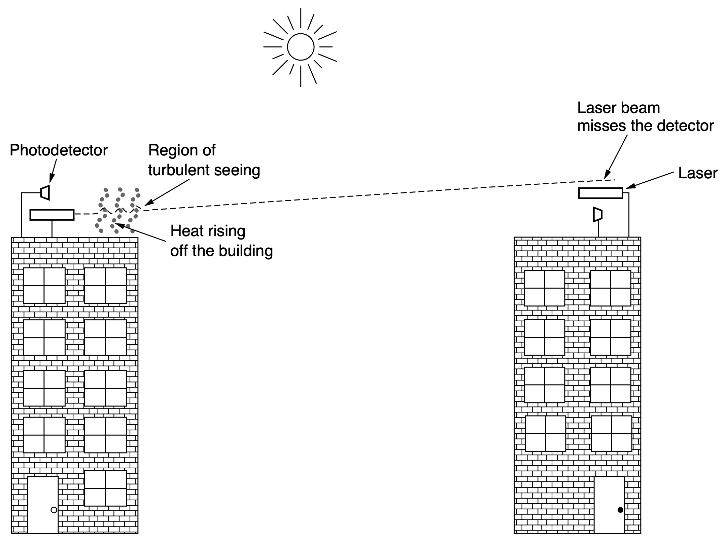
Light Transmission
Need to be engineered with a sufficient margin of error
heat from the sun during the daytime causes convection currents to rise up;
this turbulent air diverts the beam around the detector
Notes:
One of the authors (AST) once attended a conference at a modern hotel in
Europe in the 1990s at which the conference organizers thoughtfully provided a
room full of terminals to allow the attendees to read their email during boring pres-
entations. Since the local phone company was unwilling to install a large number
of telephone lines for just 3 days, the organizers put a laser on the roof and aimed it
at their university’s computer science building a few kilometers away. They tested
it the night before the conference and it worked perfectly. At 9 A.M. the next day,
which was bright and sunny, the link failed completely and stayed down all day.
The pattern repeated itself the next 2 days. It was not until after the conference
that the organizers discovered the problem: heat from the sun during the daytime
caused convection currents to rise up from the roof of the building, as shown in
Fig. 2-11. This turbulent air diverted the beam and made it dance around the
detector, much like a shimmering road on a hot day. The lesson here is that to
work well in difficult conditions as well as good conditions, unguided optical links
need to be engineered with a sufficient margin of error.

Slide 61
radio
transmission theories
microwave
infrared
light
Notes:
We will now discuss how the various parts of the electromagnetic spectrum of
Fig. 2-8 are used, starting with radio. We will assume that all transmissions use a
narrow frequency band unless otherwise stated.

Slide 62
theoretical basis
transmission theories
data rate
modulation
multiplexing
Notes:
In this section, we describe how signals are transmitted over the physical
media we have discussed. We begin with a discussion of the theoretical basis for
data communication, and follow with a discussion of modulation (the process of
converting analog waveforms to bits) and multiplexing (which allows a single
physical medium to carry multiple simultaneous transmissions).

Slide 63
Theoretical Basis
Information can be transmitted on wires by varying some physical property such as voltage or current
Model the behavior of the singal and analyze it mathematically by representing the value of voltage or current as a single-valued function of time: 𝑓(𝑡)
Notes:
::A single-valued function is a mathematical relationship where each input (from the domain) is associated with exactly one output (in the range).
Information can be transmitted on wires by varying some physical property
such as voltage or current. By representing the value of this voltage or current as a
single-valued function of time, f (t), we can model the behavior of the signal and
analyze it mathematically. This analysis is the subject of the following sections.

Slide 64
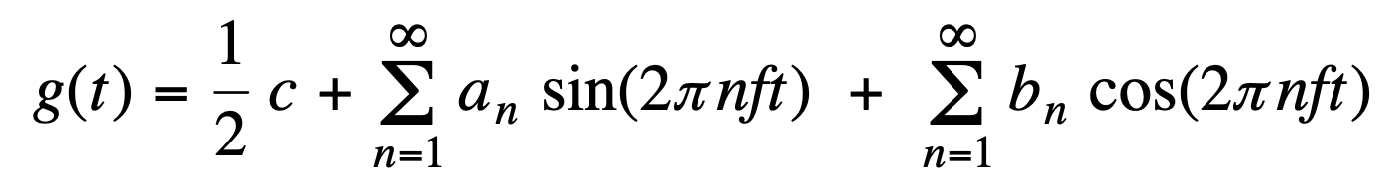
Fourier Series
Any reasonably behaved periodic function (of time 𝑡) can be constructed (decomposed) as:
T: period; f = 1/T: frequency
a_{n} and b_{n}: sine and cosine amplitudes of the nth harmonics (terms)
c: constant that determines mean value
Notes:
https://www.bilibili.com/video/BV1Ne4y1i7Kf/
That is, if the period, T, is known
and the amplitudes are given, the original function of time can be found by per-
forming the sums of Eq. (2-2).

Slide 65
Fourier Series
Any reasonably behaved periodic function (of time 𝑡) can be constructed (decomposed) as:
Given g(t), how to find a_{n}, b_{n}, and c?
a_{n} and b_{n}: sine and cosine amplitudes of the nth harmonics (terms)
c: constant that determines mean value
Notes:
https://www.bilibili.com/video/BV1Ne4y1i7Kf/

Slide 66
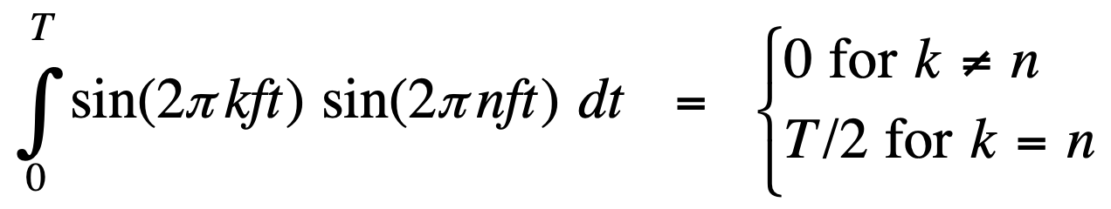
Fourier Series
Any reasonably behaved periodic function (of time 𝑡) can be constructed (decomposed) as:
Notes:
https://www.bilibili.com/video/BV1Ne4y1i7Kf/

Slide 67
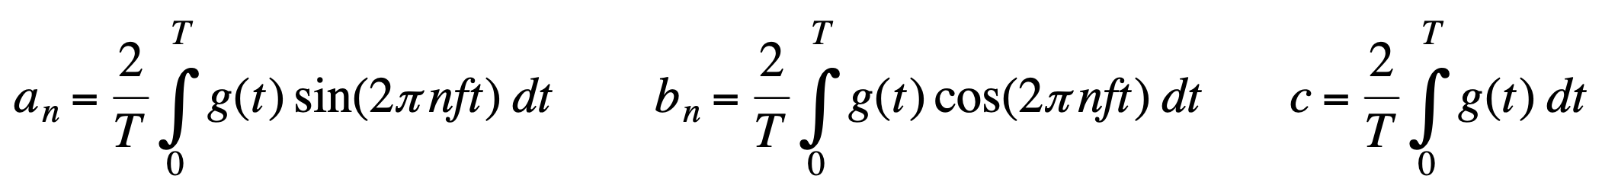
Fourier Series
Any reasonably behaved periodic function (of time 𝑡) can be constructed (decomposed) as:
Notes:
https://www.bilibili.com/video/BV1Ne4y1i7Kf/
The an amplitudes can be computed for any given g(t) by multiplying both
sides of Eq. (2-2) by sin(2 kft) and then integrating from 0 to T. Similarly, by multiplying Eq. (2-2) by cos(2 kft) and integrating between
0 and T, we can derive bn. By just integrating both sides of the equation as it
stands, we can find c.

Slide 68
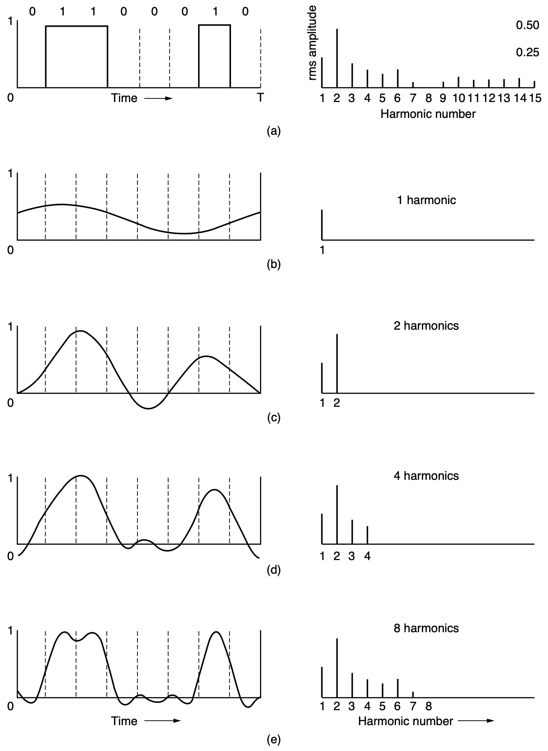
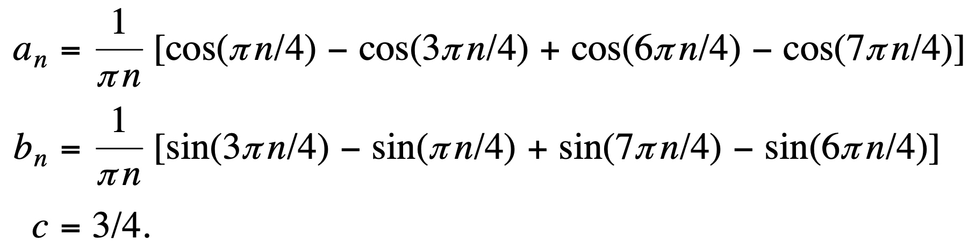
Bandwidth-
Limited Signals
Notes:
rms: root-mean-square
These values are of interest because their
squares are proportional to the energy transmitted at the corresponding frequency.
No transmission facility can transmit signals without losing some power in the
process. If all the Fourier components were equally diminished, the resulting sig-
nal would be reduced in amplitude but not distorted [i.e., it would have the same
nice squared-off shape as Fig. 2-12(a)]. Unfortunately, all transmission facilities
diminish different Fourier components by different amounts, thus introducing dis-
tortion.
For digital transmission, the goal is to receive a signal with just enough fidelity to reconstruct the sequence
of bits that was sent. We can already do this easily in Fig. 2-12(e), so it is wasteful
to use more harmonics to receive a more accurate replica.

Slide 69
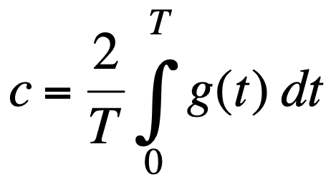
Bandwidth-
Limited Signals
T = 8
g(t) = 1 for t = 1, 2, 6
c = (2/8)(1 + 1 + 1) = 3/4
Notes:
rms: root-mean-square
These values are of interest because their
squares are proportional to the energy transmitted at the corresponding frequency.
No transmission facility can transmit signals without losing some power in the
process. If all the Fourier components were equally diminished, the resulting sig-
nal would be reduced in amplitude but not distorted [i.e., it would have the same
nice squared-off shape as Fig. 2-12(a)]. Unfortunately, all transmission facilities
diminish different Fourier components by different amounts, thus introducing dis-
tortion.
For digital transmission, the goal is to receive a signal with just enough fidelity to reconstruct the sequence
of bits that was sent. We can already do this easily in Fig. 2-12(e), so it is wasteful
to use more harmonics to receive a more accurate replica.

Slide 70
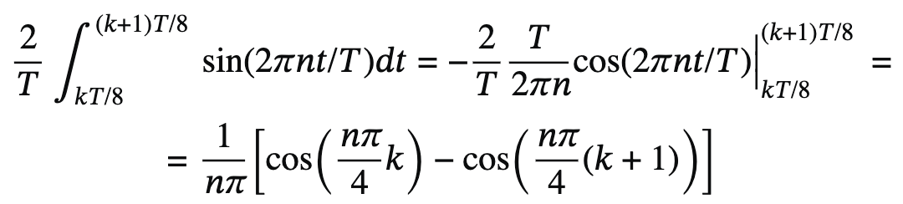
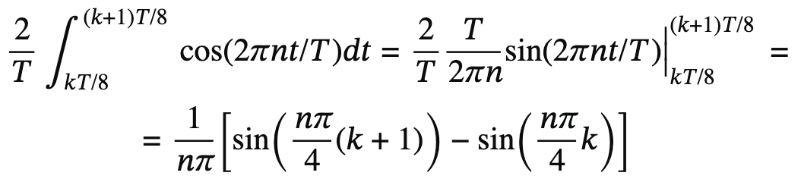
Bandwidth-
Limited Signals
T = 8
g(t) = 1 for t = 1, 2, 6
https://math.stackexchange.com/questions/928890/
how-to-get-fourier-series-of-8-bit-character-to-be-transmitted/930008#930008
Notes:
rms: root-mean-square
These values are of interest because their
squares are proportional to the energy transmitted at the corresponding frequency.
No transmission facility can transmit signals without losing some power in the
process. If all the Fourier components were equally diminished, the resulting sig-
nal would be reduced in amplitude but not distorted [i.e., it would have the same
nice squared-off shape as Fig. 2-12(a)]. Unfortunately, all transmission facilities
diminish different Fourier components by different amounts, thus introducing dis-
tortion.
For digital transmission, the goal is to receive a signal with just enough fidelity to reconstruct the sequence
of bits that was sent. We can already do this easily in Fig. 2-12(e), so it is wasteful
to use more harmonics to receive a more accurate replica.

Slide 71
Bandwidth
All transmission facilities diminish different Fourier components by different amounts, thus introducing distortion
For a wire, the amplitudes are transmitted mostly undiminished from 0 up to some frequency with all frequencies above this cutoff frequency attenuated
Notes:
No transmission facility can transmit signals without losing some power in the
process. If all the Fourier components were equally diminished, the resulting sig-
nal would be reduced in amplitude but not distorted [i.e., it would have the same
nice squared-off shape as Fig. 2-12(a)]. Unfortunately, all transmission facilities
diminish different Fourier components by different amounts, thus introducing dis-
tortion. Usually, for a wire, the amplitudes are transmitted mostly undiminished
from 0 up to some frequency fc (measured in Hz) with all frequencies above this
cutoff frequency attenuated. The width of the frequency range transmitted without
being strongly attenuated is called the bandwidth. In practice, the cutoff is not
really sharp, so often the quoted bandwidth is from 0 to the frequency at which the
received power has fallen by half.

Slide 72
Bandwidth
All transmission facilities diminish different Fourier components by different amounts, thus introducing distortion
Bandwidth: the width of the frequncy range transmitted without being strongly attenuated
Notes:
No transmission facility can transmit signals without losing some power in the
process. If all the Fourier components were equally diminished, the resulting sig-
nal would be reduced in amplitude but not distorted [i.e., it would have the same
nice squared-off shape as Fig. 2-12(a)]. Unfortunately, all transmission facilities
diminish different Fourier components by different amounts, thus introducing dis-
tortion. Usually, for a wire, the amplitudes are transmitted mostly undiminished
from 0 up to some frequency fc (measured in Hz) with all frequencies above this
cutoff frequency attenuated. The width of the frequency range transmitted without
being strongly attenuated is called the bandwidth. In practice, the cutoff is not
really sharp, so often the quoted bandwidth is from 0 to the frequency at which the
received power has fallen by half.

Slide 73
Bandwidth
All transmission facilities diminish different Fourier components by different amounts, thus introducing distortion
Bandwidth: the width of the frequncy range transmitted without being strongly attenuated
Physical property of the transmission medium that depends on, for exmaple, construction, thickness, length, material
Notes:
The bandwidth is a physical property of the transmission medium that depends
on, for example, the construction, thickness, length, and material of a wire or fiber.
Filters are often used to further limit the bandwidth of a signal. 802.11 wireless
channels generally use roughly 20 MHz, for example, so 802.11 radios filter the
signal bandwidth to this size (although in some cases an 80-MHz band is used).

Slide 74
Bandwidth
Signal channels may each occupy part of bandwidth to improve efficiency
Baseband signals: signals that run from zero to a maximum frequency
Passband signals: signals that are shifted to occupy a higher range of frequencies
Notes:
::Baseband signals are the original, unprocessed signals as they come from a source, while passband signals are those that have been modulated (shifted to a higher frequency range) to facilitate transmission, especially over longer distances. Essentially, baseband signals are "raw" and passband signals are "modified" for transmission.
::Frequency and wavelength are inversely related for waves traveling at a constant speed; higher frequencies correspond to shorter wavelengths, and vice versa. The propagation distance of a wave is influenced by its frequency, wavelength, and the medium it travels through. Longer wavelengths generally diffract (bend around obstacles) and propagate further, while shorter wavelengths may require repeater stations.
::Negative frequency is a concept used in signal processing and complex analysis, particularly in the context of the Fourier transform. It arises from representing sinusoidal waves as complex exponentials, where negative frequencies indicate a phase shift or, in the case of rotating vectors, a direction of rotation opposite to positive frequencies. While not a physical property of a signal itself (like amplitude or positive frequency), negative frequency components are mathematically valid and necessary for analyzing and reconstructing signals.
As another example, traditional (analog) television channels occupy 6 MHz
each, on a wire or over the air. This filtering lets more signals share a given region
of spectrum, which improves the overall efficiency of the system. It means that the
frequency range for some signals will not start at zero, but at some higher number.
However, this does not matter. The bandwidth is still the width of the band of fre-
quencies that are passed, and the information that can be carried depends only on
this width and not on the starting and ending frequencies. Signals that run from 0
up to a maximum frequency are called baseband signals. Signals that are shifted to
occupy a higher range of frequencies, as is the case for all wireless transmissions,
are called passband signals.

Slide 75
Bandwidth-
Limited Signals
example:
bit rate b bits/sec;
8/b sec for all 8 bits;
b/8 Hz for the first harmonic;
given up to 3000 Hz, the number of the highest harmonic is roughly:
3000/(b/8) = 24000/b
Notes:
Given a bit rate of b bits/sec, the time required to send the 8 bits in our ex-
ample 1 bit at a time is 8/b sec, so the frequency of the first harmonic of this signal
is b/8 Hz. An ordinary telephone line, often called a voice-grade line, has an arti-
ficially introduced cutoff frequency just above 3000 Hz. The presence of this
restriction means that the number of the highest harmonic passed through is rough-
ly 3000/(b/8), or 24, 000 /b (the cutoff is not sharp).

Slide 76
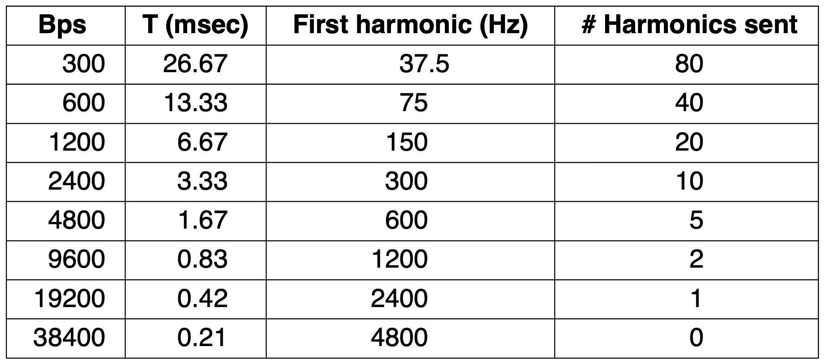
Bandwidth-Limited Signals
Limiting bandwidth limits data rate
Example: bandwidth limit as 3000 Hz
b
t sec
1/t
24000/b
Notes:
For some data rates, the numbers work out as shown in Fig. 2-13. From these
numbers, it is clear that trying to send at 9600 bps over a voice-grade telephone
line will transform Fig. 2-12(a) into something looking like Fig. 2-12(c), making
accurate reception of the original binary bit stream tricky. It should be obvious that
at data rates much higher than 38.4 kbps, there is no hope at all for binary signals,
even if the transmission facility is completely noiseless. In other words, limiting
the bandwidth limits the data rate, even for perfect channels. However, coding
schemes that make use of several voltage levels do exist and can achieve higher
data rates. We will discuss these later in this chapter.

Slide 77
Maximum
Data Rate
bandwidth B;
2B samples per second at most;
V discrete signal levels;
Nyquist’s theorem:
2Blog₂V bits/sec
Notes:
Nyquist proved that if an arbitrary signal has been run through a low-pass filter
of bandwidth B, the filtered signal can be completely reconstructed by making only
2B (exact) samples per second. Sampling the line faster than 2B times per second
is pointless because the higher-frequency components that such sampling could
recover have already been filtered out. If the signal consists of V discrete levels,
Nyquist’s theorem states:
Maximum data rate= 2B log2 V bits/sec

Slide 78
Maximum
Data Rate
bandwidth B;
2B samples per second at most;
V discrete signal levels;
Nyquist’s theorem:
2Blog₂V bits/sec
what if the channel is noisy?

Slide 79
Maximum
Data Rate
bandwidth B;
2B samples per second at most;
V discrete signal levels;
Nyquist’s theorem:
2Blog₂V bits/sec
what if the channel is noisy:
SNR (Signal to Noise Ratio) S/N;
10log₁₀S/N decibels (dBs);
Shannon’s theorem: capacity
Blog₂(1 + S/N) bits/sec

Slide 80
Digital Modulation
The process of converting between digital bits and analog signals (e.g., continuously varying voltage, light intensity, or sound intensity) that represent them
Notes:
Now that we have studied the properties of wired and wireless channels, we
turn our attention to the problem of sending digital information. Wires and wire-
less channels carry analog signals such as continuously varying voltage, light
intensity, or sound intensity. To send digital information, we must devise analog
signals to represent bits. The process of converting between bits and signals that
represent them is called digital modulation.

Slide 81
Digital Modulation
Baseband transmission: signal occupies frequencies from zero up to a maximum that depends on the signaling rate; common for wires
Passband transmission: signal occupies a band of frequencies around the frequency of the carrier signal (through regulating amplitude, phase, or frequency of a carrier); common for wireless and optical channels
Notes:
We will start with schemes that directly convert bits into a signal. These
schemes result in baseband transmission, in which the signal occupies frequen-
cies from zero up to a maximum that depends on the signaling rate. It is common
for wires. Then we will consider schemes that regulate the amplitude, phase, or
frequency of a carrier signal to convey bits. These schemes result in passband
transmission, in which the signal occupies a band of frequencies around the fre-
quency of the carrier signal. It is common for wireless and optical channels for
which the signals must reside in a given frequency band.

Slide 82
Digital Modulation
Multiplexing: enable channels to be shared by multiple signals
Multiplexing methods via time, frequency, and code division
Notes:
Channels are often shared by multiple signals. After all, it is much more con-
venient to use a single wire to carry several signals than to install a wire for every
signal. This kind of sharing is called multiplexing. It can be accomplished in sev-
eral different ways. We will present methods for time, frequency, and code division
multiplexing.

Slide 83
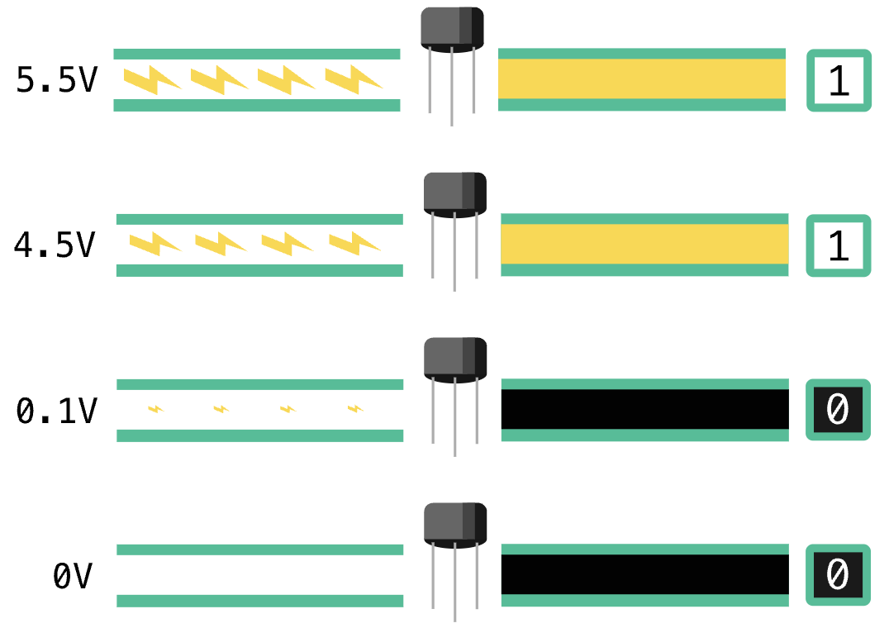
Baseband Transmission
A straightforward form: use a positive voltage to represent bit 1 and a negative voltage to represent bit 0
lower than a reference voltage, not literally less than zero;
also called ground or zero voltage
https://en.khanacademy.org/computing/computers-and-internet/xcae6f4a7ff015e7d:computers/xcae6f4a7ff015e7d:from-electricity-to-bits/a/from-electricity-to-bits
Notes:
::Negative voltage, in an electrical circuit, represents a potential difference where one point has a lower electrical potential than a reference point, often called ground or zero voltage. It doesn't mean voltage is "less than zero" in an absolute sense, but rather that it's lower than the chosen reference point.
The most straightforward form of digital modulation is to use a positive volt-
age to represent a 1 bit and a negative voltage to represent a 0 bit, as can be seen in
Fig. 2-14(a). For an optical fiber, the presence of light might represent a 1 and the
absence of light might represent a 0. This scheme is called NRZ (Non-Return-to-
Zero). The odd name is for historical reasons, and simply means that the signal
follows the data. An example is shown in Fig. 2-14(b).
Once sent, the NRZ signal propagates down the wire. At the other end, the re-
ceiver converts it into bits by sampling the signal at regular intervals of time. This
signal will not look exactly like the signal that was sent. It will be attenuated and
distorted by the channel and noise at the receiver. To decode the bits, the receiver
maps the signal samples to the closest symbols. For NRZ, a positive voltage will
be taken to indicate that a 1 was sent and a negative voltage will be taken to indi-
cate that a 0 was sent.
NRZ is a good starting point for our studies because it is simple, but it is sel-
dom used by itself in practice. More complex schemes can convert bits to signals
that better meet engineering considerations. These schemes are called line codes.
Below, we describe line codes that help with bandwidth efficiency, clock recovery,
and DC balance.

Slide 84
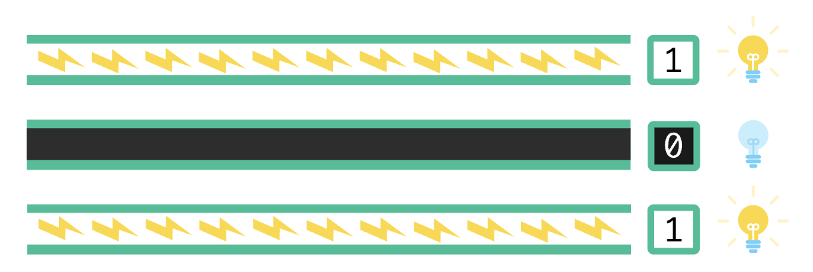
Baseband Transmission
A straightforward form for optical fiber: use the presence of light to represent bit 1 and the absence of light to represent bit 0
NRZ: Non-Return-to-Zero
https://en.khanacademy.org/computing/computers-and-internet/xcae6f4a7ff015e7d:computers/xcae6f4a7ff015e7d:from-electricity-to-bits/a/from-electricity-to-bits
Notes:
::Negative voltage, in an electrical circuit, represents a potential difference where one point has a lower electrical potential than a reference point, often called ground or zero voltage. It doesn't mean voltage is "less than zero" in an absolute sense, but rather that it's lower than the chosen reference point.
The most straightforward form of digital modulation is to use a positive volt-
age to represent a 1 bit and a negative voltage to represent a 0 bit, as can be seen in
Fig. 2-14(a). For an optical fiber, the presence of light might represent a 1 and the
absence of light might represent a 0. This scheme is called NRZ (Non-Return-to-
Zero). The odd name is for historical reasons, and simply means that the signal
follows the data. An example is shown in Fig. 2-14(b).
Once sent, the NRZ signal propagates down the wire. At the other end, the re-
ceiver converts it into bits by sampling the signal at regular intervals of time. This
signal will not look exactly like the signal that was sent. It will be attenuated and
distorted by the channel and noise at the receiver. To decode the bits, the receiver
maps the signal samples to the closest symbols. For NRZ, a positive voltage will
be taken to indicate that a 1 was sent and a negative voltage will be taken to indi-
cate that a 0 was sent.
NRZ is a good starting point for our studies because it is simple, but it is sel-
dom used by itself in practice. More complex schemes can convert bits to signals
that better meet engineering considerations. These schemes are called line codes.
Below, we describe line codes that help with bandwidth efficiency, clock recovery,
and DC balance.

Slide 85
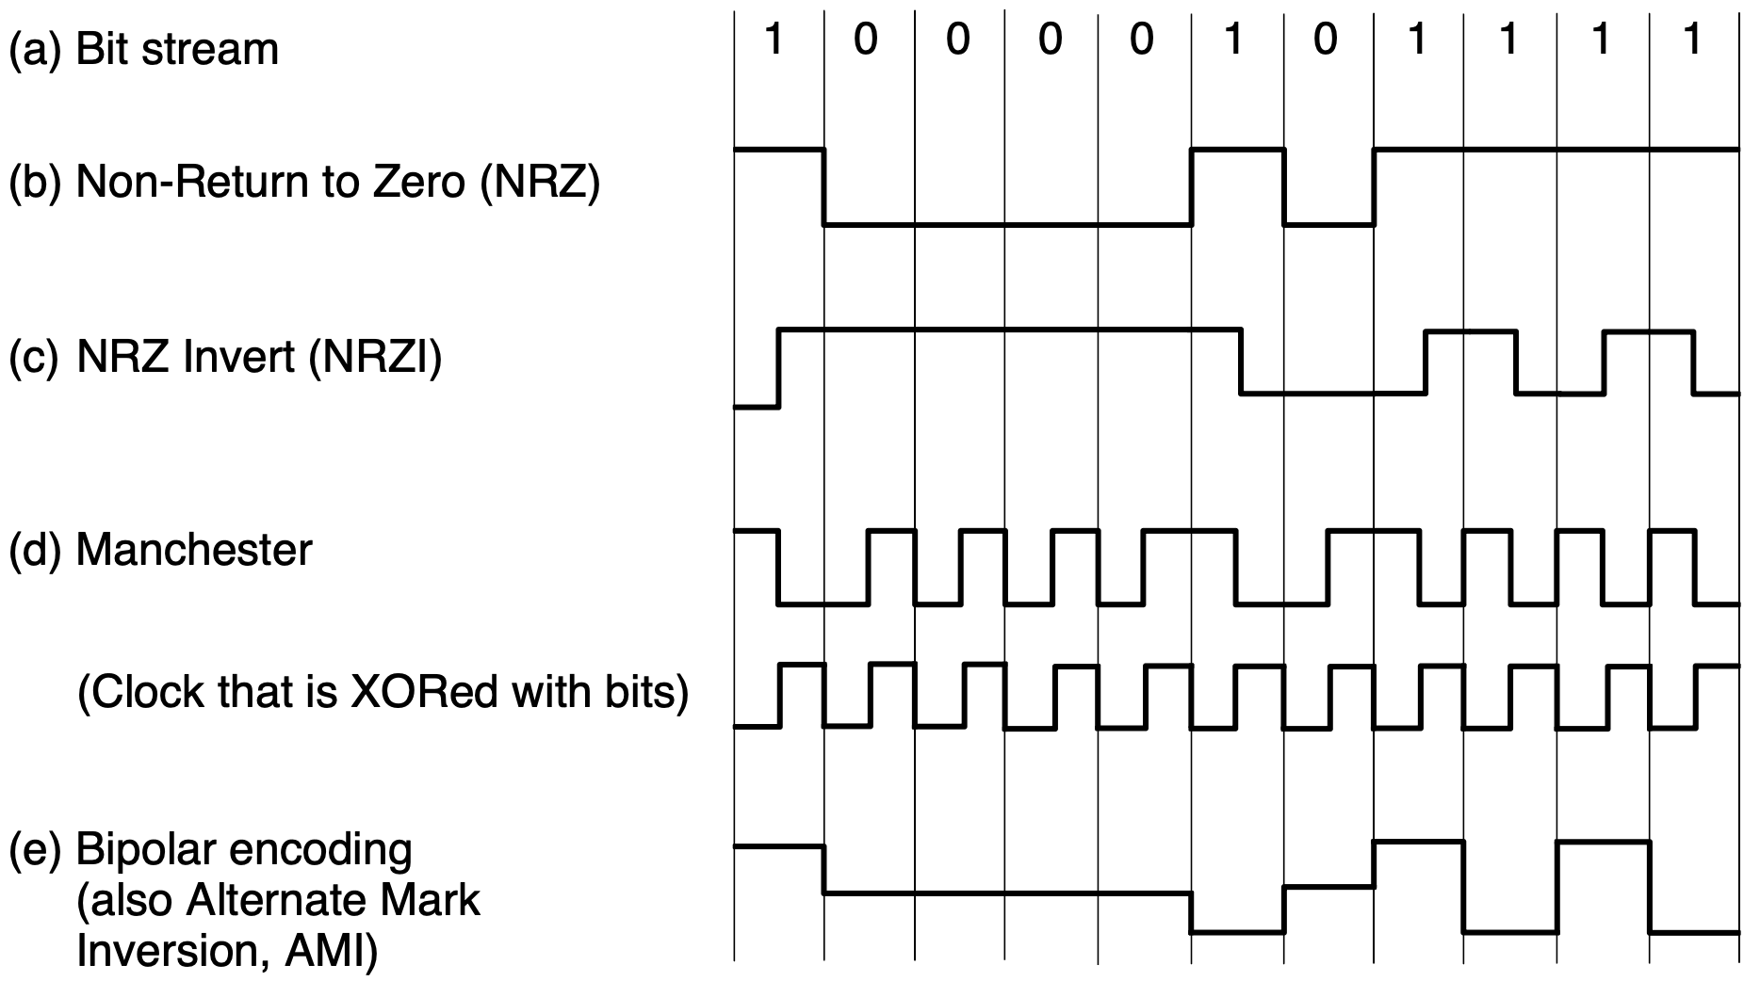
Baseband Transmission
Notes:
::Negative voltage, in an electrical circuit, represents a potential difference where one point has a lower electrical potential than a reference point, often called ground or zero voltage. It doesn't mean voltage is "less than zero" in an absolute sense, but rather that it's lower than the chosen reference point.
The most straightforward form of digital modulation is to use a positive volt-
age to represent a 1 bit and a negative voltage to represent a 0 bit, as can be seen in
Fig. 2-14(a). For an optical fiber, the presence of light might represent a 1 and the
absence of light might represent a 0. This scheme is called NRZ (Non-Return-to-
Zero). The odd name is for historical reasons, and simply means that the signal
follows the data. An example is shown in Fig. 2-14(b).
Once sent, the NRZ signal propagates down the wire. At the other end, the re-
ceiver converts it into bits by sampling the signal at regular intervals of time. This
signal will not look exactly like the signal that was sent. It will be attenuated and
distorted by the channel and noise at the receiver. To decode the bits, the receiver
maps the signal samples to the closest symbols. For NRZ, a positive voltage will
be taken to indicate that a 1 was sent and a negative voltage will be taken to indi-
cate that a 0 was sent.
NRZ is a good starting point for our studies because it is simple, but it is sel-
dom used by itself in practice. More complex schemes can convert bits to signals
that better meet engineering considerations. These schemes are called line codes.
Below, we describe line codes that help with bandwidth efficiency, clock recovery,
and DC balance.

Slide 86
Line Codes
Optimization goals: bandwidth efficiency, clock recovery, DC balance
direct current;
as much positive voltage as negative voltage even over short time periods
https://en.khanacademy.org/computing/computers-and-internet/xcae6f4a7ff015e7d:computers/xcae6f4a7ff015e7d:from-electricity-to-bits/a/from-electricity-to-bits
Notes:
NRZ is a good starting point for our studies because it is simple, but it is sel-
dom used by itself in practice. More complex schemes can convert bits to signals
that better meet engineering considerations. These schemes are called line codes.
Below, we describe line codes that help with bandwidth efficiency, clock recovery,
and DC balance.

Slide 87
Bandwidth Efficiency
With NRZ, the signal may cycle between the positive and negative levels (i.e., V=2 levels and alternating 1s and 0s) up to every 2 bits
Per Nyquist rate, need a bandwidth of at least B/2 Hz for bit rate of B bits/sec; cannot run NRZ faster without using additional bandwidth
Notes:
With NRZ, the signal may cycle between the positive and negative levels up to
every 2 bits (in the case of alternating 1s and 0s). This means that we need a band-
width of at least B/2 Hz when the bit rate is B bits/sec. This relation comes from
the Nyquist rate [Eq. (2-3)]. It is a fundamental limit, so we cannot run NRZ faster
without using additional bandwidth. Bandwidth is often a limited resource, even
for wired channels. Higher-frequency signals are increasingly attenuated, making
them less useful, and higher-frequency signals also require faster electronics.

Slide 88
Bandwidth Efficiency
Use limited bandwidth more efficiently: use more than V=2 signaling levels
Example: using 4 voltages can send log₂4=2 bits at once as a single symbol
Notes:
One strategy for using limited bandwidth more efficiently is to use more than
two signaling levels. By using four voltages, for instance, we can send 2 bits at
once as a single symbol. This design will work as long as the signal at the receiver
is sufficiently strong to distinguish the four levels. The rate at which the signal
changes is then half the bit rate, so the needed bandwidth has been reduced.

Slide 89
Bandwidth Efficiency
Symbol rate: the rate at which the signal changes; also called as baud rate for telephone modems that convey digital data over telephone lines
bit rate = number-of-bits-per-symbol
x symbol rate
Notes:
We call the rate at which the signal changes the symbol rate to distinguish it
from the bit rate. The bit rate is the symbol rate multiplied by the number of bits
per symbol. An older name for the symbol rate, particularly in the context of de-
vices called telephone modems that convey digital data over telephone lines, is the
baud rate. In the literature, the terms ‘‘bit rate’’ and ‘‘baud rate’’ are often used
incorrectly.
Note that the number of signal levels does not need to be a power of two. Often
it is not, with some of the levels used for protecting against errors and simplifying
the design of the receiver.

Slide 90
Clock Recovery
long run of 0s and 1s leaves the signal unchanged for a while;
hard to tell the bits apart without a very accurate clock
Notes:
For all schemes that encode bits into symbols, the receiver must know when
one symbol ends and the next symbol begins to correctly decode the bits. With
NRZ, in which the symbols are simply voltage levels, a long run of 0s or 1s leaves
the signal unchanged. After a while, it is hard to tell the bits apart, as 15 zeros
look much like 16 zeros unless you have a very accurate clock.
Accurate clocks would help with this problem, but they are an expensive solu-
tion for commodity equipment. Remember, we are timing bits on links that run at
many meg abits/sec, so the clock would have to drift less than a fraction of a
microsecond over the longest permitted run. This might be reasonable for slow
links or short messages, but it is not a general solution.

Slide 91
Clock Recovery
Manchester encoding: mix the clock signal with the date signal by XORing them together (no extra line solely for clock signal is needed)
The clock makes a clock transition in every bit time (at twice the bit rate)
Used for classic Ethernet
Notes:
One strategy is to send a separate clock signal to the receiver. Another clock
line is no big deal for computer buses or short cables in which there are many lines
in parallel, but it is wasteful for most network links since if we had another line to
send a signal we could use it to send data. A clever trick here is to mix the clock
signal with the data signal by XORing them together so that no extra line is need-
ed. The results are shown in Fig. 2-14(d). The clock makes a clock transition in
ev ery bit time, so it runs at twice the bit rate. When it is XORed with the 0 level, it
makes a low-to-high transition that is simply the clock. This transition is a logical
0. When it is XORed with the 1 level it is inv erted and makes a high-to-low tran-
sition. This transition is a logical 1. This scheme is called Manchester encoding
and was used for classic Ethernet.

Slide 92
Clock Recovery
require twice as much bandwidth as NRZ: 100% overhead
Notes:
The downside of Manchester encoding is that it requires twice as much band-
width as NRZ due to the clock, and we have learned that bandwidth often matters.
A different strategy is based on the idea that we should code the data to ensure that
there are enough transitions in the signal. Consider that NRZ will have clock re-
covery problems only for long runs of 0s and 1s. If there are frequent transitions, it
will be easy for the receiver to stay synchronized with the incoming stream of
symbols.

Slide 93
Clock Recovery
code bit 1 as a transition and bit 0 as no transition, or vice versa;
long runs of 1s do not cause a problem
Notes:
As a step in the right direction, we can simplify the situation by coding a 1 as a
transition and a 0 as no transition, or vice versa. This coding is called NRZI (Non-
Return-to-Zero Inv erted), a twist on NRZ. An example is shown in Fig. 2-14(c).
The popular USB (Universal Serial Bus) standard for connecting computer per-
ipherals uses NRZI. With it, long runs of 1s do not cause a problem.

Slide 94
Clock Recovery
code bit 1 as a transition and bit 0 as no transition, or vice versa;
how to deal with long runs of 0s?
Notes:
As a step in the right direction, we can simplify the situation by coding a 1 as a
transition and a 0 as no transition, or vice versa. This coding is called NRZI (Non-
Return-to-Zero Inv erted), a twist on NRZ. An example is shown in Fig. 2-14(c).
The popular USB (Universal Serial Bus) standard for connecting computer per-
ipherals uses NRZI. With it, long runs of 1s do not cause a problem.

Slide 95
Clock Recovery
T1 telephone lines: require that no more than 15 consecutive 0s be sent for them to work correctly
Notes:
Of course, long runs of 0s still cause a problem that we must fix. If we were
the telephone company, we might simply require that the sender not transmit too
many 0s. Older digital telephone lines in the United States, called T1 lines (dis-
cussed later) did, in fact, require that no more than 15 consecutive 0s be sent for
them to work correctly. To really fix the problem, we can break up runs of 0s by
mapping small groups of bits to be transmitted so that groups with successive 0s
are mapped to slightly longer patterns that do not have too many consecutive 0s.

Slide 96
Clock Recovery
Break up runs of 0s to small groups, map each small group to a slightly longer patterns that do not have too many consecutive 0s
4B/5B: every 4-bit group is mapped into a 5-bit pattern (never be a run of more than three consecutive 0s) with a fixed translation table
Notes:
To really fix the problem, we can break up runs of 0s by
mapping small groups of bits to be transmitted so that groups with successive 0s
are mapped to slightly longer patterns that do not have too many consecutive 0s.
A well-known code to do this is called 4B/5B. Every 4 bits is mapped into a
5-bit pattern with a fixed translation table. The five bit patterns are chosen so that
there will never be a run of more than three consecutive 0s. The mapping is shown
in Fig. 2-15. This scheme adds 25% overhead, which is better than the 100% over-
head of Manchester encoding. Since there are 16 input combinations and 32 output
combinations, some of the output combinations are not used. Putting aside the
combinations with too many successive 0s, there are still some codes left. As a
bonus, we can use these nondata codes to represent physical layer control signals.
For example, in some uses, ‘‘11111’’ represents an idle line and ‘‘11000’’ repres-
ents the start of a frame.

Slide 97
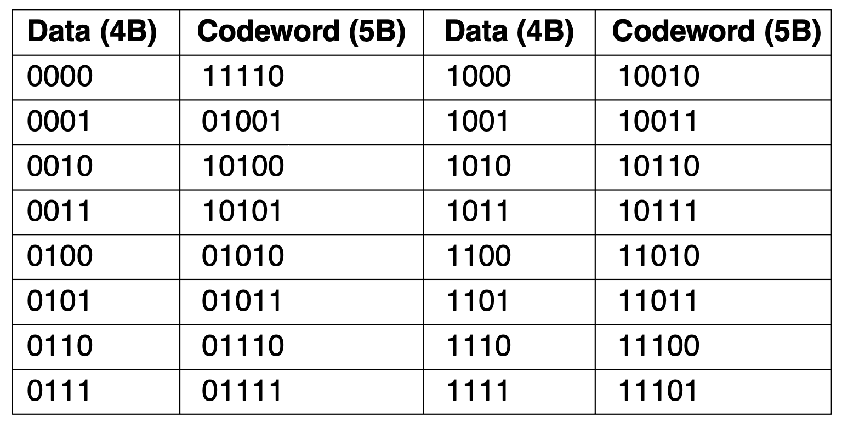
Clock Recovery
4B/5B: every 4-bit group is mapped into a 5-bit pattern (never be a run of more than three consecutive 0s) with a fixed translation table: 25% overhead
Notes:
To really fix the problem, we can break up runs of 0s by
mapping small groups of bits to be transmitted so that groups with successive 0s
are mapped to slightly longer patterns that do not have too many consecutive 0s.
A well-known code to do this is called 4B/5B. Every 4 bits is mapped into a
5-bit pattern with a fixed translation table. The five bit patterns are chosen so that
there will never be a run of more than three consecutive 0s. The mapping is shown
in Fig. 2-15. This scheme adds 25% overhead, which is better than the 100% over-
head of Manchester encoding. Since there are 16 input combinations and 32 output
combinations, some of the output combinations are not used. Putting aside the
combinations with too many successive 0s, there are still some codes left. As a
bonus, we can use these nondata codes to represent physical layer control signals.
For example, in some uses, ‘‘11111’’ represents an idle line and ‘‘11000’’ repres-
ents the start of a frame.

Slide 98
Clock Recovery
Scrambling: make the data look random by XORing the data with a pseudorandom sequence before it is transmitted
The receiver then XORs the incoming bits with the same pseudorandom sequence to recover the real data
No bandwidth or time overhead
Notes:
An alternative approach is to make the data look random, known as scram-
bling. In this case, it is very likely that there will be frequent transitions. A
scrambler works by XORing the data with a pseudorandom sequence before it is
transmitted. This kind of mixing will make the data themselves as random as the
pseudorandom sequence (assuming it is independent of the pseudorandom
sequence). The receiver then XORs the incoming bits with the same pseudoran-
dom sequence to recover the real data. For this to be practical, the pseudorandom
sequence must be easy to create. It is commonly given as the seed to a simple ran-
dom number generator.
Scrambling is attractive because it adds no bandwidth or time overhead. In
fact, it often helps to condition the signal so that it does not have its energy in dom-
inant frequency components (caused by repetitive data patterns) that might radiate
electromagnetic interference. Scrambling helps because random signals tend to be
‘‘white,’’ or have energy spread across the frequency components.

Slide 99
Clock Recovery
Scrambling: make the data look random by XORing the data with a pseudorandom sequence before it is transmitted
The receiver then XORs the incoming bits with the same pseudorandom sequence to recover the real data
Yet do not guarantee absence of long runs of 0s (i.e., when same data as pseudorandom sequence) and 1s
Notes:
However, scrambling does not guarantee that there will be no long runs. It is
possible to get unlucky occasionally. If the data are the same as the pseudorandom
sequence, they will XOR to all 0s. This outcome does not generally occur with a
long pseudorandom sequence that is difficult to predict. However, with a short or
predictable sequence, it might be possible for malicious users to send bit patterns
that cause long runs of 0s after scrambling and cause links to fail. Early versions
of the standards for sending IP packets over SONET links in the telephone system
had this defect (Malis and Simpson, 1999). It was possible for users to send cer-
tain ‘‘killer packets’’ that were guaranteed to cause problems.

Slide 100
Balanced Signals
Signals that have as much positive voltage as negative voltage even over short periods of time
Help to remove DC component
Help to provide transitions for clock recovery
Help to calibrate receivers
Notes:
::Electric current flows in two ways as an alternating current (AC) or direct current (DC). The main difference between AC and DC lies in the direction in which the electrons flow. In DC, the electrons flow steadily in a single direction, while electrons keep switching directions, going forward and then backwards in AC.
::https://www.codrey.com/dc-circuits/alternating-current-ac-and-direct-current-dc/
Signals that have as much positive voltage as negative voltage even over short
periods of time are called balanced signals. They average to zero, which means
that they have no DC electrical component. The lack of a DC component is an ad-
vantage because some channels, such as coaxial cable or lines with transformers,
strongly attenuate a DC component due to their physical properties. Also, one
method of connecting the receiver to the channel called capacitive coupling passes
only the AC portion of a signal. In either case, if we send a signal whose average
is not zero, we waste energy as the DC component will be filtered out.
Balancing helps to provide transitions for clock recovery since there is a mix
of positive and negative voltages. It also provides a simple way to calibrate re-
ceivers because the average of the signal can be measured and used as a decision
threshold to decode symbols. With unbalanced signals, the average may drift away
from the true decision level due to a density of 1s, for example, which would cause
more symbols to be decoded with errors.

Slide 101
Balanced Signals
Signals that have as much positive voltage as negative voltage even over short periods of time
Help to remove DC component
Help to provide transitions for clock recovery
Help to calibrate receivers
How to construct a balanced code?
Notes:
::Electric current flows in two ways as an alternating current (AC) or direct current (DC). The main difference between AC and DC lies in the direction in which the electrons flow. In DC, the electrons flow steadily in a single direction, while electrons keep switching directions, going forward and then backwards in AC.
::https://www.codrey.com/dc-circuits/alternating-current-ac-and-direct-current-dc/
Signals that have as much positive voltage as negative voltage even over short
periods of time are called balanced signals. They average to zero, which means
that they have no DC electrical component. The lack of a DC component is an ad-
vantage because some channels, such as coaxial cable or lines with transformers,
strongly attenuate a DC component due to their physical properties. Also, one
method of connecting the receiver to the channel called capacitive coupling passes
only the AC portion of a signal. In either case, if we send a signal whose average
is not zero, we waste energy as the DC component will be filtered out.
Balancing helps to provide transitions for clock recovery since there is a mix
of positive and negative voltages. It also provides a simple way to calibrate re-
ceivers because the average of the signal can be measured and used as a decision
threshold to decode symbols. With unbalanced signals, the average may drift away
from the true decision level due to a density of 1s, for example, which would cause
more symbols to be decoded with errors.

Slide 102
Balanced Signals
Bipolar encoding uses three voltage levels: positive, negative, and zero; bit 0 is represented by a zero voltage; bit 1 is represented by positives or negatives with polarity of every alternate bit 1 being reversed
Also called as AMI (Alternate Mark Inversion) in telephone networks
different definition from that on textbook!
Notes:
::AMI: https://electronics.stackexchange.com/questions/166262/how-do-you-design-a-circuit-to-implement-the-bipolar-line-coding-technique
::note that description from textbook about bipolar encoding / AMI might not be correct
A straightforward way to construct a balanced code is to use two voltage levels
to represent a logical 1 and a logical zero. For example, +1 V for a 1 bit and -1 V
for a 0 bit. To send a 1, the transmitter alternates between the +1 V and -1 V lev-
els so that they always average out. This scheme is called bipolar encoding. In
telephone networks, it is called AMI (Alternate Mark Inversion), building on old
terminology in which a 1 is called a ‘‘mark’’ and a 0 is called a ‘‘space.’’ An ex-
ample is given in Fig. 2-14(e).

Slide 103
Balanced Signals
Notes:
::Negative voltage, in an electrical circuit, represents a potential difference where one point has a lower electrical potential than a reference point, often called ground or zero voltage. It doesn't mean voltage is "less than zero" in an absolute sense, but rather that it's lower than the chosen reference point.
The most straightforward form of digital modulation is to use a positive volt-
age to represent a 1 bit and a negative voltage to represent a 0 bit, as can be seen in
Fig. 2-14(a). For an optical fiber, the presence of light might represent a 1 and the
absence of light might represent a 0. This scheme is called NRZ (Non-Return-to-
Zero). The odd name is for historical reasons, and simply means that the signal
follows the data. An example is shown in Fig. 2-14(b).
Once sent, the NRZ signal propagates down the wire. At the other end, the re-
ceiver converts it into bits by sampling the signal at regular intervals of time. This
signal will not look exactly like the signal that was sent. It will be attenuated and
distorted by the channel and noise at the receiver. To decode the bits, the receiver
maps the signal samples to the closest symbols. For NRZ, a positive voltage will
be taken to indicate that a 1 was sent and a negative voltage will be taken to indi-
cate that a 0 was sent.
NRZ is a good starting point for our studies because it is simple, but it is sel-
dom used by itself in practice. More complex schemes can convert bits to signals
that better meet engineering considerations. These schemes are called line codes.
Below, we describe line codes that help with bandwidth efficiency, clock recovery,
and DC balance.

Slide 104
Balanced Signals
8B/10B: split 8 bits to a group of 5 bits (mapped to 6 bits) and a group of 3 bits (mapped to 4 bits), concatenate the 6 and 4 bits into 10 bits
Map most input patterns to balanced output patterns with same number of 0s and 1s (e.g., 001 → 1001)
Notes:
Bipolar encoding adds a voltage level to achieve balance. Alternatively, we
can use a mapping like 4B/5B to achieve balance (as well as transitions for clock
recovery). An example of this kind of balanced code is the 8B/10B line code. It
maps 8 bits of input to 10 bits of output, so it is 80% efficient, just like the 4B/5B
line code. The 8 bits are split into a group of 5 bits, which is mapped to 6 bits, and
a group of 3 bits, which is mapped to 4 bits. The 6-bit and 4-bit symbols are then
concatenated. In each group, some input patterns can be mapped to balanced out-
put patterns that have the same number of 0s and 1s. For example, ‘‘001’’ is map-
ped to ‘‘1001,’’ which is balanced. But there are not enough combinations for all
output patterns to be balanced. For these cases, each input pattern is mapped to
two output patterns. One will have an extra 1 and the alternate will have an extra
0. For example, ‘‘000’’ is mapped to both ‘‘1011’’ and its complement ‘‘0100.’’ As
input bits are mapped to output bits, the encoder remembers the disparity from the
previous symbol. The disparity is the total number of 0s or 1s by which the signal
is out of balance. The encoder then selects either an output pattern or its alternate
to reduce the disparity. With 8B/10B, the disparity will be at most 2 bits. Thus,
the signal will never be far from balanced. There will also never be more than fiv e
consecutive 1s or 0s, to help with clock recovery.

Slide 105
Balanced Signals
8B/10B: split 8 bits to a group of 5 bits (mapped to 6 bits) and a group of 3 bits (mapped to 4 bits), concatenate the 6 and 4 bits into 10 bits
Map most input patterns to balanced output patterns with same number of 0s and 1s (e.g., 001 → 1001)
How to deal with lack of balanced output patterns?
Notes:
Bipolar encoding adds a voltage level to achieve balance. Alternatively, we
can use a mapping like 4B/5B to achieve balance (as well as transitions for clock
recovery). An example of this kind of balanced code is the 8B/10B line code. It
maps 8 bits of input to 10 bits of output, so it is 80% efficient, just like the 4B/5B
line code. The 8 bits are split into a group of 5 bits, which is mapped to 6 bits, and
a group of 3 bits, which is mapped to 4 bits. The 6-bit and 4-bit symbols are then
concatenated. In each group, some input patterns can be mapped to balanced out-
put patterns that have the same number of 0s and 1s. For example, ‘‘001’’ is map-
ped to ‘‘1001,’’ which is balanced. But there are not enough combinations for all
output patterns to be balanced. For these cases, each input pattern is mapped to
two output patterns. One will have an extra 1 and the alternate will have an extra
0. For example, ‘‘000’’ is mapped to both ‘‘1011’’ and its complement ‘‘0100.’’ As
input bits are mapped to output bits, the encoder remembers the disparity from the
previous symbol. The disparity is the total number of 0s or 1s by which the signal
is out of balance. The encoder then selects either an output pattern or its alternate
to reduce the disparity. With 8B/10B, the disparity will be at most 2 bits. Thus,
the signal will never be far from balanced. There will also never be more than fiv e
consecutive 1s or 0s, to help with clock recovery.

Slide 106
Balanced Signals
8B/10B: How to deal with lack of balanced output patterns?
For such input patterns, each is mapped to two output patterns, one with an extra 1 and the other with an extra 0 to be balanced (e.g., 000 mapped to 1011 and its complement 0100)
Disparity: total number of 0s or 1s by which the signal is out of balance
Notes:
Bipolar encoding adds a voltage level to achieve balance. Alternatively, we
can use a mapping like 4B/5B to achieve balance (as well as transitions for clock
recovery). An example of this kind of balanced code is the 8B/10B line code. It
maps 8 bits of input to 10 bits of output, so it is 80% efficient, just like the 4B/5B
line code. The 8 bits are split into a group of 5 bits, which is mapped to 6 bits, and
a group of 3 bits, which is mapped to 4 bits. The 6-bit and 4-bit symbols are then
concatenated. In each group, some input patterns can be mapped to balanced out-
put patterns that have the same number of 0s and 1s. For example, ‘‘001’’ is map-
ped to ‘‘1001,’’ which is balanced. But there are not enough combinations for all
output patterns to be balanced. For these cases, each input pattern is mapped to
two output patterns. One will have an extra 1 and the alternate will have an extra
0. For example, ‘‘000’’ is mapped to both ‘‘1011’’ and its complement ‘‘0100.’’ As
input bits are mapped to output bits, the encoder remembers the disparity from the
previous symbol. The disparity is the total number of 0s or 1s by which the signal
is out of balance. The encoder then selects either an output pattern or its alternate
to reduce the disparity. With 8B/10B, the disparity will be at most 2 bits. Thus,
the signal will never be far from balanced. There will also never be more than fiv e
consecutive 1s or 0s, to help with clock recovery.

Slide 107
Balanced Signals
8B/10B: How to deal with lack of balanced output patterns?
For such input patterns, each is mapped to two output patterns, one with an extra 1 and the other with an extra 0 to be balanced
While mapping an input, the encoder remembers the disparity from the previous symbol, and selects one of the two outputs to reduce the disparity
Notes:
Bipolar encoding adds a voltage level to achieve balance. Alternatively, we
can use a mapping like 4B/5B to achieve balance (as well as transitions for clock
recovery). An example of this kind of balanced code is the 8B/10B line code. It
maps 8 bits of input to 10 bits of output, so it is 80% efficient, just like the 4B/5B
line code. The 8 bits are split into a group of 5 bits, which is mapped to 6 bits, and
a group of 3 bits, which is mapped to 4 bits. The 6-bit and 4-bit symbols are then
concatenated. In each group, some input patterns can be mapped to balanced out-
put patterns that have the same number of 0s and 1s. For example, ‘‘001’’ is map-
ped to ‘‘1001,’’ which is balanced. But there are not enough combinations for all
output patterns to be balanced. For these cases, each input pattern is mapped to
two output patterns. One will have an extra 1 and the alternate will have an extra
0. For example, ‘‘000’’ is mapped to both ‘‘1011’’ and its complement ‘‘0100.’’ As
input bits are mapped to output bits, the encoder remembers the disparity from the
previous symbol. The disparity is the total number of 0s or 1s by which the signal
is out of balance. The encoder then selects either an output pattern or its alternate
to reduce the disparity. With 8B/10B, the disparity will be at most 2 bits. Thus,
the signal will never be far from balanced. There will also never be more than five
consecutive 1s or 0s, to help with clock recovery.

Slide 108
Passband Transmission
Use a range of frequencies (band) that does not start at zero to send information across a channel
Shift a baseband (0~B Hz) up by S to occupy a passband (S~S+B Hz) without changing the amount of information that it can carry
The receiver can shift it back down to baseband for ease of detecting symbols
Notes:
Communication over baseband frequencies is most appropriate for wired trans-
missions, such as twisted pair, coax, or fiber. In other circumstances, particularly
those involving wireless networks and radio transmissions, we need to use a range
of frequencies that does not start at zero to send information across a channel.
Specifically, for wireless channels, it is not practical to send very low frequency
signals because the size of the antenna needs to be a fraction of the signal
wavelength, which becomes large at high transmission frequencies. In any case,
regulatory constraints and the need to avoid interference usually dictate the choice
of frequencies. Even for wires, placing a signal in a given frequency band is useful
to let different kinds of signals coexist on the channel. This kind of transmission is
called passband transmission because an arbitrary band of frequencies is used to
pass the signal.
Fortunately, our fundamental results from earlier in the chapter are all in terms
of bandwidth, or the width of the frequency band. The absolute frequency values
do not matter for capacity. This means that we can take a baseband signal that
occupies 0 to B Hz and shift it up to occupy a passband of S to S + B Hz without
changing the amount of information that it can carry, even though the signal will
look different. To process a signal at the receiver, we can shift it back down to
baseband, where it is more convenient to detect symbols.

Slide 109
Digital Modulation
Can directly modulate a carrier signal that sits in the passband
Modulation target of the carrier signal: amplitude, frequency, or phase
Notes:
Digital modulation is accomplished with passband transmission by modulating
a carrier signal that sits in the passband. We can modulate the amplitude, frequen-
cy, or phase of the carrier signal.

Slide 110
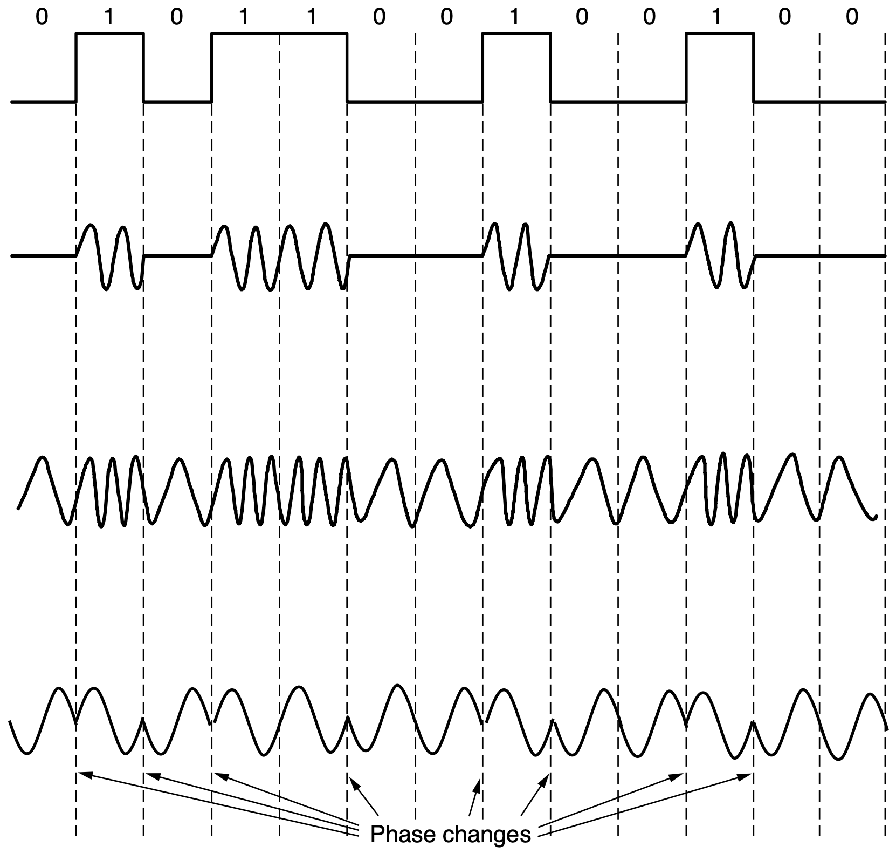
Digital Modulation
ASK: Amplitude Shift Keying
FSK: Frequency Shift Keying
PSK: Phase Shift Keying
Notes:
Figure 2-16. (a) A binary signal. (b) Amplitude shift keying. (c) Frequency
shift keying. (d) Phase shift keying.
In ASK (Amplitude Shift Keying), two different amplitudes are used to represent
0 and 1. An example with a nonzero and a zero level is shown in Fig. 2-16(b).
More than two lev els can be used to encode multiple bits per symbol.
Similarly, with FSK (Frequency Shift Keying), two or more different tones
are used. The example in Fig. 2-16(c) uses just two frequencies. In the simplest
form of PSK (Phase Shift Keying), the carrier wave is systematically shifted 0 or
180 degrees at each symbol period. Because there are two phases, it is called
BPSK (Binary Phase Shift Keying). ‘‘Binary’’ here refers to the two symbols,
not that the symbols represent 2 bits. An example is shown in Fig. 2-16(d). A bet-
ter scheme that uses the channel bandwidth more efficiently is to use four shifts,
e.g., 45, 135, 225, or 315 degrees, to transmit 2 bits of information per symbol.
This version is called QPSK (Quadrature Phase Shift Keying).

Slide 111
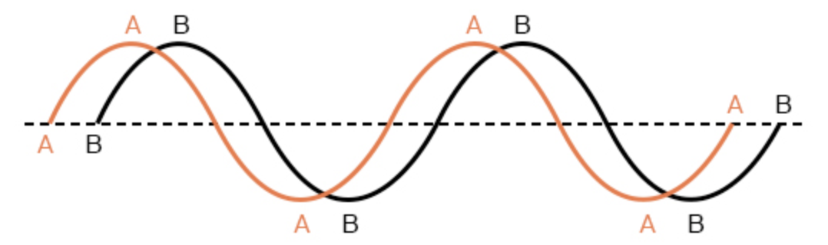
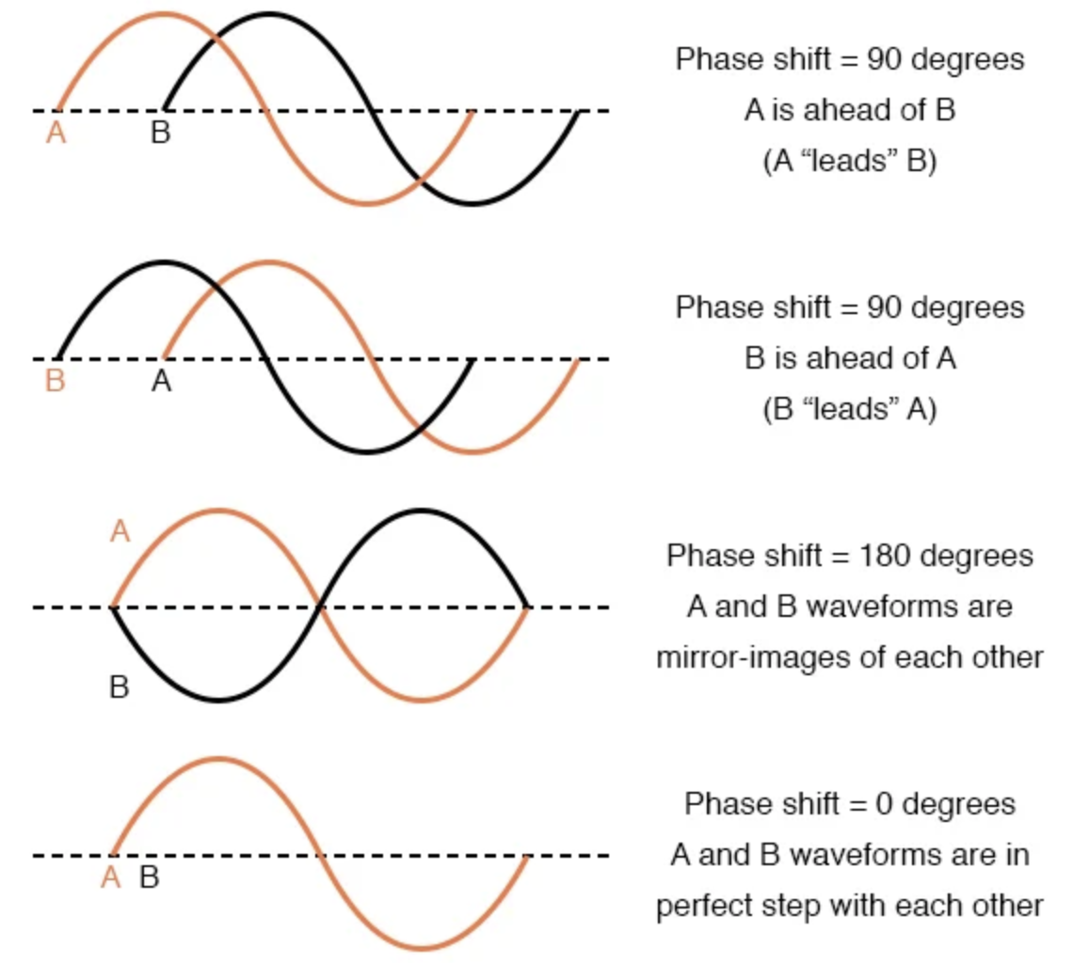
Phase Shift
https://www.allaboutcircuits.com/textbook/alternating-current/chpt-1/ac-phase/

Slide 112
Digital Modulation
ASK: Amplitude Shift Keying
FSK: Frequency Shift Keying
BPSK: Binay Phase Shift Keying
shifted 0 or 180 degrees at each symbol period
Notes:
Figure 2-16. (a) A binary signal. (b) Amplitude shift keying. (c) Frequency
shift keying. (d) Phase shift keying.
In ASK (Amplitude Shift Keying), two different amplitudes are used to represent
0 and 1. An example with a nonzero and a zero level is shown in Fig. 2-16(b).
More than two lev els can be used to encode multiple bits per symbol.
Similarly, with FSK (Frequency Shift Keying), two or more different tones
are used. The example in Fig. 2-16(c) uses just two frequencies. In the simplest
form of PSK (Phase Shift Keying), the carrier wave is systematically shifted 0 or
180 degrees at each symbol period. Because there are two phases, it is called
BPSK (Binary Phase Shift Keying). ‘‘Binary’’ here refers to the two symbols,
not that the symbols represent 2 bits. An example is shown in Fig. 2-16(d). A bet-
ter scheme that uses the channel bandwidth more efficiently is to use four shifts,
e.g., 45, 135, 225, or 315 degrees, to transmit 2 bits of information per symbol.
This version is called QPSK (Quadrature Phase Shift Keying).

Slide 113
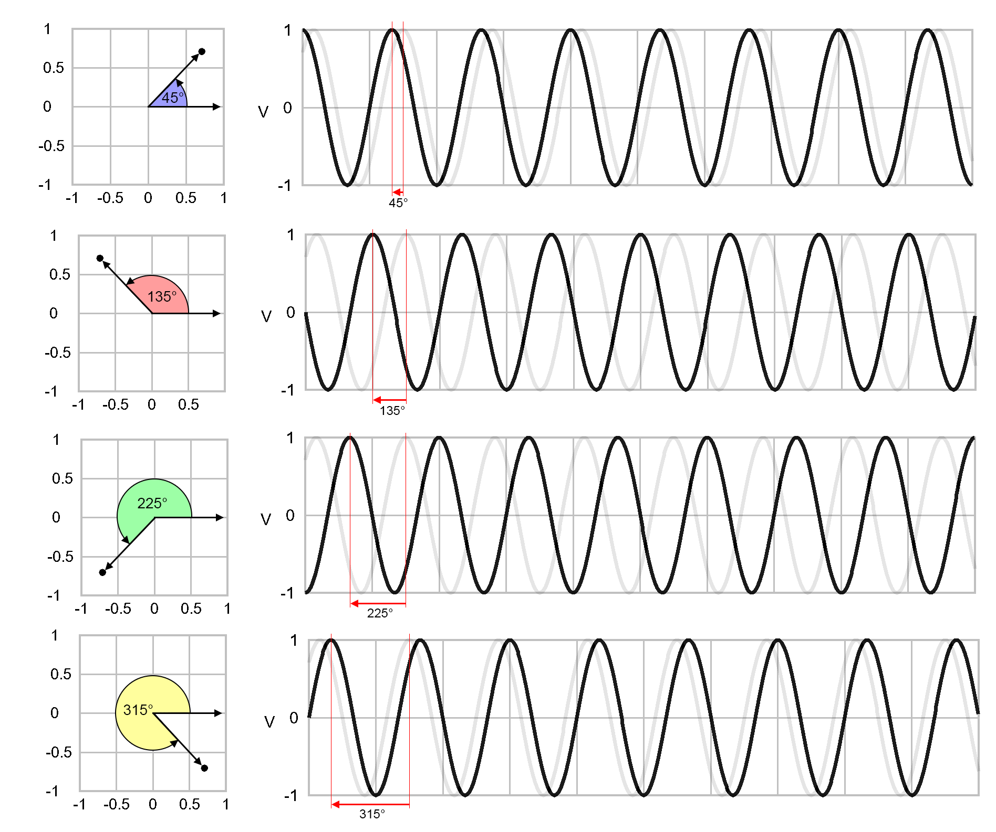
QPSK: Quadrature Phase Shift Keying
shifted, for example, 45, 135, 225, and 315 degrees
https://www.etti.unibw.de/labalive/experiment/qpsksignalgeneration/

Slide 114
11
01
constellation diagram
00
10
https://www.etti.unibw.de/labalive/experiment/qpsksignalgeneration/

Slide 115
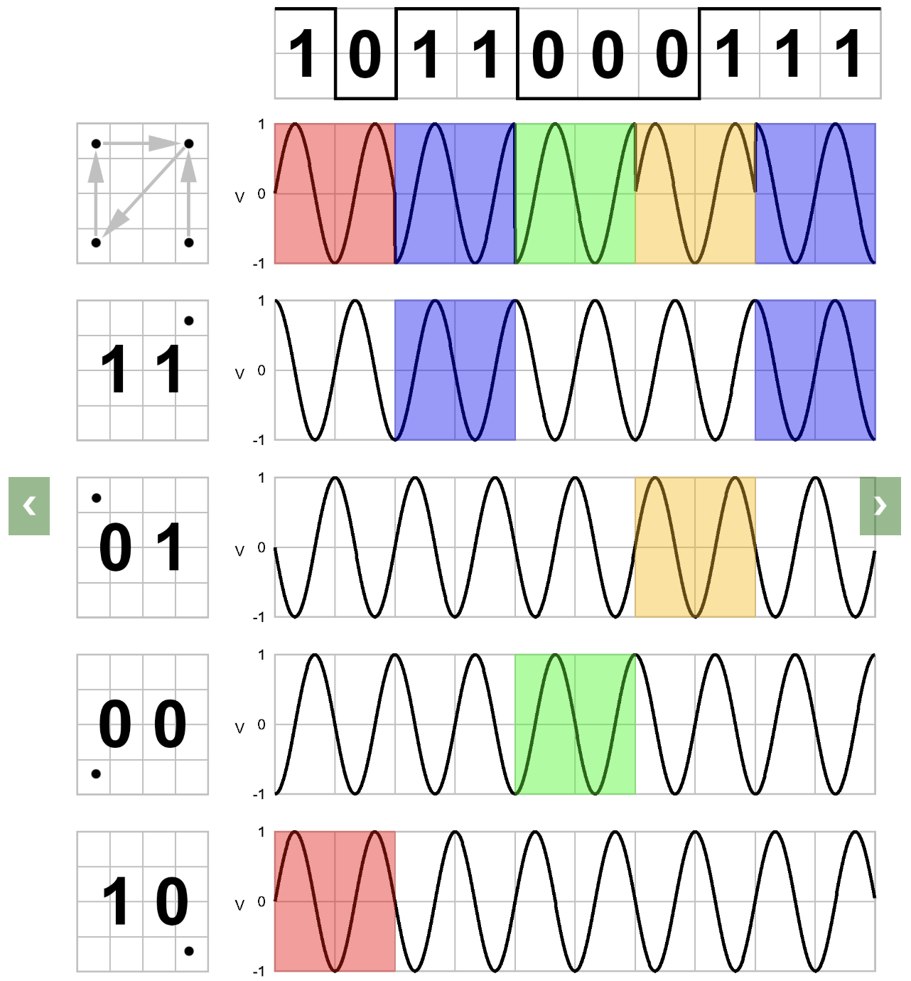
11
01
00
10
https://www.etti.unibw.de/labalive/experiment/qpsksignalgeneration/
Notes:
select f(t) from the corresponding signals

Slide 116
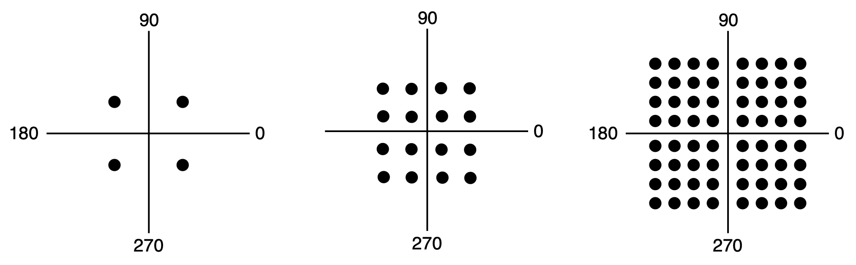
QAM
Quardrature Amplitude Modulation: module amplitude and phase together
distance of a dot from the origin
QPSK
QAM-16
QAM-64
Notes:
We can combine these schemes and use more levels to transmit more bits per
symbol. Only one of frequency and phase can be modulated at a time because they
are related, with frequency being the rate of change of phase over time. Usually,
amplitude and phase are modulated in combination. Three examples are shown in
Fig. 2-17. In each example, the points give the legal amplitude and phase combi-
nations of each symbol. In Fig. 2-17(a), we see equidistant dots at 45, 135, 225,
and 315 degrees. The phase of a dot is indicated by the angle a line from it to the
origin makes with the positive x-axis. The amplitude of a dot is the distance from
the origin. This figure is a graphical representation of QPSK.
This kind of diagram is called a constellation diagram. In Fig. 2-17(b) we
see a modulation scheme with a denser constellation. Sixteen combinations of am-
plitudes and phase are used here, so the modulation scheme can be used to transmit
4 bits per symbol. It is called QAM-16, where QAM stands for Quadrature Am-
plitude Modulation. Figure 2-17(c) is a still denser modulation scheme with 64
different combinations, so 6 bits can be transmitted per symbol. It is called
QAM-64. Even higher-order QAMs are used too. As you might suspect from
these constellations, it is easier to build electronics to produce symbols as a combi-
nation of values on each axis than as a combination of amplitude and phase values.
That is why the patterns look like squares rather than concentric circles.

Slide 117
QAM
How to assign bits to symbols to minimize bit errors?
QPSK
QAM-16
QAM-64
Notes:
The constellations we have seen so far do not show how bits are assigned to
symbols. When making the assignment, an important consideration is that a small
burst of noise at the receiver not lead to many bit errors. This might happen if we
assigned consecutive bit values to adjacent symbols. With QAM-16, for example,
if one symbol stood for 0111 and the neighboring symbol stood for 1000, if the re-
ceiver mistakenly picks the adjacent symbol, it will cause all of the bits to be
wrong.

Slide 118
QAM
Many bit errors may occur if simply assigning consecutive bit values to adjacent symbols
QPSK
QAM-16
QAM-64
Notes:
The constellations we have seen so far do not show how bits are assigned to
symbols. When making the assignment, an important consideration is that a small
burst of noise at the receiver not lead to many bit errors. This might happen if we
assigned consecutive bit values to adjacent symbols. With QAM-16, for example,
if one symbol stood for 0111 and the neighboring symbol stood for 1000, if the re-
ceiver mistakenly picks the adjacent symbol, it will cause all of the bits to be
wrong.

Slide 119
QAM
E.g., if two adjacent symbol stood for 0111 and 1000, mistakenly picking the adjacent symbol makes all bits wrong
QPSK
QAM-16
QAM-64
Notes:
The constellations we have seen so far do not show how bits are assigned to
symbols. When making the assignment, an important consideration is that a small
burst of noise at the receiver not lead to many bit errors. This might happen if we
assigned consecutive bit values to adjacent symbols. With QAM-16, for example,
if one symbol stood for 0111 and the neighboring symbol stood for 1000, if the re-
ceiver mistakenly picks the adjacent symbol, it will cause all of the bits to be
wrong.

Slide 120
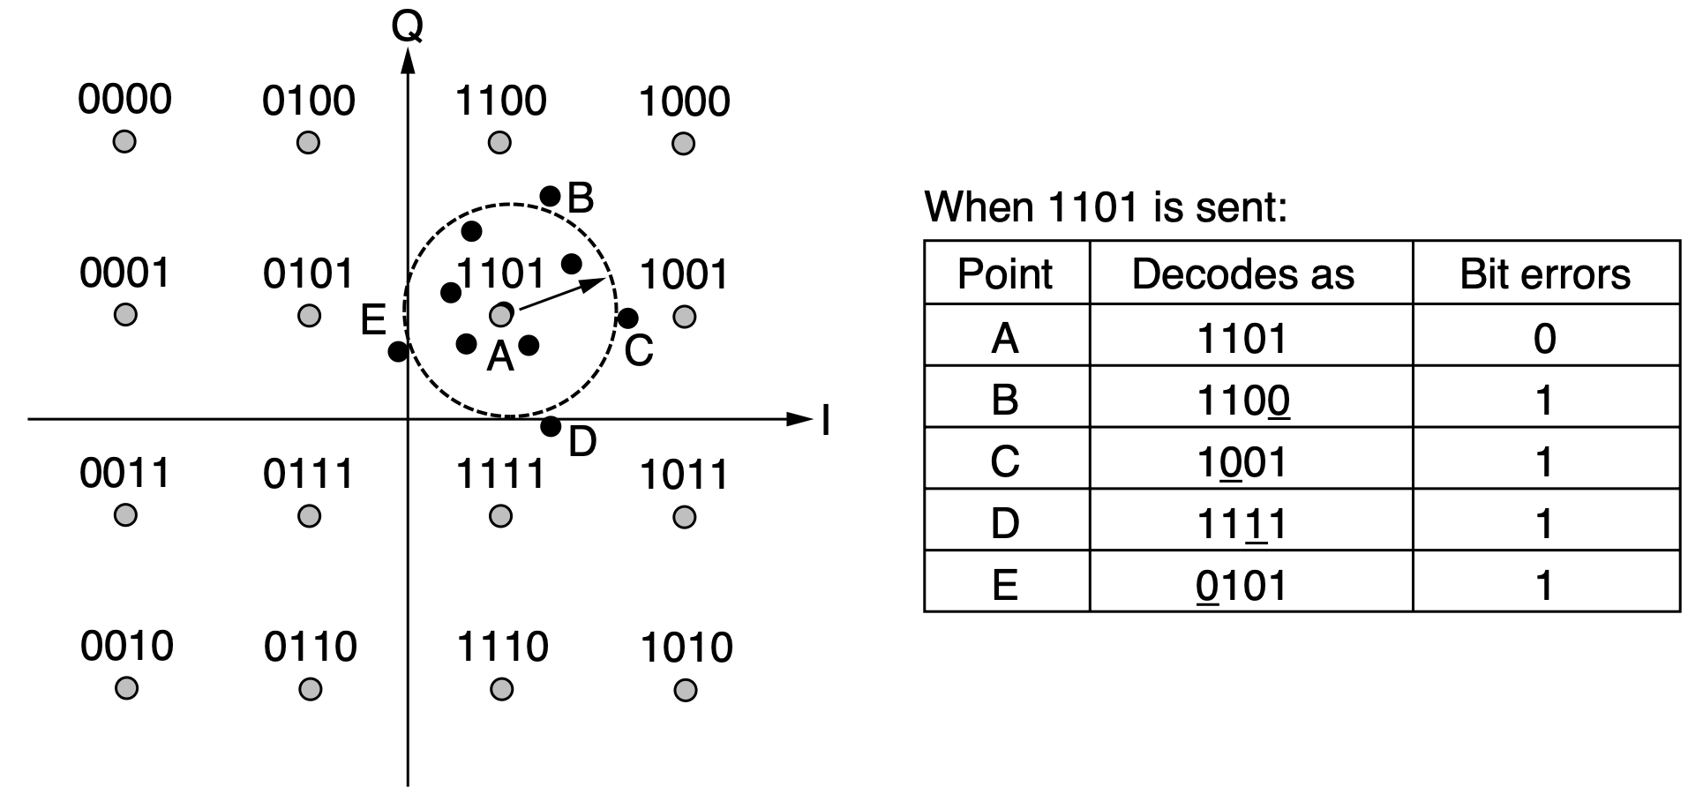
Gray Code
Map bits to symbols so that adjacent symbols differ in only 1 position
Notes:
A better solution is to map bits to symbols so that adjacent symbols differ
in only 1 bit position. This mapping is called a Gray code. Figure 2-18 shows a
QAM-16 constellation that has been Gray coded. Now if the receiver decodes the
symbol in error, it will make only a single bit error in the expected case that the
decoded symbol is close to the transmitted symbol.

Slide 121
Modulation
Only about how to transmit one bitstream at a time
Notes:
The modulation schemes we have seen let us send one signal to convey bits
along a wired or wireless link, but they only describe how to transmit one bitstream
at a time. In practice, economies of scale play an important role in how we use
networks: It costs essentially the same amount of money to install and maintain a
high-bandwidth transmission line as a low-bandwidth line between two different
offices (i.e., the costs come from having to dig the trench and not from what kind
of cable or fiber goes into it). Consequently, multiplexing schemes have been de-
veloped to share lines among many signals. The three main ways to multiplex a
single physical line are time, frequency, and code; there is also a technique called
wavelength division multiplexing, which is essentially an optical form of frequency
division multiplexing. We discuss each of these techniques below.

Slide 122
Multiplexing
How to share lines among many signals for economic usage of networks?
FDM: Frequency Division Multiplexing
TDM: Time Division Multiplexing
CDM: Code Division Multiplexing
WDM: Wavelength Division Multiplexing
Notes:
::The phrase "for economic usage of" generally refers to the application or utilization of something (a good, service, resource, or concept) in a way that is related to the production, distribution, and consumption of goods and services, or that affects material resources. It often involves considering factors like efficiency, cost-effectiveness, and impact on the economy.
The modulation schemes we have seen let us send one signal to convey bits
along a wired or wireless link, but they only describe how to transmit one bitstream
at a time. In practice, economies of scale play an important role in how we use
networks: It costs essentially the same amount of money to install and maintain a
high-bandwidth transmission line as a low-bandwidth line between two different
offices (i.e., the costs come from having to dig the trench and not from what kind
of cable or fiber goes into it). Consequently, multiplexing schemes have been de-
veloped to share lines among many signals. The three main ways to multiplex a
single physical line are time, frequency, and code; there is also a technique called
wavelength division multiplexing, which is essentially an optical form of frequency
division multiplexing. We discuss each of these techniques below.

Slide 123
FDM
Use passband transmission
Divide spectrum into frequency bands
Allocate each band to a single user for the user to send a signal
Keep interchannel separation large enough to prevent interference
Notes:
FDM (Frequency Division Multiplexing) takes advantage of passband trans-
mission to share a channel. It divides the spectrum into frequency bands, with
each user having exclusive possession of some band in which to send a signal. AM
radio broadcasting illustrates FDM. The allocated spectrum is about 1 MHz,
roughly 500 to 1500 kHz. Different frequencies are allocated to different logical
channels (stations), each operating in a portion of the spectrum, with the interchan-
nel separation great enough to prevent interference.

Slide 124
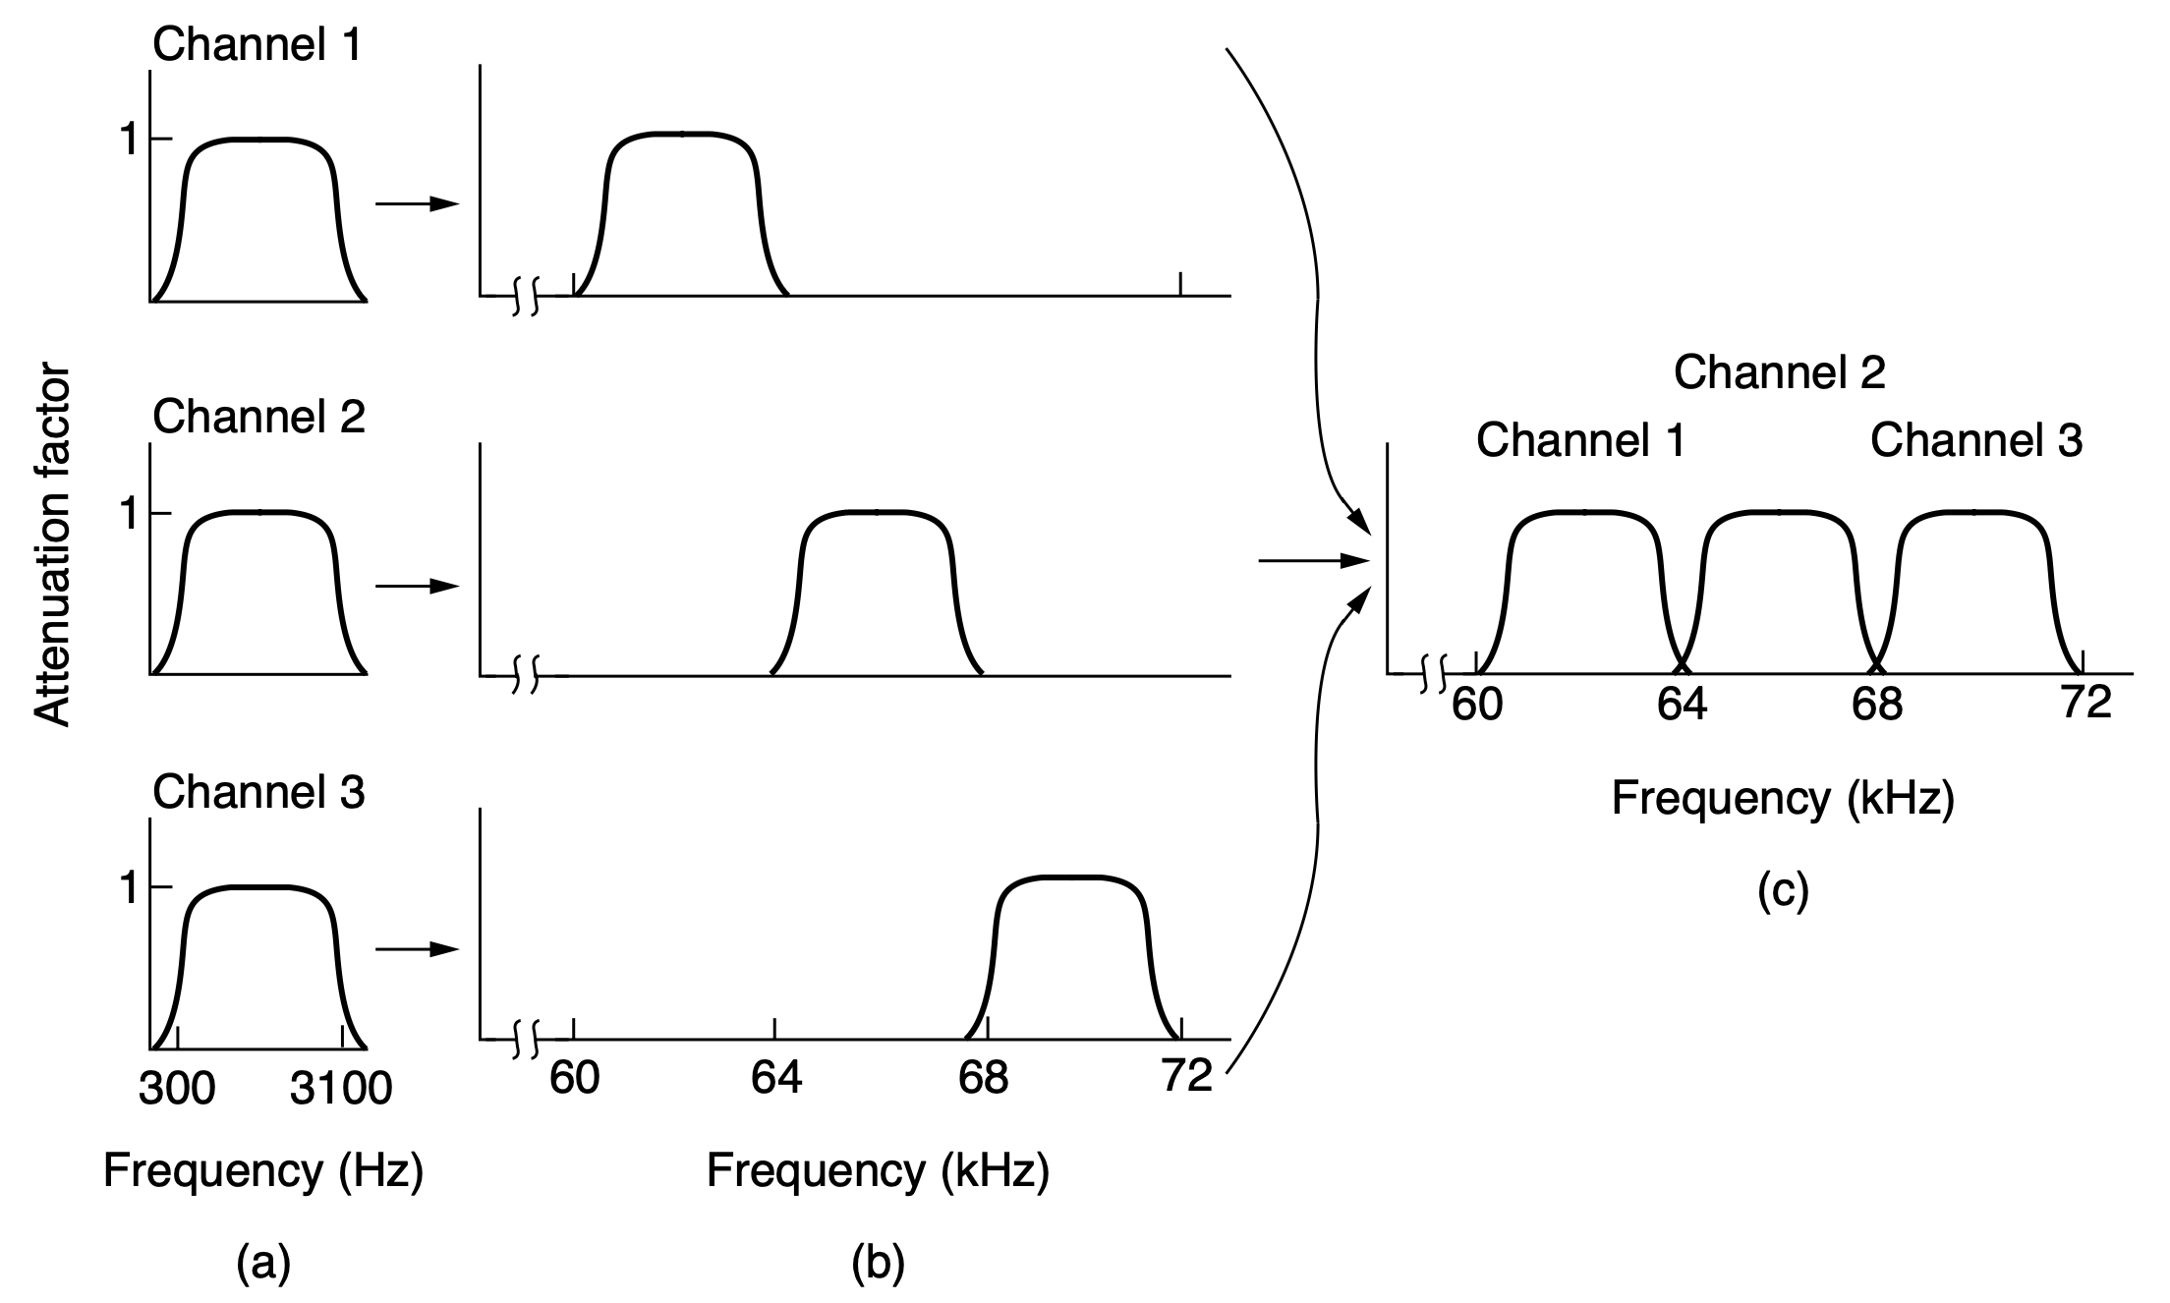
FDM
Telephone, celluar, terrestrial wirelss, and satellite networks
allocate 300~3100 Hz out of 4000 Hz, with excess bandwidth as guard band to keep channels well separated
Notes:
For a more detailed example, in Fig. 2-19 we see three voice-grade telephone
channels multiplexed using FDM. Filters limit the usable bandwidth to roughly
3100 Hz per voice-grade channel. When many channels are multiplexed together,
4000 Hz is allocated per channel. The excess bandwidth is called a guard band.
It keeps the channels well separated. First, the voice channels are raised in fre-
quency, each by a different amount. Then they can be combined because no two
channels now occupy the same portion of the spectrum. Notice that even though
there are gaps between the channels thanks to the guard bands, there is some over-
lap between adjacent channels. The overlap is there because real filters do not
have ideal sharp edges. This means that a strong spike at the edge of one channel
will be felt in the adjacent one as nonthermal noise.
This scheme has been used to multiplex calls in the telephone system for many
years, but multiplexing in time is now preferred instead. However, FDM continues
to be used in telephone networks, as well as cellular, terrestrial wireless, and satel-
lite networks at a higher level of granularity.

Slide 125

OFDM
Orthogonal Frequency Division Multiplexing divides bandwidth into subcarriers that are packed tightly together in the frquency domain
Notes:
When sending digital data, it is possible to divide the spectrum efficiently
without using guard bands. In OFDM (Orthogonal Frequency Division Multi-
plexing), the channel bandwidth is divided into many subcarriers that indepen-
dently send data (e.g., with QAM). The subcarriers are packed tightly together in
the frequency domain. Thus, signals from each subcarrier extend into adjacent
ones. However, as seen in Fig. 2-20, the frequency response of each subcarrier is
designed so that it is zero at the center of the adjacent subcarriers. The subcarriers
can therefore be sampled at their center frequencies without interference from their
neighbors. To make this work, a guard time is needed to repeat a portion of the
symbol signals in time so that they hav e the desired frequency response. However,
this overhead is much less than is needed for many guard bands.

Slide 126
OFDM
Frequency response of each subcarrier is zero at the center of the adjacent subcarriers; sample subcarriers at their center frequencies without interference
Notes:
When sending digital data, it is possible to divide the spectrum efficiently
without using guard bands. In OFDM (Orthogonal Frequency Division Multi-
plexing), the channel bandwidth is divided into many subcarriers that indepen-
dently send data (e.g., with QAM). The subcarriers are packed tightly together in
the frequency domain. Thus, signals from each subcarrier extend into adjacent
ones. However, as seen in Fig. 2-20, the frequency response of each subcarrier is
designed so that it is zero at the center of the adjacent subcarriers. The subcarriers
can therefore be sampled at their center frequencies without interference from their
neighbors. To make this work, a guard time is needed to repeat a portion of the
symbol signals in time so that they have the desired frequency response. However,
this overhead is much less than is needed for many guard bands.

Slide 127
OFDM
A guard time is needed to repeat a portion of the symbol signals in time so that they have the desired frequency response (like a training process)
Notes:
When sending digital data, it is possible to divide the spectrum efficiently
without using guard bands. In OFDM (Orthogonal Frequency Division Multi-
plexing), the channel bandwidth is divided into many subcarriers that indepen-
dently send data (e.g., with QAM). The subcarriers are packed tightly together in
the frequency domain. Thus, signals from each subcarrier extend into adjacent
ones. However, as seen in Fig. 2-20, the frequency response of each subcarrier is
designed so that it is zero at the center of the adjacent subcarriers. The subcarriers
can therefore be sampled at their center frequencies without interference from their
neighbors. To make this work, a guard time is needed to repeat a portion of the
symbol signals in time so that they have the desired frequency response. However,
this overhead is much less than is needed for many guard bands.

Slide 128
OFDM
Instead of separately modulating each subcarrier, implement OFDM efficiently in terms of a Fourier transform of a digital data over all subcarriers
Notes:
OFDM has been around for a long time, but it only began to be adopted in the
early 2000s, following the realization that it is possible to implement OFDM ef-
ficiently in terms of a Fourier transform of digital data over all subcarriers (instead
of separately modulating each subcarrier). OFDM is used in 802.11, cable net-
works, power-line networking, and fourth-generation (4G) cellular systems. Most
often, one high-rate stream of digital information is split into a number of low-rate
streams that are transmitted on the subcarriers in parallel. This division is valuable
because degradations of the channel are easier to cope with at the subcarrier level;
some subcarriers may be very degraded and excluded in favor of subcarriers that
are received well.

Slide 129
OFDM
One high-rate stream of digital information can be split into a number of low-rate streams to be transmitted on the subcarriers in parallel
Degradations of the channel are easier to cope with at the subcarrier level
Notes:
OFDM has been around for a long time, but it only began to be adopted in the
early 2000s, following the realization that it is possible to implement OFDM ef-
ficiently in terms of a Fourier transform of digital data over all subcarriers (instead
of separately modulating each subcarrier). OFDM is used in 802.11, cable net-
works, power-line networking, and fourth-generation (4G) cellular systems. Most
often, one high-rate stream of digital information is split into a number of low-rate
streams that are transmitted on the subcarriers in parallel. This division is valuable
because degradations of the channel are easier to cope with at the subcarrier level;
some subcarriers may be very degraded and excluded in favor of subcarriers that
are received well.

Slide 130
OFDM
802.11, cable networks, power-line networking, and 4G cellular systems
Notes:
OFDM has been around for a long time, but it only began to be adopted in the
early 2000s, following the realization that it is possible to implement OFDM ef-
ficiently in terms of a Fourier transform of digital data over all subcarriers (instead
of separately modulating each subcarrier). OFDM is used in 802.11, cable net-
works, power-line networking, and fourth-generation (4G) cellular systems. Most
often, one high-rate stream of digital information is split into a number of low-rate
streams that are transmitted on the subcarriers in parallel. This division is valuable
because degradations of the channel are easier to cope with at the subcarrier level;
some subcarriers may be very degraded and excluded in favor of subcarriers that
are received well.

Slide 131

TDM
Time Division Multiplexing lets users to take turns (round-robin) to periodically getting the entire bandwidth for a certain time interval (time slot)
For synchronization, use small intervals of guard time to accommodate small timing variations
Notes:
An alternative to FDM is TDM (Time Division Multiplexing). Here, the
users take turns (in a round-robin fashion), each one periodically getting the entire
bandwidth for a certain time interval. An example of three streams being multi-
plexed with TDM is shown in Fig. 2-21. Bits from each input stream are taken in a
fixed time slot and output to the aggregate stream. This stream runs at the sum rate
of the individual streams. For this to work, the streams must be synchronized in
time. Small intervals of guard time (analogous to a frequency guard band) may be
added to accommodate small timing variations.
TDM is used widely as key technique in the telephone and cellular networks.
To avoid one point of confusion, let us be clear that it is quite different from the al-
ternative STDM (Statistical Time Division Multiplexing). The prefix ‘‘statisti-
cal’’ is added to indicate that the individual streams contribute to the multiplexed
stream not on a fixed schedule, but according to the statistics of their demand.
STDM is fundamentally like packet switching under another name.

Slide 132
TDM
Time Division Multiplexing lets users to take turns (round-robin) to periodically getting the entire bandwidth for a certain time interval (time slot)
Telephone and cellular networks
Notes:
An alternative to FDM is TDM (Time Division Multiplexing). Here, the
users take turns (in a round-robin fashion), each one periodically getting the entire
bandwidth for a certain time interval. An example of three streams being multi-
plexed with TDM is shown in Fig. 2-21. Bits from each input stream are taken in a
fixed time slot and output to the aggregate stream. This stream runs at the sum rate
of the individual streams. For this to work, the streams must be synchronized in
time. Small intervals of guard time (analogous to a frequency guard band) may be
added to accommodate small timing variations.
TDM is used widely as key technique in the telephone and cellular networks.
To avoid one point of confusion, let us be clear that it is quite different from the al-
ternative STDM (Statistical Time Division Multiplexing). The prefix ‘‘statisti-
cal’’ is added to indicate that the individual streams contribute to the multiplexed
stream not on a fixed schedule, but according to the statistics of their demand.
STDM is fundamentally like packet switching under another name.

Slide 133
TDM
Time Division Multiplexing lets users to take turns (round-robin) to periodically getting the entire bandwidth for a certain time interval (time slot)
Telephone and cellular networks
Synchronous TDM:
assign fixed time slots to each user,
regardless of whether they have data to transmit
frame

Slide 134


TDM
STDM
Statistical Time Division Multiplexing allocates the entire bandwidth to individual users according to the statistics of their demand
Synchronous TDM:
frame number with each user having a fixed slot in the frame
Statistical TDM:
user number with a slot for the user
https://nriit.edu.in/files/IT-Notes/CN/UNIT-2.pdf
Notes:
::STDM (Statistical Time Division Multiplexing) and TDM (Time Division Multiplexing) are both techniques for sharing a communication channel among multiple users, but they differ in how they allocate bandwidth. TDM assigns fixed time slots to each user, regardless of whether they have data to transmit, while STDM dynamically allocates time slots based on actual data traffic, potentially improving efficiency.
TDM is used widely as key technique in the telephone and cellular networks.
To avoid one point of confusion, let us be clear that it is quite different from the al-
ternative STDM (Statistical Time Division Multiplexing). The prefix ‘‘statisti-
cal’’ is added to indicate that the individual streams contribute to the multiplexed
stream not on a fixed schedule, but according to the statistics of their demand.
STDM is fundamentally like packet switching under another name.

Slide 135
CDM
Code Division Multiplexing spreads out a narrowband signal over a wider frequency band (spread spectrum)
More tolerant of interference
Feasible for multiple signals from different users to share the same frequency band (also called as CDMA: Code Division Multiple Access)
Notes:
There is a third kind of multiplexing that works in a completely different way
than FDM and TDM. CDM (Code Division Multiplexing) is a form of spread
spectrum communication in which a narrowband signal is spread out over a wider
frequency band. This can make it more tolerant of interference, as well as allowing
multiple signals from different users to share the same frequency band. Because
code division multiplexing is mostly used for the latter purpose it is commonly
called CDMA (Code Division Multiple Access).

Slide 136
CDMA
Allow each station to transmit over the entire frequency spectrum all the time
Separate multiple simutaneous transmissions using coding theory
Cellular, satellite, and cable networks
Notes:
CDMA allows each station to transmit over the entire frequency spectrum all
the time. Multiple simultaneous transmissions are separated using coding theory.
Before getting into the algorithm, let us consider an analogy: an airport lounge
with many pairs of people conversing. TDM is comparable to pairs of people in
the room taking turns speaking. FDM is comparable to the pairs of people speak-
ing at different pitches, some high-pitched and some low-pitched such that each
pair can hold its own conversation at the same time as but independently of the oth-
ers. CDMA is somewhat comparable to each pair of people talking at once, but in
a different language. The French-speaking couple just hones in on the French,
rejecting everything that is not French as noise. Thus, the key to CDMA is to be
able to extract the desired signal while rejecting everything else as random noise.
A somewhat simplified description of CDMA follows.
As well as cellular networks, CDMA is used by satellites and cable networks.
We have glossed over many complicating factors in this brief introduction. Engin-
eers who want to gain a deep understanding of CDMA should read Viterbi (1995)
and Harte et al. (2012). These references require quite a bit of background in com-
munication engineering, however.

Slide 137
CDMA
Each data bit is encoded by an m-bit chip sequence (m users/stations)
Thus bit time is subdivided into m short intervals (chips)
Example: m = 8, chip sequence = (−1, −1, −1, +1, +1, −1, +1, +1) bit 1: send chip sequence per se (−1, −1, −1, +1, +1, −1, +1, +1) bit 0: send negation of chip sequence (+1, +1, +1, −1, −1, +1, −1, −1)
encoded by voltage levels
Notes:
In CDMA, each bit time is subdivided into m short intervals called chips,
which are multiplied against the original data sequence (the chips are a bit se-
quence, but are called chips so that the are not confused with the bits of the actual
message). Typically, there are 64 or 128 chips per bit, but in the example given
here we will use 8 chips/bit for simplicity. Each station is assigned a unique m-bit
code called a chip sequence. For pedagogical purposes, it is convenient to write
these codes as sequences of 1 and +1. We will show chip sequences in par-
entheses.
To transmit a 1 bit, a station sends its chip sequence. To transmit a 0 bit, it
sends the negation of its chip sequence. No other patterns are permitted. Thus, for
m = 8, if station A is assigned the chip sequence ( -1 -1 -1 +1 +1 -1 +1 +1), it
can send a 1 bit by transmitting the chip sequence and a 0 by transmitting its com-
plement: (+1 +1 +1 -1 -1 +1 -1 -1). It is really voltage levels that are sent,
but it is sufficient for us to think in terms of the sequences.
Increasing the amount of information to be sent from b bits/sec to mb
chips/sec for each station means that the bandwidth needed for CDMA is greater
by a factor of m than the bandwidth needed for a station not using CDMA (assum-
ing no changes in the modulation or encoding techniques). If we have a 1-MHz
band available for 100 stations, with FDM each one would have 10 kHz and could
send at 10 kbps (assuming 1 bit per Hz). With CDMA, each station uses the full
1 MHz, so the chip rate is 100 chips per bit to spread the station’s bit rate of 10
kbps across the channel.

Slide 138



CDMA
Unique and orthogonal chip sequences
Properties of normalized inner product:

Slide 139

CDMA
Example
chip sequences for four stations
signals the sequences represent
six examples of transmissions
recovery of station C’s signal
Notes:
Figure 2-22. (a) Chip sequences for four stations. (b) Signals the sequences
represent (c) Six examples of transmissions. (d) Recovery of station C’s signal.

Slide 140
WDM
Wavelength Division Multiplexing a form of FDM; multiplex signals onto an optical fiber using different wavelengths of light
DWDM: Dense WDM with a large number of channels and little space between each channel
Notes:
WDM (Wa velength Division Multiplexing) is a form of frequency division
multiplexing that multiplexes multiple signals onto an optical fiber using different
wavelengths of light. In Fig. 2-23, four fibers come together at an optical com-
biner, each with its energy present at a different wav elength. The four beams are
combined onto a single shared fiber for transmission to a distant destination. At the
far end, the beam is split up over as many fibers as there were on the input side.
Each output fiber contains a short, specially constructed core that filters out all but
one wav elength. The resulting signals can be routed to their destination or recom-
bined in different ways for additional multiplexed transport.
There is really nothing new here. This way of operating is just frequency di-
vision multiplexing at very high frequencies, with the term WDM referring to the
description of fiber optic channels by their wav elength or ‘‘color’’ rather than fre-
quency. As long as each channel has its own dedicated frequency (that is, its own
wavelength) range and all the ranges are disjoint, they can be multiplexed together
on the long-haul fiber. The only difference with electrical FDM is that an optical
system using a diffraction grating is completely passive and thus highly reliable.
The reason WDM is popular is that the energy on a single channel is typically
only a few gigahertz wide because that is the current limit of how fast we can con-
vert between electrical and optical signals. By running many channels in parallel
on different wav elengths, the aggregate bandwidth is increased linearly with the
number of channels. Since the bandwidth of a single fiber band is ca. 25,000 GHz
(see Fig. 2-5), there is theoretically room for 2500 10-Gbps channels even at 1
bit/Hz (and higher rates are also possible).
WDM technology has been progressing at a rate that puts computer technology
to shame. WDM was invented around 1990. The first commercially available sys-
tems had eight channels of 2.5 Gbps per channel; by 1998, systems with 40 chan-
nels of 2.5 Gbps were on the market and rapidly being adopted; by 2006, there
were products with 192 channels of 10 Gbps and 64 channels of 40 Gbps, capable
of moving up to 2.56 Tbps; by 2019, there were systems that can handle up to 160
channels, supporting more than 16 Tbps over a single fiber pair. That is 800 times
more capacity than the 1990 systems. The channels are also packed tightly on the
fiber, with 200, 100, or as little as 50 GHz of separation.
Narrowing the spacing to 12.5 GHz makes it possible to support 320 channels
on a single fiber, further increasing transmission capacity. Such systems with a
large number of channels and little space between each channel are referred to as
DWDM (Dense WDM). DWDM systems tend to be more expensive because they
must maintain stable wav elengths and frequencies, due to the close spacing of each
channel. As a result, these systems closely regulate their temperature to ensure that
frequencies are accurate.
Narrowing the spacing to 12.5 GHz makes it possible to support 320 channels
on a single fiber, further increasing transmission capacity. Such systems with a
large number of channels and little space between each channel are referred to as
DWDM (Dense WDM). DWDM systems tend to be more expensive because they
must maintain stable wav elengths and frequencies, due to the close spacing of each
channel. As a result, these systems closely regulate their temperature to ensure that
frequencies are accurate.

Slide 141

WDM
Example:
Notes:
In the example of Fig. 2-23, we have a fixed-wav elength system. Bits from
input fiber 1 go to output fiber 3, bits from input fiber 2 go to output fiber 1, etc.
However, it is also possible to build WDM systems that are switched in the optical
domain. In such a device, the output filters are tunable using Fabry-Perot or Mach-
Zehnder interferometers. These devices allow the selected frequencies to be
changed dynamically by a control computer. This ability provides a large amount
of flexibility to provision many different wav elength paths through the telephone
network from a fixed set of fibers. For more information about optical networks
and WDM, see Grobe and Eiselt (2013).

Slide 142

WDM
Example:
optical component for
separating light into its constituent wavelengths
https://www.edmundoptics.com/knowledge-center/application-notes/optics/ all-about-diffraction-gratings
Notes:
::A beam splitter and a diffraction grating are both optical components, but they serve different purposes. A beam splitter divides a light beam into two or more beams, while a diffraction grating separates light into its constituent wavelengths (colors).
In the example of Fig. 2-23, we have a fixed-wav elength system. Bits from
input fiber 1 go to output fiber 3, bits from input fiber 2 go to output fiber 1, etc.
However, it is also possible to build WDM systems that are switched in the optical
domain. In such a device, the output filters are tunable using Fabry-Perot or Mach-
Zehnder interferometers. These devices allow the selected frequencies to be
changed dynamically by a control computer. This ability provides a large amount
of flexibility to provision many different wav elength paths through the telephone
network from a fixed set of fibers. For more information about optical networks
and WDM, see Grobe and Eiselt (2013).

Slide 143

Comparison
timeline perspective
one user
per subchannel
all the time
one user
for the entire channel
per time slot
all users co-occupy
the entire channel
all the time
https://www.transnav.eu/Article_Analyses_of_Space_Division_Multiple_Ilcev,56,1065.html

Slide 144
Comparison
timeline perspective
one user
per subchannel
all the time
one user
for the entire channel
per time slot
all users co-occupy
the entire channel
all the time
given the same channel/bandwidth/frequency-range,
all are limited to this bandwidth and a common maximum data rate
https://www.transnav.eu/Article_Analyses_of_Space_Division_Multiple_Ilcev,56,1065.html
Notes:
High frequency (Hz, number of wave cycles per second) usually yields high data rate (bps, number of bits per second)
Bandwidth is a range of frequency (from its lowest frequency to its highest frequency),, a signal can select a specific value of frequency within this bandwidth for data transmission

Slide 145
Comparison
timeline perspective
one user
per subchannel
all the time
one user
for the entire channel
per time slot
all users co-occupy
the entire channel
all the time
TDMA employs one user to run the entire task;
FDMA employs multiple users to collaborate on the same task; each runs part of the task
in parallel
m chip bits per
time instance;
yet 1/m data bit
per user
https://www.transnav.eu/Article_Analyses_of_Space_Division_Multiple_Ilcev,56,1065.html

Slide 146

Chapter 2.1-2.4
Notes:
The following content corresponds to chapter 2 (mostly 2.1 – 2.4)

Slide 147
?

Slide 148

Thank You
be brave

Slide 149

toast to the ones here today

Slide 150
#What’s More
Why Get a Ph.D.? by Nick Feamster
3 Qualities of Successful Ph.D. Students: Perseverance, Tenacity, and Cogency by Matt Might
So Long, and Thanks for the Ph.D.!
by Ronald Azuma
Applying to Ph.D. Programs in Computer Science
by Mor Harchol-Balter

Slide 151
#What’s More
Graduate School: Keys To Success
by Remzi Arpaci-Dusseau
What My Mentors Taught Me
by Shan Lu

