Slide 1
The Physical Layer
Systems
05
Kai Bu
kaibu@zju.edu.cn
http://list.zju.edu.cn/kaibu/compnet2026

Slide 2
The Physical Layer
Systems
public switched telephone network
cellular networks
cable networks
communication satellites

Slide 3
The Physical Layer
Systems
public switched telephone network
cellular networks
cable networks
communication satellites

Slide 4
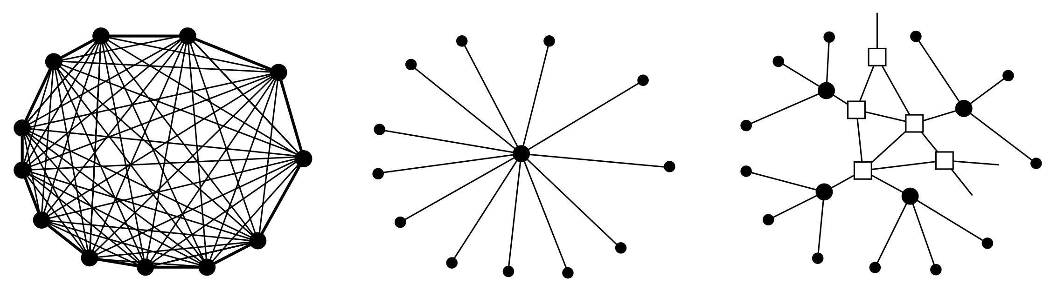
PSTN Structure
How to help a telephone owner to talk to n other telephone owners?
switch for switches
switch for users
switch for users
fully interconnected
centralized switch
two-level hierarchy
Notes:
Soon after Alexander Graham Bell patented the telephone in 1876 (just a few
hours ahead of his rival, Elisha Gray), there was an enormous demand for his new
invention. The initial market was for the sale of telephones, which came in pairs.
It was up to the customer to string a single wire between them. If a telephone
owner wanted to talk to n other telephone owners, separate wires had to be strung
to all n houses. Within a year, the cities were covered with wires passing over
houses and trees in a wild jumble. It became immediately obvious that the model
of connecting every telephone to every other telephone, as shown in Fig. 2-24(a),
was not going to work.
To his credit, Bell saw this problem early on and formed the Bell Telephone
Company, which opened its first switching office (in New Hav en, Connecticut) in
1878. The company ran a wire to each customer’s house or office. To make a call,
the customer would crank the phone to make a ringing sound in the telephone com-
pany off ice to attract the attention of an operator, who would then manually con-
nect the caller to the callee by using a short jumper cable. The model of a single
switching office is illustrated in Fig. 2-24(b).
Pretty soon, Bell System switching offices were springing up everywhere and
people wanted to make long-distance calls between cities, so the Bell System
began to connect the switching offices. The original problem soon returned: to
connect every switching office to every other switching office by means of a wire
between them quickly became unmanageable, so second-level switching offices
were invented. After a while, multiple second-level off ices were needed, as illus-
trated in Fig. 2-24(c). Eventually, the hierarchy grew to fiv e levels.

Slide 5
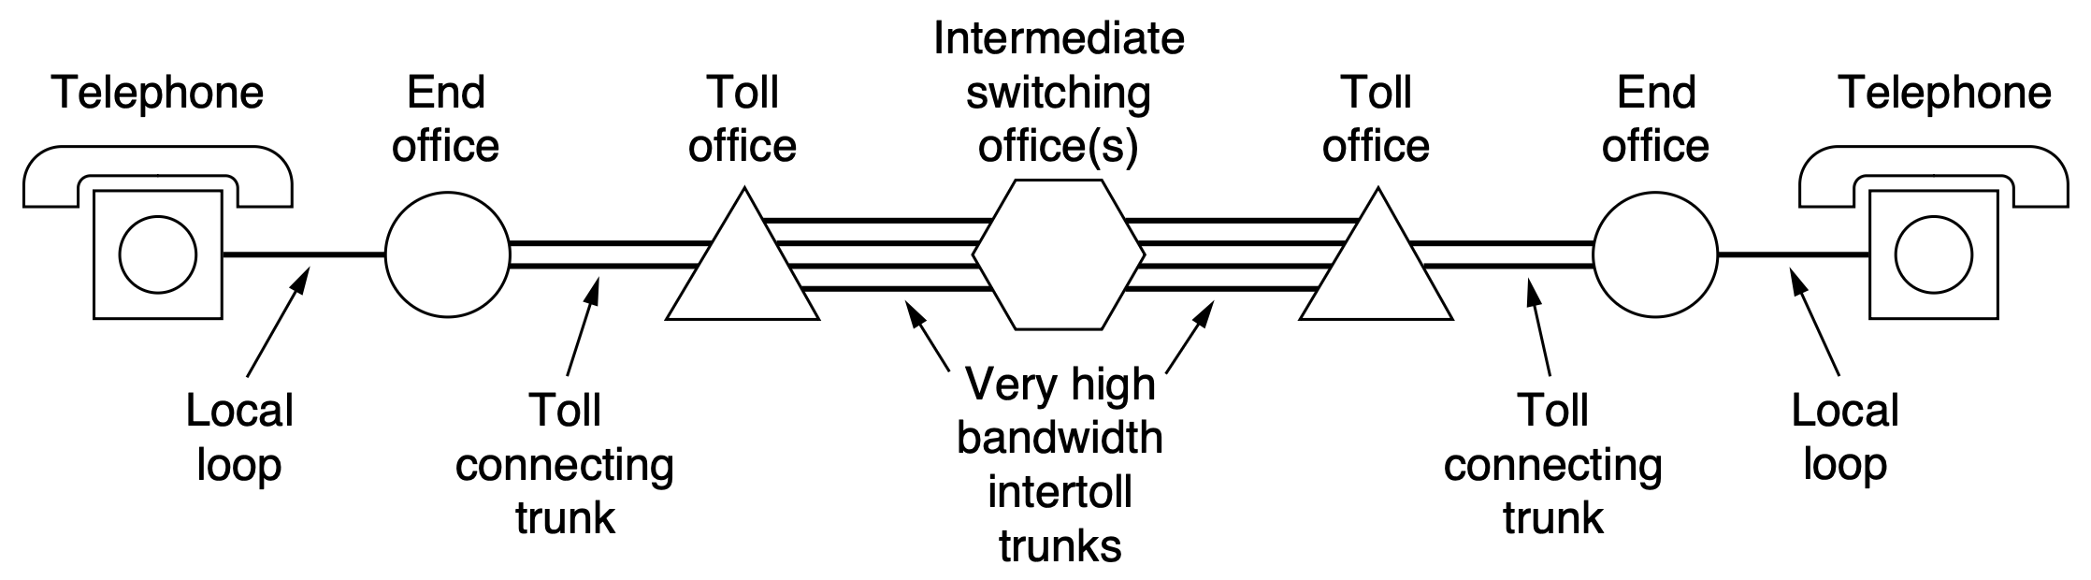
PSTN Structure
How to help a telephone owner to talk to a long-distance telephone owner?
switch for switches
digital
digital
digital
digital
analog
analog
switch for users
switch for users
category 3
twisted pairs;
fiber
coaxial cables;
microwaves;
fiber optics
Notes:
A variety of transmission media are used for telecommunication. Unlike mod-
ern office buildings, where the wiring is commonly Category 5 or Category 6, local
loops to homes mostly consist of Category 3 twisted pairs, although some local
loops are now fiber, as well. Coaxial cables, microwaves, and especially fiber
optics are widely used between switching offices.
In the past, transmission throughout the telephone system was analog, with the
actual voice signal being transmitted as an electrical voltage from source to desti-
nation. With the advent of fiber optics, digital electronics, and computers, all the
trunks and switches are now digital, leaving the local loop as the last piece of ana-
log technology in the system. Digital transmission is preferred because it is not
necessary to accurately reproduce an analog wav eform after it has passed through
many amplifiers on a long call. Being able to correctly distinguish a 0 from a 1 is
enough. This property makes digital transmission more reliable than analog. It is
also cheaper and easier to maintain.
In summary, the telephone system consists of three major components:
1. Local loops (analog twisted pairs between end offices and local
houses and businesses).
2. 3. Trunks (very high-bandwidth digital fiber-optic links connecting the
switching offices).
Switching offices (where calls are moved from one trunk to another
either electrically or optically).
The local loops provide everyone access to the whole system, so they are critical.
Unfortunately, they are also the weakest link in the system. The main challenge
for long-haul trunks involves collecting multiple calls and sending them out over
the same fiber, which is done using wav elength division multiplexing (WDM).
Finally, there are two fundamentally different ways of doing switching: circuit
switching and packet switching. We will look at both.

Slide 6
Local Loop:
Telephone Modems
Send digital data between computers over the narrow channel the telephone network provides for a voice call
Modem (modulator demodulator) convert between a stream of digital bits and an analog signal that represents the bits
Telephone modems, DSL modems, cable modems, and wireless modems
Notes:
In this section, we will study the local loop, both old and new. We will cover
telephone modems, ADSL, and fiber to the home. In some places, the local loop
has been modernized by installing optical fiber to (or at least very close to) the
home. These installations support computer networks from the ground up, with the
local loop having ample bandwidth for data services. Unfortunately, the cost of
laying fiber to homes is substantial. Sometimes, it is done when local city streets
are dug up for other purposes; some municipalities, especially in densely populated
urban areas, have fiber local loops. By and large, however, fiber local loops are the
exception, but they are clearly the future.
Most people are familiar with the two-wire local loop coming from a telephone
company end office into houses. The local loop is also frequently referred to as the
‘‘last mile,’’ although the length can be up to several miles. Much effort has been
devoted to squeezing data networking out of the copper local loops that are already
deployed. Telephone modems send digital data between computers over the nar-
row channel the telephone network provides for a voice call. They were once
widely used, but have been largely displaced by broadband technologies such as
ADSL that reuse the local loop to send digital data from a customer to the end
office, where they are siphoned off to the Internet. Both modems and ADSL must
deal with the limitations of old local loops: relatively narrow bandwidth, attenua-
tion and distortion of signals, and susceptibility to electrical noise such as
crosstalk.
To send bits over the local loop, or any other physical channel for that matter,
they must be converted to analog signals that can be transmitted over the channel.
This conversion is accomplished using the methods for digital modulation that we
studied in the previous section. At the other end of the channel, the analog signal
is converted back to bits.
A device that converts between a stream of digital bits and an analog signal
that represents the bits is called a modem, which is short for ‘‘modulator demodu-
lator.’’ Modems come in many varieties, including telephone modems, DSL
modems, cable modems, and wireless modems. In the case of a cable or DSL
modem, the device is typically a separate piece of hardware that sits in between the
physical line coming into the house and the rest of the network inside the home.
Wireless devices typically have their own built-in modems. Logically, the modem
is inserted between the (digital) computer and the (analog) telephone system, as
seen in Fig. 2-26.

Slide 7
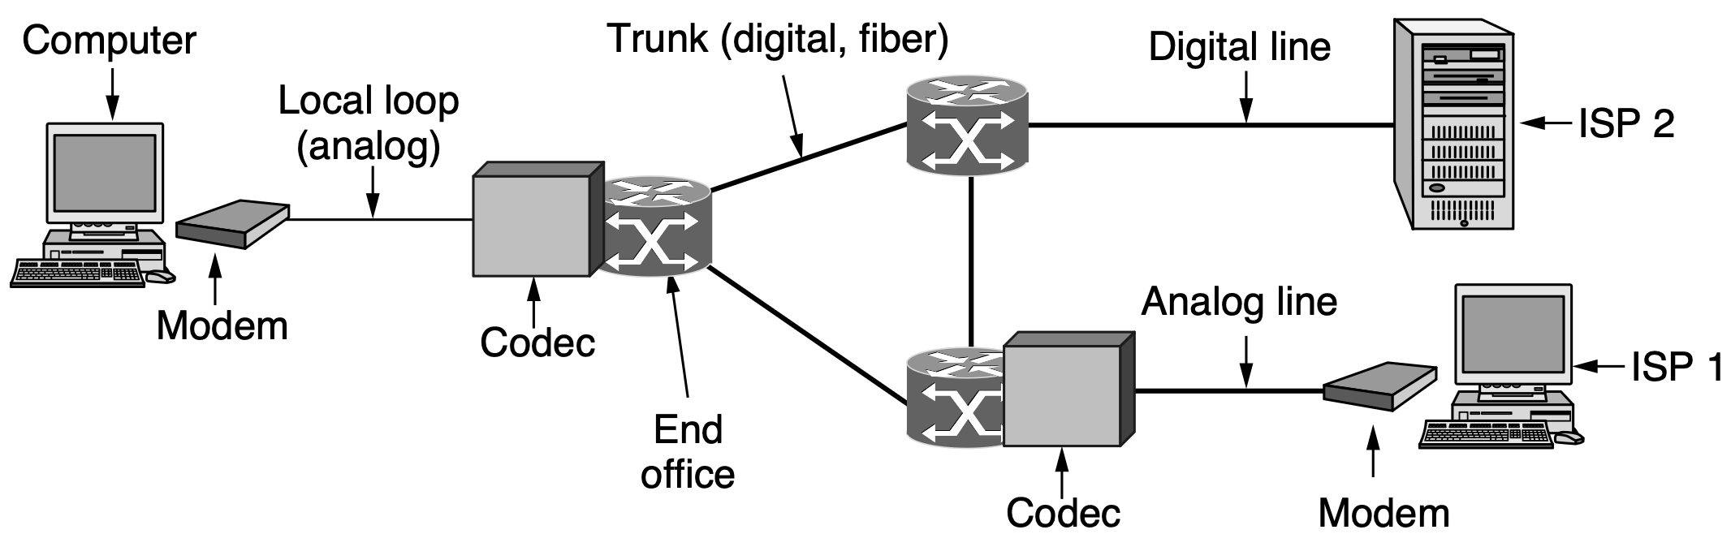
Local Loop:
Telephone Modems
Modem (modulator demodulator)
Codec (coder-decoder) convert between an analog signal and digital bits that represents the signal
Notes:
In this section, we will study the local loop, both old and new. We will cover
telephone modems, ADSL, and fiber to the home. In some places, the local loop
has been modernized by installing optical fiber to (or at least very close to) the
home. These installations support computer networks from the ground up, with the
local loop having ample bandwidth for data services. Unfortunately, the cost of
laying fiber to homes is substantial. Sometimes, it is done when local city streets
are dug up for other purposes; some municipalities, especially in densely populated
urban areas, have fiber local loops. By and large, however, fiber local loops are the
exception, but they are clearly the future.
Most people are familiar with the two-wire local loop coming from a telephone
company end office into houses. The local loop is also frequently referred to as the
‘‘last mile,’’ although the length can be up to several miles. Much effort has been
devoted to squeezing data networking out of the copper local loops that are already
deployed. Telephone modems send digital data between computers over the nar-
row channel the telephone network provides for a voice call. They were once
widely used, but have been largely displaced by broadband technologies such as
ADSL that reuse the local loop to send digital data from a customer to the end
office, where they are siphoned off to the Internet. Both modems and ADSL must
deal with the limitations of old local loops: relatively narrow bandwidth, attenua-
tion and distortion of signals, and susceptibility to electrical noise such as
crosstalk.
To send bits over the local loop, or any other physical channel for that matter,
they must be converted to analog signals that can be transmitted over the channel.
This conversion is accomplished using the methods for digital modulation that we
studied in the previous section. At the other end of the channel, the analog signal
is converted back to bits.
A device that converts between a stream of digital bits and an analog signal
that represents the bits is called a modem, which is short for ‘‘modulator demodu-
lator.’’ Modems come in many varieties, including telephone modems, DSL
modems, cable modems, and wireless modems. In the case of a cable or DSL
modem, the device is typically a separate piece of hardware that sits in between the
physical line coming into the house and the rest of the network inside the home.
Wireless devices typically have their own built-in modems. Logically, the modem
is inserted between the (digital) computer and the (analog) telephone system, as
seen in Fig. 2-26.

Slide 8
Local Loop:
Telephone Modems
modem standard | baud rate | bits per symbol | data rate bps
V.32 | 2400 | 4 (of 5) | 9600
V.32 bis | 2400 | 6 (of 7) | 14400
V.34 | 2400 | 12 | 28800
V.34 bis | 2400 | 14 | 33360
V.90 | 8000 downstream, 2400 upstream | 7 (of 8) downstream, 14 upstream | 56000 downstream, 33360 upstream V.34
V.92 | 8000 downstream | 7 (of 8) downstream | 56000 downstream, 48000 upstream
Notes:
https://datacommandnet.blogspot.com/p/dial-up-modems.html
https://en.wikipedia.org/wiki/List_of_ITU-T_V-series_recommendations
V.90 is an ITU-T recommendation for a modem, allowing 56 kbit/s digital download and 33.6 kbit/s analog upload. It replaced two vendor standards (K56flex and X2) and was designed to allow modems from both prior standards to be flash upgraded to support it. It is also known as V.Last as it was anticipated to be the last standard for modems operating near the channel capacity of POTS lines to be developed. V.90 is generally used in concert with the V.42bis compression standard.
V.92 is an ITU-T recommendation, titled Enhancements to Recommendation V.90, that establishes a modem standard allowing 56 kbit/s download, 48 kbit/s upload rates, and the new V.44 compression method. It is intended to succeed the V.90 standards. With V.92, PCM is used for both the upstream and downstream connections; previously 56K modems only used PCM for downstream data.

Slide 9
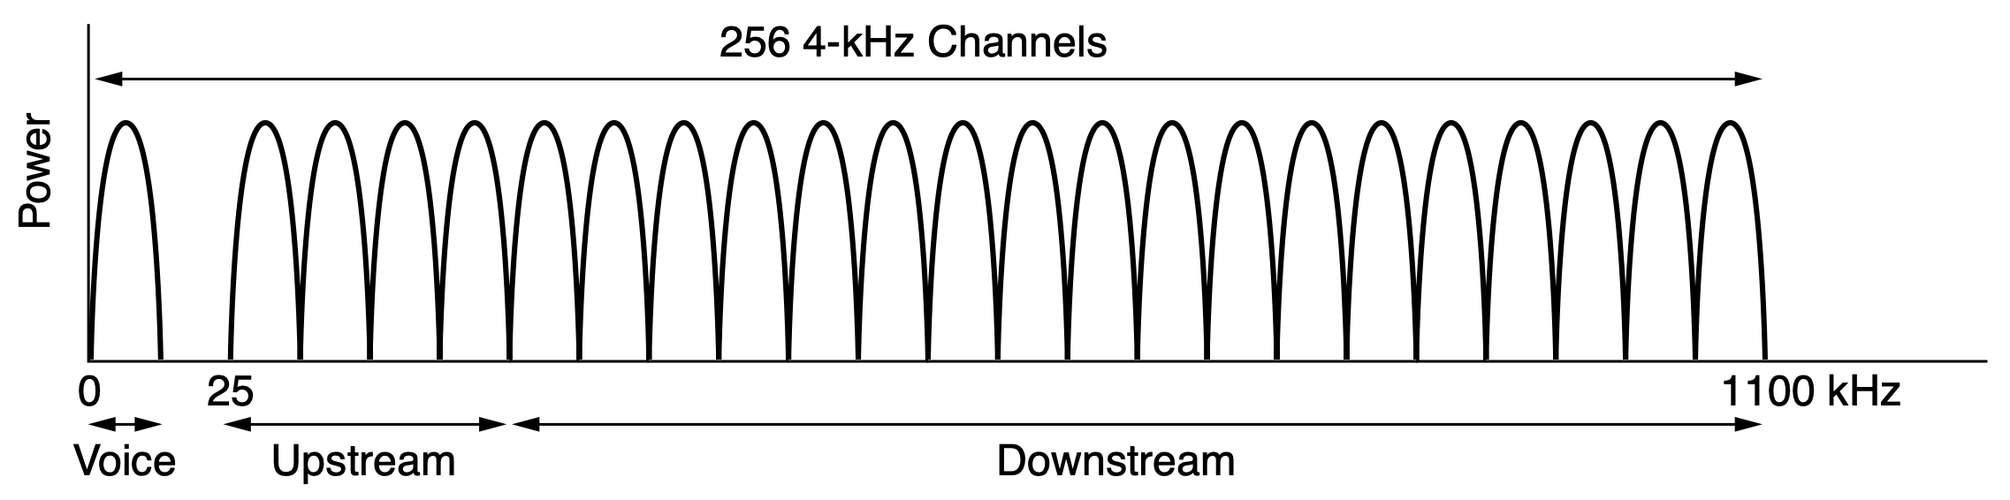
Local Loop:
Digital Subscriber Lines
ADSL: Asymmetric DSL divide 1.1-MHz spectrum on local loop into 256 independent 4312.5-Hz channels; use OFDM to send data (DMT: Discrete Telephone Service)
Notes:
To meet the technical goals, the available 1.1-MHz spectrum on the local loop
is divided into 256 independent channels of 4312.5 Hz each. This arrangement is
shown in Fig. 2-29. The OFDM scheme, which we saw in the previous section, is
used to send data over these channels, though it is often called DMT (Discrete
MultiTone) in the context of ADSL. Channel 0 is used for POTS (Plain Old
Telephone Service). Channels 1–5 are not used, to keep the voice and data signals
from interfering with each other. Of the remaining 250 channels, one is used for
upstream control and one is used for downstream control. The rest are available
for user data.

Slide 10
Local Loop:
Digital Subscriber Lines
ADSL: Asymmetric DSL
Channel 0: POTS (Plain Olad Telephone Service)
Channels 1-5: idle to keep the voice and data signals from interfering with each other
Notes:
To meet the technical goals, the available 1.1-MHz spectrum on the local loop
is divided into 256 independent channels of 4312.5 Hz each. This arrangement is
shown in Fig. 2-29. The OFDM scheme, which we saw in the previous section, is
used to send data over these channels, though it is often called DMT (Discrete
MultiTone) in the context of ADSL. Channel 0 is used for POTS (Plain Old
Telephone Service). Channels 1–5 are not used, to keep the voice and data signals
from interfering with each other. Of the remaining 250 channels, one is used for
upstream control and one is used for downstream control. The rest are available
for user data.

Slide 11
Local Loop:
Digital Subscriber Lines
ADSL: Asymmetric DSL
Channels 6-255: one for upstream control, one for downstream control, and the rest for user data (32 for upstream and the rest for downstream since most users download more data than they upload)
Notes:
In principle, each of the remaining channels can be used for a full-duplex data
stream, but harmonics, crosstalk, and other effects keep practical systems well
below the theoretical limit. It is up to the provider to determine how many chan-
nels are available for upstream and how many for downstream. A 50/50 mix of
upstream and downstream is technically possible, but most providers allocate
something like 80–90% of the bandwidth to the downstream channel since most
users download more data than they upload. This choice gives rise to the ‘‘A’’ in
ADSL. A common split is 32 channels for upstream and the rest downstream. It is
also possible to have a few of the highest upstream channels be bidirectional for in-
creased bandwidth, although making this optimization requires adding a special
circuit to cancel echoes.

Slide 12
Local Loop:
Digital Subscriber Lines
Each channel uses QAM modulation at a rate of roughly 4000 symbols/second
DSL standard | year | data rate Mps downstream | data rate Mps upstream
G.dmt | 1999 | 8 | 1
ADSL2 | 2002 | 12 | 1
ADSL2+ | 2006 | 24 | 1
VDSL | 2006 | 52 | 3
VDSL2 | 2006 | 200 | 100
Vplus | 2015 | 300 | 100
Notes:
The international ADSL standard, known as G.dmt, was approved in 1999. It
allows speeds of as much as 8 Mbps downstream and 1 Mbps upstream. It was
superseded by a second generation in 2002, called ADSL2, with various im-
provements to allow speeds of as much as 12 Mbps downstream and 1 Mbps
upstream. ADSL2+ doubles the downstream throughput to 24 Mbps by doubling
the bandwidth to use 2.2 MHz over the twisted pair.
The next improvement (in 2006) was VDSL, which pushed the data rate over
the shorter local loops to 52 Mbps downstream and 3 Mbps upstream. Then, a
series of new standards from 2007 to 2011, going under the name of VDSL2, on
high-quality local loops managed to use 12-MHz bandwidth and achieve data rates
of 200 Mbps downstream and 100 Mbps upstream. In 2015, Vplus was proposed
for local loops shorter than 250 m. In principle, it can achieve 300 Mbps down-
stream and 100 Mbps upstream, but making it work in practice is not easy. We may
be near the end of the line here for existing Category 3 wiring, except maybe for
even shorter distances.
Within each channel, QAM modulation is used at a rate of roughly 4000 symb-
ols/sec. The line quality in each channel is constantly monitored and the data rate
is adjusted by using a larger or smaller constellation, like those in Fig. 2-17. Dif-
ferent channels may have different data rates, with up to 15 bits per symbol sent on
a channel with a high SNR, and down to 2, 1, or no bits per symbol sent on a chan-
nel with a low SNR depending on the standard.

Slide 13
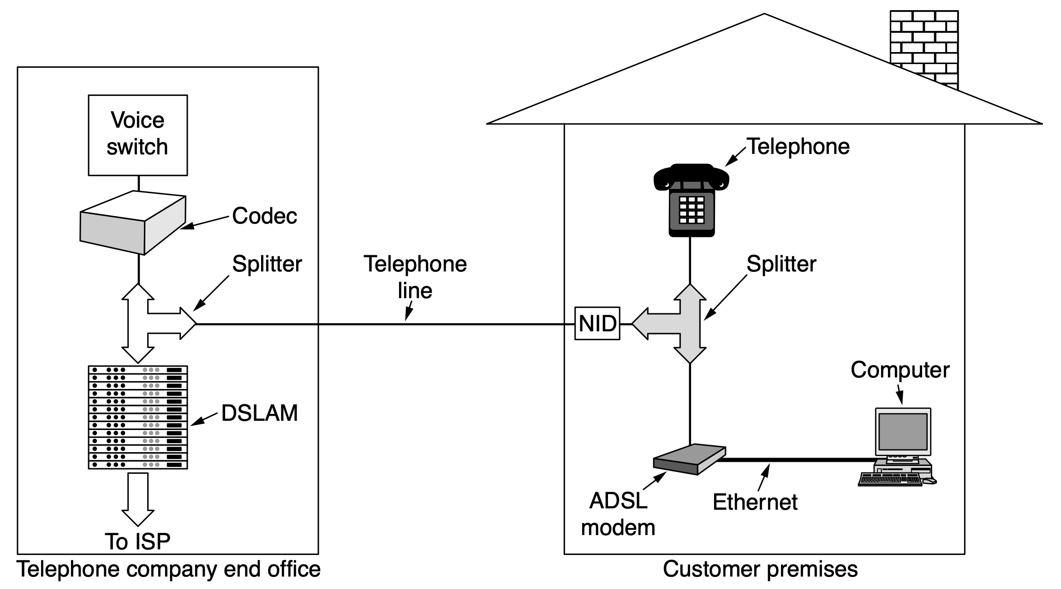
Local Loop:
Digital Subscriber Lines
analog filter to separate POTS from data
network interface device
DSL Access Multiplexer
convert signal to bits
send packets to network
Notes:
POTS: Plain Old Telephone Service
A typical ADSL arrangement is shown in Fig. 2-30. In this scheme, a tele-
phone company technician must install a NID (Network Interface Device) on the
customer’s premises. This small plastic box marks the end of the telephone com-
pany’s property and the start of the customer’s property. Close to the NID (or
sometimes combined with it) is a splitter, an analog filter that separates the
0–4000-Hz band used by POTS from the data. The POTS signal is routed to the
existing telephone or fax machine. The data signal is routed to an ADSL modem,
which uses digital signal processing to implement OFDM. Since most ADSL
modems are external, the computer must be connected to them at high speed.
Usually, this is done using Ethernet, a USB cable, or 802.11.

Slide 14
Local Loop:
Digital Subscriber Lines
Bonding creates a virtual DSL connection by combining two or more physical DSL connections
G.fast standard achieves symmetric speeds about 1 Gbps at distance of 100 meters
FTTdp (Fiber to the Distribution Point) brings fiber to a DP of hundreds of subscribers and then uses copper to transmit data to the home
Notes:
The next frontier for DSL deployments is to reach transmission speeds of
1 Gbps and higher. These efforts are focusing on a variety of complementary tech-
niques, including a technique called bonding, which creates a single virtual DSL
connection by combining two or more physical DSL connections. Obviously, if
one combines two twisted pairs, one should be able to double the bandwidth. In
some places, the telephone wires entering houses use a cable that in fact has two
twisted pairs. The original idea was to allow two separate telephone lines and num-
bers in the house, but by using pair bonding, a single higher-speed Internet con-
nection can be achieved. Increasing numbers of ISPs in Europe, Australia, Cana-
da, and the United States are already deploying a technology called G.fast that
uses pair bonding. As with other forms of DSL, the performance of G.fast depends
on the distance of the transmission; recent tests have seen symmetric speeds ap-
proaching 1 Gbps at distances of 100 meters. When coupled with a fiber deploy-
ment known as FTTdp (Fiber to the Distribution Point), which brings fiber to a
distribution point of several hundred subscribers and uses copper to transmit data
the rest of the way to the home (in VDSL2, this may be up to 1 kilometer, although
at lower speeds). FTTdp is just one type of fiber deployment that takes fiber from
the core of the network to some point close to the network edge. The next section
describes various modes of fiber deployment.

Slide 15
Local Loop:
Fiber To The X
Also as fiber in the loop because some amount of fiber is used in the local loop
FTTH: Fiber To The Home
FTTN: Fiber To The Node/Neighborhood whereby fiber is terminated in a cabinet on a street sometimes several miles from the customer home
FTTdp brings fiber to within a few meters of the customer premises
FTTC: Fiber to the Curb
Notes:
The speed of last-mile networks is often constrained by the copper cables used
in conventional telephone networks, which cannot transmit data at high rates over
as long a distance as fiber. Thus, an ultimate goal, where it is cost effective, is to
bring fiber all the way to a customer home, sometimes called FTTH (Fiber to the
Home). Telephone companies continue to try to improve the performance of the
local loop, often by deploying fiber as far as they can to the home. If not directly to
the home itself, the company may provide FTTN (Fiber to the Node) (or neigh-
borhood), whereby fiber is terminated in a cabinet on a street sometimes several
miles from the customer home. Fiber to the Distribution Point (FTTdp), as men-
tioned above, moves fiber one step closer to the customer home, often bringing
fiber to within a few meters of the customer premises. In between these options is
FTTC (Fiber to the Curb). All of these FTTX (Fiber to the X) designs are
sometimes also called ‘‘fiber in the loop’’ because some amount of fiber is used in
the local loop.

Slide 16
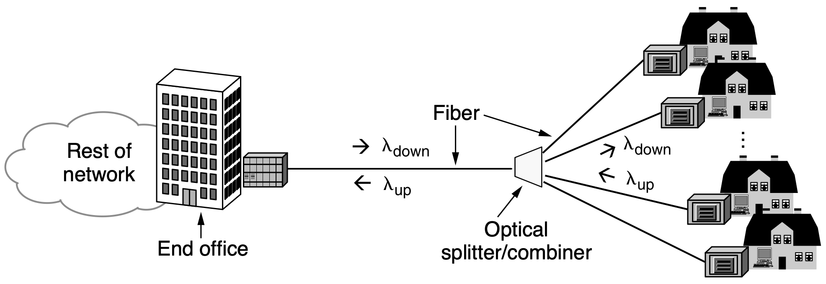
Local Loop:
FTTH
PON: Passive Optical Network
GPON: Gigabit-cable PON
EPON: Ethernet PON
2.4 Gbps downstream, 1.2/2.4 Gbps upstream
Notes:
Like the copper wires before it, the fiber local loop is passive, which means no
powered equipment is required to amplify or otherwise process signals. The fiber
simply carries signals between the home and the end office. This, in turn, reduces
cost and improves reliability. Usually, the fibers from the houses are joined toget-
her so that only a single fiber reaches the end office per group of up to 100 houses.
In the downstream direction, optical splitters divide the signal from the end office
so that it reaches all the houses. Encryption is needed for security if only one
house should be able to decode the signal. In the upstream direction, optical com-
biners merge the signals from the houses into a single signal that is received at the
end office.
This architecture is called a PON (Passive Optical Network), and it is shown
in Fig. 2-31. It is common to use one wav elength shared between all the houses
for downstream transmission, and another wav elength for upstream transmission.
Even with the splitting, the tremendous bandwidth and low attenuation of fiber
mean that PONs can provide high rates to users over distances of up to 20 km. The
actual data rates and other details depend on the type of PON. Two kinds are com-
mon. GPONs (Gigabit-capable PONs) come from the world of telecommunica-
tions, so they are defined by an ITU standard. EPONs (Ethernet PONs) are more
in tune with the world of networking, so they are defined by an IEEE standard.
Both run at around a gigabit and can carry traffic for different services, including
Internet, video, and voice. For example, GPONs provide 2.4 Gbps downstream
and 1.2 or 2.4 Gbps upstream.
Additional protocols are needed to share the capacity of the single fiber at the
end office between the different houses. The downstream direction is quite easy.
The end office can send messages to each different house in whatever order it likes.
In the upstream direction, however, messages from different houses cannot be sent
at the same time, or different signals would collide. The houses also cannot hear
each other’s transmissions so they cannot listen before transmitting. The solution
is that equipment at the houses requests and is granted time slots to use by equip-
ment in the end office. For this to work, there is a ranging process to adjust the
transmission times from the houses so that all the signals received at the end office
are synchronized. The design is similar to cable modems, which we cover later in
this chapter. For more information on PONs, see Grobe and Elbers (2008) or
Andrade et al. (2014).

Slide 17
Trunk
Much faster than local loop
Carry digital information (bits instead of voice)
End office converts analog information to digital information for transmission

Slide 18
Trunk:
Digitizing Voice Signals
End office uses codec (coder-decoder) to digitize analog signals to using PCM (Pulse Code Modulation)
8000 samples/second, 125 𝜇s/sample
Standard uncompressed data rate for a voice-grade telephone call: 64 kbps, 8 bits every 125 𝜇s

Slide 19
Trunk:
Digitizing Voice Signals
Quantization levels of signal amplitude are unevenly spaced
Companding: a logarithmic scale gives relatively more bits to smaller signal amplitudes and relatively fewer bits to large signal amplitudes
The error due to quantization is proportional to the signal amplitude
Notes:
Each sample of the amplitude of the signal is quantized to an 8-bit number. To
reduce the error due to quantization, the quantization levels are unevenly spaced. A
logarithmic scale is used that gives relatively more bits to smaller signal ampli-
tudes and relatively fewer bits to large signal amplitudes. In this way, the error is
proportional to the signal amplitude. Tw o versions of quantization are widely
used: µ-law, used in North America and Japan, and A-law, used in Europe and the
rest of the world. Both versions are specified in standard ITU G.711. An equiv-
alent way to think about this process is to imagine that the dynamic range of the
signal (or the ratio between the largest and smallest possible values) is compressed
before it is (evenly) quantized, and then expanded when the analog signal is
recreated. For this reason, it is called companding. It is also possible to compress
the samples after they are digitized so that they require much less than 64 kbps.
However, we will leave this topic for when we explore audio applications such as
voice over IP.
At the other end of the call, an analog signal is recreated from the quantized
samples by playing them out (and smoothing them) over time. It will not be exact-
ly the same as the original analog signal, even though we sampled at the Nyquist
rate, because the samples were quantized.

Slide 20
Trunk:
Digitizing Voice Signals
Quantization levels of signal amplitude are unevenly spaced
Companding: a logarithmic scale gives relatively more bits to smaller signal amplitudes and relatively fewer bits to large signal amplitudes
ITU G.711 Standard: 𝜇-law in North America and Japan; A-law in Europe and the rest of the world
Notes:
Each sample of the amplitude of the signal is quantized to an 8-bit number. To
reduce the error due to quantization, the quantization levels are unevenly spaced. A
logarithmic scale is used that gives relatively more bits to smaller signal ampli-
tudes and relatively fewer bits to large signal amplitudes. In this way, the error is
proportional to the signal amplitude. Tw o versions of quantization are widely
used: µ-law, used in North America and Japan, and A-law, used in Europe and the
rest of the world. Both versions are specified in standard ITU G.711. An equiv-
alent way to think about this process is to imagine that the dynamic range of the
signal (or the ratio between the largest and smallest possible values) is compressed
before it is (evenly) quantized, and then expanded when the analog signal is
recreated. For this reason, it is called companding. It is also possible to compress
the samples after they are digitized so that they require much less than 64 kbps.
However, we will leave this topic for when we explore audio applications such as
voice over IP.
At the other end of the call, an analog signal is recreated from the quantized
samples by playing them out (and smoothing them) over time. It will not be exact-
ly the same as the original analog signal, even though we sampled at the Nyquist
rate, because the samples were quantized.

Slide 21
Trunk:
T-Carrier
Multiplex digital signals on the phone network by sending a sample from each call every 125 𝜇s
T1 carrier consists of 24 voice channels multiplexed together
Each of the 24 channels, in turn, inserts 8 bits into the output stream
193 bits every frame per 125 𝜇s: a frame consists of 24 x 8 = 192 bits plus one extra bit for control purposes

Slide 22
Trunk:
T1-Carrier
Multiplex digital signals on the phone network by sending a sample from each call every 125 𝜇s
Each of the 24 channels, in turn, inserts 8 bits into the output stream
193 bits every frame per 125 𝜇s
Bit rate: 8000 samples per second 193 bits x 8000 = 1.544 Mbps

Slide 23
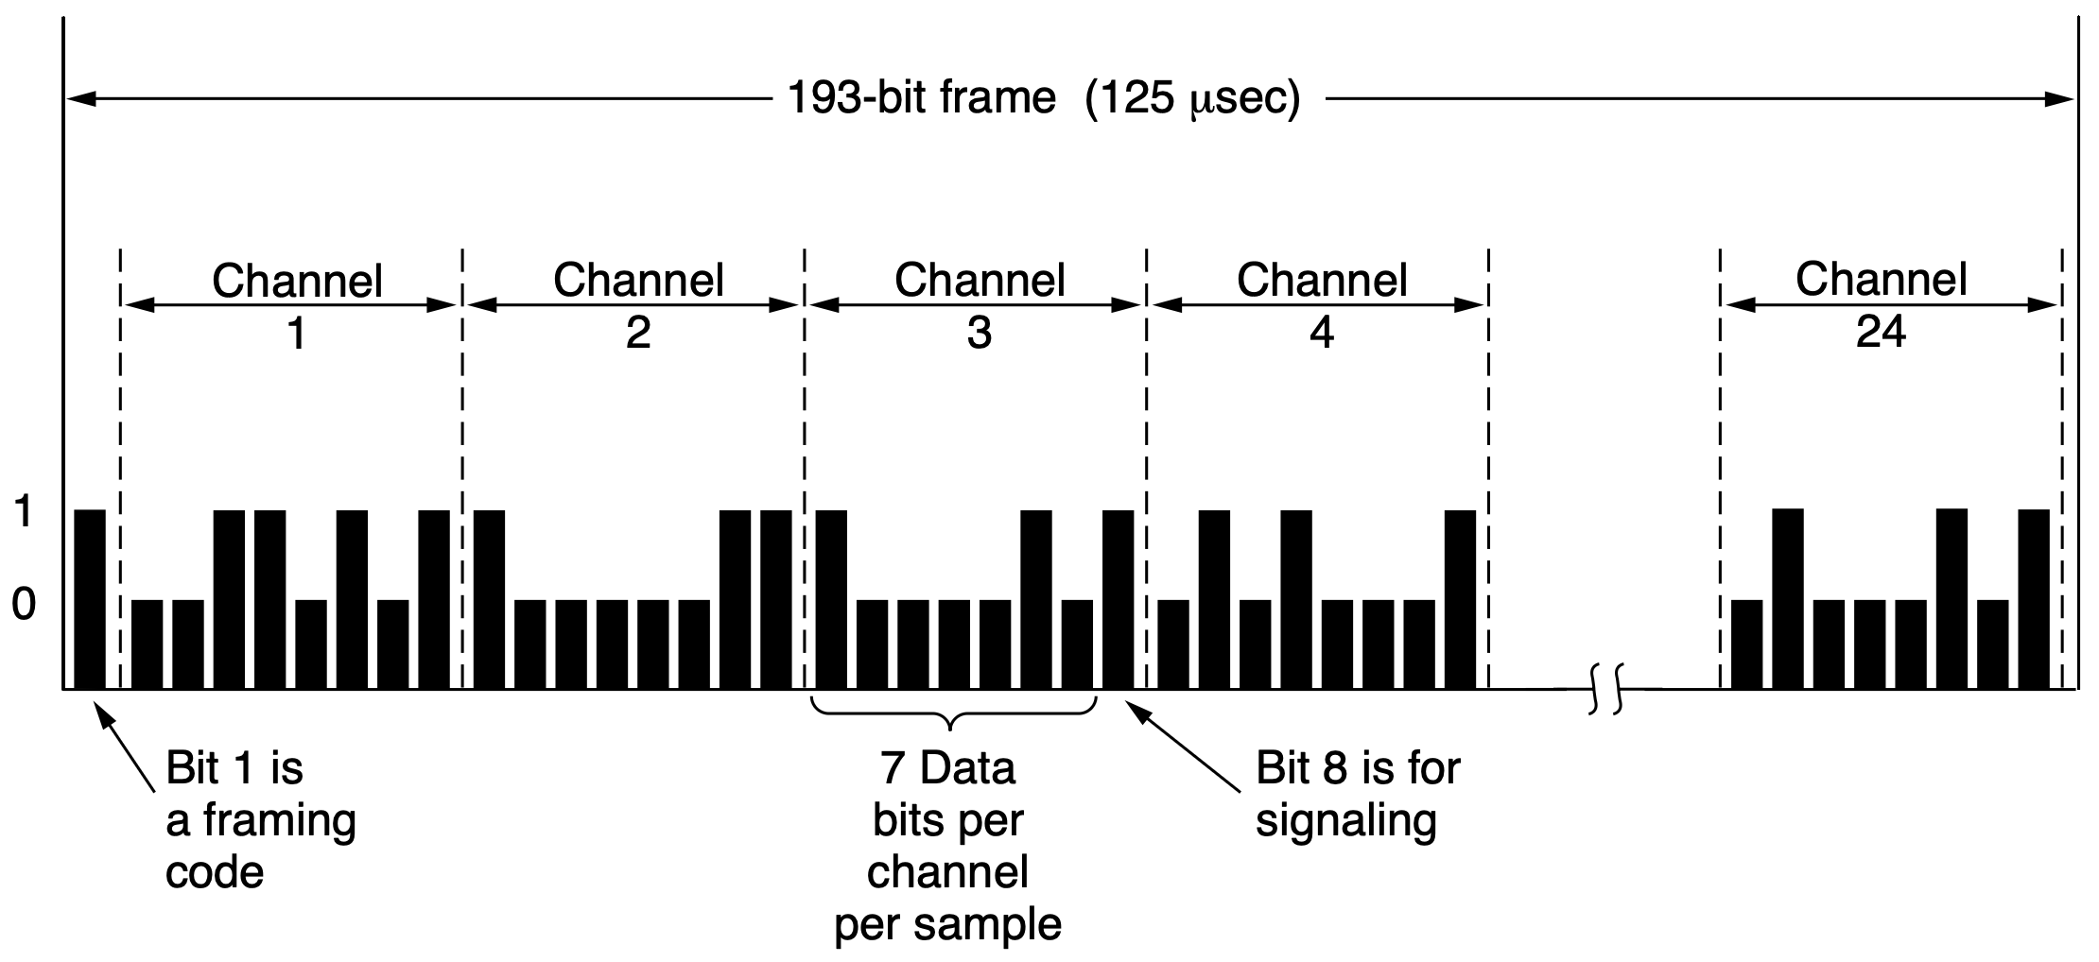
Trunk:
T1-Carrier
Multiplex digital signals on the phone network by sending a sample from each call every 125 𝜇s
24 signaling bits

Slide 24
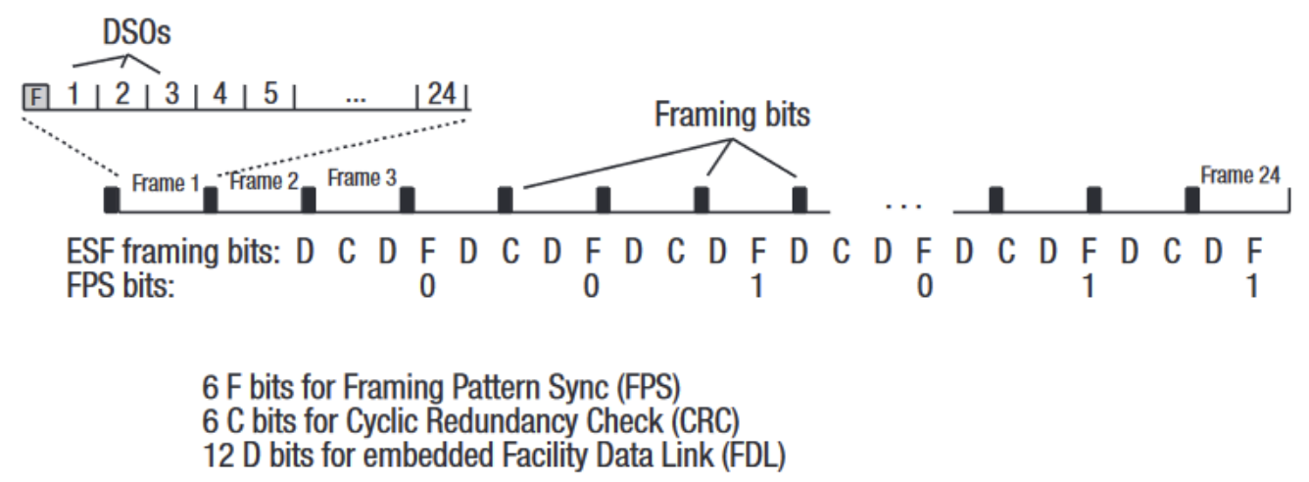
Trunk:
T1-Carrier
Multiplex digital signals on the phone network by sending a sample from each call every 125 𝜇s
24 signaling bits
https://www.tek.com/en/documents/primer/t1-network-technology-essentials-successful-field-service-technicians

Slide 25
Trunk:
T1-Carrier
In-band signaling information in the same channel as the data, by using some of the data bits
24 signaling bits
https://www.tek.com/en/documents/primer/t1-network-technology-essentials-successful-field-service-technicians
Notes:
The T1 format has several variations. The earlier versions sent signaling infor-
mation in-band, meaning in the same channel as the data, by using some of the
data bits. This design is one form of channel-associated signaling, because each
channel has its own private signaling subchannel. In one arrangement, the least
significant bit out of an 8-bit sample on each channel is used in every sixth frame.
It has the colorful name of robbed-bit signaling. The idea is that a few stolen bits
will not matter for voice calls. No one will hear the difference.

Slide 26
Trunk:
T1-Carrier
In-band signaling information in the same channel as the data (channel-associated signaling)
24 signaling bits
https://www.tek.com/en/documents/primer/t1-network-technology-essentials-successful-field-service-technicians
Notes:
The T1 format has several variations. The earlier versions sent signaling infor-
mation in-band, meaning in the same channel as the data, by using some of the
data bits. This design is one form of channel-associated signaling, because each
channel has its own private signaling subchannel. In one arrangement, the least
significant bit out of an 8-bit sample on each channel is used in every sixth frame.
It has the colorful name of robbed-bit signaling. The idea is that a few stolen bits
will not matter for voice calls. No one will hear the difference.

Slide 27
Trunk:
T1-Carrier
In-band signaling information in the same channel as the data (robbed-bit signaling)
24 signaling bits
https://www.tek.com/en/documents/primer/t1-network-technology-essentials-successful-field-service-technicians
Notes:
The T1 format has several variations. The earlier versions sent signaling infor-
mation in-band, meaning in the same channel as the data, by using some of the
data bits. This design is one form of channel-associated signaling, because each
channel has its own private signaling subchannel. In one arrangement, the least
significant bit out of an 8-bit sample on each channel is used in every sixth frame.
It has the colorful name of robbed-bit signaling. The idea is that a few stolen bits
will not matter for voice calls. No one will hear the difference.

Slide 28
Trunk:
T1-Carrier
Out-of-band signaling for voice calls is done in a separate channel from data
Common-channel signaling transmits control signals for multiple voice and data channels over a separate, dedicated channel
Notes:
For data, however, it is another story. Delivering the wrong bits is unhelpful,
to say the least. If older versions of T1 are used to carry data, only 7 of 8 bits, or
56 kbps, can be used in each of the 24 channels. Instead, newer versions of T1
provide clear channels in which all of the bits may be used to send data. Clear
channels are what businesses who lease a T1 line want when they send data across
the telephone network in place of voice samples. Signaling for any voice calls is
then handled out-of-band, meaning in a separate channel from the data. Often, the
signaling is done with common-channel signaling in which there is a shared sig-
naling channel. One of the 24 channels may be used for this purpose.

Slide 29
Trunk:
T-Carrier
E1 carrier used outside of North America and Japan
2.048 Mbps, 32 8-bit data samples per 125 𝜇s
30 channels for data and 2 channels for signaling (16 signaling bits per frame)
Each group of 4 frames provides 64 signaling bits (32 for signaling and 32 for frame synchronization or reserved bits)
Notes:
Outside of North America and Japan, the 2.048-Mbps E1 carrier is used in-
stead of T1. This carrier has 32 8-bit data samples packed into the basic 125-µsec
frame. Thirty of the channels are used for information and up to two are used for
signaling. Each group of four frames provides 64 signaling bits, half of which are
used for signaling (whether channel-associated or common-channel) and half of
which are used for frame synchronization or are reserved for each country to use as
it wishes.

Slide 30
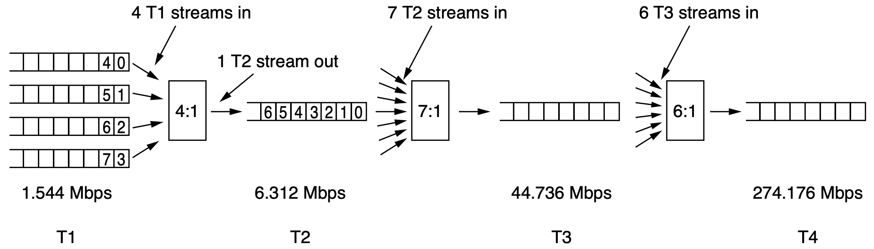
Trunk:
T-Carrier
TDM multiple T1 carriers into higher-order carriers
Each higher-order carrier adds extra bits for framing and recovery
bitwise TDM
Notes:
Time division multiplexing allows multiple T1 carriers to be multiplexed into
higher-order carriers. Figure 2-33 shows how this can be done. At the left, we see
four T1 channels being multiplexed into one T2 channel. The multiplexing at T2
and above is done bit for bit, rather than byte for byte with the 24 voice channels
that make up a T1 frame. Four T1 streams at 1.544 Mbps really ought to generate
6.176 Mbps, but T2 is actually 6.312 Mbps. The extra bits are used for framing
and recovery in case the carrier slips.
At the next level, seven T2 streams are combined bitwise to form a T3 stream.
Then, six T3 streams are joined to form a T4 stream. At each step, a small amount
of overhead is added for framing and recovery in case the synchronization between
sender and receiver is lost. T1 and T3 are widely used by customers, whereas T2
and T4 are only used within the telephone system itself, so they are not well-
known.

Slide 31
Trunk:
SONET/SDH
SONET: Synchronous Optical NETwork
SDH: Synchronous Digital Hierarchy
A synchronized frame of 810 bytes every 125 𝜇s whether or not there are any useful data to send
8000 frames per second, 51.84 Mbps

Slide 32
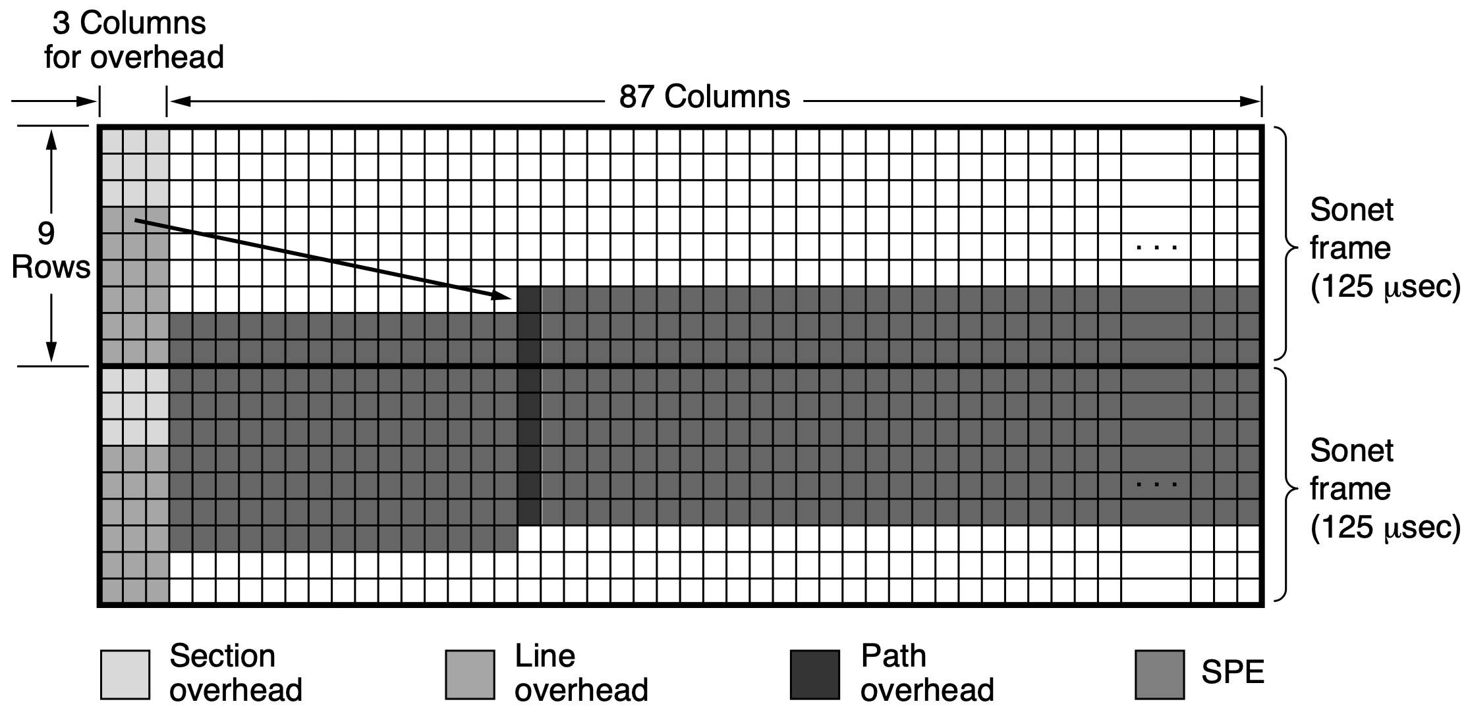
Trunk:
SONET/SDH
STS-1: Synchronous Transport Signal-1
The first 2 bytes of each frame contain a fixed pattern to signal frame start
pointer to the first SPE byte
synchronous
payload
envelope
more in https://www.rfwireless-world.com/tutorials/sdh-frame-structure
Notes:
The 810-byte SONET frames are best thought of as a rectangle of bytes, 90
columns wide by 9 rows high. Thus, 8 × 810= 6480 bits are transmitted 8000
times per second, for a gross data rate of 51.84 Mbps. This layout is the basic
SONET channel, called STS-1 (Synchronous Transport Signal-1). All SONET
trunks are multiples of STS-1.
The first three columns of each frame are reserved for system management
information, as illustrated in Fig. 2-34. In this block, the first three rows contain
the section overhead; the next six contain the line overhead. The section overhead
is generated and checked at the start and end of each section, whereas the line over-
head is generated and checked at the start and end of each line.
A SONET transmitter sends back-to-back 810-byte frames, without gaps be-
tween them, even when there are no data (in which case it sends dummy data).
From the receiver’s point of view, all it sees is a continuous bit stream, so how does
it know where each frame begins? The answer is that the first 2 bytes of each
frame contain a fixed pattern that the receiver searches for. If it finds this pattern in
the same place in a large number of consecutive frames, it assumes that it is in sync
with the sender. In theory, a user could insert this pattern into the payload in a reg-
ular way, but in practice, it cannot be done due to the multiplexing of multiple
users into the same frame and other reasons.
The final 87 columns of each frame hold 87 × 9 × 8 × 8000= 50. 112 Mbps of
user data. This user data could be voice samples, T1 and other carriers, or packets.
SONET is simply a container for transporting bits. The SPE (Synchronous Pay-
load Envelope), which carries the user data does not always begin in row 1, col-
umn 4. The SPE can begin anywhere within the frame. A pointer to the first byte
is contained in the first row of the line overhead. The first column of the SPE is
the path overhead (i.e., the header for the end-to-end path sublayer protocol).
The ability to allow the SPE to begin anywhere within the SONET frame and
ev en to span two frames, as shown in Fig. 2-34, gives added flexibility to the sys-
tem. For example, if a payload arrives at the source while a dummy SONET frame
is being constructed, it can be inserted into the current frame instead of being held
until the start of the next one.

Slide 33
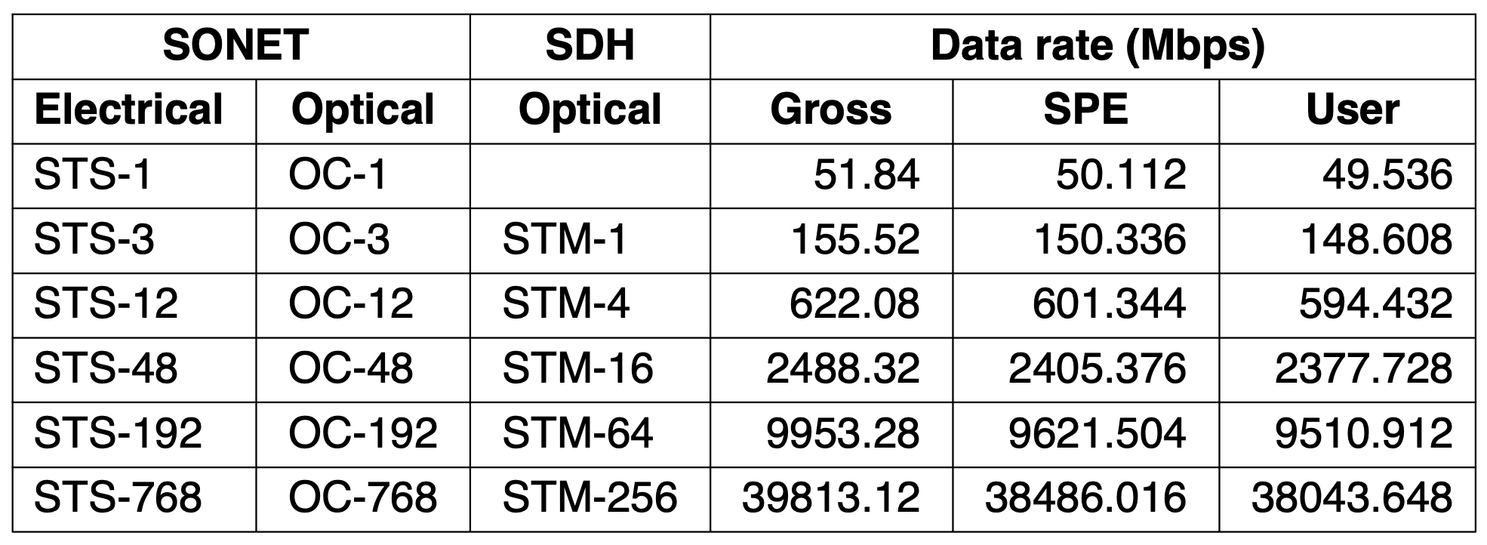
Trunk:
SONET/SDH
STS-1: Synchronous Transport Signal-1
Notes:
The SONET/SDH multiplexing hierarchy is shown in Fig. 2-35. Rates from
STS-1 to STS-768 have been defined, ranging from roughly a T3 line to 40 Gbps.
Even higher rates will surely be defined over time, with OC-3072 at 160 Gbps
being the next in line if and when it becomes technologically feasible. The optical
carrier corresponding to STS-n is called OC-n but is bit for bit the same except for
a certain bit reordering needed for synchronization. The SDH names are different,
and they start at OC-3 because ITU-based systems do not have a rate near 51.84
Mbps. We hav e shown the common rates, which proceed from OC-3 in multiples
of four. The gross data rate includes all the overhead. The SPE data rate excludes
the line and section overhead. The user data rate excludes all three kinds of over-
head and counts only the 86 payload columns.
As an aside, when a carrier, such as OC-3, is not multiplexed, but carries the
data from only a single source, the letter c (for concatenated) is appended to the de-
signation, so OC-3 indicates a 155.52-Mbps carrier consisting of three separate
OC-1 carriers, but OC-3c indicates a data stream from a single source at 155.52
Mbps. The three OC-1 streams within an OC-3c stream are interleaved by col-
umn—first column 1 from stream 1, then column 1 from stream 2, then column 1
from stream 3, followed by column 2 from stream 1, and so on—leading to a frame
270 columns wide and 9 rows deep.

Slide 34
Switching
Circuit switching
Packet switching

Slide 35
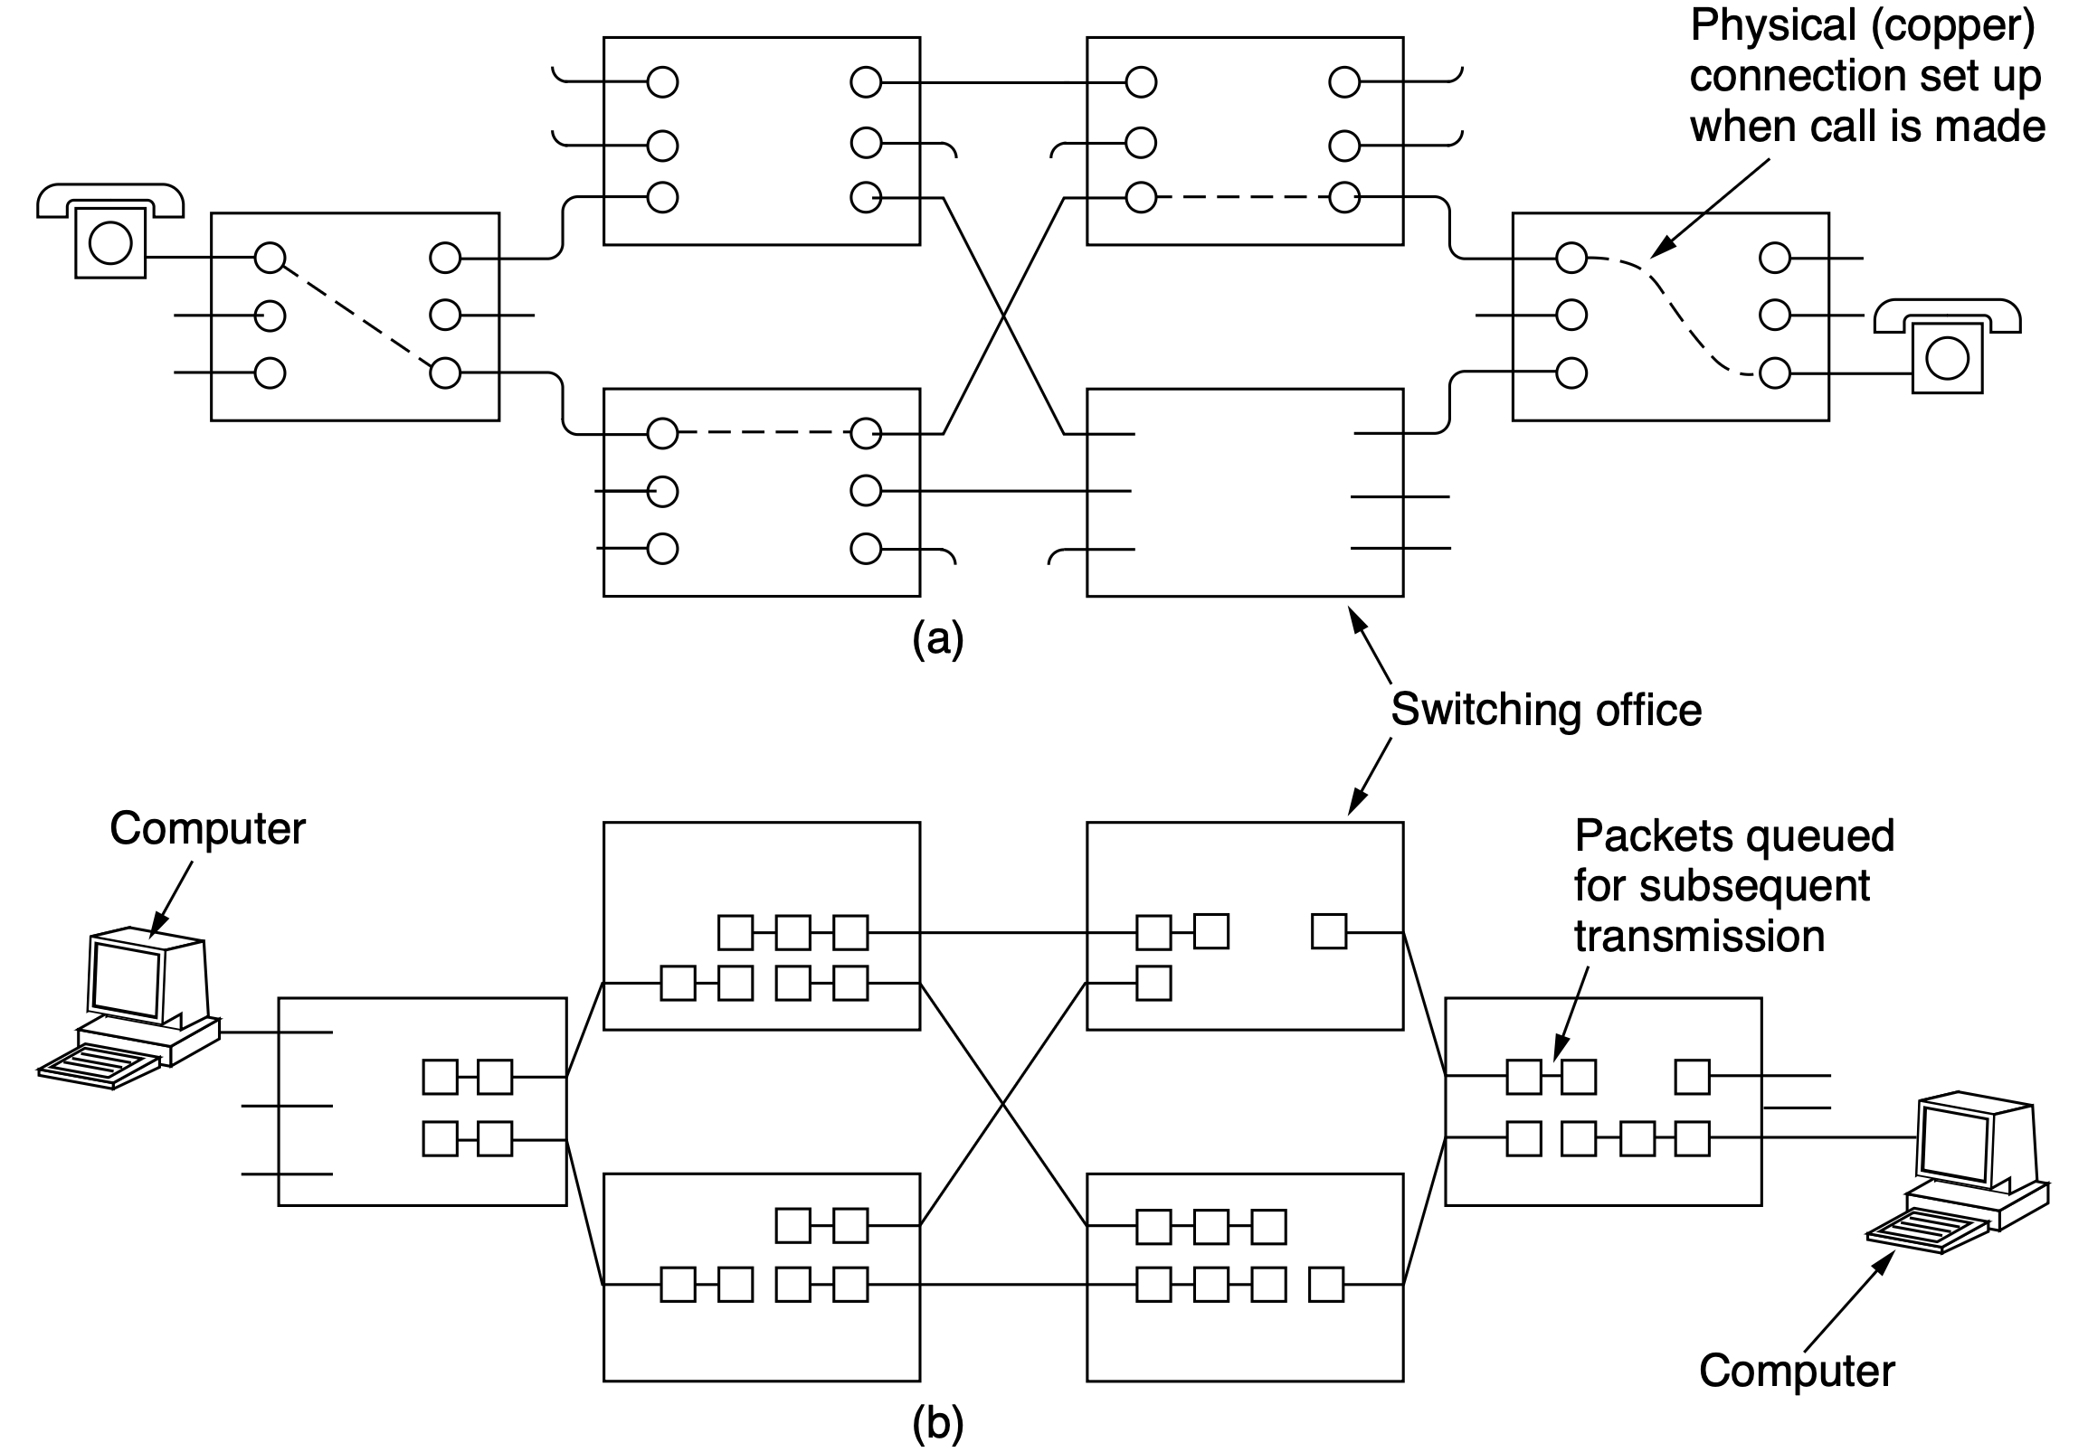
Switching
circuit switching
packet switching
Notes:
Traditionally, when you or your computer placed a telephone call, the switch-
ing equipment within the telephone system sought out a physical path all the way
from your telephone to the receiver’s telephone and maintained it for the duration
of the call. This technique is called circuit switching. It is shown schematically
in Fig. 2-36(a). Each of the six rectangles represents a carrier switching office
(end office, toll office, etc.). In this example, each office has three incoming lines
and three outgoing lines. When a call passes through a switching office, a physical
connection is established between the line on which the call came in and one of the
output lines, as shown by the dotted lines.
The alternative to circuit switching is packet switching, shown in Fig. 2-36(b)
and described in Chap. 1. With this technology, packets are sent as soon as they
are available. In contrast to circuit switching, there is no need to set up a dedicated
path in advance. Packet switching is analogous to sending a series of letters using
the postal system: each one travels independently of the others. It is up to routers
to use store-and-forward transmission to send each packet on its way toward the
destination on its own. This procedure is unlike circuit switching, where the result
of the connection setup is the reservation of bandwidth all the way from the sender
to the receiver and all data on the circuit follows this path. In circuit switching,
having all the data follow the same path means that it cannot arrive out of order.
With packet switching, there is no fixed path, so different packets can follow dif-
ferent paths, depending on network conditions at the time they are sent, and they
may arrive out of order.

Slide 36
Switching
dedicated path for the entire call;
in-order transmission
circuit switching
store-and-forward, likely out-of-order transmission
packet switching
Notes:
Traditionally, when you or your computer placed a telephone call, the switch-
ing equipment within the telephone system sought out a physical path all the way
from your telephone to the receiver’s telephone and maintained it for the duration
of the call. This technique is called circuit switching. It is shown schematically
in Fig. 2-36(a). Each of the six rectangles represents a carrier switching office
(end office, toll office, etc.). In this example, each office has three incoming lines
and three outgoing lines. When a call passes through a switching office, a physical
connection is established between the line on which the call came in and one of the
output lines, as shown by the dotted lines.
The alternative to circuit switching is packet switching, shown in Fig. 2-36(b)
and described in Chap. 1. With this technology, packets are sent as soon as they
are available. In contrast to circuit switching, there is no need to set up a dedicated
path in advance. Packet switching is analogous to sending a series of letters using
the postal system: each one travels independently of the others. It is up to routers
to use store-and-forward transmission to send each packet on its way toward the
destination on its own. This procedure is unlike circuit switching, where the result
of the connection setup is the reservation of bandwidth all the way from the sender
to the receiver and all data on the circuit follows this path. In circuit switching,
having all the data follow the same path means that it cannot arrive out of order.
With packet switching, there is no fixed path, so different packets can follow dif-
ferent paths, depending on network conditions at the time they are sent, and they
may arrive out of order.

Slide 37
Switching
potential congestion prior to path establishment;
no congestion during transmission
circuit switching
potential congestions (both prior to and) during
packet transmission
packet switching
Notes:
Circuit switching:
As a consequence of the reserved path between the calling parties, once the
setup has been completed, the only delay for data is the propagation time for the
electromagnetic signal: about 5 milliseconds per 1000 km. Also, as a consequence
of the established path, there is no danger of congestion—that is, once the call has
been put through, you never get busy signals. Of course, you might get one before
the connection has been established due to lack of switching or trunk capacity.

Slide 38
Switching
waste bandwidth on reserved path when there is no traffic
circuit switching
more fault tolerant to failed switches
packet switching
Notes:
If a circuit has been reserved for a particular user and there is no traffic, its
bandwidth is wasted. It cannot be used for other traffic. Packet switching does not
waste bandwidth and thus is more efficient from a system perspective. Under-
standing this trade-off is crucial for comprehending the difference between circuit
switching and packet switching. The trade-off is between guaranteed service and
wasting resources versus not guaranteeing service and not wasting resources.
Packet switching is more fault tolerant than circuit switching. In fact, that is
why it was invented. If a switch goes down, all of the circuits using it are termi-
nated and no more traffic can be sent on any of them. With packet switching,
packets can be routed around dead switches.

Slide 39
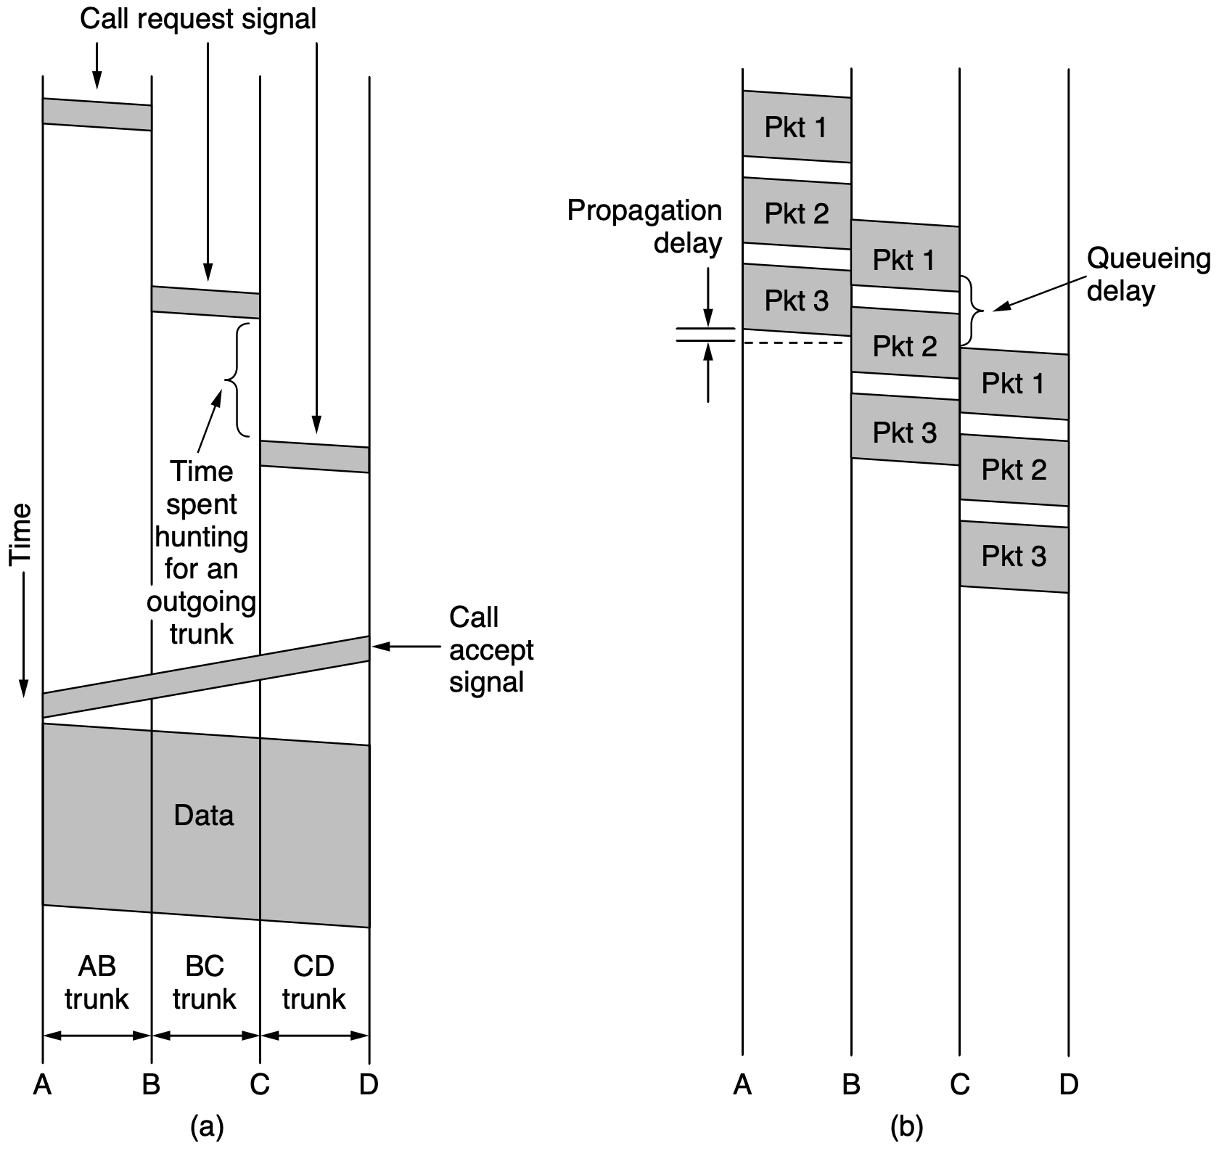
Switching
circuit switching
packet switching
Notes:
Packet-switching networks place a tight upper limit on the size of packets.
This ensures that no user can monopolize any transmission line for very long (e.g.,
many milliseconds), so that packet-switched networks can handle interactive traf-
fic. It also reduces delay since the first packet of a long message can be forwarded
before the second one has fully arrived. However, the store-and-forward delay of
accumulating a packet in the router’s memory before it is sent on to the next router
exceeds that of circuit switching. With circuit switching, the bits just flow through
the wire continuously. Nothing is ever stored and forwarded later.
Packet and circuit switching also differ in other ways. Because no bandwidth
is reserved with packet switching, packets may have to wait to be forwarded. This
introduces queueing delay and congestion if many packets are sent at the same
time. On the other hand, there is no danger of getting a busy signal and being
unable to use the network. Thus, congestion occurs at different times with circuit
switching (at setup time) and packet switching (when packets are sent).
If a circuit has been reserved for a particular user and there is no traffic, its
bandwidth is wasted. It cannot be used for other traffic. Packet switching does not
waste bandwidth and thus is more efficient from a system perspective. Under-
standing this trade-off is crucial for comprehending the difference between circuit
switching and packet switching. The trade-off is between guaranteed service and
wasting resources versus not guaranteeing service and not wasting resources.
If a circuit has been reserved for a particular user and there is no traffic, its
bandwidth is wasted. It cannot be used for other traffic. Packet switching does not
waste bandwidth and thus is more efficient from a system perspective. Under-
standing this trade-off is crucial for comprehending the difference between circuit
switching and packet switching. The trade-off is between guaranteed service and
wasting resources versus not guaranteeing service and not wasting resources.
Packet switching is more fault tolerant than circuit switching. In fact, that is
why it was invented. If a switch goes down, all of the circuits using it are termi-
nated and no more traffic can be sent on any of them. With packet switching,
packets can be routed around dead switches.

Slide 40
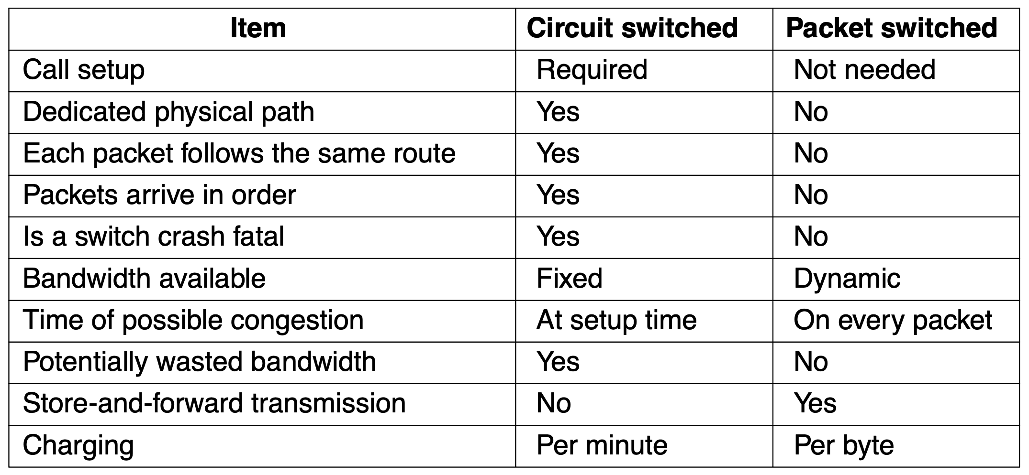
Switching

Slide 41
The Physical Layer
Systems
public switched telephone network
cellular networks
cable networks
communication satellites

Slide 42
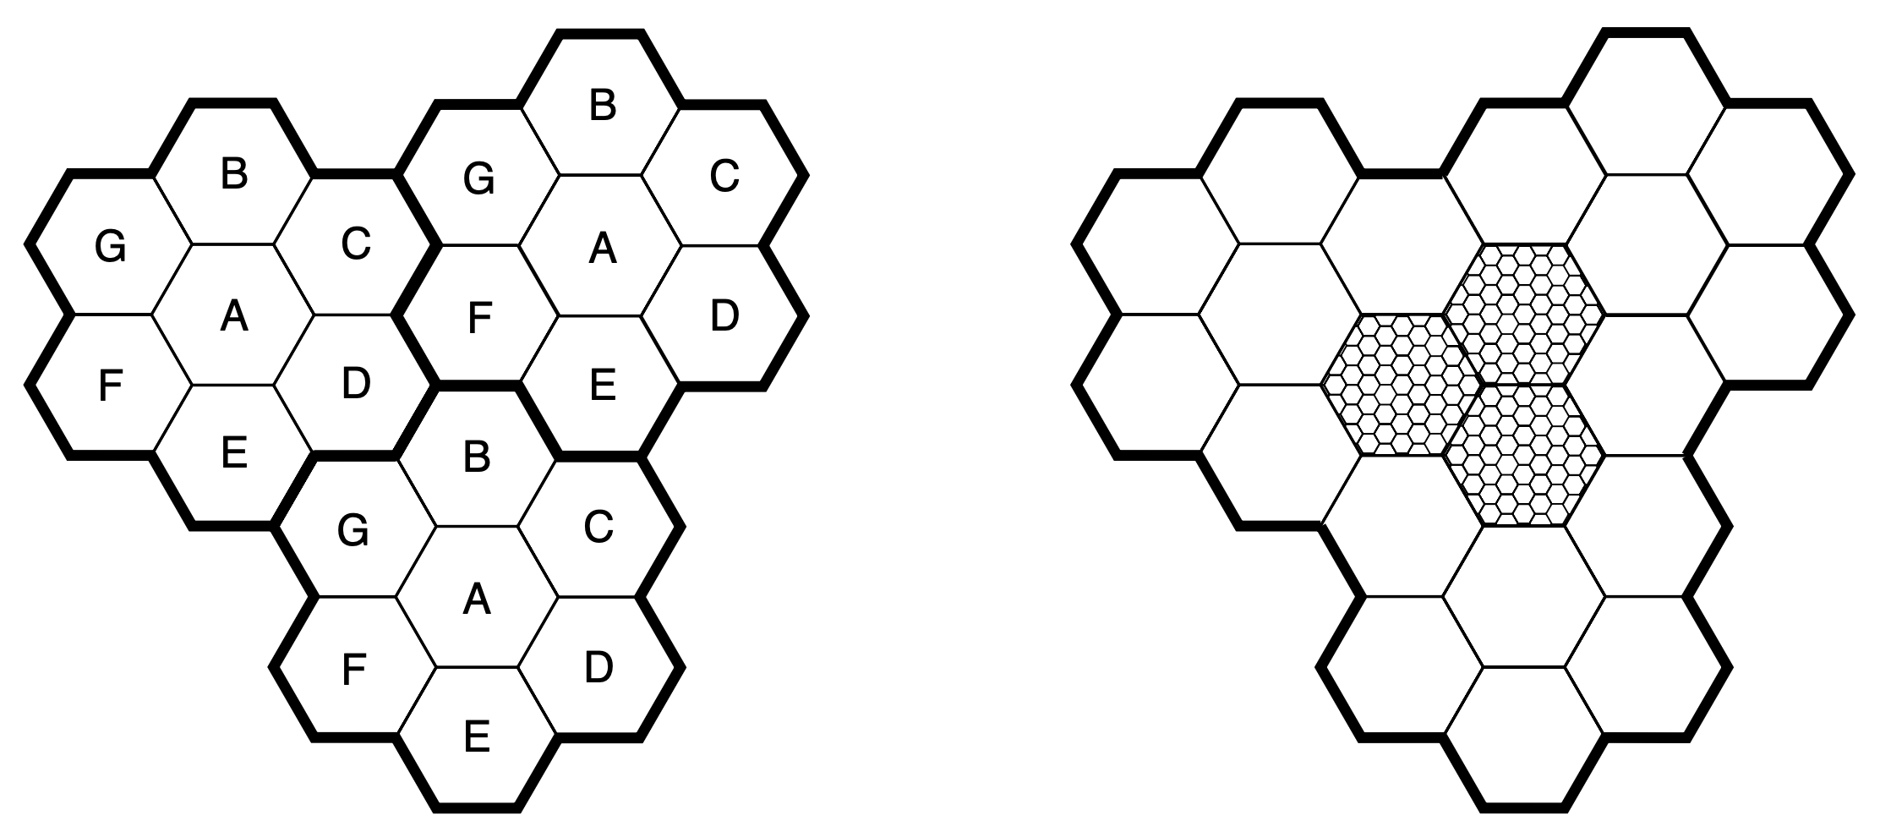
Cells
All mobile phone systems divide up a geographic region into cells
Frequency of a cell is not reused by any of its neighbors

Slide 43
Cells
All mobile phone systems divide up geographic region into cells
Usually two cells away to reuse a frequency for good separation and low interference

Slide 44
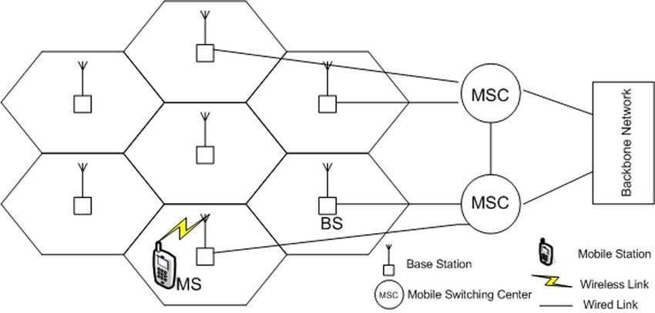
Cells
Base station provides communication to mobile devices in its cell
https://ieeexplore.ieee.org/document/4533812
Notes:
At the center of each cell is a base station to which all the telephones in the cell
transmit. The base station consists of a computer and transmitter/receiver con-
nected to an antenna. In a small system, all the base stations are connected to a
single device called an MSC (Mobile Switching Center) or MTSO (Mobile Tele-
phone Switching Office). In a larger one, several MSCs may be needed, all of
which are connected to a second-level MSC, and so on. The MSCs are essentially
end offices as in the telephone system, and are in fact connected to at least one
telephone system end office. The MSCs communicate with the base stations, each
other, and the PSTN using a packet-switching network.

Slide 45
Cells
MSC (Mobile Switching Center) or MTSO (Mobile Telephone Switching Office) connects to at least one telephone system end office, communicates with base stations and the PSTN using a packet switching network
https://ieeexplore.ieee.org/document/4533812
Notes:
At the center of each cell is a base station to which all the telephones in the cell
transmit. The base station consists of a computer and transmitter/receiver con-
nected to an antenna. In a small system, all the base stations are connected to a
single device called an MSC (Mobile Switching Center) or MTSO (Mobile Tele-
phone Switching Office). In a larger one, several MSCs may be needed, all of
which are connected to a second-level MSC, and so on. The MSCs are essentially
end offices as in the telephone system, and are in fact connected to at least one
telephone system end office. The MSCs communicate with the base stations, each
other, and the PSTN using a packet-switching network.

Slide 46
Cells
Handoff/Handover: transfer an active call or data session from one base station to another without interrupting service
https://ieeexplore.ieee.org/document/4533812
Notes:
::Handoff, also known as handover, is the process of transferring an active call or data session from one base station to another without interrupting service. This is crucial in mobile communication as users move between different cell coverage areas. Handoff ensures seamless connectivity as users transition from one base station's range to another.
At any instant, each mobile telephone is logically in one specific cell and under
the control of that cell’s base station. When a mobile telephone physically leaves a
cell, its base station notices the telephone’s signal fading away and then asks all the
surrounding base stations how much power they are getting from it. When the
answers come back, the base station then transfers ownership to the cell getting the
strongest signal; under most conditions that is the cell where the telephone is now
located. The telephone is then informed of its new boss, and if a call is in progress,
it is asked to switch to a new channel (because the old one is not reused in any of
the adjacent cells). This process, called handoff, takes about 300 milliseconds.
Channel assignment is done by the MSC, the nerve center of the system. The base
stations are really just dumb radio relays.

Slide 47
Cells
Control channels: base to mobile, manage the system
Paging channeling: base to mobile, alert mobile users to calls for them
Access channels: bidirectional, for call setup and channel assignment
Data channels: bidirectional, carry voice, fax, or data

Slide 48
1G: Analog Voice
Push-to-talk system: to talk, the user needs to push a button that enabled the transmitter and disabled the receiver
IMTS (Improved Mobile Telephone System): use two frequencies for sendings and receiving, use two channels for inbound and outbound signals (mobile users could not hear each other)

Slide 49
1G: Analog Voice
IMTS (Improved Mobile Telephone System): use two frequencies for sendings and receiving, use two channels for inbound and outbound signals (mobile users could not hear each other)
Impractical: only 23 channels (users often have to wait), large power of transmitters (heavy interference)

Slide 50
1G: Analog Voice
AMPS (Advanced Mobile Phone System): analog, 10~20-km cells; 100 10-km cells in the same area to have 10~15 calls on each frequency, in widely separated cells; FDM-separated 832 full-duplex channels, each with a pair of simplex channels (FDD: Frequency Division Duplex)

Slide 51
1G: Analog Voice
Call management
mobile phone:
32-bit serial number,
10-digit telephone number: 34 bits
3-digit/10-bit area code, 7-digit/24-bit subscriber number
https://ieeexplore.ieee.org/document/4533812

Slide 52
1G: Analog Voice
Call management
mobile phone:
use control channel with the most powerful signal,
broadcast 32-bit serial number and 34-bit telephone number
https://ieeexplore.ieee.org/document/4533812

Slide 53
1G: Analog Voice
Call management
base station:
hear mobile phone’s announcement, tell the MSC that records the customer and informs the customer’s home MSC of the customer’s current location
mobile phone:
use control channel with the most powerful signal,
broadcast 32-bit serial number and 34-bit telephone number
https://ieeexplore.ieee.org/document/4533812

Slide 54
1G: Analog Voice
Call management
mobile phone:
to make a call, the phone transmits
called number and own identity on the access channel
https://ieeexplore.ieee.org/document/4533812

Slide 55
1G: Analog Voice
Call management
base station:
get the request, inform the MSC to find an idle channel and send back the channel number on the control channel
https://ieeexplore.ieee.org/document/4533812

Slide 56
1G: Analog Voice
Call management
mobile phone:
automatically switch to the selected
voice channel and wait until the called party picks up the phone
https://ieeexplore.ieee.org/document/4533812

Slide 57
1G: Analog Voice
Call management
base station:
send a packet to the callee’s home MSC to find out where the callee is
MSC:
send a packet to the base station in the callee’s current cell
base station:
send a broadcast on the paging channel to inform the callee
mobile phone:
for incoming call, idle phone continuously
listens to the paging channel, acknowledge the base station’s broadcast message on the access channel
https://ieeexplore.ieee.org/document/4533812

Slide 58
1G: Analog Voice
Call management
base station:
send a packet to inform the callee about which channel to use
mobile phone:
switch to the designated channel
by the base station for picking up the phone call
https://ieeexplore.ieee.org/document/4533812

Slide 59
2G: Digital Voice
Provide capacity gains by allowing voice and control signals to be encrypted
deter fraud and eavesdropping
Enable new services such as text messaging
Notes:
The first generation of mobile phones was analog; the second generation is
digital. Switching to digital has several advantages. It provides capacity gains by
allowing voice signals to be digitized and compressed. It improves security by al-
lowing voice and control signals to be encrypted. This, in turn, deters fraud and
eavesdropping, whether from intentional scanning or echoes of other calls due to
RF propagation. Finally, it enables new services such as text messaging.

Slide 60
2G: Digital Voice
D-AMPS: Digital Advanced Mobile Systems
GSM: Global System for Mobile communications
CDMA: Code Division Multiple Access (International Standard IS-95)
PCS: Personal Communications Services
Notes:
Just as there was no worldwide standardization during the first generation,
there was also no worldwide standardization during the second, either. Sev eral dif-
ferent systems were developed, and three have been widely deployed. D-AMPS
(Digital Advanced Mobile Phone System) is a digital version of AMPS that
coexists with AMPS and uses TDM to place multiple calls on the same frequency
channel. It is described in International Standard IS-54 and its successor IS-136.
GSM (Global System for Mobile communications) has emerged as the dominant
system, and while it was slow to catch on in the United States it is now used virtu-
ally everywhere in the world. Like D-AMPS, GSM is based on a mix of FDM and
TDM. CDMA (Code Division Multiple Access), described in International
Standard IS-95, is a completely different kind of system and is based on neither
FDM nor TDM. While CDMA has not become the dominant 2G system, its tech-
nology has become the basis for 3G systems.
Also, the name PCS (Personal Communications Services) is sometimes used
in the marketing literature to indicate a second-generation (i.e., digital) system.
Originally it meant a mobile phone using the 1900 MHz band, but that distinction
is rarely made now. The dominant 2G system in most of the world is GSM which
we now describe in detail.

Slide 61
GSM
Same system architecture with 1G: cells, frequency reuse across cells, mobility with handoffs as subscribers move
Yet different implementation details

Slide 62
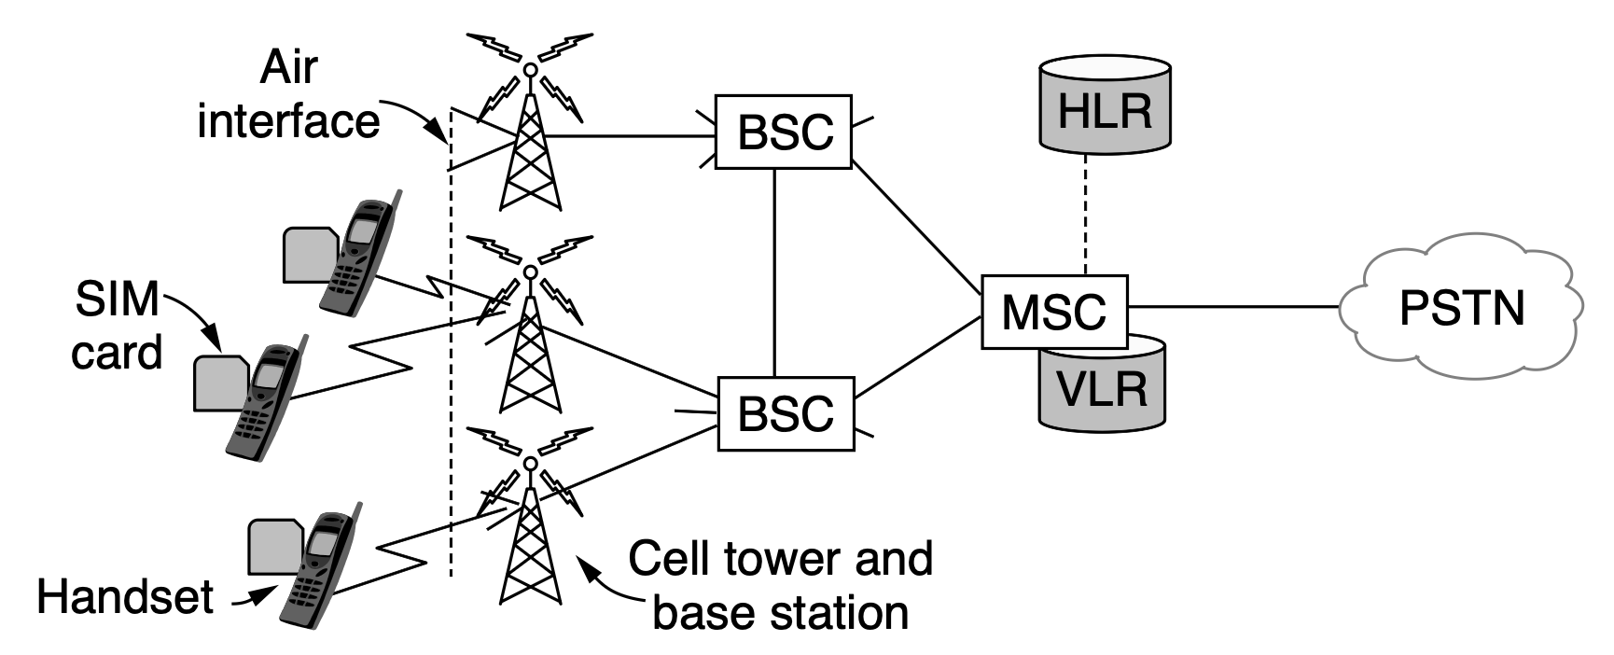
GSM
Mobile phone: handset plus a removable SIM (Subscriber Identity Module) card with subscriber and account information

Slide 63
GSM
SIM card activates the handset and contains secrets that let the mobile and the network identify each other and encrypt conversations
Notes:
The mobile talks to cell base stations over an air interface that we will de-
scribe in a moment. The cell base stations are each connected to a BSC (Base Sta-
tion Controller) that controls the radio resources of cells and handles handoff.
The BSC in turn is connected to an MSC (as in AMPS) that routes calls and con-
nects to the PSTN (Public Switched Telephone Network).

Slide 64
GSM
VLR (Visitor Location Register) records a database of nearby mobiles that are associated with the cells the related MSC manages
Notes:
To be able to route calls, the MSC needs to know where mobiles can currently
be found. It maintains a database of nearby mobiles that are associated with the
cells it manages. This database is called the VLR (Visitor Location Register).
There is also a database in the mobile network that gives the last known location of
each mobile. It is called the HLR (Home Location Register). This database is
used to route incoming calls to the right locations. Both databases must be kept up
to date as mobiles move from cell to cell.

Slide 65
GSM
HLR (Home Location Register) records a database of the last known location of each mobile in the mobile network
Help route incoming calls to the right locations
Notes:
The mobile talks to cell base stations over an air interface that we will de-
scribe in a moment. The cell base stations are each connected to a BSC (Base Sta-
tion Controller) that controls the radio resources of cells and handles handoff.
The BSC in turn is connected to an MSC (as in AMPS) that routes calls and con-
nects to the PSTN (Public Switched Telephone Network).

Slide 66
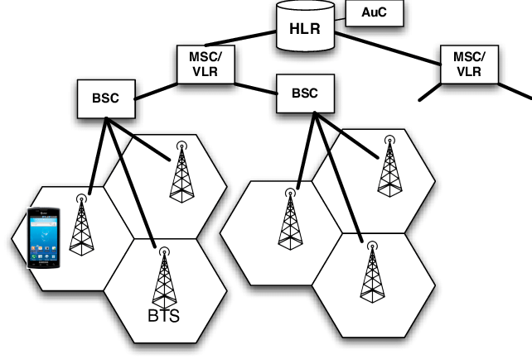
GSM
BTS: Base Transceiver Station (BS)
BSC: Base Station Controller
MSC: Mobile Switching Center
VLR: Visitor Location Register
HLR: Home Location Register
AuC: Authentication Center
http://forensics.umass.edu/pubs/Sung-MoST-2014.pdf
Notes:
::To connect, a mobile device connects via its radio interface to a radio tower, base transceiver station (BTS).
A single base station controller (BSC) can manage many
BTSs, including functions related to resource and mobility
management. The BTS and BSC form the base station
subsystem (BSS).
Each BSC is connected to one mobile switching cen-
ter/visitor location register (MSC/VLR).
The
MSC/VLR controls call setup and routing, among other
tasks. One MSC/VLR connects to many BSCs. Each
MSC/VLR is also connected to the carrier network’s
home location register (HLR), which records the particular
MSC/VLR where each phone subscriber may be found. The
HLR is associated with an authentication center (AuC) that
stores cryptographic credentials needed for communicating
with each of the carrier’s SIM cards.

Slide 67
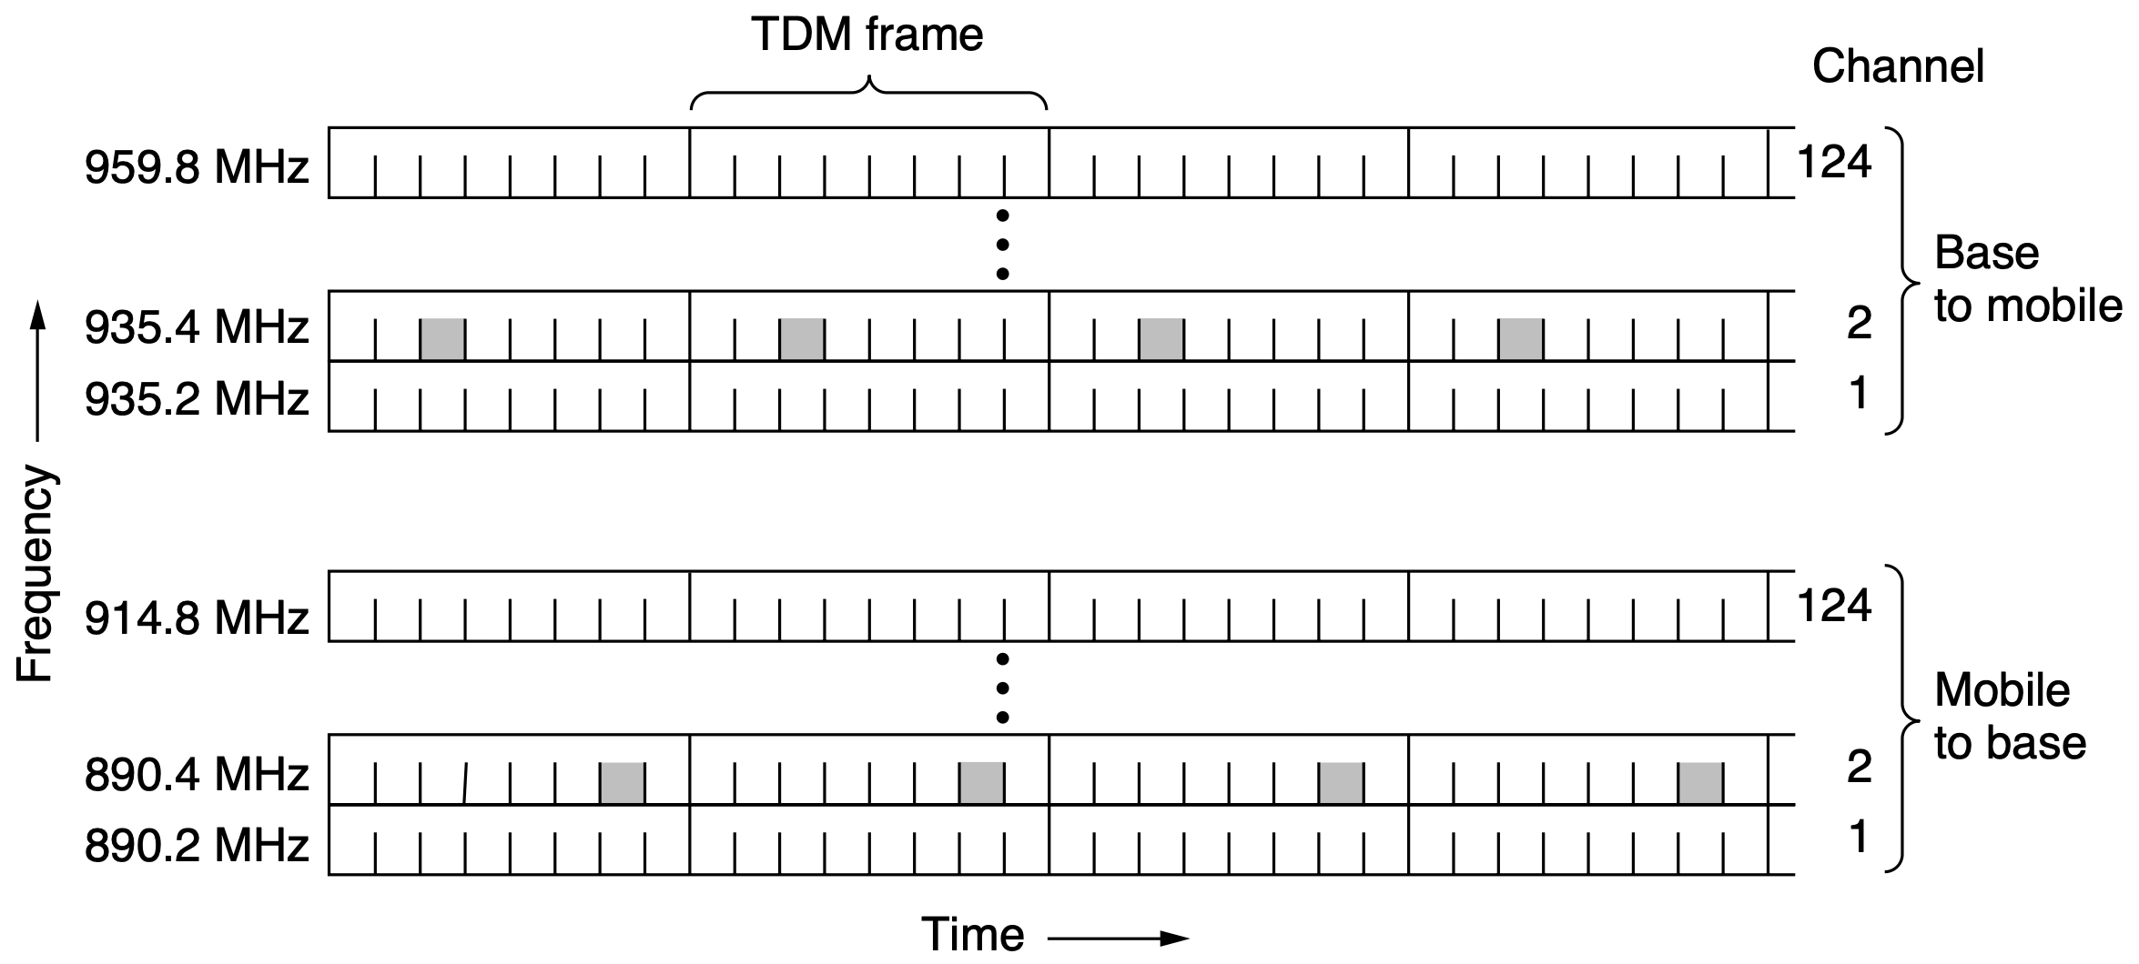
GSM
Per GSM system (base station): 124 pairs of simplex channels
Per channel: 200-kHz (0.2-MHz) wide and 8 TDM subchannels

Slide 68
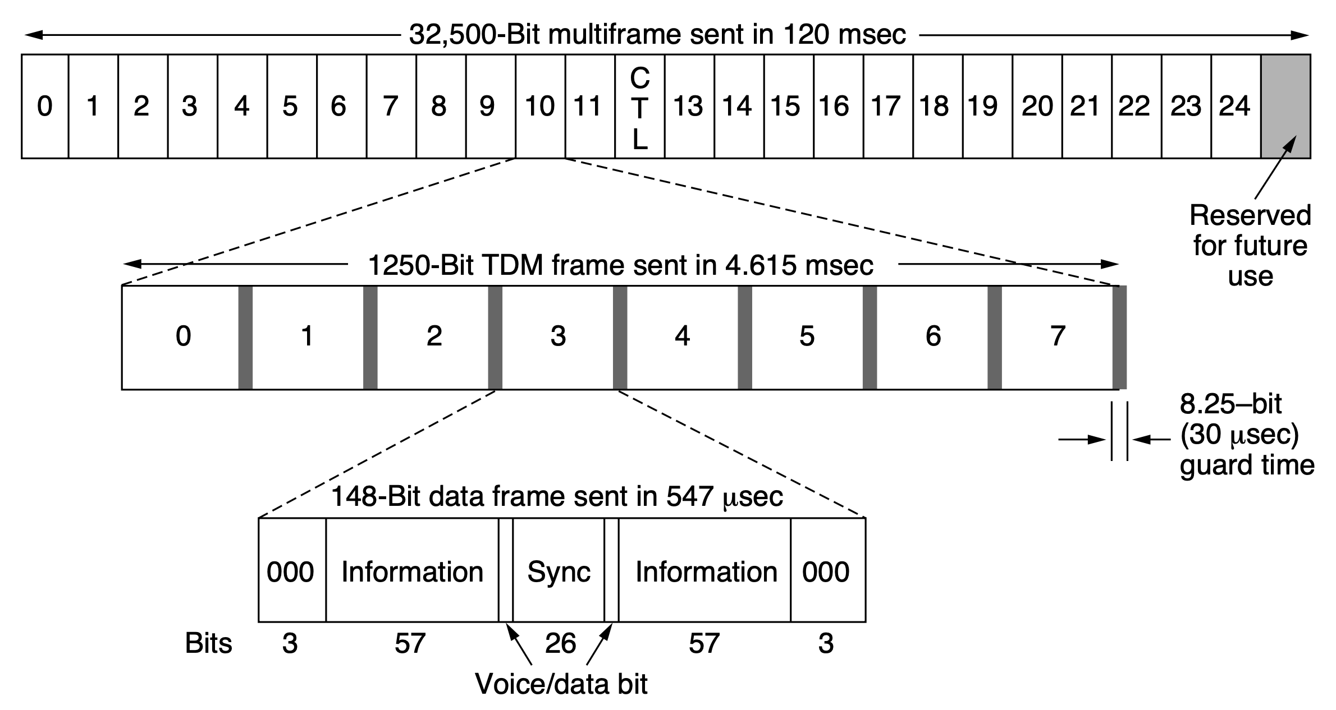
GSM
Each TDM slot: 148-bit data frame
26-slot multiframe

Slide 69
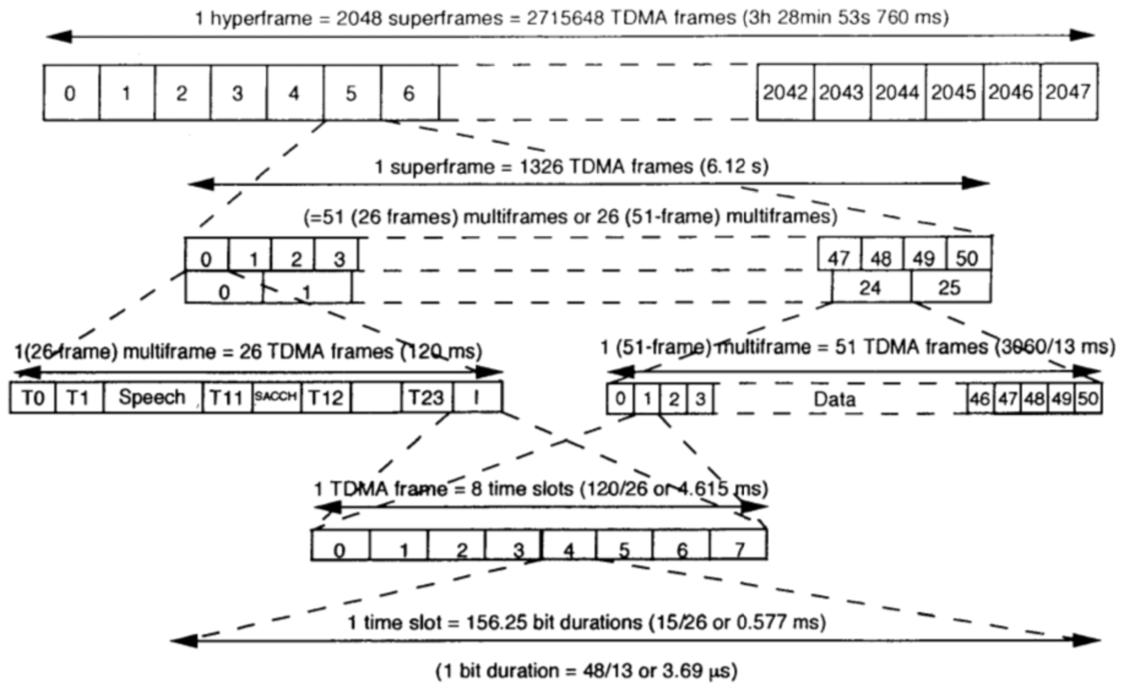
GSM
Also a 51-slot multiframe with some of its slots to hold several control channels for system management
https://dattashingate.wordpress.com/2018/09/10/types-of-gsm-frame/

Slide 70
GSM
Broadcast control channel a continuous stream of ouput from base station containing the base station’s identity and the channel status; all mobile stations monitor their signal strength to see when they have moved into a new cell
Dedicated control channel for location updating, registration, and call setup

Slide 71
GSM
Common control channel paging channel: for the base station to announce incoming calls, continuously monitored by each mobile station random access channel: allow users to request a slot on the dedicated channel to set up a call access grant channel: on which the assigned slot is announced

Slide 72
GSM
MAHO: Mobile Assisted HandOff mobile station uses idle slots to meansure signal quality to other nearby base stations and sends this information to BSC; the BSC uses it to determine when a mobile station is leaving one cell and entering another
http://forensics.umass.edu/pubs/Sung-MoST-2014.pdf

Slide 73
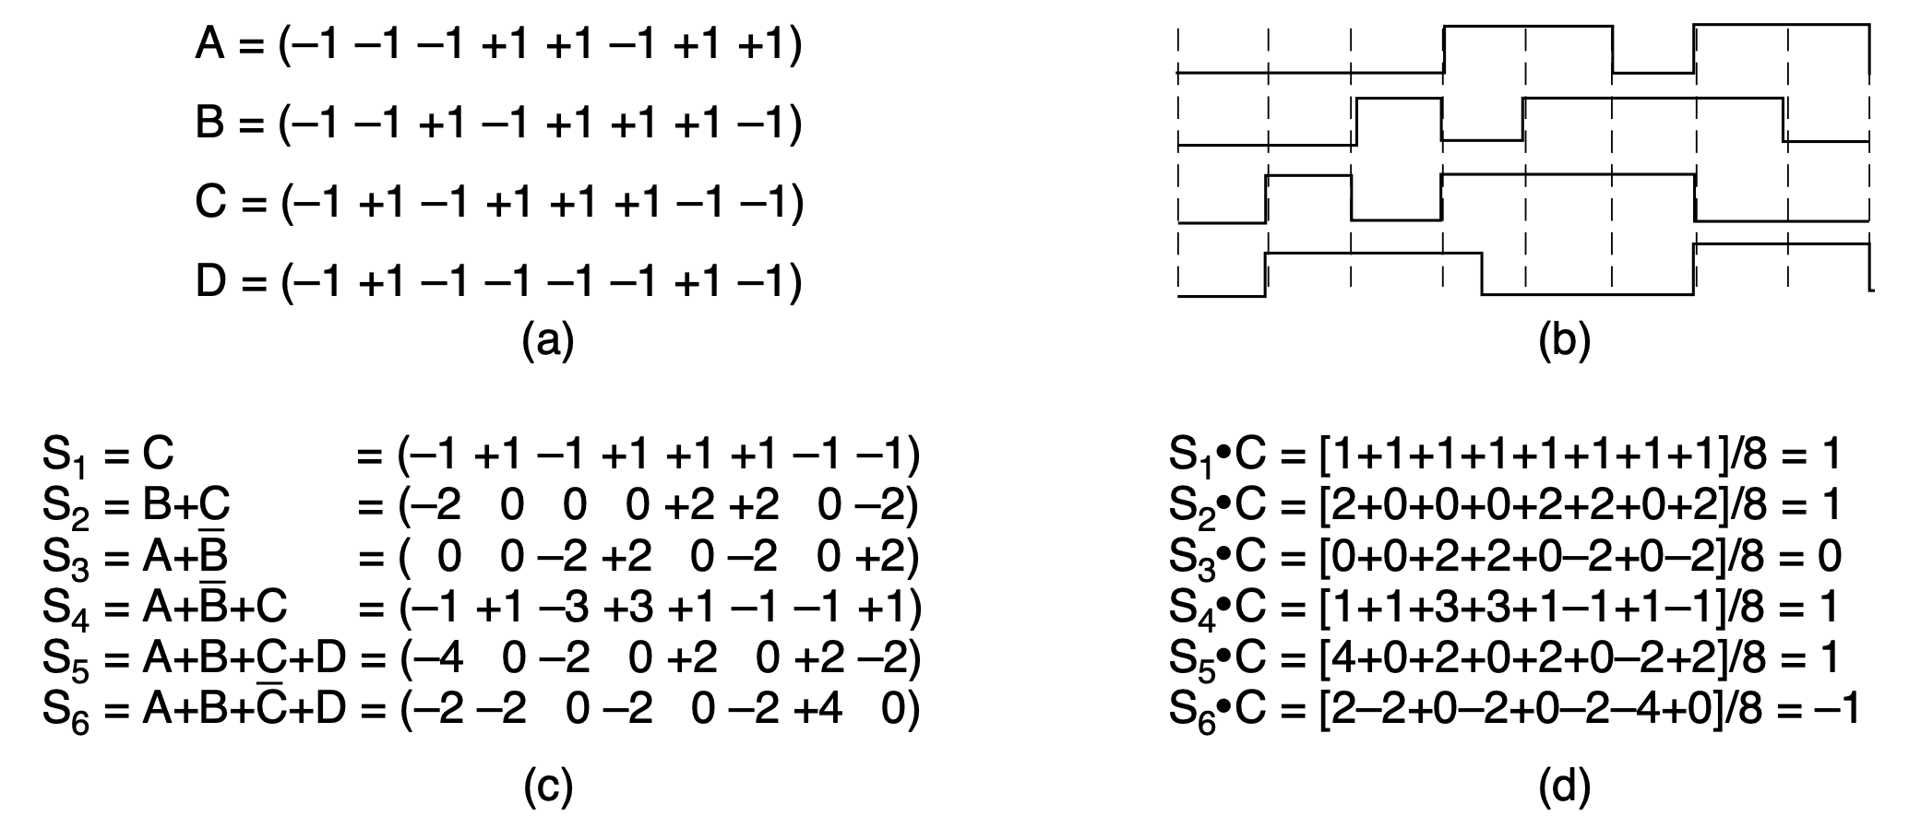
3G: Digital Voice and Data
Standard: UMTS (Universal Mobile Telecommunications System)
WCDMA: Wideband CDMA
CDMA2000
How to CDMA without synchronizing transmissions of all mobile phones?
Notes:
To make CDMA work in the mobile phone setting requires more than the basic
CDMA technique that we described in Sec. 2.4. Specifically, we described a sys-
tem called synchronous CDMA, in which the chip sequences are exactly orthogo-
nal. This design works when all users are synchronized on the start time of their
chip sequences, as in the case of the base station transmitting to mobiles. The base
station can transmit the chip sequences starting at the same time so that the signals
will be orthogonal and able to be separated. However, it is difficult to synchronize
the transmissions of independent mobile phones. Without some special efforts,
their transmissions would arrive at the base station at different times, with no guar-
antee of orthogonality. To let mobiles send to the base station without synchroni-
zation, we want code sequences that are orthogonal to each other at all possible
offsets, not simply when they are aligned at the start.

Slide 74
3G: Digital Voice and Data
Use long pseudorandom sequences to approximate general orthgonality
They have a low cross-correlation with each other at all offsets as well as a small auto-correlation with themselves exept at a zero offset
Small normalized inner product, exactly the property CDMA requires
Notes:
::Cross-correlation and autocorrelation are both statistical methods for analyzing relationships between data series, but they differ in what they compare. Autocorrelation measures the similarity of a single data series with a lagged copy of itself, while cross-correlation measures the similarity between two different data series, also potentially with a lag.
While it is not possible to find sequences that are exactly orthogonal for this
general case, long pseudorandom sequences come close enough. They hav e the
property that, with high probability, they hav e a low cross-correlation with each
other at all offsets. This means that when one sequence is multiplied by another
sequence and summed up to compute the inner product, the result will be small; it
would be zero if they were orthogonal. (Intuitively, random sequences should al-
ways look different from each other. Multiplying them together should then pro-
duce a random signal, which will sum to a small result.) This lets a receiver filter
unwanted transmissions out of the received signal. Also, the auto-correlation of
pseudorandom sequences is also small, with high probability, except at a zero off-
set. This means that when one sequence is multiplied by a delayed copy of itself
and summed, the result will be small, except when the delay is zero. (Intuitively, a
delayed random sequence looks like a different random sequence, and we are back
to the cross-correlation case.) This lets a receiver lock onto the beginning of the
wanted transmission in the received signal.

Slide 75
3G: Digital Voice and Data
Power levels of all mobiles should be the same at the receiver
Otherwise, a small cross-correlation with a powerful signal might overwhelm a large auto-correlation with a weak signal
Power levels received at a base station depend on how far away the transmitters are as well as how much power they transmit

Slide 76
3G: Digital Voice and Data
Power levels of all mobiles should be the same at the receiver
Otherwise, a small cross-correlation with a powerful signal might overwhelm a large auto-correlation with a weak signal
How to equalize received power levels given mobiles at different locations?

Slide 77
3G: Digital Voice and Data
Each mobile transmits to the base station at the inverse of the power level it receives from the base station
Base station also gives each mobile feedback (1500 times per second) to increase, decrease, or hold steady its transmit power

Slide 78
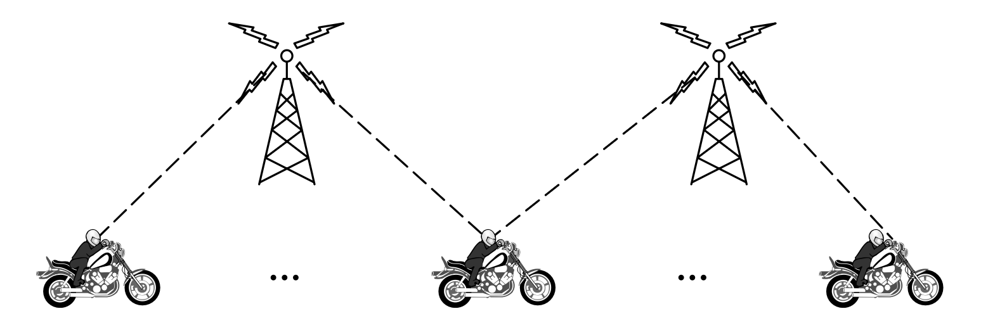
3G: Digital Voice and Data
Improve capacity by simply not transmitting silent users’ signals lowers the interference for other users
Use FDM to eliminate complicated frequency planning tasks and improve capacity (directional/sectored antenna)
Avoid loss of continuity by soft handoff
mobile is acquired by new base station before previous one signs off
Notes:
Now let us describe the advantages of CDMA. First, CDMA can improve ca-
pacity by taking advantage of small periods when some transmitters are silent. In
polite voice calls, one party is silent while the other talks. On average, the line is
busy only 40% of the time. However, the pauses may be small and are difficult to
predict. With TDM or FDM systems, it is not possible to reassign time slots or fre-
quency channels quickly enough to benefit from these small silences. However, in
CDMA, by simply not transmitting one user lowers the interference for other users,
and it is likely that some fraction of users will not be transmitting in a busy cell at
any giv en time. Thus CDMA takes advantage of expected silences to allow a larger
number of simultaneous calls.
Second, with CDMA each cell uses the same set of frequencies. Unlike GSM
and AMPS, FDM is not needed to separate the transmissions of different users.
This eliminates complicated frequency planning tasks and improves capacity. It
also makes it easy for a base station to use multiple directional antennas, or sec-
tored antennas, instead of an omnidirectional antenna. Directional antennas con-
centrate a signal in the intended direction and reduce the signal (and interference)
in other directions. This, in turn, increases capacity. Three-sector designs are com-
mon. The base station must track the mobile as it moves from sector to sector.
This tracking is easy with CDMA because all frequencies are used in all sectors.
Third, CDMA facilitates soft handoff, in which the mobile is acquired by the
new base station before the previous one signs off. In this way, there is no loss of
continuity. Soft handoff is shown in Fig. 2-43. It is easy with CDMA because all
frequencies are used in each cell. The alternative is a hard handoff, in which the
old base station drops the call before the new one acquires it. If the new one is
unable to acquire it (e.g., because there is no available frequency), the call is
disconnected abruptly. Users tend to notice this, but it is inevitable occasionally
with the current design. Hard handoff is the norm with FDM designs to avoid the
cost of having the mobile transmit or receive on two frequencies simultaneously.

Slide 79
4G: Packet Switching
Also called as IMT Advanced
Innovate packet switching through EPC (Evolved Packet Core), a simplified IP network that separates voice traffic from data network, both in IP packets (VoIP: Voice over IP)
4G LTE performance requirements: 100 Mbps download, 50 Mbps upload; spectral efficiency: 15 bps/Hz d-link, 6.75 bps/Ghz u-link
different from textbook!
Notes:
The main innovation of 4G over previous 3G systems is that 4G networks use
packet switching, as opposed to circuit switching. The innovation that allows
packet switching is called an EPC (Evolved Packet Core), which is essentially a
simplified IP network that separates voice traffic from the data network. The EPC
network carries both voice and data in IP packets. It is thus a (VoIP) Voice over IP
network, with resources allocated using the statistical multiplexing approaches de-
scribed earlier. As such, the EPC must manage resources in such a way that voice
quality remains high in the face of network resources that are shared among many
users. The performance requirements for LTE include, among other things, peak
throughput of 100 Mbps upload and 50 Mbps download. To achieve these higher
rates, 4G networks use a collection of additional frequencies, including 700 MHz,
850 MHz, 800 MHz, and others. Another aspect of the 4G standard is ‘‘spectral ef-
ficiency,’’ or how many bits can be transmitted per second for a given frequency;
for 4G technologies, peak spectral efficiency should be 15 bps/Hz for a downlink
and 6.75 bps/Ghz for uplink.

Slide 80
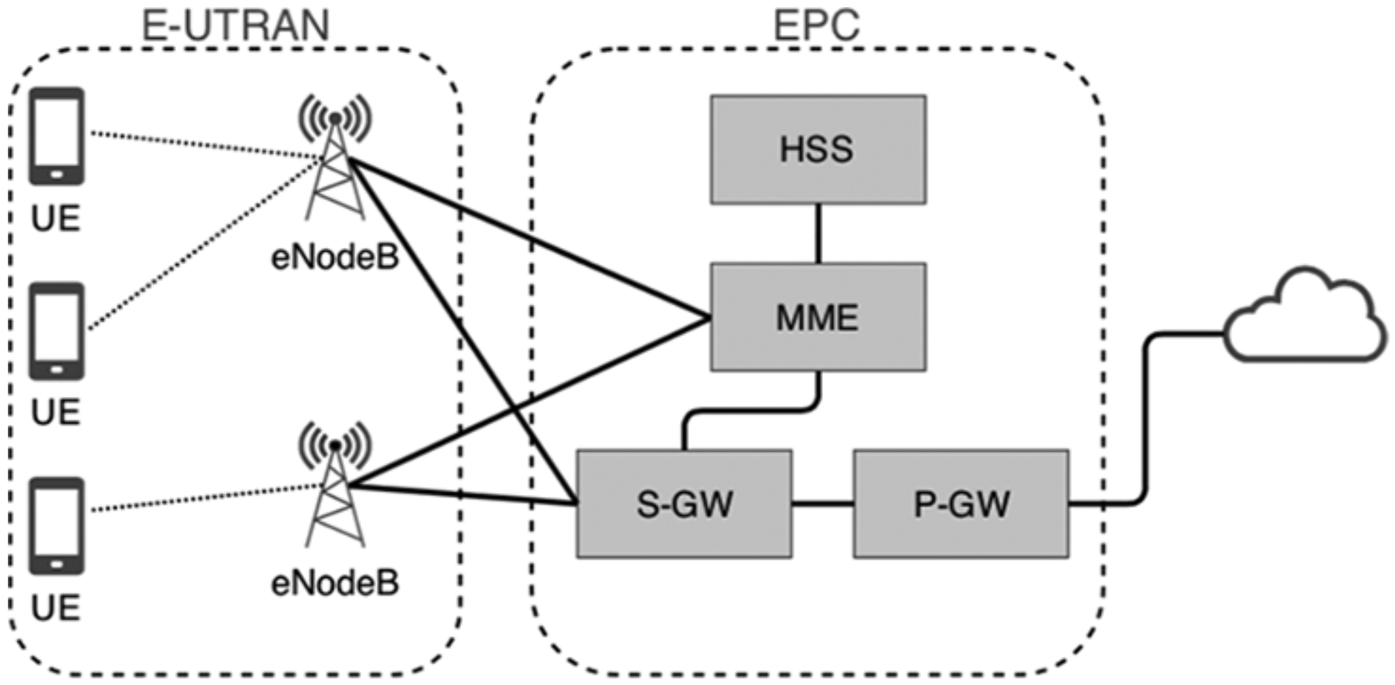
4G: Packet Switching
4G LTE Architecture
Home Subscriber Server
Mobility Management Entity
Radio
Access
Network
Core
Network
Serving
Gateway
Packet Data
Gateway
User Equipment
Notes:
The main innovation of 4G over previous 3G systems is that 4G networks use
packet switching, as opposed to circuit switching. The innovation that allows
packet switching is called an EPC (Evolved Packet Core), which is essentially a
simplified IP network that separates voice traffic from the data network. The EPC
network carries both voice and data in IP packets. It is thus a (VoIP) Voice over IP
network, with resources allocated using the statistical multiplexing approaches de-
scribed earlier. As such, the EPC must manage resources in such a way that voice
quality remains high in the face of network resources that are shared among many
users. The performance requirements for LTE include, among other things, peak
throughput of 100 Mbps upload and 50 Mbps download. To achieve these higher
rates, 4G networks use a collection of additional frequencies, including 700 MHz,
850 MHz, 800 MHz, and others. Another aspect of the 4G standard is ‘‘spectral ef-
ficiency,’’ or how many bits can be transmitted per second for a given frequency;
for 4G technologies, peak spectral efficiency should be 15 bps/Hz for a downlink
and 6.75 bps/Ghz for uplink.

Slide 81
4G: Packet Switching
S-GW forwards data packets between eNodeB toward the user’s device
Home Subscriber Server
Mobility Management Entity
Radio
Access
Network
Core
Network
Serving
Gateway
Packet Data
Gateway
User Equipment
Notes:
Serving Gateway (S-GW). The SGW forwards data packets to
ensure that packets continue to be forwarded to the user’s device
when switching from one eNodeB to another.

Slide 82
4G: Packet Switching
MME tracks and pages user device, assigns SGW for network connection, as well as during handoffs
Home Subscriber Server
Mobility Management Entity
Radio
Access
Network
Core
Network
Serving
Gateway
Packet Data
Gateway
User Equipment
Notes:
MME (Mobility Management Entity). The MME tracks and pages
the user device and chooses the SGW for a device when it first con-
nects to the network, as well as during handoffs. It also authenticates
the user’s device.

Slide 83
4G: Packet Switching
MME also authenticates the user’s device
Home Subscriber Server
Mobility Management Entity
Radio
Access
Network
Core
Network
Serving
Gateway
Packet Data
Gateway
User Equipment
Notes:
MME (Mobility Management Entity). The MME tracks and pages
the user device and chooses the SGW for a device when it first con-
nects to the network, as well as during handoffs. It also authenticates
the user’s device.

Slide 84
4G: Packet Switching
P-GW interfaces between the user device and a packet data network
Home Subscriber Server
Mobility Management Entity
Radio
Access
Network
Core
Network
Serving
Gateway
Packet Data
Gateway
User Equipment
Notes:
Packet Data Network Gateway (P-GW). The PDN GW interfaces
between the user device and a packet data network (i.e., a pack-
et-switched network), and can perform such functions such as address
allocation for that network (e.g., via DHCP), rate limiting, filtering,
deep packet inspection, and lawful interception of traffic. User de-
vices establish connection-oriented service with the packet gateway
using a so-called EPS bearer, which is established when the user de-
vice attaches to the network.

Slide 85
4G: Packet Switching
P-GW connects to user device using EPS bearer (a tunnel established when user device attaches to the network)
Home Subscriber Server
Mobility Management Entity
Radio
Access
Network
Core
Network
Serving
Gateway
Packet Data
Gateway
User Equipment
Notes:
Packet Data Network Gateway (P-GW). The PDN GW interfaces
between the user device and a packet data network (i.e., a pack-
et-switched network), and can perform such functions such as address
allocation for that network (e.g., via DHCP), rate limiting, filtering,
deep packet inspection, and lawful interception of traffic. User de-
vices establish connection-oriented service with the packet gateway
using a so-called EPS bearer, which is established when the user de-
vice attaches to the network.

Slide 86
4G: Packet Switching
HSS: queried by MME to determine that the user device corresponds to a valid subscriber
Home Subscriber Server
Mobility Management Entity
Radio
Access
Network
Core
Network
Serving
Gateway
Packet Data
Gateway
User Equipment
Notes:
HSS (Home Subscriber Server), The MME queries the HSS to de-
termine that the user device corresponds to a valid subscriber.

Slide 87
4G: Packet Switching
eNodeB performs operations at layers of physical, MAC, RLC, and PDCP
Home Subscriber Server
Mobility Management Entity
Radio
Access
Network
Core
Network
Serving
Gateway
Packet Data
Gateway
User Equipment
Notes:
The 4G network also has an evolved Radio Access Network (RAN). The
radio access network for LTE introduces an access node called an eNodeB, which
performs operations at the physical layer (as we focus on in this chapter), as well
as the MAC (Medium Access Control), RLC (Radio Link Control), and PDCP
(Packet Data Control Protocol) layers, many of which are specific to the cellular
network architecture. The eNodeB performs resource management, admission con-
trol, scheduling, and other control-plane functions.

Slide 88
4G: Packet Switching
eNodeB: resource management, admission control, scheduling, and other control-plane functions
Home Subscriber Server
Mobility Management Entity
Radio
Access
Network
Core
Network
Serving
Gateway
Packet Data
Gateway
User Equipment
Notes:
The 4G network also has an evolved Radio Access Network (RAN). The
radio access network for LTE introduces an access node called an eNodeB, which
performs operations at the physical layer (as we focus on in this chapter), as well
as the MAC (Medium Access Control), RLC (Radio Link Control), and PDCP
(Packet Data Control Protocol) layers, many of which are specific to the cellular
network architecture. The eNodeB performs resource management, admission con-
trol, scheduling, and other control-plane functions.

Slide 89
4G: Packet Switching
VoLTE (Voice over LTE): carry voice traffic over the EPC
Home Subscriber Server
Mobility Management Entity
Radio
Access
Network
Core
Network
Serving
Gateway
Packet Data
Gateway
User Equipment
Notes:
On 4G networks, voice traffic can be carried over the EPC using a technology
called VoLTE (Voice over LTE), making it possible for carriers to transmit voice
traffic over the packet-switched network and removing any dependency on the
legacy circuit-switched voice network.

Slide 90
5G
Aim to improve aggregate data rate or area capacity by 1000 times in comparison with 4G: total amount of data that the netowrk can serve in bits per unit area
Notes:
Cellular network performance is often measured in terms of aggregate data
rate or area capacity, which is the total amount of data that the network can serve
in bits per unit area. One goal of 5G is to improve the area capacity of the network
by three orders of magnitude (more than 1000 times that of 4G), using a combina-
tion of technologies:

Slide 91
5G
Ultra-densification and offloading picocell less than 100m in diameter; femtocell with WiFi-like range of tens of meters
Increased bandwidth with mm waves use directional antennas to tackle propagation challenges
Notes:
Ultra-densification and offloading. One of the most straightforward
ways to improve network capacity is by adding more cells per area.
Whereas 1G cell sizes were on the order of hundreds of square kilo-
meters, 5G aims for smaller cell sizes, including picocells (cells that
are less than 100 meters in diameter) and even femtocells (cells that
have WiFi-like range of tens of meters). One of the most important
benefits of the shrinking of the cell size is the ability to reuse spec-
trum in a given geographic area, thus reducing the number of users
that are competing for resources at any giv en base station. Of course,
shrinking the cell size comes with its own set of complications, in-
cluding more complicated mobility management and handoff.
Increased bandwidth with millimeter waves. Most spectrum from pre-
vious technologies has been in the range of several hundred MHz to a
few GHz, corresponding to wav elengths that are in range of centime-
ters to about a meter. This spectrum has become increasingly
crowded, especially in major markets during peak hours. There are
considerable amounts of unused spectrum in the millimeter wav e
range of 20 300 GHz, with wav elengths of less than 10 millimeters.
Until recently, this spectrum was not considered suitable for wireless
communication because shorter wav elengths do not propagate as
well. One of the ways that propagation challenges are being tackled is
by using large arrays of directional antennas, which is a significant
architectural shift from previous generations of cellular networks:
ev erything from interference properties to the process of associating
a user to a base station is different.

Slide 92
5G
Massive MIMO (Multiple-Input Multiple-Output) improve radio-link capacity by using multiple transmit and receive antennas to take advantage of multipath propagation (transmitted radio signal reaches the receiver via two or more paths); increase the number of base station antennas as more than endpoints
Notes:
Increased spectral efficiency through advances in massive MIMO
(Multiple-Input Multiple-Output) technology. MIMO improves the
capacity of a radio link by using multiple transmit and receive anten-
nas to take advantage of multipath propagation, whereby the trans-
mitted radio signal reaches the receiver via two or more paths. MIMO
was introduced into WiFi communication and 3G cellular technolo-
gies around 2006. MIMO has quite a few variations; earlier cellular
standards take advantage of MU-MIMO (Multi-User MIMO). Gen-
erally, these technologies take advantage of the spatial diversity of
users to cancel out interference that may occur at either end of the
wireless transmission. Massive MIMO is a type of MU-MIMO that
increases the number of base station antennas so that there are many
more antennas than endpoints. There is even the possibility of using a
three-dimensional antenna array, in a so-called FD-MIMO (Full-
Dimension MIMO).

Slide 93
5G
Network slicing create multiple virtual networks on top of the same shared physical infrastructure; devote portions of the network to specific customer use cases
Notes:
Another capability that will accompany 5G is network slicing, which will let
cellular carriers create multiple virtual networks on top of the same shared physical
infrastructure, devoting portions of their network to specific customer use cases.
Distinct fractions of the network (and its resources) may be dedicated to different
application providers, where different applications may have different re-
quirements. For example, applications that require high throughput may be allo-
cated to a different network slice than those that do not require high throughput.
SDN (Software-Defined Networking) and NFV (Network Functions Virtualiza-
tion) are emerging technologies that will help support slicing. We will discuss
these technologies in later chapters.

Slide 94
The Physical Layer
Systems
public switched telephone network
cellular networks
cable networks
communication satellites

Slide 95
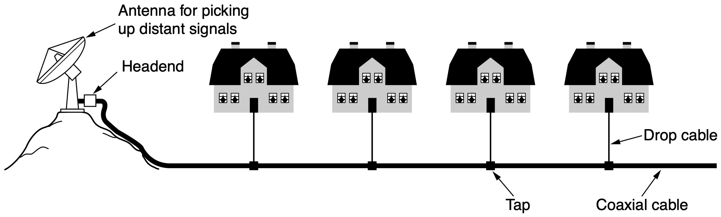
CATV
Community Antenna Television
Notes:
Cable television was conceived in the late 1940s as a way to provide better
television reception to people living in rural or mountainous areas. The system ini-
tially consisted of a big antenna on top of a hill to pluck the television signal out of
the air, an amplifier, called the headend, to strengthen it, and a coaxial cable to de-
liver it to people’s houses, as illustrated in Fig. 2-44.
In the early years, cable television was called CATV (Community Antenna
Television). It was very much a mom-and-pop operation; anyone handy with elec-
tronics could set up a service for his town, and the users would chip in to pay the
costs. As the number of subscribers grew, additional cables were spliced onto the
original cable and amplifiers were added as needed. Transmission was one way,
from the headend to the users. By 1970, thousands of independent systems
existed.

Slide 96
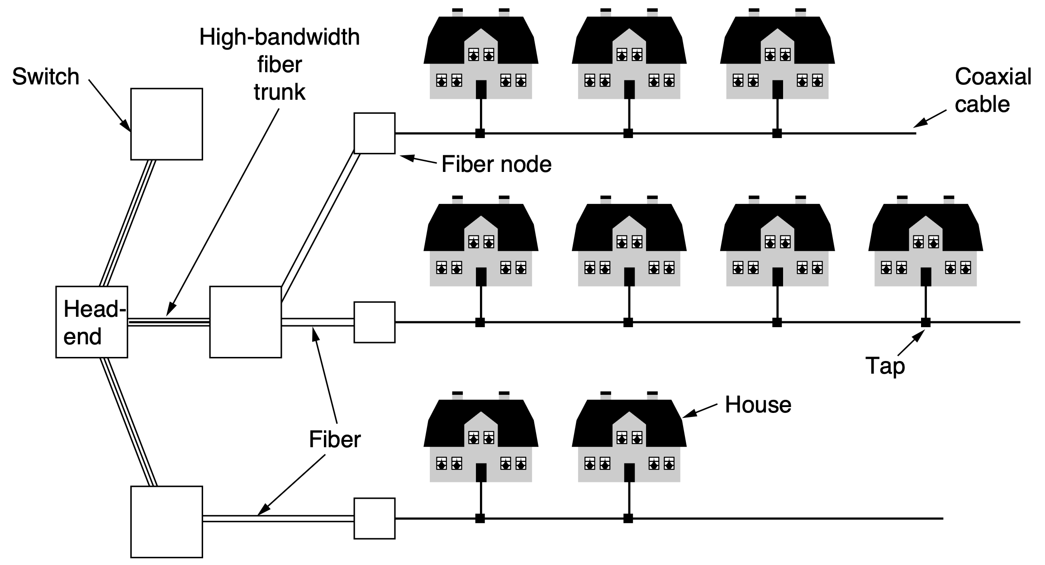
HFC Network
Hybrid Fiber Coax system with fiber for the long-haul runs and coaxial cable to the houses
electro-optical converter
CMTS:
Cable Modem
Termination System

Slide 97
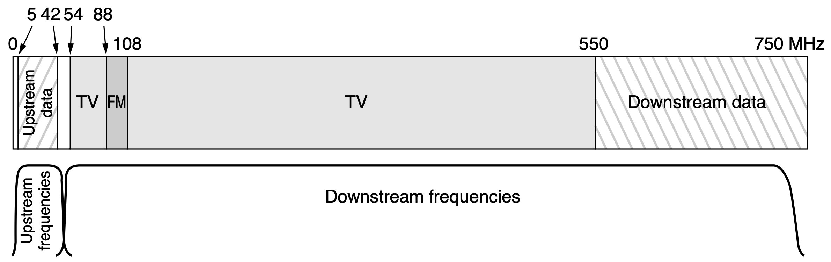
HFC Network
Frequency division multiplexing in a typical cable TV system used for Internet access
Notes:
Figure 2-46. Frequency allocation in a typical cable TV system used for Internet
access.

Slide 98
DOCSIS Standard
Data Over Cable Service Interface Specification for last-mile connections with HFC
Notes:
Cable companies operate networks that include HFC physical-layer technology
for last-mile connectivity, as well as fiber and wireless last-mile connections. The
HFC part of those networks is widely deployed across the United States, Canada,
Europe, and other markets, and use the CableLabs DOCSIS (Data Over Cable
Service Interface Specification) standards.

Slide 99
Resource Sharing in DOCSIS
More users sharing a single cable creates more competition for the bandwidth of the cable
electro-optical converter
CMTS:
Cable Modem
Termination System

Slide 100
Resource Sharing in DOCSIS
Split up long cables and connect each one directly to a fiber node, toward fewer subscribers on each segment
electro-optical converter
CMTS:
Cable Modem
Termination System

Slide 101
Resource Sharing in DOCSIS
Simultaneous users all contend for upstream and downstream access
electro-optical converter
CMTS:
Cable Modem
Termination System
Notes:
Today’s DOCSIS modems request a time to transmit, and then the CMTS
grants one or more timeslots that the modem can transmit, based on availability; si-
multaneous users all contend for upstream and downstream access. The network
uses TDM to share upstream bandwidth across multiple subscribers. Time is divid-
ed into minislots; each subscriber sends in a different minislot. The headend an-
nounces the start of a new round of minislots periodically, but the announcement
for the start of each minislot is not heard at all modems simultaneously due to sig-
nal propagation time down the cable. By knowing how far it is from the headend,
each modem can compute how long ago the first minislot really started.

Slide 102
Resource Sharing in DOCSIS
The network uses TDM to share upstream bandwidth across multiple subscribers (minislot per subscriber)
electro-optical converter
CMTS:
Cable Modem
Termination System
Notes:
Today’s DOCSIS modems request a time to transmit, and then the CMTS
grants one or more timeslots that the modem can transmit, based on availability; si-
multaneous users all contend for upstream and downstream access. The network
uses TDM to share upstream bandwidth across multiple subscribers. Time is divid-
ed into minislots; each subscriber sends in a different minislot. The headend an-
nounces the start of a new round of minislots periodically, but the announcement
for the start of each minislot is not heard at all modems simultaneously due to sig-
nal propagation time down the cable. By knowing how far it is from the headend,
each modem can compute how long ago the first minislot really started.
During initialization, the headend assigns each modem to a minislot to use for
requesting upstream bandwidth. When a computer wants to send a packet, it trans-
fers the packet to the modem, which then requests the necessary number of minis-
lots for it. If the request is accepted, the headend puts an acknowledgement on the
downstream channel telling the modem which minislots have been reserved for its
packet. The packet is then sent, starting in the minislot allocated to it. Additional
packets can be requested using a field in the header.

Slide 103
Resource Sharing in DOCSIS
The modem needs to know its distance from the headend for time/minislot synchronization
electro-optical converter
CMTS:
Cable Modem
Termination System
Notes:
Today’s DOCSIS modems request a time to transmit, and then the CMTS
grants one or more timeslots that the modem can transmit, based on availability; si-
multaneous users all contend for upstream and downstream access. The network
uses TDM to share upstream bandwidth across multiple subscribers. Time is divid-
ed into minislots; each subscriber sends in a different minislot. The headend an-
nounces the start of a new round of minislots periodically, but the announcement
for the start of each minislot is not heard at all modems simultaneously due to sig-
nal propagation time down the cable. By knowing how far it is from the headend,
each modem can compute how long ago the first minislot really started.

Slide 104
Resource Sharing in DOCSIS
Ranging: the modem sends a special packet to the headend and estimates the distance by how long it takes to get the response
electro-optical converter
CMTS:
Cable Modem
Termination System
Notes:
It is important for the modem to know its distance to the headend to get the
timing right. The modem first determines its distance from the headend by sending
it a special packet and seeing how long it takes to get the response. This process is
called ranging. Each upstream packet must fit in one or more consecutive minis-
lots at the headend when it is received. Minislot length is network dependent. A
typical payload is 8 bytes.

Slide 105
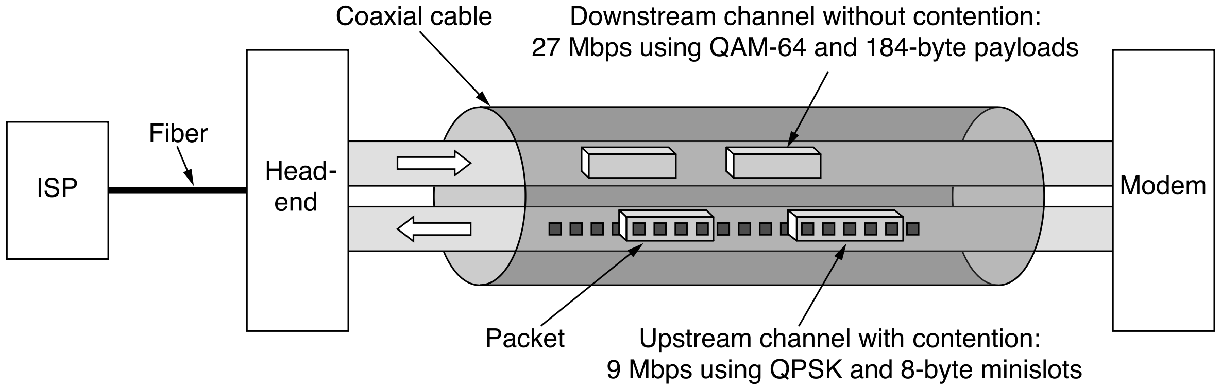
Resource Sharing in DOCSIS
Downstream: only the headend as the sole sender, no contention and thus no need for minislots; 204-byte packet with Reed-Soloman error-correcting code and some other overhead (184-byte user payload)
Notes:
The downstream channels are managed differently from the upstream chan-
nels. For starters, there is only one sender (the headend), so there is no contention
and no need for minislots. For another, the amount of traffic downstream is usually
much larger than upstream, so a fixed packet size of 204 bytes is used. Part of that
is a Reed-Solomon error-correcting code and some other overhead, leaving a user
payload of 184 bytes. These numbers were chosen for compatibility with digital
television using MPEG-2, so the TV and downstream data channels are formatted
the same way. Logically, the connections are as depicted in Fig. 2-47.

Slide 106
The Physical Layer
Systems
public switched telephone network
cellular networks
cable networks
communication satellites

Slide 107
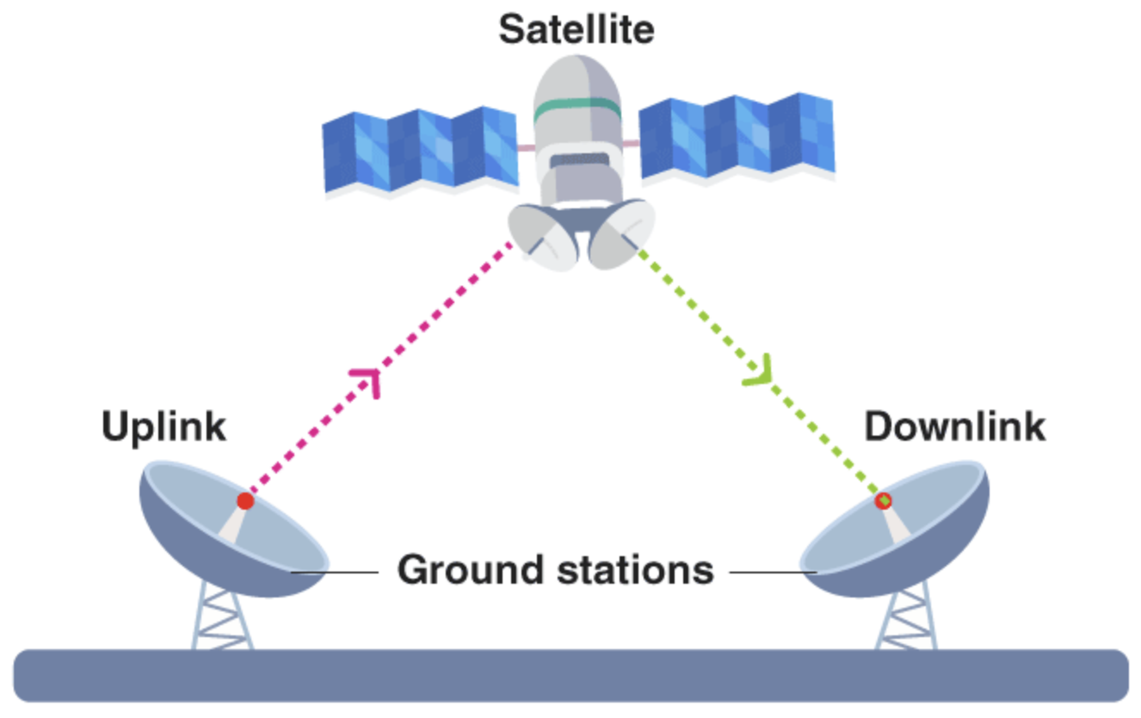
Communication Satellite
Can be thought of as a big microwave repeater in the sky
https://byjus.com/physics/satellite-communication/

Slide 108
Communication Satellite
Contain several transponders, each of which listens to some portion of the spectrum, amplifies the incoming signal, and then rebroadcasts it at another frequency to avoid interference with the incoming signal (bent pipe)
https://byjus.com/physics/satellite-communication/

Slide 109
Communication Satellite
Contain several transponders, each of which listens to some portion of the spectrum, amplifies the incoming signal, and then rebroadcasts it at another frequency to avoid interference with the incoming signal (bent pipe)
noise is also amplified in the upward signal!
https://byjus.com/physics/satellite-communication/

Slide 110
Communication Satellite
Contain several on-board processing transponders, each of which listens to some portion of the spectrum, digital-processes the incoming signal, and rebroadcasts the regenerated signal
https://byjus.com/physics/satellite-communication/
Notes:
::A satellite can regenerate digital signals using on-board processing techniques, specifically within regenerative transponders. This involves demodulating the incoming signal, processing it digitally (including error correction, decoding, and re-encoding), and then re-modulating it for retransmission. This process effectively reconstructs the original signal, mitigating the effects of noise and distortion accumulated during transmission.
Digital processing can be added to separately manipulate or redirect data streams in the
overall band, or digital information can even be received by the satellite and
rebroadcast. Regenerating signals in this way improves performance compared to a
bent pipe because the satellite does not amplify noise in the upward signal. The
downward beams can be broad, covering a substantial fraction of the earth’s sur-
face, or narrow, covering an area only hundreds of kilometers in diameter.

Slide 111
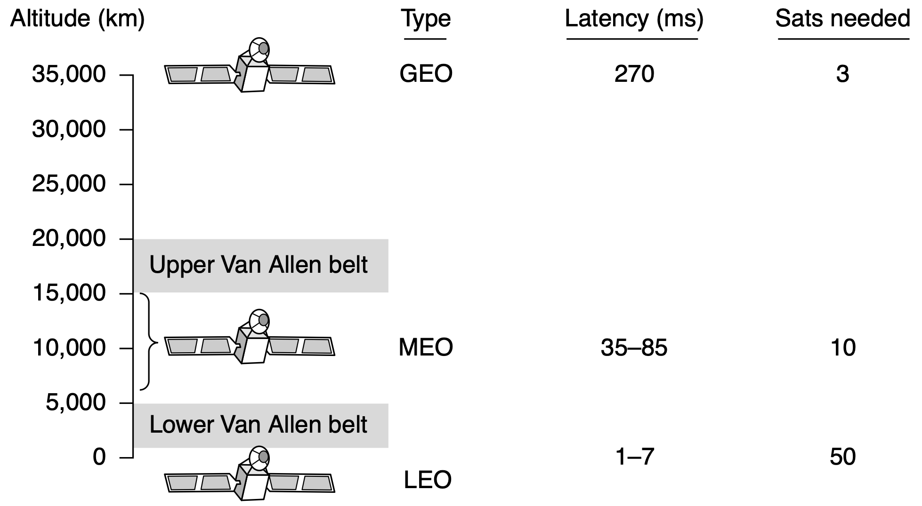

Communication Satellite
for global coverage
geosynchronous equatorial orbit
35786 km
90 minutes to circle the earth
medium earth orbit
2000~36000 km
6 hours to circle the earth
low earth orbit: 160~2000 km
Notes:
::Figure 2-48. Communication satellites and some of their properties, including
altitude above the earth, round-trip delay time, and number of satellites needed
for global coverage.
According to Kepler’s law, the orbital period of a satellite varies as the radius
of the orbit to the 3/2 power. The higher the satellite, the longer the period. Near
the surface of the earth, the period is about 90 minutes. Consequently, low-orbit
satellites pass out of view fairly quickly (due to the satellites’ motion), so many of
them are needed to provide continuous coverage and ground antennas must track
them. At an altitude of about 35,800 km, the period is 24 hours. At an altitude of
384,000 km, the period is about 1 month, as anyone who has observed the moon
regularly can testify.
A satellite’s period is important, but it is not the only issue in determining
where to place it. Another issue is the presence of the Van Allen belts, layers of
highly charged particles trapped by the earth’s magnetic field. Any satellite flying
within them would be destroyed fairly quickly by the particles. These factors lead
to three regions in which satellites can be placed safely. These regions and some
of their properties are illustrated in Fig. 2-48. Below, we will briefly describe the
satellites that inhabit each of these regions.

Slide 112
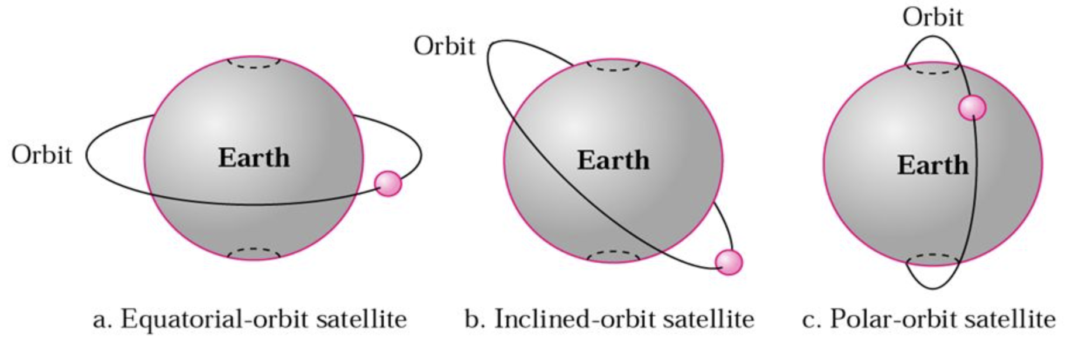
Geostationary Satellite
A satellite at an altitude of 35,800 km in a circular equatorial orbit would appear to remain motionless in the sky, so it would not need to be tracked
https://slideplayer.com/slide/8926750/
Notes:
::A circular equatorial orbit is a specific type of orbit where a satellite travels around a planet in a circular path, always staying directly above the Earth's equator. This means the orbit is both circular and aligned with the Earth's equator. A geostationary orbit, often used for communication satellites, is a type of circular equatorial orbit.

Slide 113
Geostationary Satellite
Station keeping: fine-tuning activity by on-board roket motors to counter effects of solar, lunar, and planetary gravity from moving satellites away from assigned orbit slots and orientations
https://slideplayer.com/slide/8926750/
Notes:
Modern satellites can be quite large, weighing over 5000 kg and consuming
several kilowatts of electric power produced by the solar panels. The effects of
solar, lunar, and planetary gravity tend to move them away from their assigned
orbit slots and orientations, an effect countered by on-board rocket motors. This
fine-tuning activity is called station keeping. Howev er, when the fuel for the
motors has been exhausted (typically after about 10 years), the satellite drifts and
tumbles helplessly, so it has to be turned off. Eventually, the orbit decays and the
satellite reenters the atmosphere and burns up or (very rarely) crashes to earth.

Slide 114
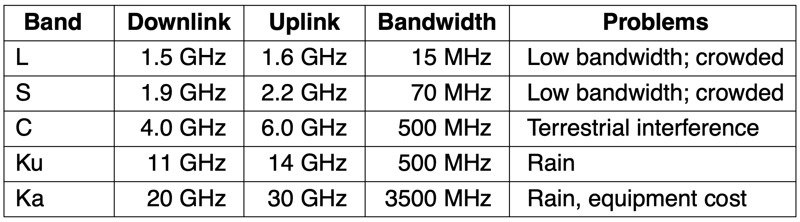
Geostationary Satellite
ITU has allocated certain frequency bands to satellite users to mitigate interference of downlink transmissions with existing microwave users
Notes:
Modern satellites can be quite large, weighing over 5000 kg and consuming
several kilowatts of electric power produced by the solar panels. The effects of
solar, lunar, and planetary gravity tend to move them away from their assigned
orbit slots and orientations, an effect countered by on-board rocket motors. This
fine-tuning activity is called station keeping. Howev er, when the fuel for the
motors has been exhausted (typically after about 10 years), the satellite drifts and
tumbles helplessly, so it has to be turned off. Eventually, the orbit decays and the
satellite reenters the atmosphere and burns up or (very rarely) crashes to earth.

Slide 115
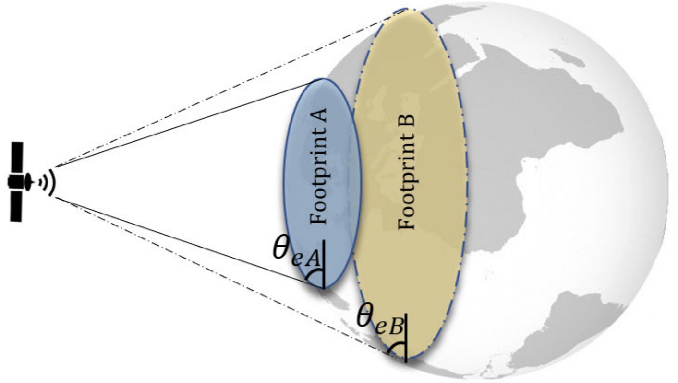
Geostationary Satellite
Footprint: geographical area of earth covered by microwave radiation from a satellite
https://ieeexplore.ieee.org/stamp/stamp.jsp?tp=&arnumber=9691385

Slide 116
Geostationary Satellite
Spot beam: downward beam focused on a small geographical area, multiple upward and downward transmissions can take place simultaneously
https://ieeexplore.ieee.org/stamp/stamp.jsp?tp=&arnumber=9691385

Slide 117
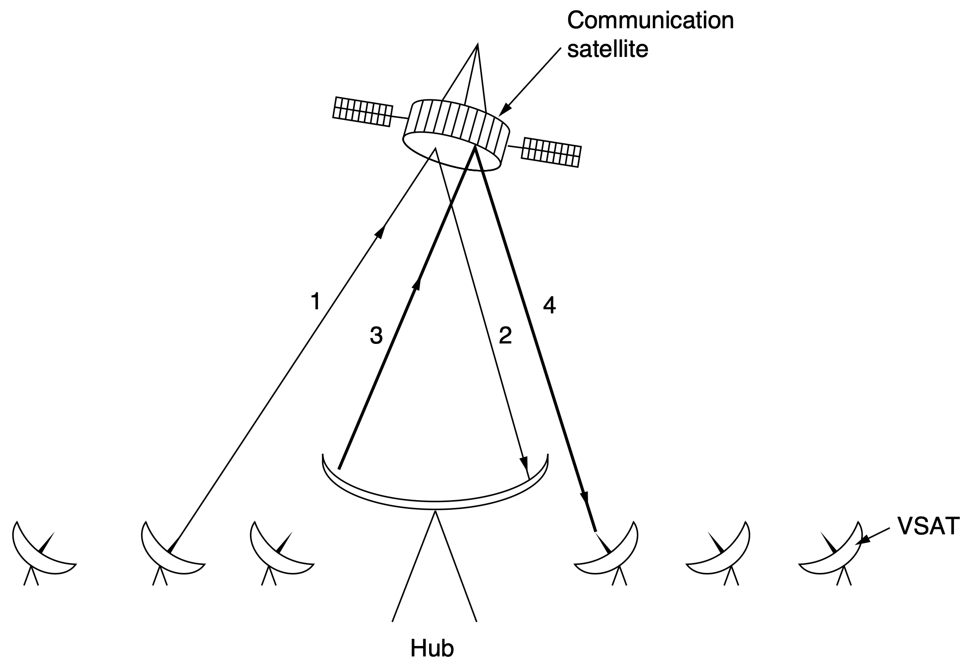
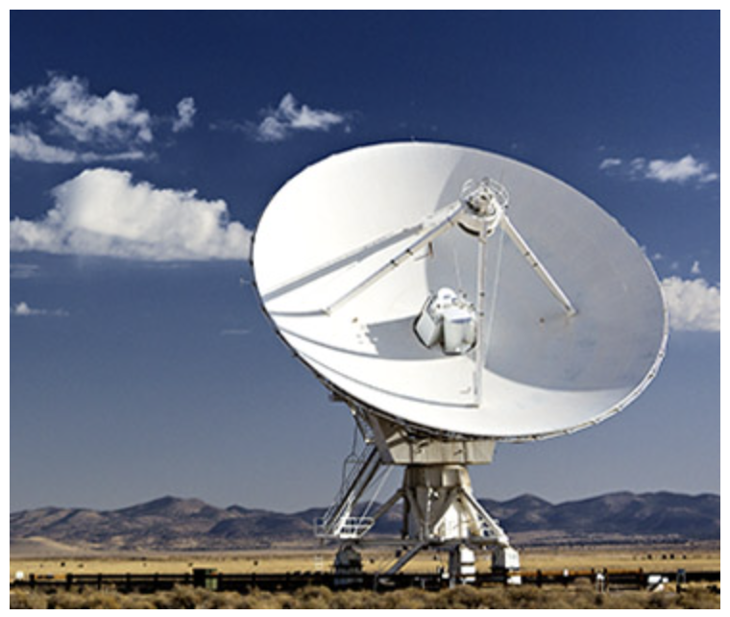
Geostationary Satellite
VSAT: Very Small Aperture Terminal low-cost microstations with about 1-Mbps uplink and several-Mbps downlink
Hub: a spectial ground station with a large, high-gain antenna to relay traffic between VSATs
https://www.lyntia.com/en/services/vsat/

Slide 118
MEO Satellite
Take about 6 hours to circle the earth
Must be tracked as they move
Have smaller footprint and require less powerful transmitters than GEOs do
For navigation systems rather than telecommunications
Notes:
At much lower altitudes, between the two Van Allen belts, we find the MEO
(Medium-Earth Orbit) satellites. As viewed from the earth, these drift slowly in
longitude, taking something like 6 hours to circle the earth. Accordingly, they
must be tracked as they move through the sky. Because they are lower than the
GEOs, they have a smaller footprint on the ground and require less powerful trans-
mitters to reach them. Currently, they are used for navigation systems rather than
telecommunications, so we will not examine them further here. The constellation
of roughly 30 GPS (Global Positioning System) satellites orbiting at about 20,200
km are examples of MEO satellites.

Slide 119
LEO Satellite
Low in altitude and rapid in motion, need a large number of them for a complete system
Ground stations need not much power
Less round-trip delay: 40~150 ms
Notes:
Moving down in altitude, we come to the LEO (Low-Earth Orbit) satellites.
Due to their rapid motion, large numbers of them are needed for a complete sys-
tem. On the other hand, because the satellites are so close to the earth, the ground
stations do not need much power, and the round-trip delay is much less: deploy-
ments see round-trip latencies of anywhere between around 40 and 150 millisec-
onds. The launch cost is substantially cheaper too. In this section, we will exam-
ine two examples of satellite constellations used for voice service: Iridium and
Globalstar.

Slide 120
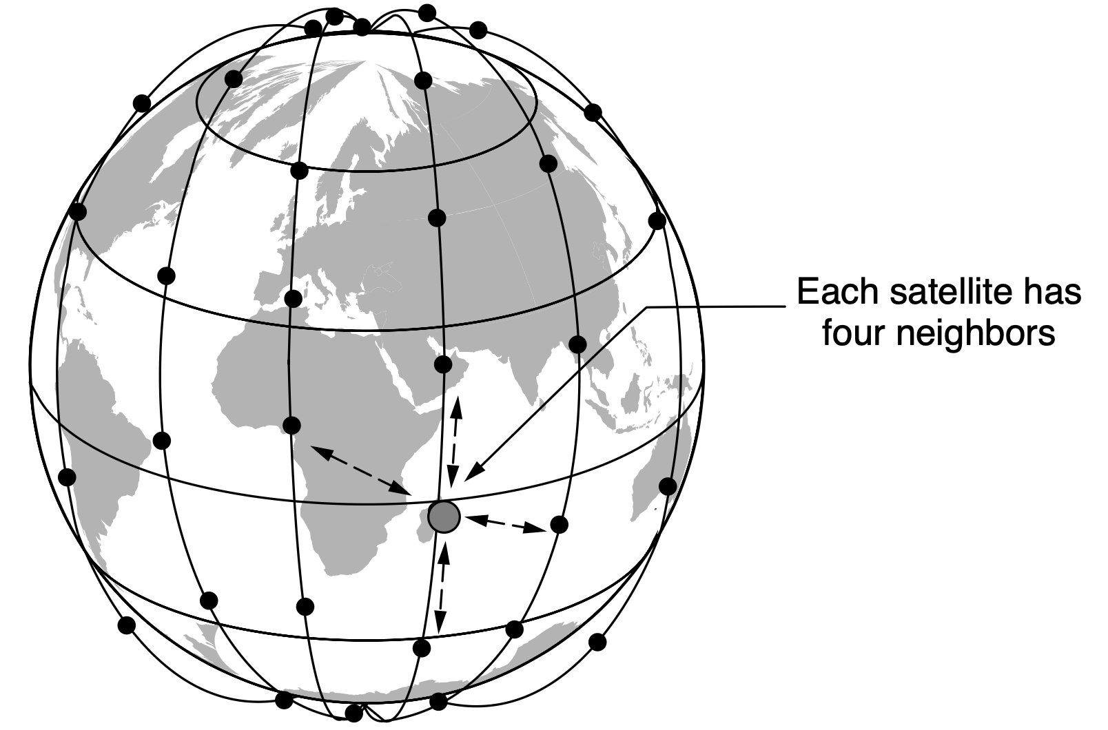

LEO Satellite
Iridium (77 satellites) then Dysprosium (66 satellites): as soon as one satellite goes out of view, another would replace it
https://insidegnss.com/iridium-next-leo-satellites-as-an-alternative-pnt-in-gnss-denied-environments-part-1/
Notes:
For the first 30 years of the satellite era, low-orbit satellites were rarely used
because they zip into and out of view so quickly. In 1990, Motorola broke new
ground by filing an application with the FCC asking for permission to launch 77
low-orbit satellites for the Iridium project (element 77 is iridium). The plan was
later revised to use only 66 satellites, so the project should have been renamed
Dysprosium (element 66), but that probably sounded too much like a disease. The
idea was that as soon as one satellite went out of view, another would replace it.
This proposal set off a feeding frenzy among other communication companies. All
of a sudden, everyone wanted to launch a chain of low-orbit satellites.
The Iridium satellites are positioned at an altitude of 670 km, in circular polar
orbits. They are arranged in north-south necklaces, with one satellite every 32
degrees of latitude, as shown in Fig. 2-51. Each satellite has a maximum of 48
cells (spot beams) and a capacity of 3840 channels, some of which are used for
paging and navigation, while others are used for data and voice.

Slide 121
LEO Satellite
670 km in circular polar orbits
One satellite every 32-degrees of latitude along north-south necklaces, 48 cells (spot beams), 3840 channels
https://insidegnss.com/iridium-next-leo-satellites-as-an-alternative-pnt-in-gnss-denied-environments-part-1/
Notes:
The Iridium satellites are positioned at an altitude of 670 km, in circular polar
orbits. They are arranged in north-south necklaces, with one satellite every 32
degrees of latitude, as shown in Fig. 2-51. Each satellite has a maximum of 48
cells (spot beams) and a capacity of 3840 channels, some of which are used for
paging and navigation, while others are used for data and voice.

Slide 122
LEO Satellite
Globalstar (48 satellites) uses bent-pipe design
Call from ground is sent back to earth, picked up by a bent-pipe connection, and then relayed
Notes:
An alternative design to Iridium is Globalstar. It is based on 48 LEO satel-
lites but uses a different switching scheme than the one used by Iridium. Whereas
Iridium relays calls from satellite to satellite, which requires complex switching
equipment in the satellites, Globalstar uses a traditional bent-pipe design. The call
originating at the North Pole in Fig. 2-52(b) is sent back to earth and picked up by
the large ground station at Santa’s Workshop. The call is then routed via a terres-
trial network to the ground station nearest the callee and delivered by a bent-pipe
connection as shown. The advantage of this scheme is that it puts much of the
complexity on the ground, where it is much easier to manage. Also, the use of
large ground station antennas that can put out a powerful signal and receive a weak
one means that lower-powered telephones can be used. After all, the telephone
puts out only a few milliwatts of power, so the signal that gets back to the ground
station is fairly weak, even after having been amplified by the satellite.

Slide 123
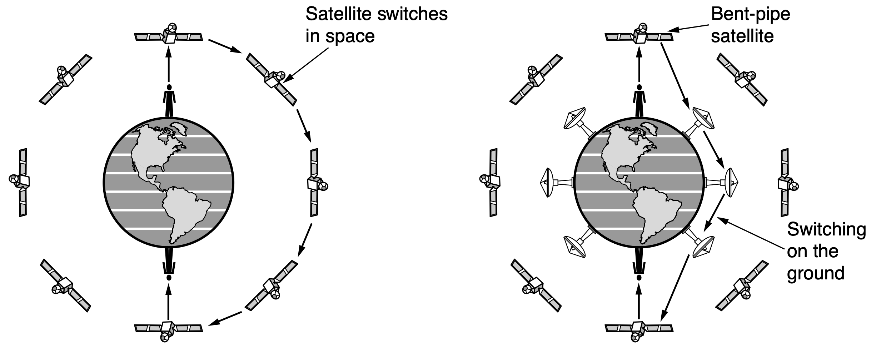
LEO Satellite
relaying in space:
Iridium
relaying on the ground:
Globalstar

Slide 124
LEO Satellite
Cubesats: satellites in units of 10 cm x 10 cm x 10 cm cubes with low launch costs
Progressive pitch: in OneWeb’s deployment of satellite-based Internet backbone network, satellites are turned slightly to avoid interference with GEO satellites transmitting in the same band
Notes:
::Progressive pitch is a technique used by low Earth orbit (LEO) satellite constellations, like OneWeb, to avoid interference with geostationary (GEO) satellites, particularly those operating in the Ku-band. It involves slightly tilting the LEO satellite's antenna beams as it moves across the sky, adjusting the pitch angle and the number of off-beams based on the satellite's latitude. This tilting helps maintain a specific angle of separation from the GEO satellites, preventing signal interference.
Satellites continue to be launched at a rate of around 20 satellites per year, in-
cluding ever-larger satellites that now weigh over 5000 kilograms. But there are
also very small satellites for the more budget-conscious organization. To make
space research more accessible, academic researchers from California Polytechnic
University and Stanford got together in 1999 to define a standard for miniature sat-
ellites and an associated launcher that would greatly lower launch costs (Nugent et
al., 2008). These cubesats are satellites in units of 10 cm × 10 cm × 10 cm cubes,
each weighing no more than 1 kilogram, that can be launched for a price as little as
$40,000 each. The launcher flies as a secondary payload on commercial space
missions. It is basically a tube that takes up to three units of cubesats and uses
springs to release them into orbit. Roughly 20 cubesats have launched so far, with
many more in the works. Most of them communicate with ground stations on the
UHF and VHF bands.
Another deployment of LEO satellites is an attempted satellite-based Internet
backbone network, OneWeb’s deployment will initially involve a constellation of
several hundred satellites. If successful, the project promises to bring high-speed
Internet access to places which may not currently have it. The satellites will oper-
ate in the Ku band and will use a technique called ‘‘progressive pitch,’’ whereby
the satellites are turned slightly to avoid interference with geostationary satellites
that are transmitting in the same band.

Slide 125
The Physical Layer
Systems
public switched telephone network
cellular networks
cable networks
communication satellites
Notes:
Various aspects of the physical layer involve regulatory and policy decisions
that ultimately affect how these technologies are used and developed. We briefly
discuss ongoing policy activity in both terrestrial networks (i.e., the telephone and
cable networks) and wireless networks.

Slide 126
Spectrum Allocation
National and international agreements about who gets to use which frequencies
National governments allocate spectrum for AM and FM radio, television, and mobile phones, as well as for telephone companies, police, maritime, navigation, military, government, and many other competing users

Slide 127
Spectrum Allocation
National and international agreements about who gets to use which frequencies
ITU-R (WRC) tries to coordinate this allocation so devices that work in multiple countries can be manufactured

Slide 128
Spectrum Allocation
When a portion of spectrum has been allocated to a specific use, how to determine which company gets to use which frequencies?
Three conventional algorithms: beauty contest lottery auction

Slide 129
Spectrum Allocation
Beauty contest requires each carrier to explain why its proposal serves the public interest best
Government officials then decide which of the nice stories they enjoy most
Limitation: potential bribery, corruption, etc.
Notes:
The oldest algorithm, often called the beauty contest, requires each carrier to explain why its
proposal serves the public interest best. Government officials then decide which of
the nice stories they enjoy most. Having a government official award property
worth billions of dollars to his favorite company often leads to bribery, corruption,
nepotism, and worse. Furthermore, even a scrupulously honest government official
who thought that a foreign company could do a better job than any of the national
companies would have a lot of explaining to do.

Slide 130
Spectrum Allocation
Lottery holds a lottery among the interested companies
Limitation: companies with no interest in using the spectrum can enter and win the lottery, and then resell the spectrum to a carrier at a huge profit and with no risk
Notes:
This observation led to the second algorithm: holding a lottery among the in-
terested companies. The problem with lotteries is that companies with no interest
in using the spectrum can enter the lottery. If, say, a hamburger restaurant or shoe
store chain wins, it can resell the spectrum to a carrier at a huge profit and with no
risk.

Slide 131
Spectrum Allocation
Auction allocates the spectrum to the highest bidder
Limitation: carriers win the auction yet with so much debt, close to bankruptcy or at least to recoup licensing fees in many years
Notes:
Bestowing huge windfalls on alert but otherwise random companies has been
severely criticized by many, which led to the third approach: auction the spectrum
to the highest bidder. When the British government auctioned off the frequencies
needed for 3G mobile systems in 2000, it expected to get about $4 billion. It ac-
tually received about $40 billion because the carriers got into a feeding frenzy,
scared to death of missing the mobile boat. This event switched on other govern-
ments’ greedy bits and inspired them to hold their own auctions. It worked, but it
also left some of the carriers with so much debt that they are close to bankruptcy.
Even in the best cases, it will take many years to recoup these licensing fees.

Slide 132
Spectrum Allocation
Not allocate them at all! let everyone transmit at will, but regulate the power used so that stations have such a short range that they do not interfere with each other
ISM (Industrial, Scientific, Medical) bands for unlicensed usage
Notes:
A completely different approach to allocating frequencies is to not allocate
them at all. Instead, let everyone transmit at will, but regulate the power used so
that stations have such a short range that they do not interfere with each other.
Accordingly, most governments have set aside some frequency bands, called the
ISM (Industrial, Scientific, Medical) bands for unlicensed usage. Garage door
openers, cordless phones, radio-controlled toys, wireless mice, and numerous other
wireless household devices use the ISM bands. To minimize interference between
these uncoordinated devices, the FCC mandates that all devices in the ISM bands
limit their transmit power (e.g., to 1 Watt) and use techniques to spread their sig-
nals over a range of frequencies. Devices may also need to take care to avoid inter-
ference with radar installations.

Slide 133
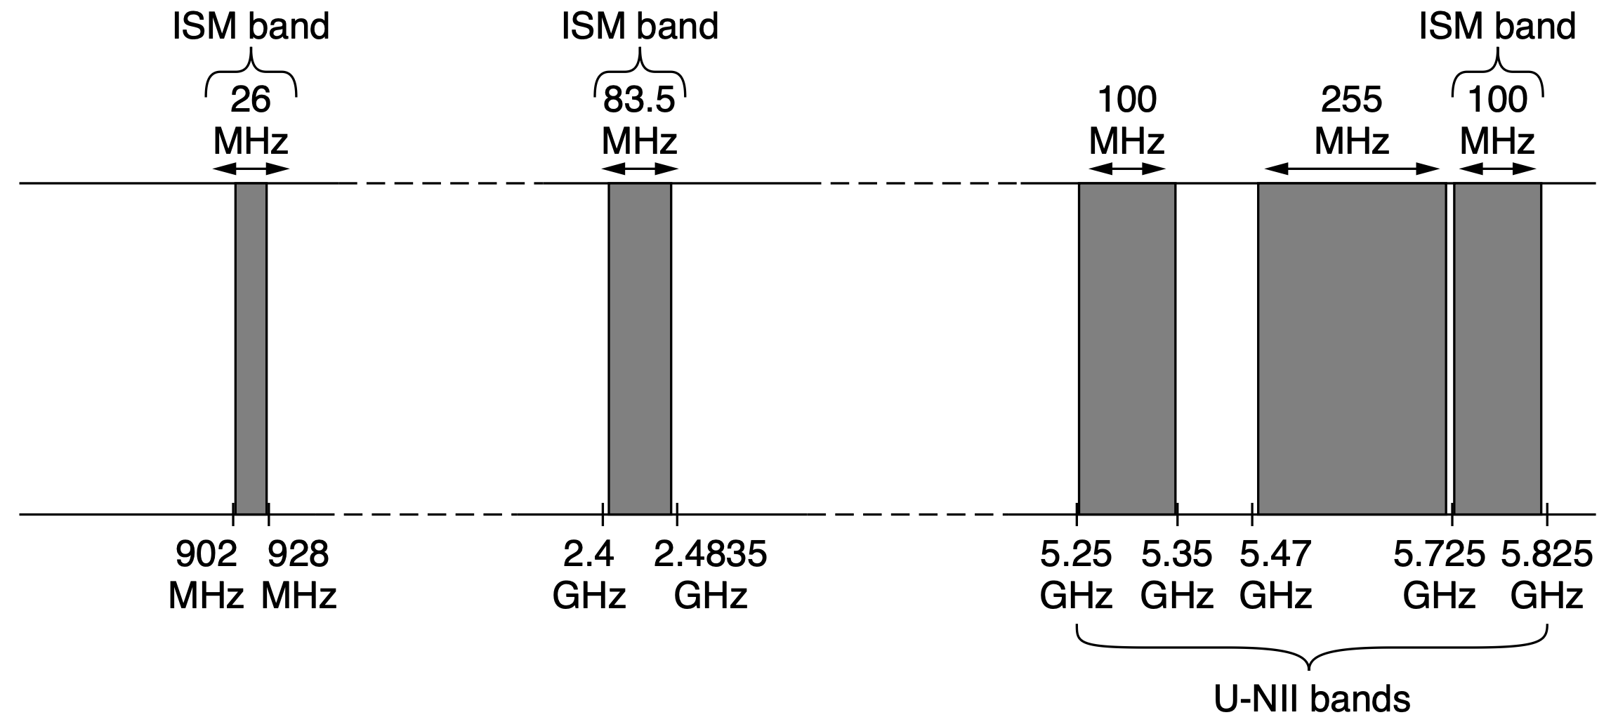
Spectrum Allocation
Not allocate them at all!
ISM (Industrial, Scientific, Medical)
U-NII (Unlicensed National Information Infrastructure)
more:
white spaces around 700 MHz, 57~64 GHz, etc
Notes:
The location of these bands varies somewhat from country to country. In the
United States, for example, the bands that networking devices use in practice with-
out requiring a FCC license are shown in Fig. 2-53. The 900-MHz band was used
for early versions of 802.11, but it is crowded. The 2.4-GHz band is available in
most countries and widely used for 802.11b/g and Bluetooth, though it is subject to
interference from microwave ovens and radar installations. The 5-GHz part of the
spectrum includes U-NII (Unlicensed National Information Infrastructure)
bands. The 5-GHz bands are relatively undeveloped but, since they hav e the most
bandwidth and are used by WiFi specifications such as 802.11ac, they hav e be-
come massively popular and crowded, as well.

Slide 134
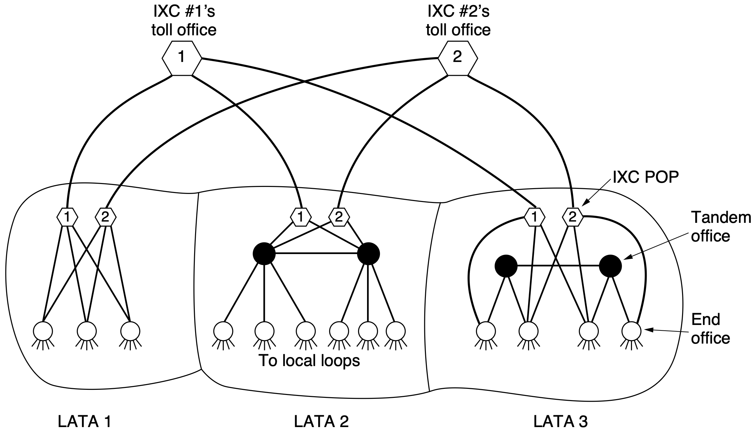
Telephone Network
IntereXchange Carrier
Point of Presence
LEC:
Local Exchange Carrier
Local Access and Transport Areas
Notes:
Figure 2-54. The relationship of LATAs, LECs, and IXCs. All the circles are
LEC switching offices. Each hexagon belongs to the IXC whose number is in it.
Of direct relevance to our studies is that the brand new competitive framework
caused a key technical feature to be added to the architecture of the telephone net-
work. To make it clear who could do what, the United States was divided up into
164 LATAs (Local Access and Transport Areas). Very roughly, a LAT A is about
as big as the area covered by one area code. Within each LATA, there was one
LEC (Local Exchange Carrier) with a monopoly on traditional telephone service
within its area. The most important LECs were the BOCs, although some LATAs
contained one or more of the 1500 independent telephone companies operating as
LECs.
The new feature was that all inter-LATA traffic was handled by a different kind
of company, an IXC (IntereXchange Carrier). Originally, AT&T Long Lines
was the only serious IXC, but now there are well-established competitors such as
Verizon and Sprint in the IXC business. One of the concerns at the breakup was to
ensure that all the IXCs would be treated equally in terms of line quality, tariffs,
and the number of digits their customers would have to dial to use them. The way
this is handled is illustrated in Fig. 2-54. Here we see three example LATAs, each
with several end offices. LATAs 2 and 3 also have a small hierarchy with tandem
offices (intra-LATA toll offices).
Any IXC that wishes to handle calls originating in a LATA can build a switch-
ing office called a POP (Point of Presence) there. The LEC is required to connect
each IXC to every end office, either directly, as in LAT As 1 and 3, or indirectly, as
in LATA 2. Furthermore, the terms of the connection, both technical and financial,
must be identical for all IXCs. This requirement enables, a subscriber in, say,
LATA 1, to choose which IXC to use for calling subscribers in LATA 3.

Slide 135
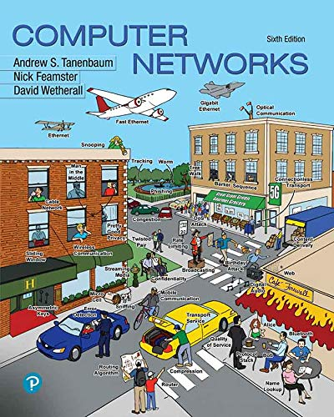
Chapter 2.5-2.11
Notes:
The following content corresponds to chapter 2 (mostly 2.1 – 2.4)
atop the basic working principles of memory hierarchy we have learnt from Appendix B.

Slide 136
?

Slide 137

Thank You
be consistent

Slide 138

be consistent
gently, but firmly

Slide 139
#What’s More
The Story of Xiaoyan
Peaceful Warrior
“Old urges continue to arise, but urges do not matter; only actions do. A warrior is as a warrior does.”

