Slide 1
Race Condition Attack

Slide 2
Outline
What is race condition
Launch race condition attacks
Defense
Lab: Race Condition Vulnerability Lab

Slide 3

Race Condition at Different Levels
Application: this lecture
Kernel: Dirty COW Attack
Hardware (CPU): Meltdown/Spectre Attack

Slide 4
What Is Race Condition?

Slide 5
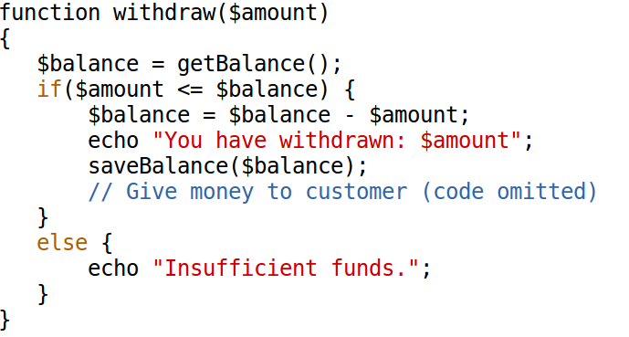

An Example

Slide 6
Definition of Race Condition
From Wikipedia:
A race condition or race hazard is the condition of an electronics, software, or other system where the system's substantive behavior is dependent on the sequence or timing of other uncontrollable events. It becomes a bug when one or more of the possible behaviors is undesirable.

Slide 7
Race Condition Vulnerability

Slide 8

Background: Symbolic Link

Slide 9
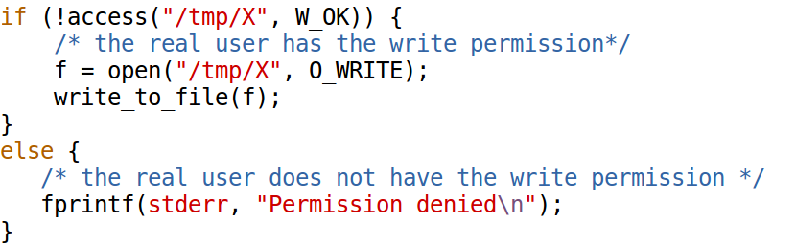
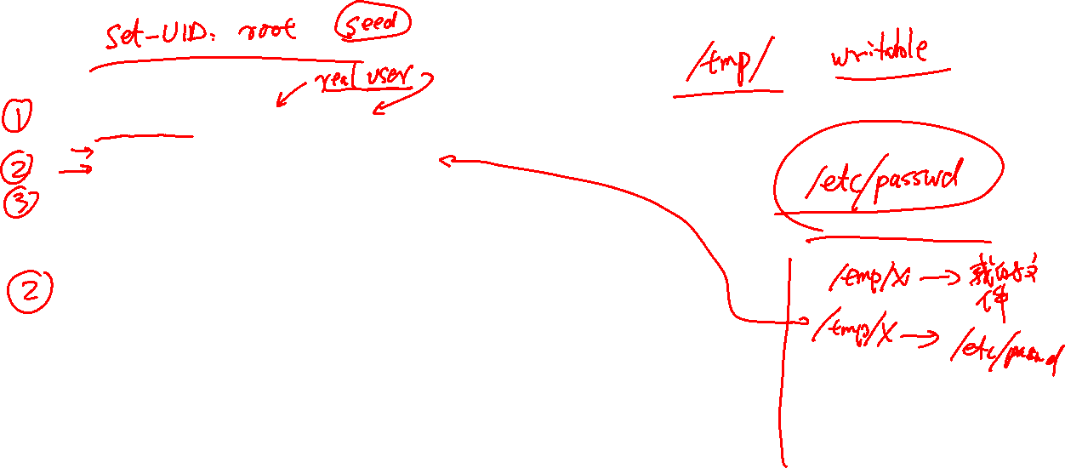
A Vulnerable Program

Slide 10

How to Attack
access(“/tmp/x”, …)
open(“/tmp/x”, …)

Slide 11
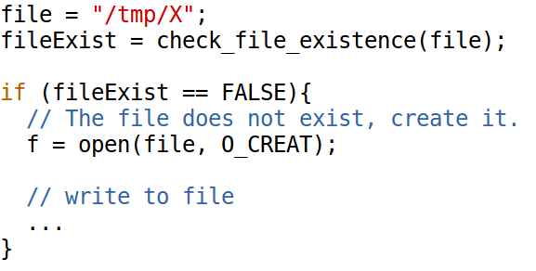
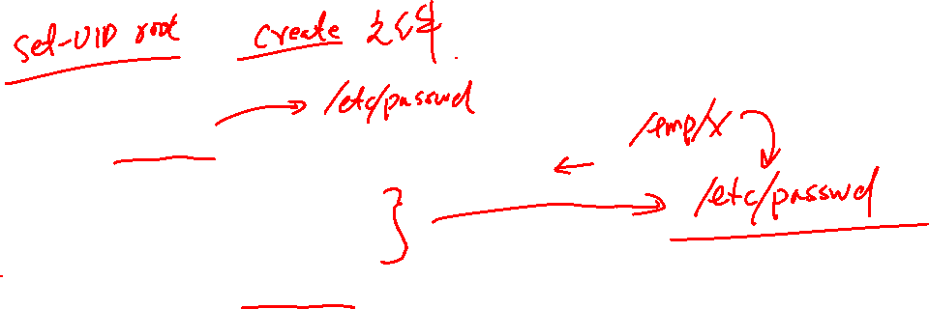
Another Vulnerable Program

Slide 12

Special Type of Race Condition
TOCTTOU: Time Of Check To Time Of Use

Slide 13
Launch the attack

Slide 14
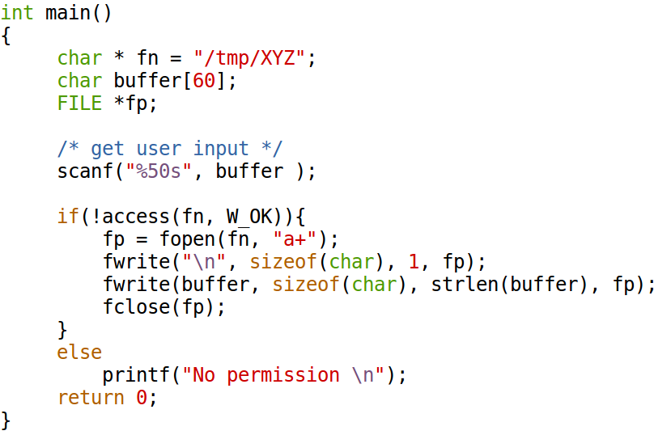
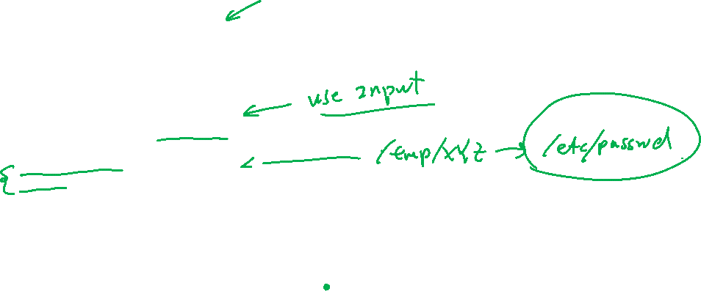
The Vulnerable Program

Slide 15
Targets: How to Gain Root Privilege?
Discussion: If you can modify a root-owned file, which file do you want to modify so you can gain the root privilege?

Slide 16
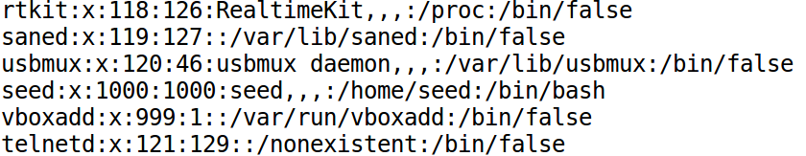

How to Gain Root Privilege?
The /etc/passwd file
test:U6aMy0wojraho:0:0:test:/root:/bin/bash

Slide 17
Preparation
Turn off the countermeasure
// On Ubuntu 20.04, use the following:
$ sudo sysctl -w fs.protected_symlinks=0
$ sudo sysctl fs.protected_regular=0

Slide 18
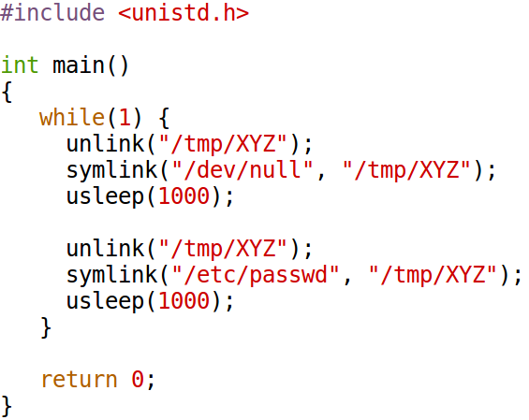
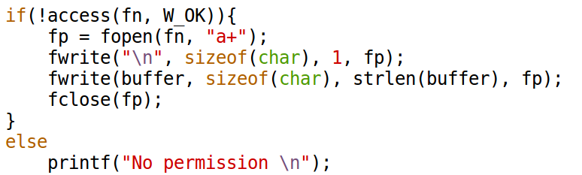
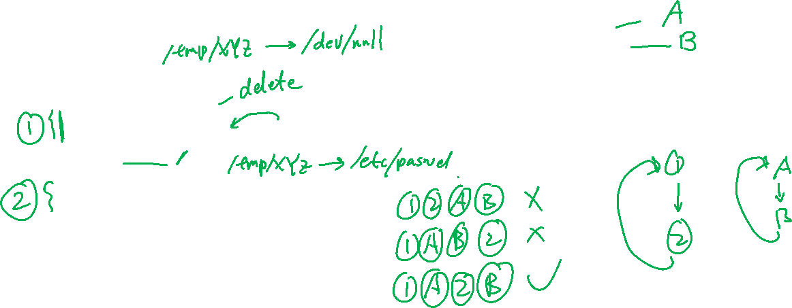
Attacking Script
Attack Program (attack_process.c)
Vulnerable Program

Slide 19
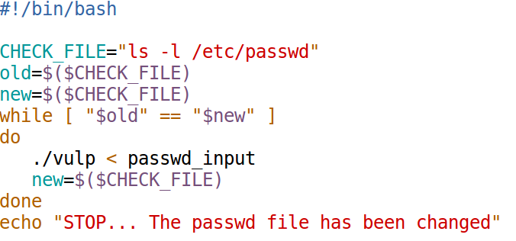

Run the vulnerable program repeatedly

Slide 20
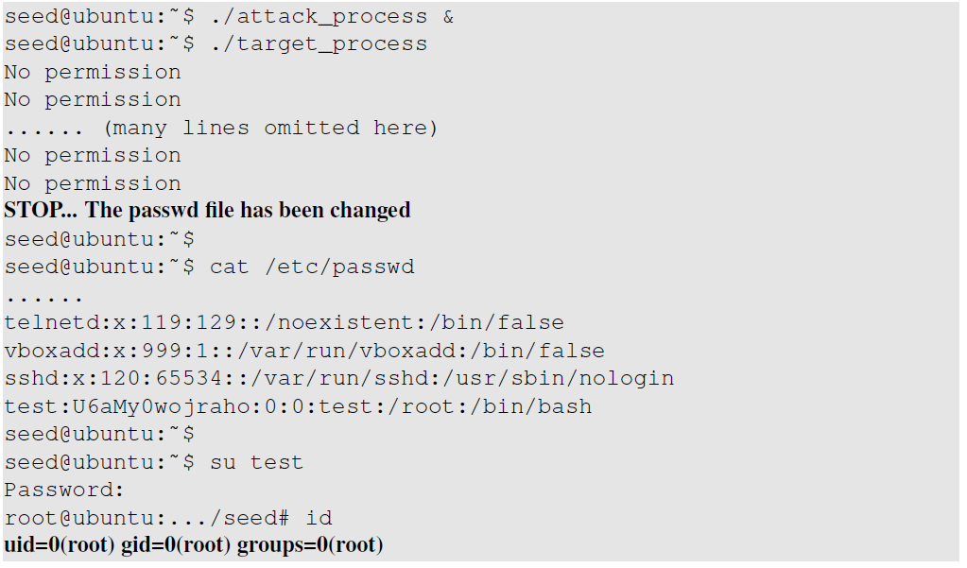

Attack Result: Demo

Slide 21
An Improvement

Slide 22
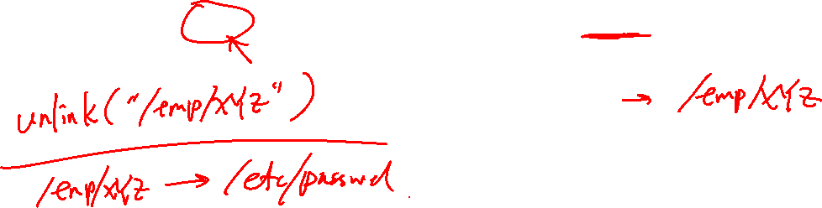
A Problem
Notes:
Discuss the problem in this slide.
See the book for the problem description.

Slide 23
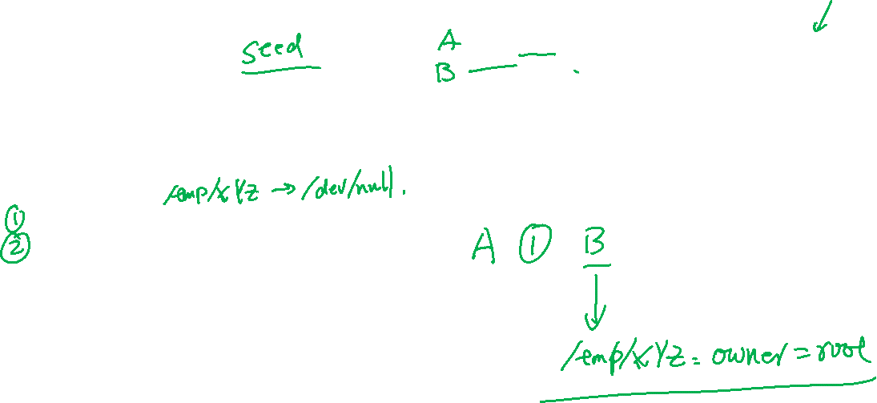
The Problem in Our Code
Attack Program (attack_process.c)
Vulnerable Program (root process)

Slide 24
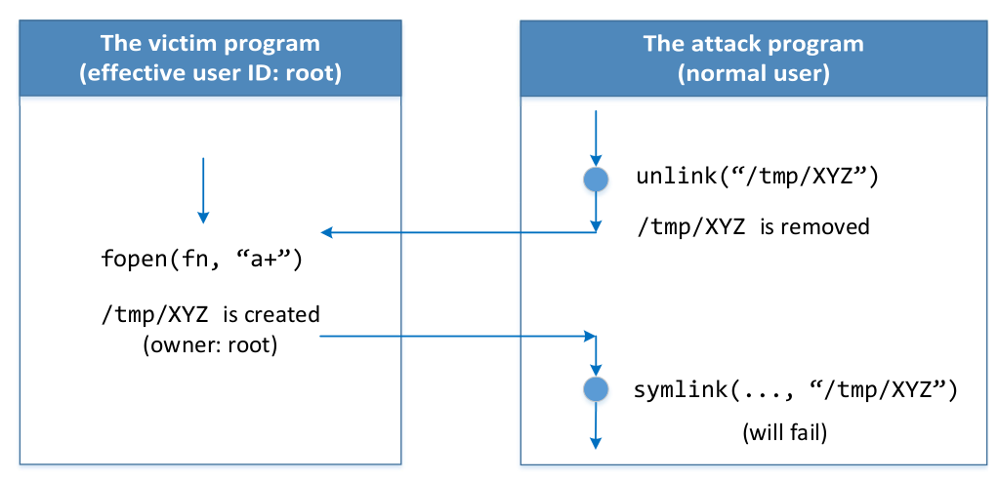
The Race Condition in the Attack Program

Slide 25
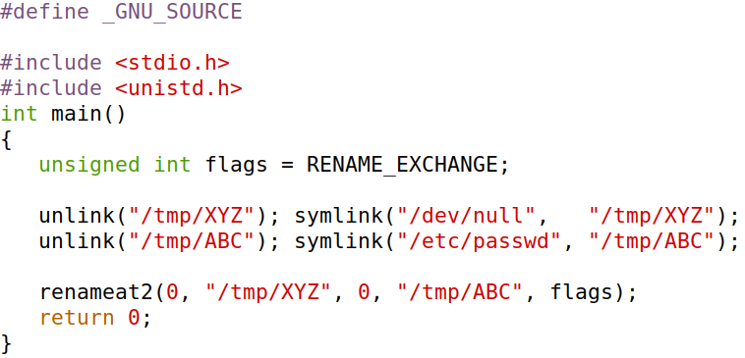
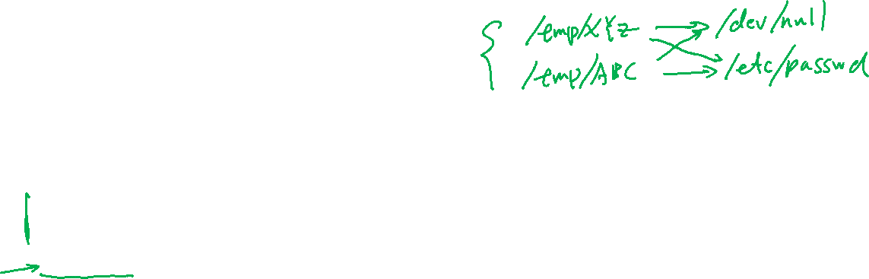
Improvement

Slide 26
countermeasure

Slide 27
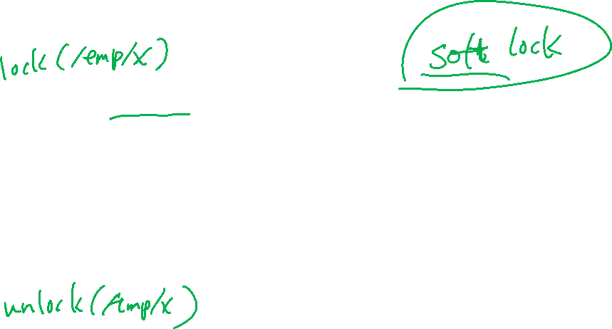
Locking the File

Slide 28
Note on File Locking
File locks under Unix are by default advisory. This means that cooperating processes may use locks to coordinate access to a file among themselves, but uncooperative processes are also free to ignore locks and access the file in any way they choose.

Slide 29
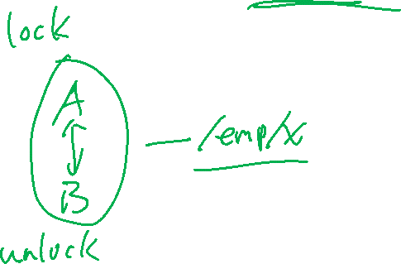
Make Operation Atomic

Slide 30


Example 1: Make unlink + symlink Atomic

Slide 31

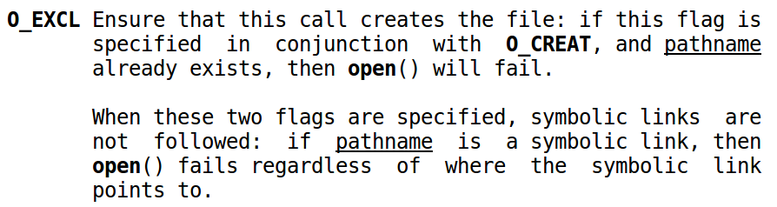
Example 2: Make existence-checking + open Atomic
f = open(file, O_CREAT | O_EXCL);

Slide 32

Example 3: Make access + open Atomic

Slide 33
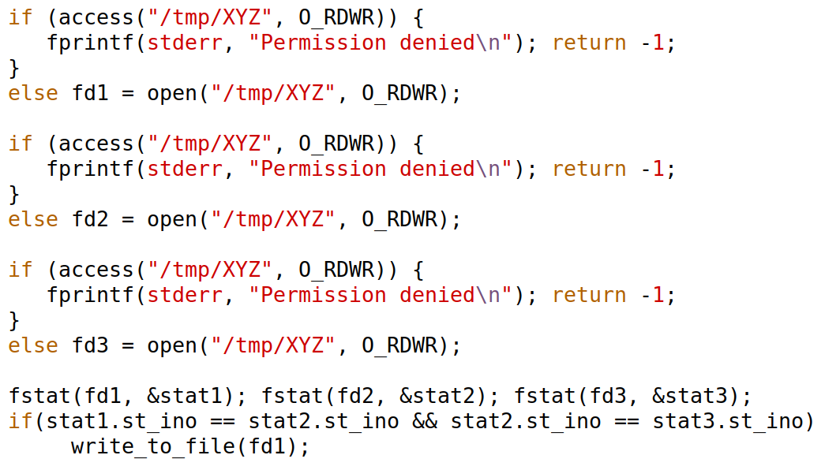
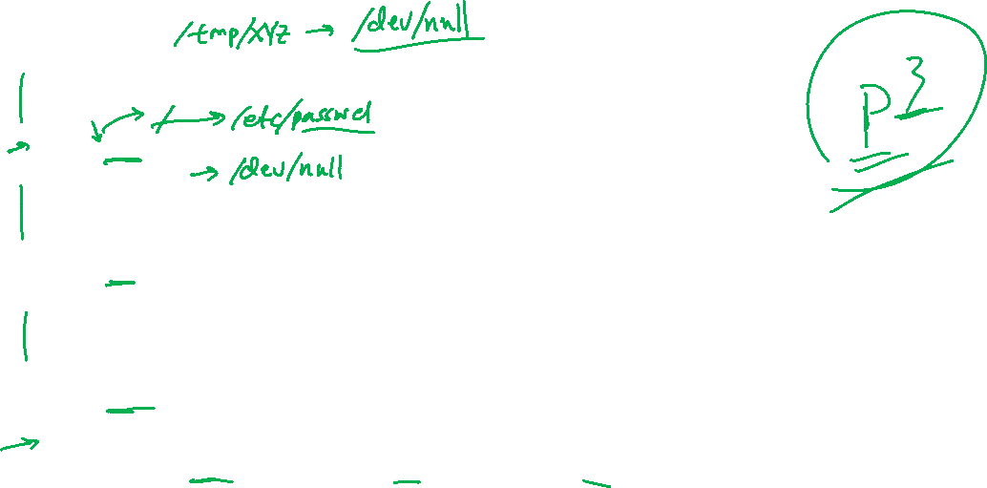
Check-Use-Repeat Approach

Slide 34
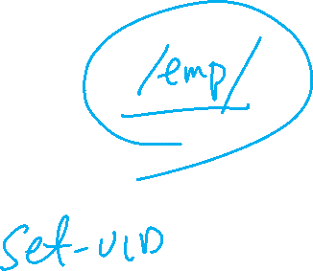
Ubuntu's Sticky Link Protection
$ sudo sysctl -w fs.protected_symlinks=1

Slide 35
Least-Privilege Principle

Slide 36
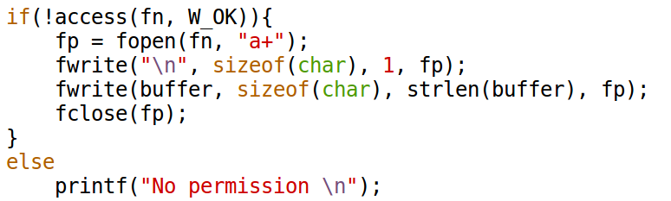
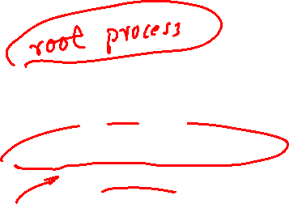
The Fundamental Problem

Slide 37
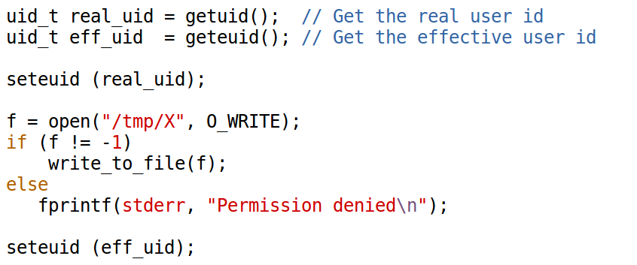

Applying the Least-Privilege Principle

