Slide 1
TEAM TEXAS_LONGHORNS
Title odds, top 5 contenders
Who wins the 2019 national title?
Villanova
Villanova
38.6%
Duke
14.5%
Projected #1 seed, East
38.6%
Michigan State
8.9%
Virginia
7.4%
chance to win it all, across 10,000 simulated tournaments
Kentucky
4.3%
Projected margin +32.8 pts / 100 poss. (80% band +24.5 to +41.2)
A forecast, not a guess.
1
Notes:
OPEN WITH THE ANSWER (30s). The NCAA hired us as its new data team and asked one question: who wins the next title? Our system's answer: Villanova, with a 38.6 percent chance to win the 2019 championship, well ahead of Duke at 14.5. That number is not a hunch. It comes from projecting every team's strength into next season, building a likely field of 68, and playing that tournament ten thousand times inside BigQuery. It is a forecast with honest uncertainty: Villanova's projected margin has an 80 percent band of plus 24.5 to plus 41.2, and the projection cannot see early NBA departures or transfers.

Slide 2


THE LEAGUE
A strong, changing league with a noisy March
Strongest conferences, 2017-18
A faster game
More threes
Big 12
+17.0
Big East
+15.8
66.5 → 70.9
34.3% → 37.4%
ACC
+15.7
Big Ten
+14.7
possessions per game, 2014-15 to 2017-18
share of shots from three, up every season
SEC
+14.4
Average adjusted margin, pts / 100 poss.
24%
CHAMPION'S STRENGTH RANK GOING IN
So we don't pick a team.
We play the tournament 10,000 times and count champions.
#4
#8
#3
#1
of NCAA tournament games went to the worse seed, 2015–2017
Duke
2014-15
Villanova
2015-16
UNC
2016-17
Villanova
2017-18
2
Notes:
THE LEAGUE (30s). First, what the league looks like. The Big 12 was the strongest conference in 2017-18, just ahead of the Big East and ACC. The game is changing: pace rose from 66.5 to about 71 possessions per game, and the share of shots from three went up every season, from 34.3 to 37.4 percent. And March is noisy: about one tournament game in four went to the worse seed. Three of the last four champions were not the strongest team going in. So we do not pick a team. We play the tournament ten thousand times and count champions.

Slide 3



ARCHITECTURE
One governed engine, from raw data to answer
SOURCES
dbt ON BIGQUERY
INTELLIGENCE
DELIVERY
ncaa_basketball
raw tables, read-only
stg_ · dq_
clean + quality gate
BQML win model
P(A beats B), any matchup
BigQuery Data Agent
Agents Hub · in progress
2018-19 projection
field of 68 + bracket
f_ report cards
every team, every season
Looker Studio
report · in progress
Knowledge Catalog
scans + 151-term glossary
10,000× simulation
pure SQL, seeded
mart_ tables
what the agent reads
Gemini Enterprise
target state
AI.GENERATE
anonymized scouting
Compute stays in BigQuery
Every claim traces to SQL
Rebuilt from code
Models, simulation and Gemini run where the data lives.
Answers come from governed tables; Gemini never sees a team name.
Two commands, raw data to marts; 322 dbt tests pass.
3
Notes:
ARCHITECTURE (1 min 15s). Read left to right. Raw NCAA tables and Knowledge Catalog scans come in; one dbt project cleans them, tests them, and builds a report card for every team and season. The intelligence layer is all in BigQuery: a BQML model predicts any single matchup, we project every team into next season and build a likely field of 68, a pure-SQL simulation plays that bracket ten thousand times, and AI.GENERATE writes scouting reports. On top, the Data Agent and the Looker report are being built now on these marts, and Gemini Enterprise is the target front door. Three choices, and why: compute stays next to the data, so governance holds. Every answer traces to SQL, and Gemini sees numbers, never names, so it cannot lean on what it knows about 2019. And everything rebuilds from code: one command for the pipeline, one for the Gemini outputs, and 322 dbt tests pass.

Slide 4
STRATEGY
Why we trust the pick
Tested on unseen tournaments · next-season projection RMSE 6.49 vs 7.63 carrying ratings forward
What the model sees in Villanova
Prediction error, lower is better (log loss)
201 games, 2015–2017 NCAA tournaments
Adjusted offense
+14.8 pts / 100 poss. vs. field
0.703
0.574
Adjusted scoring margin
+18.4 pts / 100 poss. vs. field
0.524
Strength of schedule
+5.3 vs. field
FRONT OFFICE ANALYST · REHEARSED Q&A
Did you see past champions coming?
Our model
Better seed wins
Better record wins
Before each tournament, Duke ranked 4th (10.3%), Villanova 6th (5.2%) and North Carolina 3rd (11.7%) in our title odds.
9% less error than seeds · beat both baselines every year
↳ SQL-verified answer, stored in mart_agent_qa
4
Notes:
WHY TRUST IT (1 min). A forecast is only worth something if it beats the simple answers. We replayed the 2015, 2016 and 2017 tournaments, 201 games, using only games played before each one. Log loss punishes confident wrong calls. Our model's error was 0.524, against 0.574 for "the better seed always wins" and 0.703 for "the better record always wins". It beat both baselines in all three years, and called 72 percent of games. The forecast uses the ratings-only version, which scored 0.526. In Villanova's 2017-18 profile, the model weighs adjusted offense, adjusted scoring margin, and strength of schedule most. The next-season projection also beat simply carrying ratings forward, RMSE 6.49 against 7.63. And the rehearsed agent answer, verified in SQL, shows the real champions ranked fourth, sixth and third in our pre-tournament odds.

Slide 5



DISCOVERY & GROWTH
Three walls, three workarounds
THE WALL
HOW WE GOT PAST IT
No permission to create Dataform repositories
dbt on BigQuery
runs from laptops and CI, tests built in
AI.GENERATE_TABLE needs a connection we can't create
AI.GENERATE with output_schema
the same structured scouting output
Gemini already knows who won in 2019
Anonymized prompts
numbers only: no team name, conference or seed
KEY TAKEAWAY
Keep compute next to the data. Ground every AI claim in a query.
5
Notes:
WHAT WE LEARNED (45s). The judges asked what we explored and what we overcame. We hit three walls. No permission for Dataform, so we moved to dbt, which gave us tests and CI for free. AI.GENERATE_TABLE needs a connection we could not create, so we used AI.GENERATE with an output schema and got the same structured scouting reports. And Gemini already knows real results after 2018, so our prompts give it only a team's numbers, with no name, conference or seed, and it cannot peek. The lesson we would take to any client: keep compute next to the data, and ground every AI claim in a query.

Slide 6




CONSULTING · 66DEGREES
Same engine, any client
Discover
Knowledge Catalog
Govern
dbt semantic layer
Predict
BQML + simulation
Explain
grounded Data Agent
Retail
Banking
Subscriptions
B2B sales
Which products sell out next season
Which loans are likely to default
Which customers are about to churn
Which deals close this quarter
Grounded. Reproducible. Reusable.
Packaged as a 2-week discovery-to-agent engagement for clients already on GCP
6
Notes:
CONSULTING REUSE AND CLOSE (1 min). Nothing here is really about basketball. The pattern is: discover the data with Knowledge Catalog, govern it in a dbt semantic layer, predict with BQML and simulation, and explain through a grounded agent. Swap the dataset and it is a retailer asking which products sell out, a bank asking which loans default, a subscription business asking who churns, or a sales team asking which deals close. For clients already on Google Cloud, we can package it as a two-week engagement, from discovery to a working agent. So: Villanova, 38.6 percent. Grounded, reproducible, reusable. Thank you.

Slide 7
APPENDIX
Backup for Q&A
A1 Team: six-station assembly line
A2 Forecast mechanics
A3 Architecture detail
A4 The grounding chain
A5 Agent runtime
A6 Engineering backbone
A7 Learning journey, in full
A8 Assessment matrix
7

Slide 8
A1 · TEAM
A six-station assembly line
Each station hands finished BigQuery tables to the next. A hand-off is a pass; the table is the ball.
Station | Role | Produces
1 · Clean | Data Engineer 1 | Staging views + data-quality checks (stg_, dq_)
2 · Grade | Data Engineer 2 | Team report cards + mart tables (f_, mart_)
3 · Predict | Data Scientist 1 | BQML matchup model + matchup odds (m_, p_)
4 · Simulate | Data Scientist 2 | 10,000-run simulation, backtests, projection (sim_, eval_)
5 · Narrate | Analytics Engineer | AI.GENERATE scouting + Looker dashboard (ai_)
6 · Answer | Team Captain | Front Office Analyst agent + the pitch
8

Slide 9



A2 · FORECAST MECHANICS
Matchup model → simulation → backtest
Predict one game
Play it 10,000×
Prove it works
BQML · STATION 3
PROJECTION + SIMULATION
BACKTEST · STATION 4
Walk-forward: P(A beats B) on a neutral court; seeds never enter
Logistic regression chosen over boosted tree (log loss 0.524 vs 0.537)
The 2018-19 forecast uses the ratings-only version (0.526)
ML.EXPLAIN_PREDICT gives each team's top 3 drivers
Projected ratings beat carry-forward (RMSE 6.49 vs 7.63)
Build a projected field of 68 and its bracket
One SQL model: 10,000 brackets × 67 games, seeded
Count how often each team wins each round
Replay March 2015–2018; train only on earlier games
Beat seed + record baselines all 3 core years
Seed baseline 2015–2017 only (no 2018 seeds)
Boosted tree won 2018, but the choice uses core years only
9

Slide 10
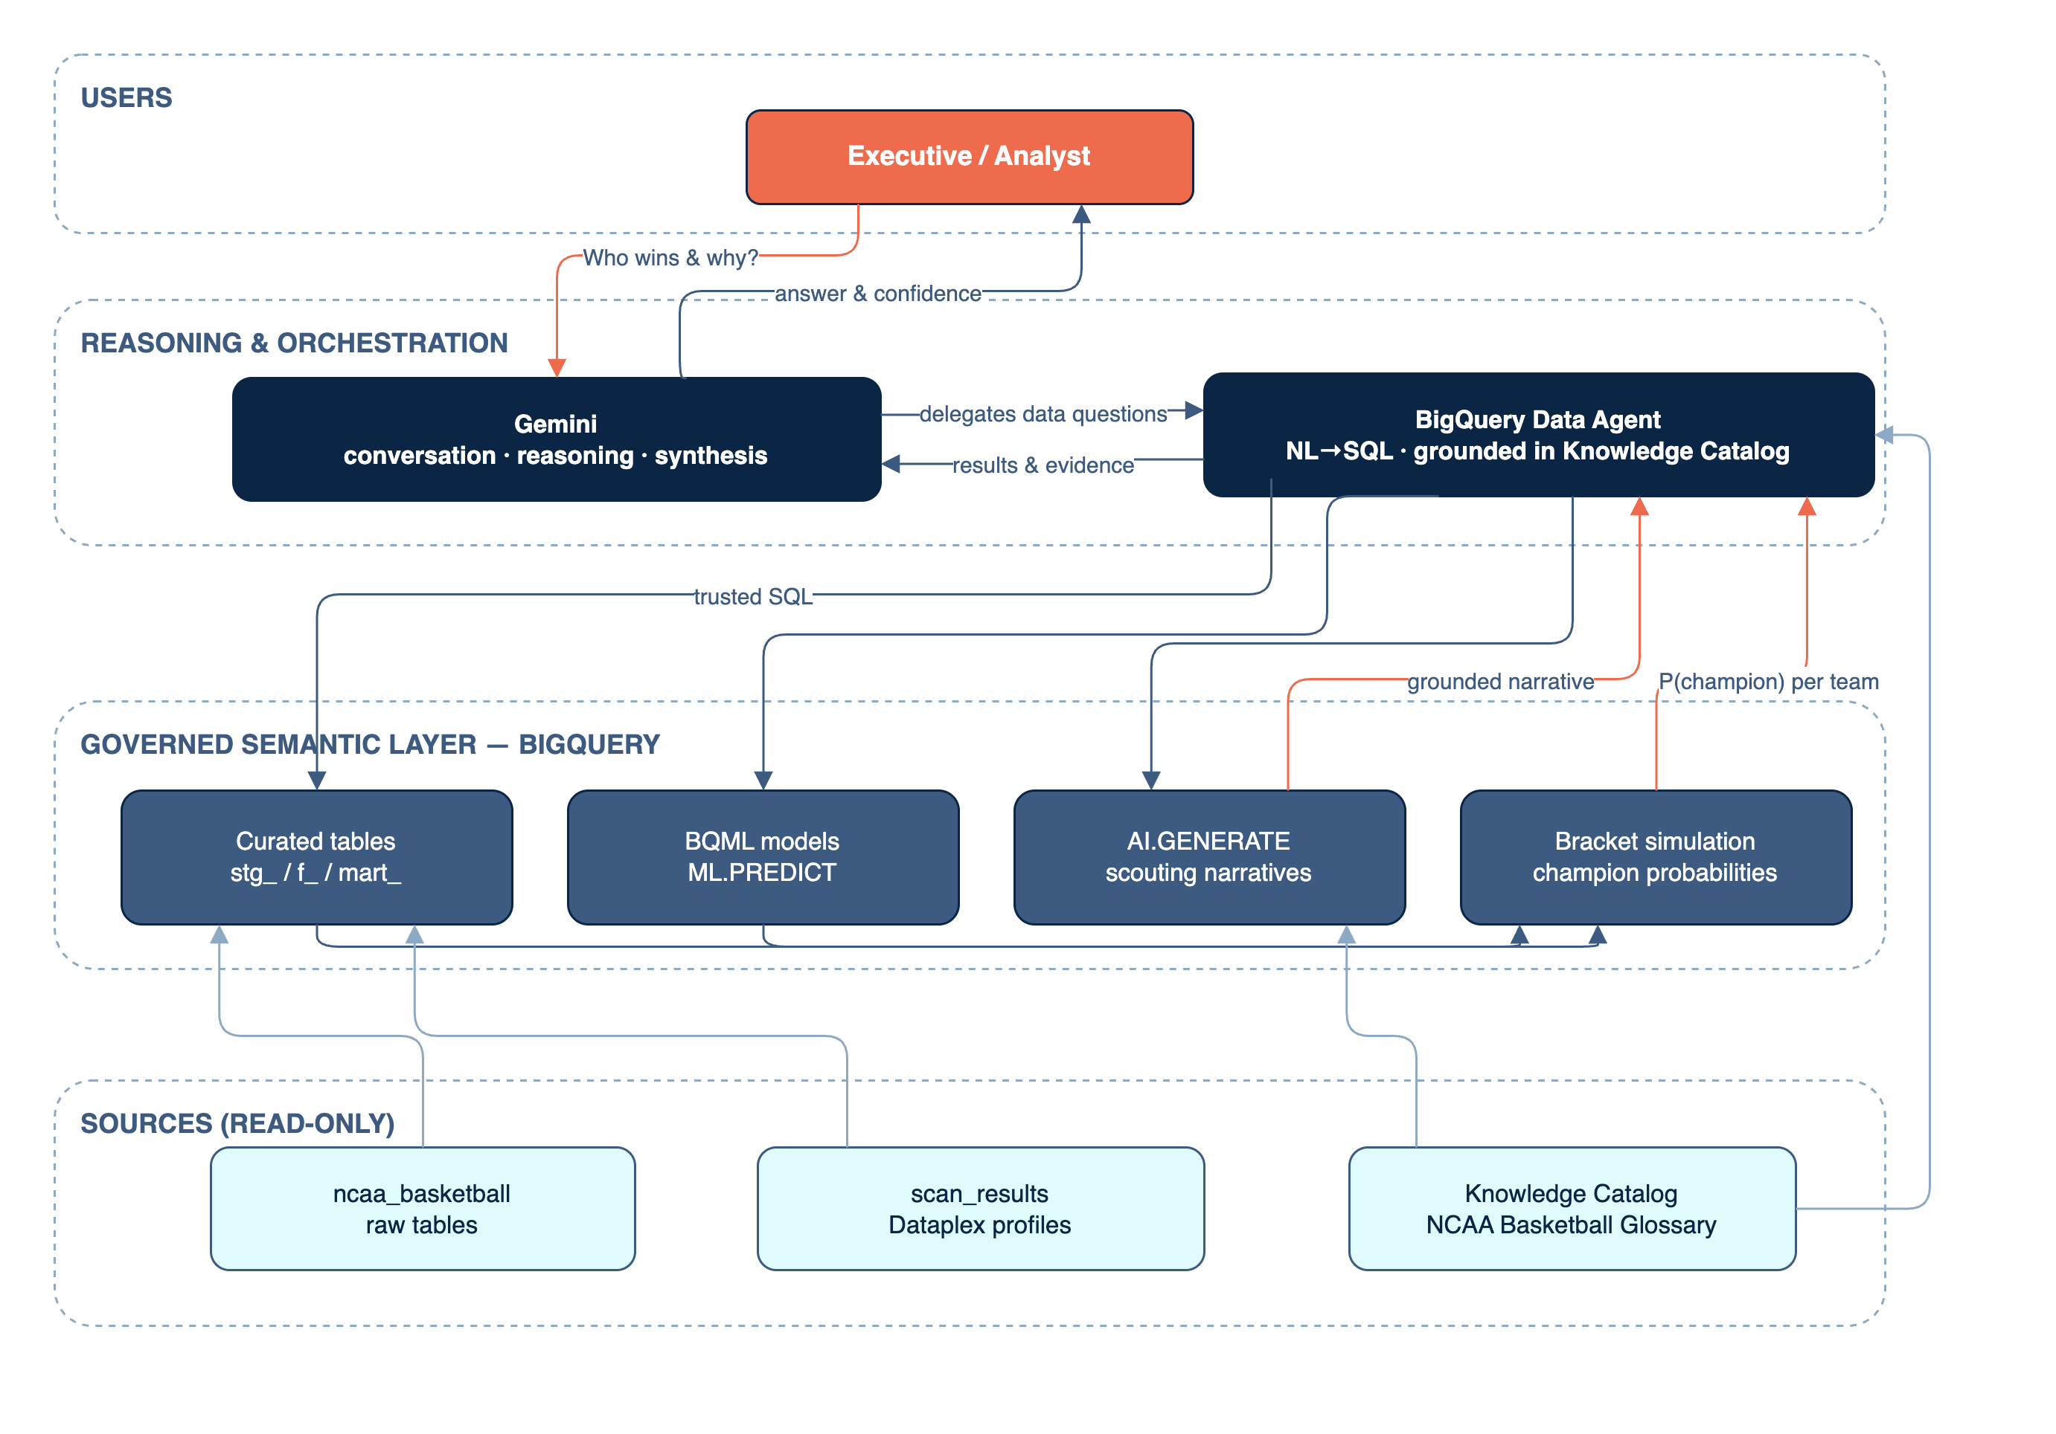
A3 · ARCHITECTURE DETAIL
End-to-end agentic solution (target state)
1
User query
prompt submitted to Gemini
2
Agent handoff
delegated to the BigQuery Data Agent
3
NL → SQL
natural language becomes SQL
4
Semantic grounding
curated tables, BQML, AI.GENERATE
5
Read-only query
runs over immutable sources
6
Insight delivery
synthesized answer with evidence
10

Slide 11
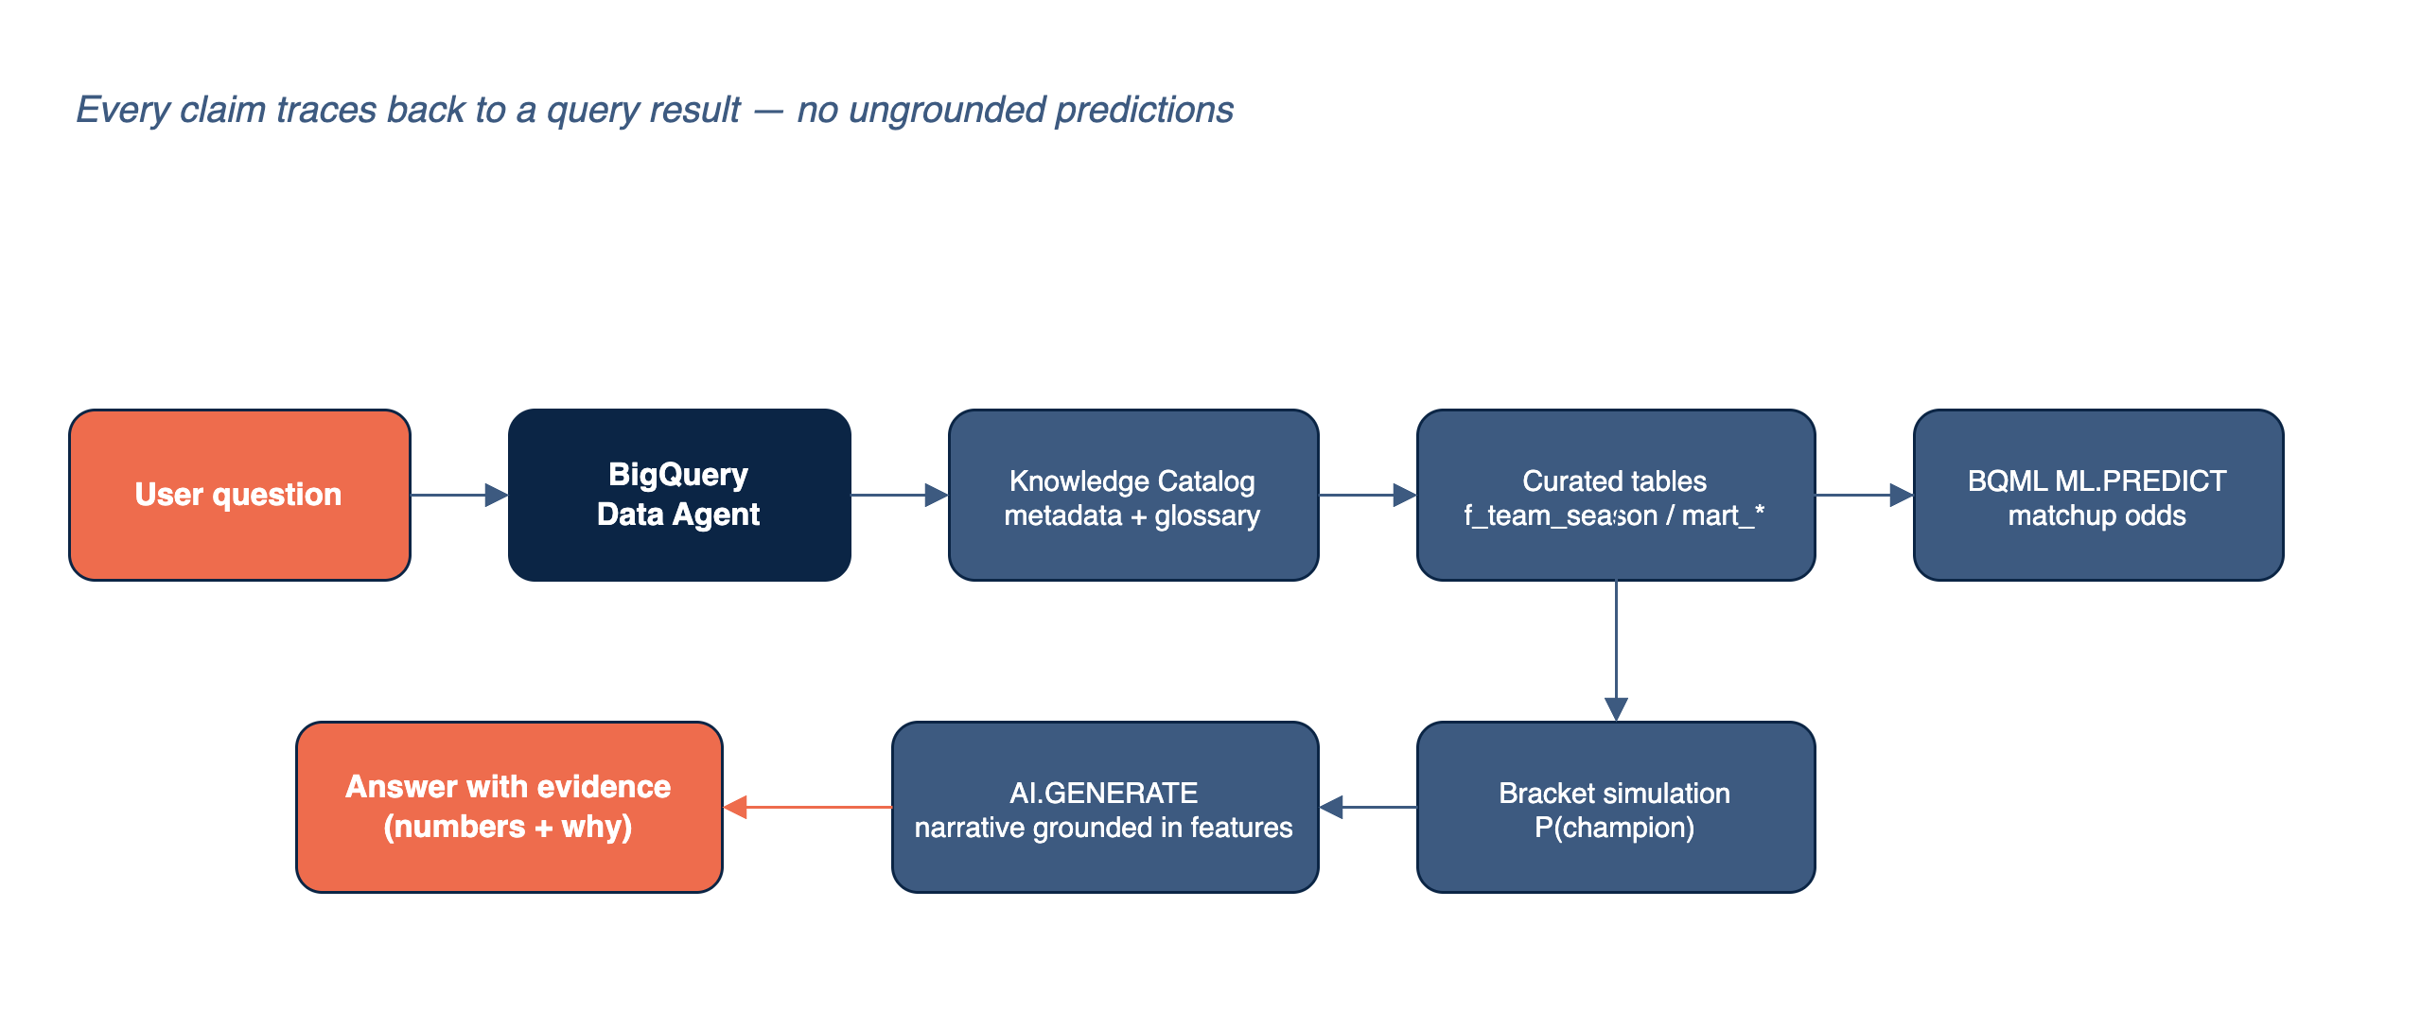
A4 · TRUST BY DESIGN
The grounding chain
Every LLM claim traces to a query result. No ungrounded predictions.
11

Slide 12
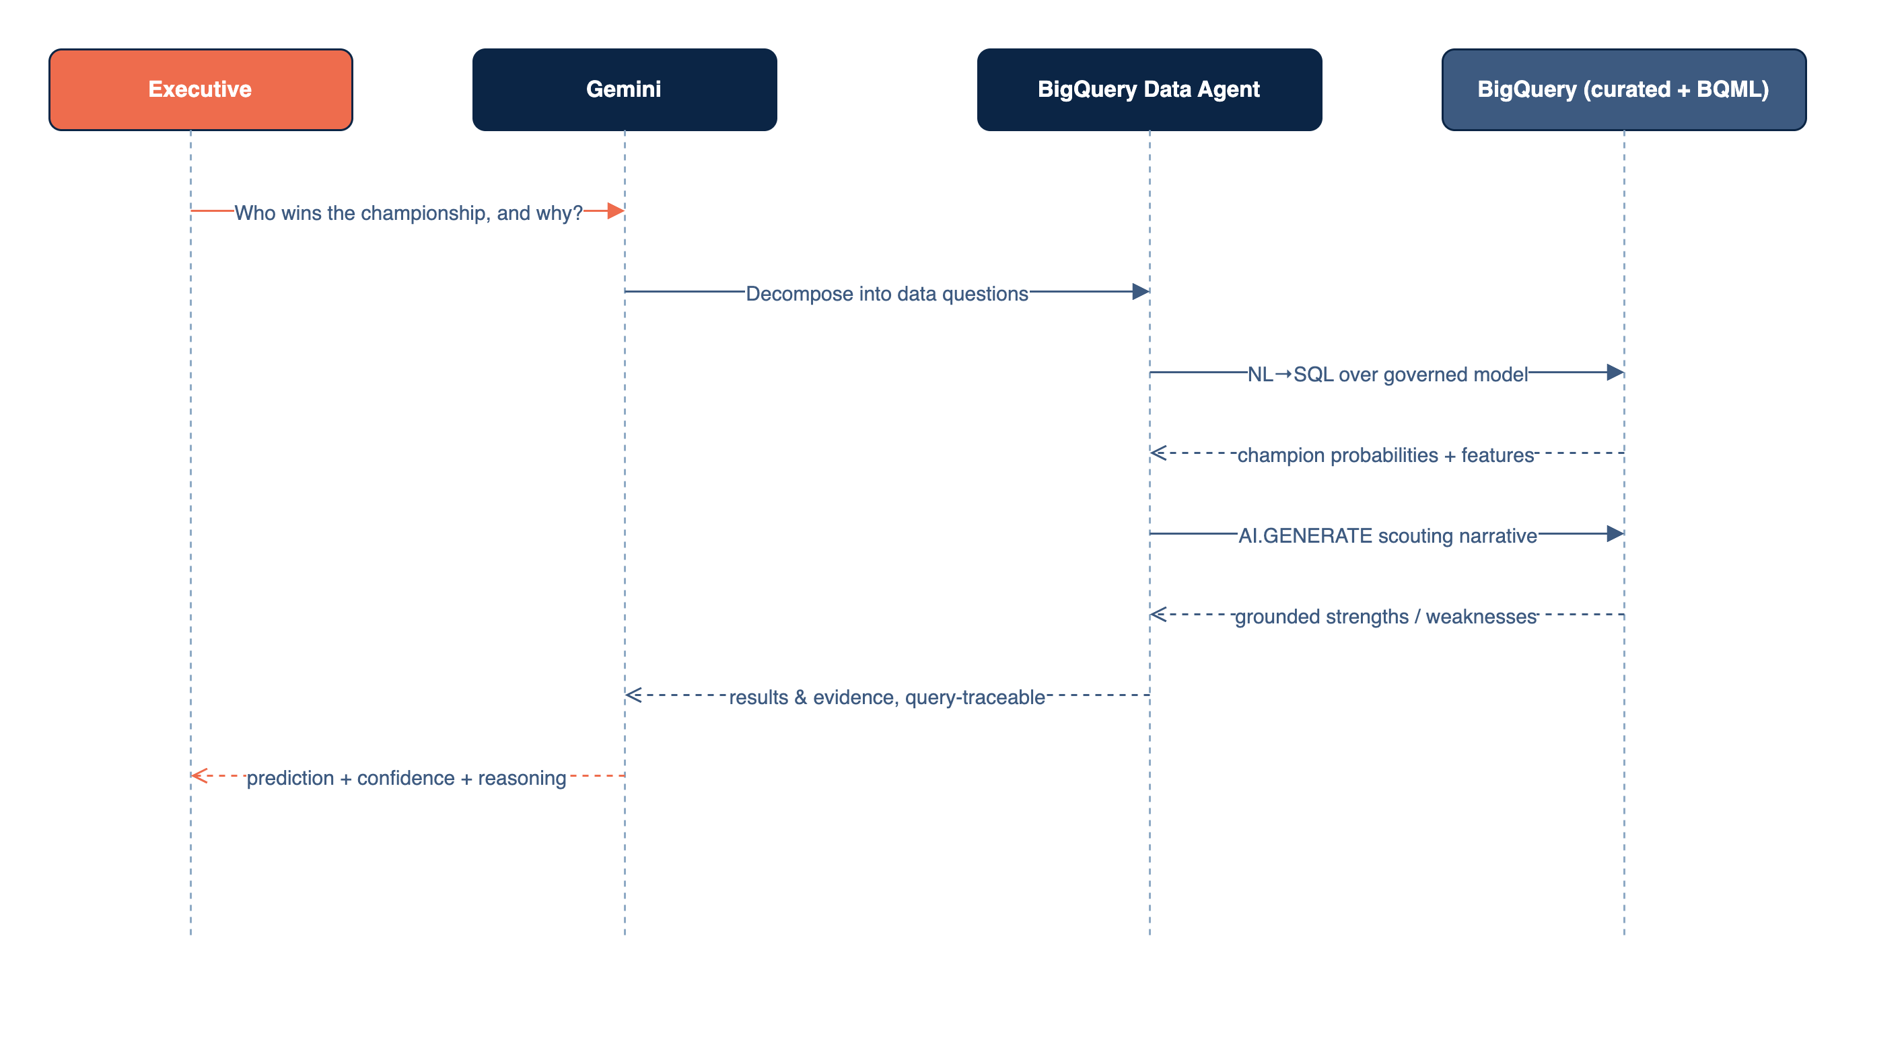
A5 · THE AI LAYER
Front Office Analyst: target runtime
AI.GENERATE with gemini-2.5-flash, temperature 0, output_schema
Prompts carry numbers only: no team name, conference or seed
Agent in progress; 8 SQL-verified Q&A ready in mart_agent_qa
12

Slide 13



A6 · ENGINEERING BACKBONE
One dbt project, gated by CI
validate · every PR LIVE
ruff + dbt parse. Required check, passing on main.
Seven layers, one prefix each
stg_
00_stg staging views, brackets
dq_
01_dq quality gate from Catalog scans
e2e · pull requests NOT ENABLED
Full build into an ephemeral dataset, 100 sims.
f_
02_features report cards, matchup rows
m_ p_
03_models BQML training + predictions
deploy · main NOT ENABLED
Full build + tests into texas_longhorns.
sim_ eval_
04_sim simulation, backtests
ai_
05_ai AI.GENERATE (tag: ai)
322 dbt tests pass on the deployed dataset. Before enabling: e2e must build the AI table its mart needs, and deploy shouldn't retrain 17 models per push.
mart_
06_marts what dashboard + agent read
13

Slide 14


A7 · DISCOVERY & GROWTH
The learning journey, in full
New capabilities
Challenges overcome
Key takeaways
BigQuery Data Agents (Agents Hub) for governed NL → SQL
AI.GENERATE with output_schema for structured scouting
BQML training + ML.PREDICT entirely in-warehouse
Knowledge Catalog as the grounding source
No Dataform permission → dbt on BigQuery
AI.GENERATE_TABLE needs a connection → AI.GENERATE
dbt OAuth blocked → gcloud access-token target
Gemini knows post-2018 results → anonymized prompts
Keep compute next to the data: no movement, governed, fast
Ground every claim in a query result to stop hallucination
Pick models on core years only; never tune to the extension
Let data quality decide: 2013-14 dropped (65% of box scores missing)
14

Slide 15
A8 · HOW WE MAP TO THE CRITERIA
Assessment matrix
Criterion | How we satisfy it | Evidence | Owner
Technical Execution | BQML with backtests, in-warehouse AI.GENERATE, SQL-verified agent Q&A | Backtest scorecard, agent Q&A | Data + ML Eng
Discovery & Growth | Catalog scan to data map; dbt + CI; documented learnings | Learnings log, CI history | Captain + DE
Value & Impact | Beats seed and record baselines; reusable client pattern | Log-loss delta, use cases | ML Eng + Captain
Storytelling | Prediction-first narrative, grounded scouting cards | This briefing | Captain + Analytics
15

