Slide 1
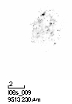
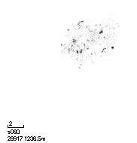
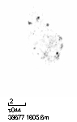
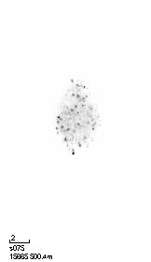

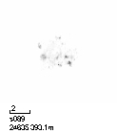



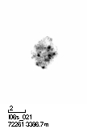







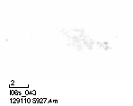



















































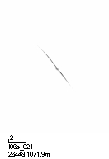




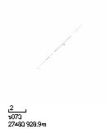









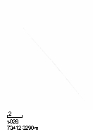
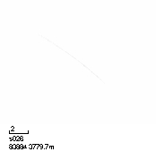
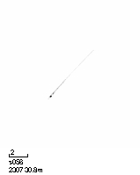


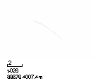
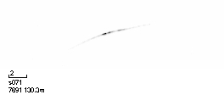




































































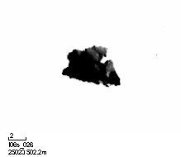


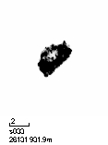












a: Fluffy Aggregates
Phaeocystis
mc_aggregate_fluffy
Fluffy agg circular in Figure 7
mc_aggregate_dark_round_to_puff
mc_aggregate_fluffy_dark_to_aggregate_dense
mc_aggregate_fluffy_elongated
Fluffy agg elongated in Figure 7
mc_aggregate_fluffy_elongated_to_aggregate_dense_elong
mc_aggregate_fluffy_grainy
mc_aggregate_fluffy_grainy_elongated
mc_aggregate_fluffy_grainy_to_aggregate_dense
Fluffy agg grainy/dense in Figure 7
mc_aggregate_fluffy_grey
mc_aggregate_fluffy_grey_elongated
mc_aggregate_fluffy_grey_to_aggregate_badfocus
Fluffy agg gray/badfocus in Figure 7
b: Dense Aggregates
mc_aggregate_fluffy_grey_to_rhizaria
mc_aggregate_dense_amorphous_to_detritus_dense_round
mc_aggregate_dense_dark_round_to_rhizaria
mc_aggregate_dense_elongated_to_aggregate_fluffy
mc_aggregate_dense_elongated_two_elements_to_bubbles
c: Fibers
mc_fiber_fluffy_to_feces
mc_fiber_thin_to_fiber_fluffy
mc_aggregate_dense_to_aggregate_fluffy_dark
mc_mc_aggregate_dense_to_crustacea
mc_fiber_thin_straight
mc_fiber_thin_straight_with_black_element
mc_aggregate_dense_to_feces
mc_aggregate_dense_2_black_to_aggregate_fluffy_dark
d: Feces
feces_little_fluffy
mc_feces_bent_circular_fluffy
mc_feces_bent_thin
mc_feces_bent_to_crustacea
mc_feces_dark_roundish
mc_feces_dark_small_irregular_shape
mc_feces_short_straight
mc_feces_small_round_grey
mc_feces_straight_to_feces_bent
mc_feces_straight_fluffy
mc_feces_straight_fluffy_to_trichodesmium_tuff
mc_feces_straight_thin
mc_feces_to_copepoda
mc_feces_to_fiber
mc_feces_straight_thin_to_fiber
t006
e: Photosynthetic
like_Trichodesmium
puff
tuff

Slide 2
mc_aggregate_dense_amorphous_to_detritus_dense_round
mc_aggregate_dense_dark_round_to_rhizaria
mc_fiber_fluffy_to_feces
mc_fiber_thin_to_fiber_fluffy
mc_aggregate_dense_elongated_to_aggregate_fluffy
mc_aggregate_dense_elongated_two_elements_to_bubbles
mc_fiber_thin_straight
mc_fiber_thin_straight_with_black_element
mc_aggregate_dense_to_aggregate_fluffy_dark
mc_mc_aggregate_dense_to_crustacea
mc_aggregate_dense_to_feces
mc_aggregate_dense_2_black_to_aggregate_fluffy_dark

Slide 3
mc_fiber_fluffy_to_feces
mc_fiber_thin_to_fiber_fluffy
mc_fiber_thin_straight
mc_fiber_thin_straight_with_black_element

Slide 4
feces_little_fluffy
mc_feces_bent_circular_fluffy
mc_feces_bent_thin
mc_feces_bent_to_crustacea
mc_feces_dark_roundish
mc_feces_dark_small_irregular_shape
mc_feces_short_straight
mc_feces_small_round_grey
mc_feces_straight_to_feces_bent
mc_feces_straight_fluffy
mc_feces_straight_fluffy_to_trichodesmium_tuff
mc_feces_straight_thin
mc_feces_to_copepoda
mc_feces_to_fiber
mc_feces_straight_thin_to_fiber
t006

