Slide 1























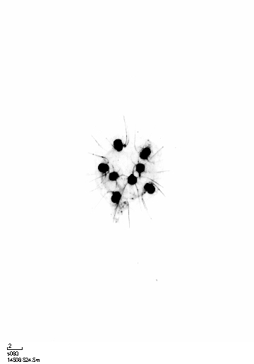
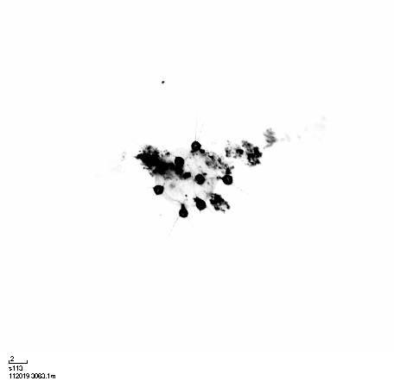
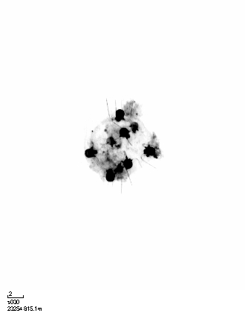



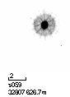


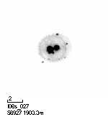
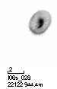

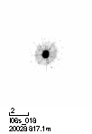


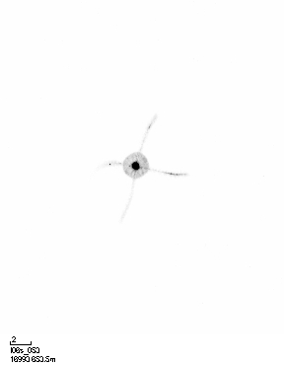
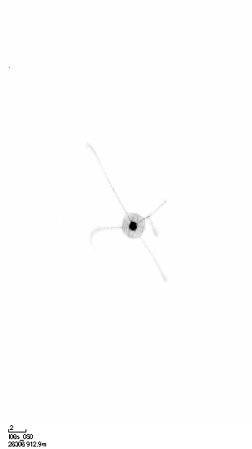





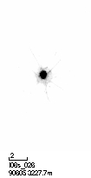


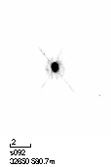
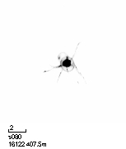
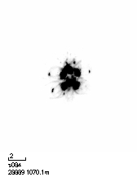
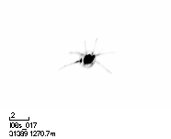
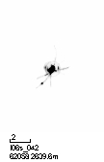




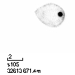
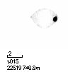


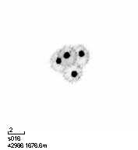
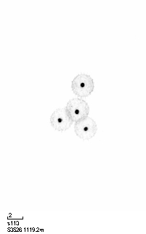





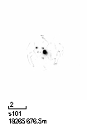


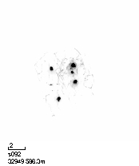
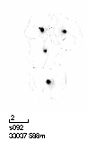











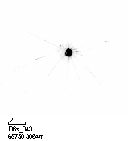
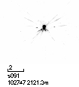

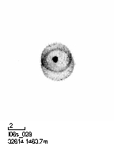
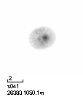


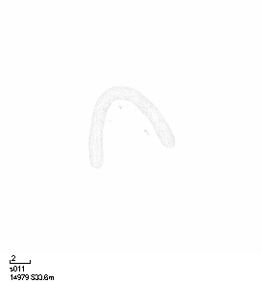
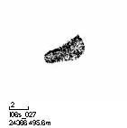
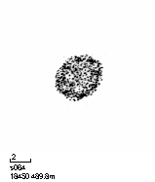










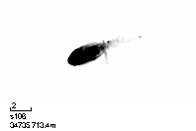
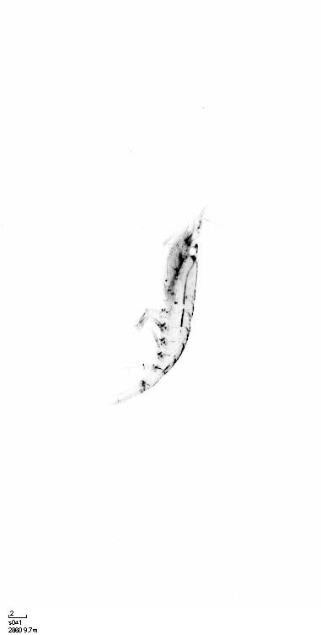

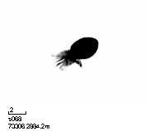
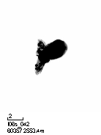






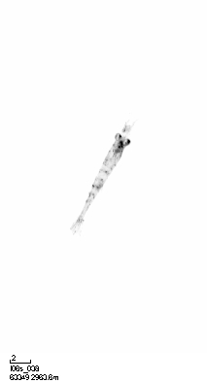
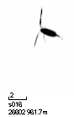


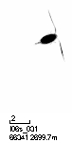
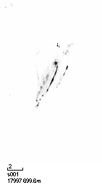








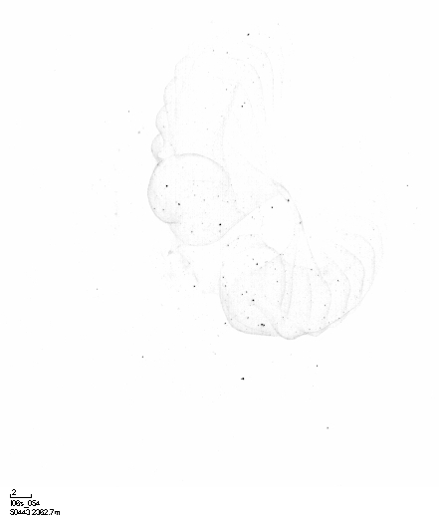
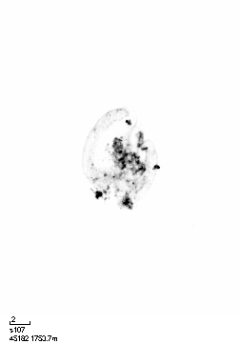

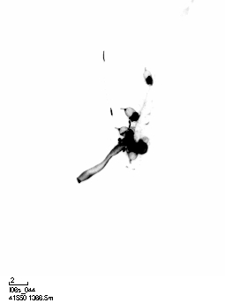
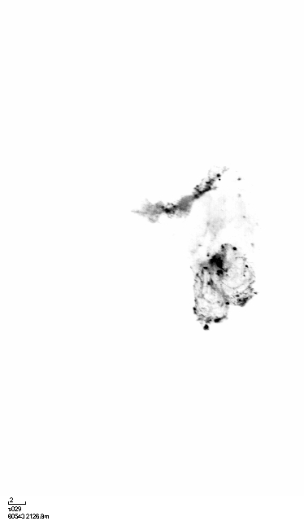
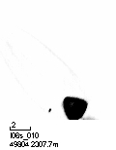
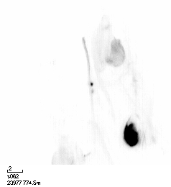
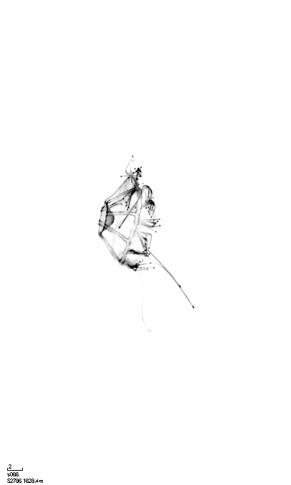
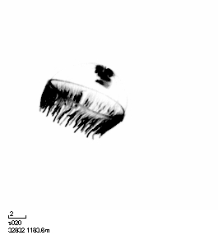
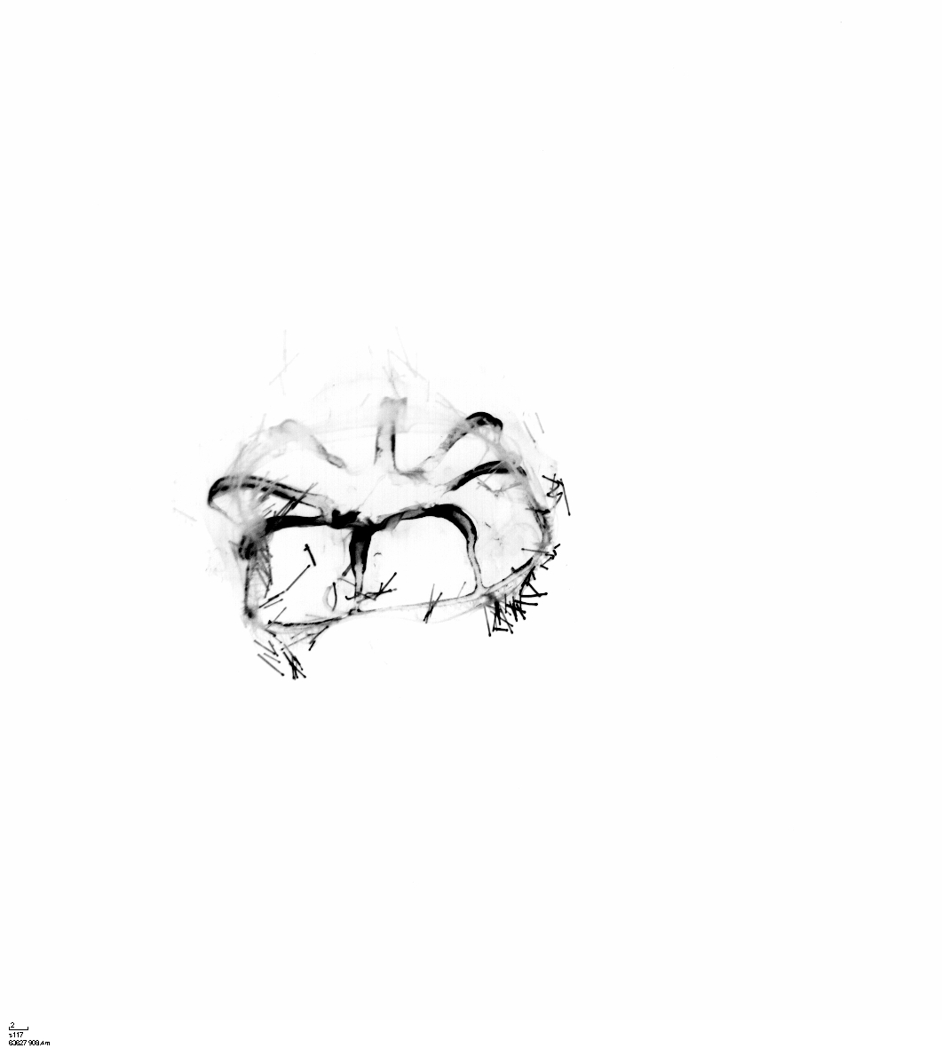


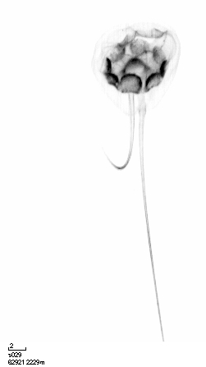

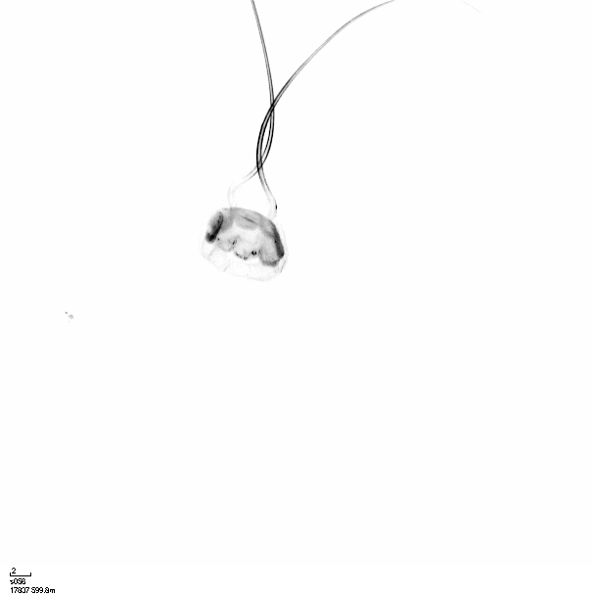




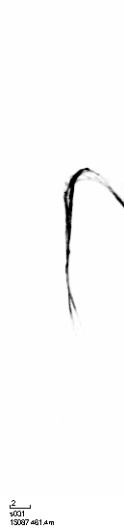

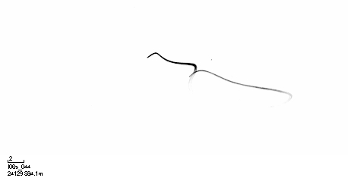






e: Photosynthetic
like_Trichodesmium
puff
tuff
f: Rhizarians
Rhizaria
Phaeodaria
Castanellidae
Circoporidae
Tuscaroridae
Aulacantha
Aulographis
mc_aulacantha_to_foraminifera
Coelodendrum
Coelographis
leg_Coelodendridae
Medusettidae
Aulosphaeridae
Aulatractus
colonial_Aulosphaeridae
Mc_aulosphaeridae_to_cannosphaeridae
Aulo./Canno. Unknown in Figure 7
Cannosphaeridae
colonial_Cannosphaeridae
unknown_Phaeodaria
Acantharea
Foraminifera
Collodaria
colonial_Collodaria
mc_solitary_black_to_puff
solitaryblack
g: Crustaceans
Crustacea
Eumalacostraca
Hyperia
like_Amphipoda
shrimp_like
Copepoda_Maxillopoda
Eucalanidae
like_Copepoda
Ostracoda
h: Gelatinous
house
Doliolida
Salpida
Cnidaria_Metazoa
Hydrozoa
Siphonophorae
Narcomedusae
Solmundella_bitentaculata
tentacle_Cnidaria
Ctenophora_Metazoa
t005

Slide 2
f: Rhizarians
Rhizaria
Phaeodaria
Castanellidae
Circoporidae
Tuscaroridae
Aulacantha
Aulographis
mc_aulacantha_to_foraminifera
Coelodendrum
Coelographis
leg_Coelodendridae
Medusettidae
Aulosphaeridae
Aulatractus
colonial_Aulosphaeridae
Mc_aulosphaeridae_to_cannosphaeridae
Aulo./Canno. Unknown in Figure 7
Cannosphaeridae
colonial_Cannosphaeridae
unknown_Phaeodaria
Acantharea
Foraminifera
Collodaria
colonial_Collodaria
mc_solitary_black_to_puff
solitaryblack
g: Crustaceans
Crustacea
Eumalacostraca
Hyperia
like_Amphipoda
shrimp_like
Copepoda_Maxillopoda
Eucalanidae
like_Copepoda
Ostracoda
h: Gelatinous
house
Doliolida
Salpida
Cnidaria_Metazoa
Hydrozoa
Siphonophorae
Narcomedusae
Solmundella_bitentaculata
tentacle_Cnidaria
Ctenophora_Metazoa
t005

Slide 3
Crustacea
Eumalacostraca
Hyperia
like_Amphipoda
shrimp_like
Copepoda_Maxillopoda
Eucalanidae
like_Copepoda
Ostracoda

