Slide 1



Detecting Pneumonia with Deep Learning
METIS PROJECT 5
SONALI DASGUPTA
JUNE 16, 2020

Slide 2

Data Science In Healthcare
Disease diagnosis = patterns of symptoms
Healthcare professionals deal with massive sets of structured and unstructured data:
Numerical
Text
Images

Slide 3

Pneumonia
250,000 people get pneumonia every year
50,000 deaths
Symptoms:
Cough
Fever
Shortness of breath
Chills or shaking

Slide 4
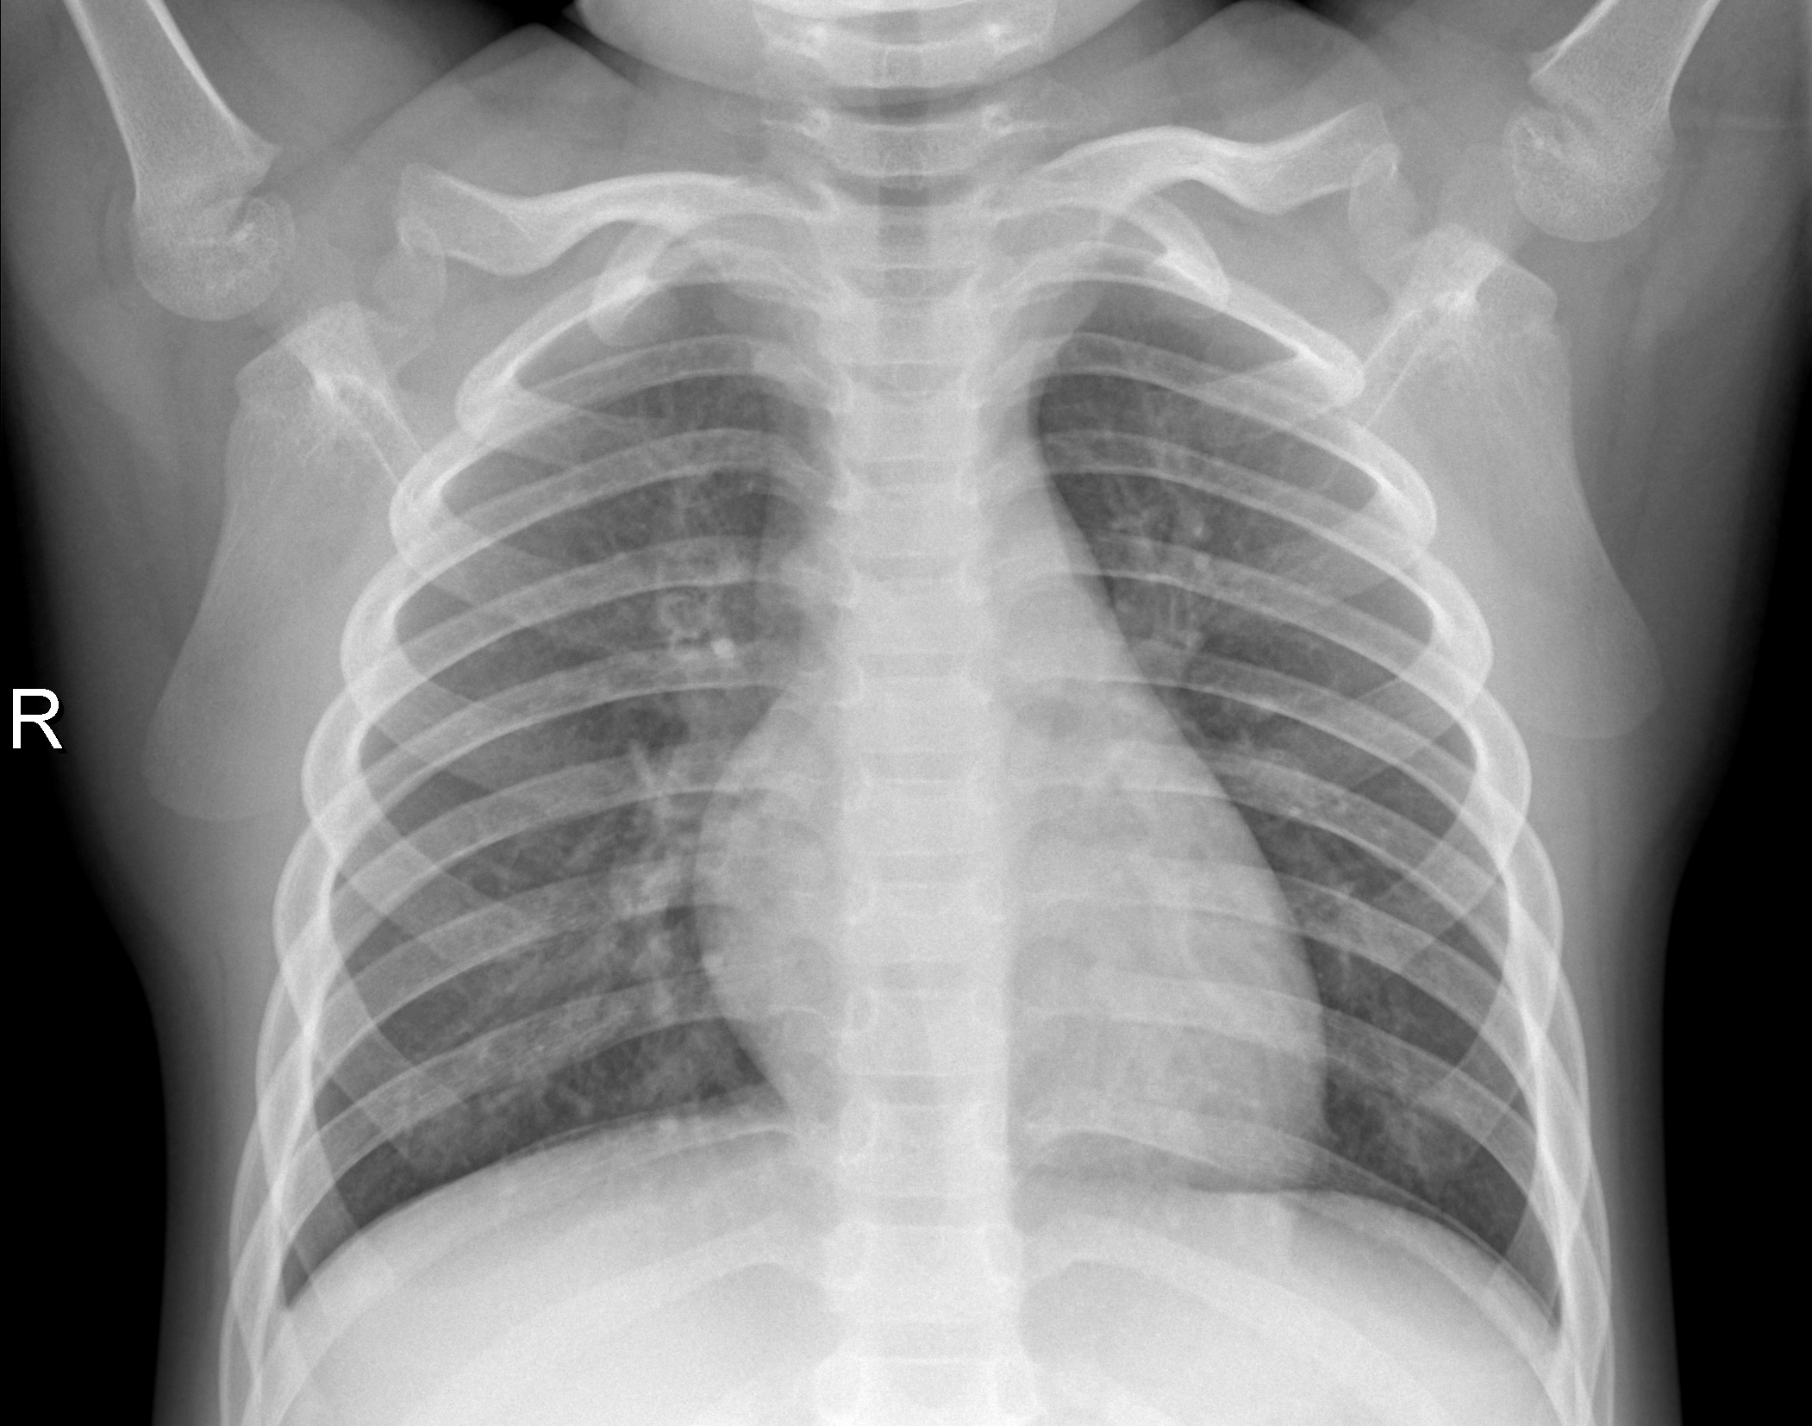
Diagnosis
Methods:
X-ray
Chest CT
Ultrasound
Needle biopsy
Radiologists detect:
Subtle changes in opacity around the diaphragm
White spots on lungs (infiltrates)

Slide 5
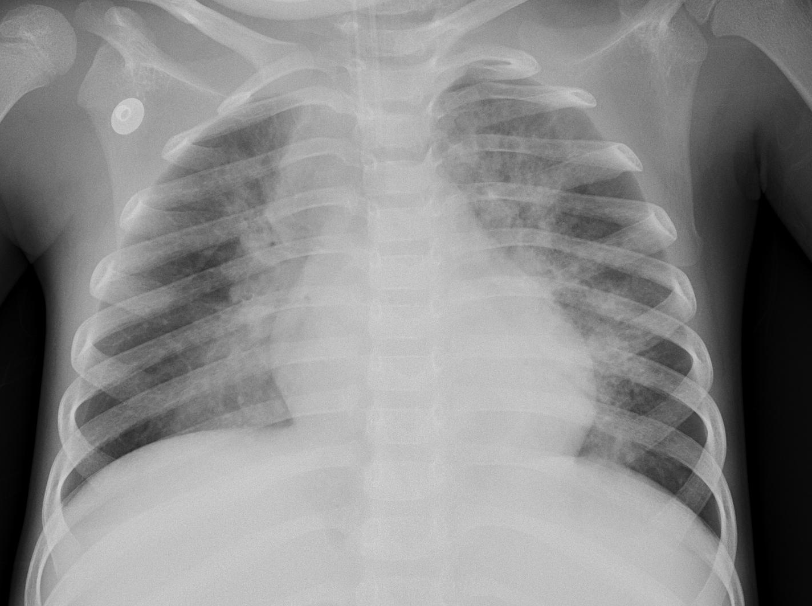
Detection
Deep learning can:
Reduce ambiguity between images = diagnostic efficiency
Save time for radiologists
Alert for more severe cases
Help clinics with high traffic or limited number of physicians
Normal
Pneumonia
Notes:
pre-existing pulmonary opacities from other diseases such as interstitial lung disease, cystic fibrosis, or malignancy, detection of a new opacity is sometimes difficult, even for radiologists

Slide 6
Building a neural Network: Data Cleaning & Preprocessing
Acquired 5856 images from a Kaggle dataset of chest-rays (normal and pneumonia)
Image preprocessing/augmentation of training data
Shear range
Zoom range
Horizonal flip
 | Original Dataset | Modified Dataset
Training | 5216 | 3786
Validation | 16 | 1446
Test | 624 | 624

Slide 7
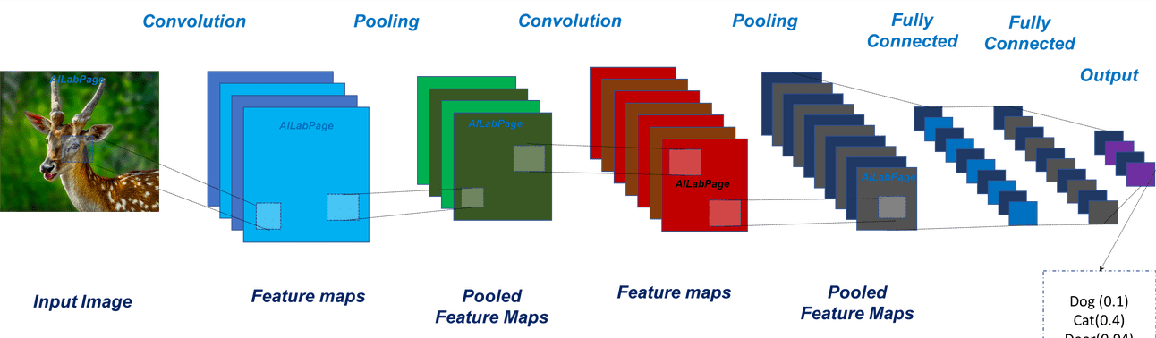
Convolutional Neural Network (CNN) Architecture
Normal (0.9)
Pneumonia
(0.1)
Optimizer: Adam
Loss: Binary Cross Entropy
Dropout: 5%
Early stopping
Notes:
Max pooling: returns the maximum value from the portion of the image covered by the Kernel; functions better than average pooling

Slide 8
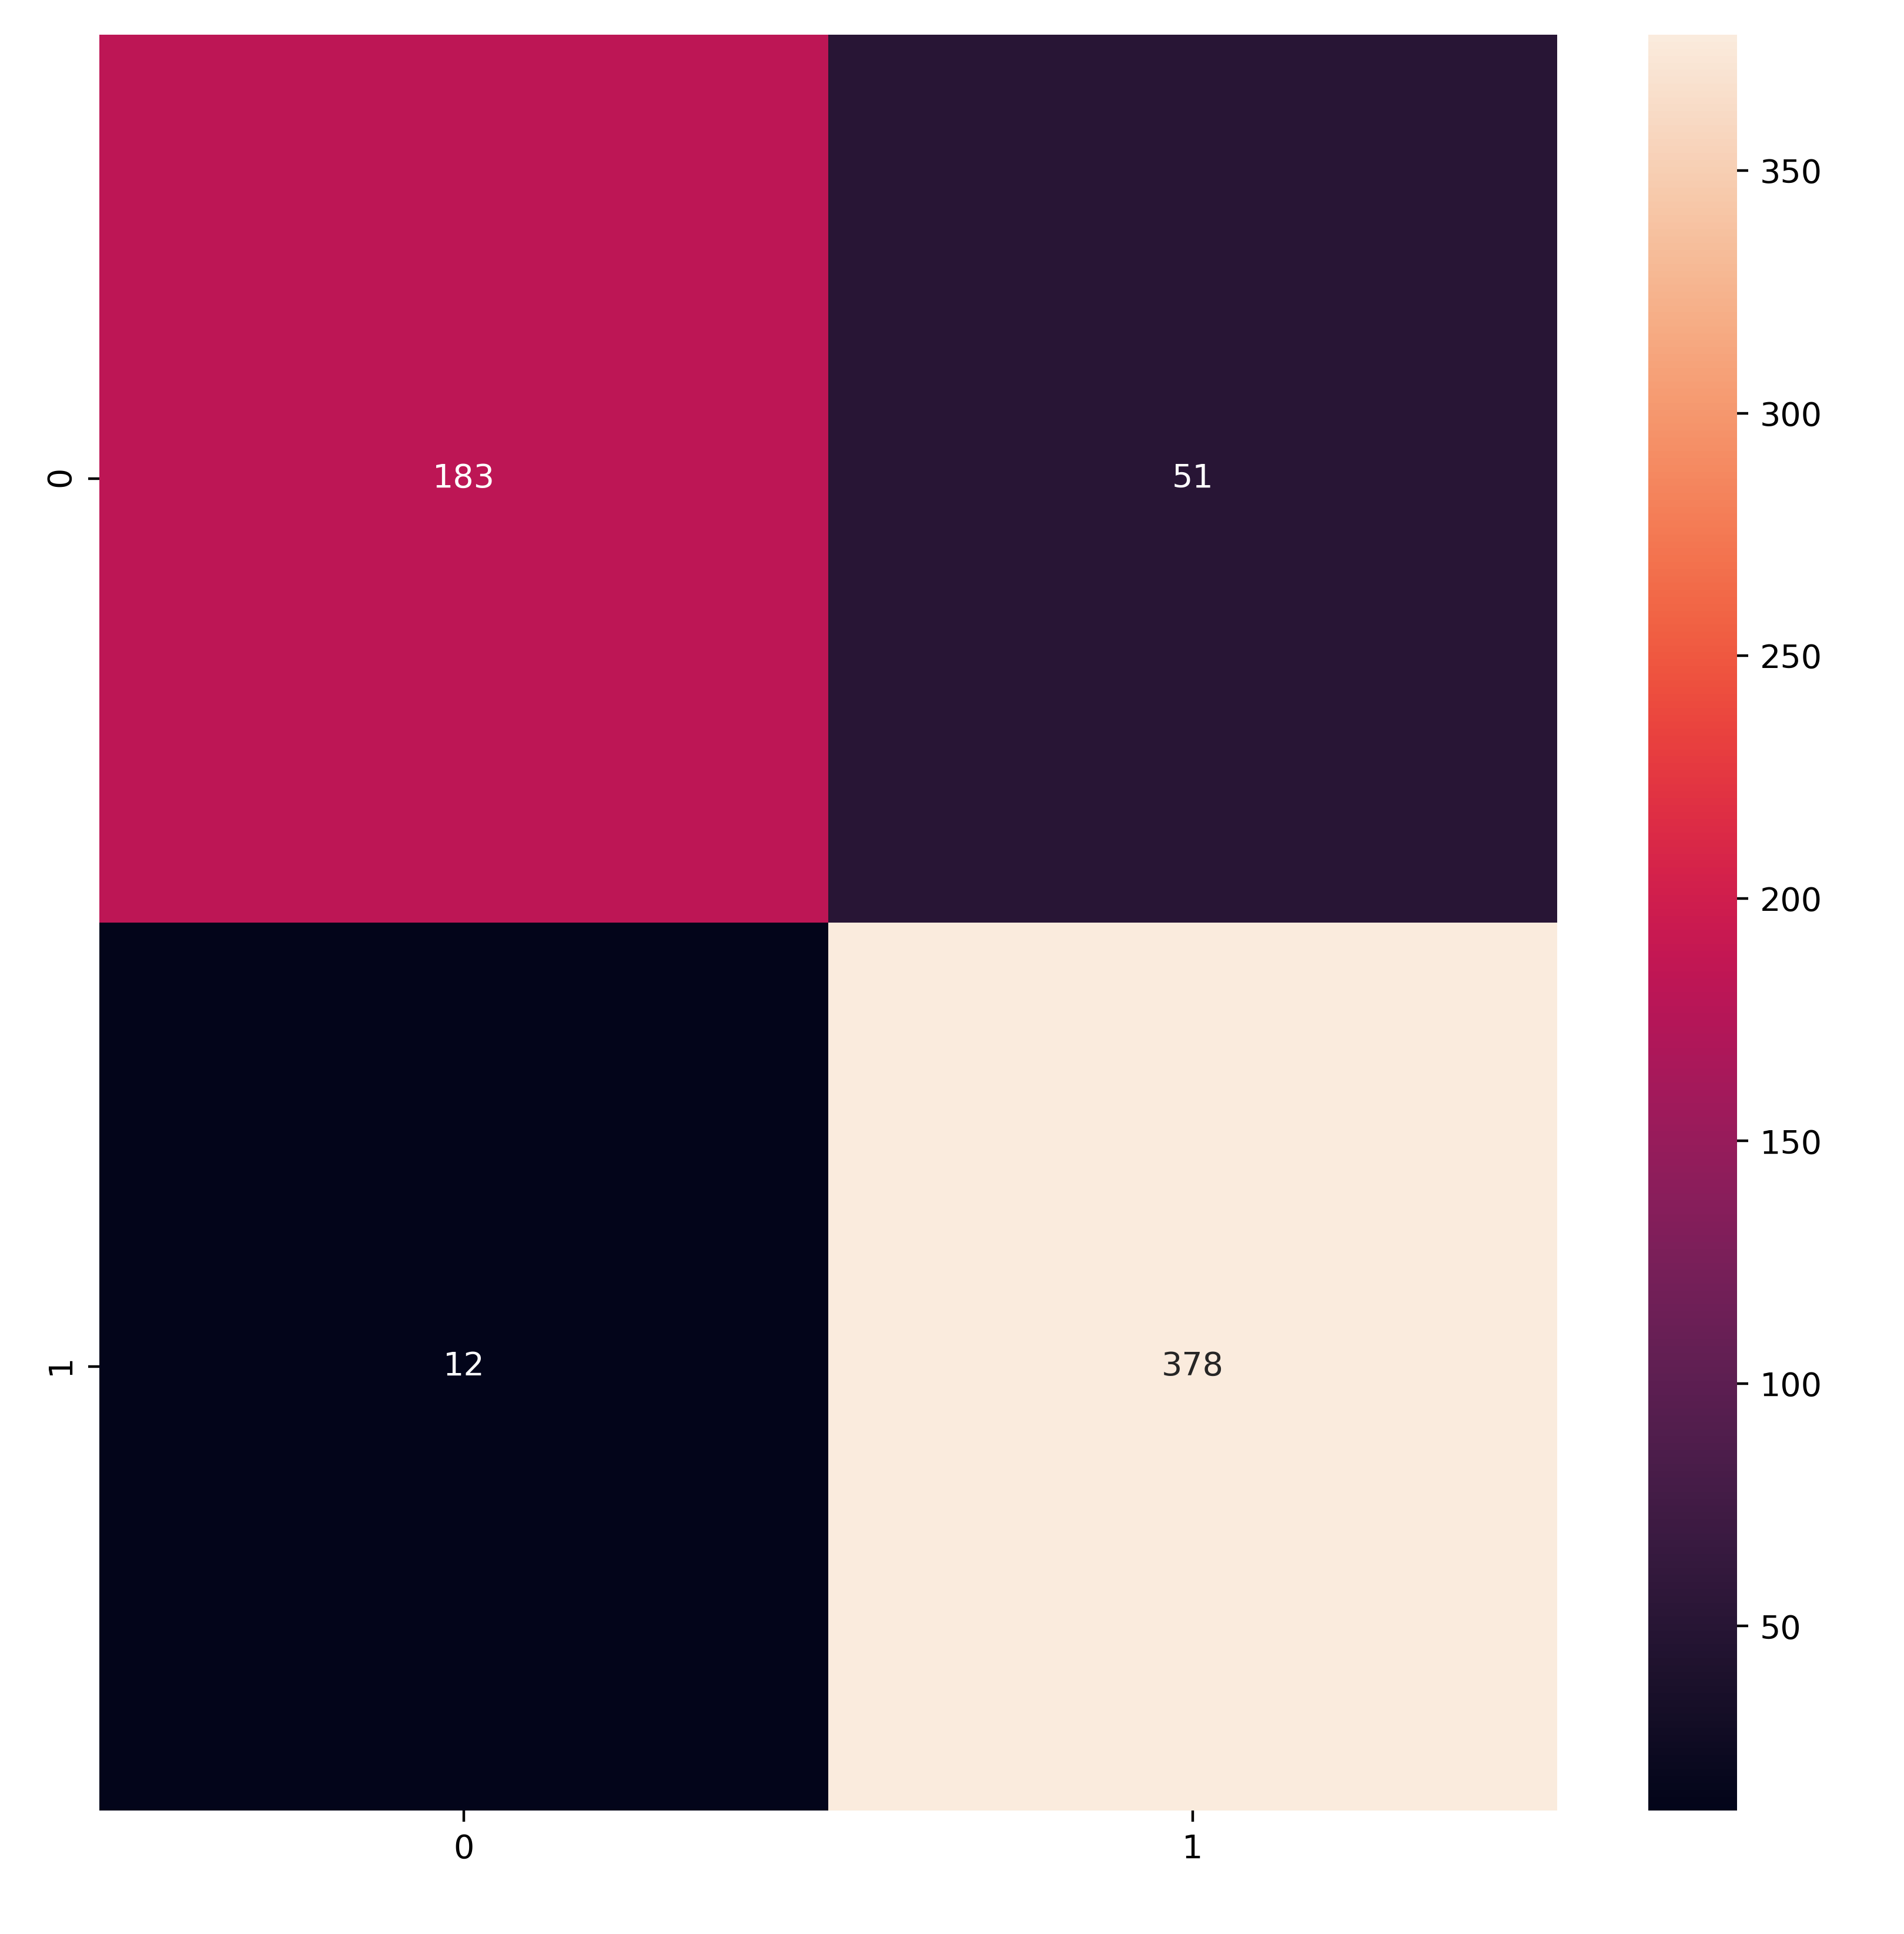
Model Results
Predicted Classes
Normal
Pneumonia
This CNN classifies “Normal” or “Pneumonia”
X-rays with 90% accuracy on test set
Normal
183
51
True Neg
False Pos
Actual
Classes
Pneumonia
12
378
False Neg
True Pos

Slide 9
Future work
Further tune model to improve accuracy
Use other imaging forms to improve false positives
Applications to other respiratory diseases
Chest x-rays are a component of Covid-19 diagnoses
Subtle differences between different respiratory illnesses could be distinguished by an algorithm

Slide 10
Thank you!
Sonali Dasgupta
sgdas32@gmail.com
https://github.com/sodas32

Slide 11
References
Data:
https://www.kaggle.com/paultimothymooney/chest-xray-pneumonia
Background & Images:
https://www.acrdsi.org/DSI-Services/Define-AI/Use-Cases/Pneumonia
https://vinodsblog.com/2018/10/15/everything-you-need-to-know-about-convolutional-neural-networks/
https://www.expertinstitute.com/resources/case-studies/aspiration-pneumonia-missed-by-medical-team/
https://www.healthlinkbc.ca/medical-tests/hw205975

Slide 12
appendix

Slide 13
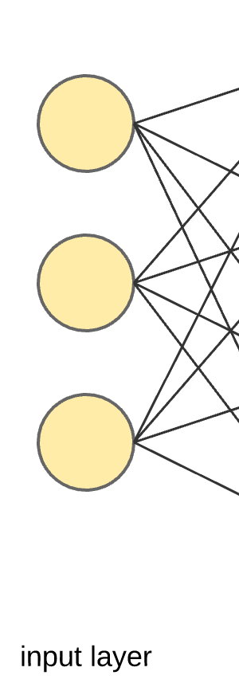

Convolutional Neural Network LAYERS
Notes:
Max pooling: to save on memory
Using sigmoid for classification (only accepts values that are non-negative—thus you need a relu function before that)
-how to make images same color as background

Slide 14
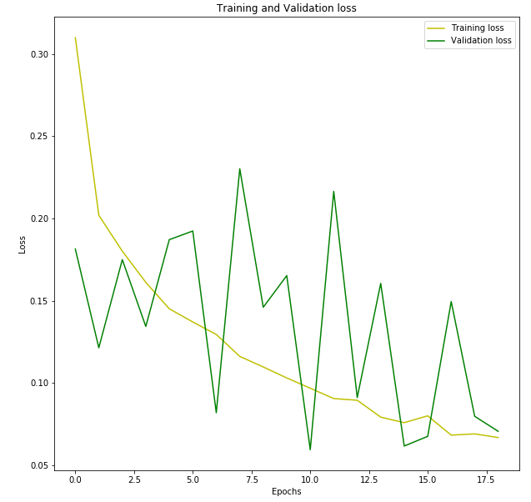
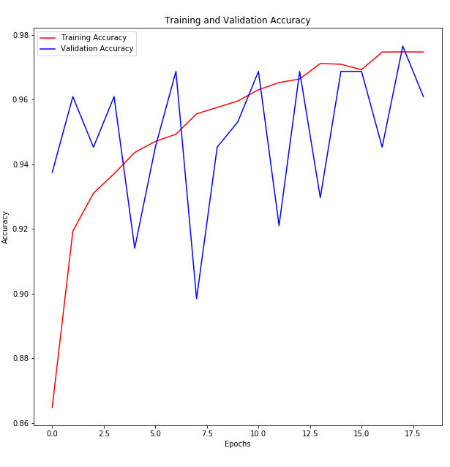
Loss and Accuracy Curves

Slide 15
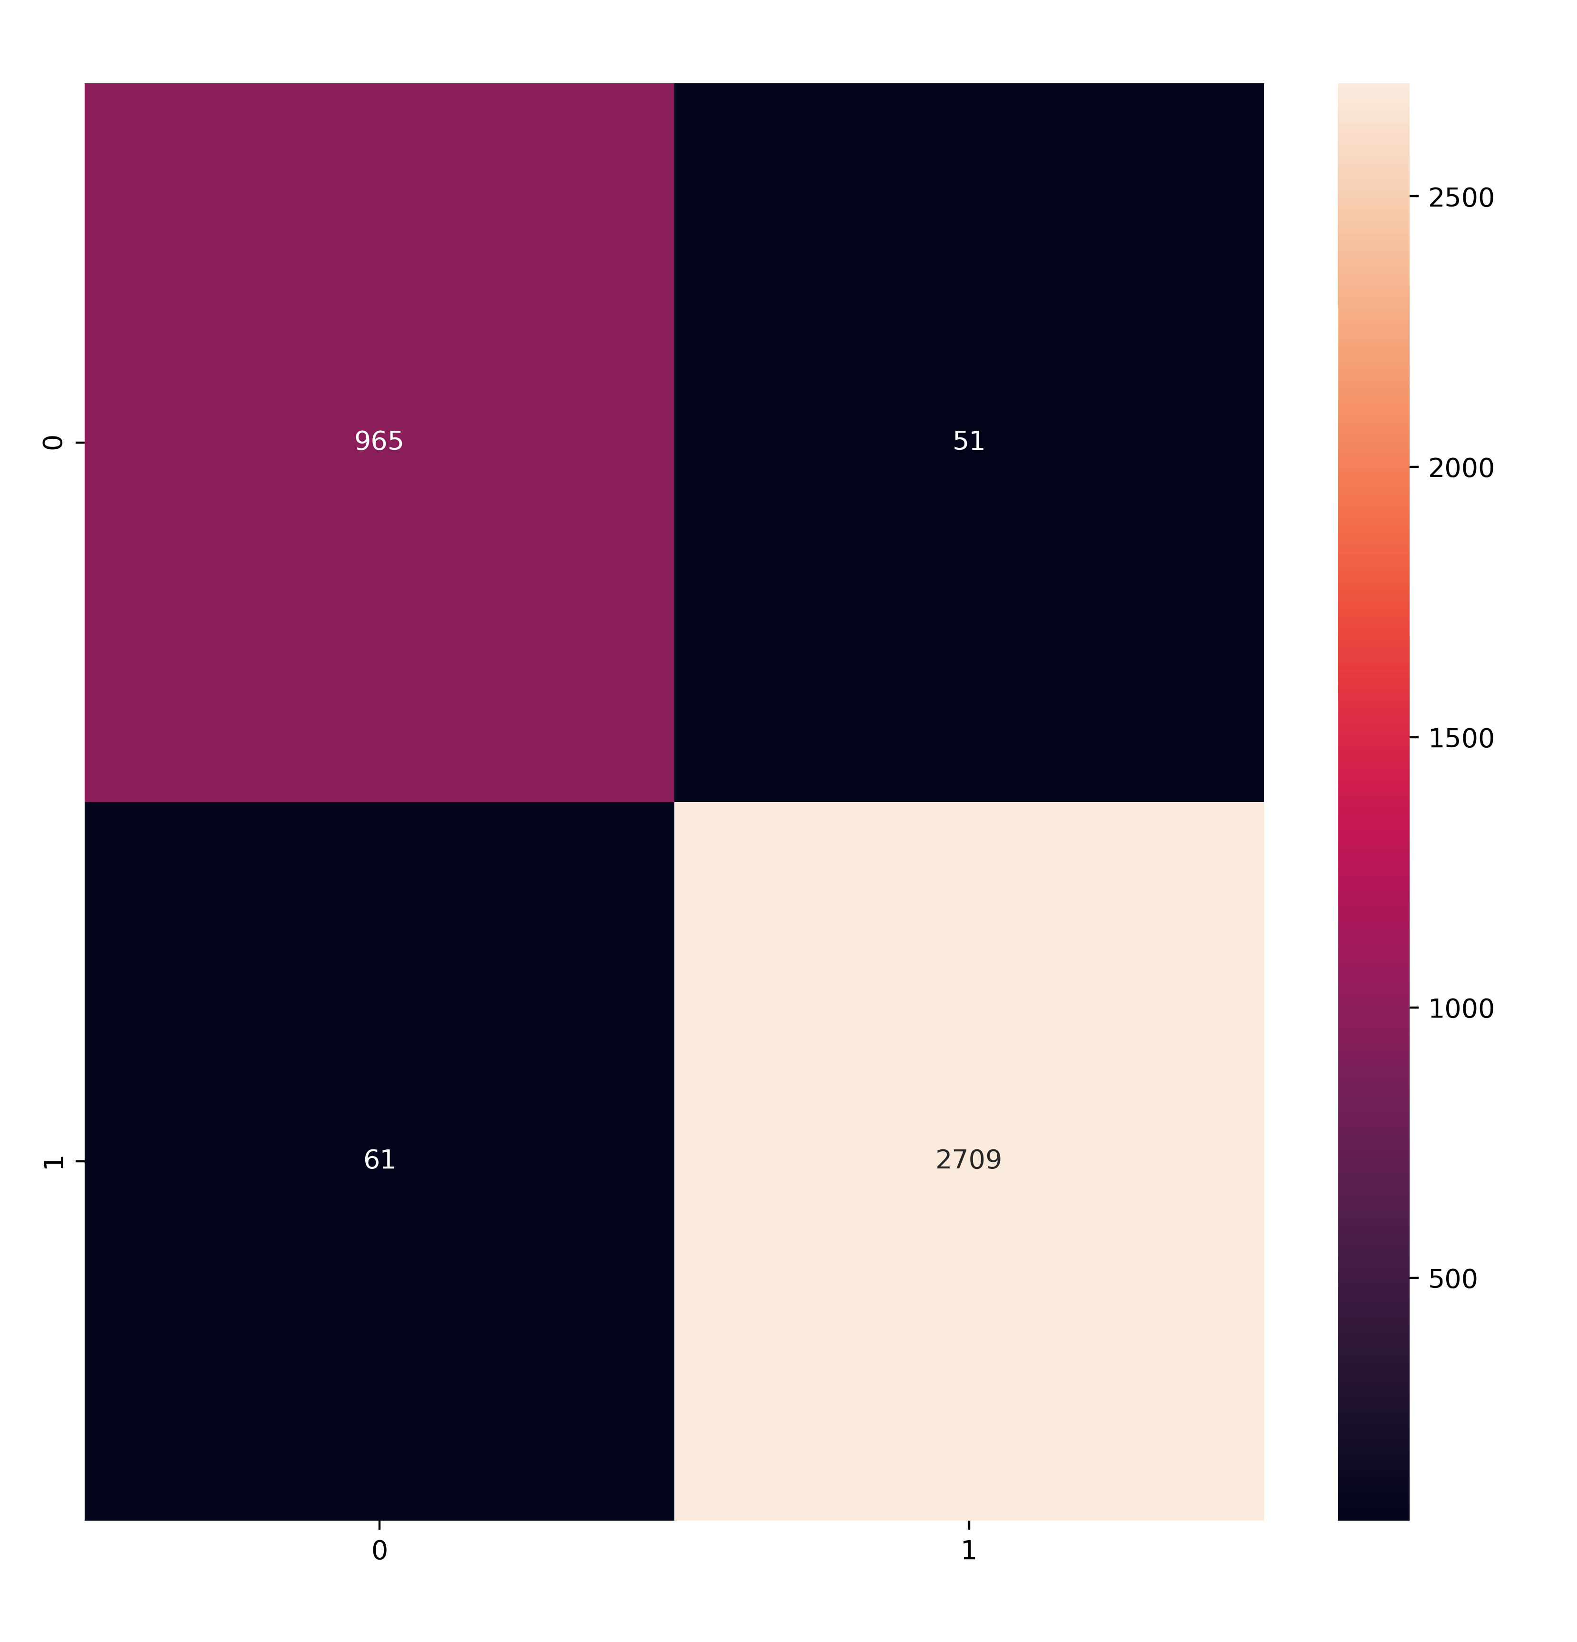

Confusion Matrices
Training data
Validation data

Slide 16
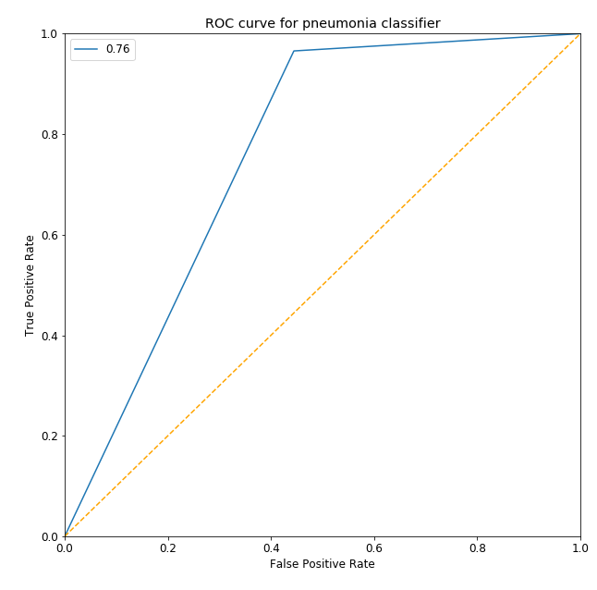
ROC Curve

