Slide 1
Introduction to sf
---
---

Slide 2
Simple Features
“A simple feature is defined by the OpenGIS Abstract specification to have both spatial and non-spatial attributes. Spatial attributes are geometry valued, and simple features are based on 2D geometry with linear interpolation between vertices.”
A simple feature is a standard representation of physical objects that has spatial and non-spatial attributes
17 simple feature types (like point, line, polygon)
Supported by many databases and software

Slide 3
Simple Features in R (sf)
In R simple features are implemented in the package sf
Provides simple features in data.frames or tibbles with a geometry list-column
sf supports all simple feature types
library(sf)
# > Linking to GEOS 3.7.2, GDAL 2.4.2, PROJ 5.2.0

Slide 4
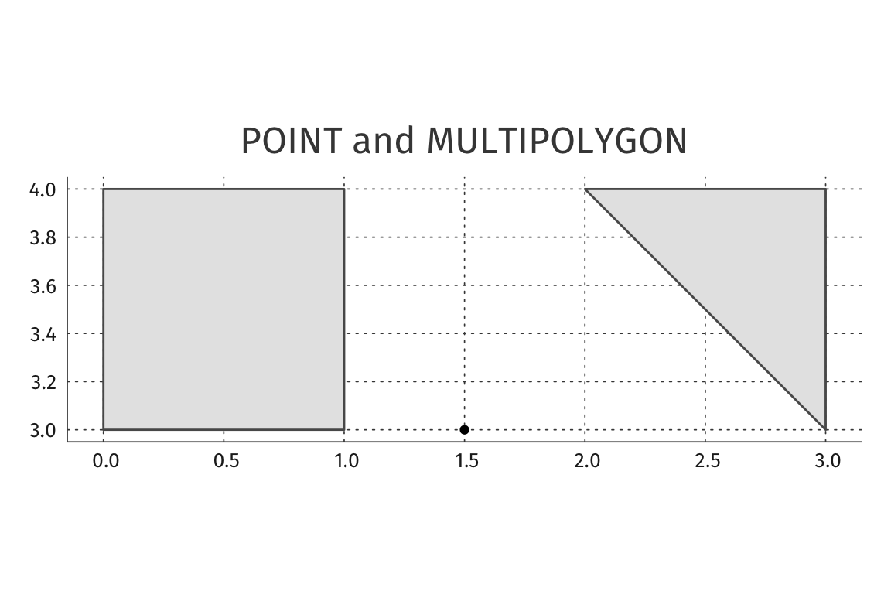
Simple Features:
POINT and MULTIPOLYGON
st_point(c(3,4)) # POINT
p1 <- rbind(c(0,3), c(0,4), c(1,4), c(1,3), c(0,3))
p2 <- rbind(c(3,3), c(2,4), c(3,4), c(3,3))
pol <- st_multipolygon(list(list(p1), list(p2))) # MULTIPOLYGON

Slide 5
Simple Features and data.frames
The common use case is working with datasets consisting of sets of features with attributes
nc <- st_read(system.file("shape/nc.shp", package="sf"))
## Reading layer `nc' from data source
##/Library/Frameworks/R.framework/Versions/3.6/Resources/library/sf
## ESRI Shapefile’
## Simple feature collection with 100 features and 14 fields
## geometry type: MULTIPOLYGON
## dimension: XY
## bbox: xmin: -84.32385 ymin: 33.88199 xmax: -75.45698 ymax:
## 36.58965 CRS: 4267

Slide 6
Simple Features and data.frames
head(nc[,c("CNTY_ID", "NAME")])
## Simple feature collection with 6 features and 2 fields geometry type:
## MULTIPOLYGON
## dimension: XY
## bbox: xmin: -81.74107 ymin: 36.07282 xmax: -75.77316 ymax: 36.58965
## CRS: 4267
## CNTY_ID NAME geometry
## 1 1825 Ashe MULTIPOLYGON (((-81.47276 3...
## 2 1827 Alleghany MULTIPOLYGON (((-81.23989 3...
## 3 1828 Surry MULTIPOLYGON (((-80.45634 3...
## 4 1831 Currituck MULTIPOLYGON (((-76.00897 3...
## 1832 Northampton MULTIPOLYGON (((-77.21767 3...
## 6 1833 Hertford MULTIPOLYGON (((-76.74506 3...

Slide 7
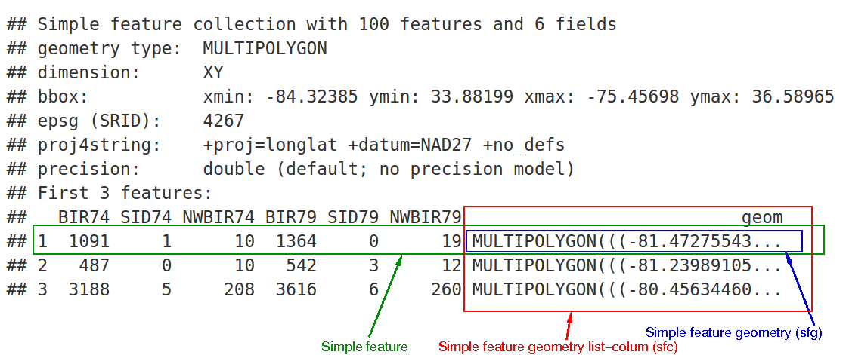
Simple Features and data.frames

Slide 8
sf and OpenStreetMap (OSM) data
Common use case is working with spatial or geographic data
The osmdata R package helps with extracting data from OSM
Potential use case of sf to extract and plot trees and shops within Utrecht
library("sf")
library("osmdata")
library("dplyr")

Slide 9
Example - Extract Utrecht Geometry
Extract the boundaries of Utrecht (“bbox”) using osmdata
utrecht_sf <- osmdata::opq(bbox = “utrecht nl”)
utrecht_sf$bbox
## “52.026282,5.0041822,52.1356715,5.195155”

Slide 10
Example - Extract Features
With the boundary of Utrecht it is possible to add OSM features
Shops
shops <- utrecht_sf %>%
osmdata::add_osm_feature(key = "shop", value = NULL) %>%
osmdata::osmdata_sf()
Trees
trees <- utrecht_sf %>%
osmdata::add_osm_feature(key = "natural", value = "tree") %>%
osmdata::osmdata_sf()

Slide 11
Example - Plot Features
Use ggplot to plot the points downloaded from OSM
library(ggplot2)
ggplot() +
geom_sf(
data=shops$osm_points,
fill="blue",
color="blue"
) +
geom_sf(
data=trees$osm_points,
fill="darkgreen",
color="darkgreen"
)

Slide 12
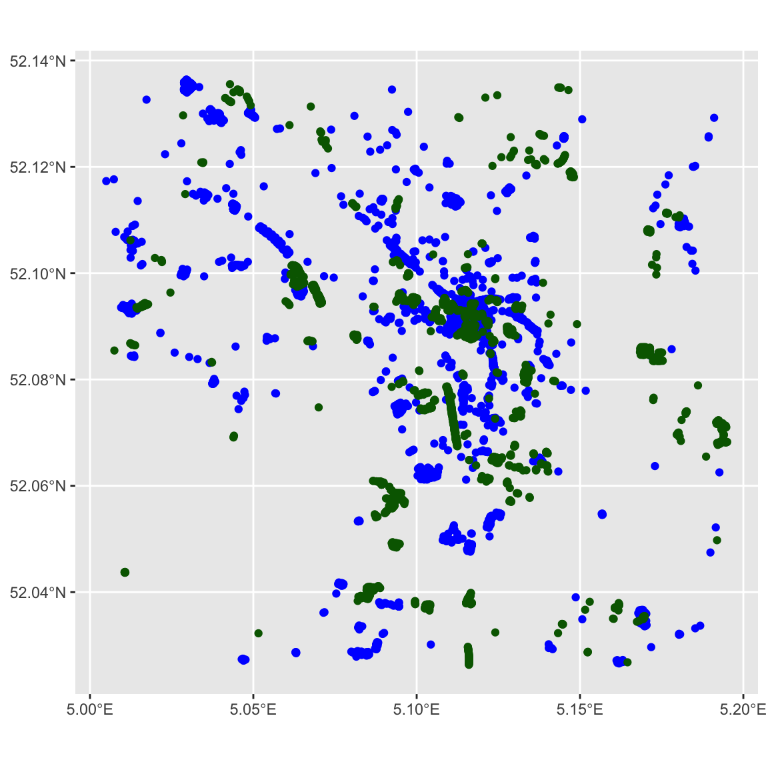
Example - Plot Features

Slide 13
Example – Add Map of Utrecht
A map of Utrecht improves the visualization of the position of these points
library(ggmap)
utrecht_map <- ggmap::get_map(
c(bottom = 52.026282,
left = 5.0041822,
top = 52.1356715,
right = 5.195155), maptype = "toner-background")

Slide 14
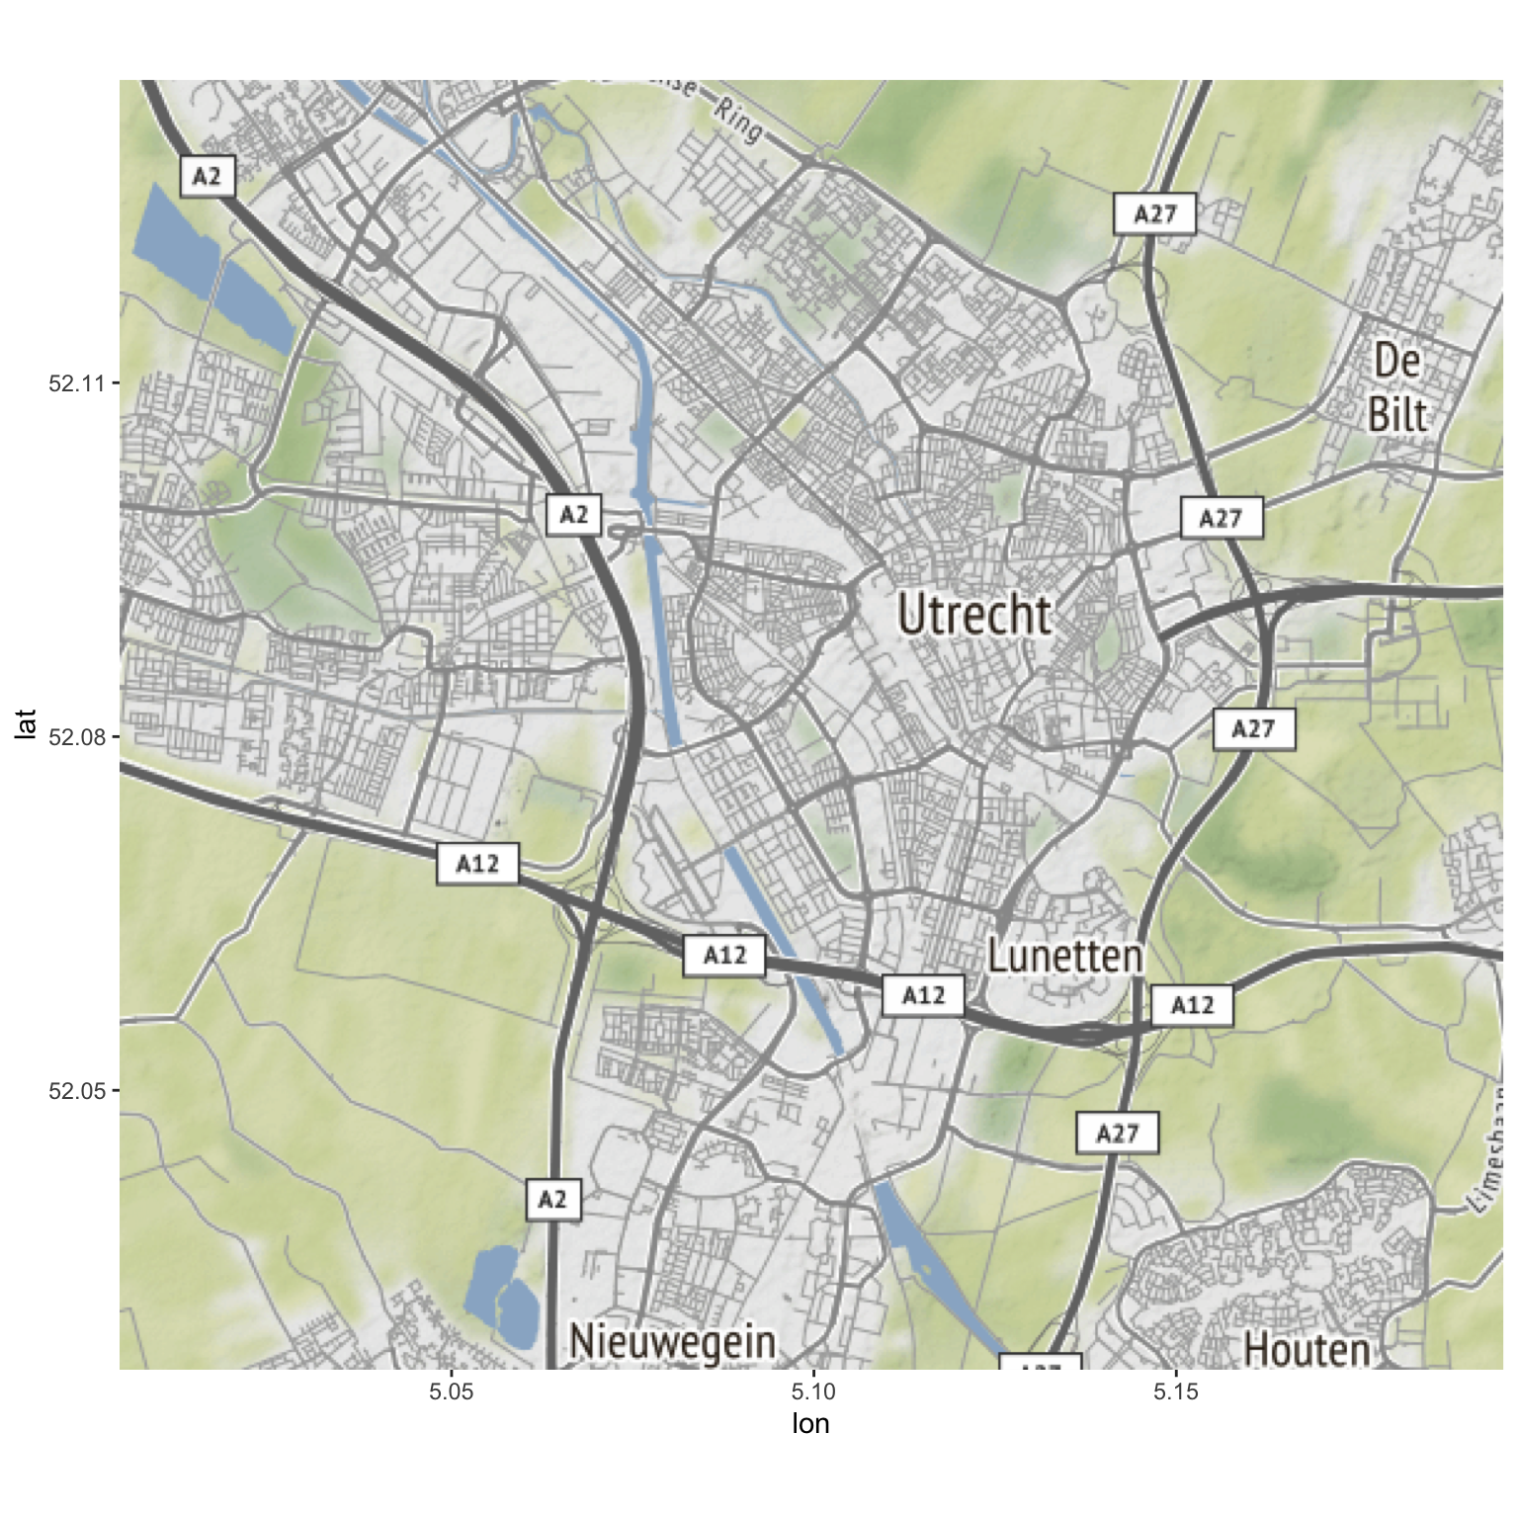
Example – Add Map of Utrecht

Slide 15
Example – Combine Map and Features
Combining the map and the points to show the final result
ggmap(utrecht_map) +
geom_sf(
data = shops$osm_points,
inherit.aes = FALSE,
fill = "blue",
color = "blue"
) +
geom_sf(
data = trees$osm_points,
inherit.aes = FALSE,
fill = "darkgreen",
color = "darkgreen"
)

Slide 16
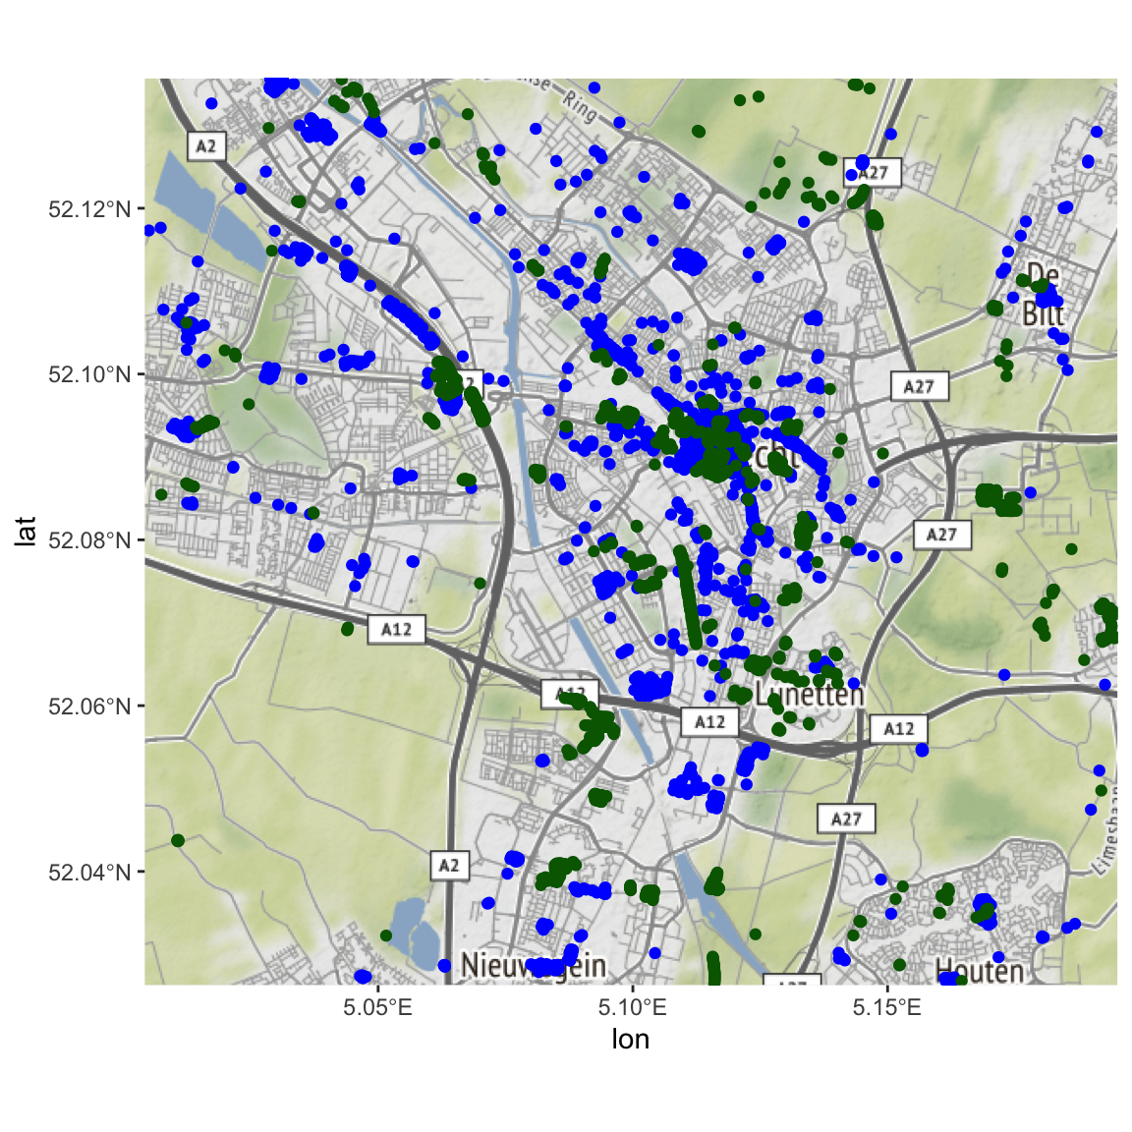
Example – Combine Map and Features

Slide 17
What is it missing?
Complex workflow
Retrieving data points in data.frame
Distances from original points to features
Large queries

