Slide 1
Spatial data science with R
Introducing the osmenrich package
ODISSEI Social Data Science team

Slide 2
A 3-part journey
Part 1.
ODISSEI and the SoDa team.
Helen Lam
Part 2.
Spatial data in R with simple features & the osmenrich package.
Leonardo Vida
Part 3.
Spatial regression with features from osmenrich.
Erik-Jan van Kesteren

Slide 3
Part 1.
ODISSEI and the SoDa team

Slide 4
Open Data and Research Infrastructure for Social Science and Economics
Consortium of 34 Dutch scientific organizations
In Utrecht:
  Faculty of Geosciences
  Faculty of Social Sciences
  Faculty of Law, Economics and Governance (REBO)
Support researchers by e.g., access to CBS microdata or LISS panel, use of the supercomputer, support in computational challenges

Slide 5
The SoDa team
ODISSEI Social Data Science team (SoDa)
Providing data science support to social scientists at ODISSEI institutes
SoDa team members
  Daniel Oberski
  Erik-Jan van Kesteren
  Leonardo Vida
  Helen Lam
  Jonathan de Bruin

Slide 7
Where to find us
On the website of ODISSEI
https://odissei-data.nl/soda
On GitHub
https://github.com/sodascience
https://github.com/sodascience/osmenrich
Your contributions, questions, and issue reports are greatly appreciated!
Via email
soda@odissei-data.nl
e.vankesteren1@uu.nl (also teams!)

Slide 8
Part 2.
Spatial data in R with simple features & the osmenrich package

Slide 9
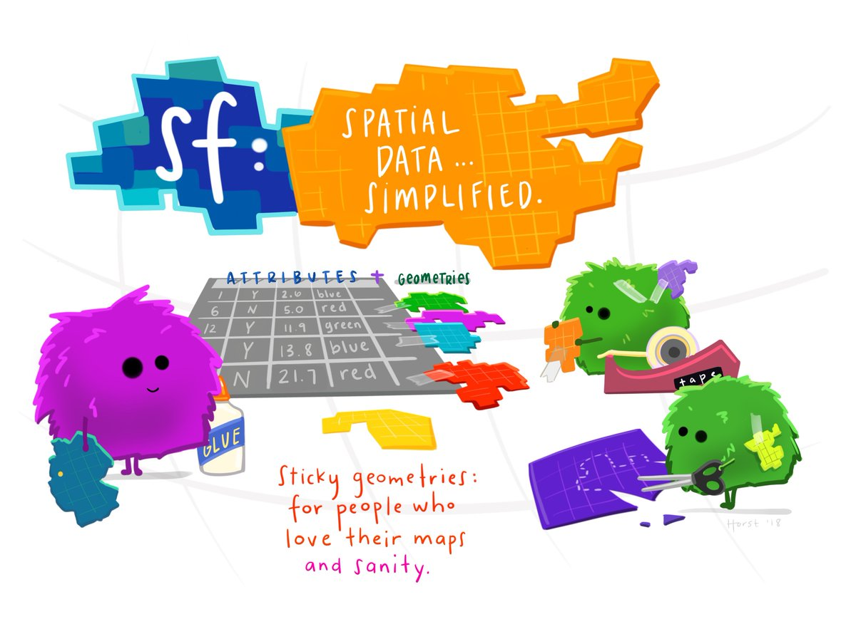
Simple Features
Illustration (c) by AllisonHorst)

Slide 10
Simple Features
“A simple feature is defined by the OpenGIS Abstract specification to have both spatial and non-spatial attributes. Spatial attributes are geometry valued, and simple features are based on 2D geometry with linear interpolation between vertices.”
A simple feature is a standard representation of physical objects that has spatial and non-spatial attributes
17 simple feature types (like point, line, polygon)
Supported by many databases and software

Slide 11
Simple Features in R (sf)
In R simple features are implemented in the package sf
Provides simple features in data.frames or tibbles with a geometry list-column
sf supports all simple feature types
library(sf)
# > Linking to GEOS 3.7.2, GDAL 2.4.2, PROJ 5.2.0

Slide 12
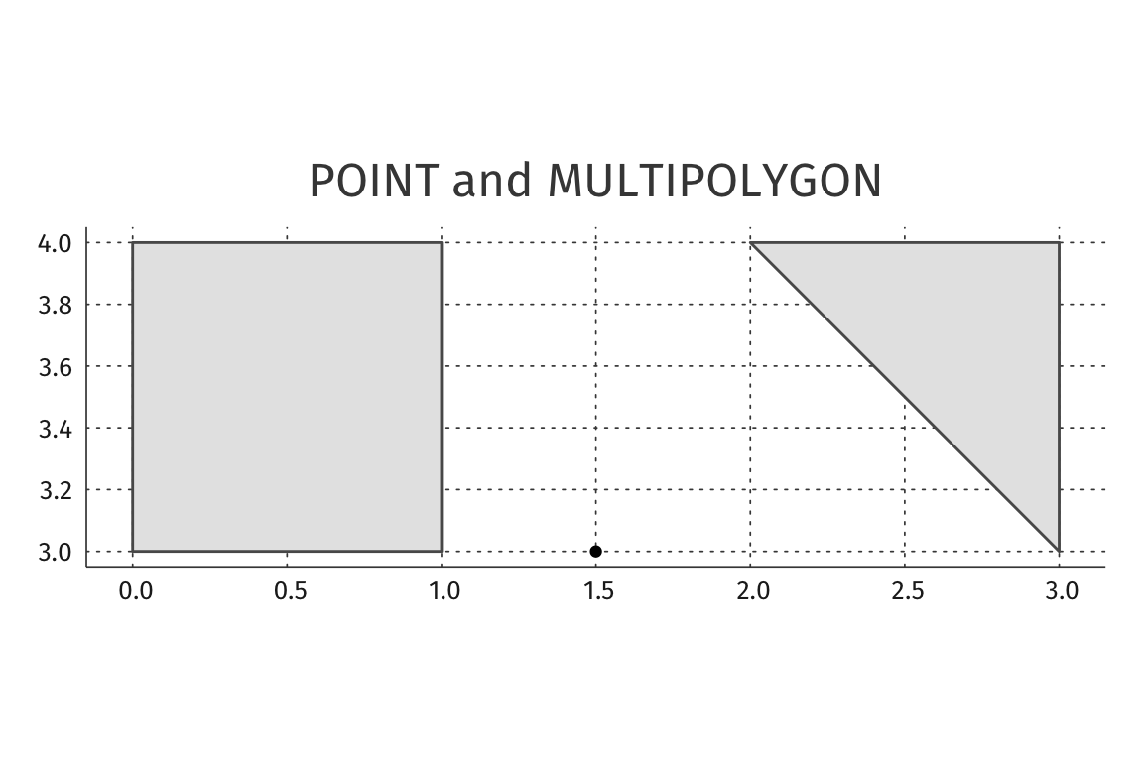
Simple Features:
POINT and MULTIPOLYGON
st_point(c(3,1.5)) # POINT
p1 <- rbind(c(0,3), c(0,4), c(1,4), c(1,3), c(0,3))
p2 <- rbind(c(3,3), c(2,4), c(3,4), c(3,3))
pol <- st_multipolygon(list(list(p1), list(p2))) # MULTIPOLYGON
Notes:
Sfs are easily created: example point and a multipolygon → once defined you can easily plot or do spatial transformations

Slide 13
Simple Features and data.frames
The common use case is working with datasets consisting of sets of features with attributes
nc_data_path <- system.file("shape/nc.shp", package = "sf")
nc <-
st_read(nc_data_path) %>%
select(CNTY_ID, NAME, BIR74)
Notes:
However, usually one works with a dataset having a set of features → here I load a dataset with some data from North Carolina and select three features (city id, city name and the number of births in 74). If I decide to look at my selection calling the selection I just made:..

Slide 14
Simple Features and data.frames
nc
## Simple feature collection with 100 features and 3 fields
## geometry type: MULTIPOLYGON
## dimension: XY
## bbox: xmin: -84.32 ymin: 33.88 xmax: -75.45 ymax: 36.58
## geographic CRS: NAD27
## First 6 features:
## CNTY_ID NAME BIR74 geometry
## 1 1825 Ashe 1091 MULTIPOLYGON (((-81.47276 3...
## 2 1827 Alleghany 487 MULTIPOLYGON (((-81.23989 3...
## 3 1828 Surry 3188 MULTIPOLYGON (((-80.45634 3...
## 4 1831 Currituck 508 MULTIPOLYGON (((-76.00897 3...
## 5 1832 Northampton 1421 MULTIPOLYGON (((-77.21767 3...
## 6 1833 Hertford 1452 MULTIPOLYGON (((-76.74506 3...
Notes:
We see that the upper part is metadata, lower part is “just” a familiar data frame. Mention what a bounding box (whose coordinates define the box within all the geometry point lie), mention coordinate reference system, mention the geometry column, indicate the births in 1974 column

Slide 15
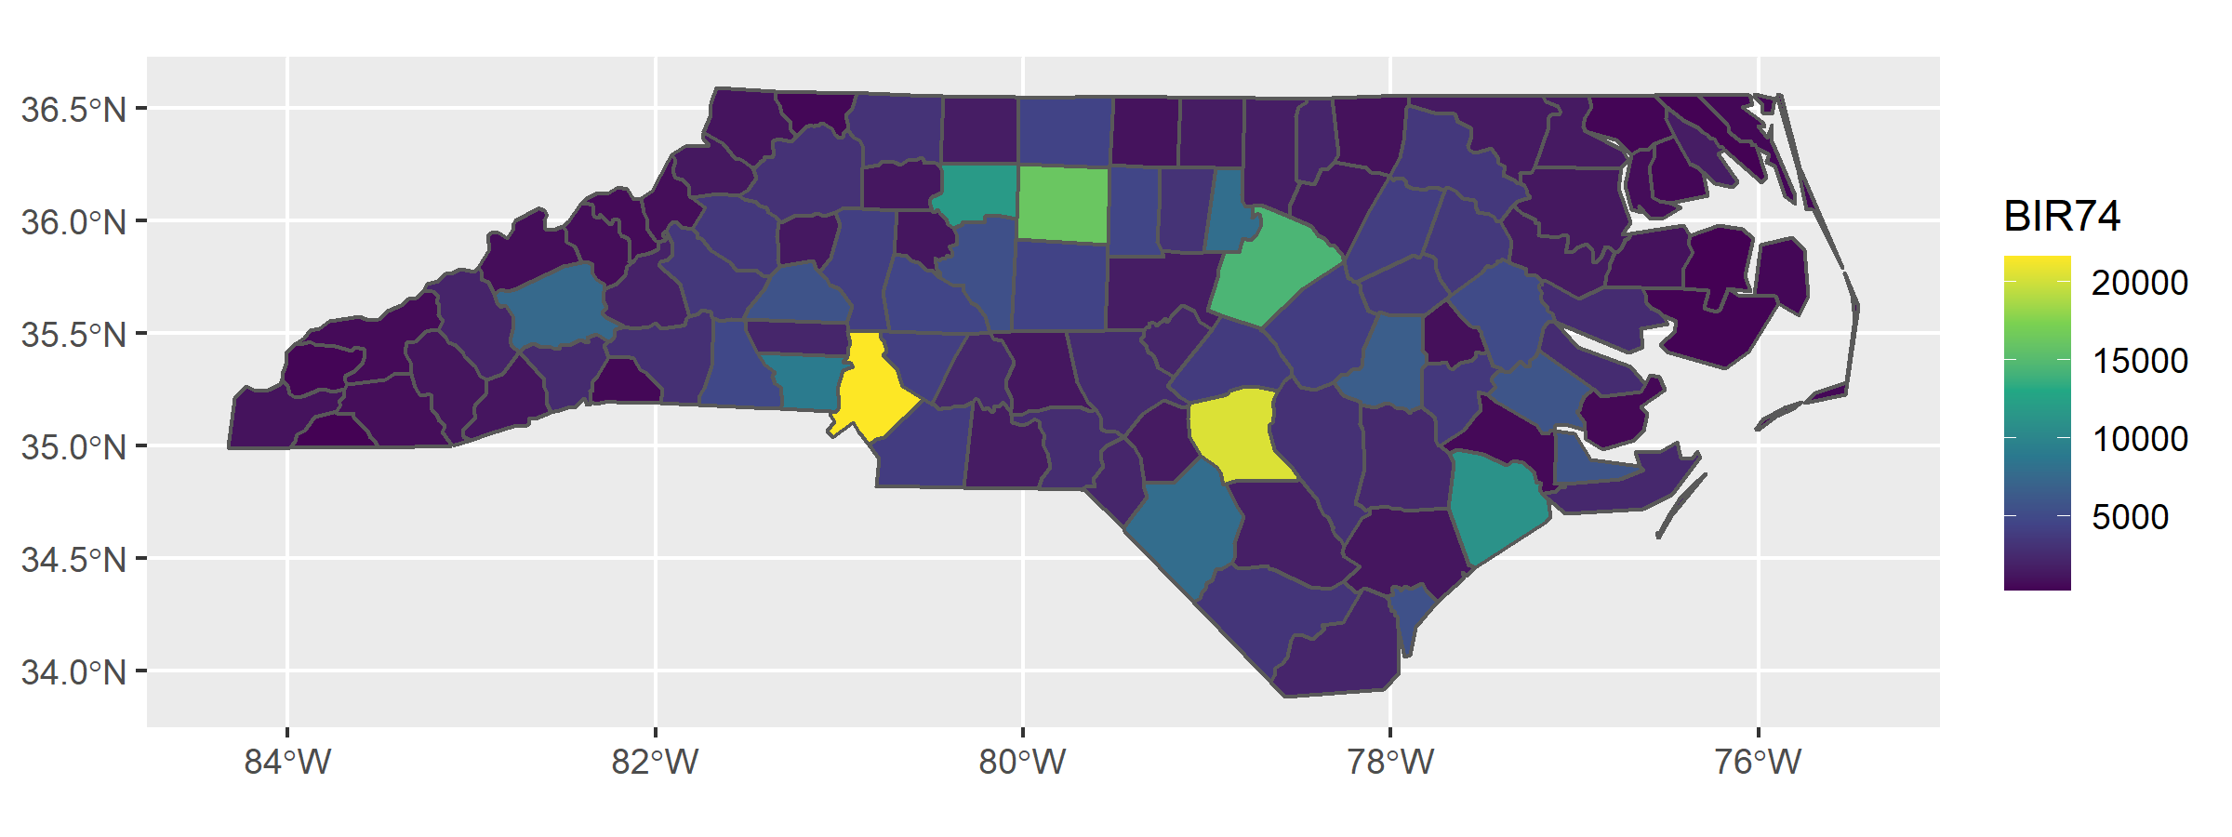
Plotting simple features with ggplot
ggplot(nc) +
geom_sf(aes(fill = BIR74)) +
scale_fill_viridis_c()
Notes:
“ggplot has built-in support for sf via geom_sf()”

Slide 16
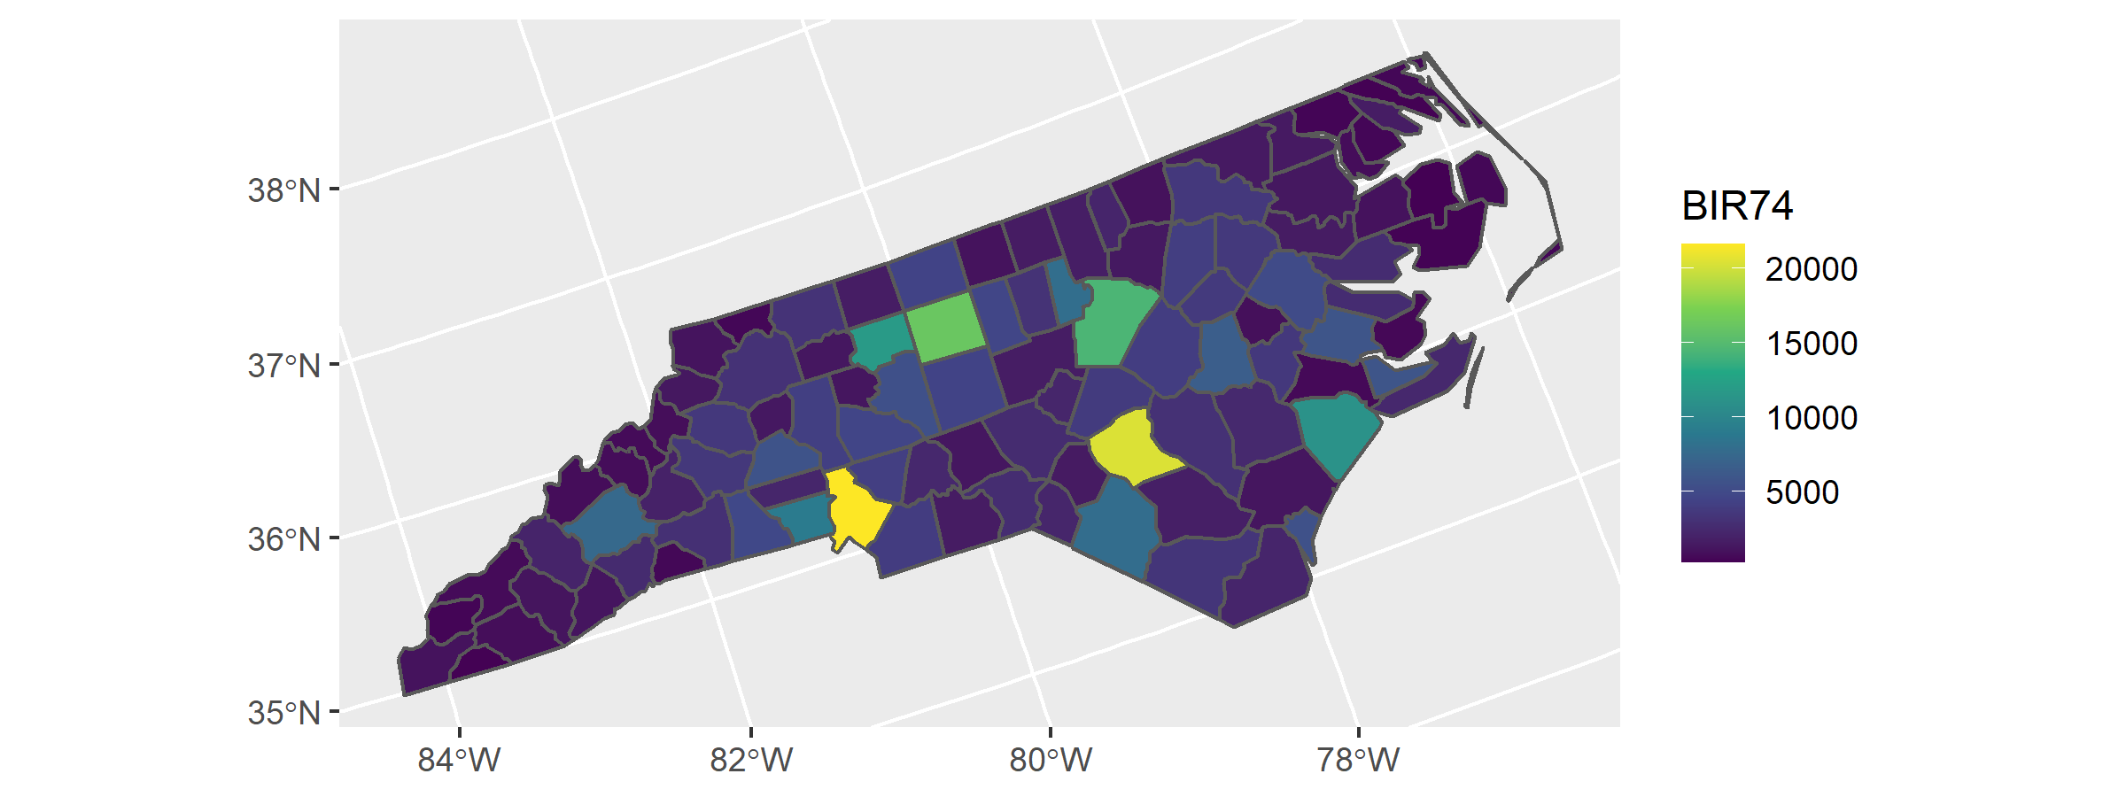
Different coordinate system
ggplot(st_transform(nc, 26912)) +
geom_sf(aes(fill = BIR74)) +
scale_fill_viridis_c()
Notes:
Sf handles all the difficult stuff like transforming the coordinate our collection of objects to a new projection

Slide 17
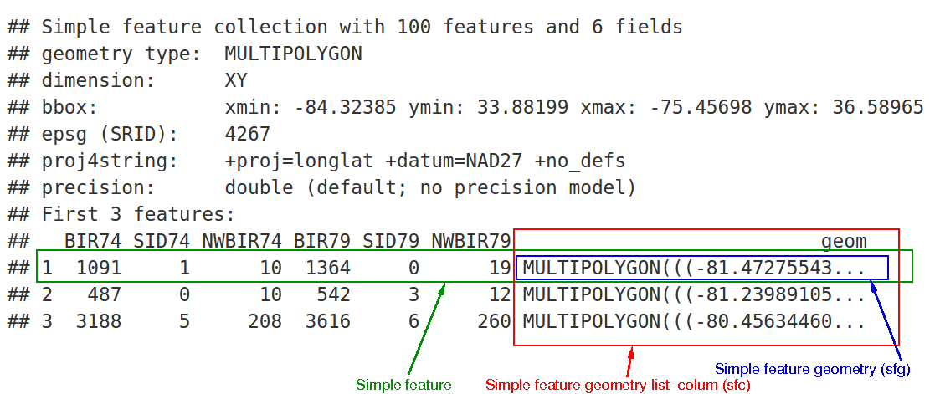
Simple Features and data.frames

Slide 18

Notes:
Now that we saw the basic functionalities of the sf package, we would like to introduce you to the package that we developed: osmenrich

Slide 19
What is osmenrich?
A package to enrich geocoded data (lat/lon) with OpenStreetMap data
Aims to make data enrichment as intuitive and easy as possible
Designed to work with the sf package to deal with geocoded data
Notes:
- It is integrated to work out-of-the-box with the sf package so that all the nice features such as transformations and easiness of plotting will be kept
-

Slide 20
How to install osmenrich
To install from GitHub you need the “remotes” package:
install.packages("remotes")
To install and load osmenrich:
remotes::install_github("sodascience/osmenrich")
library(osmenrich)
Notes:
Osmenrich is now available to be installed from GitHub, later will be available from CRAN as well. For the moment, you will need to have the “remotes” package installed

Slide 21
Simple enrichment example
Alice and Bob want to count waste baskets in a 100m radius from them
Let’s create a dataset with Alice and Bob and transform it into an sf dataset
library(tidyverse)
library(sf)
sf_example <-
  tribble(
    ~person, ~lat, ~lon,
    "Alice", 52.12, 5.09,
    "Bob", 52.13, 5.08,
  ) %>%
  sf::st_as_sf(
    coords = c("lon", "lat"),
    crs = 4326
  )
Notes:
After importing tidyverse to simplify our life in transforming data, we create an example dataset called sf_example.
Describe the dataset → then we use an sf function to recognize the two columns lat and lon as spatial coordinates and transform the dataset into an sf dataset

Slide 22
Simple enrichment example
Printing the example dataset shows the typical sf view
sf_example
## Simple feature collection with 2 features and 3 fields
## geometry type: POINT
## dimension: XY
## bbox: xmin: 5.08 ymin: 52.12 xmax: 5.09 ymax: 52.13
## CRS: EPSG:4326
## # A tibble: 2 x 4
## person id val geometry
## * <chr> <dbl> <int> <POINT [°]>
## 1 Alice 1 5 (5.09 52.12)
## 2 Bob 2 2 (5.08 52.13)
Notes:
We can print this newly created dataset to see the view we previously saw → note that both Alice and Bob now have a geometry column that is a spatial sf object

Slide 23
Simple enrichment example
osmenrich is used to count the waste baskets and add the count to the dataset
sf_example_simple <- sf_example %>%
osmenrich::enrich_osm(
name = "n_waste_baskets",
key = "amenity",
value = "waste_basket",
r = 100
)
#> Downloading data for waste_baskets... Done.
#> Downloaded 26 points, 0 lines, 0 polygons, 0 mlines, 0 mpolygons.
#> Computing distance matrix for wastebaskets...Done.
#> Adding waste_baskets to data.
Notes:
To count the waste baskets we use the main enrichment function of osmenrich which is enrich_osm
This function, in its most basic form takes a name → that will be the name assigned to the newly created column with the waste baskets count, a key and value, used to search the feature that we want to add, and the radius of the search → from points in the dataset
Once we ran it we see that points are being downloaded and the counts are added to the dataset

Slide 24
Simple enrichment example
Print the enriched example dataset to look at the results
sf_example_simple
#> Simple feature collection with 2 features and 4 fields
#> geometry type: POINT
#> dimension: XY
#> bbox: xmin: 5.08 ymin: 52.12 xmax: 5.09 ymax: 52.13
#> CRS: EPSG:4326
#> A tibble: 2 x 5
#> person id val geometry n_waste_baskets
#> * <chr> <dbl> <int> <POINT [°]> <int>
#> 1 Alice 1 5 (5.09 52.12) 3
#> 2 Bob 2 2 (5.08 52.13) 0
Notes:
If we print the dataset, we see the newly created column
The result is still a sf dataset with the enriched results

Slide 25
Special features of osmenrich
How could osmenrich know that we wanted the sum of all waste baskets?
enrich_osm() has a kernel variable that enables users to define the aggregation of the retrieved data
osmenrich can also retrieve distances and durations from points in the dataset (e.g. Alice and Bob) to features (e.g. waste baskets)
Notes:
However, usually one works with a dataset having a set of features → here I load a dataset with some data from North Carolina and select three features (city id, city name and the number of births in 74). If I decide to look at my selection calling the selection I just made:..

Slide 26
osmenrich is still in development!
Actively searching for new projects that use osmenrich
Any contribution and question on our GitHub page is welcome
https://github.com/sodascience/osmenrich
Notes:
However, usually one works with a dataset having a set of features → here I load a dataset with some data from North Carolina and select three features (city id, city name and the number of births in 74). If I decide to look at my selection calling the selection I just made:..

Slide 27
sf and OpenStreetMap (OSM) data
Common use case is working with spatial or geographic data
The osmdata R package helps with extracting data from OSM
Potential use case of sf to extract and plot trees and shops within Utrecht
library("sf")
library("osmdata")
library("dplyr")

Slide 28
Example - Extract Utrecht Geometry
Extract the boundaries of Utrecht (“bbox”) using osmdata
utrecht_sf <- osmdata::opq(bbox = “utrecht nl”)
utrecht_sf$bbox
## “52.026282,5.0041822,52.1356715,5.195155”

Slide 29
Example - Extract Features
With the boundary of Utrecht it is possible to add OSM features
Shops
shops <- utrecht_sf %>%
osmdata::add_osm_feature(key = "shop", value = NULL) %>%
osmdata::osmdata_sf()
Trees
trees <- utrecht_sf %>%
osmdata::add_osm_feature(key = "natural", value = "tree") %>%
osmdata::osmdata_sf()

Slide 30
Example - Plot Features
Use ggplot to plot the points downloaded from OSM
library(ggplot2)
ggplot() +
geom_sf(
data=shops$osm_points,
fill="blue",
color="blue"
) +
geom_sf(
data=trees$osm_points,
fill="darkgreen",
color="darkgreen"
)

Slide 31
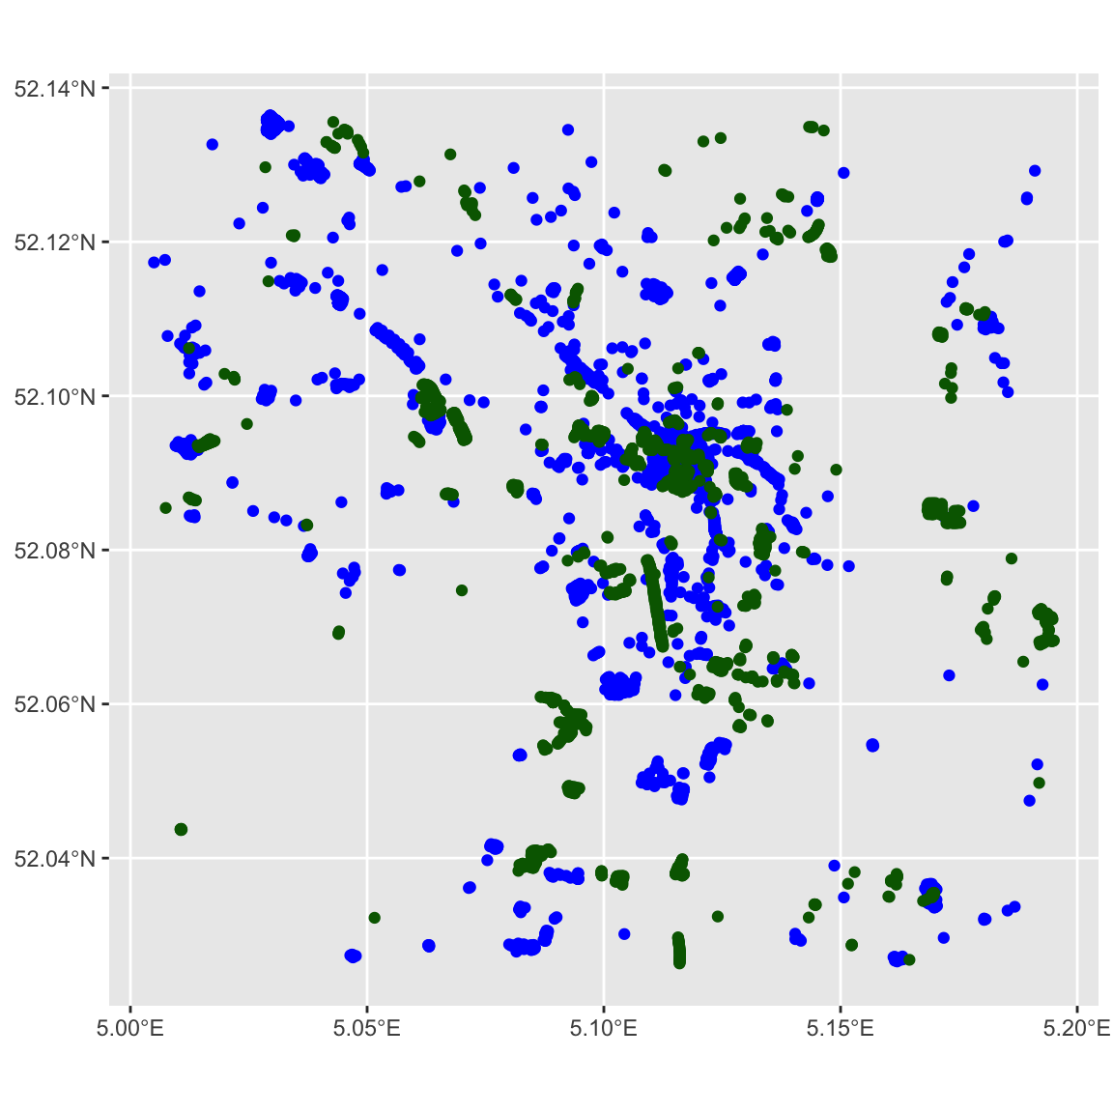
Example - Plot Features

Slide 32
Example – Add Map of Utrecht
A map of Utrecht improves the visualization of the position of these points
library(ggmap)
utrecht_map <- ggmap::get_map(
c(bottom = 52.026282,
left = 5.0041822,
top = 52.1356715,
right = 5.195155), maptype = "toner-background")

Slide 33
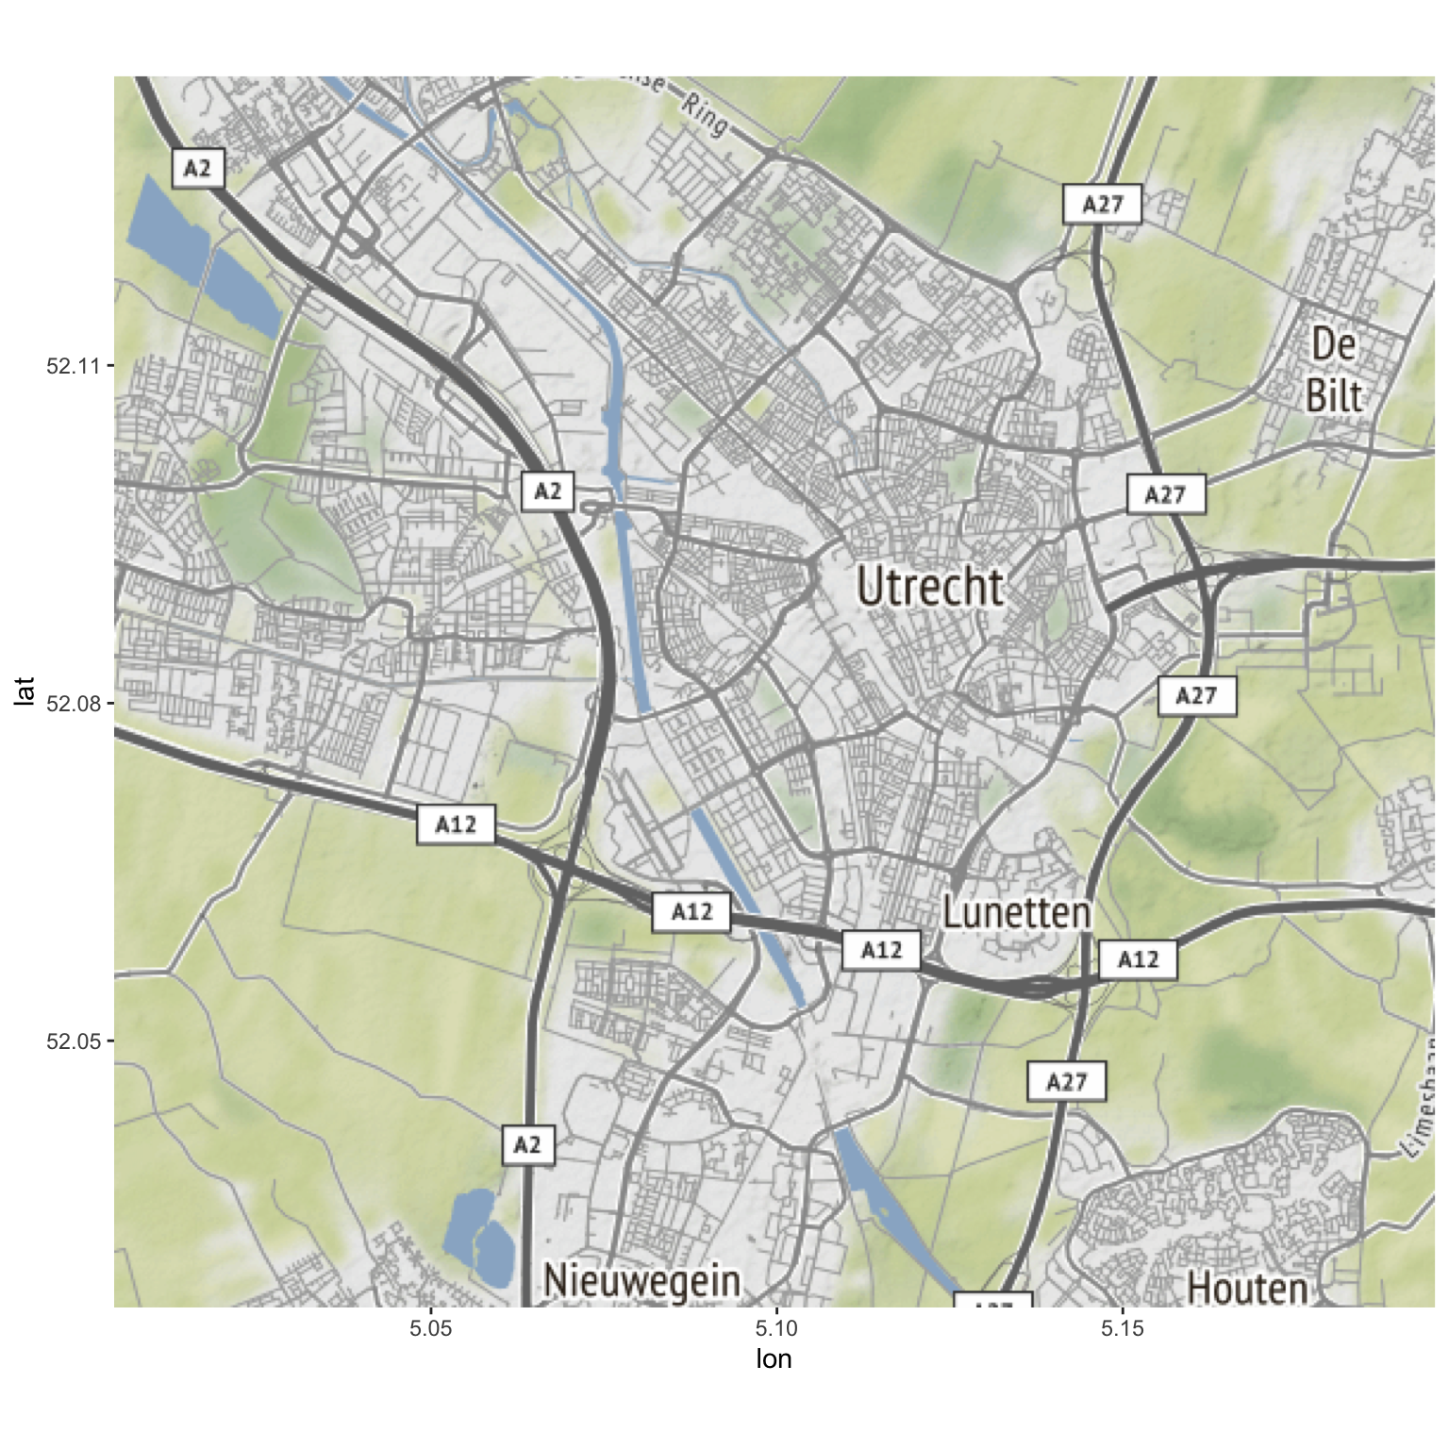
Example – Add Map of Utrecht

Slide 34
Example – Combine Map and Features
Combining the map and the points to show the final result
ggmap(utrecht_map) +
geom_sf(
data = shops$osm_points,
inherit.aes = FALSE,
fill = "blue",
color = "blue"
) +
geom_sf(
data = trees$osm_points,
inherit.aes = FALSE,
fill = "darkgreen",
color = "darkgreen"
)

Slide 35
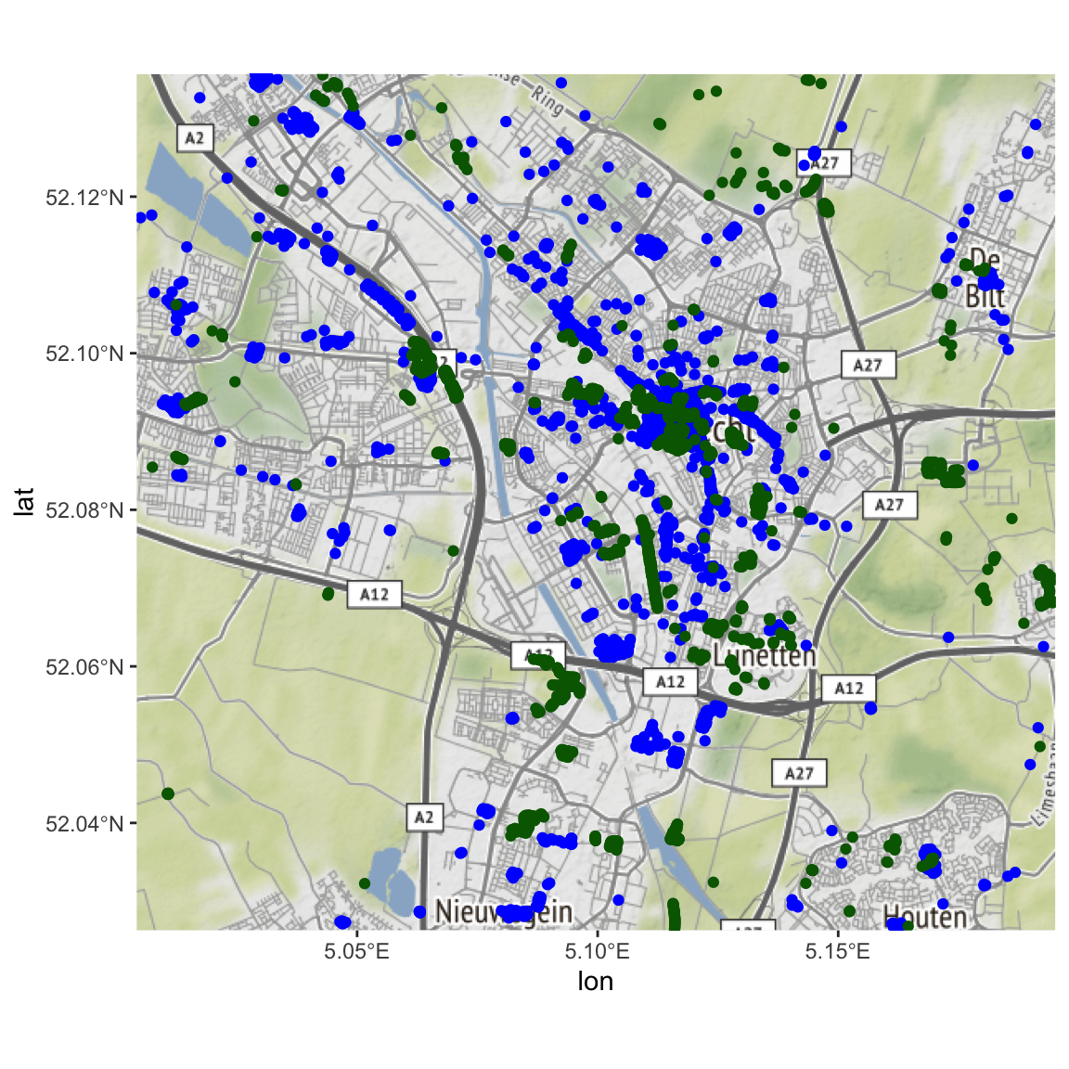
Example – Combine Map and Features

Slide 36
What is it missing?
Complex workflow
Retrieving data points in data.frame
Distances from original points to features
Large queries

Slide 37

Part 3.
Spatial regression with features from osmenrich
Disclaimer: this is an example analysis,
NOT a careful research project!

Slide 38

Running example: gierzwaluw
Open data from Utrecht municipality
https://ckan.dataplatform.nl/dataset/8ceaae10-fb90-4ec0-961c-ef02691bb861
Gierzwaluwinventarisatie 2014
Counting the nests of the common swift
CC-0 license
Variables
Nest count (1-4)
Latitude
Longitude
Address information
Detailed description of the nest
Full code available at:
https://github.com/sodascience/presentation-osmenrich-sig

Slide 39
Loading the data
library(tidyverse)
library(sf)
data_url <- "https://ckan.dataplatform.nl/dataset/8ceaae10-fb90-4ec0-961c-ef02691bb861/resource/baae4cde-cf33-416b-aa4e-d0fba160eed9/download/gierzwaluwinventarisatie2014.csv"
bird_sf <-
read_csv(data_url) %>%
drop_na(latitude, longitude, `aantal nesten`) %>%
st_as_sf(coords = c("longitude", "latitude"), crs = 4326) %>%
select(nestcount = "aantal nesten", geometry)

Slide 40
Loading the data
Simple feature collection with 99 features and 1 field
geometry type: POINT
dimension: XY
bbox: xmin: 5.075877 ymin: 52.06334 xmax: 5.133265 ymax: 52.12635
geographic CRS: WGS 84
# A tibble: 99 x 2
nestcount geometry
<dbl> <POINT [°]>
1 1 (5.086195 52.0884)
2 2 (5.086602 52.08866)
3 1 (5.086619 52.0884)
4 1 (5.086604 52.08837)
# ... with 95 more rows

Slide 41
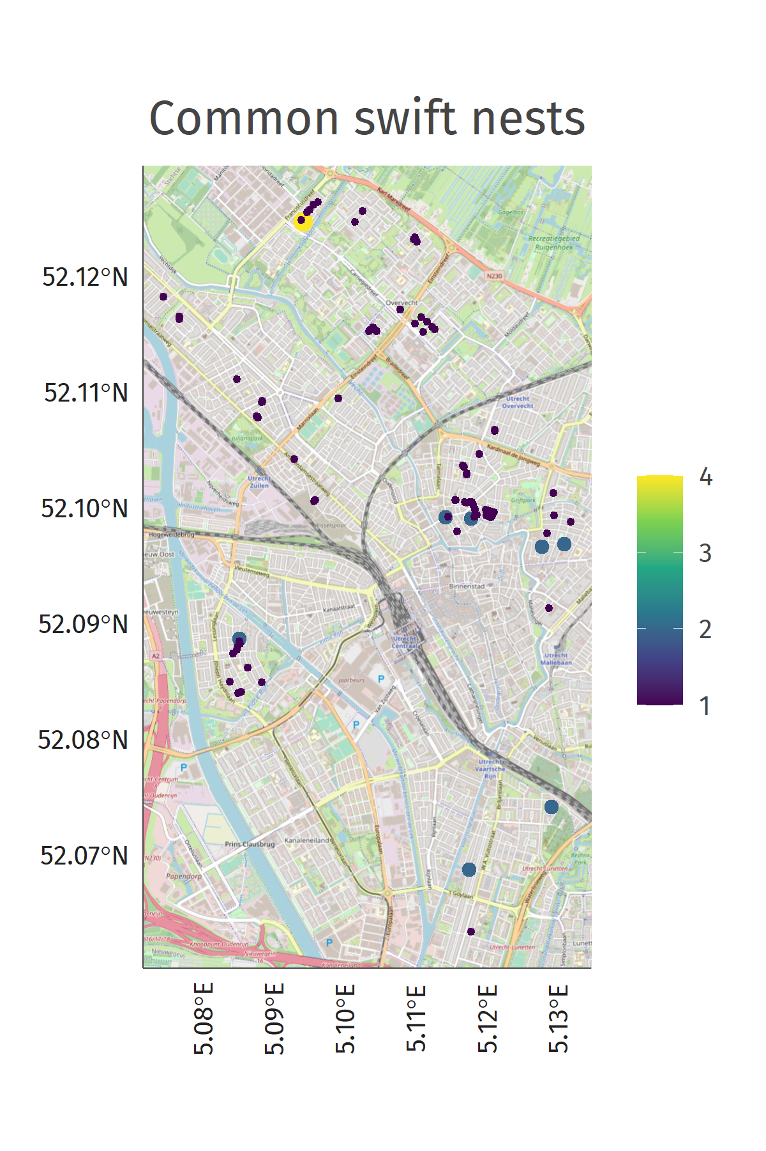
The gierzwaluw data
library(ggspatial)
plot_bird <-
ggplot(bird_sf) +
annotation_map_tile() +
geom_sf() +
labs(title = "Common swift nests")

Slide 42
Sneaky trick
We want to predict nestcount
But dataset only contains observed nests
Simplifying assumption: data contains all nests in Utrecht
i.e. all other locations have 0 nests!
Randomly sample points with 0 nestcount
= Data augmentation
You should use a more sophisticated model to get around this

Slide 43
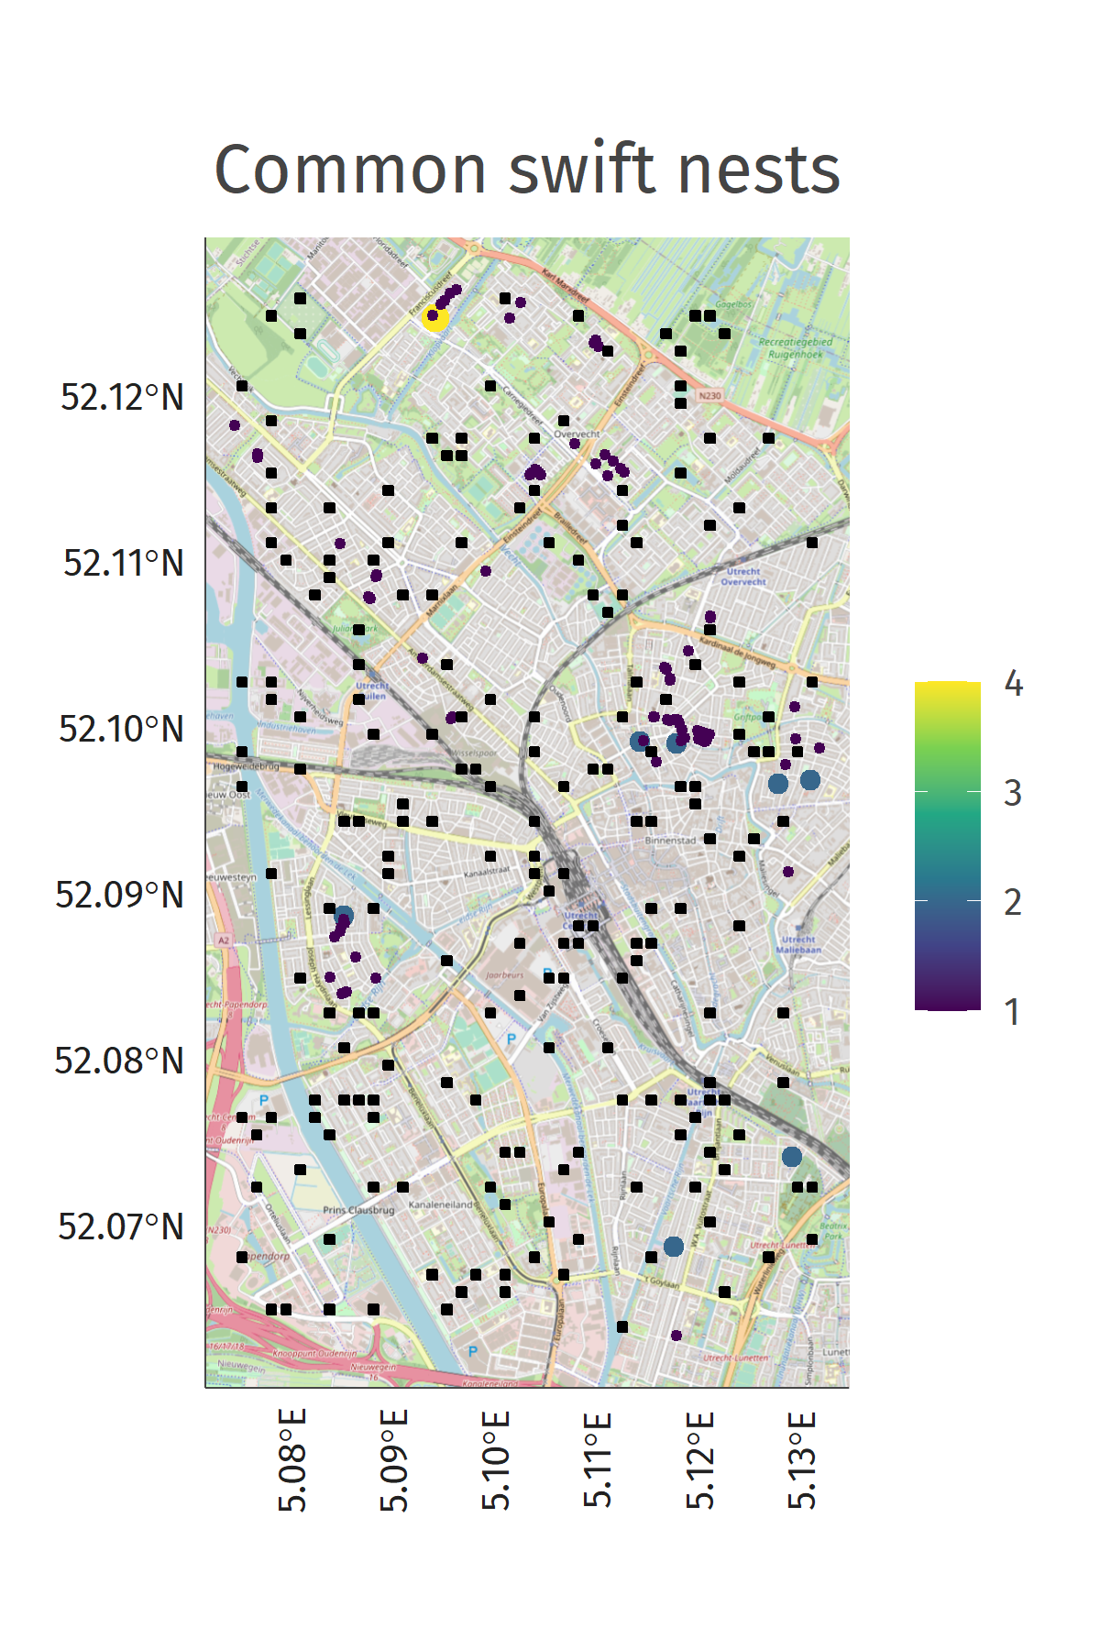
The gierzwaluw data
bird_sf <- bind_rows(bird_sf, nonbird_sf)
plot_bird <-
ggplot(bird_sf) +
annotation_map_tile() +
geom_sf() +
labs(title = "Common swift nests")

Slide 44
I’m an ecologist now
My expectations
Nesting behaviour is spatially correlated
We are more likely to find a nest close to other nests
Common swifts benefit from commercial activity, but not too much
The birds need food but also they need peace. They are peaceful birds.
Nature is important to the common swift
The birds need trees to do bird things like sitting and nesting
PS. I am not an ecologist
But let’s test these expectations anyway!

Slide 45
We need more data to test our expectations about nesting behaviour
We can gather a lot of this data from open sources such as OSM

Slide 46
Data enrichment
library(osmenrich)
bird_sf <-
bird_sf %>%
enrich_osm(
name = "commercial_activity_1km",
key = "shop",
kernel = "gaussian",
r = 1000
)

Slide 47
Data enrichment
Simple feature collection with 299 features and 2 fields
geometry type: POINT
dimension: XY
bbox: xmin: 5.075877 ymin: 52.06334 xmax: 5.133265 ymax: 52.12635
geographic CRS: WGS 84
# A tibble: 299 x 3
nestcount commercial_activity_1km geometry
<dbl> <dbl> <POINT [°]>
1 1 0.0167 (5.086195 52.0884)
2 2 0.0165 (5.086602 52.08866)
3 1 0.0167 (5.086619 52.0884)
4 1 0.0167 (5.086604 52.08837)
# ... with 295 more rows

Slide 48
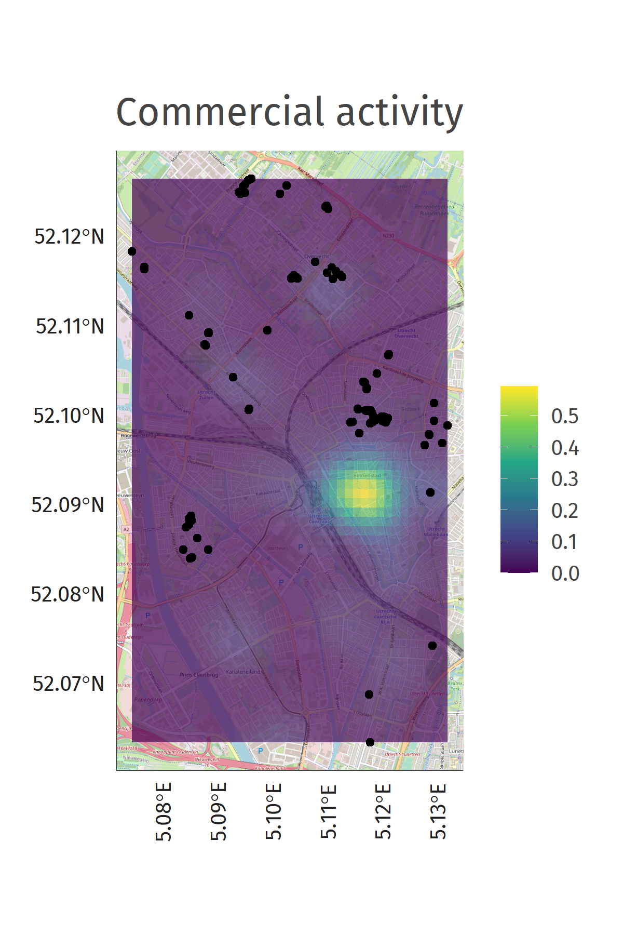

Slide 49

Data enrichment
bird_sf <-
bird_sf %>%
enrich_osm(
name = "tree_1km",
key = "natural",
value = "tree",
kernel = "gaussian",
r = 1000
)

Slide 50
Data enrichment
Simple feature collection with 299 features and 3 fields
geometry type: POINT
dimension: XY
bbox: xmin: 5.075877 ymin: 52.06334 xmax: 5.133265 ymax: 52.12635
geographic CRS: WGS 84
# A tibble: 299 x 4
nestcount commercial_activity_1km tree_1km geometry
<dbl> <dbl> <dbl> <POINT [°]>
1 1 0.0167 0.00799 (5.086195 52.0884)
2 2 0.0165 0.00692 (5.086602 52.08866)
3 1 0.0167 0.00689 (5.086619 52.0884)
4 1 0.0167 0.00693 (5.086604 52.08837)
# ... with 295 more rows

Slide 51
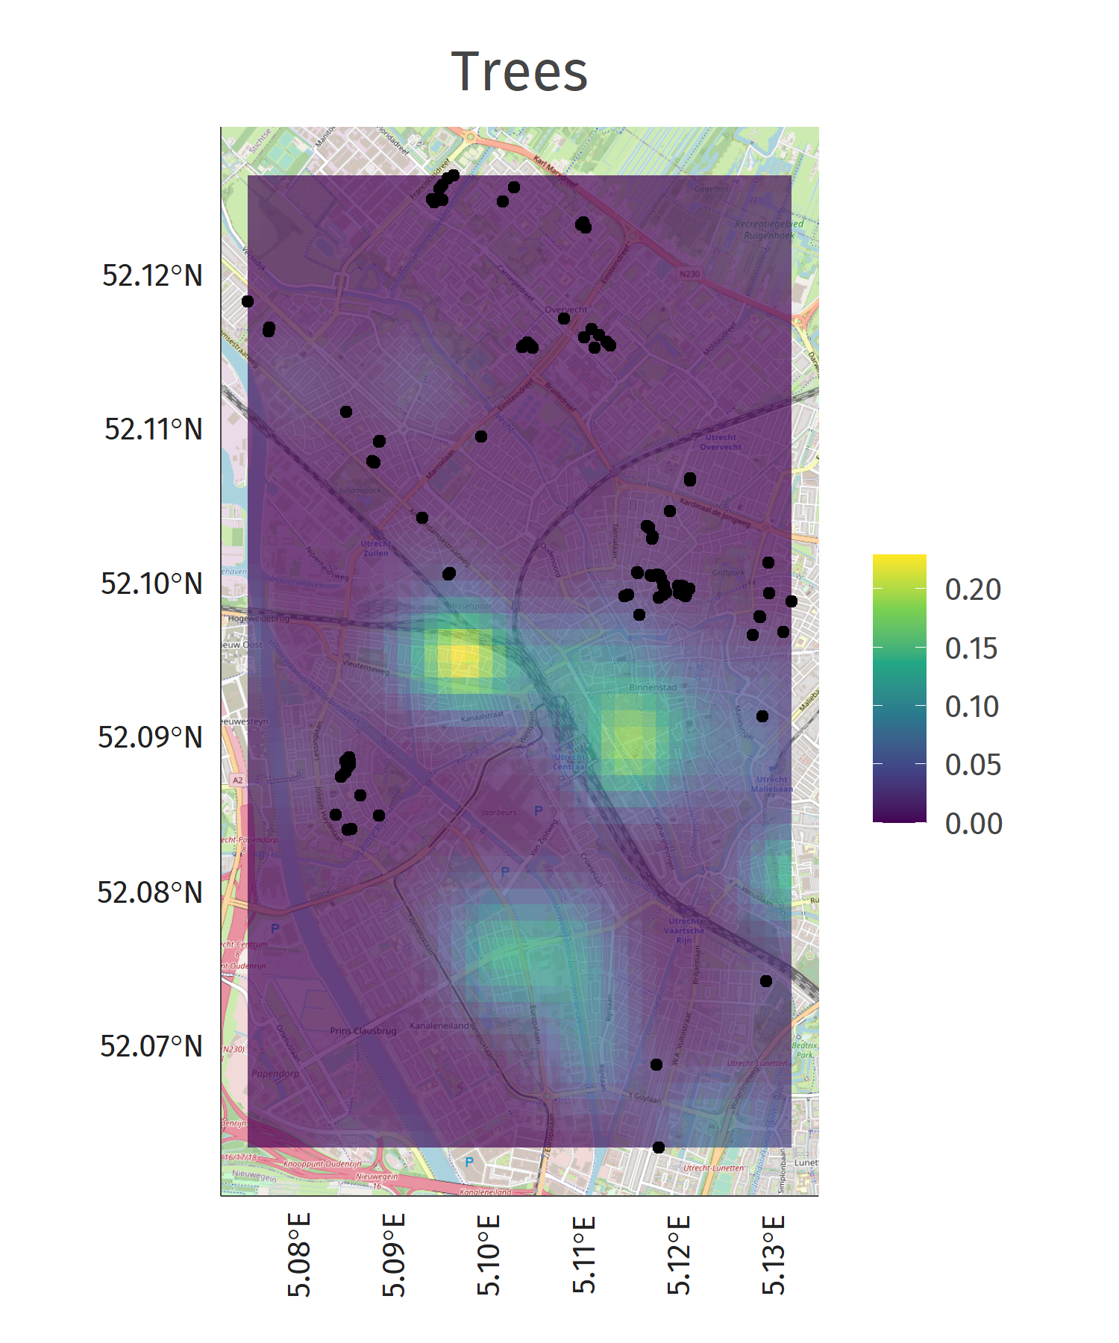

Slide 52
Now we have our data

Slide 53
Regression model
Count outcome
Zero-inflated poisson regression with identity link function
Predictors: generalized additive model
Bivariate spline for the spatial component (smooth spatial variation)
Quadratic effect of commercial activity
Linear effect of trees
NB: There are many options here: gaussian process regression, regression kriging, other smoothing techniques, ….

Slide 54
Regression model
library(mgcv)
fit <- gam(
nestcount ~
te(x, y, bs = "ts") +
poly(commercial_activity_1km, 2) +
tree_1km,
family = "ziP",
data = sf_to_df(bird_sf)
)

Slide 55
Regression model
Parametric coefficients:
Estimate Std. Error z value Pr(>|z|)
(Intercept) -5.4450 0.9183 -5.929 3.04e-09 ***
poly(commercial_activity_1km, 2)1 -241.9024 85.0221 -2.845 0.00444 **
poly(commercial_activity_1km, 2)2 -154.0026 47.7631 -3.224 0.00126 **
tree_300m -27.3748 14.8989 -1.837 0.06615 .
---
Signif. codes: 0 ‘***’ 0.001 ‘**’ 0.01 ‘*’ 0.05 ‘.’ 0.1 ‘ ’ 1
Approximate significance of smooth terms:
edf Ref.df Chi.sq p-value
te(x,y) 14.97 24 86.81 8.59e-14 ***
---
Signif. codes: 0 ‘***’ 0.001 ‘**’ 0.01 ‘*’ 0.05 ‘.’ 0.1 ‘ ’ 1

Slide 56
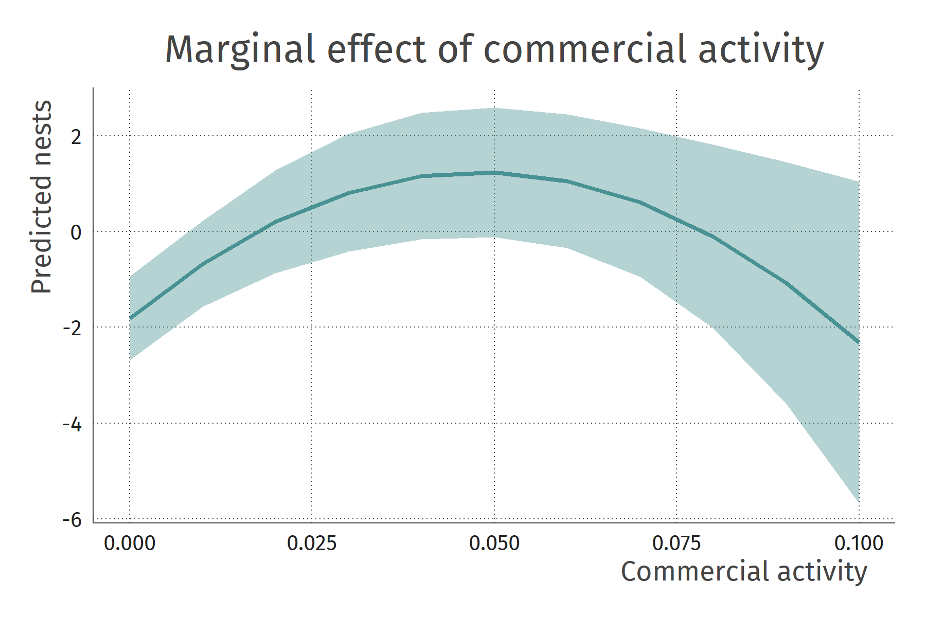

Slide 57
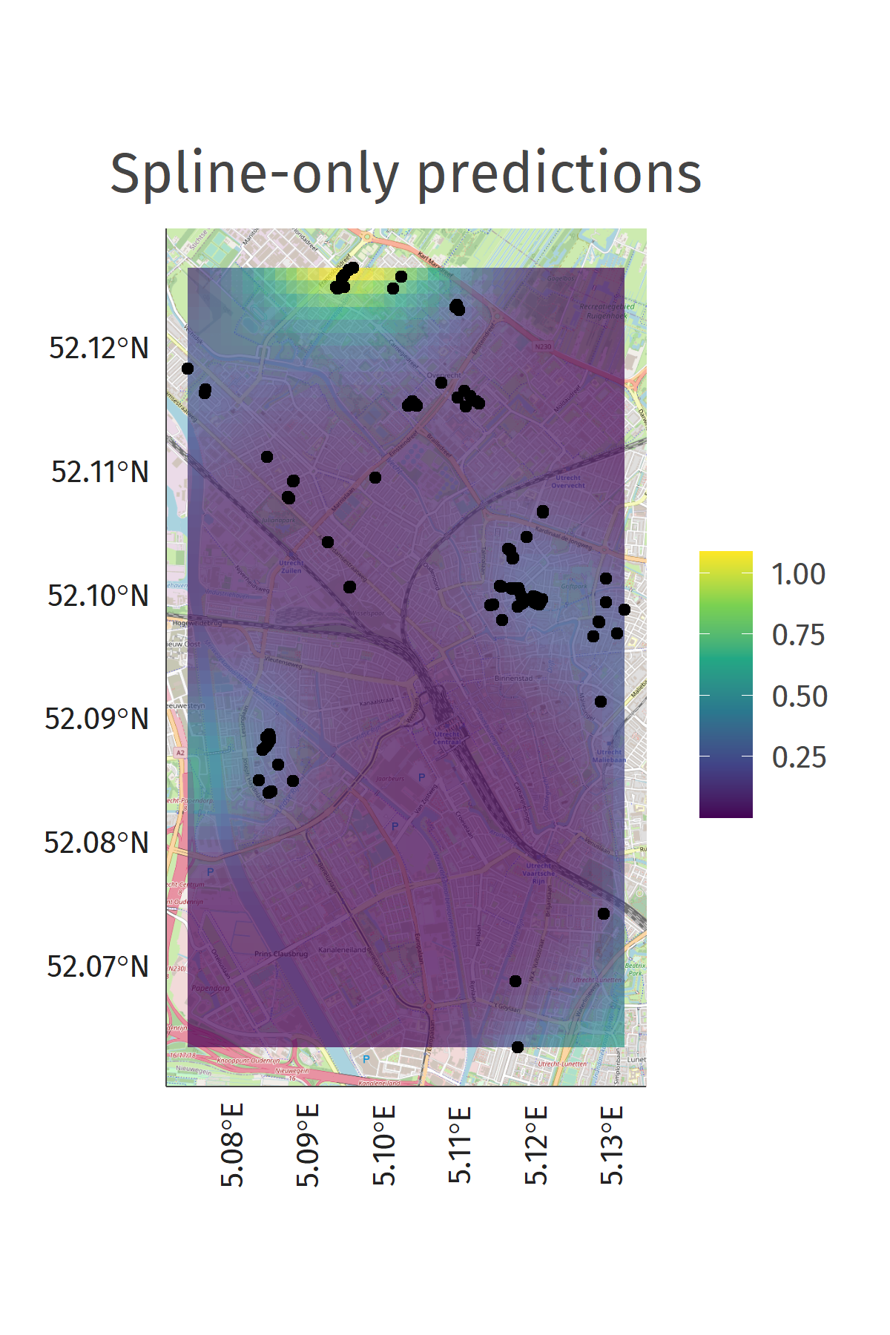

Slide 58
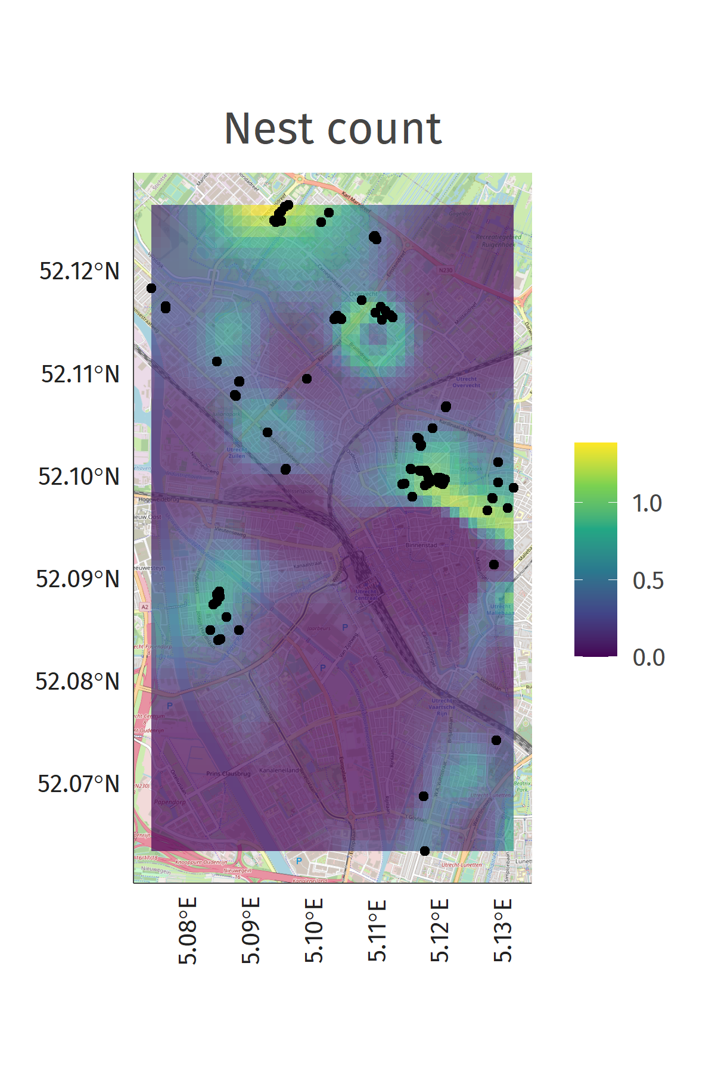

Slide 59
Conclusion
Spatial observational data can be enriched easily using sf and osmenrich
Spatial models can then be used to test expectations about behaviour in the environment
Spatial predictions from these models can guide future data collection efforts

Slide 60
Questions?

Slide 61
Thank you!

