Slide 1



Synthetic data for
Pilot project update
Erik-Jan van Kesteren
Assistant professor
Utrecht University / ODISSEI

Slide 2
Programme today
Context and goals of the pilot
Privacy-friendly synthetic data: primer & metasyn
Current status of synthetic data for YOUth
Targeted discussion: what’s next to use the synthetic data?

Slide 3
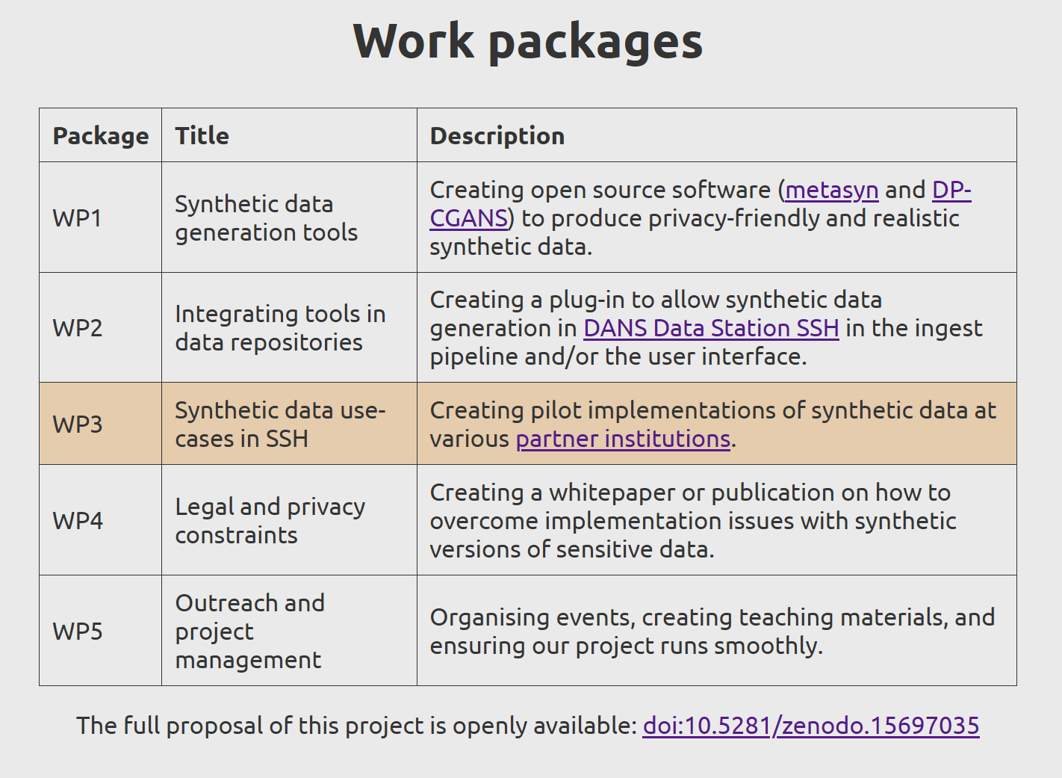
tdcc-synthetic-data.nl

Slide 4
Synthetic data pilot with YOUth
Goal: improve accessibility of YOUth data for prospective researchers
Stretch goal: code-to-data
Don’t give access to real data to researchers
Researchers send in their code
YOUth runs it and researchers receive only results

Slide 5
What we do
Consultations
Collaborations
Tutorials
Workshops
Fellowships

Slide 6
Collaborations

Slide 7
Collaborations
Longer-term collaborative work on projects
Focus on valuable projects that could not be done without our technical help
Based on principles of openness, team science, clear goal orientation
Statistical & data science expertise, research design, technical implementation, open science, open-source software development, research pipelines

Slide 8
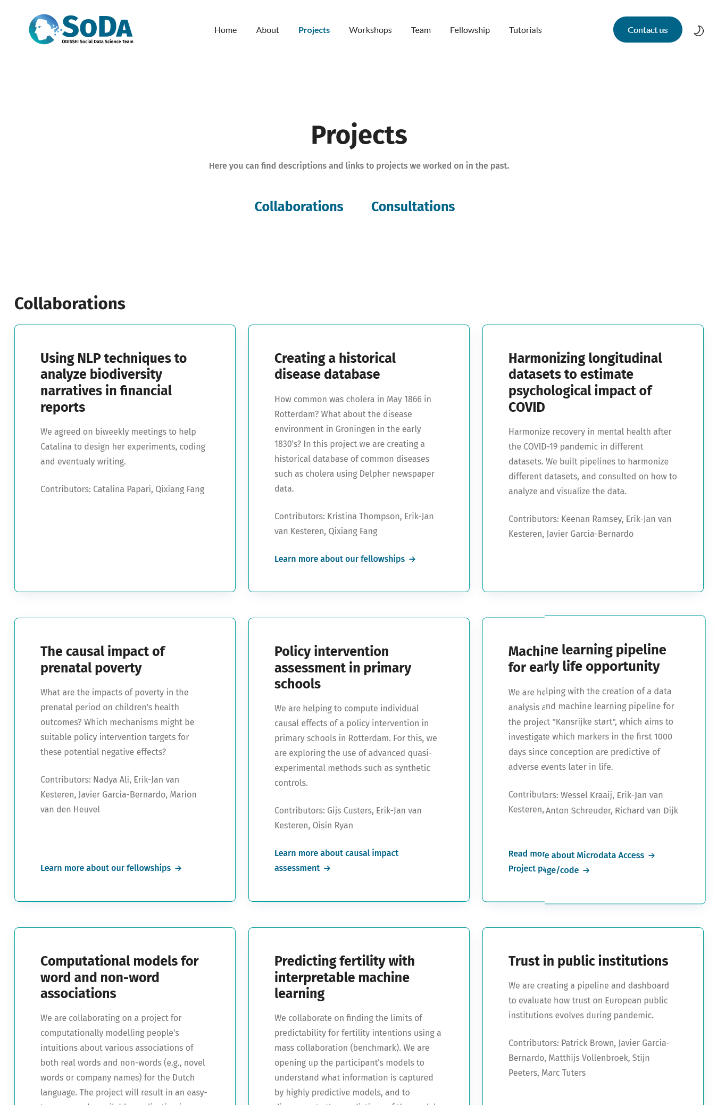
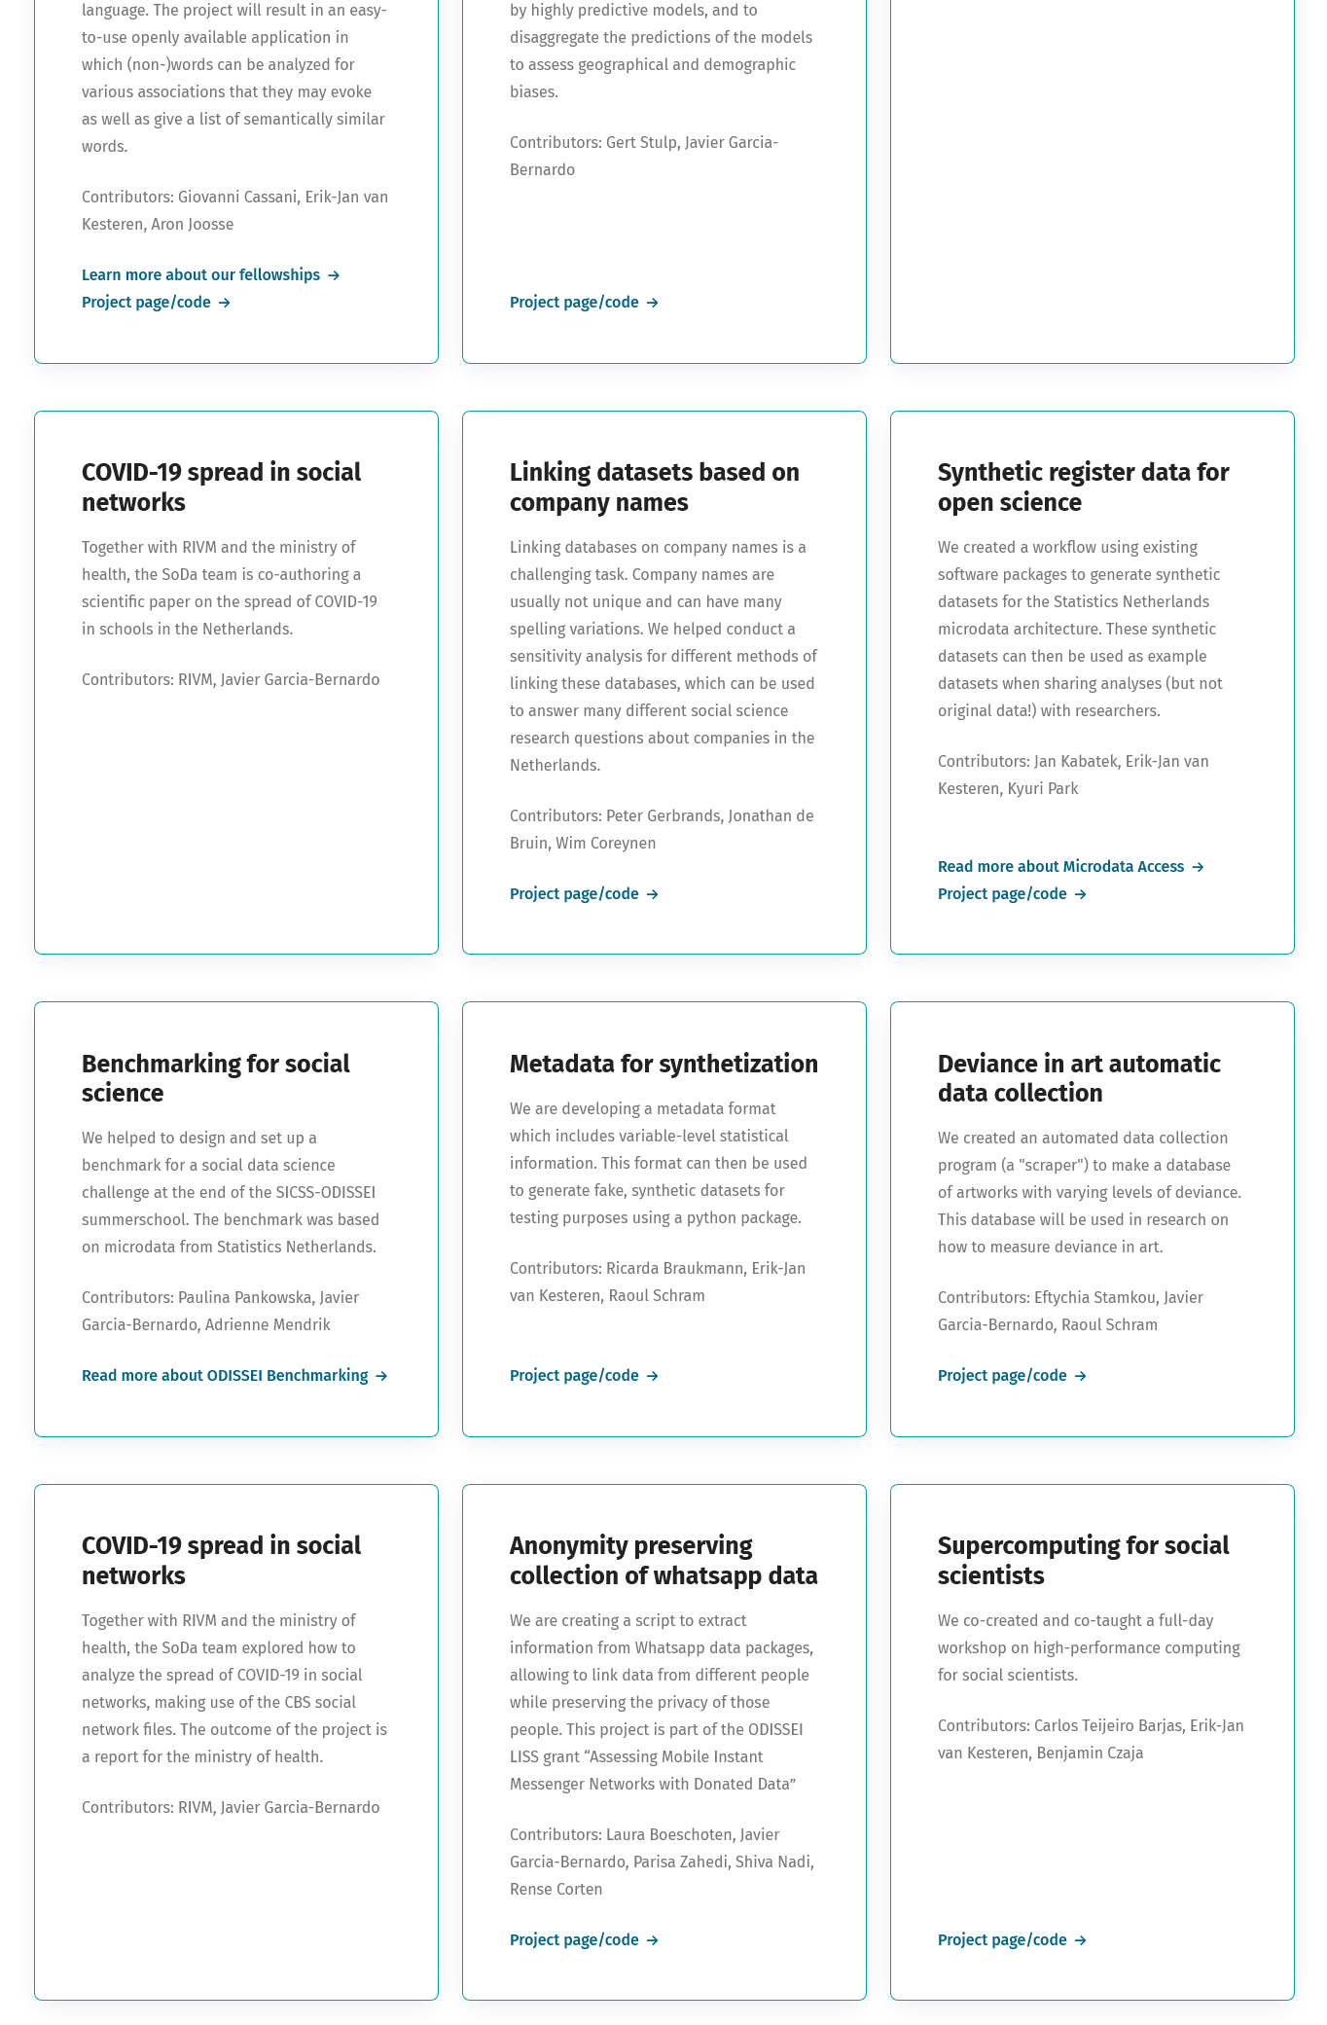

Slide 9
Impact of extending school week
Does extending the school week with extra activities in primary schools improve study outcomes for these schools?
Policy evaluation collaboration with
Dr. Gijs Custers (Erasmus University)

Slide 10
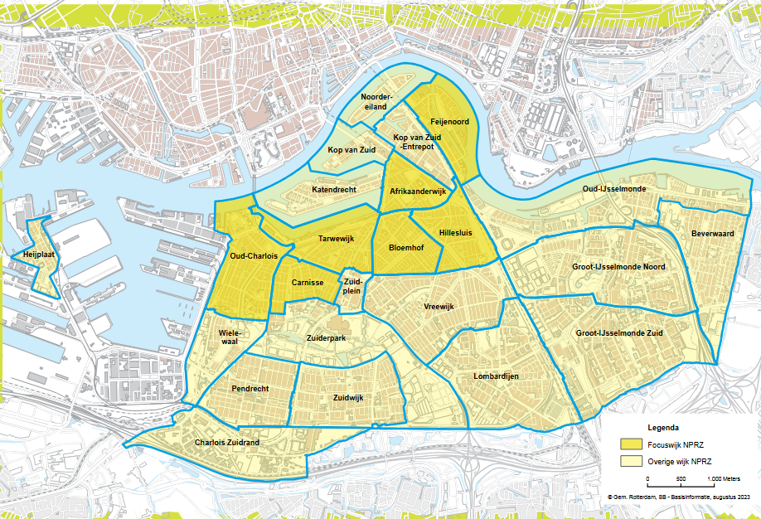
Impact of extending school week
22 treated schools in focus area
Intervention in 2013/2014
CBS Microdata: compare to untreated schools
Nationaal Programma Rotterdam Zuid

Slide 11
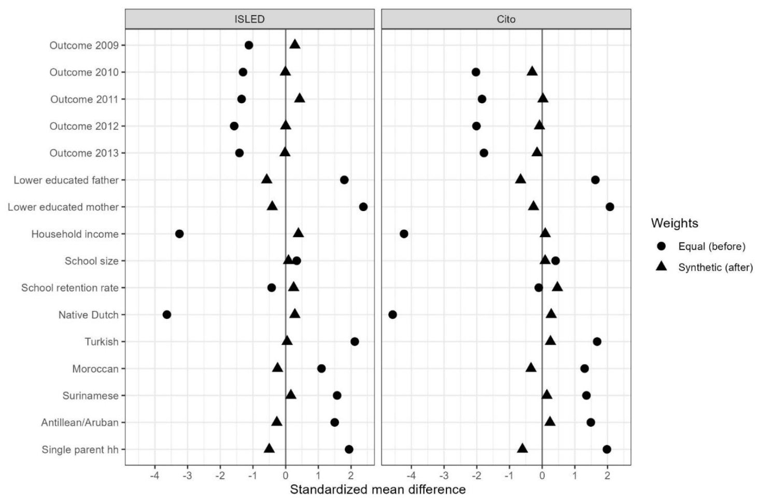
Impact of extending school week
Assignment to treatment is not random!
Quasi-experimental methods needed
We used (penalized) synthetic control

Slide 12
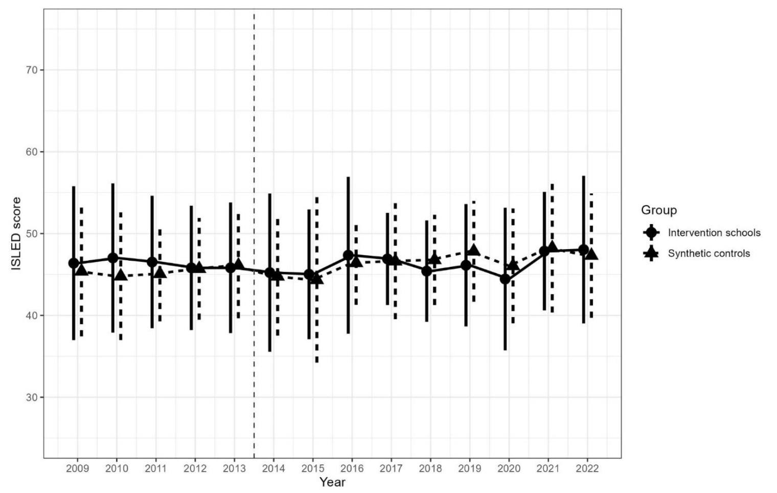
Impact of extending school week
Preprint:
osf.io/h4m7p
Code: github.com/sodascience/nprz_synthetic_controls

Slide 13
Workshops

Slide 14
Workshops
What data analysis skills are needed by our social science community?
Create workshops out of these skill gaps
Let’s look at some past workshops

Slide 15
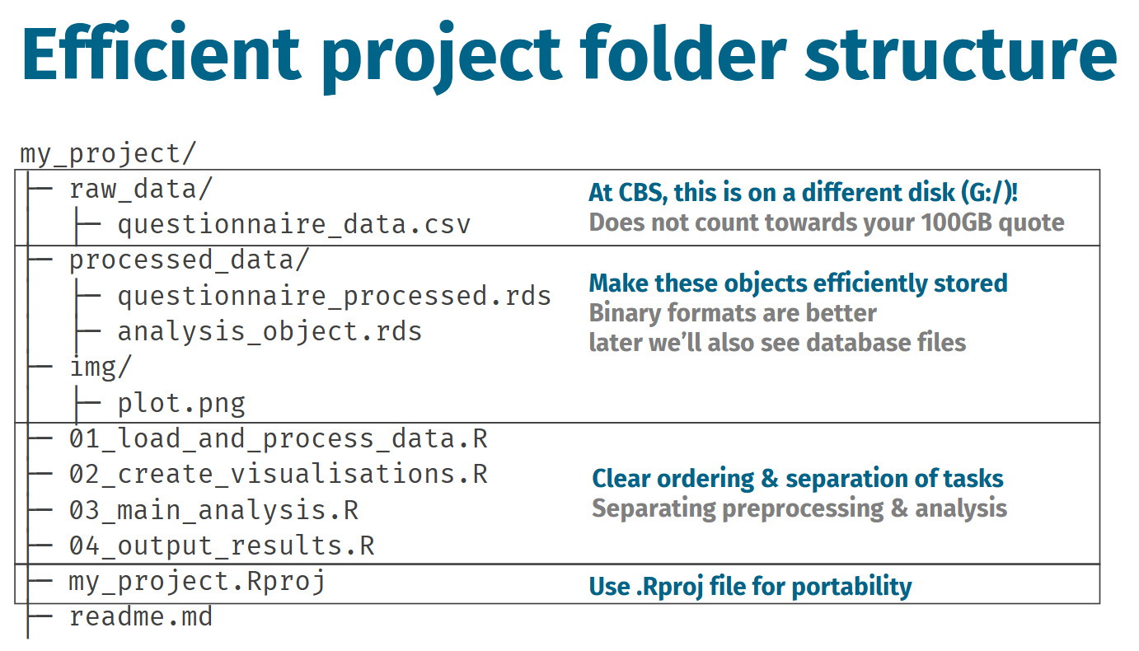
Efficient microdata programming
Getting started with CBS RA data & environment
Reproducible, understandable, collaborative projects

Slide 16
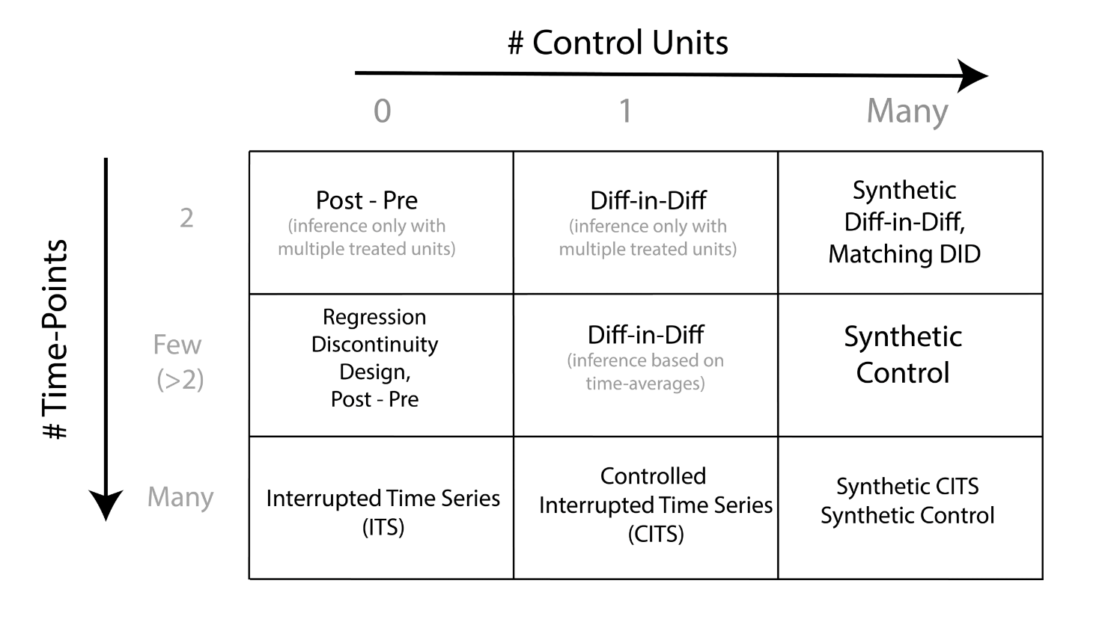
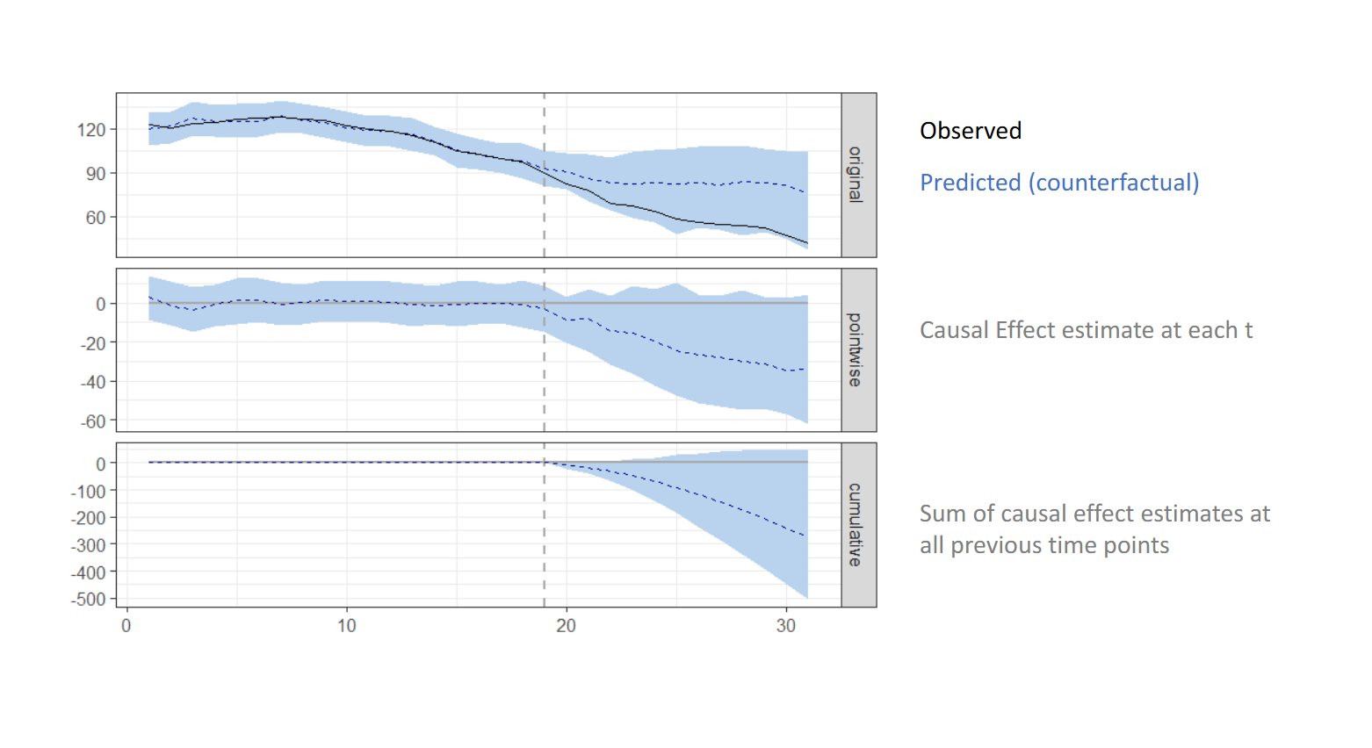
Causal impact assessment
Evaluating causal effects of policy interventions
Overview, connecting and using different methods from different fields
https://causalpolicy.nl/

Slide 17
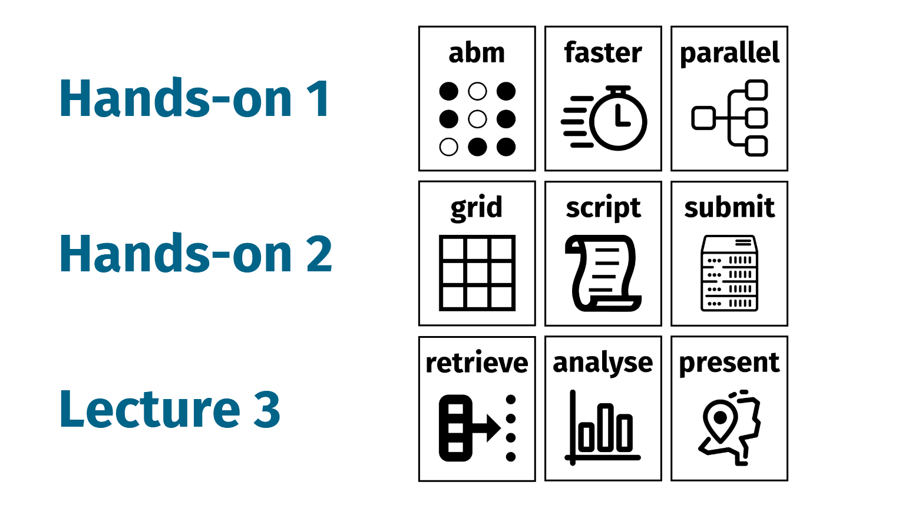
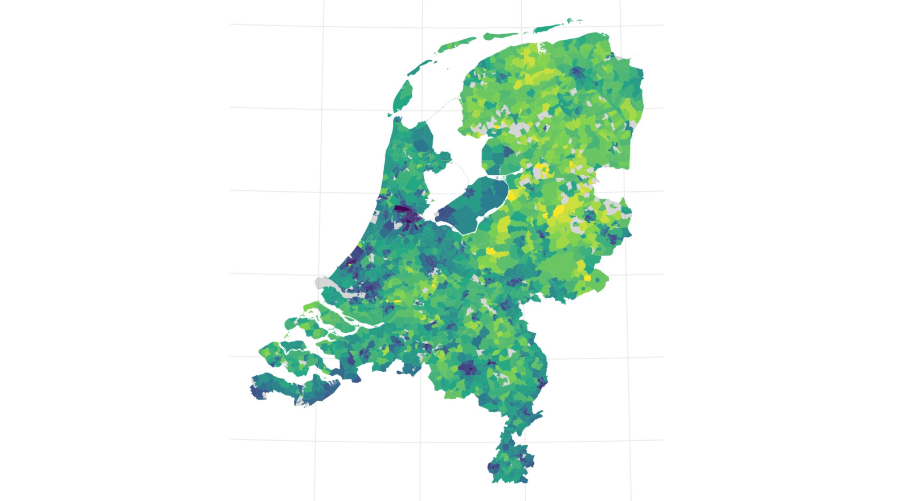
Supercomputing
How to move workflow to cluster computer
Create ABM and parallellize it for SURF’s Snellius (ODISSEI’s OSSC)
6 months -> 1 hour

Slide 18
What’s next?

Slide 19
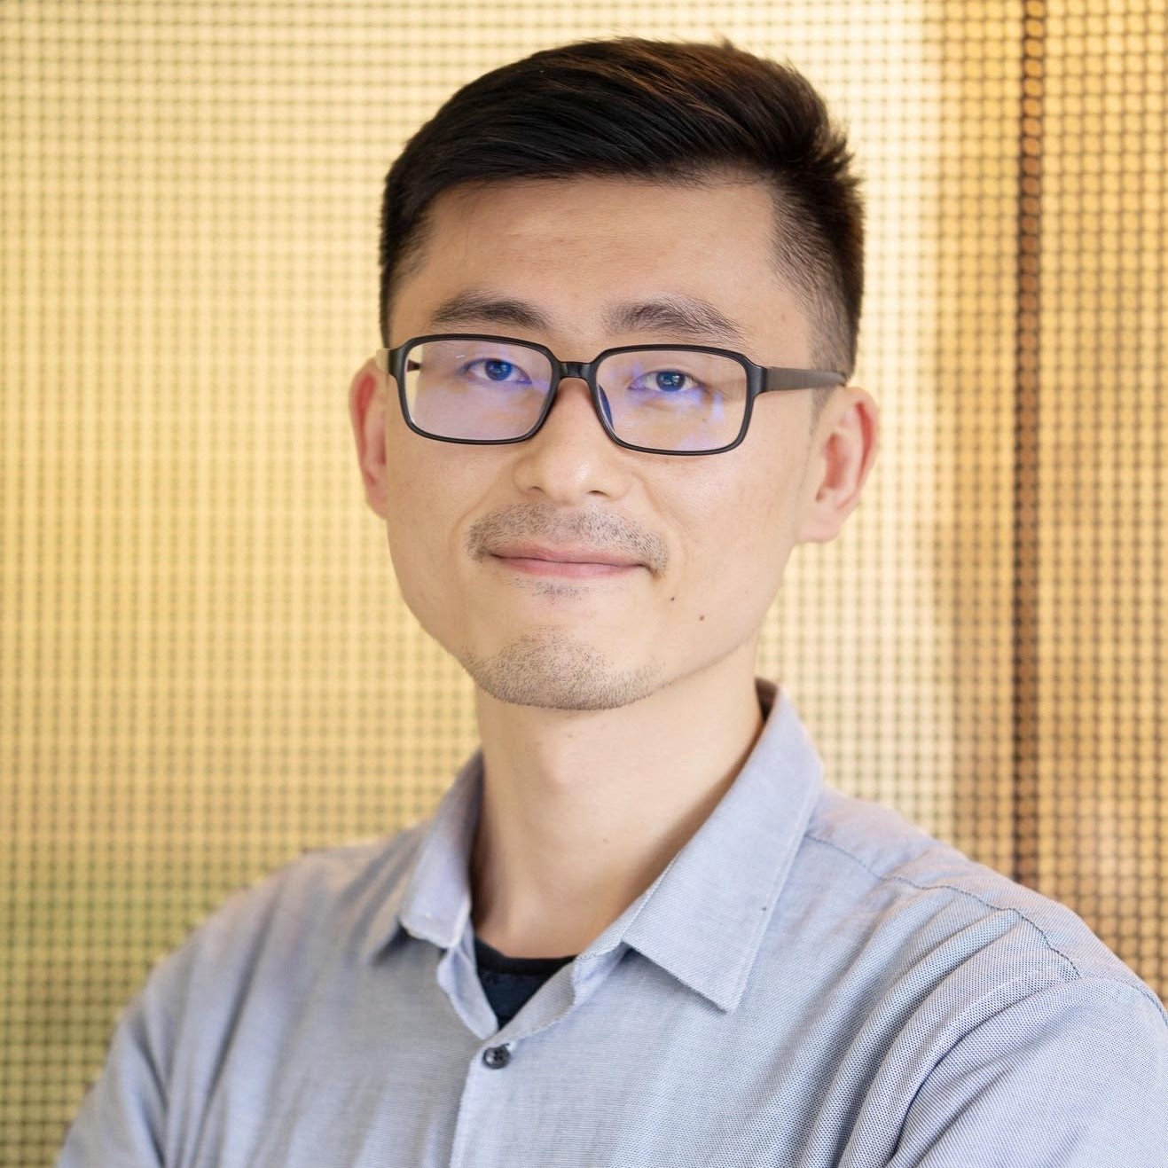
LLMs for data collection in SSH
Friday, March 21st, 9:30-14:00, Utrecht University
How to use LLMs to label unstructured data? How to use these labels in inferential research?
Prompt engineering with rubrics, structured data extraction, batch processing, reliability & validity, structural bias correction, and more…
Sign up!
https://odissei-data.nl/event/workshop-llm/

Slide 20
Workshop based on your idea?
An applied topic that is useful beyond your own team in the broader SSH community
Range of possibilities in AI, data science, research engineering, statistics at beginner or advanced level
Come talk to us or contact us via our website ☺

Slide 21
https://odissei-soda.nl

