Slide 1
Default light slide
Default subheading
This is the body of the text
Default subheading
Note that the text is not black, but “black, text 1, lighter 25%”
Default subheading
This makes things easier on the eyes
Default subheading
This is the body of the text

Slide 2
Controlled ITS & CausalImpact

Slide 3
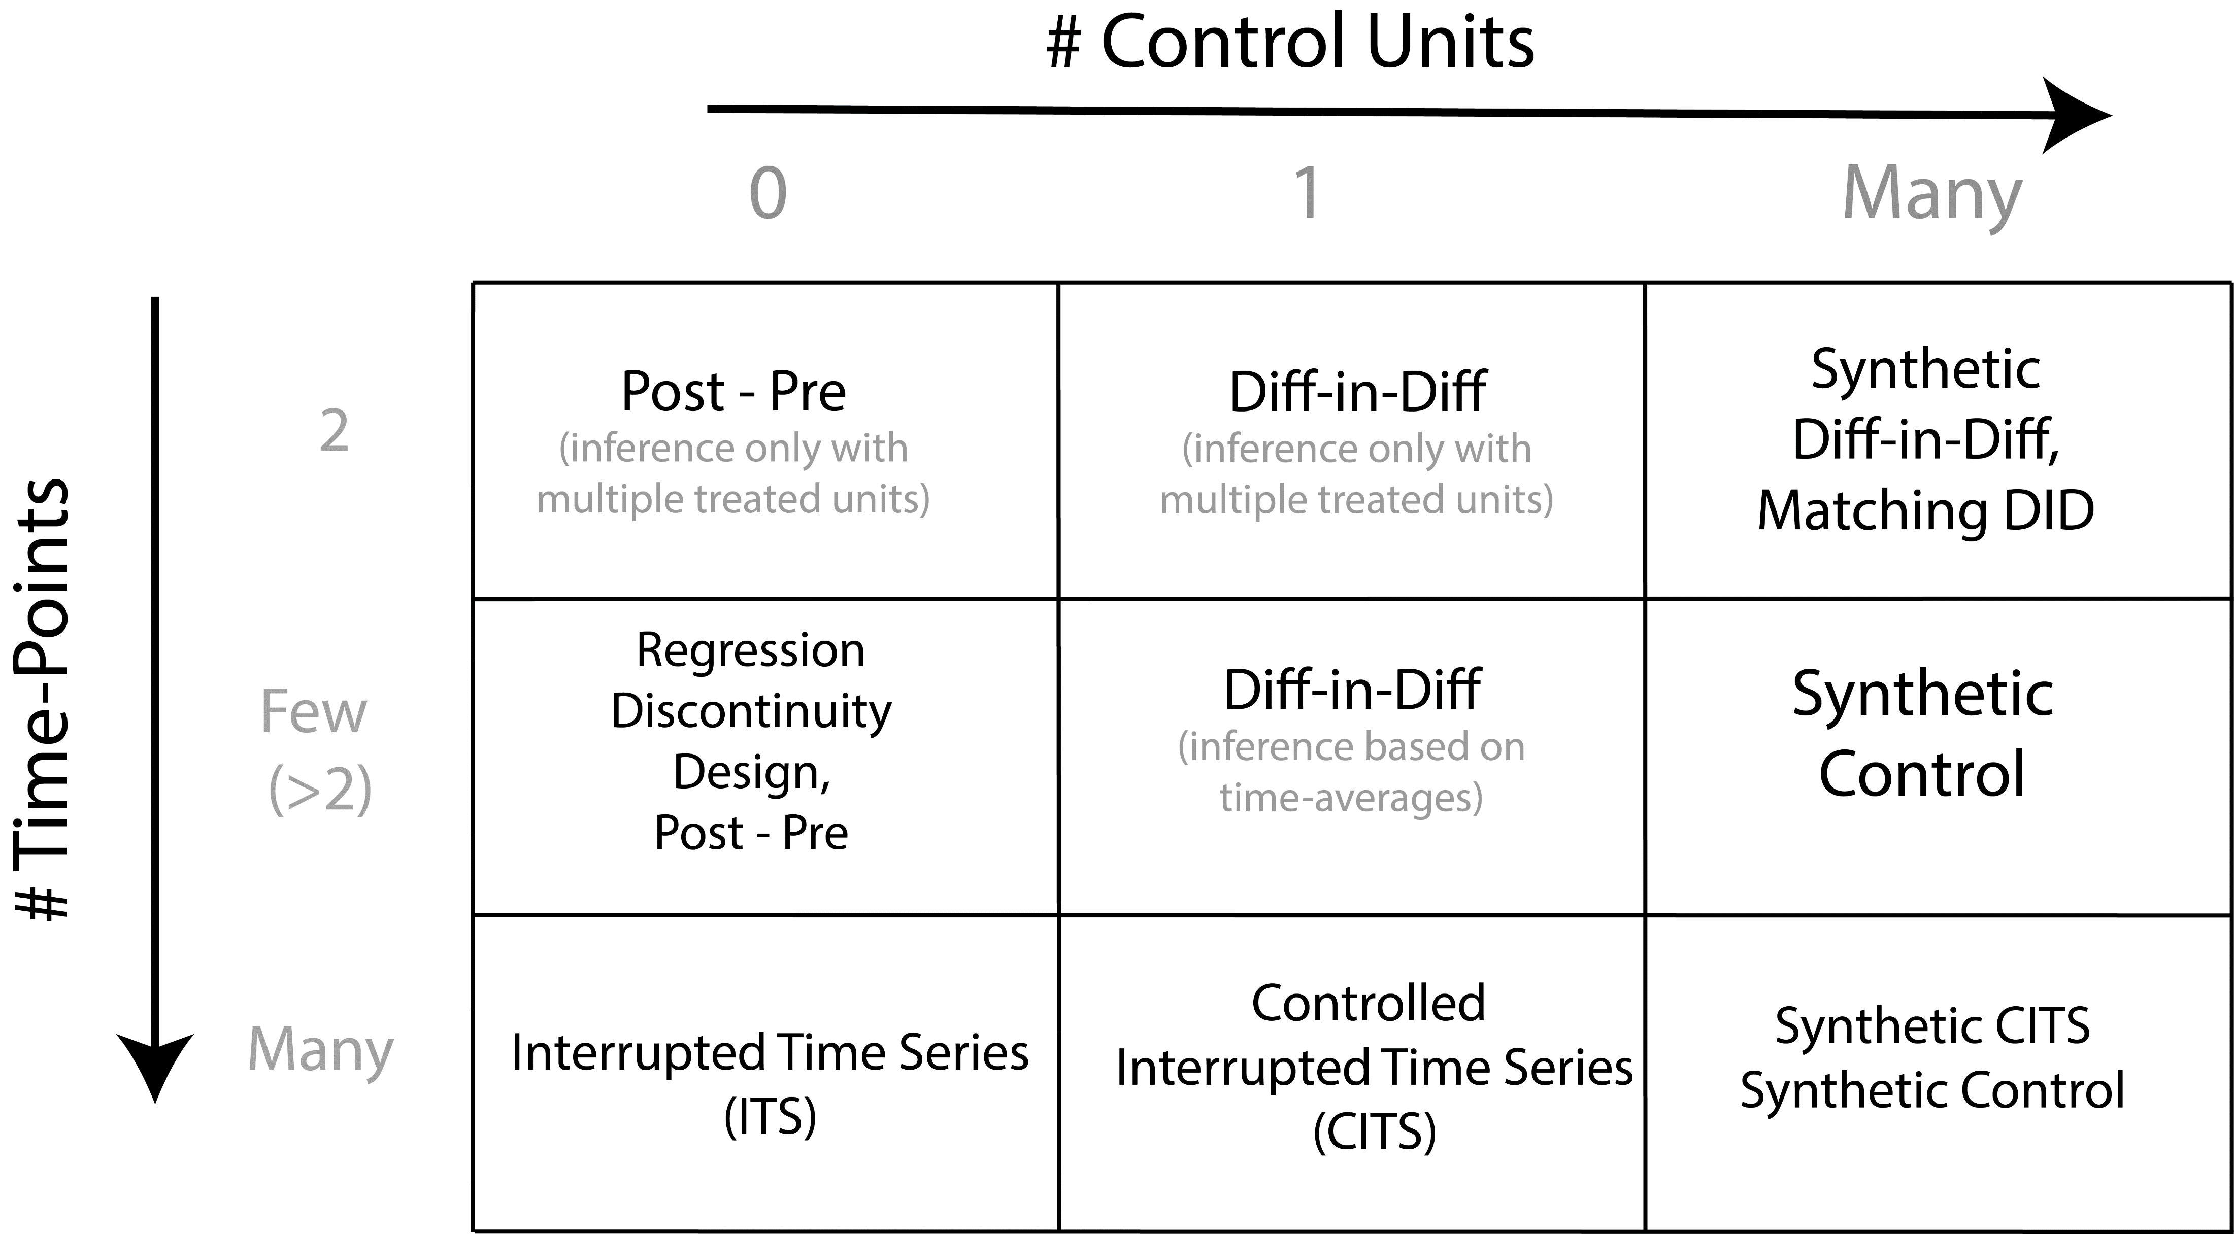

Slide 4
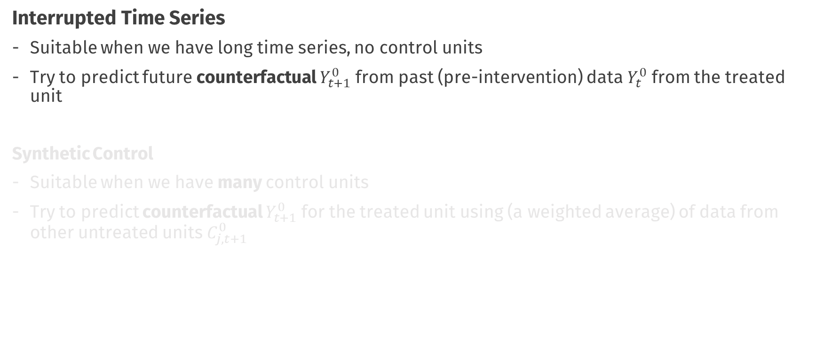
So far…
Interrupted Time Series
Suitable when we have long time series, no control units
Try to predict future counterfactual $Y_{t+1}^{0}$ from past (pre-intervention) data $Y_{t}^{0}$ from the treated unit
Synthetic Control
Suitable when we have many control units
Try to predict counterfactual $Y_{t+1}^{0}$ for the treated unit using (a weighted average) of data from other untreated units $C_{j, t+1}^{0}$

Slide 5

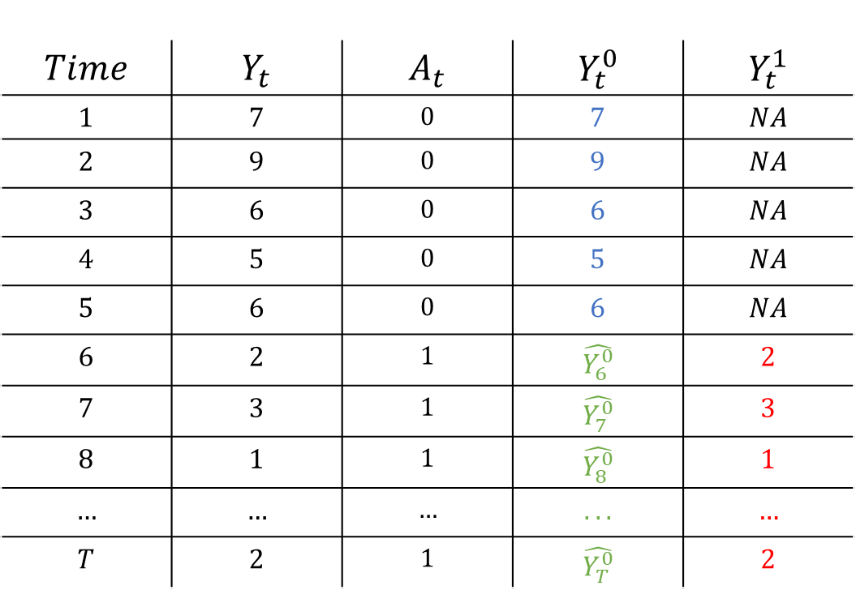

Interrupted Time Series
$$Time$$ | $$Y_{t}$$ | $$A_{t}$$ | $$Y_{t}^{0}$$ | $$Y_{t}^{1}$$
$$1$$ | $$7$$ | $$0$$ | $$7$$ | $$NA$$
$$2$$ | $$9$$ | $$0$$ | $$9$$ | $$NA$$
$$3$$ | $$6$$ | $$0$$ | $$6$$ | $$NA$$
$$4$$ | $$5$$ | $$0$$ | $$5$$ | $$NA$$
$$5$$ | $$6$$ | $$0$$ | $$6$$ | $$NA$$
$$6$$ | $$2$$ | $$1$$ | $$\hat{Y_{6}^{0}}$$ | $$2$$
$$7$$ | $$3$$ | $$1$$ | $$\hat{Y_{7}^{0}}$$ | $$3$$
$$8$$ | $$1$$ | $$1$$ | $$\hat{Y_{8}^{0}}$$ | $$1$$
$$…$$ | $$…$$ | $$…$$ | $$...$$ | $$…$$
$$T$$ | $$2$$ | $$1$$ | $$\hat{Y_{T}^{0}}$$ | $$2$$
Fit a forecasting Model
$$\hat{Y_{t}}=φ_{1}Y_{t−1}+φ_{2}Y_{t−2}+…β ∗ Time$$
Make forecasts
$$\hat{CE_{t}}=Y_{t}^{1} −\hat{Y_{t}^{0}}$$

Slide 6
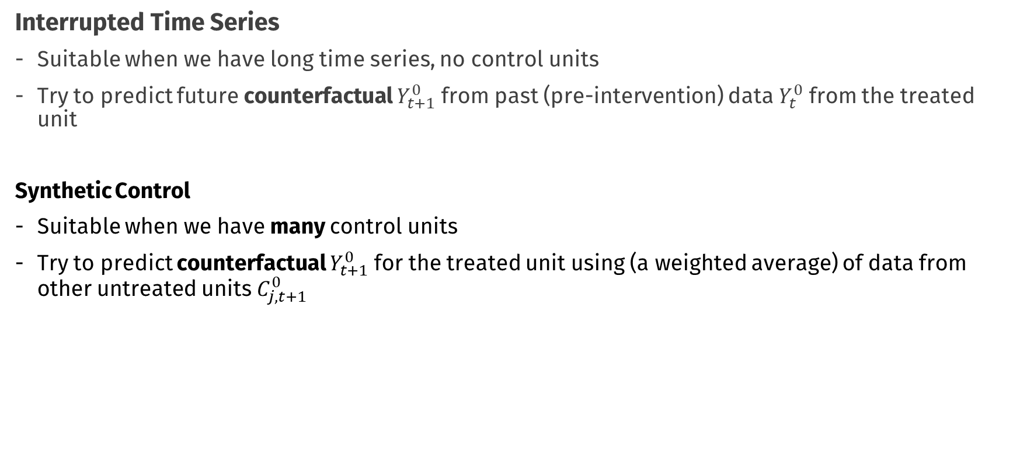
So far…
Interrupted Time Series
Suitable when we have long time series, no control units
Try to predict future counterfactual $Y_{t+1}^{0}$ from past (pre-intervention) data $Y_{t}^{0}$ from the treated unit
Synthetic Control
Suitable when we have many control units
Try to predict counterfactual $Y_{t+1}^{0}$ for the treated unit using (a weighted average) of data from other untreated units $C_{j, t+1}^{0}$

Slide 7

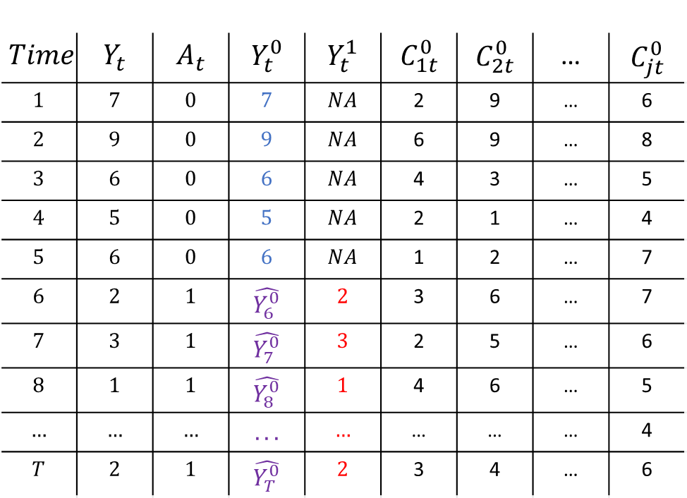


Synthetic Control
$$Time$$ | $$Y_{t}$$ | $$A_{t}$$ | $$Y_{t}^{0}$$ | $$Y_{t}^{1}$$ | $$C_{1t}^{0}$$ | $$C_{2t}^{0}$$ | … | $$C_{jt}^{0}$$
$$1$$ | $$7$$ | $$0$$ | $$7$$ | $$NA$$ | 2 | 9 | … | 6
$$2$$ | $$9$$ | $$0$$ | $$9$$ | $$NA$$ | 6 | 9 | … | 8
$$3$$ | $$6$$ | $$0$$ | $$6$$ | $$NA$$ | 4 | 3 | … | 5
$$4$$ | $$5$$ | $$0$$ | $$5$$ | $$NA$$ | 2 | 1 | … | 4
$$5$$ | $$6$$ | $$0$$ | $$6$$ | $$NA$$ | 1 | 2 | … | 7
$$6$$ | $$2$$ | $$1$$ | $$\hat{Y_{6}^{0}}$$ | $$2$$ | 3 | 6 | … | 7
$$7$$ | $$3$$ | $$1$$ | $$\hat{Y_{7}^{0}}$$ | $$3$$ | 2 | 5 | … | 6
$$8$$ | $$1$$ | $$1$$ | $$\hat{Y_{8}^{0}}$$ | $$1$$ | 4 | 6 | … | 5
$$…$$ | $$…$$ | $$…$$ | $$...$$ | $$…$$ | … | … | … | 4
$$T$$ | $$2$$ | $$1$$ | $$\hat{Y_{T}^{0}}$$ | $$2$$ | 3 | 4 | … | 6
Estimate Weights
$$Y_{t}= \sum_{j=1}^{J}{\hat{w_{j}}C_{jt}}$$
t < s
$$\hat{Y_{t}^{0}}= \sum_{j=1}^{J}{\hat{w_{j}}C_{jt}}$$
t > s
Impute counterfactual
$$\hat{CE_{t}}=Y_{t}^{1} −\hat{Y_{t}^{0}}$$

Slide 8
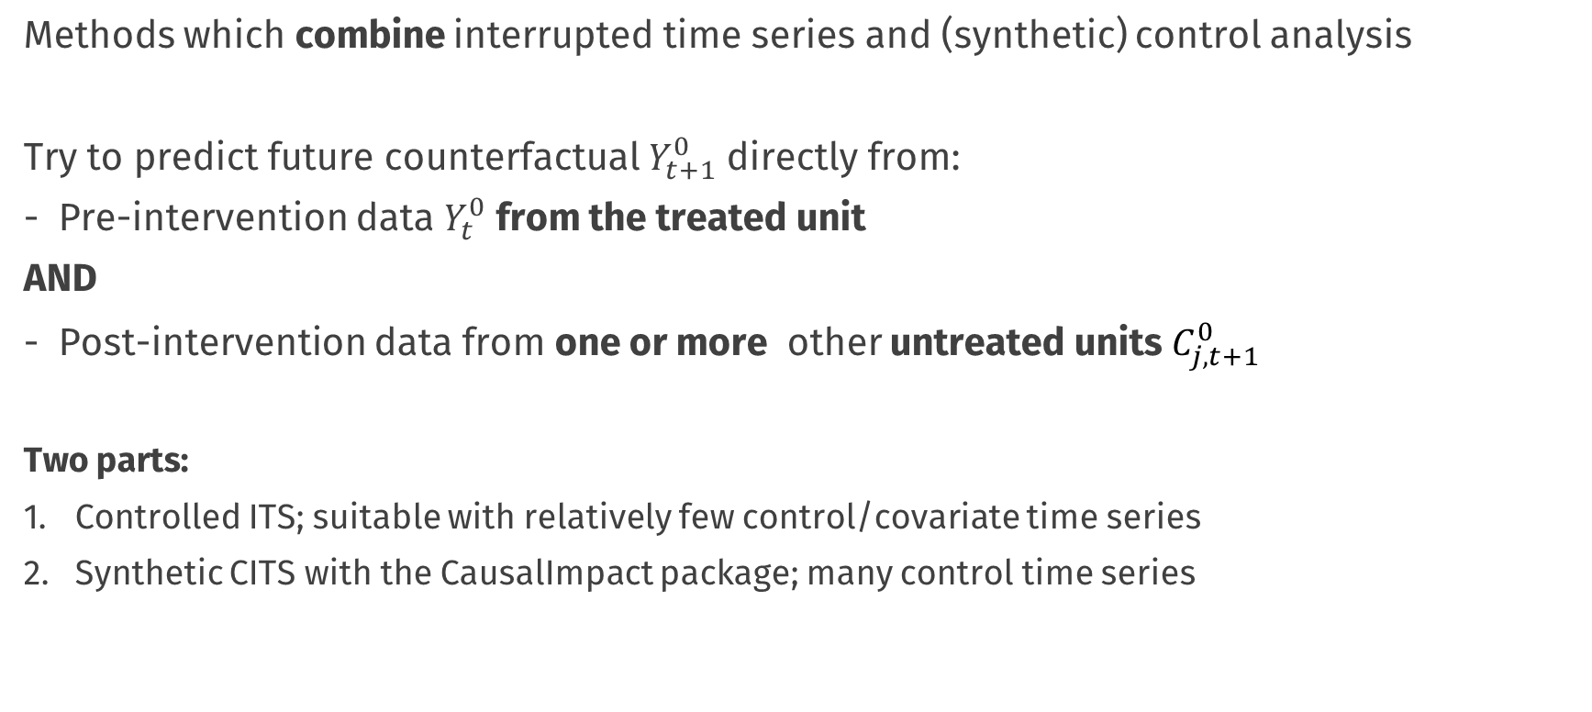
Now
Methods which combine interrupted time series and (synthetic) control analysis
Try to predict future counterfactual $Y_{t+1}^{0}$ directly from:
Pre-intervention data $Y_{t}^{0}$ from the treated unit
AND
Post-intervention data from one or more other untreated units $C_{j,t+1}^{0}$
Two parts:
Controlled ITS; suitable with relatively few control/covariate time series
Synthetic CITS with the CausalImpact package; many control time series

Slide 10
Controlled Interrupted Time Series
An extension of Interrupted Time Series when we have access to a control time series
Typically observations of the same process, for a different unit, which is correlated with (i.e. predictive of) the target time series, but which does not experience the intervention
Similar criteria as the synthetic control and DiD method “control” data
Two parts:
Controlled ITS; suitable with relatively few control/covariate time series
Synthetic CITS with the CausalImpact package; many control time series

Slide 11
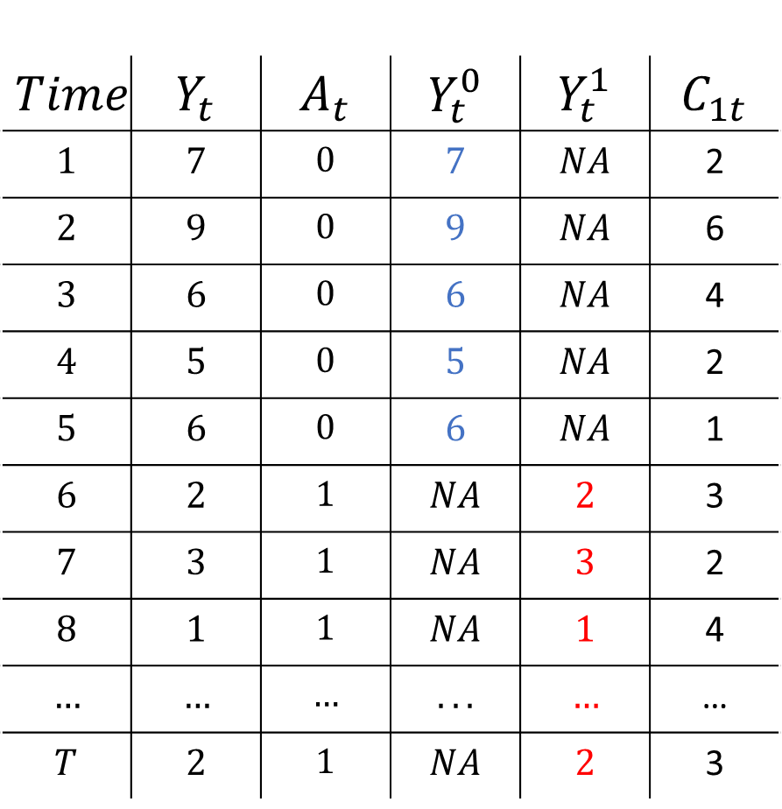
$$Time$$ | $$Y_{t}$$ | $$A_{t}$$ | $$Y_{t}^{0}$$ | $$Y_{t}^{1}$$ | $$C_{1t}$$
$$1$$ | $$7$$ | $$0$$ | $$7$$ | $$NA$$ | 2
$$2$$ | $$9$$ | $$0$$ | $$9$$ | $$NA$$ | 6
$$3$$ | $$6$$ | $$0$$ | $$6$$ | $$NA$$ | 4
$$4$$ | $$5$$ | $$0$$ | $$5$$ | $$NA$$ | 2
$$5$$ | $$6$$ | $$0$$ | $$6$$ | $$NA$$ | 1
$$6$$ | $$2$$ | $$1$$ | $$NA$$ | $$2$$ | 3
$$7$$ | $$3$$ | $$1$$ | $$NA$$ | $$3$$ | 2
$$8$$ | $$1$$ | $$1$$ | $$NA$$ | $$1$$ | 4
$$…$$ | $$…$$ | $$…$$ | $$...$$ | $$…$$ | …
$$T$$ | $$2$$ | $$1$$ | $$NA$$ | $$2$$ | 3

Slide 12
Method figure

Slide 13
Data figure – DiD Utah but not aggregated

Slide 14
Assumptions: very similar to seen before (no interference, relation pre-post stable/stationary)

Slide 15
But what if we have many many control time series?
- examples

Slide 16
CausalImpact; combining synthetic control + time series forecasting model
Balances both components in a smart way (Bayesian estimation)
Figures, figures
You get lots of nice stuff

Slide 17
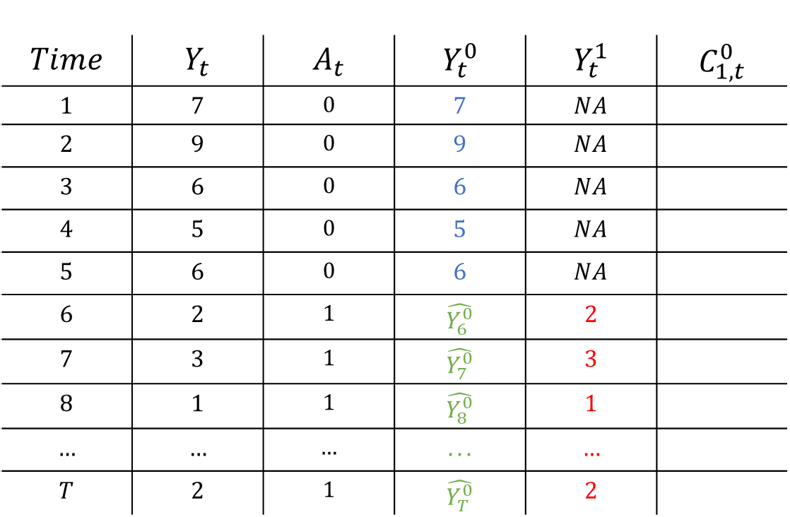
Interrupted Time Series
$$Time$$ | $$Y_{t}$$ | $$A_{t}$$ | $$Y_{t}^{0}$$ | $$Y_{t}^{1}$$ | $$C_{1,t}^{0}$$
$$1$$ | $$7$$ | $$0$$ | $$7$$ | $$NA$$
$$2$$ | $$9$$ | $$0$$ | $$9$$ | $$NA$$
$$3$$ | $$6$$ | $$0$$ | $$6$$ | $$NA$$
$$4$$ | $$5$$ | $$0$$ | $$5$$ | $$NA$$
$$5$$ | $$6$$ | $$0$$ | $$6$$ | $$NA$$
$$6$$ | $$2$$ | $$1$$ | $$\hat{Y_{6}^{0}}$$ | $$2$$
$$7$$ | $$3$$ | $$1$$ | $$\hat{Y_{7}^{0}}$$ | $$3$$
$$8$$ | $$1$$ | $$1$$ | $$\hat{Y_{8}^{0}}$$ | $$1$$
$$…$$ | $$…$$ | $$…$$ | $$...$$ | $$…$$
$$T$$ | $$2$$ | $$1$$ | $$\hat{Y_{T}^{0}}$$ | $$2$$

Slide 20

Data analysis & visualisation
Workshop rijksoverheid
Erik-Jan van Kesteren

Slide 21


About me
Erik-Jan van Kesteren
Background in statistics / social science
Assistant professor @ methodology & statistics UU
Social Data Science team lead @ ODISSEI (consortium of universities)
Some stuff I work on:
Latent variables, high-dimensional data, optimization, regularization, visualisation, Bayesian statistics, multilevel models, spatial data, generalized linear models, privacy, synthetic data, high-performance computing, software development, open science & reproducibility

Slide 22
Today’s plan: morning
Introduction & Recap (60 minutes)
Short break (10 minutes)
Supervised learning: bias/variance (80 minutes)
Supervised learning: classification (40 minutes)
Lunch around 12:40

Slide 23
Today’s plan: afternoon
Prediction competition in groups (90 minutes)
Short break (10 minutes)
Intermezzo: fairness & feedback loops in prediction (30 minutes)
Unsupervised learning (45 minutes)
Finish around 16:30

Slide 24
Data wrangling, visualisation
A short recap
Erik-Jan van Kesteren

Slide 25
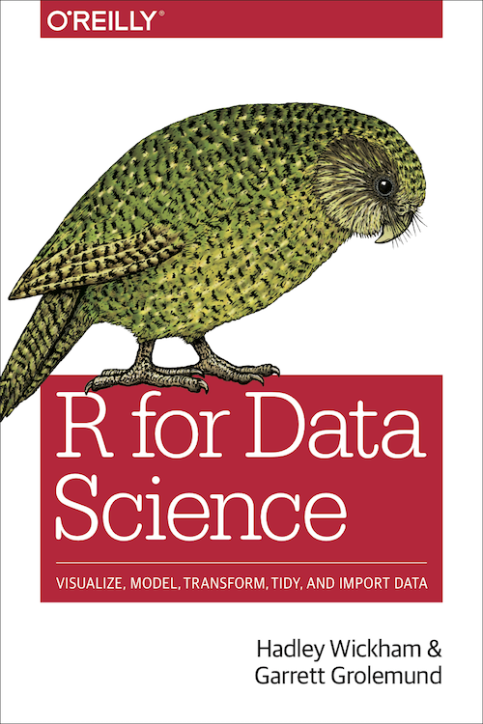
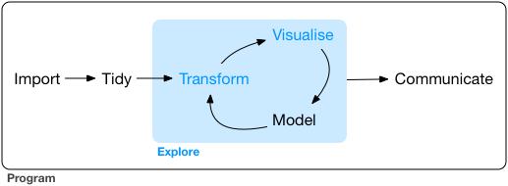
Exploratory data analysis
The goal of data exploration is to generate many promising leads that you can later explore in more depth.
https://r4ds.had.co.nz/

Slide 26
Data wrangling with dplyr
filter
Get only rows that satisfy a condition
select
Select columns from a dataset
mutate
Compute new columns / change existing columns
arrange
Sort/reorder the dataset based on a column

Slide 27
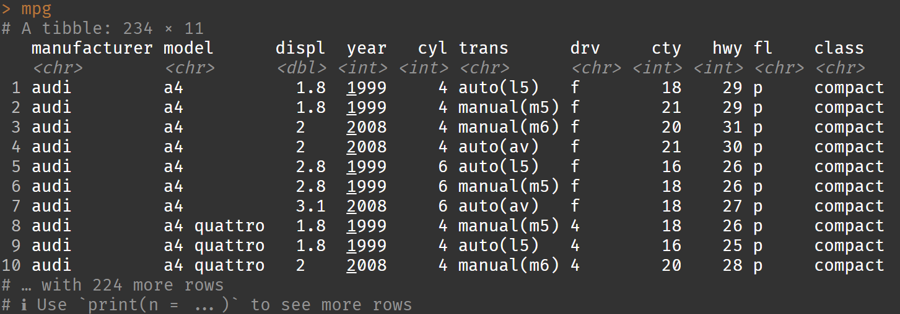
Example dataset: cars

Slide 28
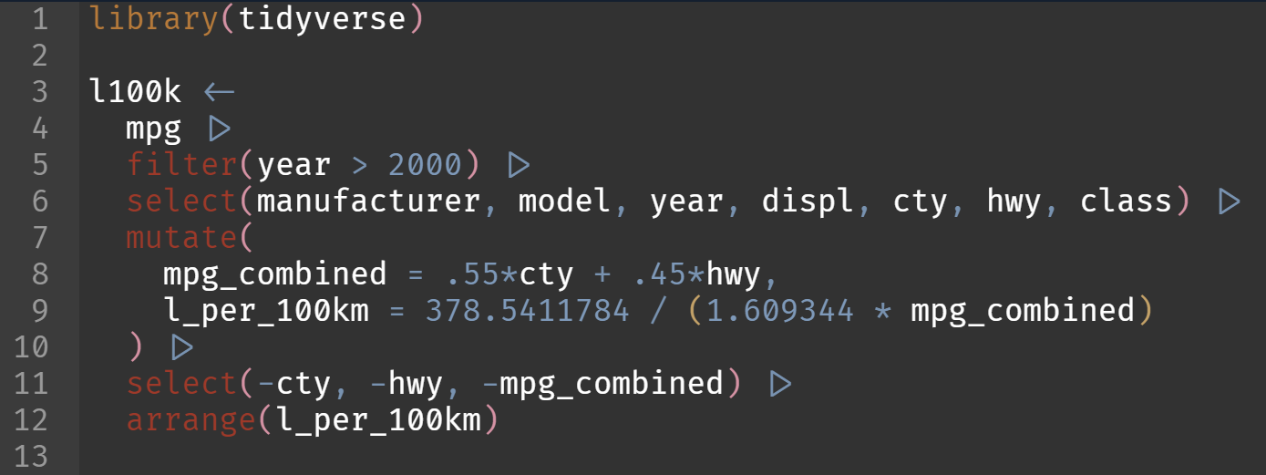
Data wrangling with dplyr
Which are the most efficient (combined city-highway) cars after 2000 in terms of litres / 100km?

Slide 29
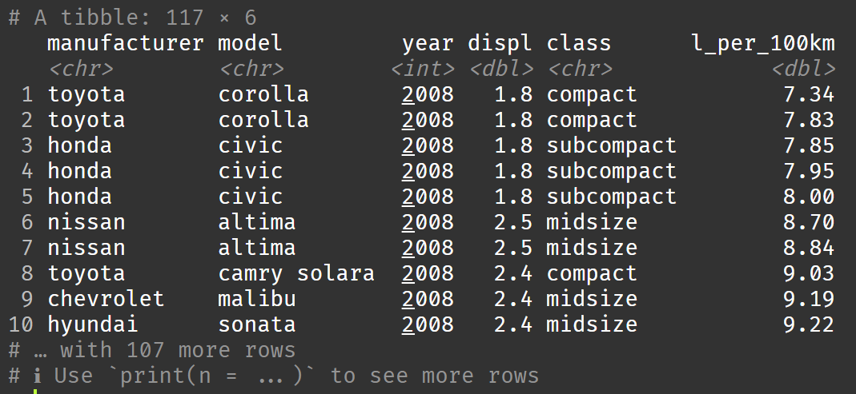
Data wrangling with dplyr

Slide 30
Data visualisation with ggplot2
https://r4ds.had.co.nz/data-visualisation.html
Raw data maps to:
Aesthetics: data-bound properties of the picture (position, shape, colour, …)
Geometric objects, or geom: visual objects on the plot (points, lines, bars, polygons …)
Scales: how data values map to aesthetic values (continuous or discrete)
Facets: subplots / small multiples
Additionally, can apply:
Statistical transformations: transform data before mapping
Alternative coordinate system (cartesian, polar, …)

Slide 31
Example dataset: l100k

Slide 32
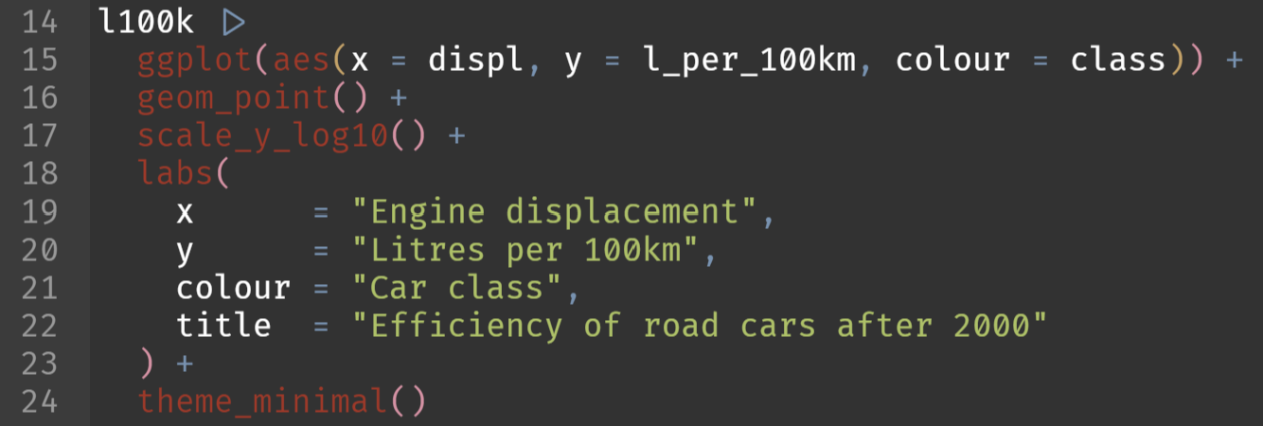
Data visualisation with ggplot2
Display a scatter plot with on the x axis the engine displacement and on the y-axis the efficiency. Colour the points by the car class

Slide 33
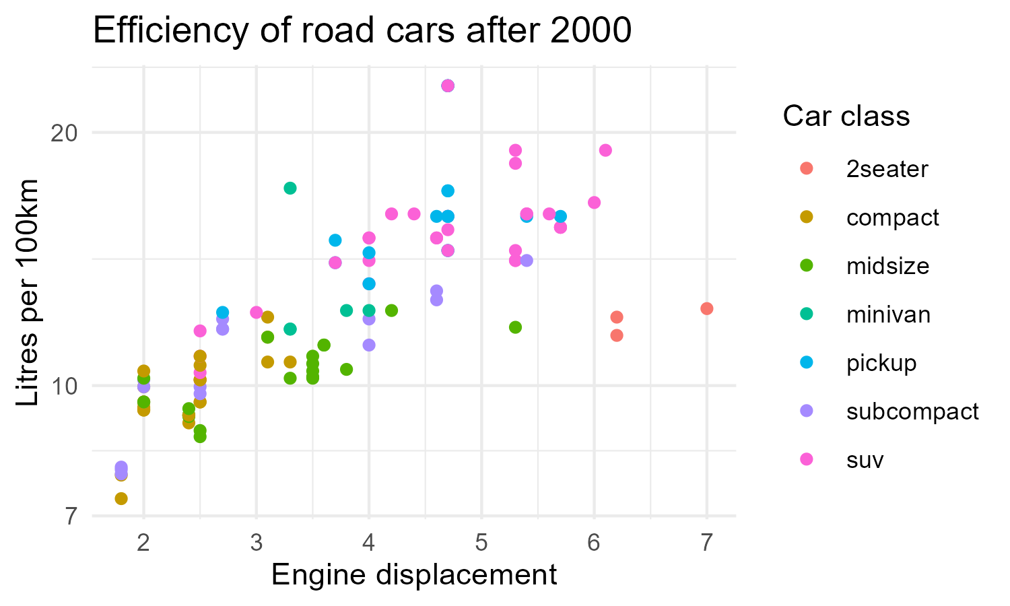
Data visualisation with ggplot2

Slide 34
More data wrangling with dplyr
group by
Registers groups by which to perform further operations (usually mutate, summarise)
summarise
Create summaries based on a function applied to each group

Slide 35
Example dataset: l100k

Slide 36
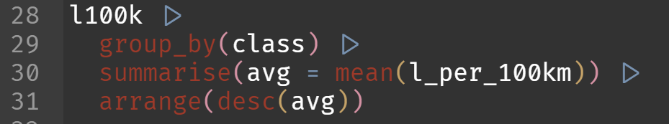
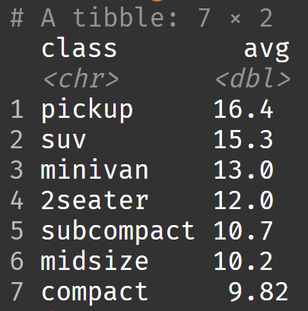
More data wrangling with dplyr
Which type of car should I buy to be the least efficient?

Slide 37
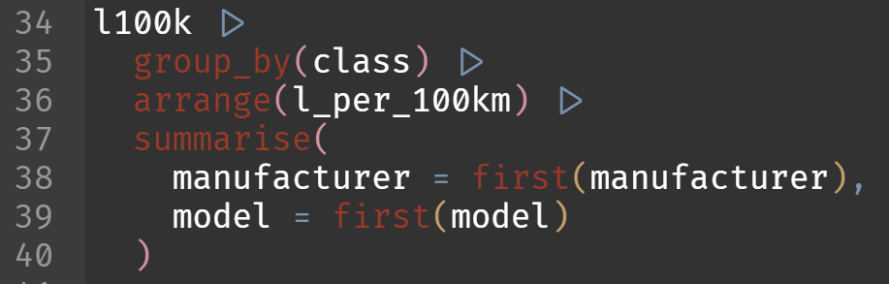
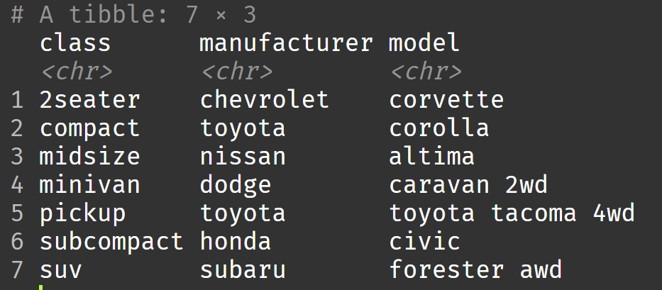
More data wrangling with dplyr
What is the most efficient car within each class?

Slide 38
Pivoting with tidyr
pivot_longer
Combines various columns into a single “value” column with an additional “name” column to indicate where the value came from
pivot_wider
The opposite: puts rows of different categories in separate columns

Slide 39
Example dataset: l100k

Slide 40
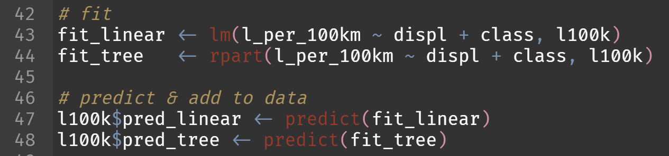
Pivoting with tidyr
Let’s generate predictions for efficiency using two models: a linear regression and a regression tree

Slide 41
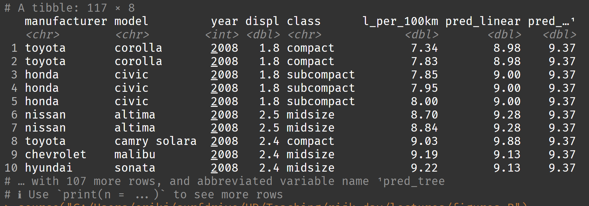
Pivoting with tidyr

Slide 42
Pivoting with tidyr
Let’s plot these predictions with the following mapped aesthetics:
x: engine size
y: predicted efficiency
colour: model type
???

Slide 43
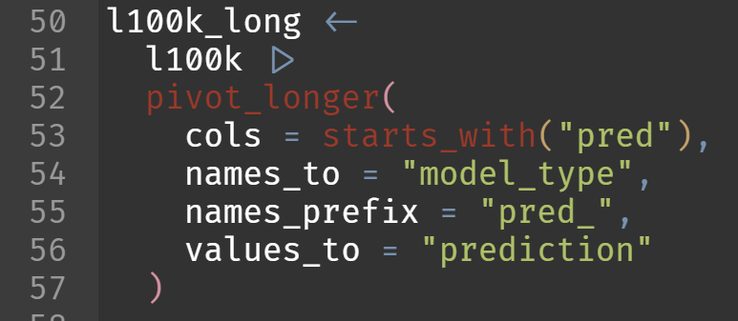
Pivoting with tidyr
ggplot wants tidy data. Let’s pivot our data so that model type becomes a column.

Slide 44
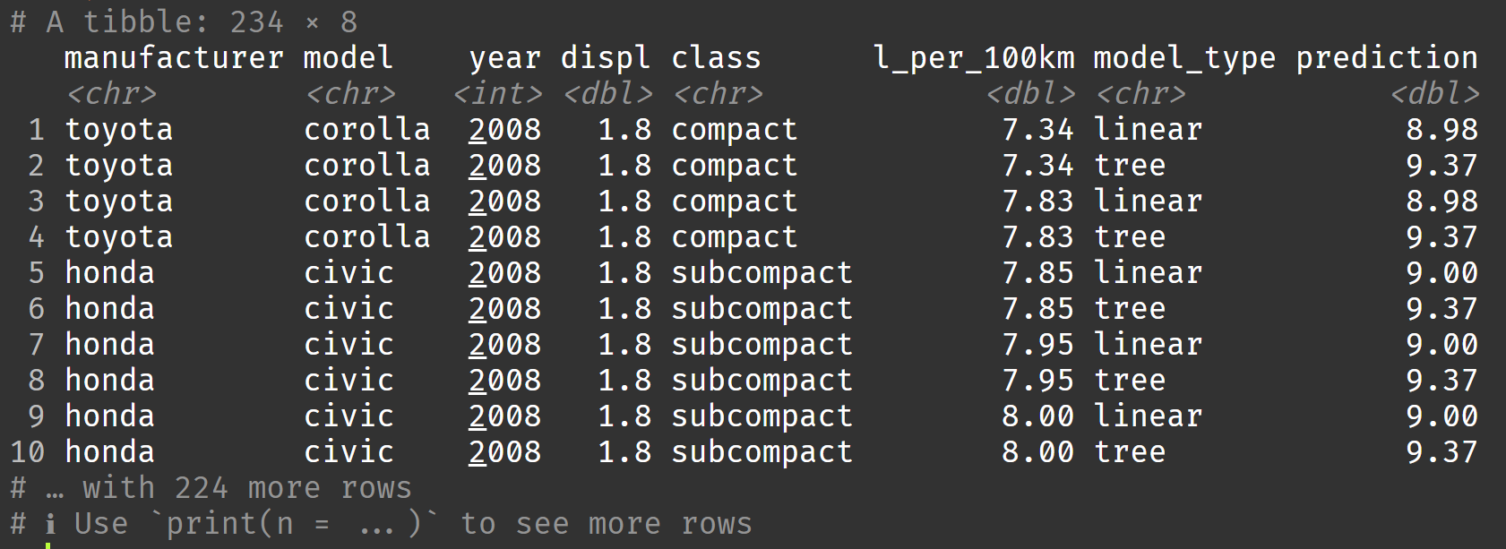
Pivoting with tidyr

Slide 45
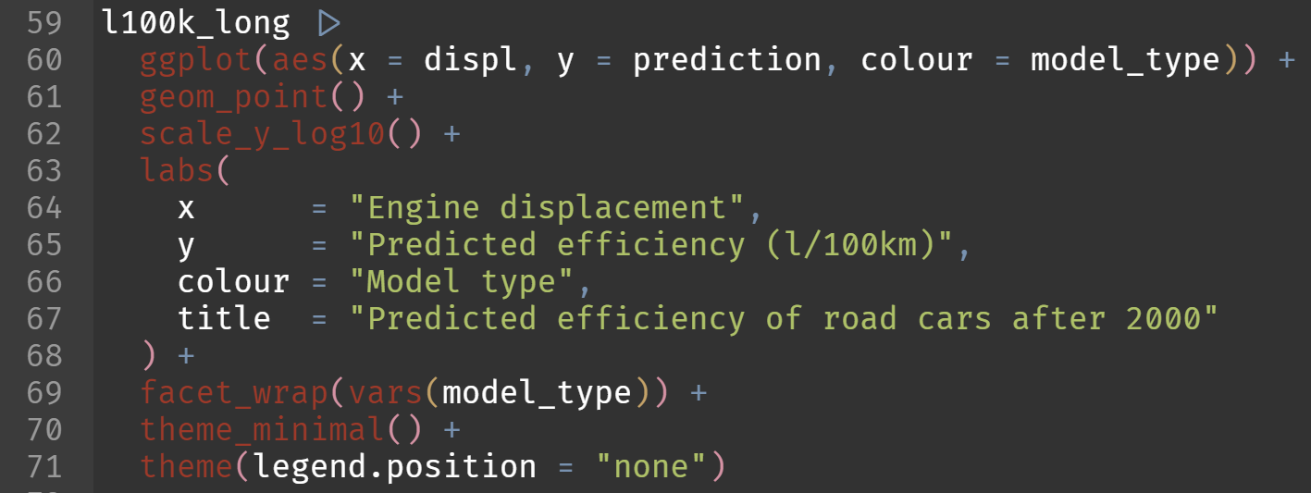
Pivoting with tidyr
Let’s plot these predictions!

Slide 46
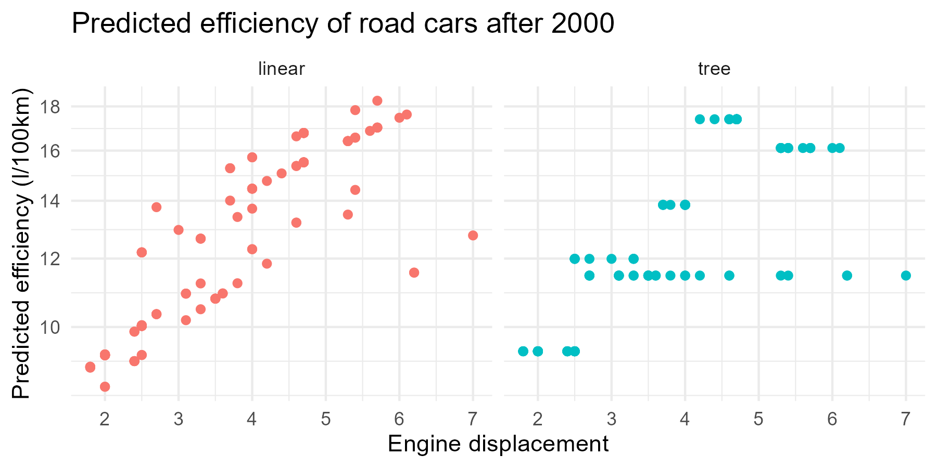
Pivoting with tidyr

Slide 47
Practical: dplyr, ggplot, tidyr
Work in your groups!
Take a break from 10:30 to 10:40

Slide 48
Break

Slide 49
Default dark slide
Default subheading
The dark slide brings some variation
Default subheading
It can highlight important aspects of the presentation.
Default subheading
This is the body of the text
Default subheading
This is the body of the text

Slide 50
Is this an impact slide?

Slide 51
Here is an impactful slide with a sentence on it.
Here is a topic related to the aforementioned question.

Slide 52
Questions?

