Slide 1

Leveraging register data to estimate causal
effects of policy interventions
Workshop ODISSEI
Oisín Ryan & Erik-Jan van Kesteren

Slide 2


About us
Erik-Jan van Kesteren
Background in statistics / social science
Assistant professor @ methodology & statistics UU
Social Data Science team lead @ ODISSEI (consortium of universities)
Some stuff I work on:
Latent variables, high-dimensional data, optimization, regularization, visualisation, Bayesian statistics, multilevel models, spatial data, generalized linear models, privacy, synthetic data, high-performance computing, software development, open science & reproducibility

Slide 3
About us
Erik-Jan van Kesteren
Background in statistics / social science
Assistant professor @ methodology & statistics UU
Social Data Science team lead @ ODISSEI (consortium of universities)
Some stuff I work on:
Latent variables, high-dimensional data, optimization, regularization, visualisation, Bayesian statistics, multilevel models, spatial data, generalized linear models, privacy, synthetic data, high-performance computing, software development, open science & reproducibility

Slide 4
github.com/sodascience/workshop_causal_impact_assessment

Slide 5
Today’s plan: morning
Introduction (60 minutes)
Policy Interventions and Causal Inference
Pre-Post Analyses and Difference-in-Difference
Practical (30 minutes)
Break (15 minutes)
Interrupted Time Series (45 minutes)
Practical (30 minutes)
Lunch around 12:00 ; re-start at 13:00

Slide 6
Today’s plan: afternoon
Synthetic Control Methods (45 minutes)
Practical (45 minutes)
Break (15 minutes)
CausalImpact (45 minutes)
Practical (45 minutes)
Break (15 minutes)
Discussion session (30 minutes)
Finish around 17:00

Slide 7
Context: “Policy Evaluations”
Many social science research questions concern evaluating what the effect of implementing a particular policy or intervention was on some outcome of interest
Examples:
- What was the effect of raising the maximum speed limit on road deaths?
What effect did introducing students loans have on post-graduation debt levels?
Did introducing an after-school programme in disadvantaged neighbourhoods lead to improved educational outcomes in children from that neighbourhood?

Slide 8
Context: “Policy Evaluations”
Sometimes referred to as “policy evaluation” research or “comparative case studies”
Basic Structure:
We have some unit which we observe before and after some intervention or action
Did the intervention produces changes in the outcome for that unit?

Slide 9
Methods for Policy Evaluation
Many different methods have been developed to answer these types of research questions
These methods differ in terms of:
The amount and type of information they use
Amount of time-points and amount of potential “control” units
The specific statistical approach they take
The types of assumptions they make
Today we aim to give you a brief introduction to many of these different methods!

Slide 10
Big Table of Methods

Slide 11
Causal Inference: A primer

Slide 12
Potential Outcomes
Causal Inference is (broadly) concerned with using data to estimate what the effect is of intervening on a particular variable.
Using the potential outcomes framework, we can define causal inference as a missing data problem

Slide 13



Slide 14
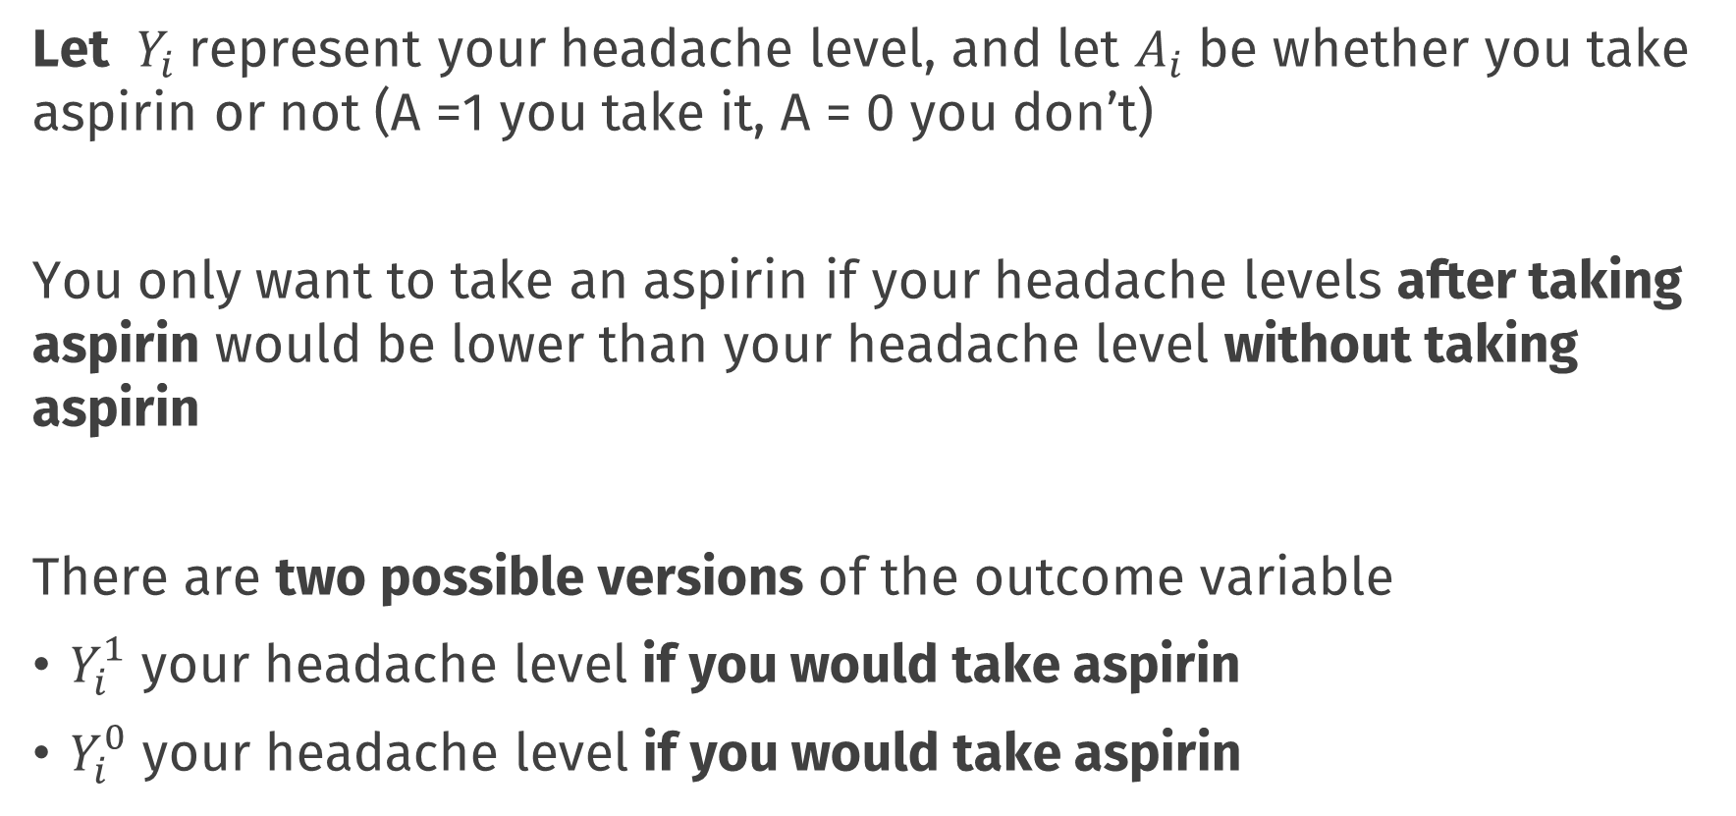
Potential Outcomes
Let $Y_{i}$ represent your headache level, and let $A_{i}$ be whether you take aspirin or not (A =1 you take it, A = 0 you don’t)
You only want to take an aspirin if your headache levels after taking aspirin would be lower than your headache level without taking aspirin
There are two possible versions of the outcome variable
$Y_{i}^{1}$ your headache level if you would take aspirin
$Y_{i}^{0}$ your headache level if you would take aspirin

Slide 15
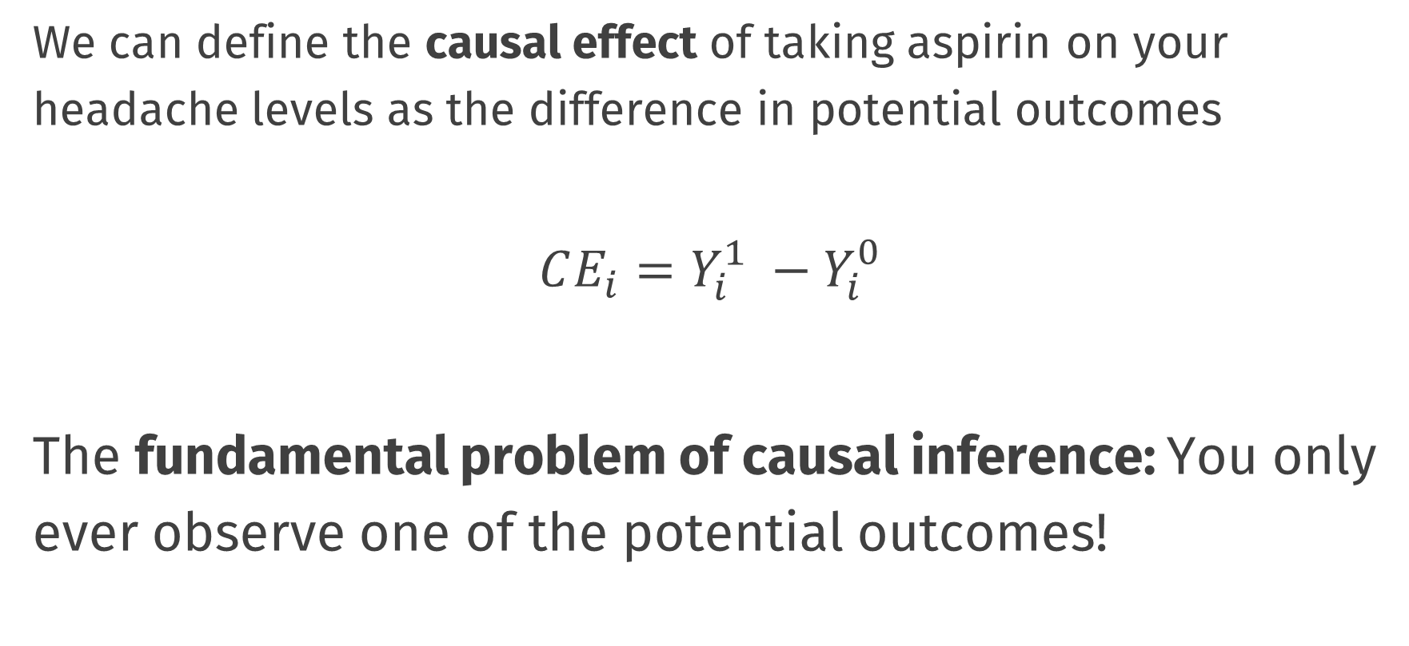
Causal Effects
We can define the causal effect of taking aspirin on your headache levels as the difference in potential outcomes
$$CE_{i}=Y_{i}^{1} −Y_{i}^{0}$$
The fundamental problem of causal inference: You only ever observe one of the potential outcomes!

Slide 16
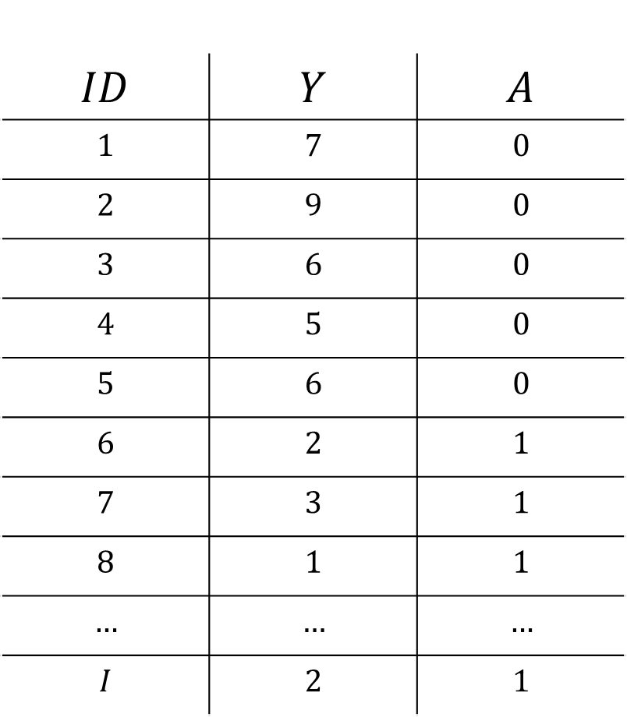
Data and Potential Outcomes
$$ID$$ | $$Y$$ | $$A$$
$$1$$ | $$7$$ | $$0$$
$$2$$ | $$9$$ | $$0$$
$$3$$ | $$6$$ | $$0$$
$$4$$ | $$5$$ | $$0$$
$$5$$ | $$6$$ | $$0$$
$$6$$ | $$2$$ | $$1$$
$$7$$ | $$3$$ | $$1$$
$$8$$ | $$1$$ | $$1$$
$$…$$ | $$…$$ | $$…$$
$$I$$ | $$2$$ | $$1$$

Slide 17

Data and Potential Outcomes
$$ID$$ | $$Y$$ | $$A$$
$$1$$ | $$7$$ | $$0$$
$$2$$ | $$9$$ | $$0$$
$$3$$ | $$6$$ | $$0$$
$$4$$ | $$5$$ | $$0$$
$$5$$ | $$6$$ | $$0$$
$$6$$ | $$2$$ | $$1$$
$$7$$ | $$3$$ | $$1$$
$$8$$ | $$1$$ | $$1$$
$$…$$ | $$…$$ | $$…$$
$$I$$ | $$2$$ | $$1$$

Slide 18
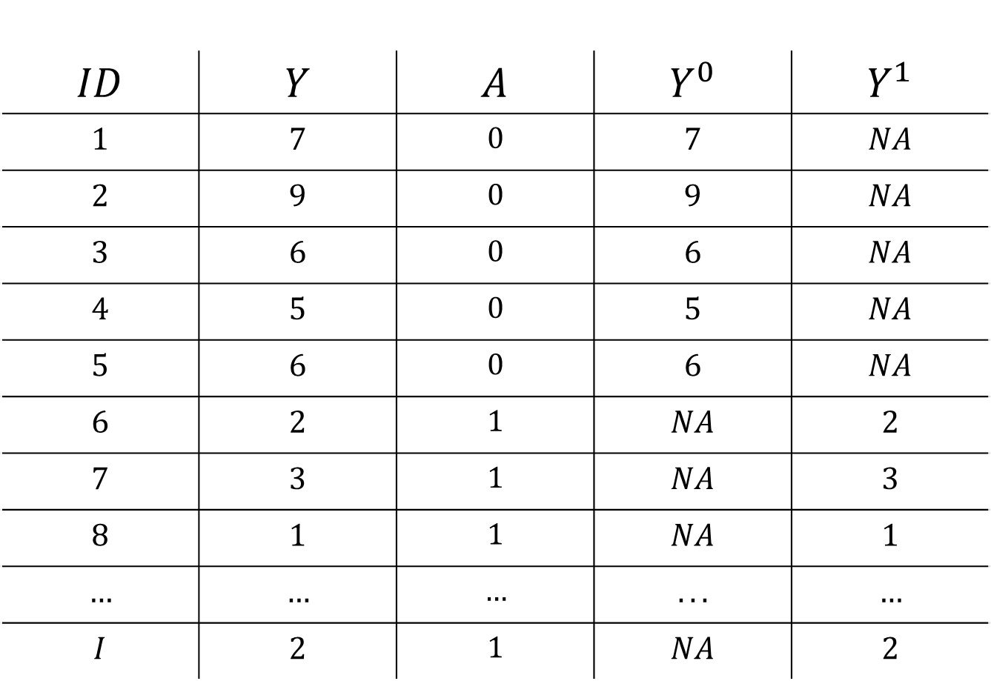
Data and Potential Outcomes
$$ID$$ | $$Y$$ | $$A$$ | $$Y^{0}$$ | $$Y^{1}$$
$$1$$ | $$7$$ | $$0$$ | $$7$$ | $$NA$$
$$2$$ | $$9$$ | $$0$$ | $$9$$ | $$NA$$
$$3$$ | $$6$$ | $$0$$ | $$6$$ | $$NA$$
$$4$$ | $$5$$ | $$0$$ | $$5$$ | $$NA$$
$$5$$ | $$6$$ | $$0$$ | $$6$$ | $$NA$$
$$6$$ | $$2$$ | $$1$$ | $$NA$$ | $$2$$
$$7$$ | $$3$$ | $$1$$ | $$NA$$ | $$3$$
$$8$$ | $$1$$ | $$1$$ | $$NA$$ | $$1$$
$$…$$ | $$…$$ | $$…$$ | $$...$$ | $$…$$
$$I$$ | $$2$$ | $$1$$ | $$NA$$ | $$2$$

Slide 19
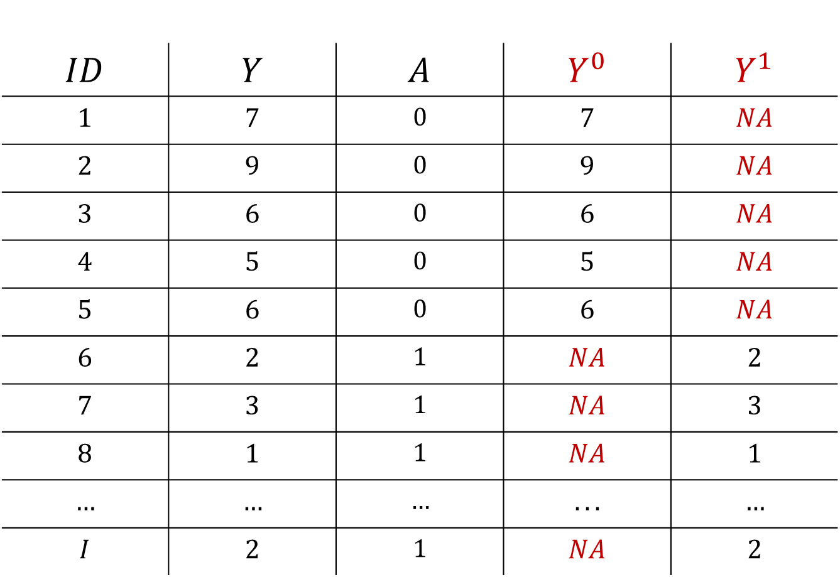
Data and Potential Outcomes
$$ID$$ | $$Y$$ | $$A$$ | $$Y^{0}$$ | $$Y^{1}$$
$$1$$ | $$7$$ | $$0$$ | $$7$$ | $$NA$$
$$2$$ | $$9$$ | $$0$$ | $$9$$ | $$NA$$
$$3$$ | $$6$$ | $$0$$ | $$6$$ | $$NA$$
$$4$$ | $$5$$ | $$0$$ | $$5$$ | $$NA$$
$$5$$ | $$6$$ | $$0$$ | $$6$$ | $$NA$$
$$6$$ | $$2$$ | $$1$$ | $$NA$$ | $$2$$
$$7$$ | $$3$$ | $$1$$ | $$NA$$ | $$3$$
$$8$$ | $$1$$ | $$1$$ | $$NA$$ | $$1$$
$$…$$ | $$…$$ | $$…$$ | $$...$$ | $$…$$
$$I$$ | $$2$$ | $$1$$ | $$NA$$ | $$2$$

Slide 20
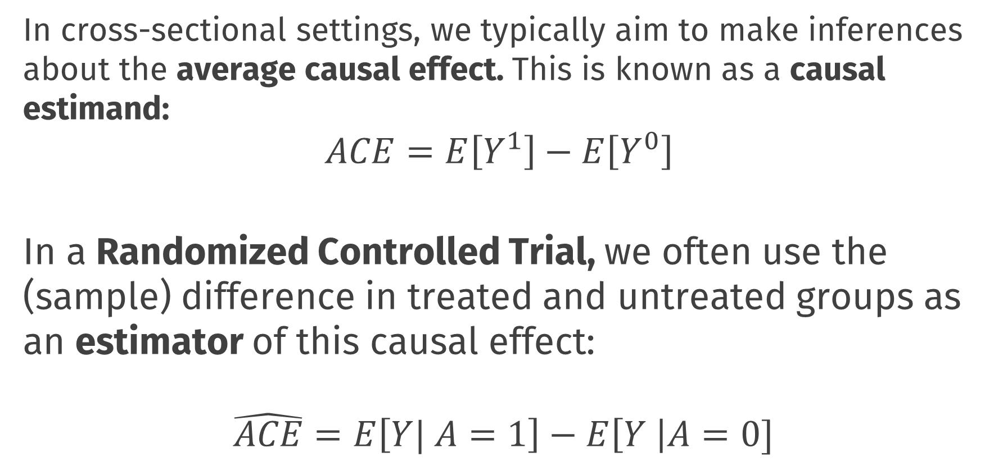
Causal Inference
In cross-sectional settings, we typically aim to make inferences about the average causal effect. This is known as a causal estimand:
$$ACE=E\left[Y^{1}\right]−E\left[Y^{0}\right]$$ In a Randomized Controlled Trial, we often use the (sample) difference in treated and untreated groups as an estimator of this causal effect:
$$\hat{ACE}=E\left[Y| A=1\right]−E\left[Y \right|A=0]$$
Notes:
Even though we can’t directly observe both $Y_{i}^{1}$ and $Y_{i}^{0}$ for the same individuals, under certain conditions, we can make inferences about these potential outcome variables

Slide 21
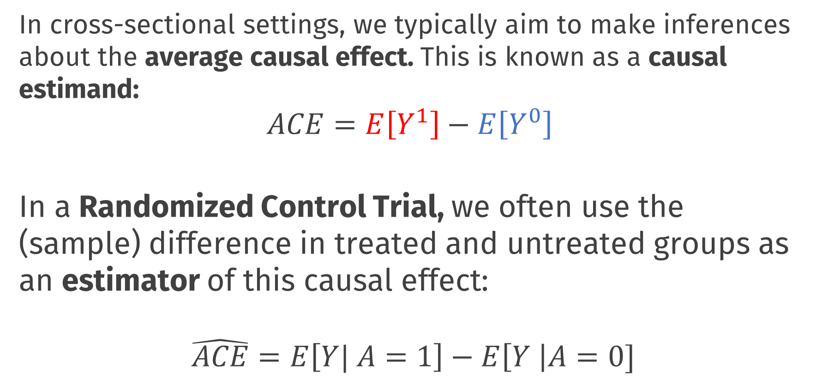
Causal Inference
In cross-sectional settings, we typically aim to make inferences about the average causal effect. This is known as a causal estimand:
$$ACE=E\left[Y^{1}\right]−E\left[Y^{0}\right]$$ In a Randomized Control Trial, we often use the (sample) difference in treated and untreated groups as an estimator of this causal effect:
$$\hat{ACE}=E\left[Y| A=1\right]−E\left[Y \right|A=0]$$
Notes:
Even though we can’t directly observe both $Y_{i}^{1}$ and $Y_{i}^{0}$ for the same individuals, under certain conditions, we can make inferences about these potential outcome variables

Slide 22
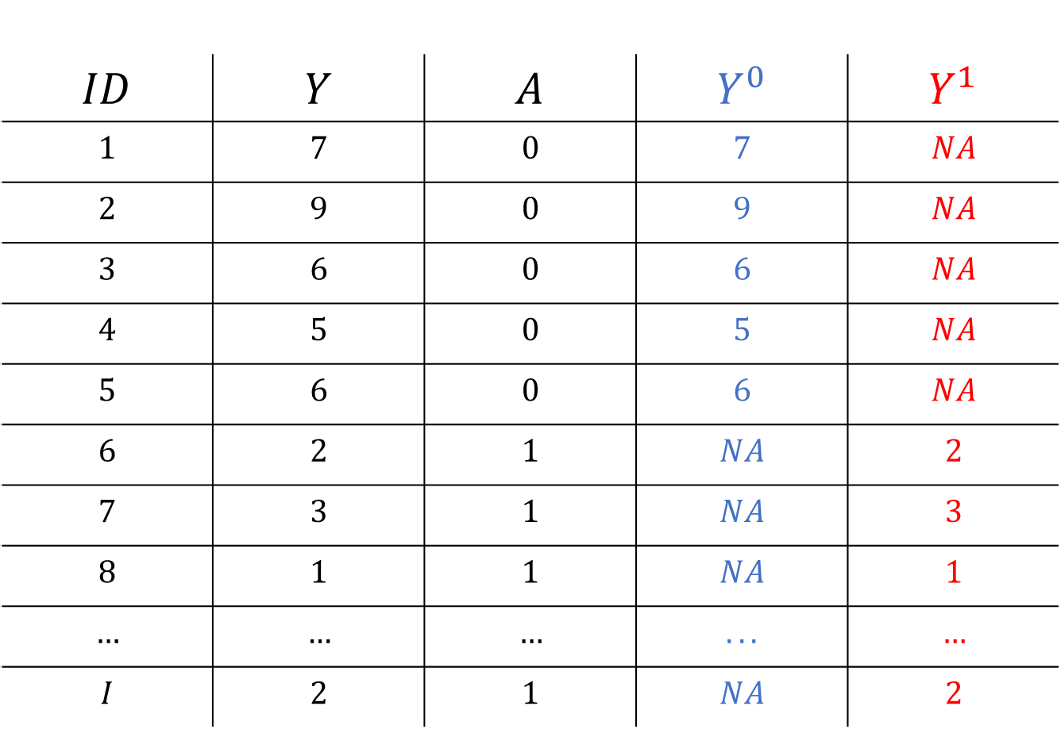
Causal Inference
$$ID$$ | $$Y$$ | $$A$$ | $$Y^{0}$$ | $$Y^{1}$$
$$1$$ | $$7$$ | $$0$$ | $$7$$ | $$NA$$
$$2$$ | $$9$$ | $$0$$ | $$9$$ | $$NA$$
$$3$$ | $$6$$ | $$0$$ | $$6$$ | $$NA$$
$$4$$ | $$5$$ | $$0$$ | $$5$$ | $$NA$$
$$5$$ | $$6$$ | $$0$$ | $$6$$ | $$NA$$
$$6$$ | $$2$$ | $$1$$ | $$NA$$ | $$2$$
$$7$$ | $$3$$ | $$1$$ | $$NA$$ | $$3$$
$$8$$ | $$1$$ | $$1$$ | $$NA$$ | $$1$$
$$…$$ | $$…$$ | $$…$$ | $$...$$ | $$…$$
$$I$$ | $$2$$ | $$1$$ | $$NA$$ | $$2$$

Slide 23
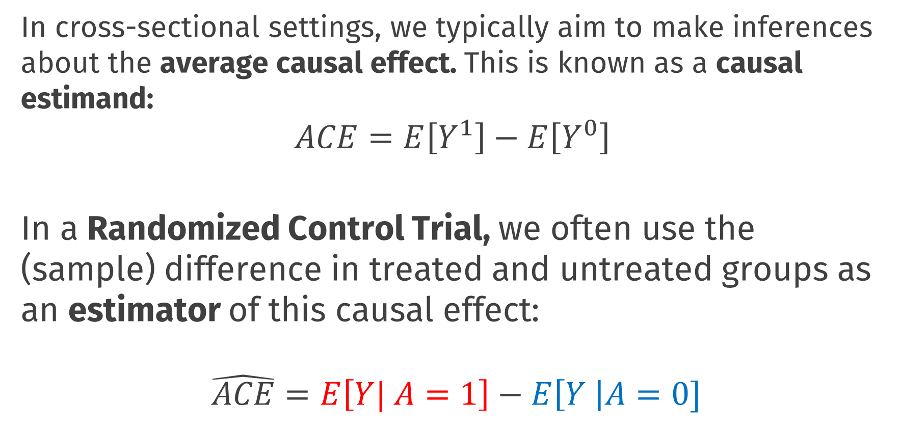
Causal Inference
In cross-sectional settings, we typically aim to make inferences about the average causal effect. This is known as a causal estimand:
$$ACE=E\left[Y^{1}\right]−E\left[Y^{0}\right]$$ In a Randomized Control Trial, we often use the (sample) difference in treated and untreated groups as an estimator of this causal effect:
$$\hat{ACE}=E\left[Y| A=1\right]−E\left[Y \right|A=0]$$
Notes:
Even though we can’t directly observe both $Y_{i}^{1}$ and $Y_{i}^{0}$ for the same individuals, under certain conditions, we can make inferences about these potential outcome variables

Slide 24
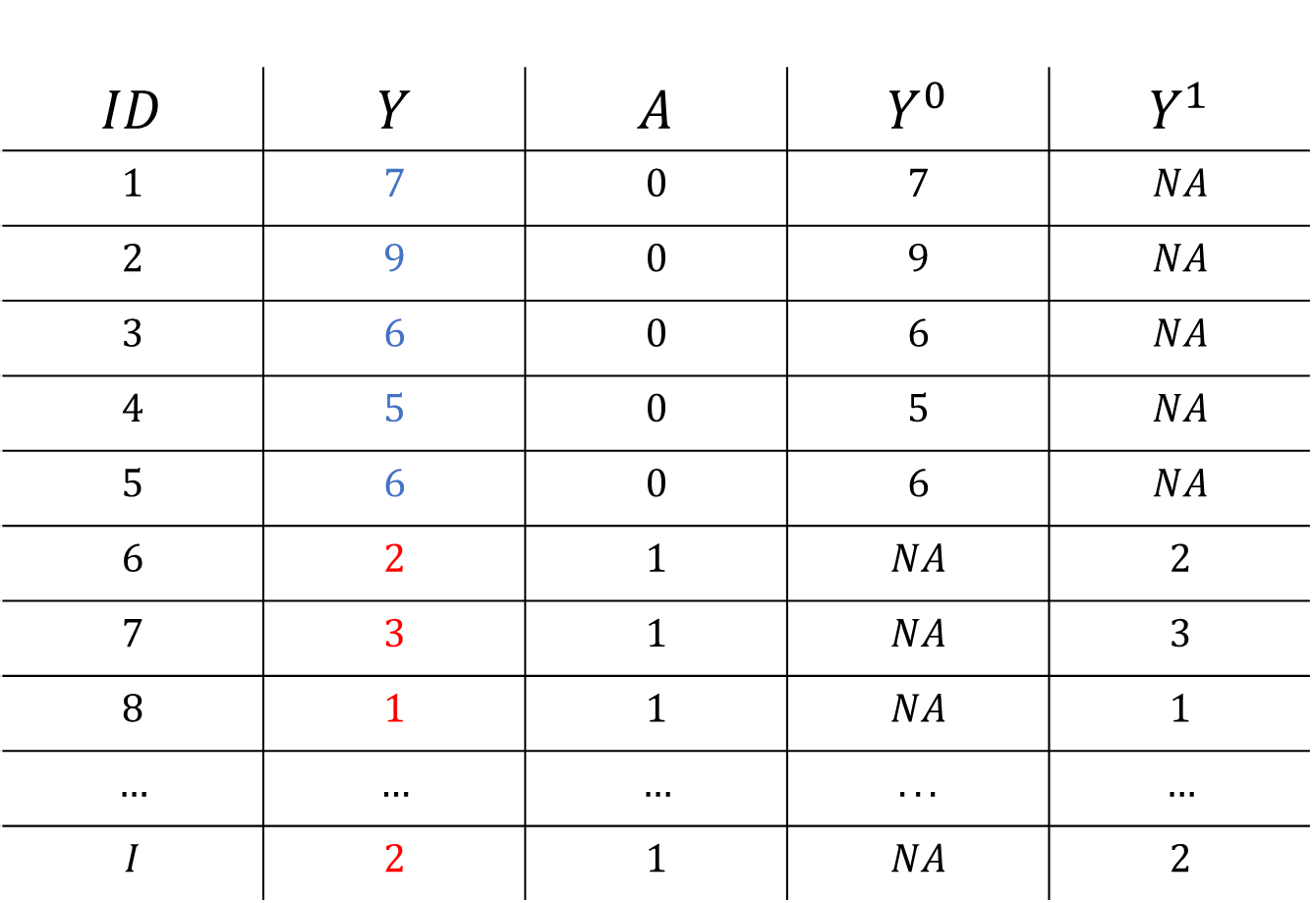
Causal Inference
$$ID$$ | $$Y$$ | $$A$$ | $$Y^{0}$$ | $$Y^{1}$$
$$1$$ | $$7$$ | $$0$$ | $$7$$ | $$NA$$
$$2$$ | $$9$$ | $$0$$ | $$9$$ | $$NA$$
$$3$$ | $$6$$ | $$0$$ | $$6$$ | $$NA$$
$$4$$ | $$5$$ | $$0$$ | $$5$$ | $$NA$$
$$5$$ | $$6$$ | $$0$$ | $$6$$ | $$NA$$
$$6$$ | $$2$$ | $$1$$ | $$NA$$ | $$2$$
$$7$$ | $$3$$ | $$1$$ | $$NA$$ | $$3$$
$$8$$ | $$1$$ | $$1$$ | $$NA$$ | $$1$$
$$…$$ | $$…$$ | $$…$$ | $$...$$ | $$…$$
$$I$$ | $$2$$ | $$1$$ | $$NA$$ | $$2$$

Slide 25
Causal Inference Assumptions
This type of inference about causal effects from observed data is only possible under certain conditions or assumptions
Exchangeability
Essentially relates to the absence of (unaccounted for) confounder variables
If we were to reverse treatment assignment we would observe the same group differences. Information is exchangeable between groups
RCTs are powerful because randomization ensures exchangeability
In practice we need conditional exchangeability; to control for confounders!
Notes:
Even though we can’t directly observe both $Y_{i}^{1}$ and $Y_{i}^{0}$ for the same individuals, under certain conditions, we can make inferences about these potential outcome variables

Slide 26
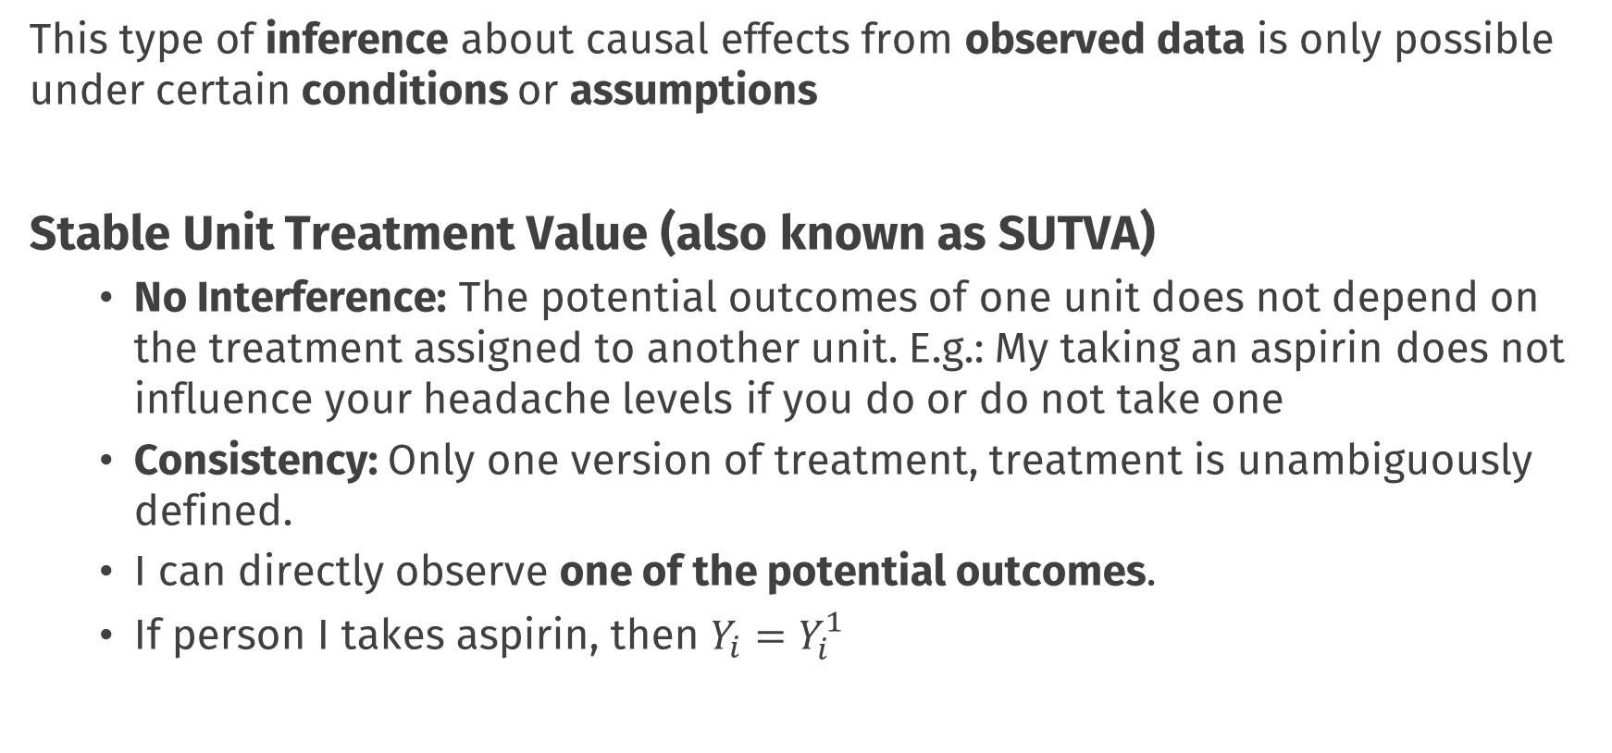
Causal Inference Assumptions
This type of inference about causal effects from observed data is only possible under certain conditions or assumptions
Stable Unit Treatment Value (also known as SUTVA)
No Interference: The potential outcomes of one unit does not depend on the treatment assigned to another unit. E.g.: My taking an aspirin does not influence your headache levels if you do or do not take one
Consistency: Only one version of treatment, treatment is unambiguously defined.
I can directly observe one of the potential outcomes.
If person I takes aspirin, then $Y_{i}=Y_{i}^{1}$
Notes:
Even though we can’t directly observe both $Y_{i}^{1}$ and $Y_{i}^{0}$ for the same individuals, under certain conditions, we can make inferences about these potential outcome variables
E.g.: If I want to make inferences about the effect of losing weight on heart health, my inferences will be different if I study people who gradually lost weight due to diet and exercise vs those who are lighter due to liposuction!

Slide 27
Causal Inference Assumptions
These two generic assumptions essentially always appear in causal inference problems, and as we will see, we will have to deal with concerns around confounders and no interference repeatedly today
Other assumptions or conditions may also be needed depending on the specific design and analytic approach you take
Notes:
Here; I could show the derivation of how you get from estimand to estimator using those assumptions, but I think it’s good to leave this out

Slide 28
Causal Inference and Policy Evaluations

Slide 29
Todays Topic
Policy evaluation is a special case of causal inference
We have one unit observed repeatedly over time
At some point in time an intervention takes place
Notes:
Even though we can’t directly observe both $Y_{i}^{1}$ and $Y_{i}^{0}$ for the same individuals, under certain conditions, we can make inferences about these potential outcome variables

Slide 30

Data and Potential Outcomes
$$Time$$ | $$Y_{t}$$ | $$A_{t}$$
$$1$$ | $$7$$ | $$0$$
$$2$$ | $$9$$ | $$0$$
$$3$$ | $$6$$ | $$0$$
$$4$$ | $$5$$ | $$0$$
$$5$$ | $$6$$ | $$0$$
$$6$$ | $$2$$ | $$1$$
$$7$$ | $$3$$ | $$1$$
$$8$$ | $$1$$ | $$1$$
$$…$$ | $$…$$ | $$…$$
$$I$$ | $$2$$ | $$1$$

Slide 31
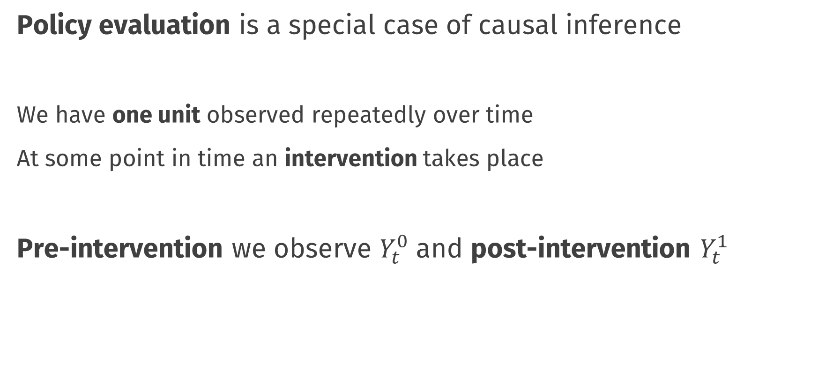
Todays Topic
Policy evaluation is a special case of causal inference
We have one unit observed repeatedly over time
At some point in time an intervention takes place
Pre-intervention we observe $Y_{t}^{0}$ and post-intervention $Y_{t}^{1}$
Notes:
Even though we can’t directly observe both $Y_{i}^{1}$ and $Y_{i}^{0}$ for the same individuals, under certain conditions, we can make inferences about these potential outcome variables

Slide 32
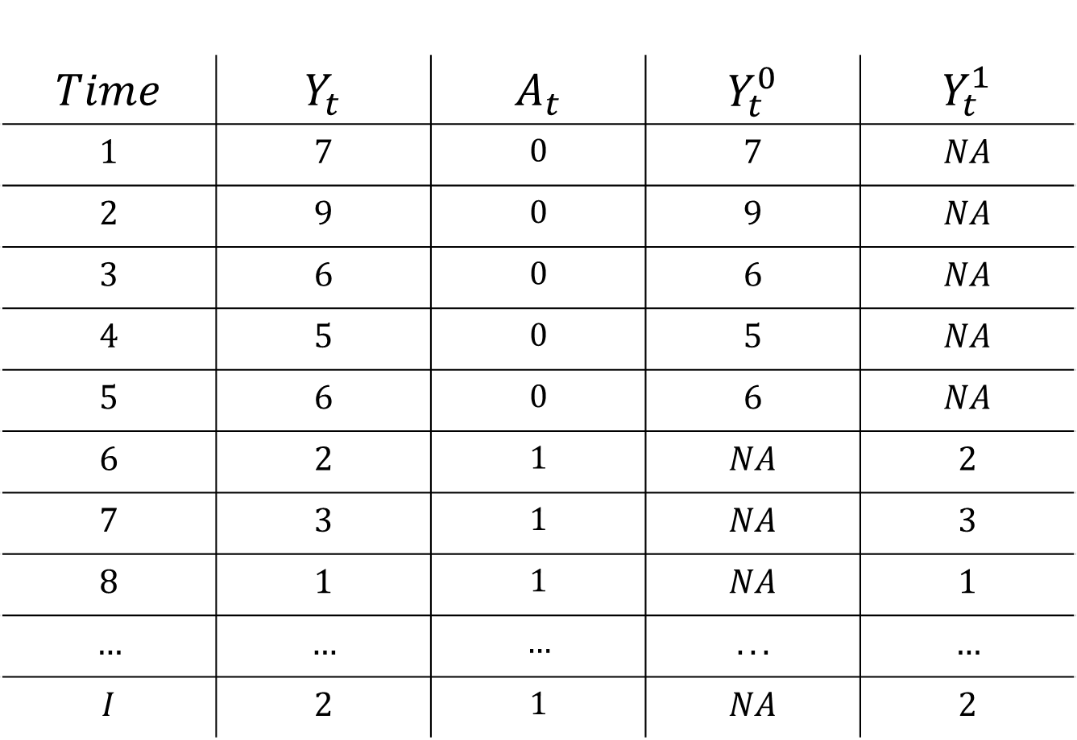
Data and Potential Outcomes
$$Time$$ | $$Y_{t}$$ | $$A_{t}$$ | $$Y_{t}^{0}$$ | $$Y_{t}^{1}$$
$$1$$ | $$7$$ | $$0$$ | $$7$$ | $$NA$$
$$2$$ | $$9$$ | $$0$$ | $$9$$ | $$NA$$
$$3$$ | $$6$$ | $$0$$ | $$6$$ | $$NA$$
$$4$$ | $$5$$ | $$0$$ | $$5$$ | $$NA$$
$$5$$ | $$6$$ | $$0$$ | $$6$$ | $$NA$$
$$6$$ | $$2$$ | $$1$$ | $$NA$$ | $$2$$
$$7$$ | $$3$$ | $$1$$ | $$NA$$ | $$3$$
$$8$$ | $$1$$ | $$1$$ | $$NA$$ | $$1$$
$$…$$ | $$…$$ | $$…$$ | $$...$$ | $$…$$
$$I$$ | $$2$$ | $$1$$ | $$NA$$ | $$2$$

Slide 34
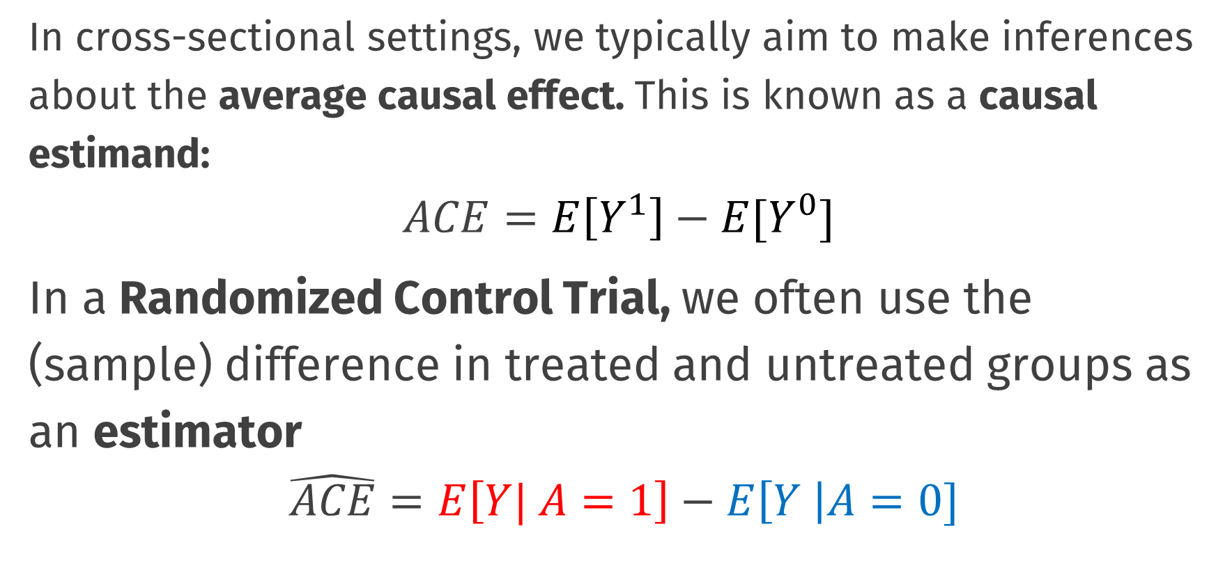
Causal Inference
In cross-sectional settings, we typically aim to make inferences about the average causal effect. This is known as a causal estimand:
$$ACE=E\left[Y^{1}\right]−E[Y^{0}]$$
In a Randomized Control Trial, we often use the (sample) difference in treated and untreated groups as an estimator
$$\hat{ACE}=E\left[Y| A=1\right]−E\left[Y \right|A=0]$$
Notes:
Even though we can’t directly observe both $Y_{i}^{1}$ and $Y_{i}^{0}$ for the same individuals, under certain conditions, we can make inferences about these potential outcome variables

Slide 35
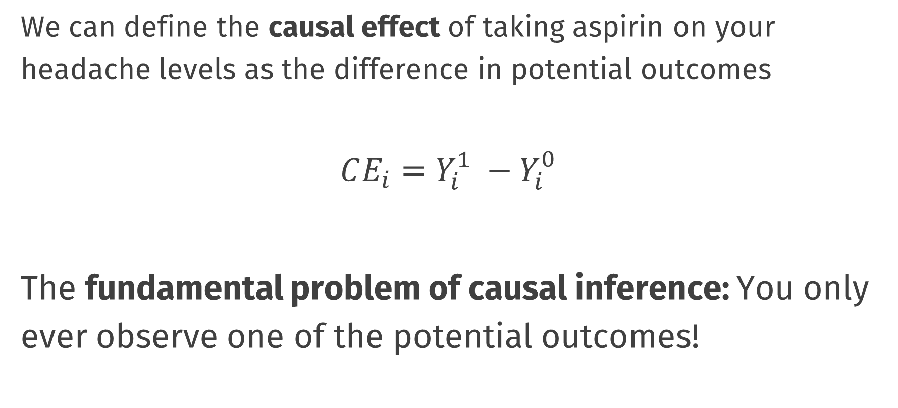
Causal Inference
We can define the causal effect of taking aspirin on your headache levels as the difference in potential outcomes
$$CE_{i}=Y_{i}^{1} −Y_{i}^{0}$$
The fundamental problem of causal inference: You only ever observe one of the potential outcomes!

Slide 36
Data visualisation with ggplot2
https://r4ds.had.co.nz/data-visualisation.html
Raw data maps to:
Aesthetics: data-bound properties of the picture (position, shape, colour, …)
Geometric objects, or geom: visual objects on the plot (points, lines, bars, polygons …)
Scales: how data values map to aesthetic values (continuous or discrete)
Facets: subplots / small multiples
Additionally, can apply:
Statistical transformations: transform data before mapping
Alternative coordinate system (cartesian, polar, …)

Slide 37
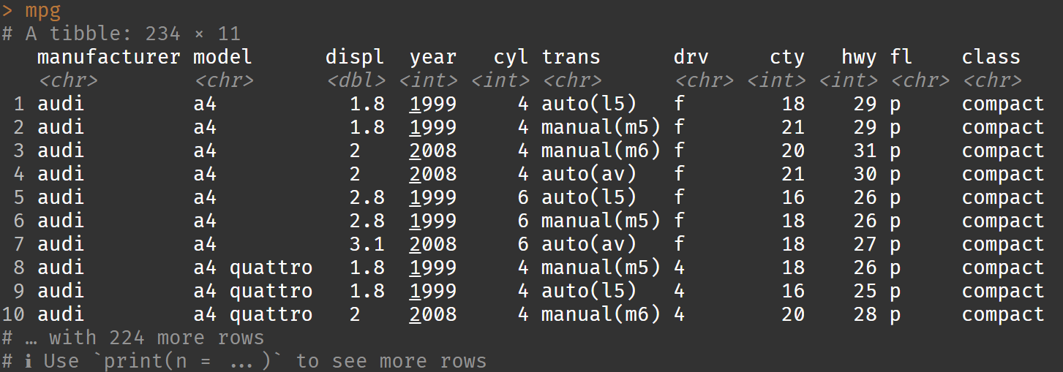
Example dataset: cars

Slide 38
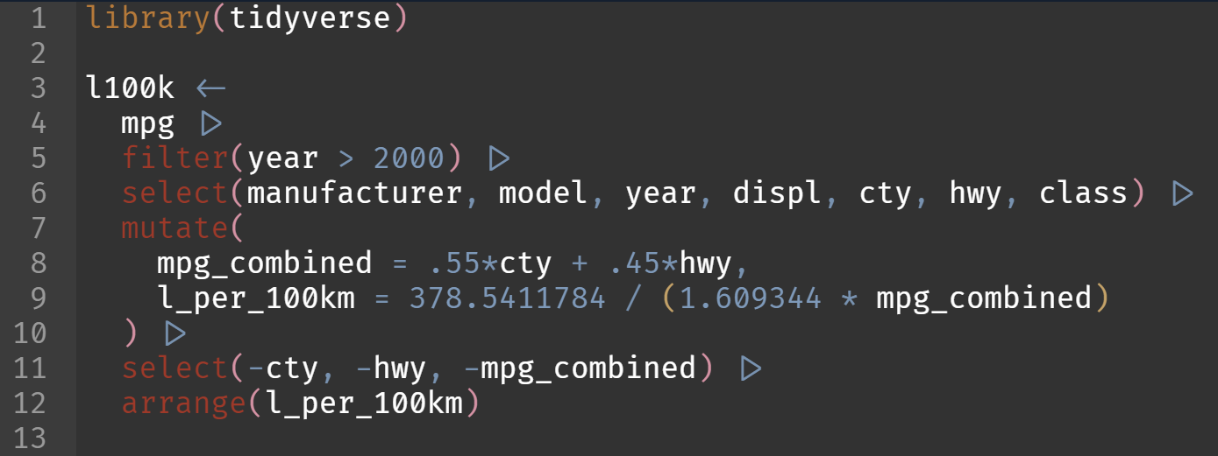
Data wrangling with dplyr
Which are the most efficient (combined city-highway) cars after 2000 in terms of litres / 100km?

Slide 39
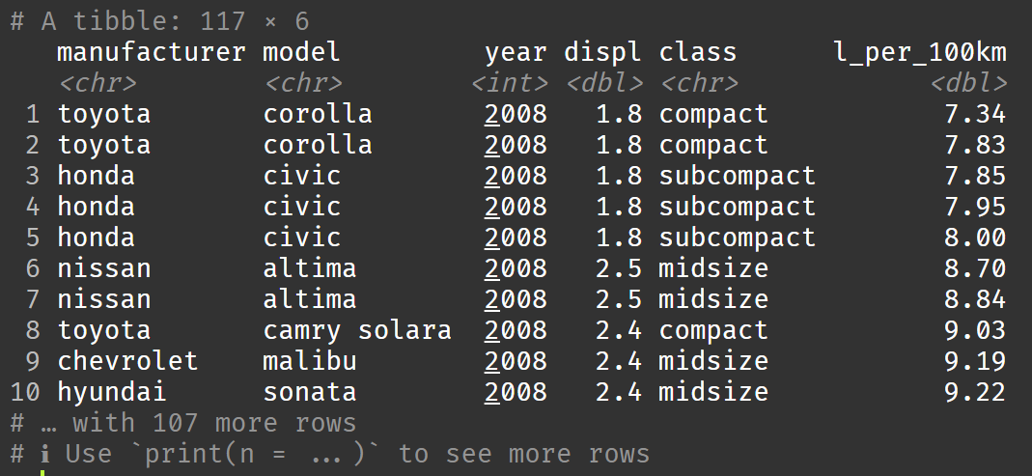
Data wrangling with dplyr

Slide 40
Data visualisation with ggplot2
https://r4ds.had.co.nz/data-visualisation.html
Raw data maps to:
Aesthetics: data-bound properties of the picture (position, shape, colour, …)
Geometric objects, or geom: visual objects on the plot (points, lines, bars, polygons …)
Scales: how data values map to aesthetic values (continuous or discrete)
Facets: subplots / small multiples
Additionally, can apply:
Statistical transformations: transform data before mapping
Alternative coordinate system (cartesian, polar, …)

Slide 41
Example dataset: l100k

Slide 42
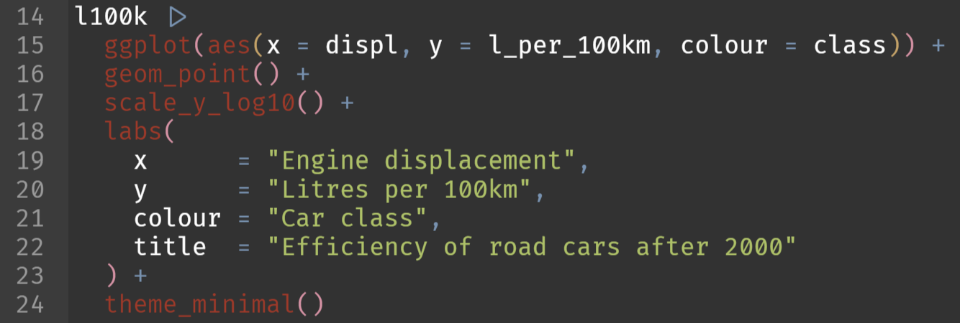
Data visualisation with ggplot2
Display a scatter plot with on the x axis the engine displacement and on the y-axis the efficiency. Colour the points by the car class

Slide 43
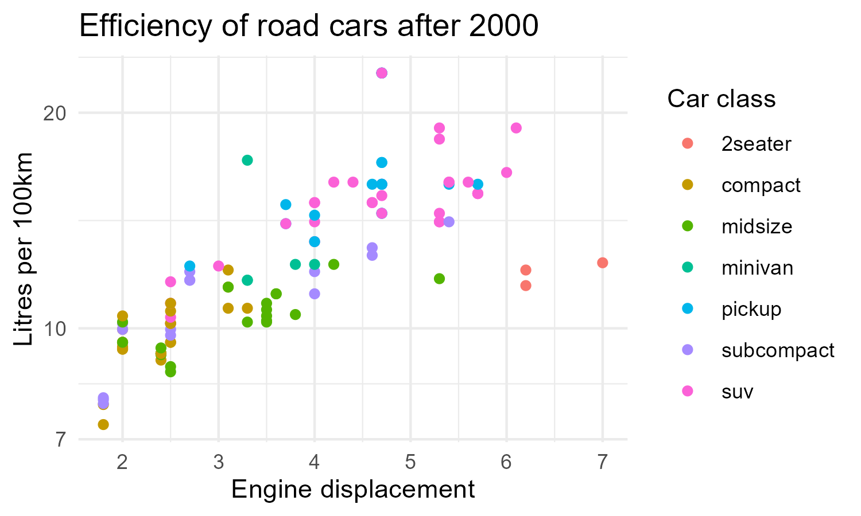
Data visualisation with ggplot2

Slide 44
More data wrangling with dplyr
group by
Registers groups by which to perform further operations (usually mutate, summarise)
summarise
Create summaries based on a function applied to each group

Slide 45
Example dataset: l100k

Slide 46
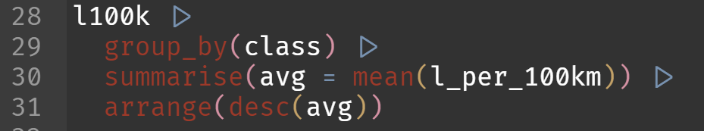
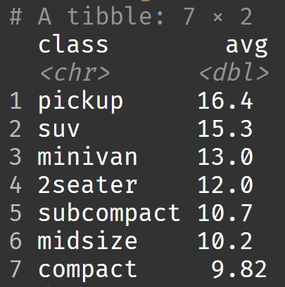
More data wrangling with dplyr
Which type of car should I buy to be the least efficient?

Slide 47
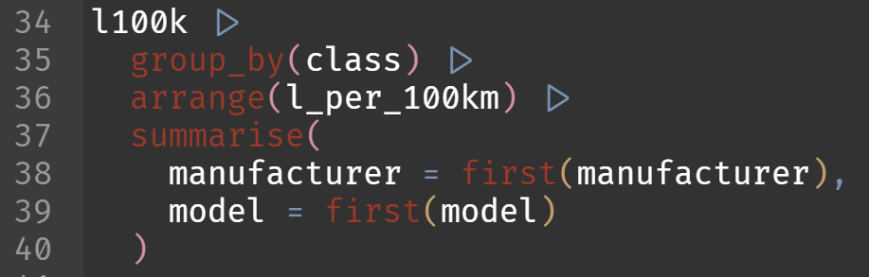
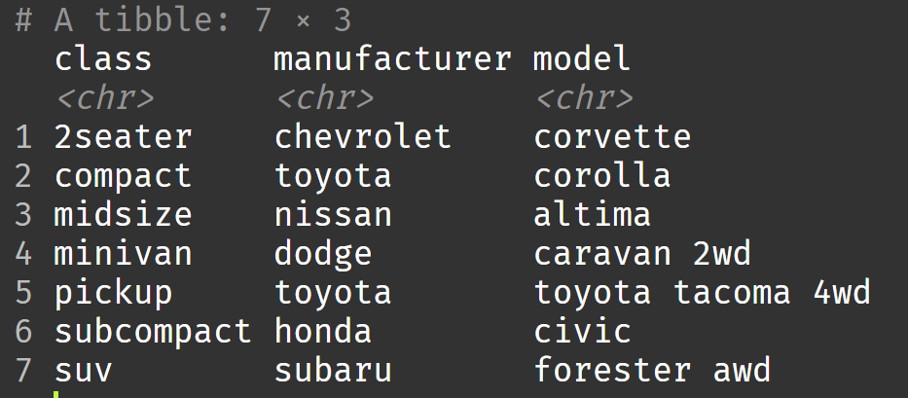
More data wrangling with dplyr
What is the most efficient car within each class?

Slide 48
Pivoting with tidyr
pivot_longer
Combines various columns into a single “value” column with an additional “name” column to indicate where the value came from
pivot_wider
The opposite: puts rows of different categories in separate columns

Slide 49
Example dataset: l100k

Slide 50
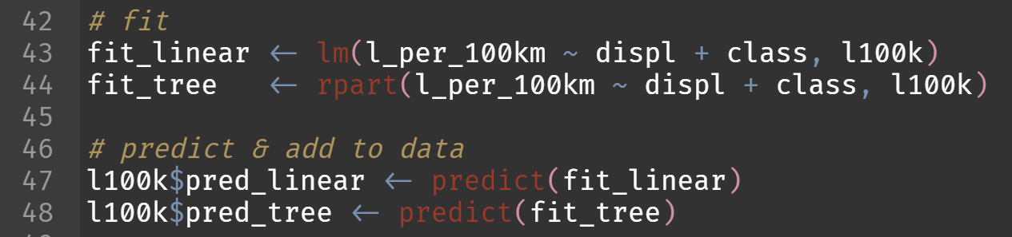
Pivoting with tidyr
Let’s generate predictions for efficiency using two models: a linear regression and a regression tree

Slide 51
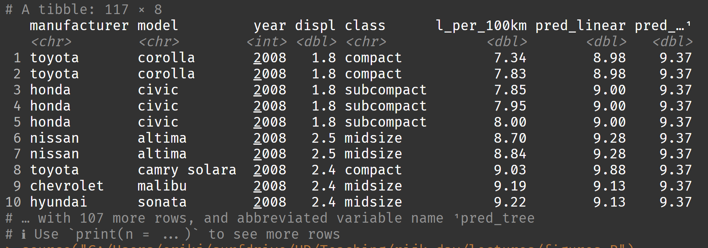
Pivoting with tidyr

Slide 52
Pivoting with tidyr
Let’s plot these predictions with the following mapped aesthetics:
x: engine size
y: predicted efficiency
colour: model type
???

Slide 53
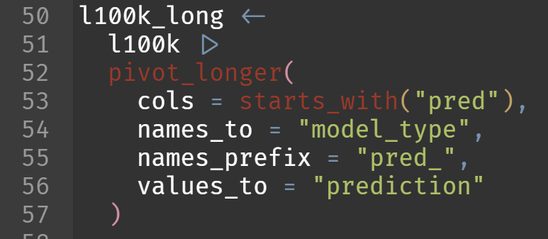
Pivoting with tidyr
ggplot wants tidy data. Let’s pivot our data so that model type becomes a column.

Slide 54
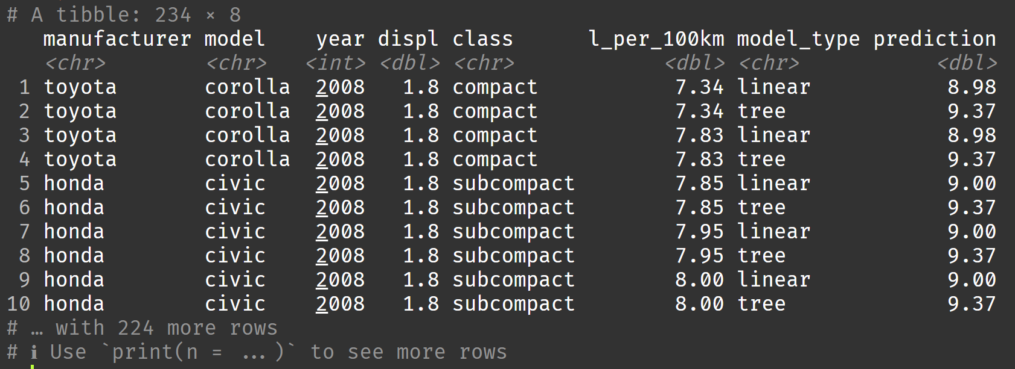
Pivoting with tidyr

Slide 55
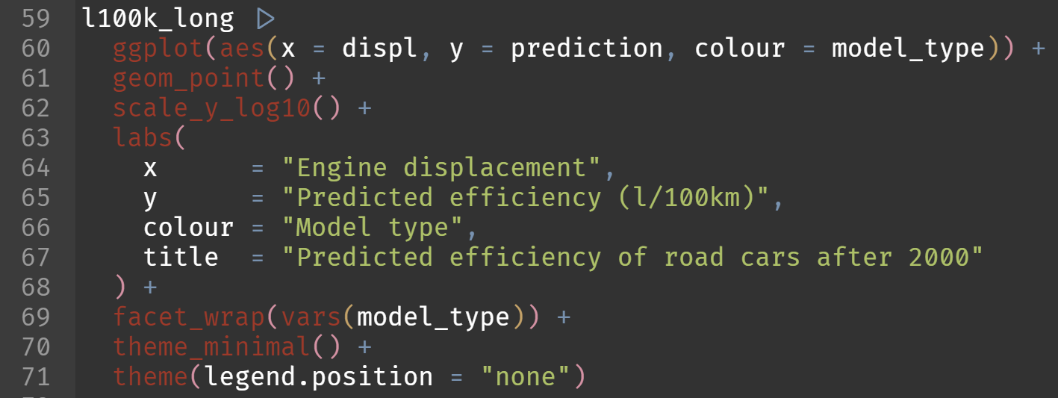
Pivoting with tidyr
Let’s plot these predictions!

Slide 56
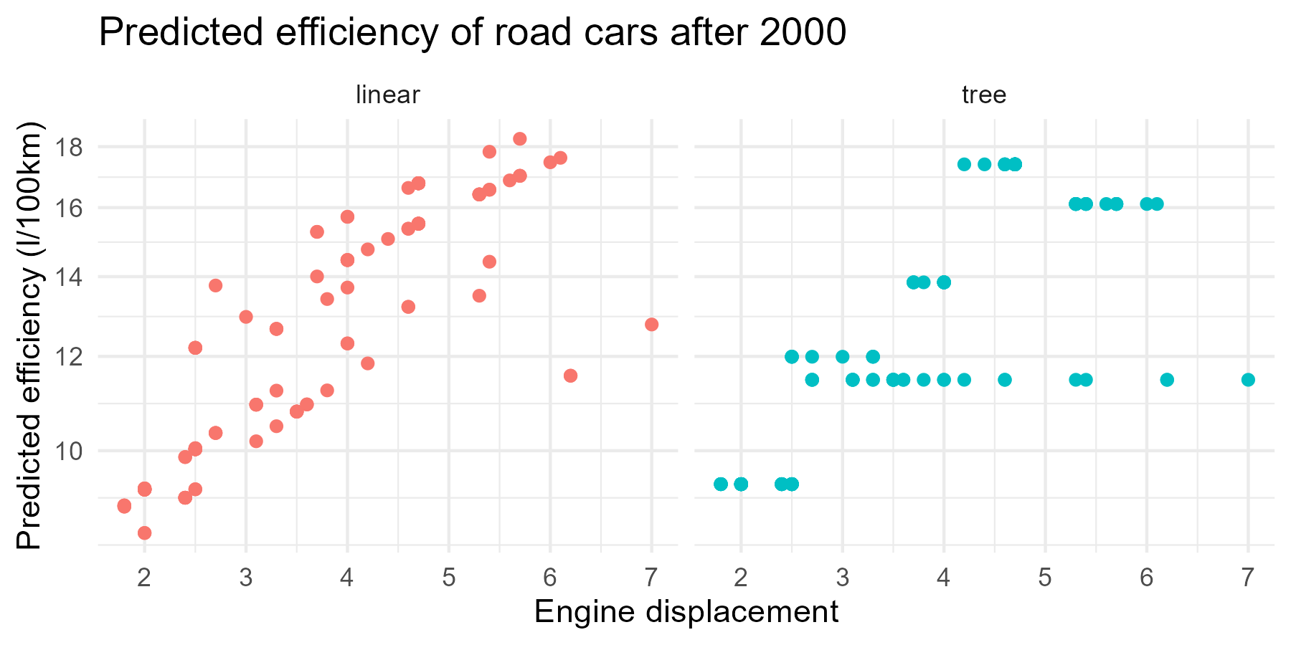
Pivoting with tidyr

Slide 57
Practical: dplyr, ggplot, tidyr
Work in your groups!
Take a break from 10:30 to 10:40

Slide 58
Break

Slide 59
Break

Slide 60
Default light slide
Default subheading
This is the body of the text
Default subheading
Note that the text is not black, but “black, text 1, lighter 25%”
Default subheading
This makes things easier on the eyes
Default subheading
This is the body of the text

Slide 61
Default dark slide
Default subheading
The dark slide brings some variation
Default subheading
It can highlight important aspects of the presentation.
Default subheading
This is the body of the text
Default subheading
This is the body of the text

Slide 62
Here is an impactful slide with a sentence on it.
Here is a topic related to the aforementioned question.

Slide 63
Questions?

