Slide 1
Estimating the causal effect
Basic methods

Slide 2
In this part
Running example: California proposition 99 data
Pre-post estimator
Difference-in-differences estimator

Slide 3
Proposition 99

Slide 4
Proposition 99
Most famous example in causal inference literature
In 1988, the state of California imposed a 25% tax on tobacco cigarettes
Total savings in personal health care expenditure until 2004 is $86 billion (Lightwood et al., 2008)
Abadie, A., Diamond, A., & Hainmueller, J. (2010). Synthetic control methods for comparative case studies: Estimating the effect of California’s tobacco control program. Journal of the American statistical Association, 105(490), 493-505.

Slide 5
Proposition 99
We prepared a dataset for this workshop:
proposition99.rds
Panel dataset
Can be downloaded from the website
Let’s explore!

Slide 6
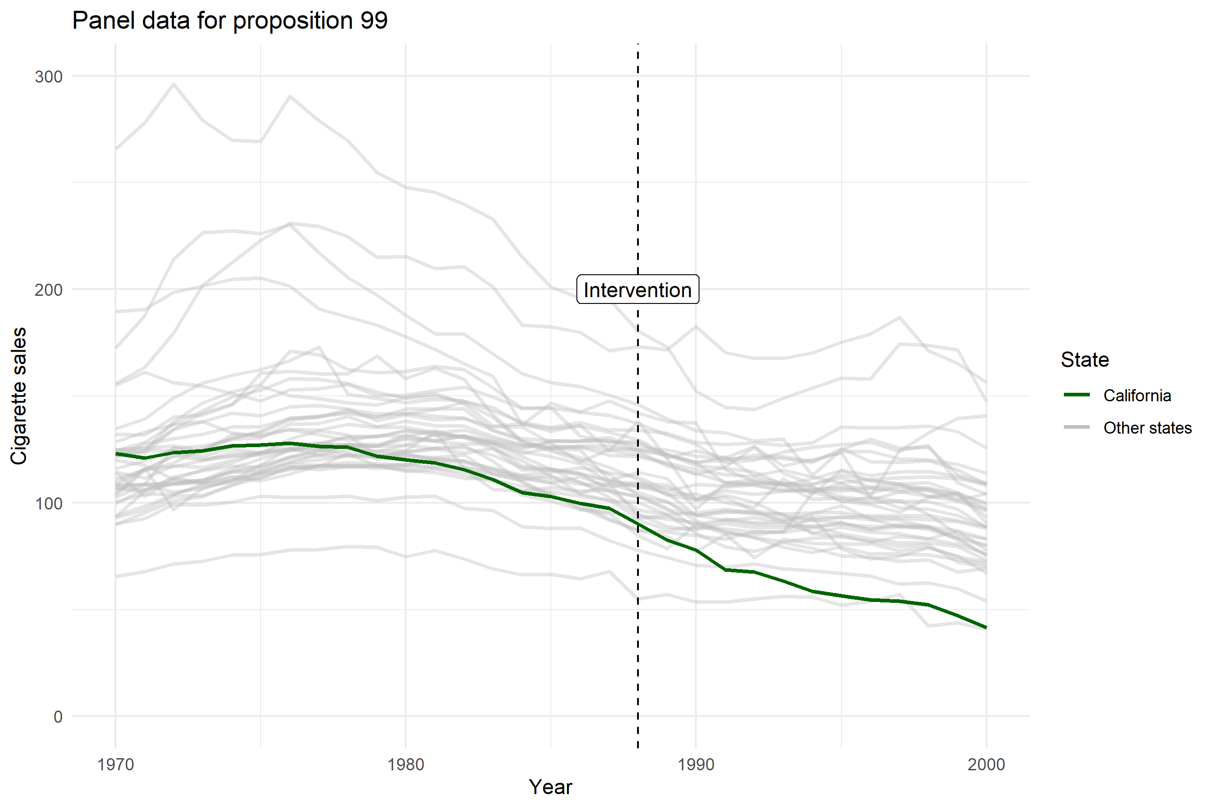

Slide 7
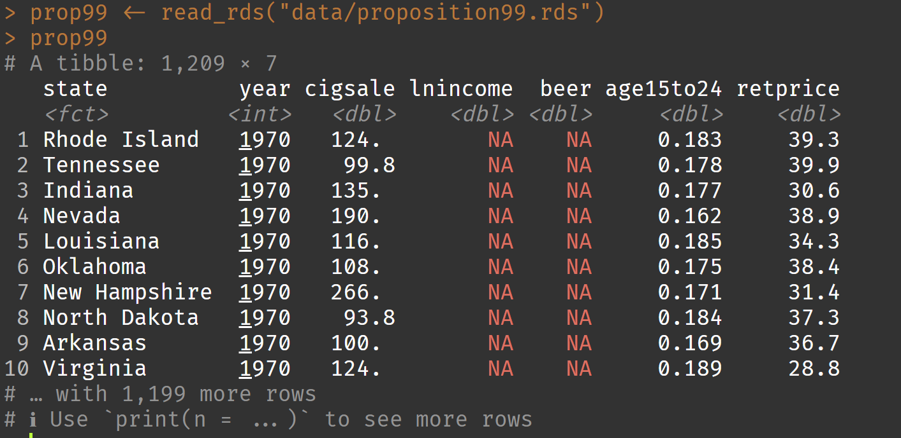
Proposition 99

Slide 8
Proposition 99
state: 39 different states, used in Abadie et al. (2010)
year: 1970 until 2000
cigsale: packs of cigarettes per 100 000 people
lnincome: natural log of mean income
beer: beer sales per 100 000 people
age15to24: proportion of people between 15 & 24
retprice: retail price of a box of cigarettes

Slide 9
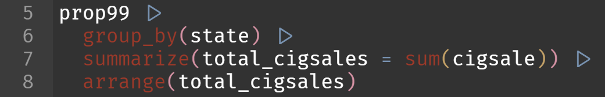
Proposition 99
Which state sold the least cigarettes per capita?
We make use of tidyverse:
This works well with our prepared dataset

Slide 10
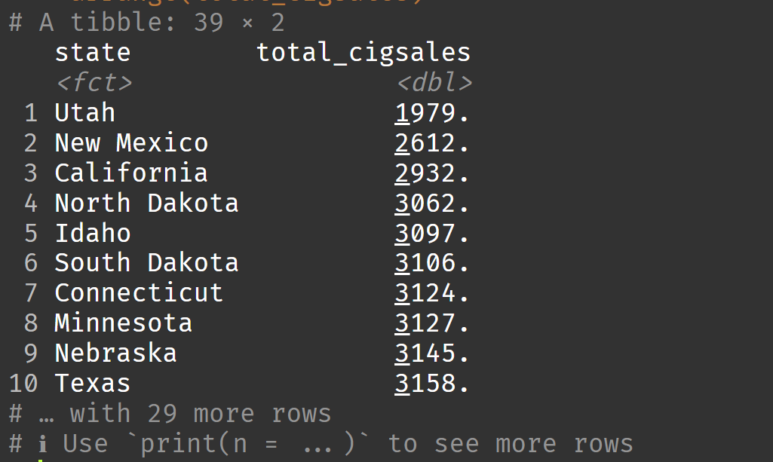
Proposition 99

Slide 11
Pre-post estimator

Slide 12
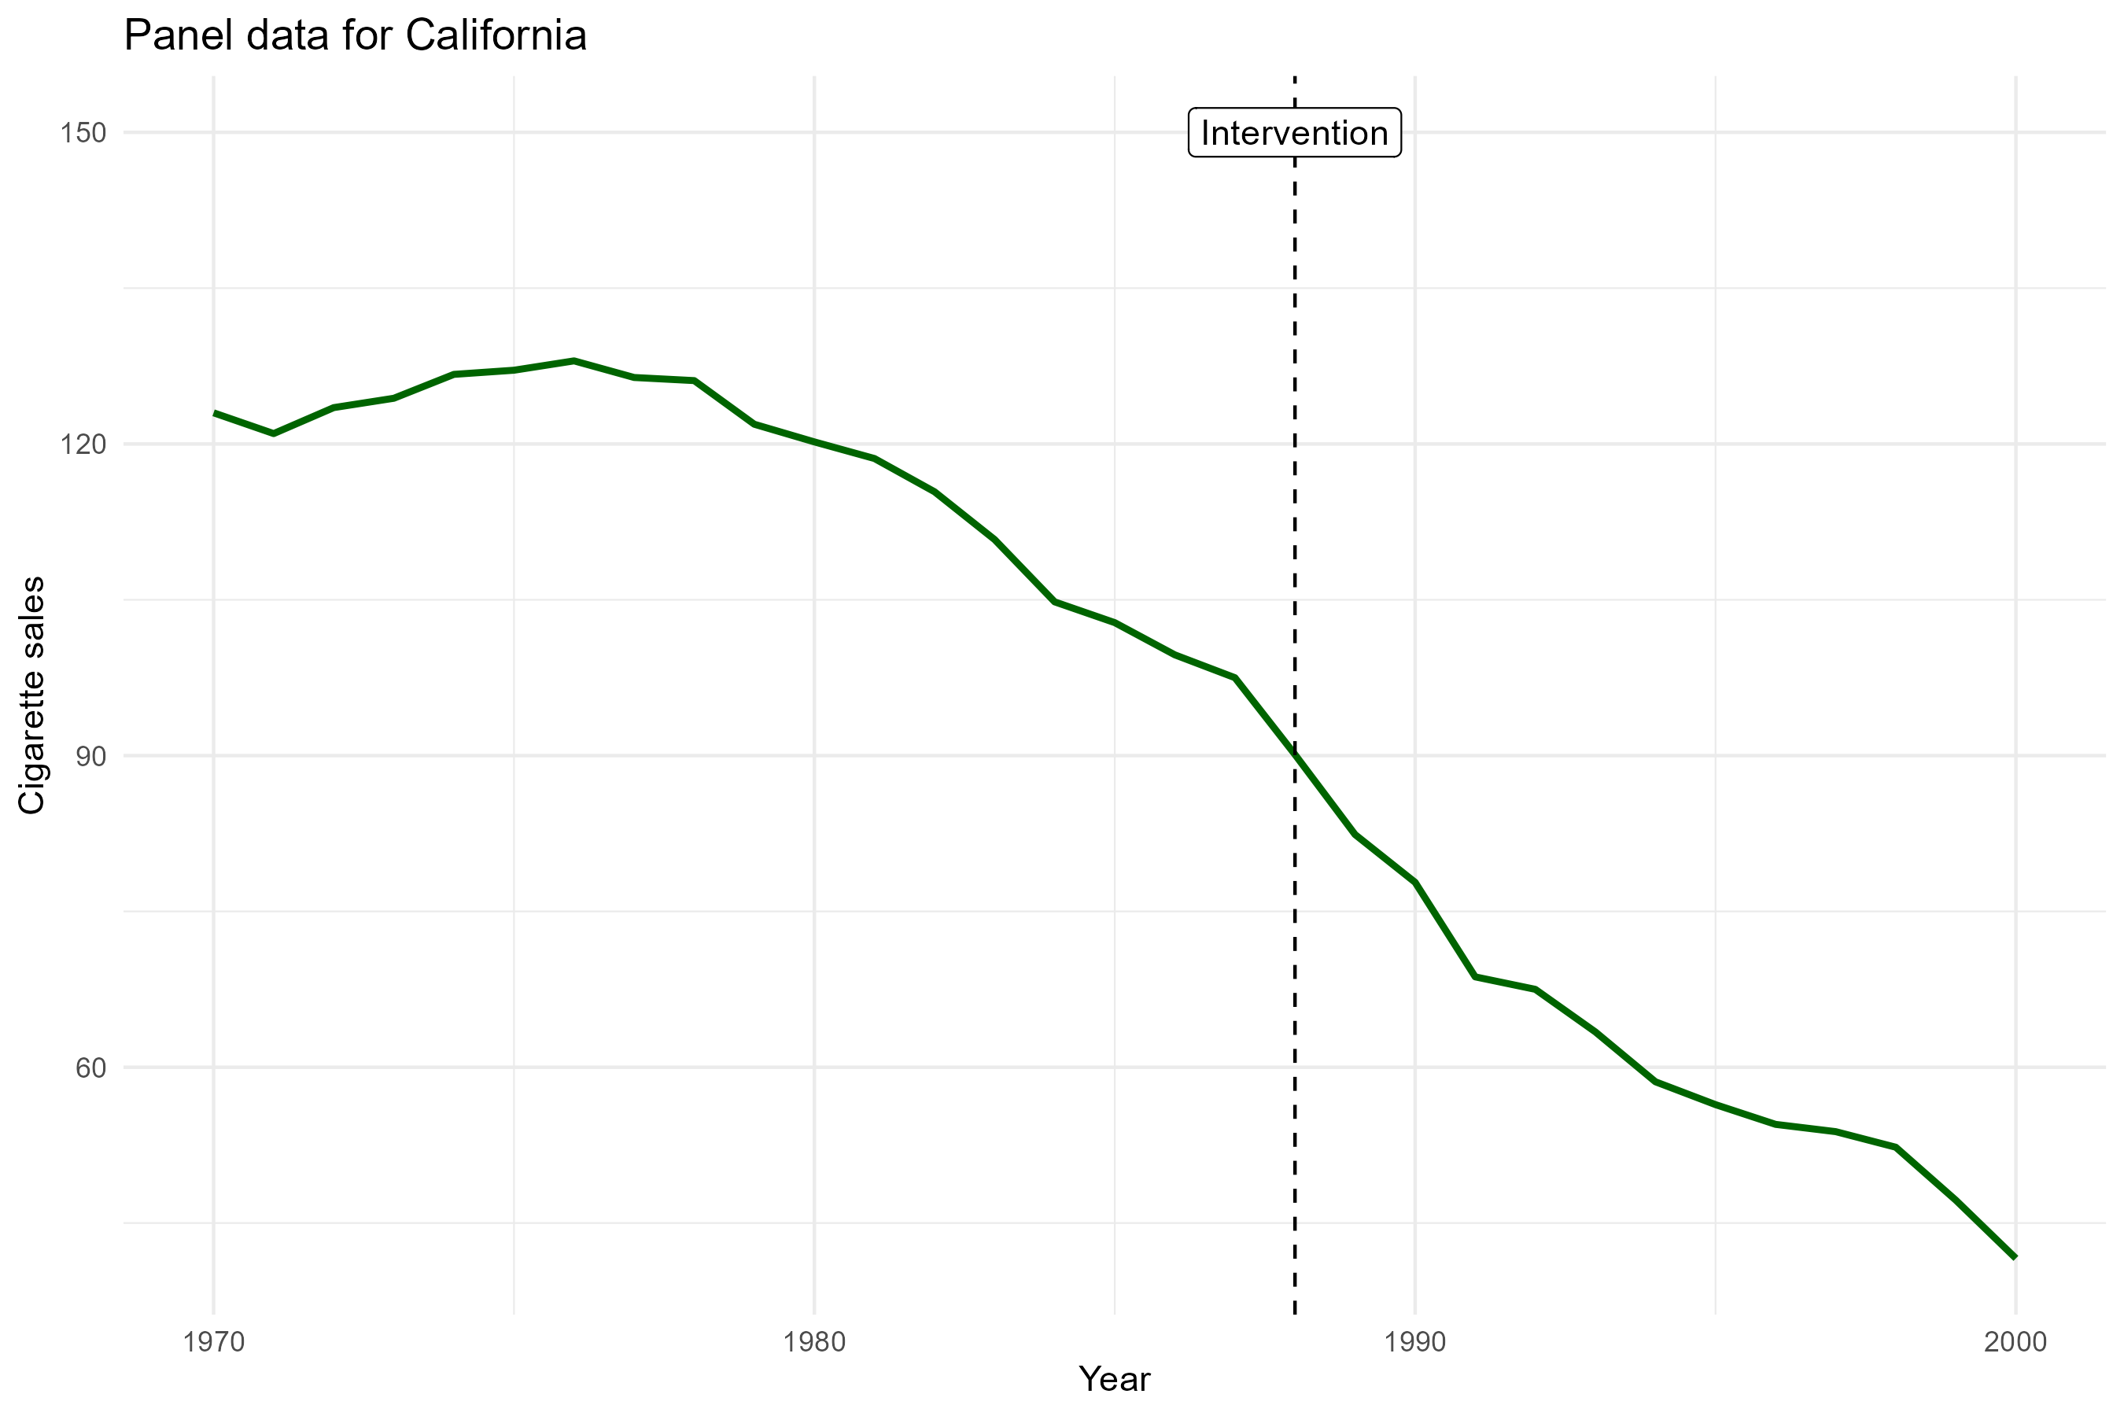
Pre-post estimator
We use only the cigarette sales time series for California

Slide 13
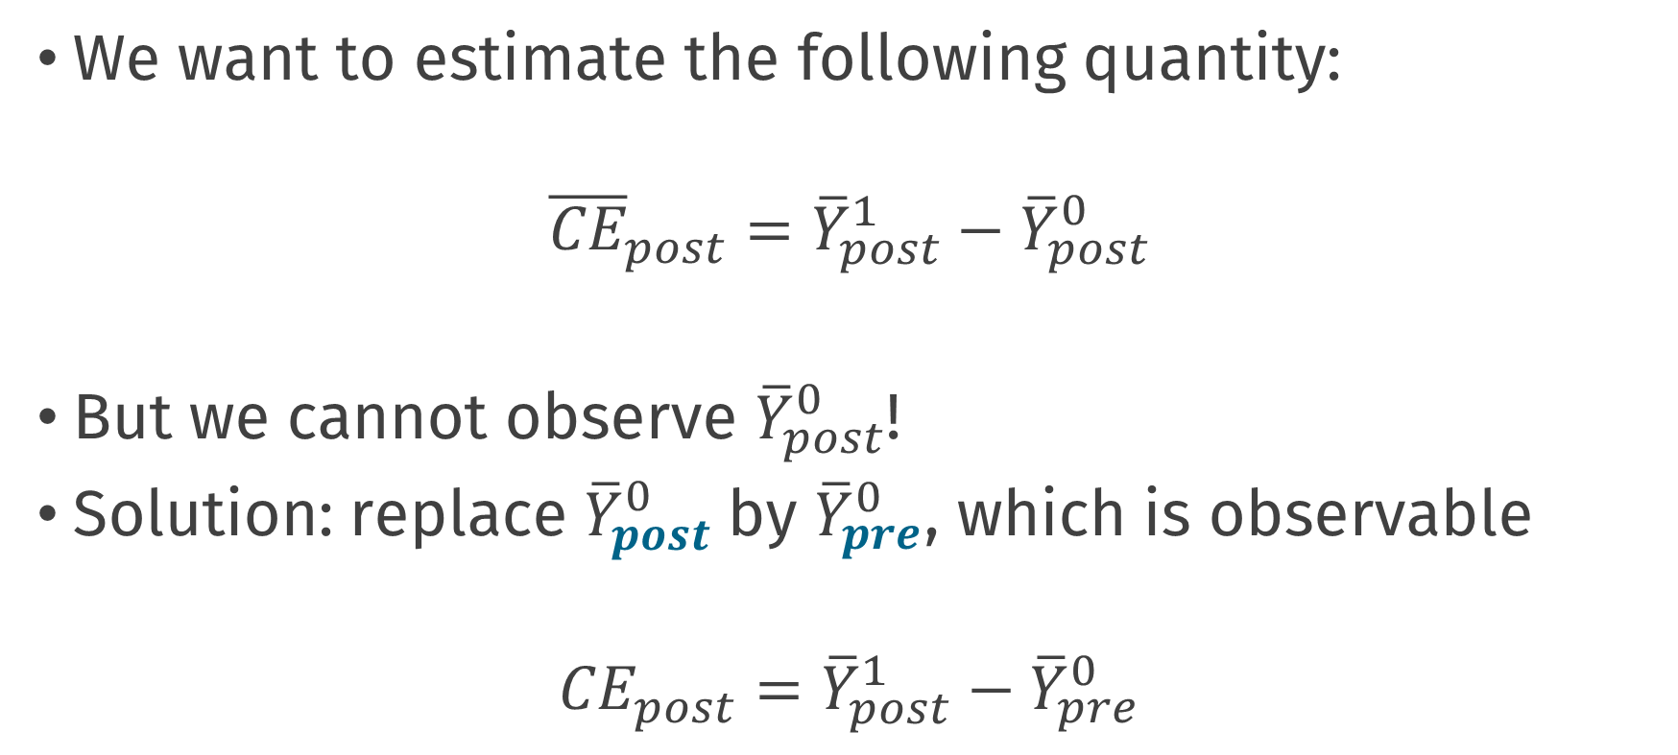
Pre-post estimator
We want to estimate the following quantity:
$${\overline{CE}}_{post}={\overline{Y}}_{post}^{1}−{\overline{Y}}_{post}^{0}$$
But we cannot observe ${\overline{Y}}_{post}^{0}$!
Solution: replace ${\overline{Y}}_{post}^{0}$by ${\overline{Y}}_{pre}^{0}$, which is observable
$${CE}_{post}={\overline{Y}}_{post}^{1}−{\overline{Y}}_{pre}^{0}$$
Notes:
OR note: Should we define this in words? Change in the average number of cigarette sales in the years that follow the intervention, relative to what we would have expected average cigarette sales to be in the absence of an intervention
Also, note here, no “bar” over the latter quantity, maybe just also remove it from the first?; we also use different notation (Expected values, post and pre vs t, s)

Slide 14
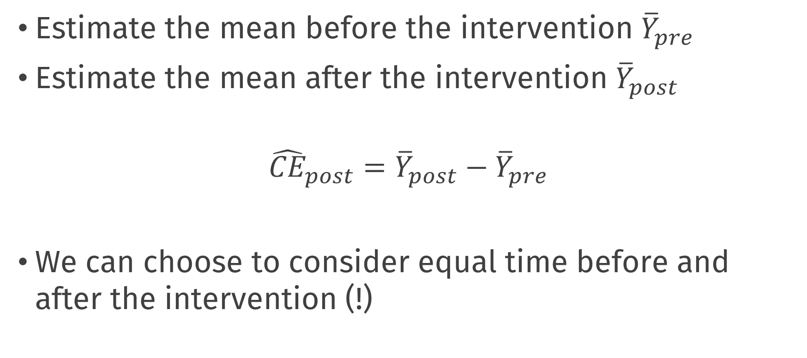
Pre-post estimator
Estimate the mean before the intervention ${\overline{Y}}_{pre}$
Estimate the mean after the intervention ${\overline{Y}}_{post}$
$${\hat{CE}}_{post}={\overline{Y}}_{post}−{\overline{Y}}_{pre}$$
We can choose to consider equal time before and after the intervention (!)

Slide 15
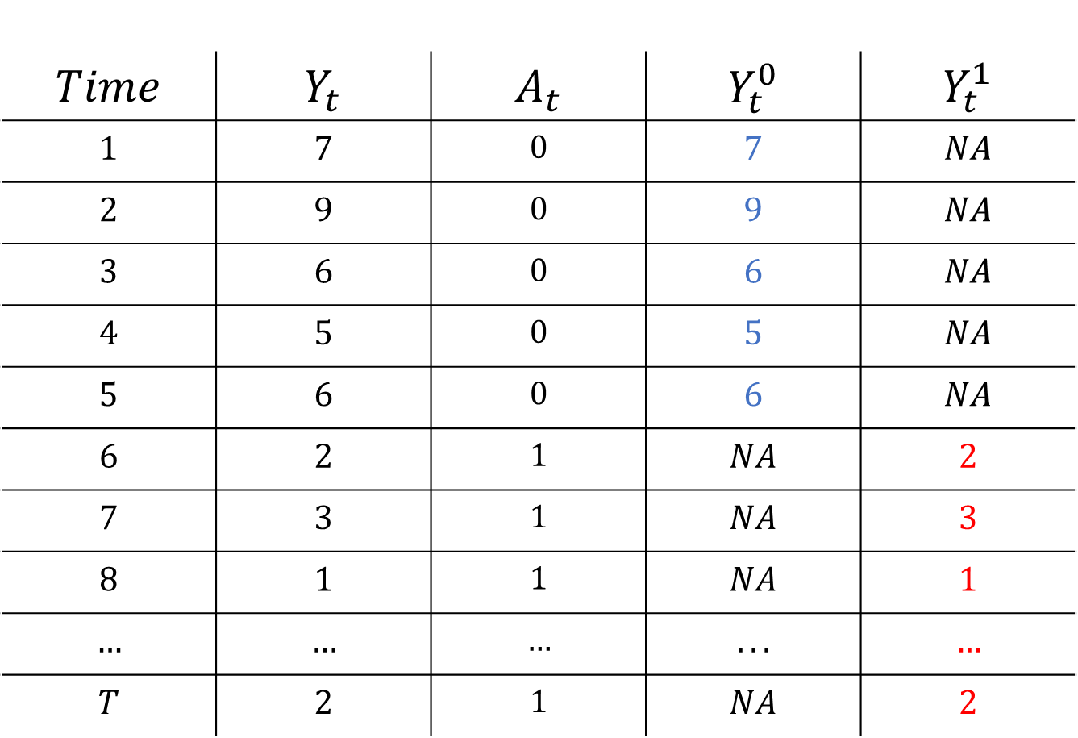
$$Time$$ | $$Y_{t}$$ | $$A_{t}$$ | $$Y_{t}^{0}$$ | $$Y_{t}^{1}$$
$$1$$ | $$7$$ | $$0$$ | $$7$$ | $$NA$$
$$2$$ | $$9$$ | $$0$$ | $$9$$ | $$NA$$
$$3$$ | $$6$$ | $$0$$ | $$6$$ | $$NA$$
$$4$$ | $$5$$ | $$0$$ | $$5$$ | $$NA$$
$$5$$ | $$6$$ | $$0$$ | $$6$$ | $$NA$$
$$6$$ | $$2$$ | $$1$$ | $$NA$$ | $$2$$
$$7$$ | $$3$$ | $$1$$ | $$NA$$ | $$3$$
$$8$$ | $$1$$ | $$1$$ | $$NA$$ | $$1$$
$$…$$ | $$…$$ | $$…$$ | $$...$$ | $$…$$
$$T$$ | $$2$$ | $$1$$ | $$NA$$ | $$2$$

Slide 16
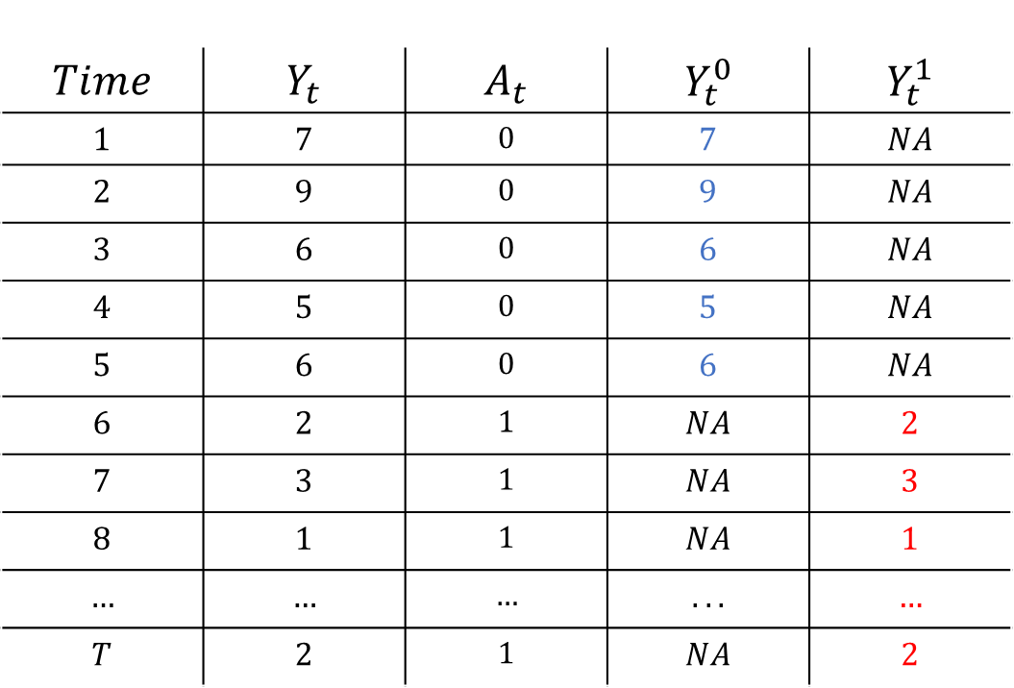
Pre – Post analysis
$$Time$$ | $$Y_{t}$$ | $$A_{t}$$ | $$Y_{t}^{0}$$ | $$Y_{t}^{1}$$
$$1$$ | $$7$$ | $$0$$ | $$7$$ | $$NA$$
$$2$$ | $$9$$ | $$0$$ | $$9$$ | $$NA$$
$$3$$ | $$6$$ | $$0$$ | $$6$$ | $$NA$$
$$4$$ | $$5$$ | $$0$$ | $$5$$ | $$NA$$
$$5$$ | $$6$$ | $$0$$ | $$6$$ | $$NA$$
$$6$$ | $$2$$ | $$1$$ | $$NA$$ | $$2$$
$$7$$ | $$3$$ | $$1$$ | $$NA$$ | $$3$$
$$8$$ | $$1$$ | $$1$$ | $$NA$$ | $$1$$
$$…$$ | $$…$$ | $$…$$ | $$...$$ | $$…$$
$$T$$ | $$2$$ | $$1$$ | $$NA$$ | $$2$$
$${\overline{Y}}_{pre}^{0}$$
$${\overline{Y}}_{post}^{1}$$

Slide 17

Pre – Post analysis
$$Time$$ | $$Y_{t}$$ | $$A_{t}$$ | $$Y_{t}^{0}$$ | $$Y_{t}^{1}$$
$$1$$ | $$7$$ | $$0$$ | $$7$$ | $$NA$$
$$2$$ | $$9$$ | $$0$$ | $$9$$ | $$NA$$
$$3$$ | $$6$$ | $$0$$ | $$6$$ | $$NA$$
$$4$$ | $$5$$ | $$0$$ | $$5$$ | $$NA$$
$$5$$ | $$6$$ | $$0$$ | $$6$$ | $$NA$$
$$6$$ | $$2$$ | $$1$$ | $$NA$$ | $$2$$
$$7$$ | $$3$$ | $$1$$ | $$NA$$ | $$3$$
$$8$$ | $$1$$ | $$1$$ | $$NA$$ | $$1$$
$$…$$ | $$…$$ | $$…$$ | $$...$$ | $$…$$
$$T$$ | $$2$$ | $$1$$ | $$NA$$ | $$2$$
$${\overline{Y}}_{pre}^{0}$$
Assume equal to
$${\overline{Y}}_{post}^{1}$$
$${ − \overline{Y}}_{post}^{0}$$
$${\overline{CE}}_{post}={\overline{Y}}_{post}^{1}−{\overline{Y}}_{post}^{0}$$

Slide 18
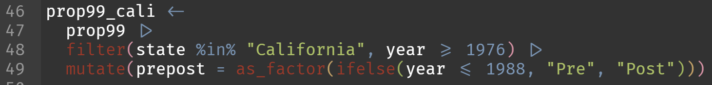
Pre-post estimator
Filter & compute pre-post factor variable
Compute the pre-post difference

Slide 19
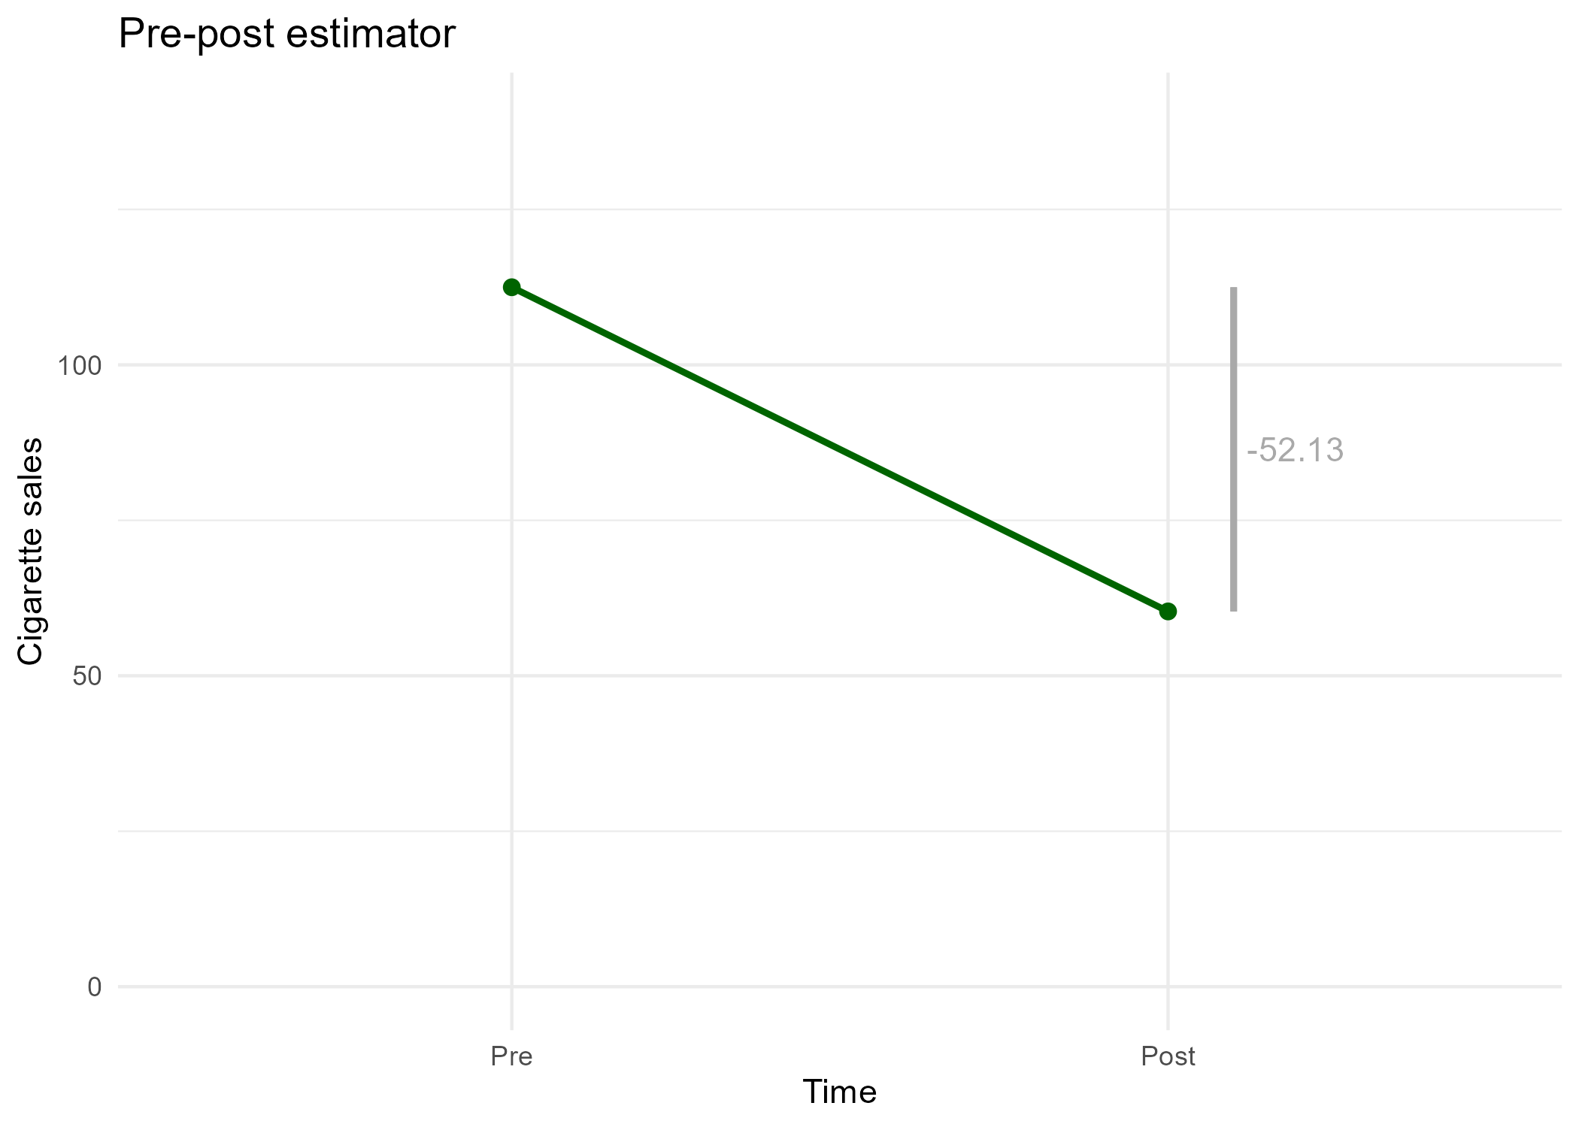
Pre-post estimator

Slide 20

Pre-post estimator
But what about uncertainty?
Use linear regression / OLS to compute $\hat{CE}$

Slide 21
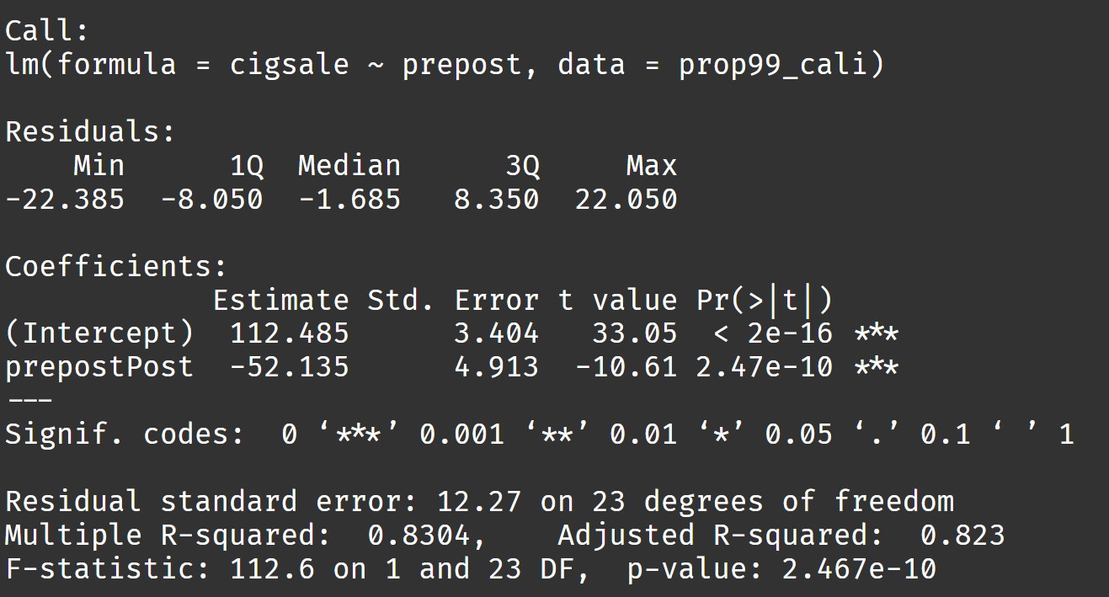
Pre-post estimator
Result:
Standard errors
assume no
autocorrelation
(!)
Notes:
OR: Here the variance is coming from the fact that you don’t feed the means in, but instead the raw data, which are now treated as observations from two groups
Maybe here we could include the “data” type slide, or do you do that in the practical? See my part 1 slides

Slide 22
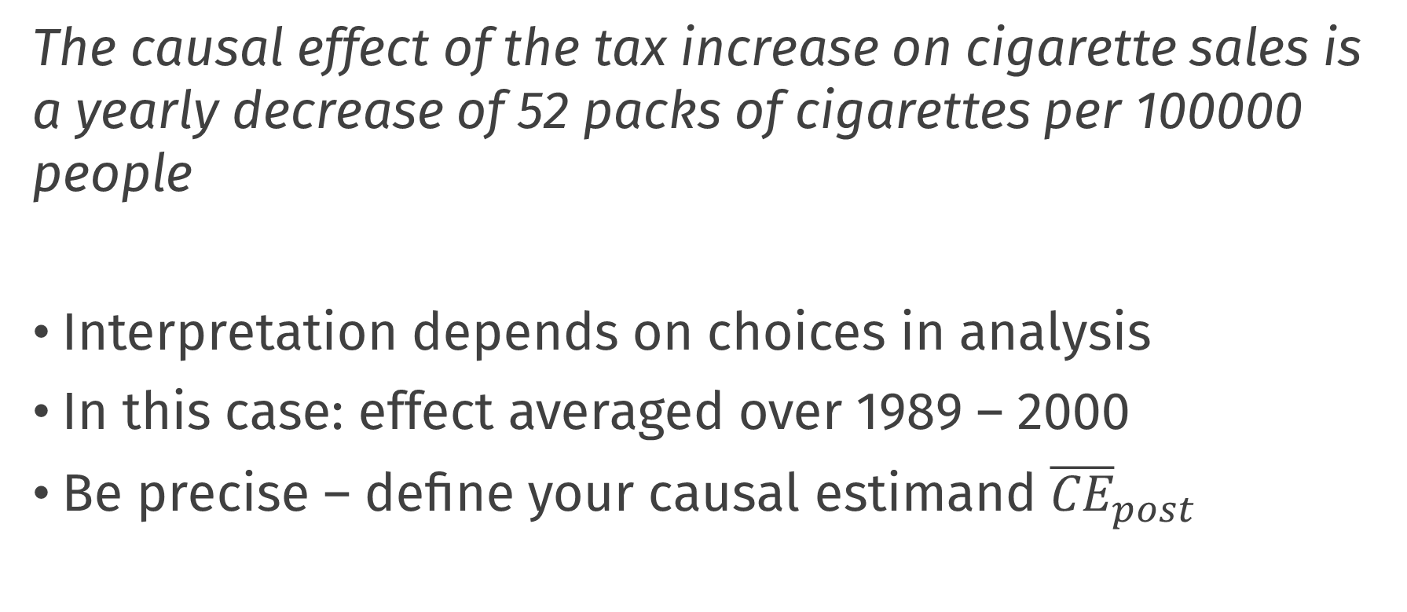
Pre-post estimator
The causal effect of the tax increase on cigarette sales is a yearly decrease of 52 packs of cigarettes per 100000 people
Interpretation depends on choices in analysis
In this case: effect averaged over 1989 – 2000
Be precise – define your causal estimand ${\overline{CE}}_{post}$

Slide 23
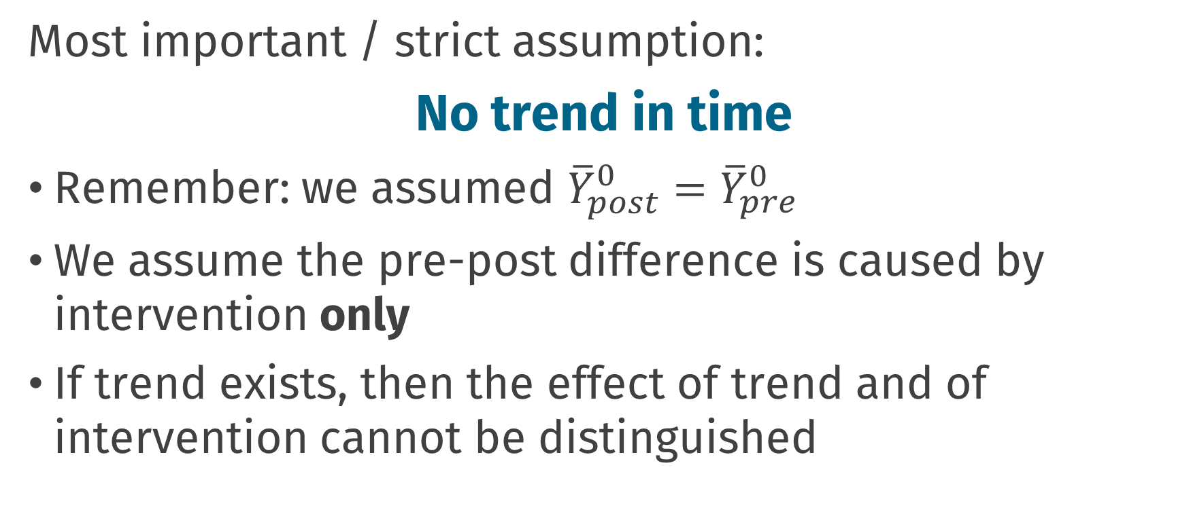
Pre-post estimator
Most important / strict assumption:
No trend in time
Remember: we assumed ${\overline{Y}}_{post}^{0}={\overline{Y}}_{pre}^{0}$
We assume the pre-post difference is caused by intervention only
If trend exists, then the effect of trend and of intervention cannot be distinguished

Slide 24
Pre-post estimator
Is there a trend in time, independent of the intervention?
How much of pre-post difference is caused by intervention?

Slide 25
Difference-in-differences

Slide 26
Difference-in-differences
,,transparent and often at least superficially plausible”
Used a lot in economics
There is a lot of discussion around this topic
We will explain the basic method here
There are a lot of possible extensions!
Angrist, J. D. and Krueger, A. B. (1999). Empirical strategies in labor economics. In Handbook of labor economics, volume 3, pages 1277–1366. Elsevier.

Slide 27
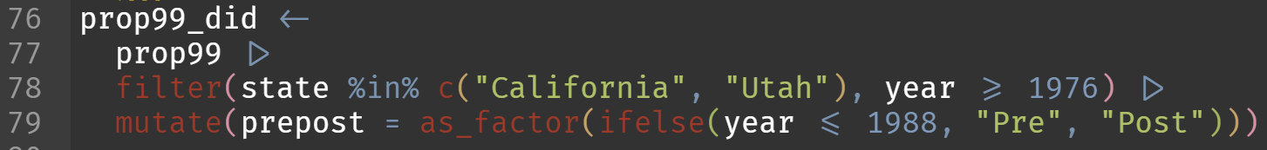
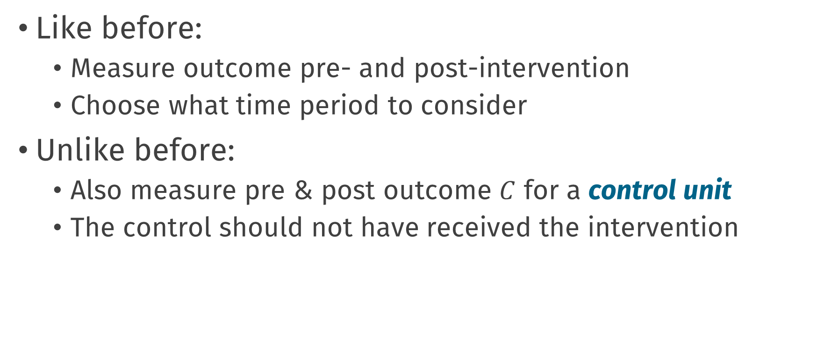
Difference-in-differences
Like before:
Measure outcome pre- and post-intervention
Choose what time period to consider
Unlike before:
Also measure pre & post outcome $C$ for a control unit
The control should not have received the intervention

Slide 28
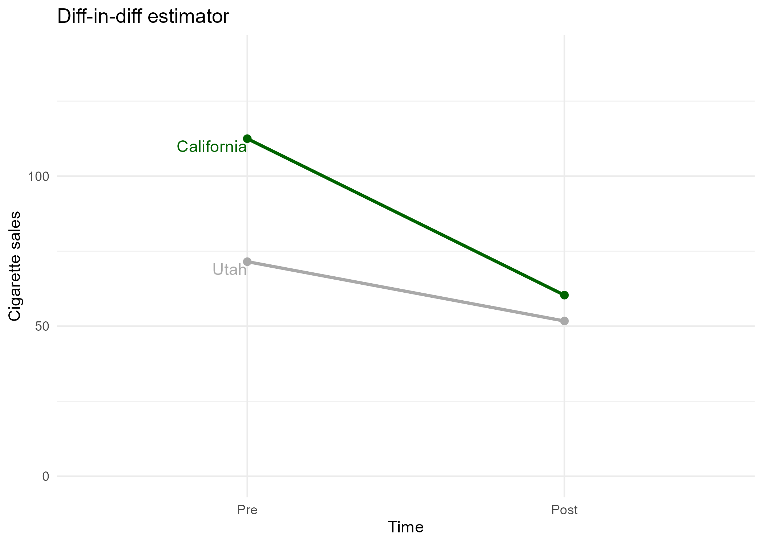
Difference-in-differences

Slide 29
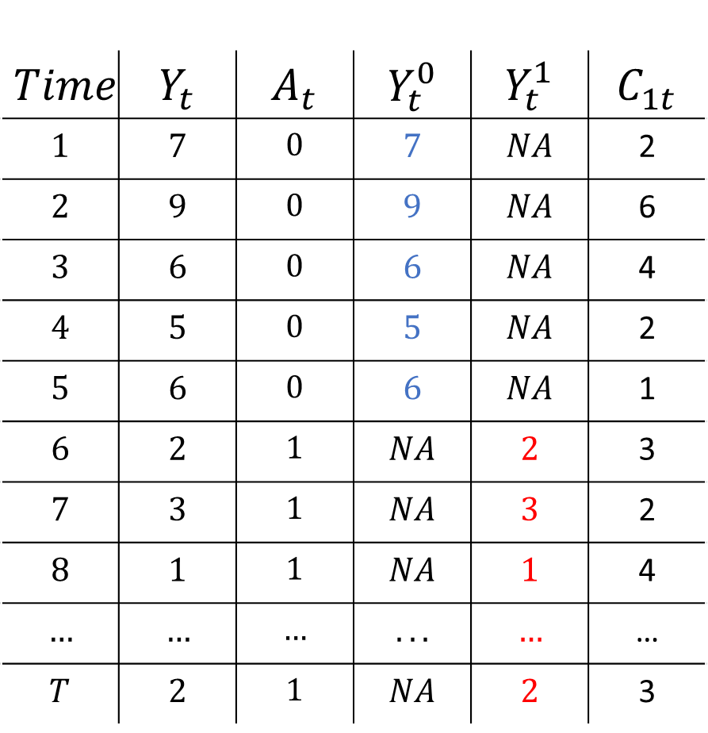
$$Time$$ | $$Y_{t}$$ | $$A_{t}$$ | $$Y_{t}^{0}$$ | $$Y_{t}^{1}$$ | $$C_{1t}$$
$$1$$ | $$7$$ | $$0$$ | $$7$$ | $$NA$$ | 2
$$2$$ | $$9$$ | $$0$$ | $$9$$ | $$NA$$ | 6
$$3$$ | $$6$$ | $$0$$ | $$6$$ | $$NA$$ | 4
$$4$$ | $$5$$ | $$0$$ | $$5$$ | $$NA$$ | 2
$$5$$ | $$6$$ | $$0$$ | $$6$$ | $$NA$$ | 1
$$6$$ | $$2$$ | $$1$$ | $$NA$$ | $$2$$ | 3
$$7$$ | $$3$$ | $$1$$ | $$NA$$ | $$3$$ | 2
$$8$$ | $$1$$ | $$1$$ | $$NA$$ | $$1$$ | 4
$$…$$ | $$…$$ | $$…$$ | $$...$$ | $$…$$ | …
$$T$$ | $$2$$ | $$1$$ | $$NA$$ | $$2$$ | 3

Slide 30
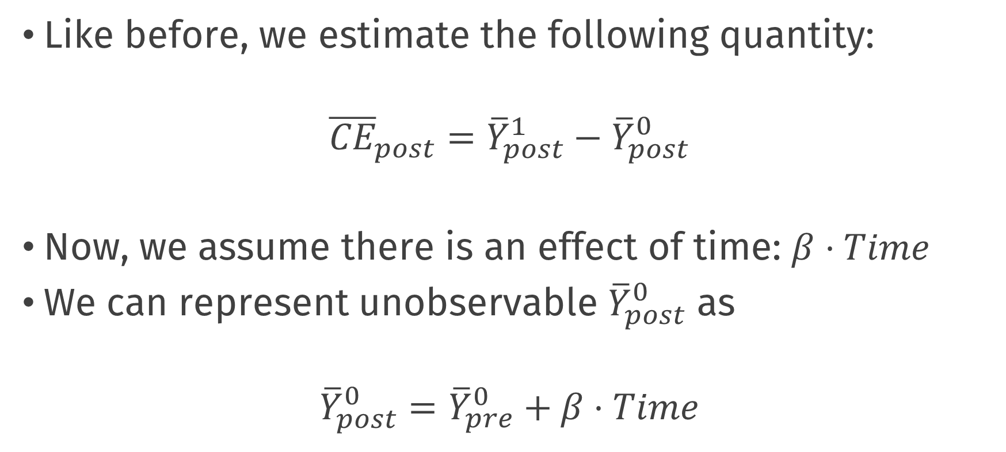
Pre-post estimator
Like before, we estimate the following quantity:
$${\overline{CE}}_{post}={\overline{Y}}_{post}^{1}−{\overline{Y}}_{post}^{0}$$
Now, we assume there is an effect of time: $β⋅Time$
We can represent unobservable ${\overline{Y}}_{post}^{0}$ as
$${\overline{Y}}_{post}^{0}={\overline{Y}}_{pre}^{0}+β⋅Time$$

Slide 31
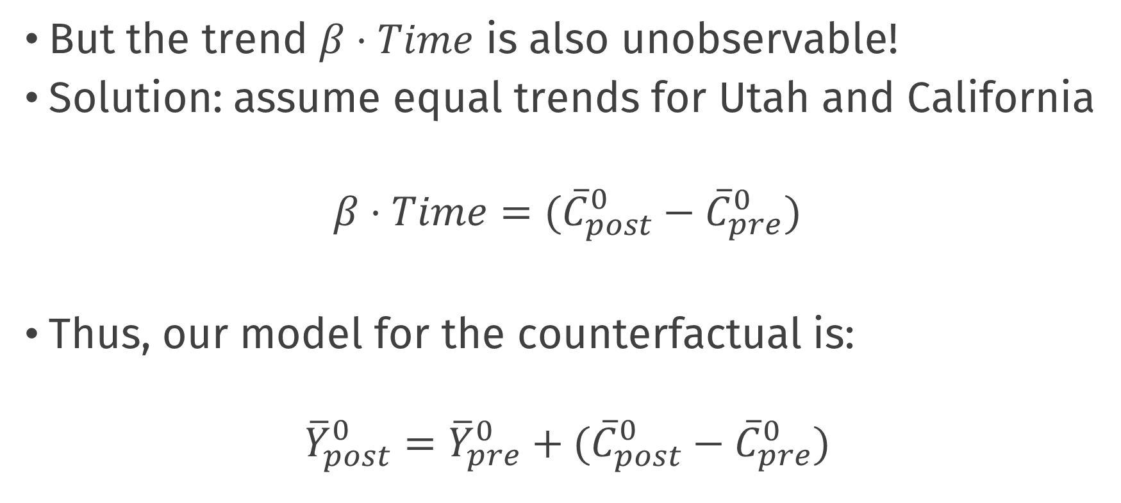
Pre-post estimator
But the trend $β⋅Time$ is also unobservable!
Solution: assume equal trends for Utah and California
$$β⋅Time=({\overline{C}}_{post}^{0}−{\overline{C}}_{pre}^{0})$$
Thus, our model for the counterfactual is:
$${\overline{Y}}_{post}^{0}={\overline{Y}}_{pre}^{0}+({\overline{C}}_{post}^{0}−{\overline{C}}_{pre}^{0})$$

Slide 32
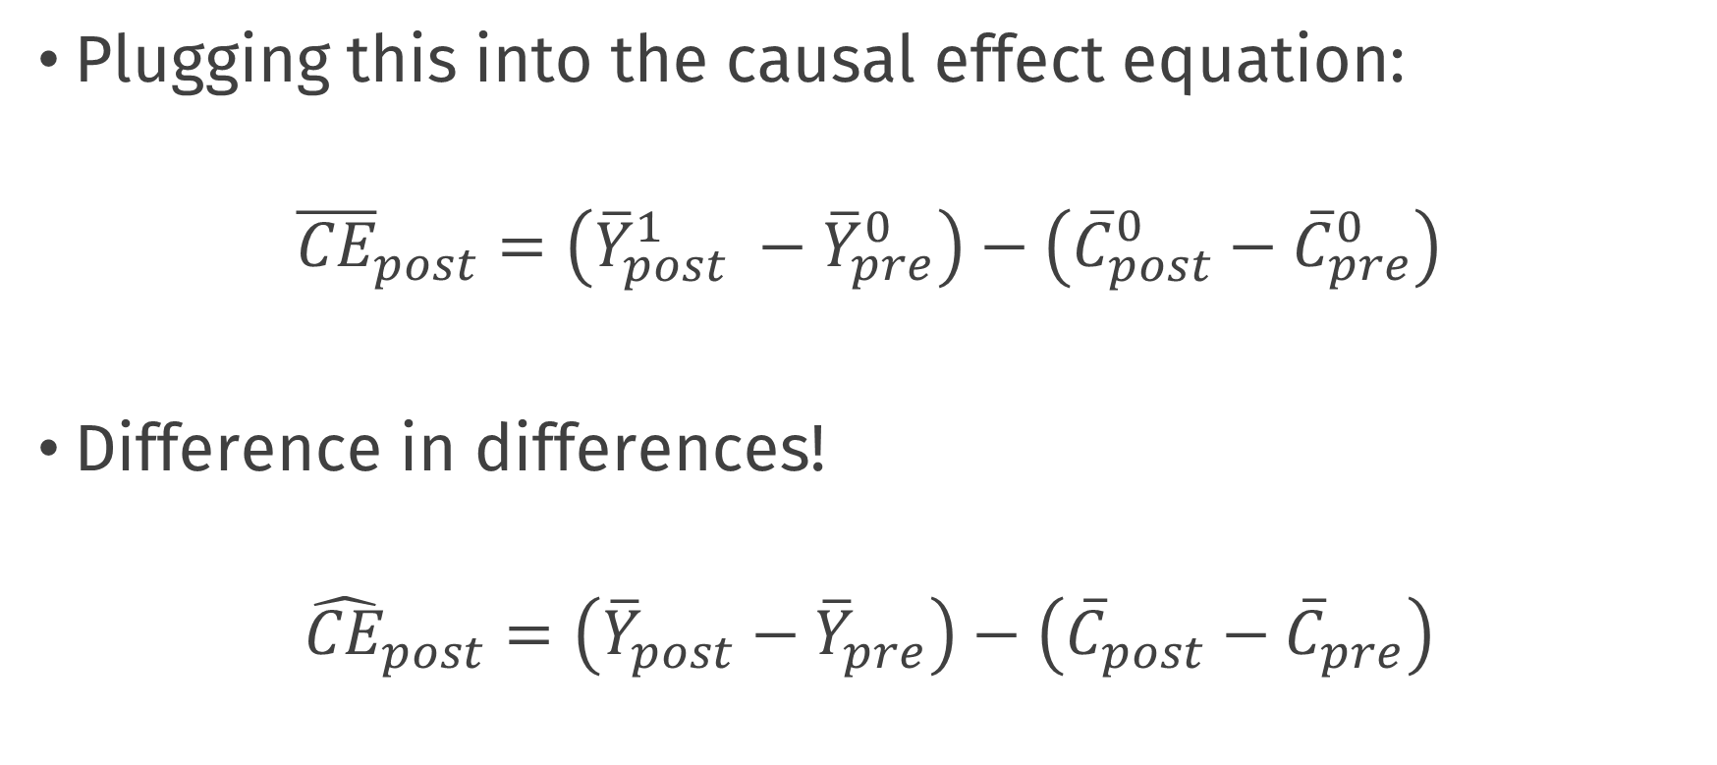
Pre-post estimator
Plugging this into the causal effect equation:
$${\overline{CE}}_{post}=\left({\overline{Y}}_{post}^{1} −{\overline{Y}}_{pre}^{0}\right)−\left({\overline{C}}_{post}^{0}−{\overline{C}}_{pre}^{0}\right)$$
Difference in differences!
$${\hat{CE}}_{post}=\left({\overline{Y}}_{post}−{\overline{Y}}_{pre}\right)−\left({\overline{C}}_{post}−{\overline{C}}_{pre}\right)$$

Slide 33
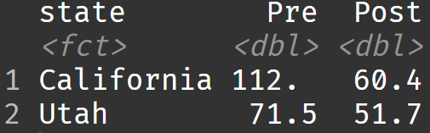
Difference-in-differences
CE = (Cali_post – Cali_pre) – (Utah_post – Utah_pre)
(60.4 - 112)-(51.7 - 71.5) = -32.3

Slide 34
Difference-in-differences

Slide 35




Difference-in-differences
$${\overline{Y}}_{pre}^{0}$$
$${\overline{Y}}_{post}^{1}$$
$${\overline{C}}_{pre}^{0}$$
$${\overline{C}}_{post}^{0}$$

Slide 36
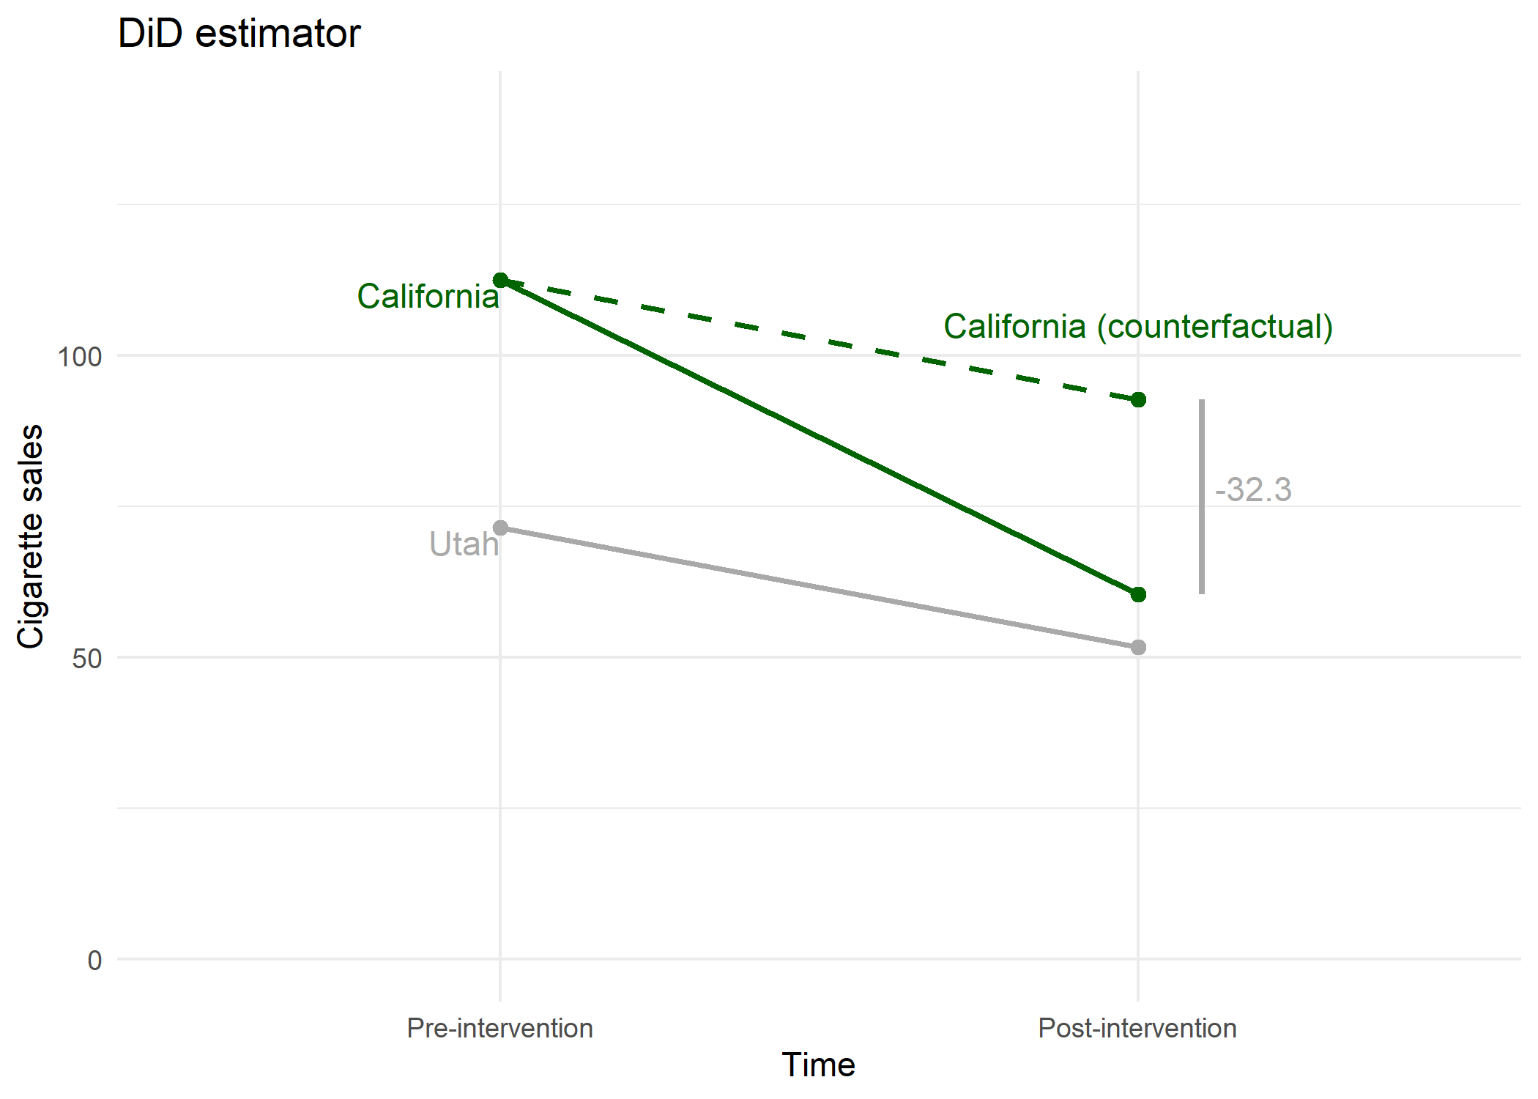

Difference-in-differences
$${\overline{Y}}_{pre}^{0}$$
$${\overline{Y}}_{post}^{0}$$
$${\overline{Y}}_{post}^{1}$$
$${\overline{C}}_{pre}^{0}$$
$${\overline{C}}_{post}^{0}$$

Slide 37
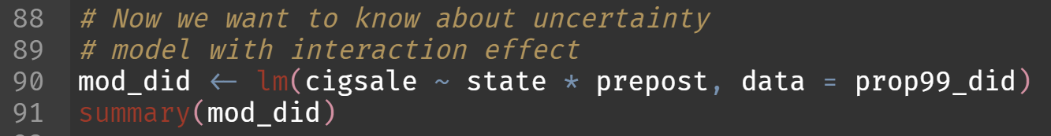
Difference-in-differences
But what about uncertainty?
Use linear regression / OLS to compute $\hat{CE}$

Slide 38
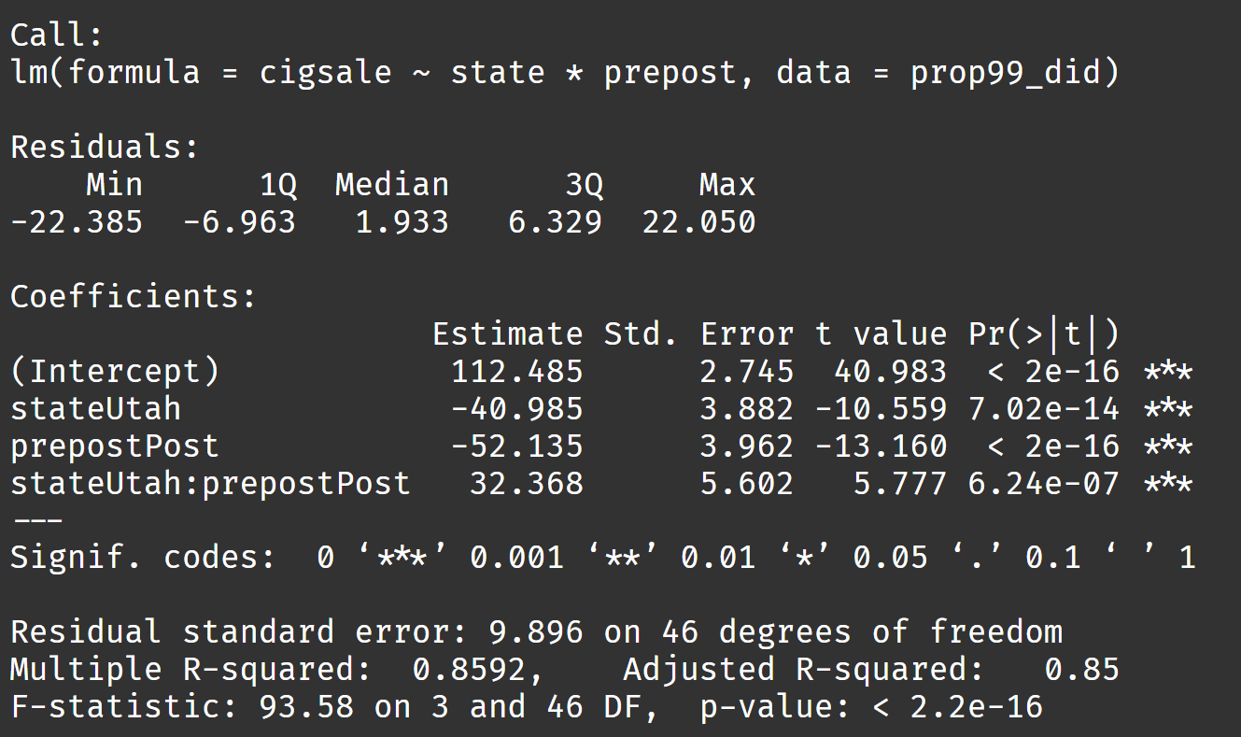
Difference-in-differences
Standard errors
assume no
autocorrelation
(!)

Slide 39
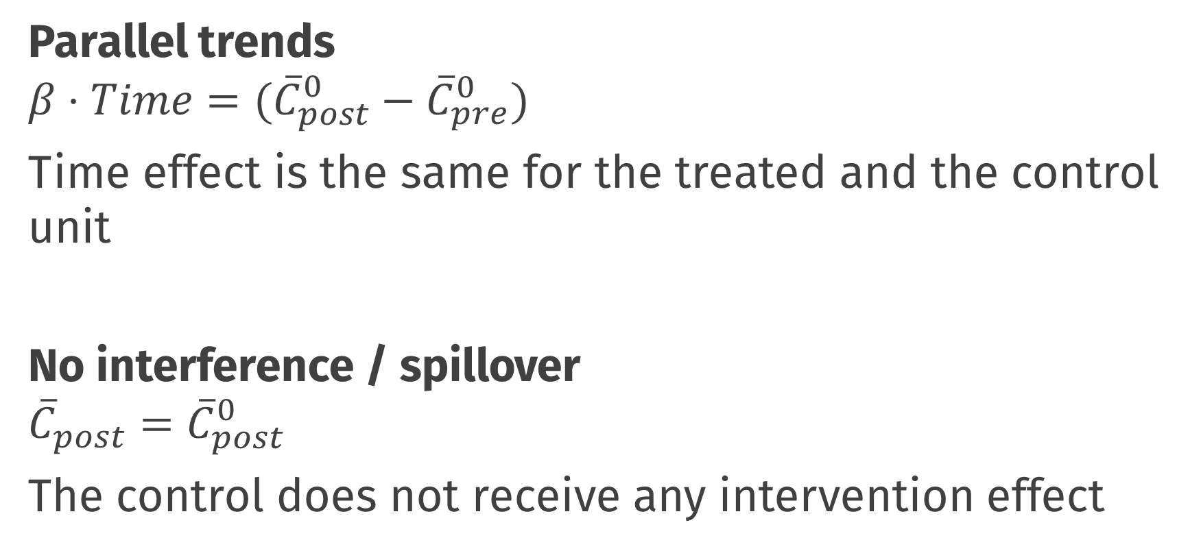
Most important assumptions
Parallel trends
$$β⋅Time=({\overline{C}}_{post}^{0}−{\overline{C}}_{pre}^{0})$$
Time effect is the same for the treated and the control unit
No interference / spillover
$${{\overline{C}}_{post}=\overline{C}}_{post}^{0}$$
The control does not receive any intervention effect
Notes:
OR: No interference; the fact that California has a smoking ban has no effect on cigarette sales in Utah (cig sales Utah is the same as it would be if California had no cigarette ban). Can we think of any problems with this? For example, Utah might also follow suit to the nearby state and not allow smoking… people living in Utah might work in California, etc… bias in either direction possible

Slide 40
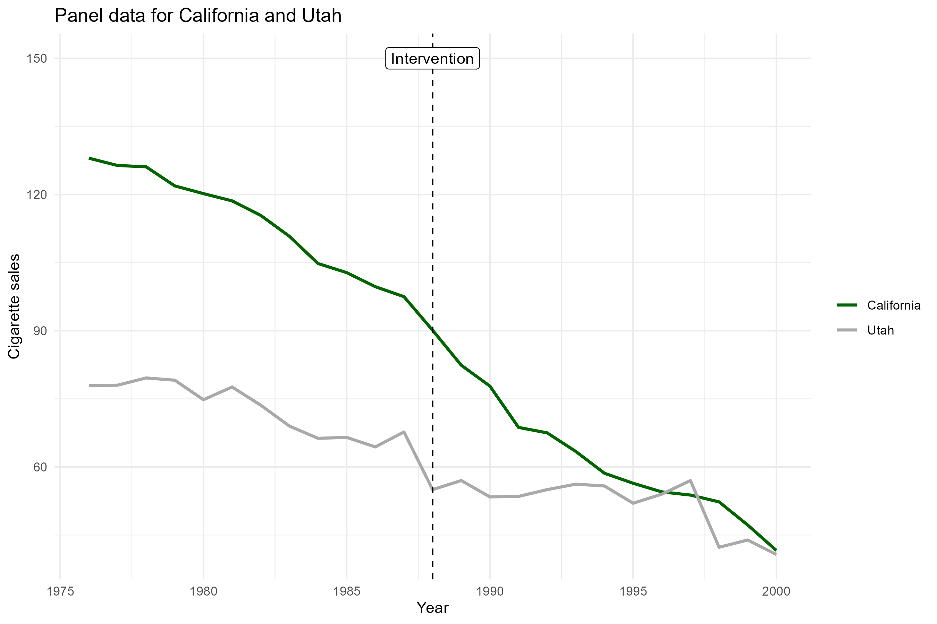
Most important assumptions
Can we assume parallel trends?
At least superficially plausible ☺

Slide 41
Practical: data, pre-post, DiD
Work in pairs!
Take a break from 10:30 to 10:45

Slide 42
Break

Slide 43
Default light slide
Default subheading
This is the body of the text
Default subheading
Note that the text is not black, but “black, text 1, lighter 25%”
Default subheading
This makes things easier on the eyes
Default subheading
This is the body of the text

Slide 44
Default dark slide
Default subheading
The dark slide brings some variation
Default subheading
It can highlight important aspects of the presentation.
Default subheading
This is the body of the text
Default subheading
This is the body of the text

Slide 45
Is this an impact slide?

Slide 46
Here is an impactful slide with a sentence on it.
Here is a topic related to the aforementioned question.

Slide 47
Questions?

