Slide 1
Interrupted Time Series & Regression Discontinuity

Slide 2
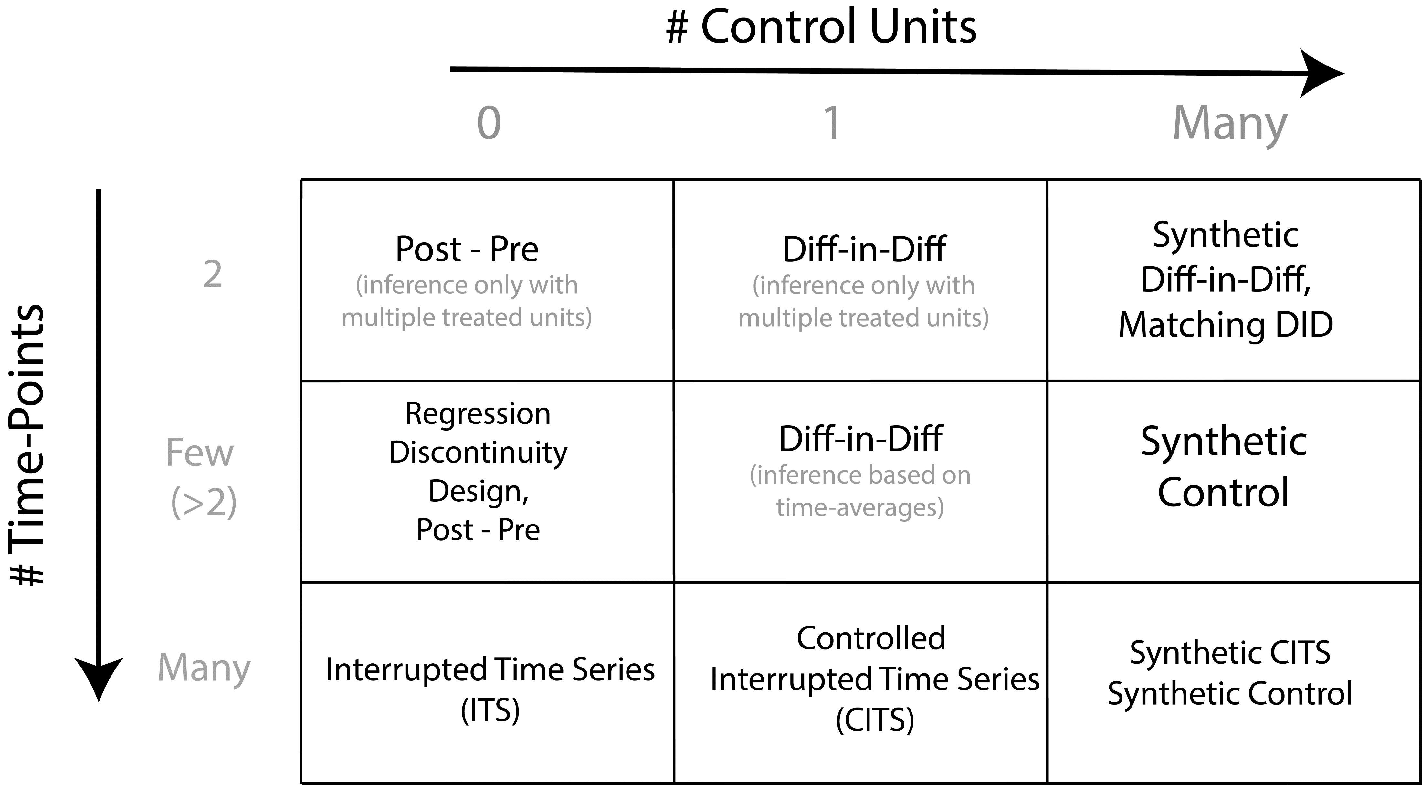

Slide 6
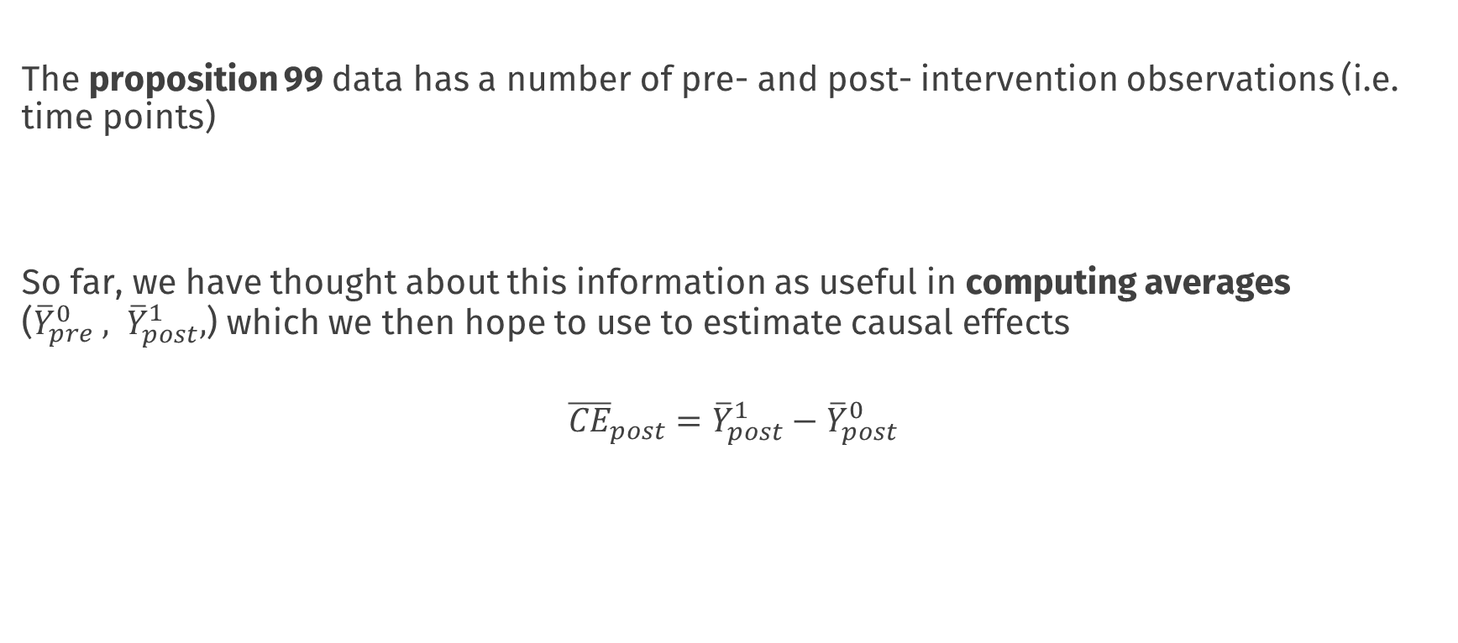
The story so far
The proposition 99 data has a number of pre- and post- intervention observations (i.e. time points)
So far, we have thought about this information as useful in computing averages (${\overline{Y}}_{pre}^{0} , {\overline{Y}}_{post}^{1},$) which we then hope to use to estimate causal effects
$${\overline{CE}}_{post}={\overline{Y}}_{post}^{1}−{\overline{Y}}_{post}^{0}$$

Slide 7
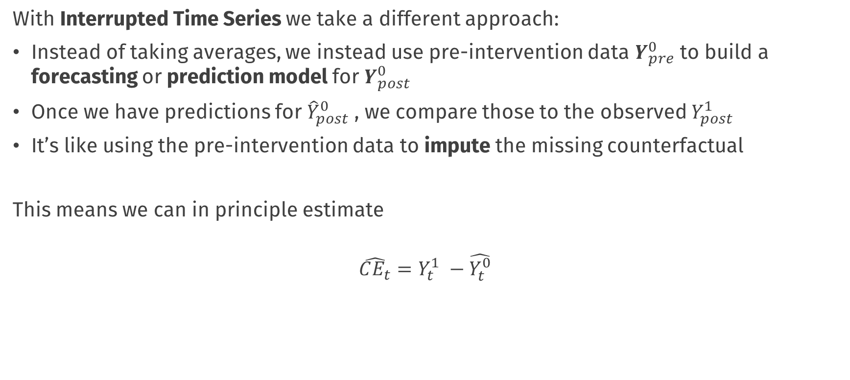
Interrupted Time Series
With Interrupted Time Series we take a different approach:
Instead of taking averages, we instead use pre-intervention data $Y_{pre}^{0}$ to build a forecasting or prediction model for $Y_{post}^{0}$
Once we have predictions for ${\hat{Y}}_{post}^{0}$ , we compare those to the observed $Y_{post}^{1}$
It’s like using the pre-intervention data to impute the missing counterfactual
This means we can in principle estimate
$$\hat{CE_{t}}=Y_{t}^{1} −\hat{Y_{t}^{0}}$$

Slide 8
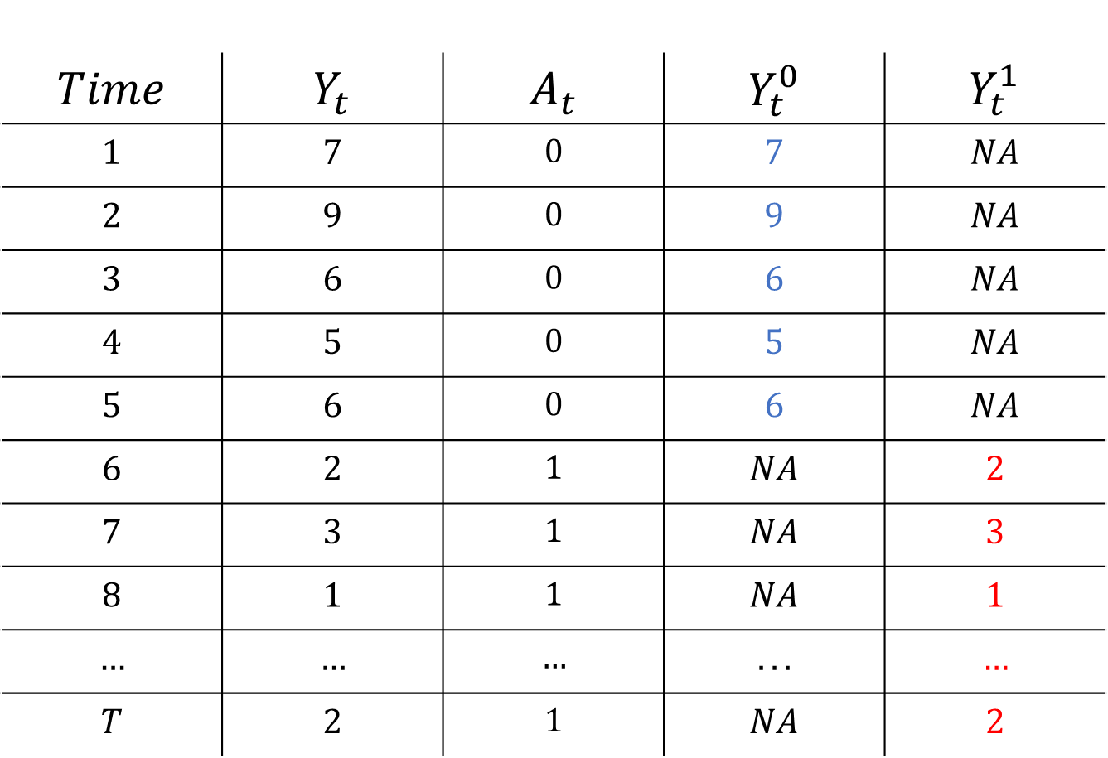
$$Time$$ | $$Y_{t}$$ | $$A_{t}$$ | $$Y_{t}^{0}$$ | $$Y_{t}^{1}$$
$$1$$ | $$7$$ | $$0$$ | $$7$$ | $$NA$$
$$2$$ | $$9$$ | $$0$$ | $$9$$ | $$NA$$
$$3$$ | $$6$$ | $$0$$ | $$6$$ | $$NA$$
$$4$$ | $$5$$ | $$0$$ | $$5$$ | $$NA$$
$$5$$ | $$6$$ | $$0$$ | $$6$$ | $$NA$$
$$6$$ | $$2$$ | $$1$$ | $$NA$$ | $$2$$
$$7$$ | $$3$$ | $$1$$ | $$NA$$ | $$3$$
$$8$$ | $$1$$ | $$1$$ | $$NA$$ | $$1$$
$$…$$ | $$…$$ | $$…$$ | $$...$$ | $$…$$
$$T$$ | $$2$$ | $$1$$ | $$NA$$ | $$2$$

Slide 9

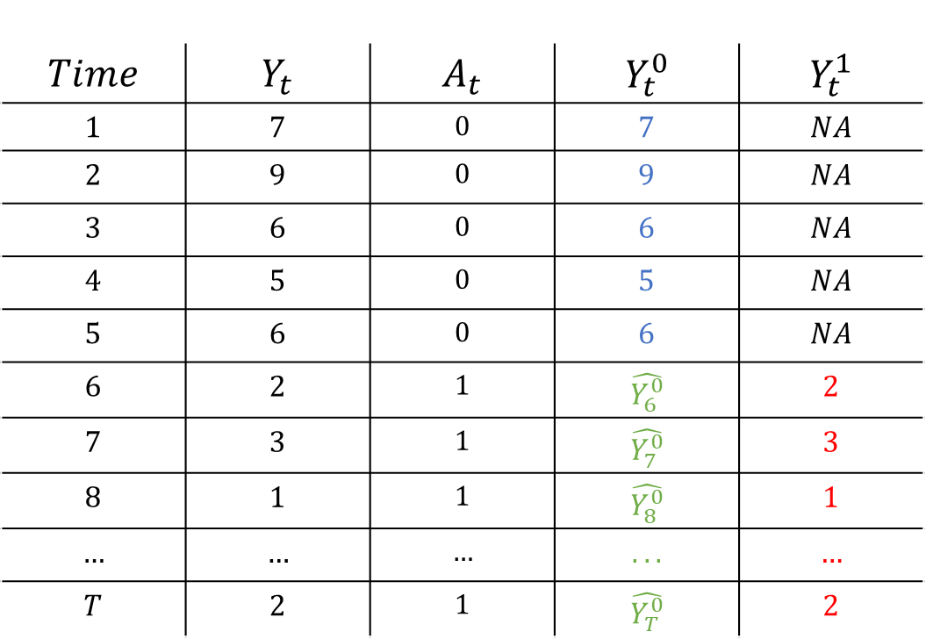
Interrupted Time Series
$$Time$$ | $$Y_{t}$$ | $$A_{t}$$ | $$Y_{t}^{0}$$ | $$Y_{t}^{1}$$
$$1$$ | $$7$$ | $$0$$ | $$7$$ | $$NA$$
$$2$$ | $$9$$ | $$0$$ | $$9$$ | $$NA$$
$$3$$ | $$6$$ | $$0$$ | $$6$$ | $$NA$$
$$4$$ | $$5$$ | $$0$$ | $$5$$ | $$NA$$
$$5$$ | $$6$$ | $$0$$ | $$6$$ | $$NA$$
$$6$$ | $$2$$ | $$1$$ | $$\hat{Y_{6}^{0}}$$ | $$2$$
$$7$$ | $$3$$ | $$1$$ | $$\hat{Y_{7}^{0}}$$ | $$3$$
$$8$$ | $$1$$ | $$1$$ | $$\hat{Y_{8}^{0}}$$ | $$1$$
$$…$$ | $$…$$ | $$…$$ | $$...$$ | $$…$$
$$T$$ | $$2$$ | $$1$$ | $$\hat{Y_{T}^{0}}$$ | $$2$$
Fit a forecasting Model
$$\hat{Y_{t}}=φ_{1}Y_{t−1}+φ_{2}Y_{t−2}+…β ∗ Time$$

Slide 10
Interrupted Time Series
$$Time$$ | $$Y_{t}$$ | $$A_{t}$$ | $$Y_{t}^{0}$$ | $$Y_{t}^{1}$$
$$1$$ | $$7$$ | $$0$$ | $$7$$ | $$NA$$
$$2$$ | $$9$$ | $$0$$ | $$9$$ | $$NA$$
$$3$$ | $$6$$ | $$0$$ | $$6$$ | $$NA$$
$$4$$ | $$5$$ | $$0$$ | $$5$$ | $$NA$$
$$5$$ | $$6$$ | $$0$$ | $$6$$ | $$NA$$
$$6$$ | $$2$$ | $$1$$ | $$\hat{Y_{6}^{0}}$$ | $$2$$
$$7$$ | $$3$$ | $$1$$ | $$\hat{Y_{7}^{0}}$$ | $$3$$
$$8$$ | $$1$$ | $$1$$ | $$\hat{Y_{8}^{0}}$$ | $$1$$
$$…$$ | $$…$$ | $$…$$ | $$...$$ | $$…$$
$$T$$ | $$2$$ | $$1$$ | $$\hat{Y_{T}^{0}}$$ | $$2$$
Fit a forecasting Model
$$\hat{Y_{t}}=φ_{1}Y_{t−1}+φ_{2}Y_{t−2}+…β ∗ Time$$
Make forecasts

Slide 11

Interrupted Time Series
$$Time$$ | $$Y_{t}$$ | $$A_{t}$$ | $$Y_{t}^{0}$$ | $$Y_{t}^{1}$$
$$1$$ | $$7$$ | $$0$$ | $$7$$ | $$NA$$
$$2$$ | $$9$$ | $$0$$ | $$9$$ | $$NA$$
$$3$$ | $$6$$ | $$0$$ | $$6$$ | $$NA$$
$$4$$ | $$5$$ | $$0$$ | $$5$$ | $$NA$$
$$5$$ | $$6$$ | $$0$$ | $$6$$ | $$NA$$
$$6$$ | $$2$$ | $$1$$ | $$\hat{Y_{6}^{0}}$$ | $$2$$
$$7$$ | $$3$$ | $$1$$ | $$\hat{Y_{7}^{0}}$$ | $$3$$
$$8$$ | $$1$$ | $$1$$ | $$\hat{Y_{8}^{0}}$$ | $$1$$
$$…$$ | $$…$$ | $$…$$ | $$...$$ | $$…$$
$$T$$ | $$2$$ | $$1$$ | $$\hat{Y_{T}^{0}}$$ | $$2$$
Fit a forecasting Model
$$\hat{Y_{t}}=φ_{1}Y_{t−1}+φ_{2}Y_{t−2}+…β ∗ Time$$
Make forecasts
$$\hat{CE_{t}}=Y_{t}^{1} −\hat{Y_{t}^{0}}$$

Slide 12
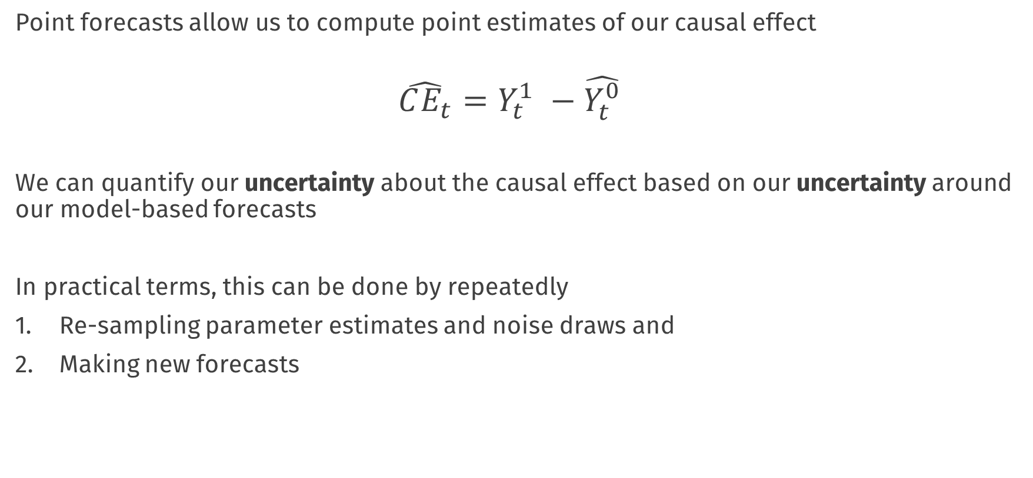
Interrupted Time Series
Point forecasts allow us to compute point estimates of our causal effect
$$\hat{CE_{t}}=Y_{t}^{1} −\hat{Y_{t}^{0}}$$
We can quantify our uncertainty about the causal effect based on our uncertainty around our model-based forecasts
In practical terms, this can be done by repeatedly
Re-sampling parameter estimates and noise draws and
Making new forecasts

Slide 13

Building a forecasting model
Much of the challenge of this approach is in choosing an appropriate forecasting model
These can be very simple or very complex, e.g.:
If we forecast with the mean we are very close to the post – pre analysis
$$Y_{t}=μ_{pre}+e_{t}$$

Slide 14


Building a forecasting model
Much of the challenge of this approach is in choosing an appropriate forecasting model
These can be very simple or very complex, e.g.:
If we forecast with the mean we are very close to the post – pre analysis
$$Y_{t}=μ_{pre}+e_{t}$$
We can forecast by fitting a growth curve which would model the overall time trend
$$Y_{t}=β_{0}+ β_{1} Time+e_{t}$$

Slide 15
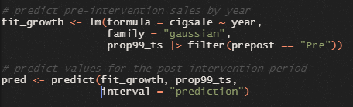
Forecasting with growth curves

Slide 16
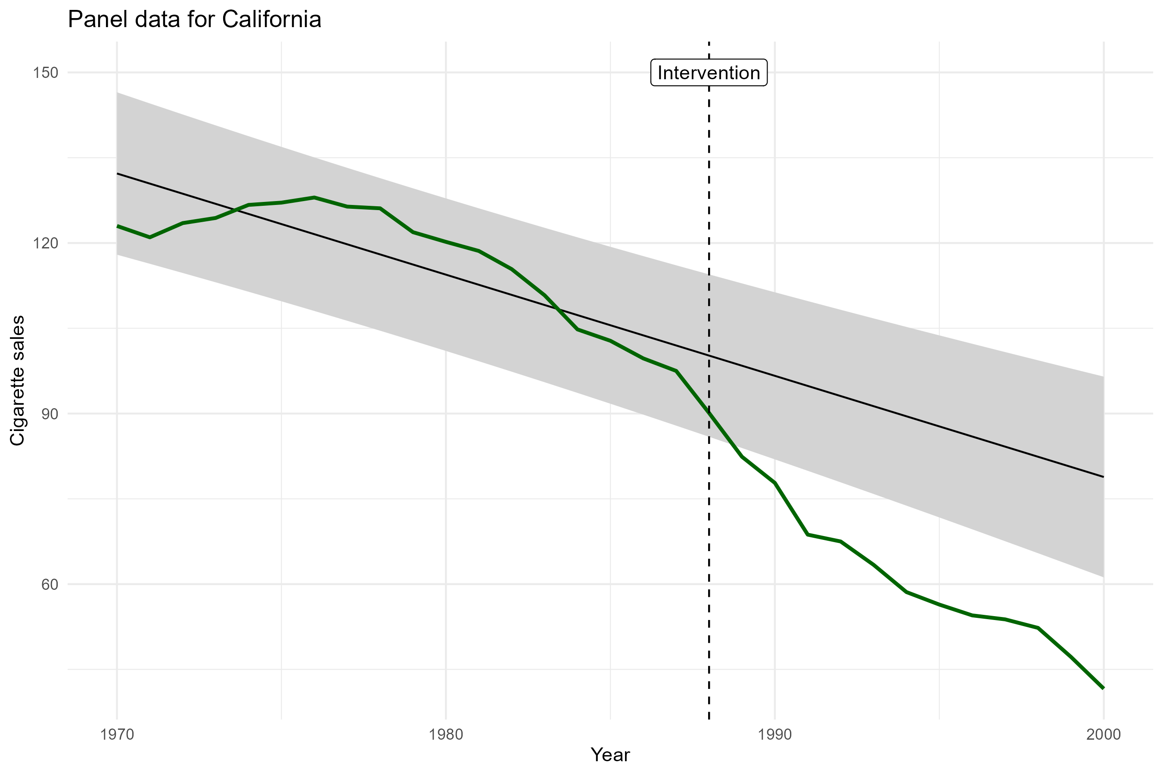

Slide 17




Building a forecasting model
Much of the challenge of this approach is in choosing an appropriate forecasting model
These can be very simple or very complex, e.g.:
If we forecast with the mean we are very close to the post – pre analysis
$$Y_{t}=μ_{pre}+e_{t}$$
We can forecast by fitting a growth curve which would model the overall time trend
$$Y_{t}=β_{0}+ β_{1} Time+e_{t}$$
We can forecast by using time-series models that model autocorrelation
e.g. ARIMA models can account for autocorrelation and time trends
$$Y_{t}=φ_{1}Y_{t−1 }+e_{t}$$
$$Y_{t}=φ_{1}Y_{t−1 }+φ_{2}Y_{t−2}+e_{t}$$
$$Y_{t}−Y_{t−1}=γe_{t−1} +e_{t}$$

Slide 18
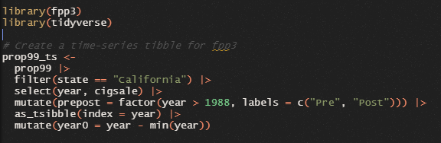

Fitting time-series models fpp3

Slide 19
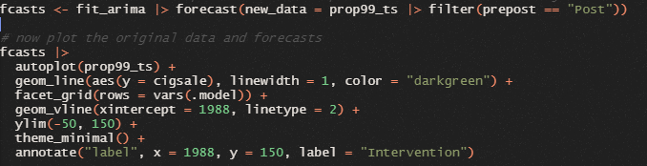
Forecasting with fpp3

Slide 20
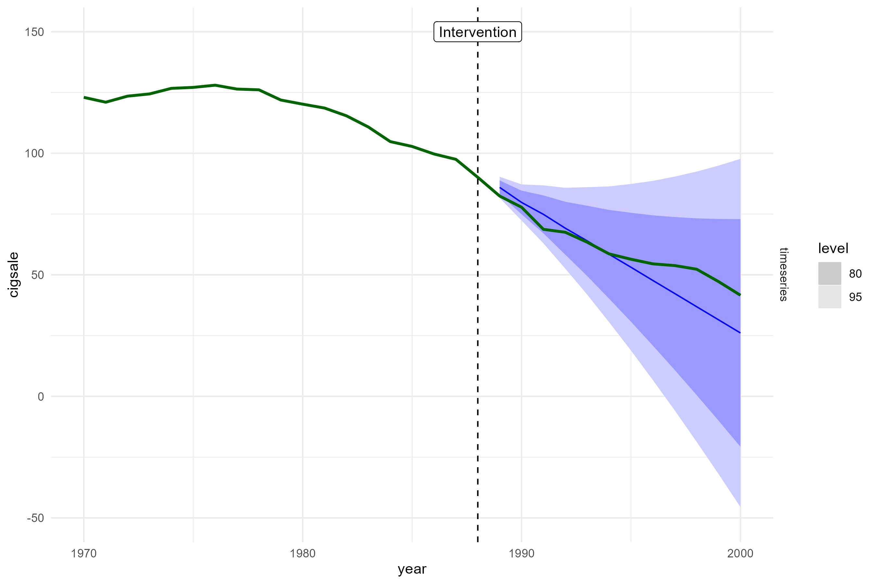

Slide 21
Key Assumptions
Our inferences about the causal effect are entirely dependent on being able to fit an appropriate forecasting model
i.e. one that correctly captures the trend and autocorrelation structures in the data
In practice, this may be very difficult
Data driven approaches to fitting time series models (such as using model selection, cross-validation) can be applied, but may only be feasible with a large amount of pre-intervention training data
Even then, different forecasting models come with their own assumptions, for example, that there is a constant trend, or time-invariant relationships
Poor forecasts = Poor estimates (and uncertainty bounds) of causal effects

Slide 22
Key Assumptions
We also here rely on a no-confounding assumption, in the sense that we assume that any changes in the process under study can be attributed to the intervention
And not, e.g., something else that happened around the same time
When comparing to the pre-post design;
With many pre-intervention time points we can try to model any trend and serial dependence
But we still have to assume that any changes are due to the intervention, and not some other change (e.g., a naturally accelerating trend, global changes)
For that we may need control units, and more assumptions….
Notes:
Notes; fuzzy regression discontinuity, check slides of Andrew heiss (sometimes you don’t have a single time point etc.)

Slide 23
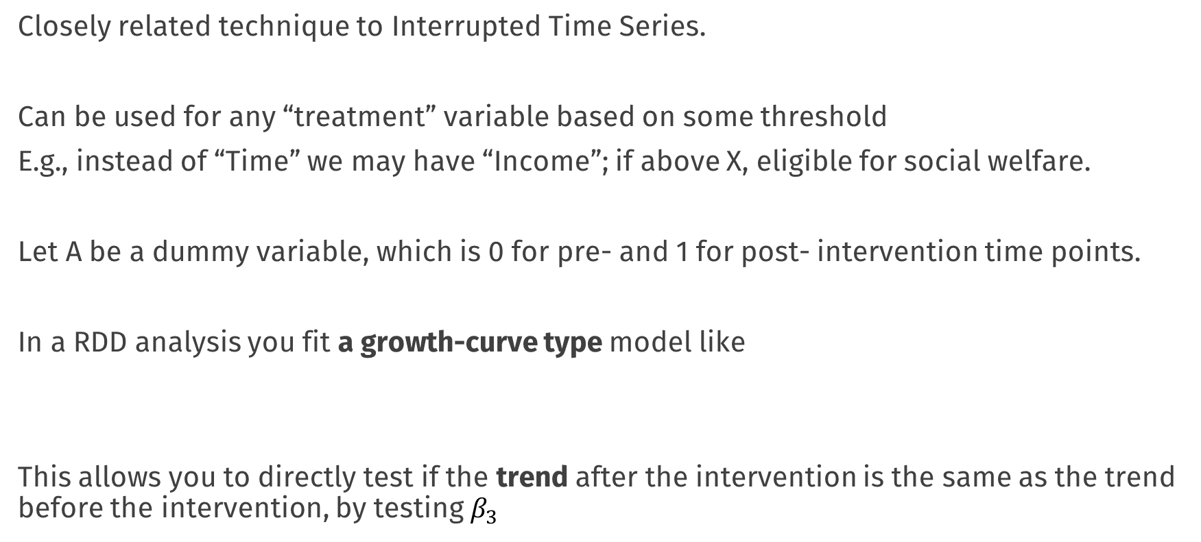
Regression Discontinuity
Closely related technique to Interrupted Time Series.
Can be used for any “treatment” variable based on some threshold
E.g., instead of “Time” we may have “Income”; if above X, eligible for social welfare.
Let A be a dummy variable, which is 0 for pre- and 1 for post- intervention time points.
In a RDD analysis you fit a growth-curve type model like
This allows you to directly test if the trend after the intervention is the same as the trend before the intervention, by testing $β_{3}$
$$Y_{t}=β_{0}+β_{1}A_{t}{+ β}_{2} Time+β_{3}∗Time ∗A_{t}+e_{t}$$

Slide 24
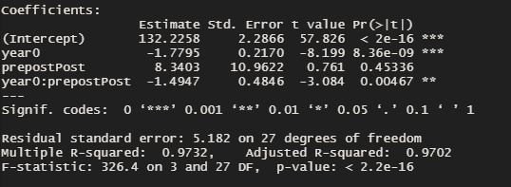
Regression Discontinuity in Practice

Slide 25
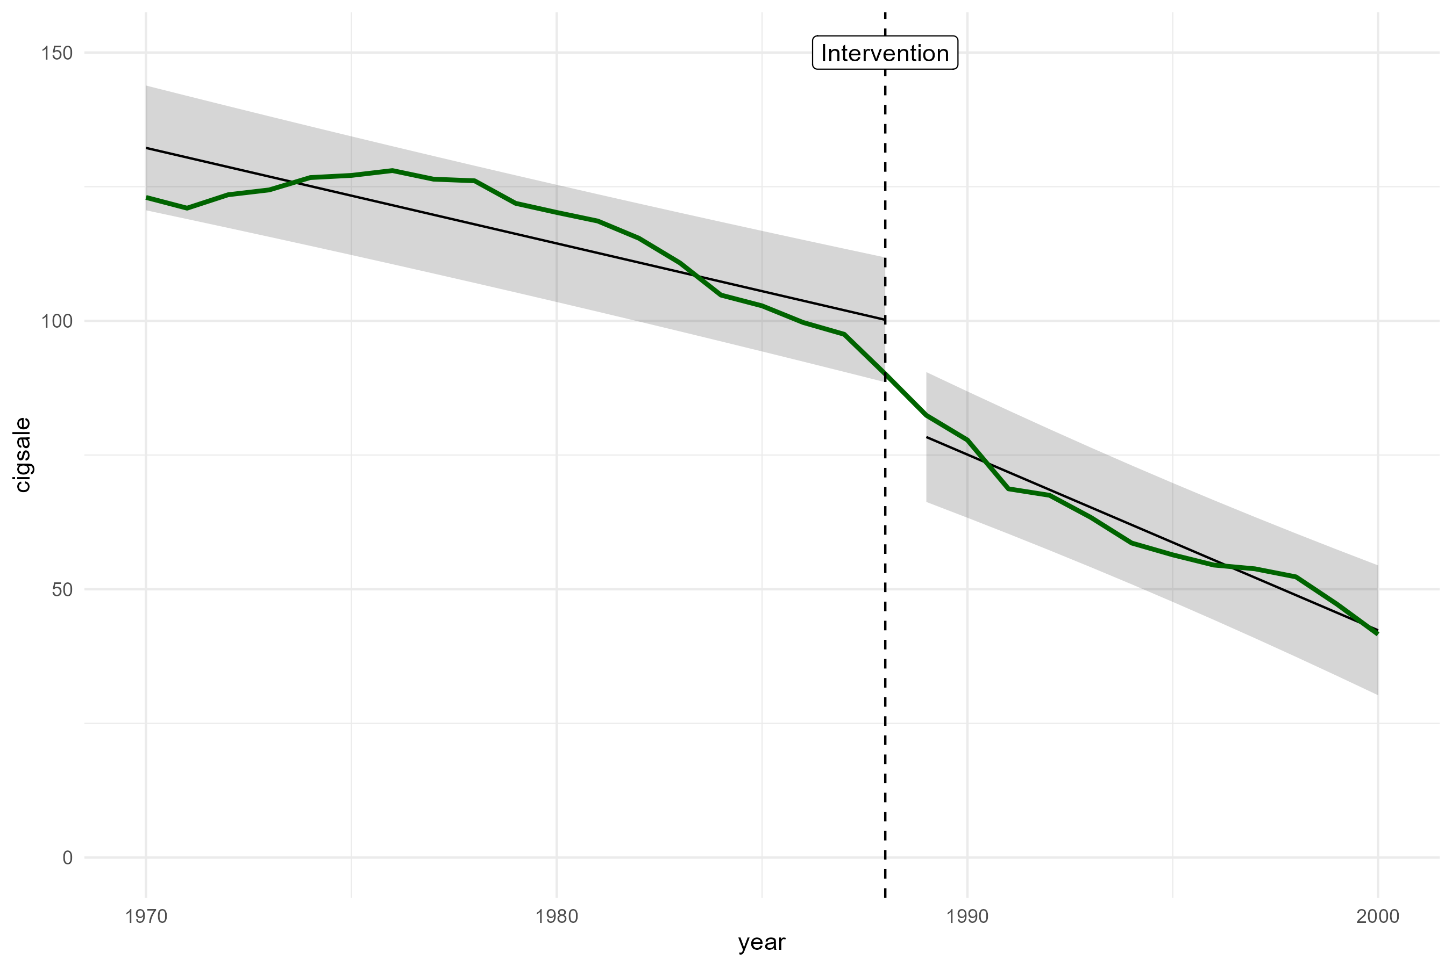
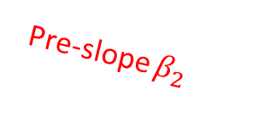
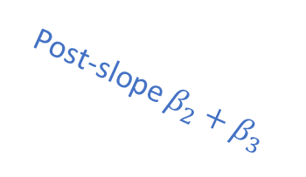
Pre-slope $β_{2}$
Post-slope $β_{2}+β_{3}$

Slide 26
Regression Discontinuity
Basic Idea:
You directly model whatever changes you think happen to the target process
- Instead of making forecasts/predictions of the counterfactual directly
Advantages
More direct. Inference about CE based on significance tests on “change” parameters
Many extensions and theory to deal with, e.g., “sharp” vs “fuzzy” designs
Disadvantages
Even more strongly need to rely on correct model specification and model interpretability; specify “where” or “how” the intervention has an effect
Contrast to ITS; model itself not as interesting, focus only on if post-observations are “unusual” relative to what you would expect

Slide 27
Practical
Work in your groups!

Slide 28
Break

Slide 29
Default light slide
Default subheading
This is the body of the text
Default subheading
Note that the text is not black, but “black, text 1, lighter 25%”
Default subheading
This makes things easier on the eyes
Default subheading
This is the body of the text

Slide 30
Default light slide
Default subheading
This is the body of the text
Default subheading
Note that the text is not black, but “black, text 1, lighter 25%”
Default subheading
This makes things easier on the eyes
Default subheading
This is the body of the text

Slide 31
Default light slide
Default subheading
This is the body of the text
Default subheading
Note that the text is not black, but “black, text 1, lighter 25%”
Default subheading
This makes things easier on the eyes
Default subheading
This is the body of the text

Slide 32
Default light slide
Default subheading
This is the body of the text
Default subheading
Note that the text is not black, but “black, text 1, lighter 25%”
Default subheading
This makes things easier on the eyes
Default subheading
This is the body of the text

Slide 33
Estimating the causal effect
Basic methods

Slide 34

Data analysis & visualisation
Workshop rijksoverheid
Erik-Jan van Kesteren

Slide 35
Break

Slide 36
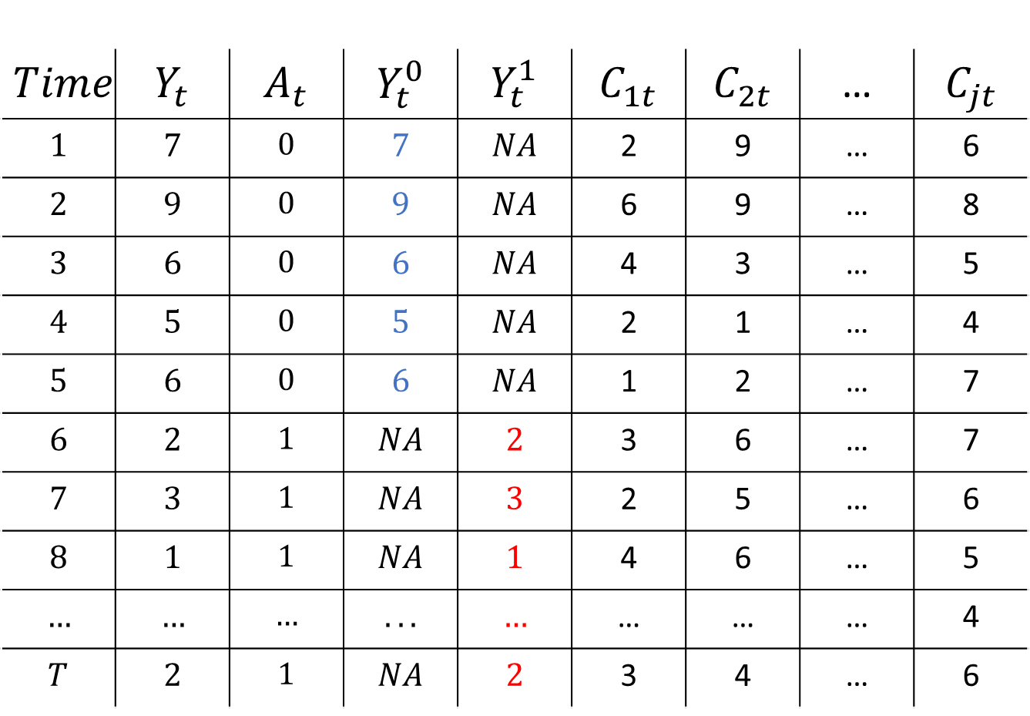
$$Time$$ | $$Y_{t}$$ | $$A_{t}$$ | $$Y_{t}^{0}$$ | $$Y_{t}^{1}$$ | $$C_{1t}$$ | $$C_{2t}$$ | … | $$C_{jt}$$
$$1$$ | $$7$$ | $$0$$ | $$7$$ | $$NA$$ | 2 | 9 | … | 6
$$2$$ | $$9$$ | $$0$$ | $$9$$ | $$NA$$ | 6 | 9 | … | 8
$$3$$ | $$6$$ | $$0$$ | $$6$$ | $$NA$$ | 4 | 3 | … | 5
$$4$$ | $$5$$ | $$0$$ | $$5$$ | $$NA$$ | 2 | 1 | … | 4
$$5$$ | $$6$$ | $$0$$ | $$6$$ | $$NA$$ | 1 | 2 | … | 7
$$6$$ | $$2$$ | $$1$$ | $$NA$$ | $$2$$ | 3 | 6 | … | 7
$$7$$ | $$3$$ | $$1$$ | $$NA$$ | $$3$$ | 2 | 5 | … | 6
$$8$$ | $$1$$ | $$1$$ | $$NA$$ | $$1$$ | 4 | 6 | … | 5
$$…$$ | $$…$$ | $$…$$ | $$...$$ | $$…$$ | … | … | … | 4
$$T$$ | $$2$$ | $$1$$ | $$NA$$ | $$2$$ | 3 | 4 | … | 6

Slide 37
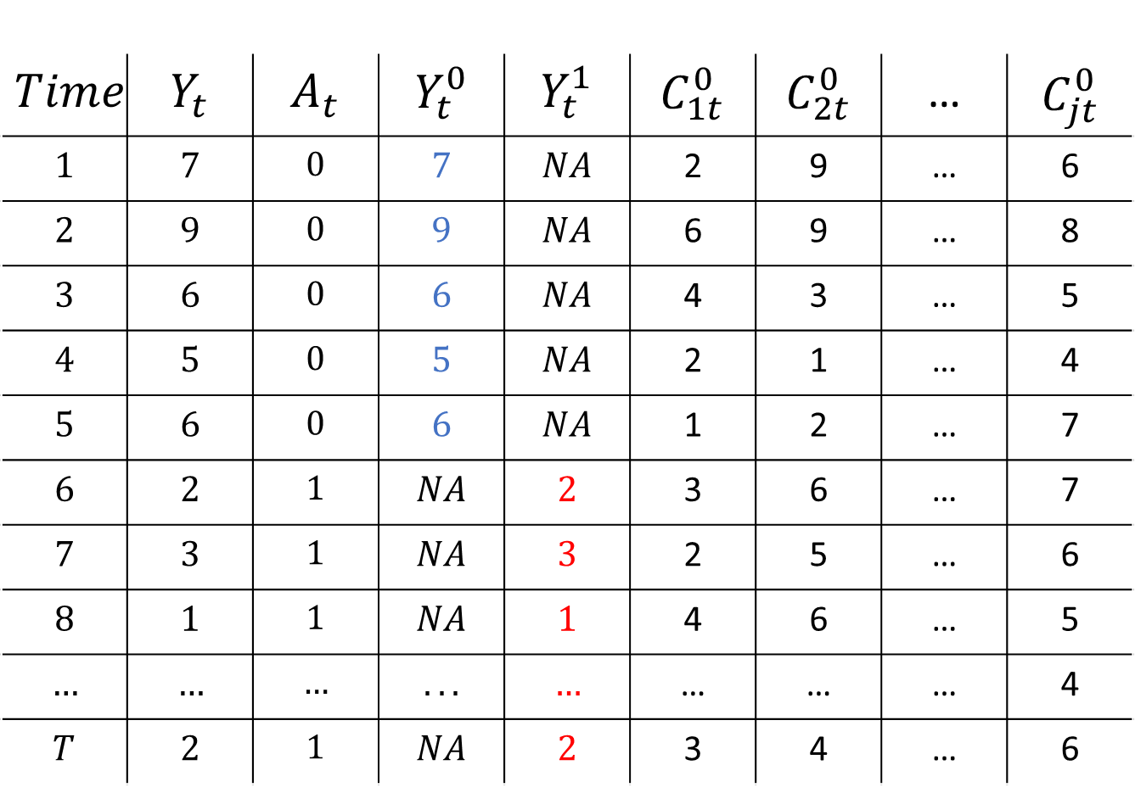
$$Time$$ | $$Y_{t}$$ | $$A_{t}$$ | $$Y_{t}^{0}$$ | $$Y_{t}^{1}$$ | $$C_{1t}^{0}$$ | $$C_{2t}^{0}$$ | … | $$C_{jt}^{0}$$
$$1$$ | $$7$$ | $$0$$ | $$7$$ | $$NA$$ | 2 | 9 | … | 6
$$2$$ | $$9$$ | $$0$$ | $$9$$ | $$NA$$ | 6 | 9 | … | 8
$$3$$ | $$6$$ | $$0$$ | $$6$$ | $$NA$$ | 4 | 3 | … | 5
$$4$$ | $$5$$ | $$0$$ | $$5$$ | $$NA$$ | 2 | 1 | … | 4
$$5$$ | $$6$$ | $$0$$ | $$6$$ | $$NA$$ | 1 | 2 | … | 7
$$6$$ | $$2$$ | $$1$$ | $$NA$$ | $$2$$ | 3 | 6 | … | 7
$$7$$ | $$3$$ | $$1$$ | $$NA$$ | $$3$$ | 2 | 5 | … | 6
$$8$$ | $$1$$ | $$1$$ | $$NA$$ | $$1$$ | 4 | 6 | … | 5
$$…$$ | $$…$$ | $$…$$ | $$...$$ | $$…$$ | … | … | … | 4
$$T$$ | $$2$$ | $$1$$ | $$NA$$ | $$2$$ | 3 | 4 | … | 6

Slide 38

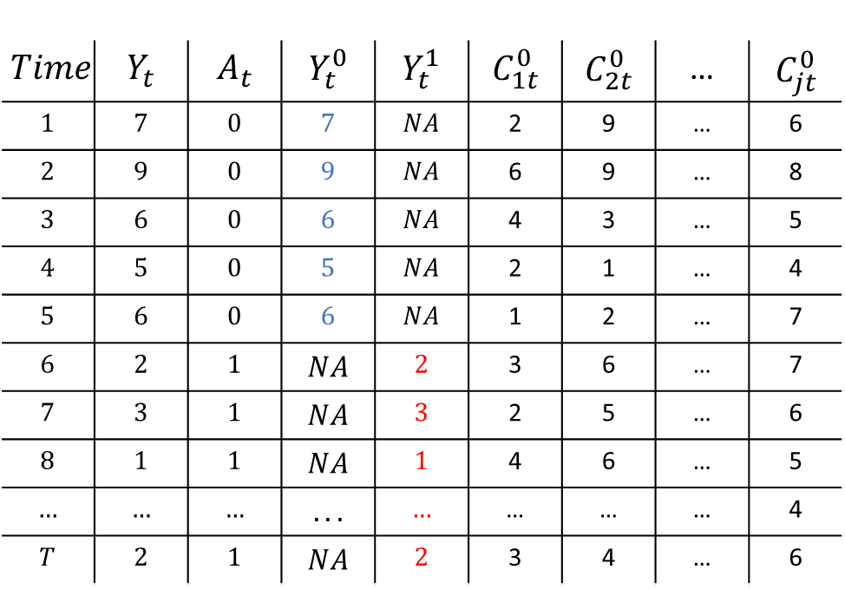
Synthetic Control
$$Time$$ | $$Y_{t}$$ | $$A_{t}$$ | $$Y_{t}^{0}$$ | $$Y_{t}^{1}$$ | $$C_{1t}^{0}$$ | $$C_{2t}^{0}$$ | … | $$C_{jt}^{0}$$
$$1$$ | $$7$$ | $$0$$ | $$7$$ | $$NA$$ | 2 | 9 | … | 6
$$2$$ | $$9$$ | $$0$$ | $$9$$ | $$NA$$ | 6 | 9 | … | 8
$$3$$ | $$6$$ | $$0$$ | $$6$$ | $$NA$$ | 4 | 3 | … | 5
$$4$$ | $$5$$ | $$0$$ | $$5$$ | $$NA$$ | 2 | 1 | … | 4
$$5$$ | $$6$$ | $$0$$ | $$6$$ | $$NA$$ | 1 | 2 | … | 7
$$6$$ | $$2$$ | $$1$$ | $$NA$$ | $$2$$ | 3 | 6 | … | 7
$$7$$ | $$3$$ | $$1$$ | $$NA$$ | $$3$$ | 2 | 5 | … | 6
$$8$$ | $$1$$ | $$1$$ | $$NA$$ | $$1$$ | 4 | 6 | … | 5
$$…$$ | $$…$$ | $$…$$ | $$...$$ | $$…$$ | … | … | … | 4
$$T$$ | $$2$$ | $$1$$ | $$NA$$ | $$2$$ | 3 | 4 | … | 6
Estimate Weights
$$Y_{t}= \sum_{j=1}^{J}{\hat{w_{j}}C_{jt}}$$
t < s

Slide 39
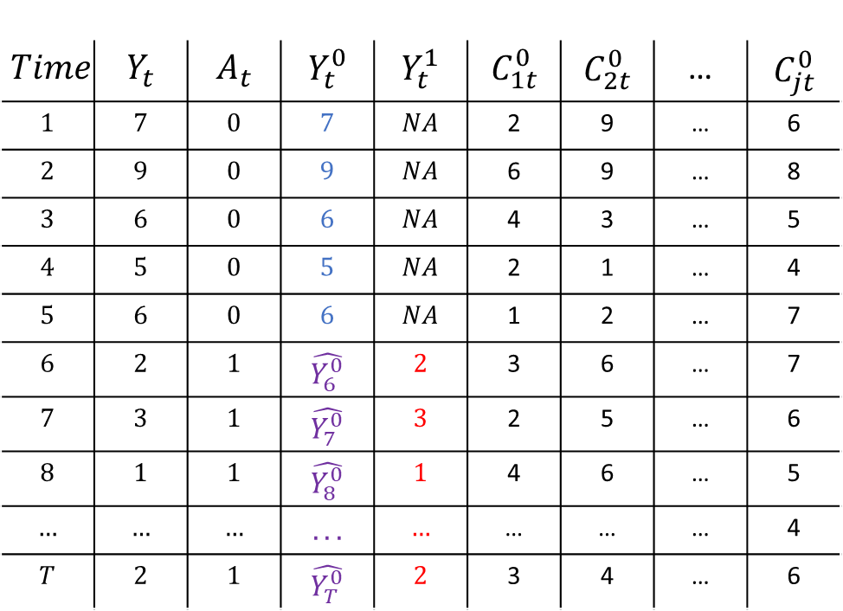


Synthetic Control
$$Time$$ | $$Y_{t}$$ | $$A_{t}$$ | $$Y_{t}^{0}$$ | $$Y_{t}^{1}$$ | $$C_{1t}^{0}$$ | $$C_{2t}^{0}$$ | … | $$C_{jt}^{0}$$
$$1$$ | $$7$$ | $$0$$ | $$7$$ | $$NA$$ | 2 | 9 | … | 6
$$2$$ | $$9$$ | $$0$$ | $$9$$ | $$NA$$ | 6 | 9 | … | 8
$$3$$ | $$6$$ | $$0$$ | $$6$$ | $$NA$$ | 4 | 3 | … | 5
$$4$$ | $$5$$ | $$0$$ | $$5$$ | $$NA$$ | 2 | 1 | … | 4
$$5$$ | $$6$$ | $$0$$ | $$6$$ | $$NA$$ | 1 | 2 | … | 7
$$6$$ | $$2$$ | $$1$$ | $$\hat{Y_{6}^{0}}$$ | $$2$$ | 3 | 6 | … | 7
$$7$$ | $$3$$ | $$1$$ | $$\hat{Y_{7}^{0}}$$ | $$3$$ | 2 | 5 | … | 6
$$8$$ | $$1$$ | $$1$$ | $$\hat{Y_{8}^{0}}$$ | $$1$$ | 4 | 6 | … | 5
$$…$$ | $$…$$ | $$…$$ | $$...$$ | $$…$$ | … | … | … | 4
$$T$$ | $$2$$ | $$1$$ | $$\hat{Y_{T}^{0}}$$ | $$2$$ | 3 | 4 | … | 6
Estimate Weights
$$Y_{t}= \sum_{j=1}^{J}{\hat{w_{j}}C_{jt}}$$
t < s
$$\hat{Y_{t}^{0}}= \sum_{j=1}^{J}{\hat{w_{j}}C_{jt}}$$
t > s
Impute counterfactual
$$\hat{CE_{t}}=Y_{t}^{1} −\hat{Y_{t}^{0}}$$

Slide 40
Default light slide
Default subheading
This is the body of the text
Default subheading
Note that the text is not black, but “black, text 1, lighter 25%”
Default subheading
This makes things easier on the eyes
Default subheading
This is the body of the text

Slide 41
Default dark slide
Default subheading
The dark slide brings some variation
Default subheading
It can highlight important aspects of the presentation.
Default subheading
This is the body of the text
Default subheading
This is the body of the text

Slide 42
Is this an impact slide?

Slide 43
Here is an impactful slide with a sentence on it.
Here is a topic related to the aforementioned question.

Slide 44
Questions?

