Slide 1
Interrupted Time Series & Regression Discontinuity

Slide 2
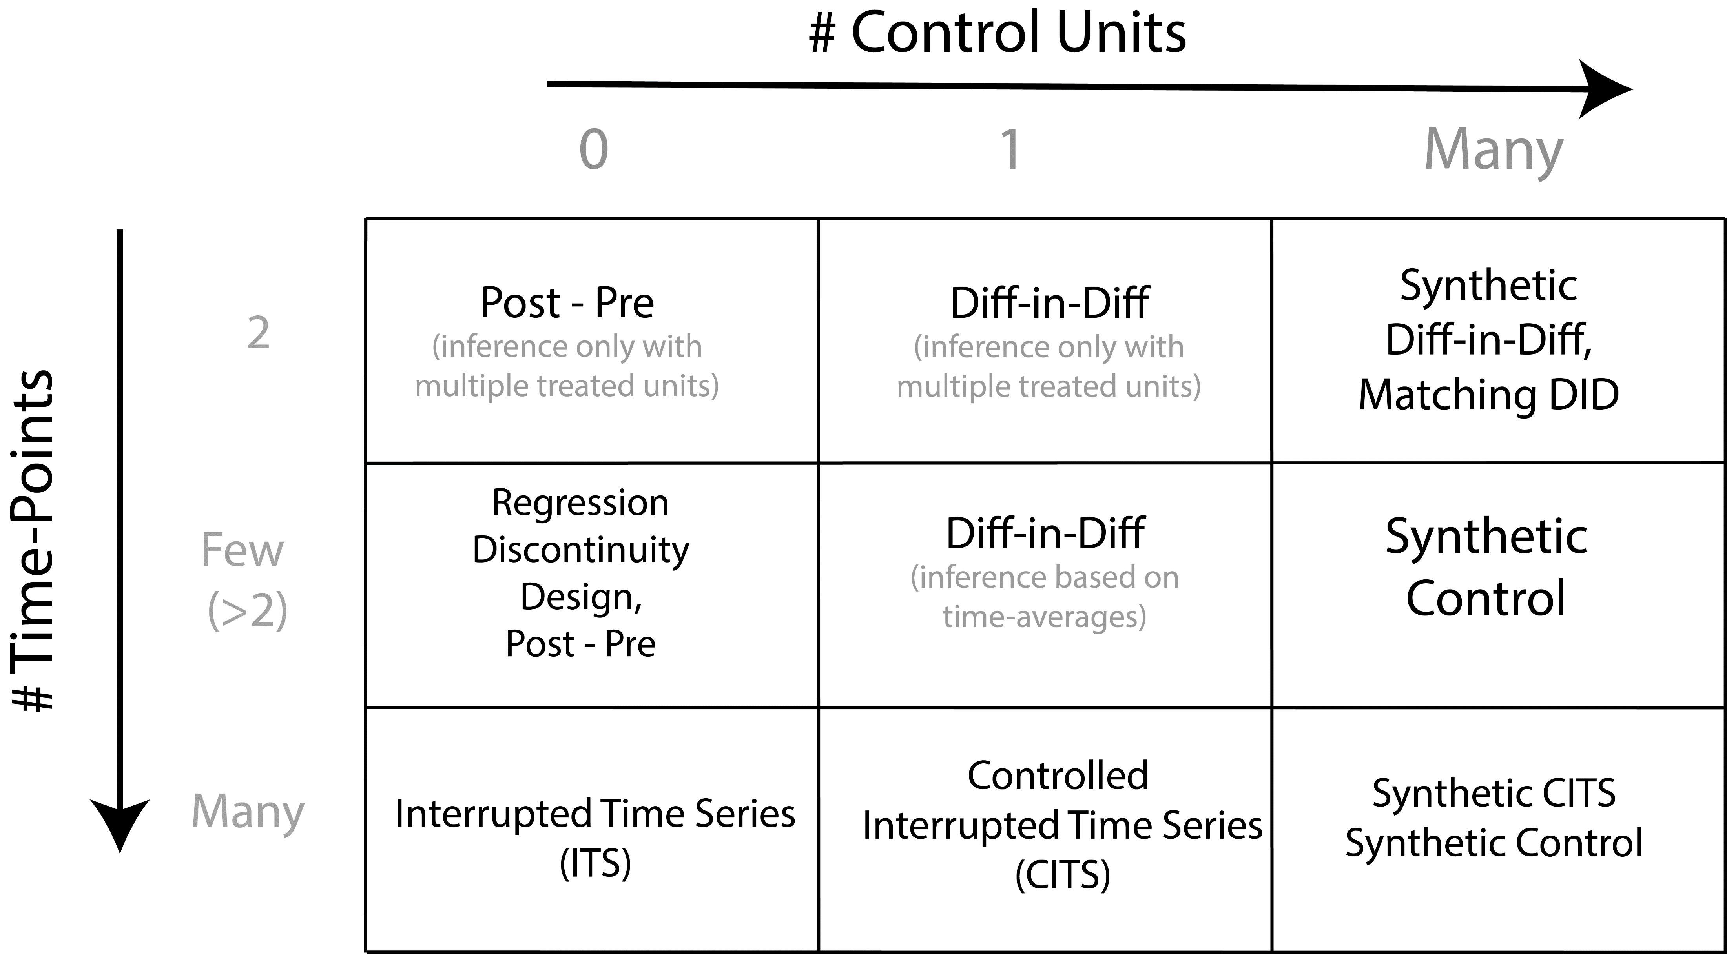

Slide 6
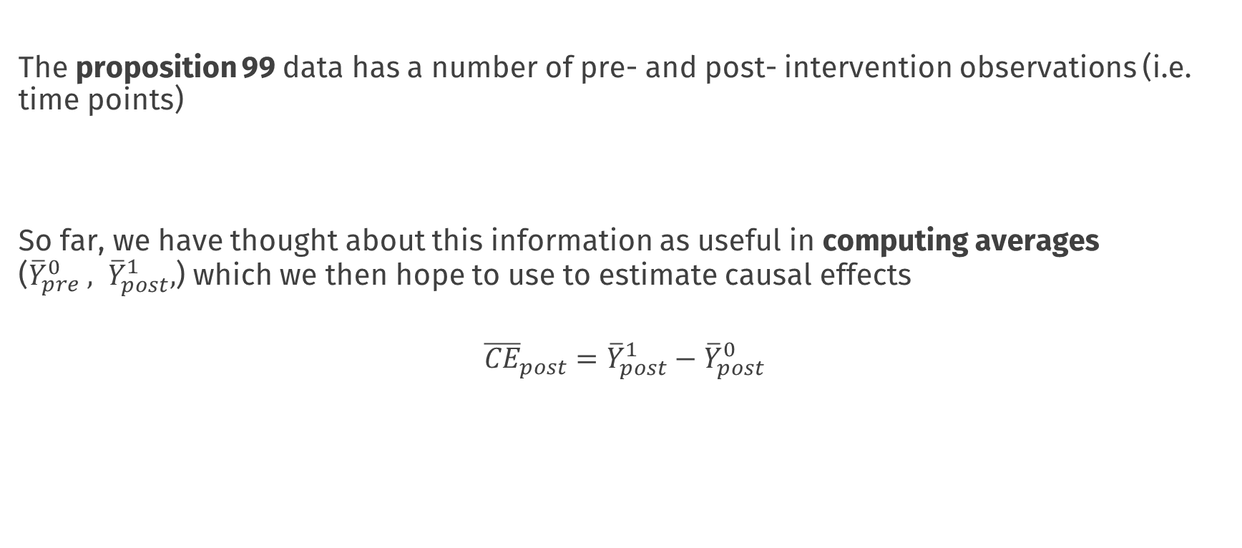
The story so far
The proposition 99 data has a number of pre- and post- intervention observations (i.e. time points)
So far, we have thought about this information as useful in computing averages (${\overline{Y}}_{pre}^{0} , {\overline{Y}}_{post}^{1},$) which we then hope to use to estimate causal effects
$${\overline{CE}}_{post}={\overline{Y}}_{post}^{1}−{\overline{Y}}_{post}^{0}$$

Slide 7
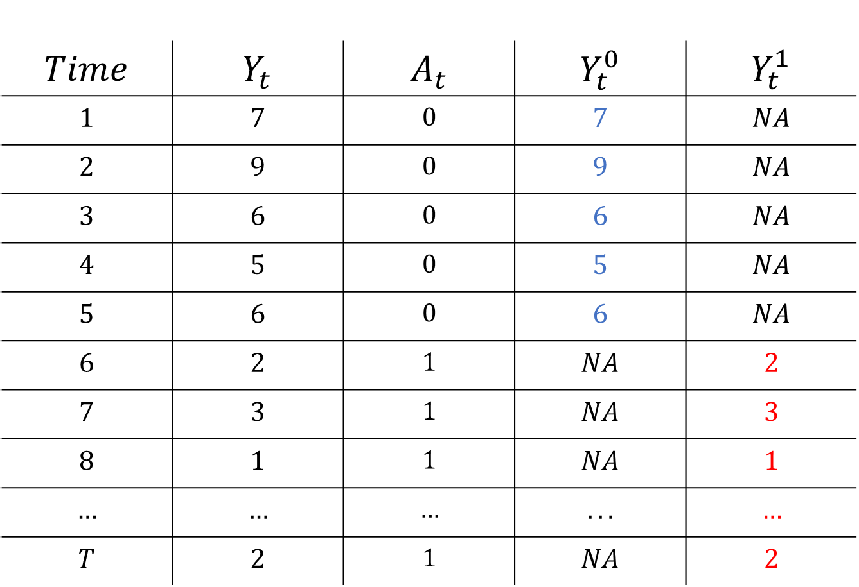
$$Time$$ | $$Y_{t}$$ | $$A_{t}$$ | $$Y_{t}^{0}$$ | $$Y_{t}^{1}$$
$$1$$ | $$7$$ | $$0$$ | $$7$$ | $$NA$$
$$2$$ | $$9$$ | $$0$$ | $$9$$ | $$NA$$
$$3$$ | $$6$$ | $$0$$ | $$6$$ | $$NA$$
$$4$$ | $$5$$ | $$0$$ | $$5$$ | $$NA$$
$$5$$ | $$6$$ | $$0$$ | $$6$$ | $$NA$$
$$6$$ | $$2$$ | $$1$$ | $$NA$$ | $$2$$
$$7$$ | $$3$$ | $$1$$ | $$NA$$ | $$3$$
$$8$$ | $$1$$ | $$1$$ | $$NA$$ | $$1$$
$$…$$ | $$…$$ | $$…$$ | $$...$$ | $$…$$
$$T$$ | $$2$$ | $$1$$ | $$NA$$ | $$2$$

Slide 8
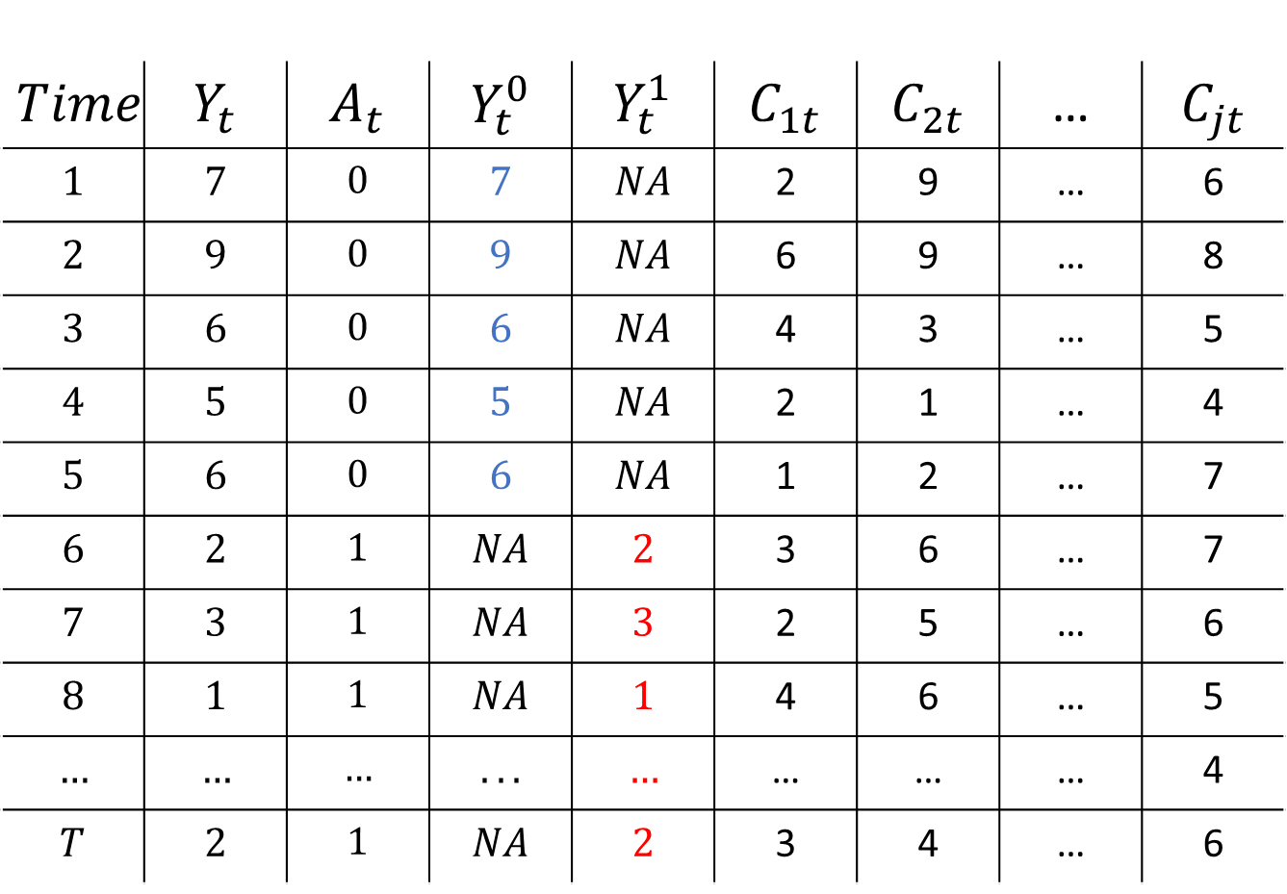
$$Time$$ | $$Y_{t}$$ | $$A_{t}$$ | $$Y_{t}^{0}$$ | $$Y_{t}^{1}$$ | $$C_{1t}$$ | $$C_{2t}$$ | … | $$C_{jt}$$
$$1$$ | $$7$$ | $$0$$ | $$7$$ | $$NA$$ | 2 | 9 | … | 6
$$2$$ | $$9$$ | $$0$$ | $$9$$ | $$NA$$ | 6 | 9 | … | 8
$$3$$ | $$6$$ | $$0$$ | $$6$$ | $$NA$$ | 4 | 3 | … | 5
$$4$$ | $$5$$ | $$0$$ | $$5$$ | $$NA$$ | 2 | 1 | … | 4
$$5$$ | $$6$$ | $$0$$ | $$6$$ | $$NA$$ | 1 | 2 | … | 7
$$6$$ | $$2$$ | $$1$$ | $$NA$$ | $$2$$ | 3 | 6 | … | 7
$$7$$ | $$3$$ | $$1$$ | $$NA$$ | $$3$$ | 2 | 5 | … | 6
$$8$$ | $$1$$ | $$1$$ | $$NA$$ | $$1$$ | 4 | 6 | … | 5
$$…$$ | $$…$$ | $$…$$ | $$...$$ | $$…$$ | … | … | … | 4
$$T$$ | $$2$$ | $$1$$ | $$NA$$ | $$2$$ | 3 | 4 | … | 6

Slide 9
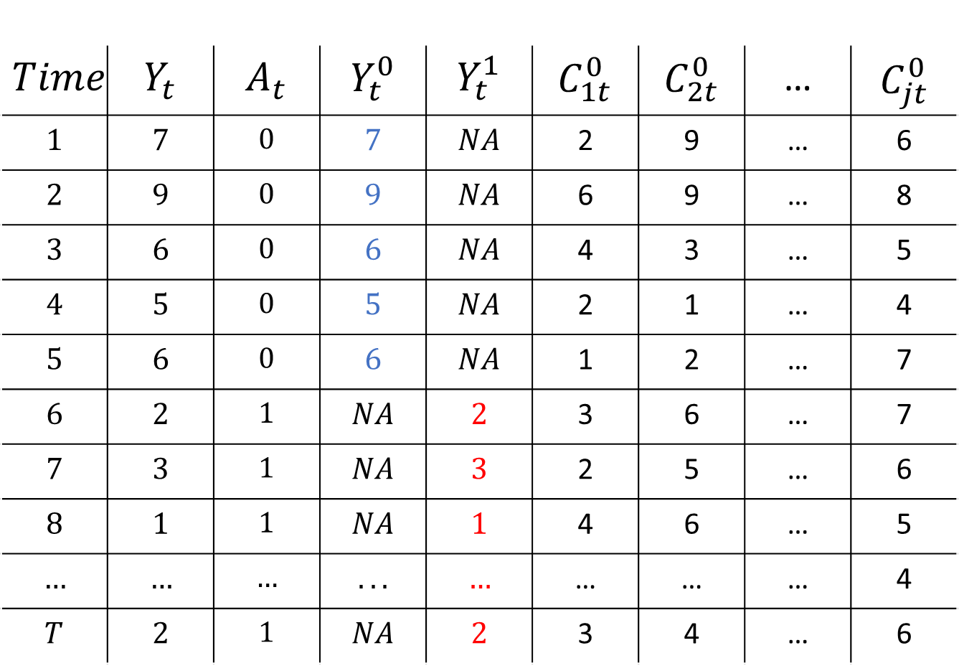
$$Time$$ | $$Y_{t}$$ | $$A_{t}$$ | $$Y_{t}^{0}$$ | $$Y_{t}^{1}$$ | $$C_{1t}^{0}$$ | $$C_{2t}^{0}$$ | … | $$C_{jt}^{0}$$
$$1$$ | $$7$$ | $$0$$ | $$7$$ | $$NA$$ | 2 | 9 | … | 6
$$2$$ | $$9$$ | $$0$$ | $$9$$ | $$NA$$ | 6 | 9 | … | 8
$$3$$ | $$6$$ | $$0$$ | $$6$$ | $$NA$$ | 4 | 3 | … | 5
$$4$$ | $$5$$ | $$0$$ | $$5$$ | $$NA$$ | 2 | 1 | … | 4
$$5$$ | $$6$$ | $$0$$ | $$6$$ | $$NA$$ | 1 | 2 | … | 7
$$6$$ | $$2$$ | $$1$$ | $$NA$$ | $$2$$ | 3 | 6 | … | 7
$$7$$ | $$3$$ | $$1$$ | $$NA$$ | $$3$$ | 2 | 5 | … | 6
$$8$$ | $$1$$ | $$1$$ | $$NA$$ | $$1$$ | 4 | 6 | … | 5
$$…$$ | $$…$$ | $$…$$ | $$...$$ | $$…$$ | … | … | … | 4
$$T$$ | $$2$$ | $$1$$ | $$NA$$ | $$2$$ | 3 | 4 | … | 6

Slide 10

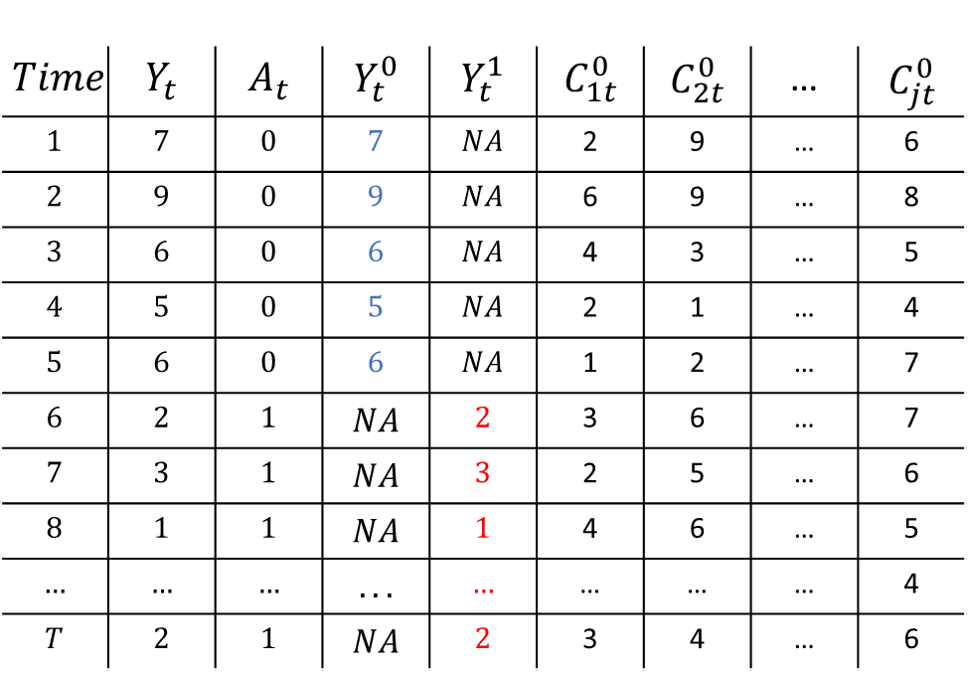
Synthetic Control
$$Time$$ | $$Y_{t}$$ | $$A_{t}$$ | $$Y_{t}^{0}$$ | $$Y_{t}^{1}$$ | $$C_{1t}^{0}$$ | $$C_{2t}^{0}$$ | … | $$C_{jt}^{0}$$
$$1$$ | $$7$$ | $$0$$ | $$7$$ | $$NA$$ | 2 | 9 | … | 6
$$2$$ | $$9$$ | $$0$$ | $$9$$ | $$NA$$ | 6 | 9 | … | 8
$$3$$ | $$6$$ | $$0$$ | $$6$$ | $$NA$$ | 4 | 3 | … | 5
$$4$$ | $$5$$ | $$0$$ | $$5$$ | $$NA$$ | 2 | 1 | … | 4
$$5$$ | $$6$$ | $$0$$ | $$6$$ | $$NA$$ | 1 | 2 | … | 7
$$6$$ | $$2$$ | $$1$$ | $$NA$$ | $$2$$ | 3 | 6 | … | 7
$$7$$ | $$3$$ | $$1$$ | $$NA$$ | $$3$$ | 2 | 5 | … | 6
$$8$$ | $$1$$ | $$1$$ | $$NA$$ | $$1$$ | 4 | 6 | … | 5
$$…$$ | $$…$$ | $$…$$ | $$...$$ | $$…$$ | … | … | … | 4
$$T$$ | $$2$$ | $$1$$ | $$NA$$ | $$2$$ | 3 | 4 | … | 6
Estimate Weights
$$Y_{t}= \sum_{j=1}^{J}{\hat{w_{j}}C_{jt}}$$
t < s

Slide 11
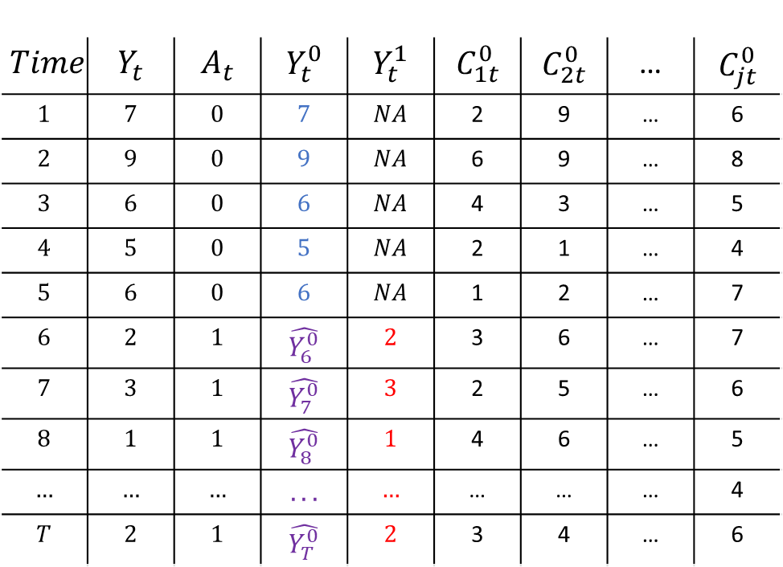


Synthetic Control
$$Time$$ | $$Y_{t}$$ | $$A_{t}$$ | $$Y_{t}^{0}$$ | $$Y_{t}^{1}$$ | $$C_{1t}^{0}$$ | $$C_{2t}^{0}$$ | … | $$C_{jt}^{0}$$
$$1$$ | $$7$$ | $$0$$ | $$7$$ | $$NA$$ | 2 | 9 | … | 6
$$2$$ | $$9$$ | $$0$$ | $$9$$ | $$NA$$ | 6 | 9 | … | 8
$$3$$ | $$6$$ | $$0$$ | $$6$$ | $$NA$$ | 4 | 3 | … | 5
$$4$$ | $$5$$ | $$0$$ | $$5$$ | $$NA$$ | 2 | 1 | … | 4
$$5$$ | $$6$$ | $$0$$ | $$6$$ | $$NA$$ | 1 | 2 | … | 7
$$6$$ | $$2$$ | $$1$$ | $$\hat{Y_{6}^{0}}$$ | $$2$$ | 3 | 6 | … | 7
$$7$$ | $$3$$ | $$1$$ | $$\hat{Y_{7}^{0}}$$ | $$3$$ | 2 | 5 | … | 6
$$8$$ | $$1$$ | $$1$$ | $$\hat{Y_{8}^{0}}$$ | $$1$$ | 4 | 6 | … | 5
$$…$$ | $$…$$ | $$…$$ | $$...$$ | $$…$$ | … | … | … | 4
$$T$$ | $$2$$ | $$1$$ | $$\hat{Y_{T}^{0}}$$ | $$2$$ | 3 | 4 | … | 6
Estimate Weights
$$Y_{t}= \sum_{j=1}^{J}{\hat{w_{j}}C_{jt}}$$
t < s
$$\hat{Y_{t}^{0}}= \sum_{j=1}^{J}{\hat{w_{j}}C_{jt}}$$
t > s
Impute counterfactual
$$\hat{CE_{t}}=Y_{t}^{1} −\hat{Y_{t}^{0}}$$

Slide 12
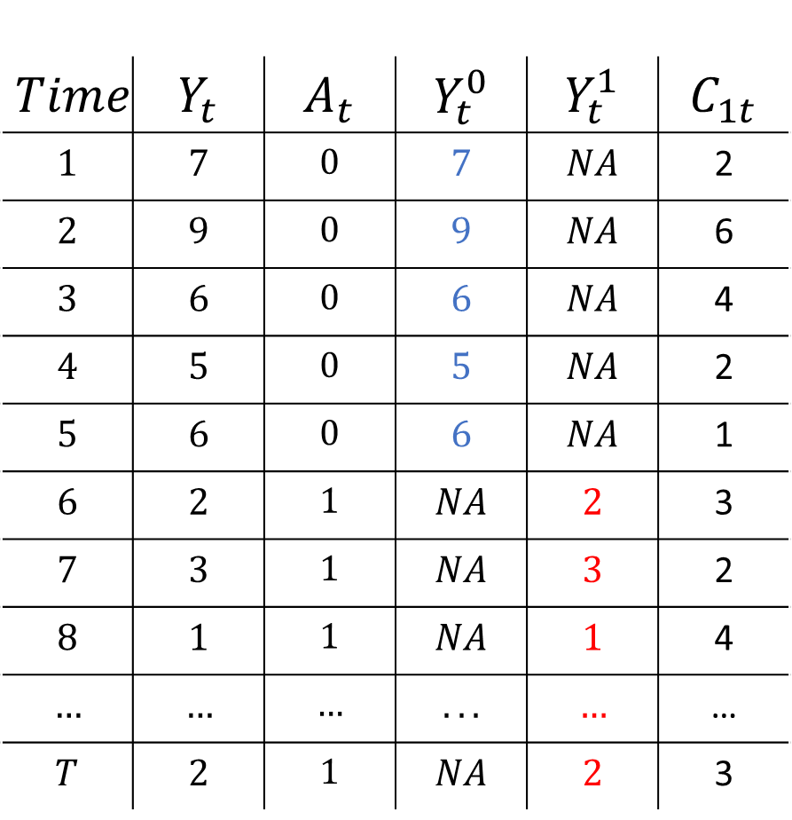
$$Time$$ | $$Y_{t}$$ | $$A_{t}$$ | $$Y_{t}^{0}$$ | $$Y_{t}^{1}$$ | $$C_{1t}$$
$$1$$ | $$7$$ | $$0$$ | $$7$$ | $$NA$$ | 2
$$2$$ | $$9$$ | $$0$$ | $$9$$ | $$NA$$ | 6
$$3$$ | $$6$$ | $$0$$ | $$6$$ | $$NA$$ | 4
$$4$$ | $$5$$ | $$0$$ | $$5$$ | $$NA$$ | 2
$$5$$ | $$6$$ | $$0$$ | $$6$$ | $$NA$$ | 1
$$6$$ | $$2$$ | $$1$$ | $$NA$$ | $$2$$ | 3
$$7$$ | $$3$$ | $$1$$ | $$NA$$ | $$3$$ | 2
$$8$$ | $$1$$ | $$1$$ | $$NA$$ | $$1$$ | 4
$$…$$ | $$…$$ | $$…$$ | $$...$$ | $$…$$ | …
$$T$$ | $$2$$ | $$1$$ | $$NA$$ | $$2$$ | 3

Slide 13
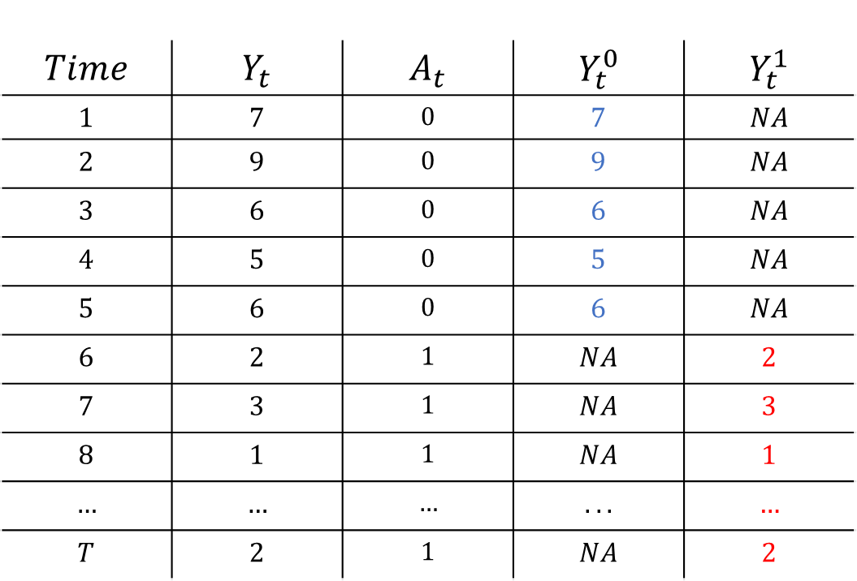
Pre – Post analysis
$$Time$$ | $$Y_{t}$$ | $$A_{t}$$ | $$Y_{t}^{0}$$ | $$Y_{t}^{1}$$
$$1$$ | $$7$$ | $$0$$ | $$7$$ | $$NA$$
$$2$$ | $$9$$ | $$0$$ | $$9$$ | $$NA$$
$$3$$ | $$6$$ | $$0$$ | $$6$$ | $$NA$$
$$4$$ | $$5$$ | $$0$$ | $$5$$ | $$NA$$
$$5$$ | $$6$$ | $$0$$ | $$6$$ | $$NA$$
$$6$$ | $$2$$ | $$1$$ | $$NA$$ | $$2$$
$$7$$ | $$3$$ | $$1$$ | $$NA$$ | $$3$$
$$8$$ | $$1$$ | $$1$$ | $$NA$$ | $$1$$
$$…$$ | $$…$$ | $$…$$ | $$...$$ | $$…$$
$$T$$ | $$2$$ | $$1$$ | $$NA$$ | $$2$$
$${\overline{Y}}_{pre}^{0}$$
$${\overline{Y}}_{post}^{1}$$

Slide 14

Pre – Post analysis
$$Time$$ | $$Y_{t}$$ | $$A_{t}$$ | $$Y_{t}^{0}$$ | $$Y_{t}^{1}$$
$$1$$ | $$7$$ | $$0$$ | $$7$$ | $$NA$$
$$2$$ | $$9$$ | $$0$$ | $$9$$ | $$NA$$
$$3$$ | $$6$$ | $$0$$ | $$6$$ | $$NA$$
$$4$$ | $$5$$ | $$0$$ | $$5$$ | $$NA$$
$$5$$ | $$6$$ | $$0$$ | $$6$$ | $$NA$$
$$6$$ | $$2$$ | $$1$$ | $$NA$$ | $$2$$
$$7$$ | $$3$$ | $$1$$ | $$NA$$ | $$3$$
$$8$$ | $$1$$ | $$1$$ | $$NA$$ | $$1$$
$$…$$ | $$…$$ | $$…$$ | $$...$$ | $$…$$
$$T$$ | $$2$$ | $$1$$ | $$NA$$ | $$2$$
$${\overline{Y}}_{pre}^{0}$$
Assume equal to
$${\overline{Y}}_{post}^{1}$$
$${ − \overline{Y}}_{post}^{0}$$
$${\overline{CE}}_{post}={\overline{Y}}_{post}^{1}−{\overline{Y}}_{post}^{0}$$

Slide 15
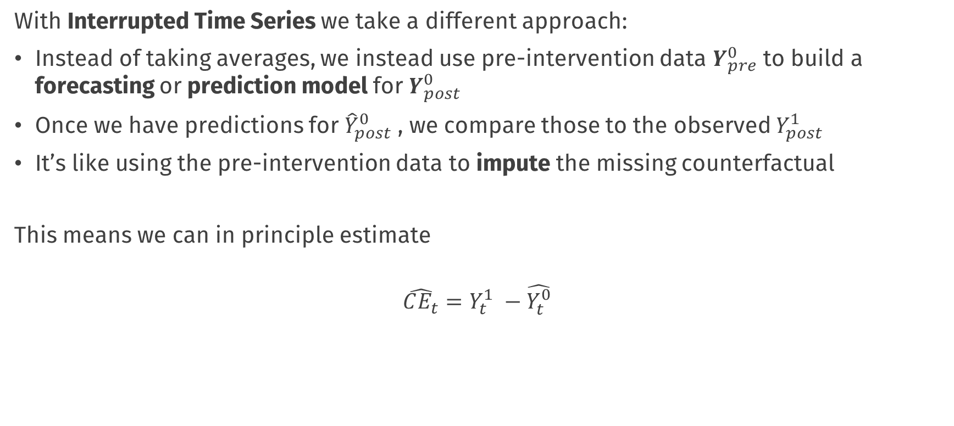
Interrupted Time Series
With Interrupted Time Series we take a different approach:
Instead of taking averages, we instead use pre-intervention data $Y_{pre}^{0}$ to build a forecasting or prediction model for $Y_{post}^{0}$
Once we have predictions for ${\hat{Y}}_{post}^{0}$ , we compare those to the observed $Y_{post}^{1}$
It’s like using the pre-intervention data to impute the missing counterfactual
This means we can in principle estimate
$$\hat{CE_{t}}=Y_{t}^{1} −\hat{Y_{t}^{0}}$$

Slide 16

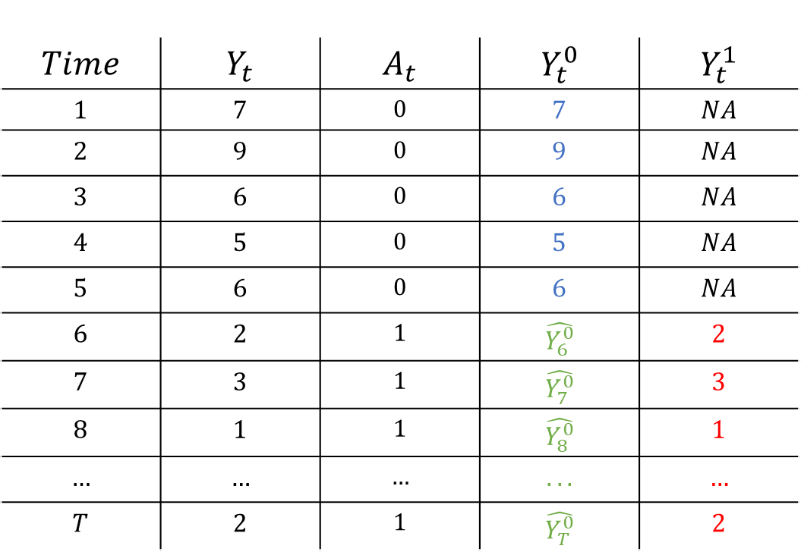
Interrupted Time Series
$$Time$$ | $$Y_{t}$$ | $$A_{t}$$ | $$Y_{t}^{0}$$ | $$Y_{t}^{1}$$
$$1$$ | $$7$$ | $$0$$ | $$7$$ | $$NA$$
$$2$$ | $$9$$ | $$0$$ | $$9$$ | $$NA$$
$$3$$ | $$6$$ | $$0$$ | $$6$$ | $$NA$$
$$4$$ | $$5$$ | $$0$$ | $$5$$ | $$NA$$
$$5$$ | $$6$$ | $$0$$ | $$6$$ | $$NA$$
$$6$$ | $$2$$ | $$1$$ | $$\hat{Y_{6}^{0}}$$ | $$2$$
$$7$$ | $$3$$ | $$1$$ | $$\hat{Y_{7}^{0}}$$ | $$3$$
$$8$$ | $$1$$ | $$1$$ | $$\hat{Y_{8}^{0}}$$ | $$1$$
$$…$$ | $$…$$ | $$…$$ | $$...$$ | $$…$$
$$T$$ | $$2$$ | $$1$$ | $$\hat{Y_{T}^{0}}$$ | $$2$$
Fit a forecasting Model
$$\hat{Y_{t+1}}=φ_{1}Y_{t}+φ_{2}Y_{t−1}+…β ∗ Time$$

Slide 17
Interrupted Time Series
$$Time$$ | $$Y_{t}$$ | $$A_{t}$$ | $$Y_{t}^{0}$$ | $$Y_{t}^{1}$$
$$1$$ | $$7$$ | $$0$$ | $$7$$ | $$NA$$
$$2$$ | $$9$$ | $$0$$ | $$9$$ | $$NA$$
$$3$$ | $$6$$ | $$0$$ | $$6$$ | $$NA$$
$$4$$ | $$5$$ | $$0$$ | $$5$$ | $$NA$$
$$5$$ | $$6$$ | $$0$$ | $$6$$ | $$NA$$
$$6$$ | $$2$$ | $$1$$ | $$\hat{Y_{6}^{0}}$$ | $$2$$
$$7$$ | $$3$$ | $$1$$ | $$\hat{Y_{7}^{0}}$$ | $$3$$
$$8$$ | $$1$$ | $$1$$ | $$\hat{Y_{8}^{0}}$$ | $$1$$
$$…$$ | $$…$$ | $$…$$ | $$...$$ | $$…$$
$$T$$ | $$2$$ | $$1$$ | $$\hat{Y_{T}^{0}}$$ | $$2$$
Fit a forecasting Model
$$\hat{Y_{t+1}}=φ_{1}Y_{t}+φ_{2}Y_{t−1}+…β ∗ Time$$
Make forecasts

Slide 18

Interrupted Time Series
$$Time$$ | $$Y_{t}$$ | $$A_{t}$$ | $$Y_{t}^{0}$$ | $$Y_{t}^{1}$$
$$1$$ | $$7$$ | $$0$$ | $$7$$ | $$NA$$
$$2$$ | $$9$$ | $$0$$ | $$9$$ | $$NA$$
$$3$$ | $$6$$ | $$0$$ | $$6$$ | $$NA$$
$$4$$ | $$5$$ | $$0$$ | $$5$$ | $$NA$$
$$5$$ | $$6$$ | $$0$$ | $$6$$ | $$NA$$
$$6$$ | $$2$$ | $$1$$ | $$\hat{Y_{6}^{0}}$$ | $$2$$
$$7$$ | $$3$$ | $$1$$ | $$\hat{Y_{7}^{0}}$$ | $$3$$
$$8$$ | $$1$$ | $$1$$ | $$\hat{Y_{8}^{0}}$$ | $$1$$
$$…$$ | $$…$$ | $$…$$ | $$...$$ | $$…$$
$$T$$ | $$2$$ | $$1$$ | $$\hat{Y_{T}^{0}}$$ | $$2$$
Fit a forecasting Model
$$\hat{Y_{t}}=φ_{1}Y_{t−1}+φ_{2}Y_{t−2}+…β ∗ Time$$
Make forecasts

Slide 19

Interrupted Time Series
$$Time$$ | $$Y_{t}$$ | $$A_{t}$$ | $$Y_{t}^{0}$$ | $$Y_{t}^{1}$$
$$1$$ | $$7$$ | $$0$$ | $$7$$ | $$NA$$
$$2$$ | $$9$$ | $$0$$ | $$9$$ | $$NA$$
$$3$$ | $$6$$ | $$0$$ | $$6$$ | $$NA$$
$$4$$ | $$5$$ | $$0$$ | $$5$$ | $$NA$$
$$5$$ | $$6$$ | $$0$$ | $$6$$ | $$NA$$
$$6$$ | $$2$$ | $$1$$ | $$\hat{Y_{6}^{0}}$$ | $$2$$
$$7$$ | $$3$$ | $$1$$ | $$\hat{Y_{7}^{0}}$$ | $$3$$
$$8$$ | $$1$$ | $$1$$ | $$\hat{Y_{8}^{0}}$$ | $$1$$
$$…$$ | $$…$$ | $$…$$ | $$...$$ | $$…$$
$$T$$ | $$2$$ | $$1$$ | $$\hat{Y_{T}^{0}}$$ | $$2$$
Fit a forecasting Model
$$\hat{Y_{t}}=φ_{1}Y_{t−1}+φ_{2}Y_{t−2}+…β ∗ Time$$
Make forecasts
$$\hat{CE_{t}}=Y_{t}^{1} −\hat{Y_{t}^{0}}$$

Slide 20




Interrupted Time Series
Much of the challenge of this approach is in choosing an appropriate forecasting model
These can be very simple or very complex, e.g.:
If we forecast with the mean we are very close to the post – pre analysis
We can forecast by fitting a growth curve which would model the overall time trend
We can forecast by using time-series models that model autocorrelation
Or using models which combine all of these features
$$Y_{t}=β_{0}+ β_{1} Time+e_{t}$$
$$Y_{t}=φ_{1}Y_{t−1 }+e_{t}$$
$$Y_{t}=φ_{1}Y_{t−1 }+φ_{2}Y_{t−2}+e_{t}$$
$$Y_{t}−Y_{t−1}=γe_{t−1} +e_{t}$$

Slide 21
Figure here; Data + growth curve model fit + predictions + uncertainty interval

Slide 22
Figure here; Data + best fitting time series model from lab + uncertainty (assume it will be slightly different right now, if not just have the one)

Slide 23
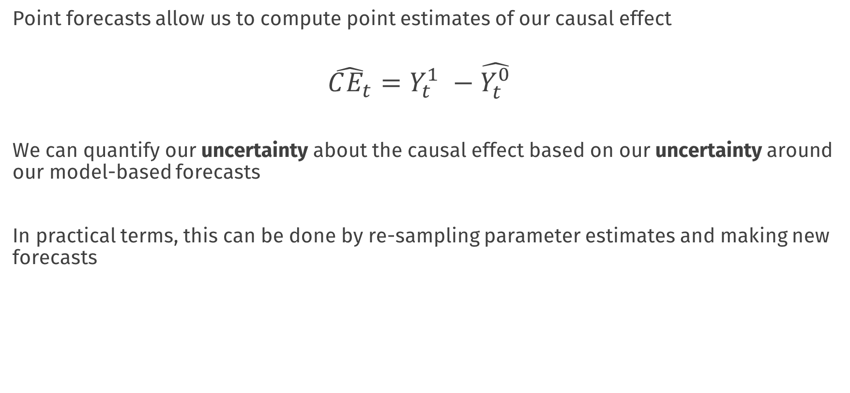
Interrupted Time Series
Point forecasts allow us to compute point estimates of our causal effect
$$\hat{CE_{t}}=Y_{t}^{1} −\hat{Y_{t}^{0}}$$
We can quantify our uncertainty about the causal effect based on our uncertainty around our model-based forecasts
In practical terms, this can be done by re-sampling parameter estimates and making new forecasts

Slide 24
Key Assumptions
Our inferences about the causal effect are entirely dependent on being able to fit an appropriate forecasting model
i.e. one that correctly captures the trend and autocorrelation structures in the data
In practice, this may be very difficult
Data driven approaches to fitting time series models (such as using model selection, cross-validation) exist and can be applied, but may only be feasible with a large amount of pre-intervention training data
Even then, different forecasting models come with their own assumptions, for example, that there is a constant trend, or time-invariant relationships in the pre-intervention period
Poor forecasts = Poor estimates (and uncertainty bounds) of causal effects

Slide 25
Key Assumptions
We also here rely on a no-confounding assumption, in the sense that we assume that any changes in the process under study can be attributed to the intervention
And not, e.g., something else that happened around the same time
When comparing to the pre-post design;
With many pre-intervention time points we can try to model any trend and serial dependence
But we still have to assume that any changes are due to the intervention, and not some other change (e.g., a naturally accelerating trend, global changes)
For that we need control units……. to follow….
Notes:
Notes; fuzzy regression discontinuity, check slides of Andrew heiss (sometimes you don’t have a single time point etc.)

Slide 26
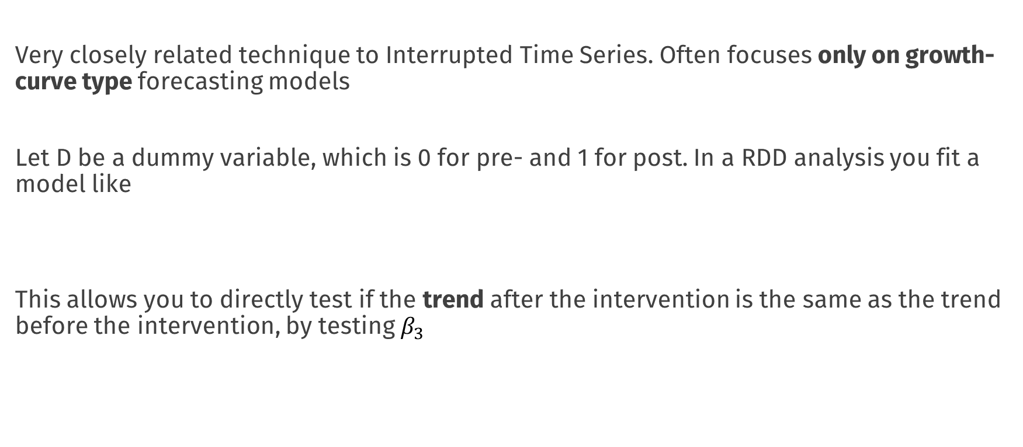
On Regression Discontinuity
Very closely related technique to Interrupted Time Series. Often focuses only on growth-curve type forecasting models
Let D be a dummy variable, which is 0 for pre- and 1 for post. In a RDD analysis you fit a model like
This allows you to directly test if the trend after the intervention is the same as the trend before the intervention, by testing $β_{3}$
$$Y_{t}=β_{0}+β_{1}D{+ β}_{2} Time+β_{3}∗Time ∗D+e_{t}$$

Slide 27
Figure RDD design, two slopes

Slide 28
Advantages: More direct, significance test on B3 is a test of whether the causal effect is zero
Disadvantages: again, you need to rely on correct model specification, and to be able to model “where” the intervention has an effect
ITS; you don’t need this, you only see if observations are “unusual” relative to what you would expect from the best fitting TS model (don’t need model interpretability for that)

Slide 29
Default light slide
Default subheading
This is the body of the text
Default subheading
Note that the text is not black, but “black, text 1, lighter 25%”
Default subheading
This makes things easier on the eyes
Default subheading
This is the body of the text

Slide 30
Default light slide
Default subheading
This is the body of the text
Default subheading
Note that the text is not black, but “black, text 1, lighter 25%”
Default subheading
This makes things easier on the eyes
Default subheading
This is the body of the text

Slide 31
Default light slide
Default subheading
This is the body of the text
Default subheading
Note that the text is not black, but “black, text 1, lighter 25%”
Default subheading
This makes things easier on the eyes
Default subheading
This is the body of the text

Slide 32
Default light slide
Default subheading
This is the body of the text
Default subheading
Note that the text is not black, but “black, text 1, lighter 25%”
Default subheading
This makes things easier on the eyes
Default subheading
This is the body of the text

Slide 33
Estimating the causal effect
Basic methods

Slide 34

Data analysis & visualisation
Workshop rijksoverheid
Erik-Jan van Kesteren

Slide 35
Practical: dplyr, ggplot, tidyr
Work in your groups!
Take a break from 10:30 to 10:40

Slide 36
Break

Slide 37
Default light slide
Default subheading
This is the body of the text
Default subheading
Note that the text is not black, but “black, text 1, lighter 25%”
Default subheading
This makes things easier on the eyes
Default subheading
This is the body of the text

Slide 38
Default dark slide
Default subheading
The dark slide brings some variation
Default subheading
It can highlight important aspects of the presentation.
Default subheading
This is the body of the text
Default subheading
This is the body of the text

Slide 39
Is this an impact slide?

Slide 40
Here is an impactful slide with a sentence on it.
Here is a topic related to the aforementioned question.

Slide 41
Questions?

