Slide 1
Estimating the causal effect
Synthetic control method

Slide 2
,,arguably the most important innovation in the policy evaluation literature in the last 15 years”
Athey, S., & Imbens, G. W. (2017). The state of applied econometrics: Causality and policy evaluation. Journal of Economic perspectives, 31(2), 3-32.

Slide 3
In this part
Introducing the synthetic control method
How to quantify uncertainty
What choices do we need to make and how do these impact our causal effect estimates?
Performing the synthetic control method with tidysynth package

Slide 4
Synthetic control

Slide 5
Basic idea
With diff-in-diff we used a control unit to attempt a correction for unmeasured time-varying confounders (e.g., macroeconomic situation in U.S.A.)
You need a good control unit!
How much is Utah like California?
We can instead use a weighted average of a donor pool of control units to create a synthetic control unit
Choose the weights such that control is like California

Slide 6
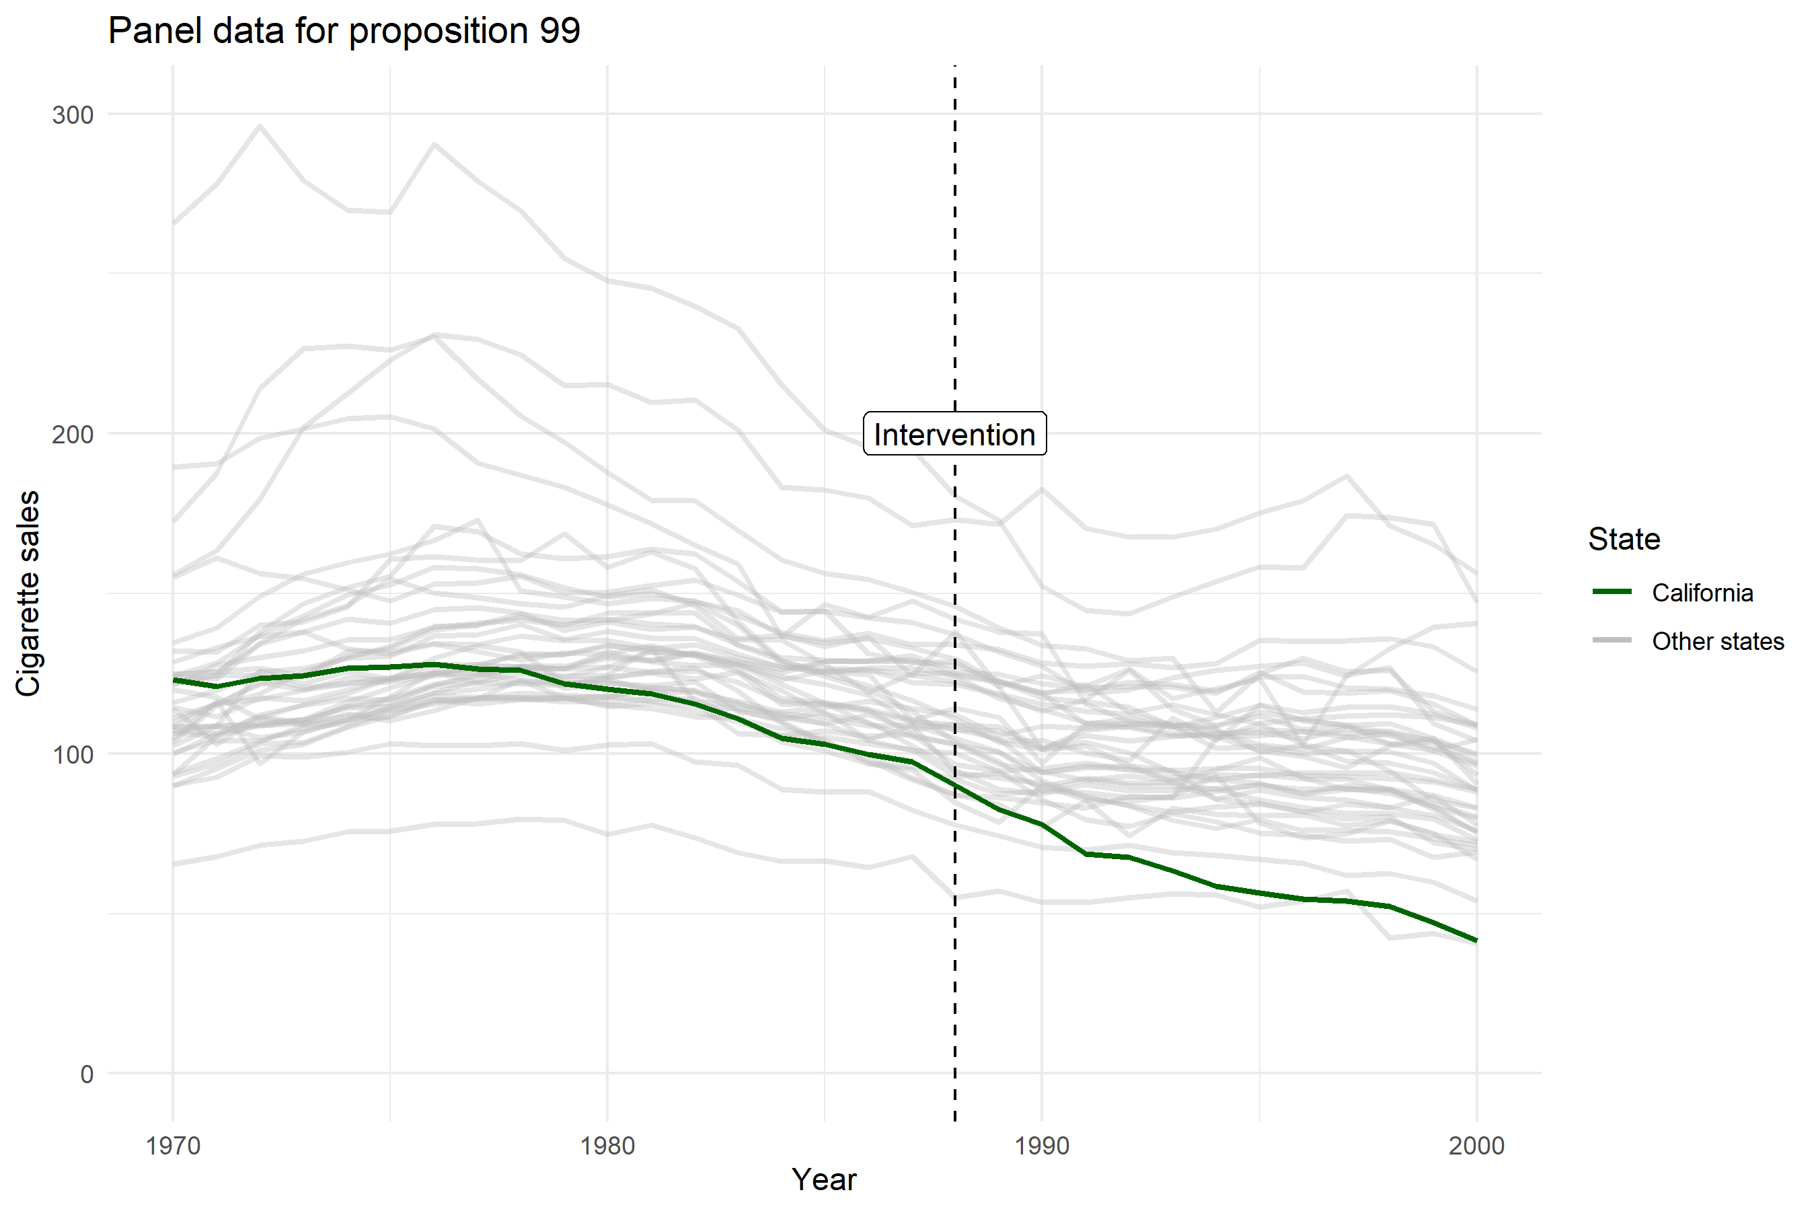

Slide 7
Synthetic control
Introduced in 2000s
Abadie, A., & Gardeazabal, J. (2003). The economic costs of conflict: A case study of the Basque Country. American Economic Review, 93(1), 113-132.
Abadie, A., Diamond, A., & Hainmueller, J. (2010). Synthetic control methods for comparative case studies: Estimating the effect of California’s tobacco control program. Journal of the American Statistical Association, 105(490), 493-505.
An R package with JSS paper in 2011
Abadie, A., Diamond, A., & Hainmueller, J. (2011). Synth: An R package for synthetic control methods in comparative case studies. Journal of Statistical Software, 42(13).
A great overview paper with recent learnings in 2021
Abadie, A. (2021). Using synthetic controls: Feasibility, data requirements, and methodological aspects. Journal of Economic Literature, 59(2), 391-425.

Slide 8
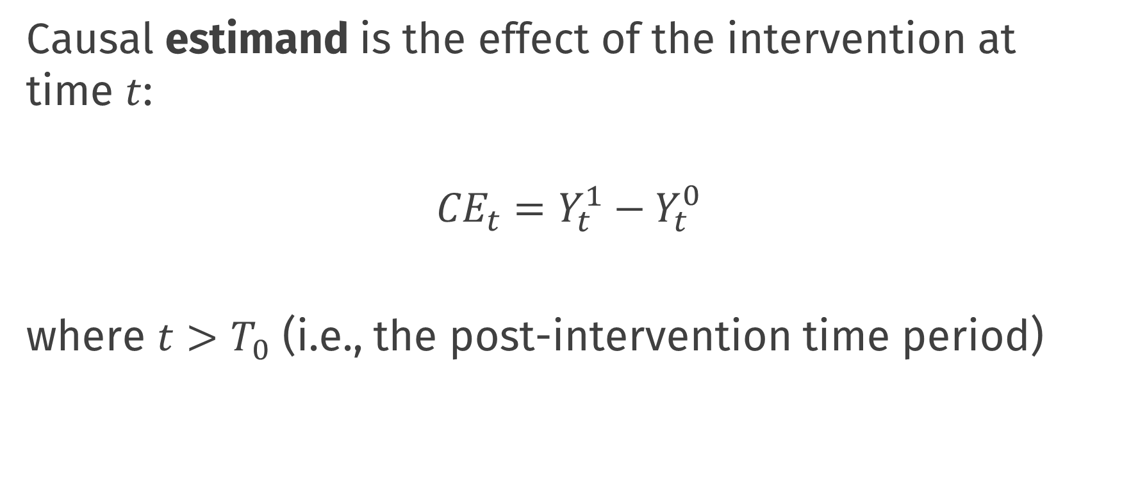
Synthetic control
Causal estimand is the effect of the intervention at time $t$:
$${CE}_{t}=Y_{t}^{1}−Y_{t}^{0}$$
where $t>T_{0}$ (i.e., the post-intervention time period)

Slide 9
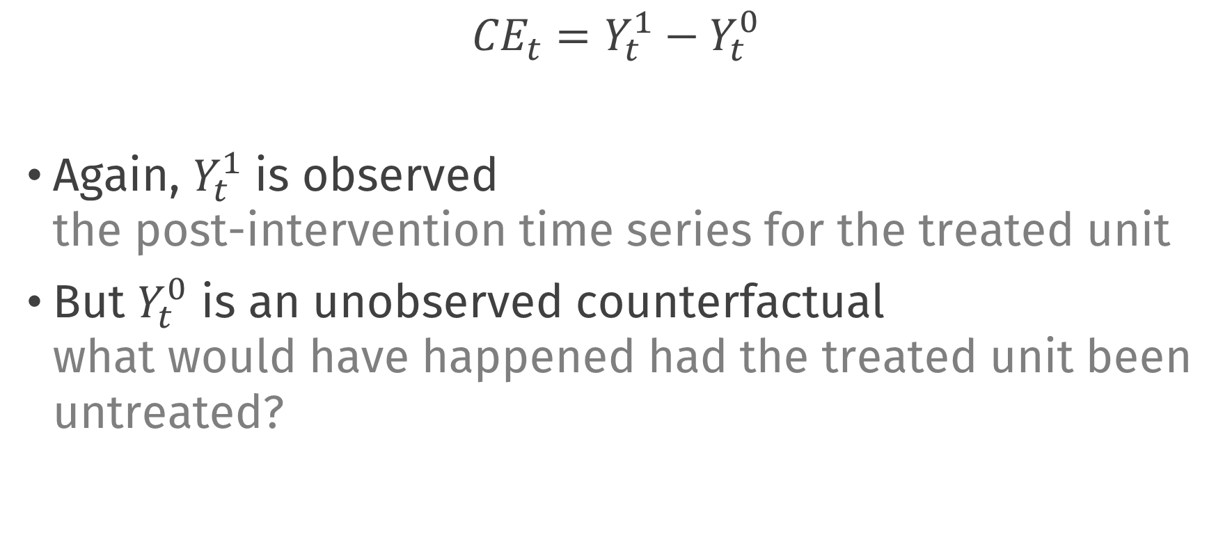
Synthetic control
$${CE}_{t}=Y_{t}^{1}−Y_{t}^{0}$$
Again, $Y_{t}^{1}$ is observed the post-intervention time series for the treated unit
But $Y_{t}^{0}$ is an unobserved counterfactual what would have happened had the treated unit been untreated?

Slide 10
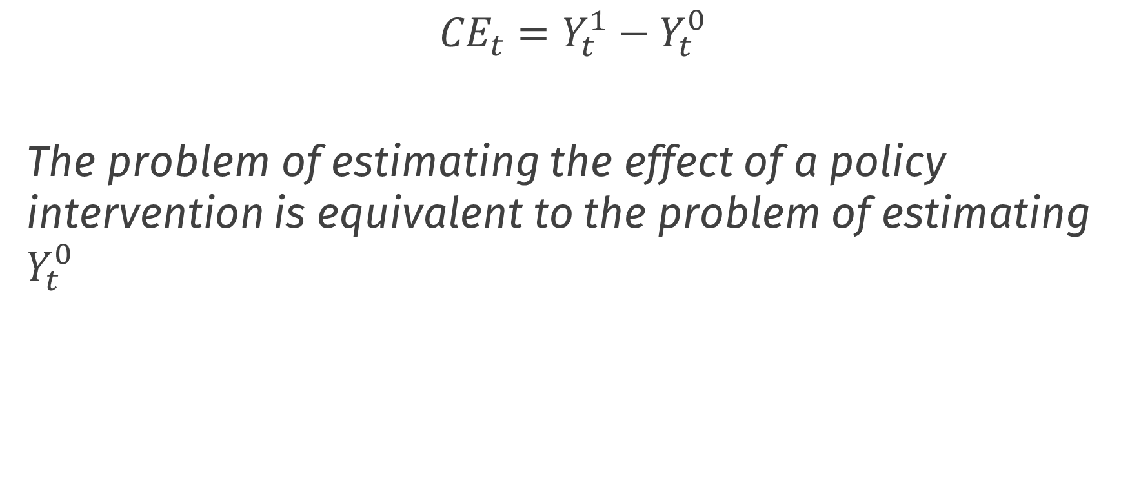
Synthetic control
$${CE}_{t}=Y_{t}^{1}−Y_{t}^{0}$$
The problem of estimating the effect of a policy intervention is equivalent to the problem of estimating $Y_{t}^{0}$
Abadie, A. (2021). Using synthetic controls: Feasibility, data requirements, and methodological aspects. Journal of Economic Literature, 59(2), 391-425.

Slide 11
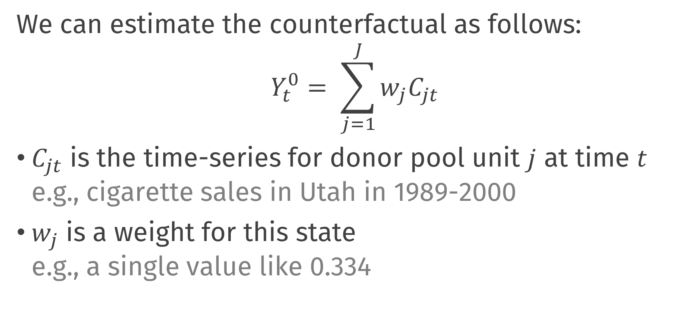
Synthetic control
We can estimate the counterfactual as follows:
$$Y_{t}^{0}= \sum_{j=1}^{J}{w_{j}C_{jt}}$$
$C_{jt}$ is the time-series for donor pool unit $j$ at time $t$ e.g., cigarette sales in Utah in 1989-2000
$w_{j}$ is a weight for this state e.g., a single value like 0.334

Slide 12
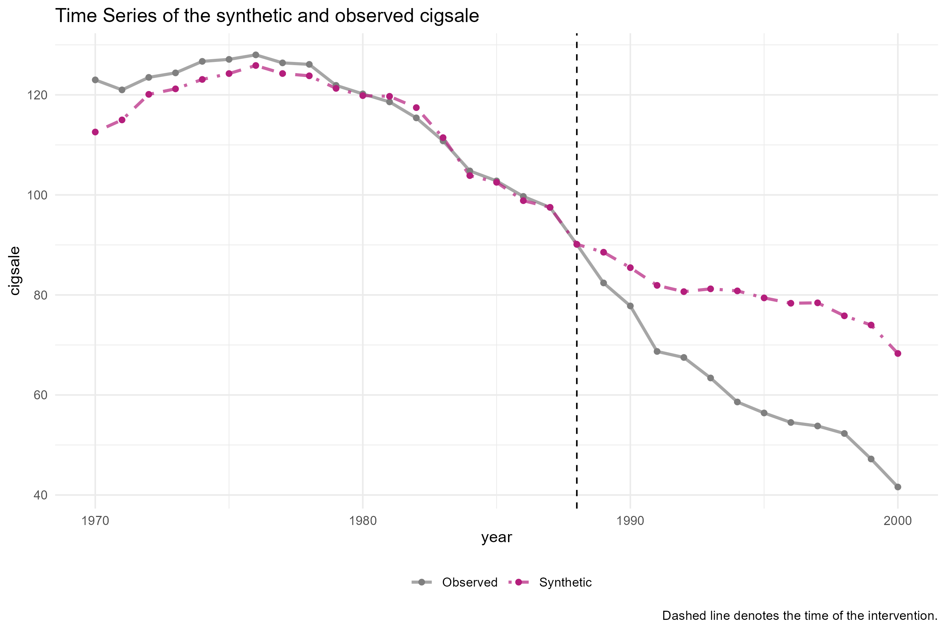


$$Y_{t}^{0}$$
$$Y_{t}^{1}$$

Slide 13
Three questions
How to choose the weights?
Which units can go in the donor pool?
How to make sure that the synthetic control is interpretable?

Slide 14
Estimating weights

Slide 15
Estimating weights
Choose weights such that the synthetic control looks like the treated unit
Use only pre-intervention data for this
Weights should be positive and sum to one Interpolation constraint / convex hull

Slide 16
Estimating weights
What does it mean to looks like California? This is a choice by the researcher!
Pre-intervention target variables
Cigarette sales
Pre-intervention covariates
Population composition
Average income of population
Price of cigarettes
Beer consumption

Slide 17
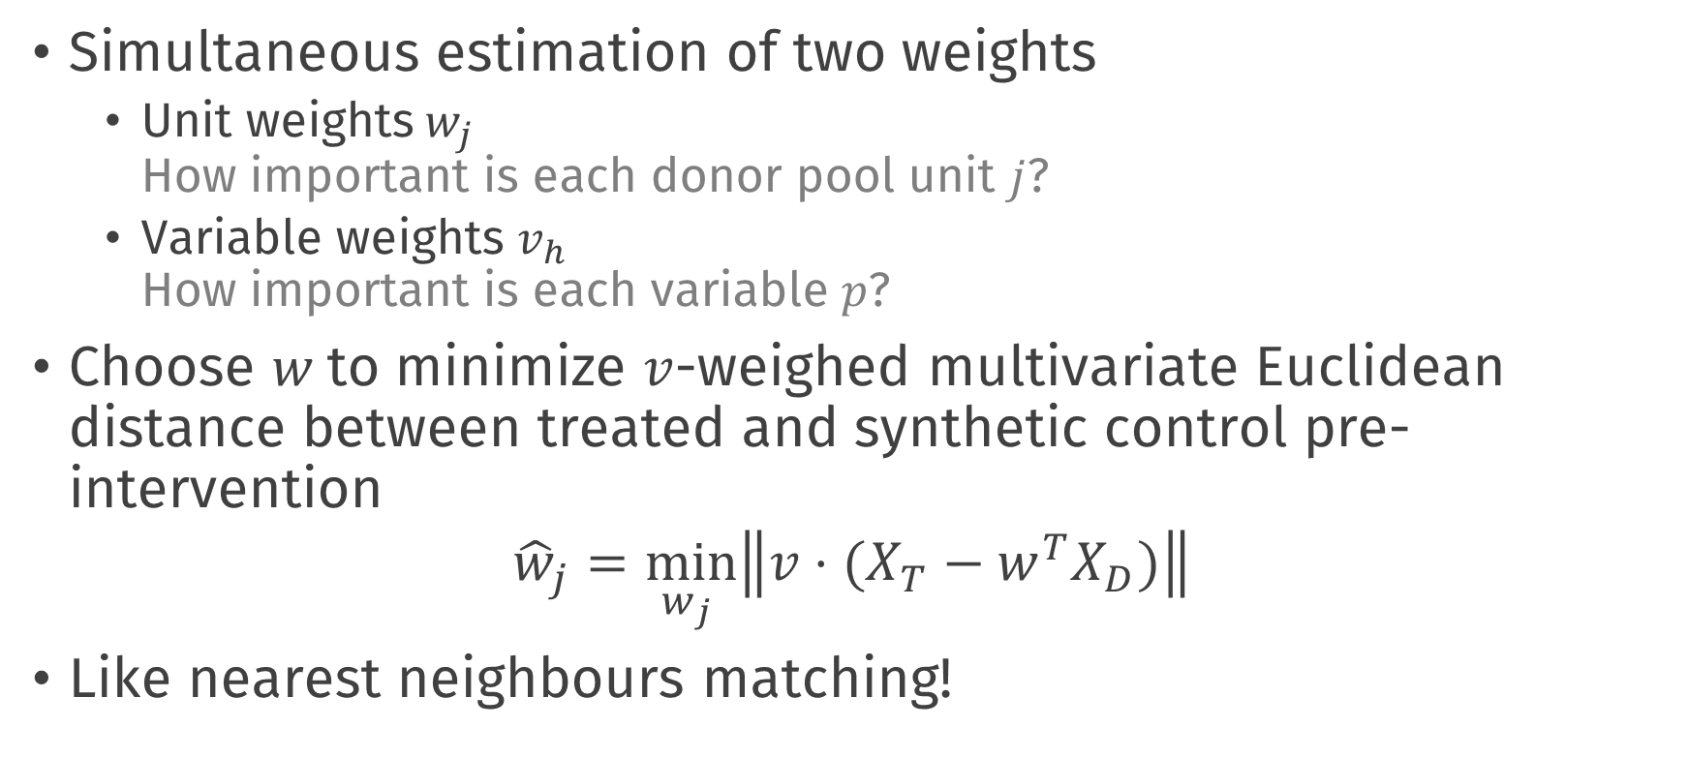
Estimating weights
Simultaneous estimation of two weights
Unit weights$w_{j}$ How important is each donor pool unit $j$?
Variable weights $v_{h}$ How important is each variable $p$?
Choose $w$to minimize $v$-weighed multivariate Euclidean distance between treated and synthetic control pre-intervention
$${\hat{w}}_{j}=\min_{w_{j} }\left\|v⋅(\left.X_{T}−w^{T}X_{D})\right\|\right.$$
Like nearest neighbours matching!

Slide 18
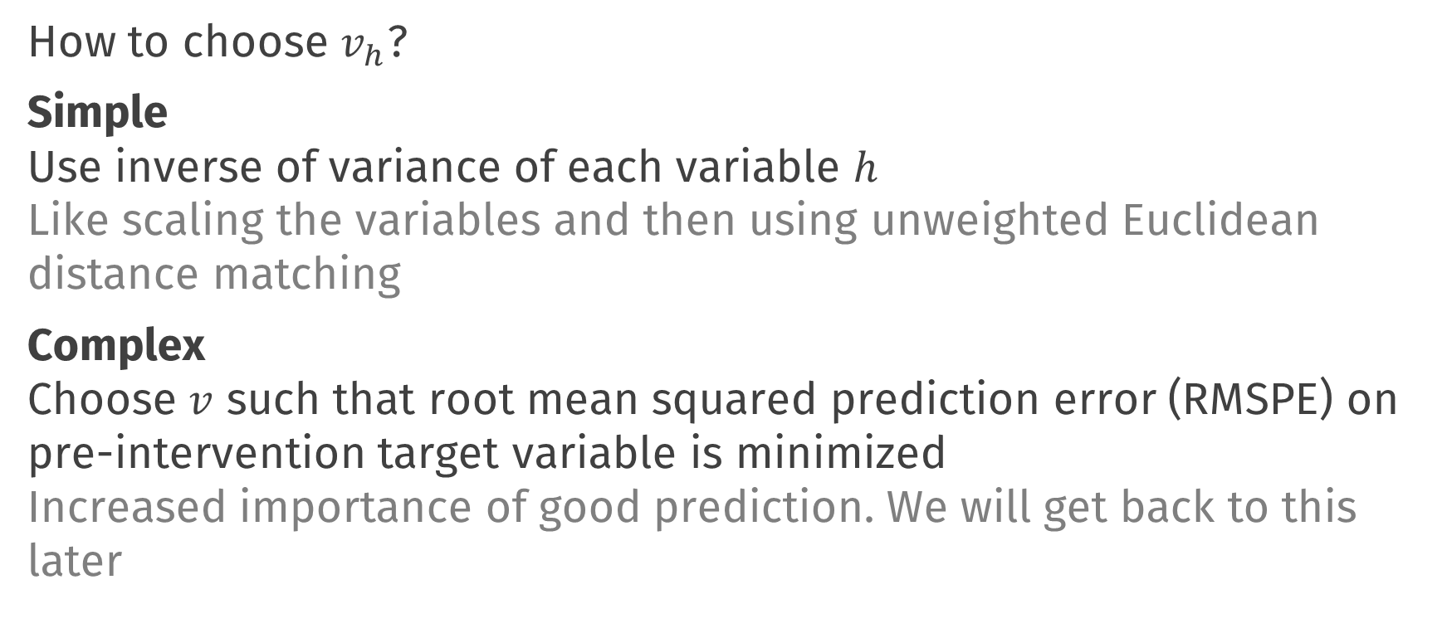
Estimating weights
How to choose $v_{h}$?
Simple Use inverse of variance of each variable $h$ Like scaling the variables and then using unweighted Euclidean distance matching
Complex Choose $v$ such that root mean squared prediction error (RMSPE) on pre-intervention target variable is minimized Increased importance of good prediction. We will get back to this later

Slide 19
Choosing donor pool

Slide 20
No interference / spillover
The donor pool unit does not receive any intervention effect
Example spillover effects
Californians living near the border may buy their cigarettes in states across the border
Other states may pass laws similar to on California

Slide 21
Measurement
Measure control variables and target variable in the donor pool unit before and after the intervention
Ideally, large pre-intervention time window Otherwise, risk overfitting pre-intervention; bad prediction for counterfactual
Be able to measure target variable after intervention counterfactual is weighted average of this

Slide 22
Convex hull condition
Distribution of control and target variables in donor pool should cover treated unit
It should be possible to interpolate the target unit values pre-intervention using the donor pool units
If donor pool units all have much higher cigarette sales, it is impossible to represent cigarette sales in California using positive weights which sum to 1

Slide 23
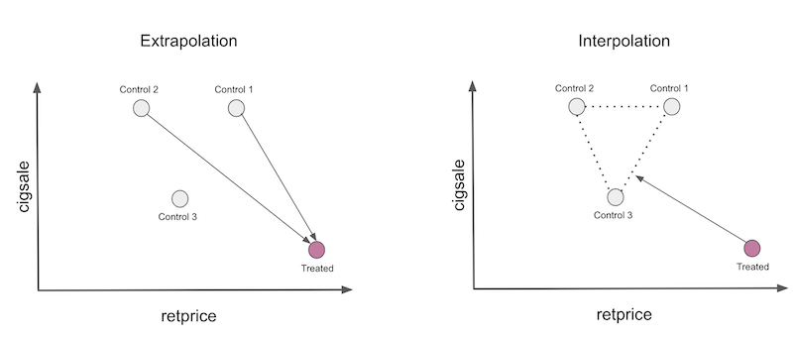
Interpolation
Alves, M. F. (2022). Causal inference for the brave and true.

Slide 24
Interpretability

Slide 25
Interpretability
If donor pool is large, synthetic control can be combination of many units
Hard to interpret what the synthetic control unit is!
Therefore: sparse estimation of weights
Additional penalty such that most weights are 0
The units belonging to nonzero weights can be manually inspected

Slide 26
Synthetic control using tidysynth

Slide 27
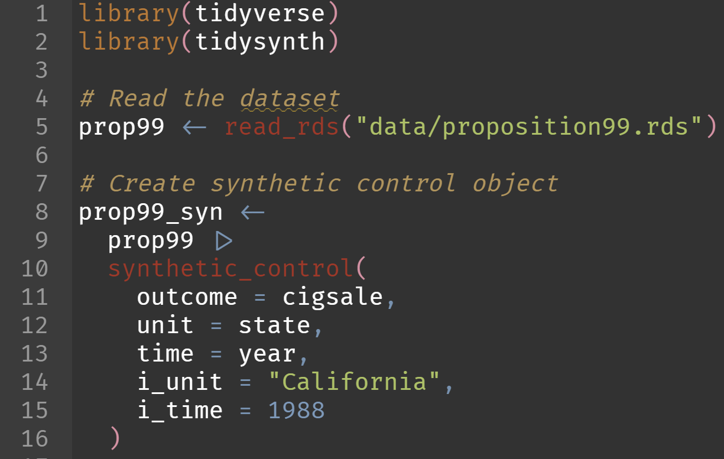
Synthetic control in practice

Slide 28
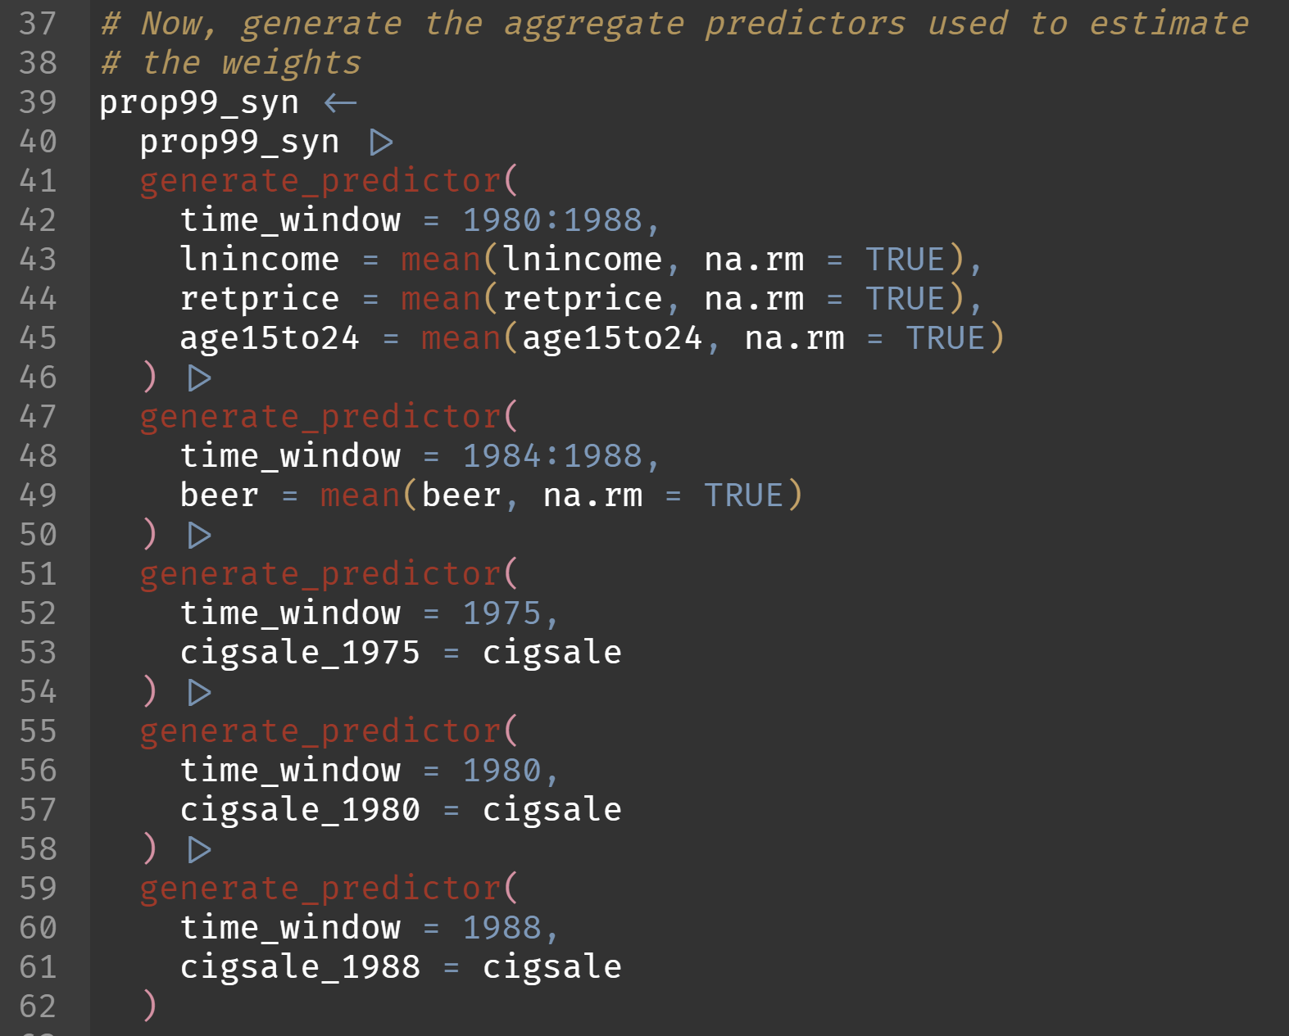

Slide 29
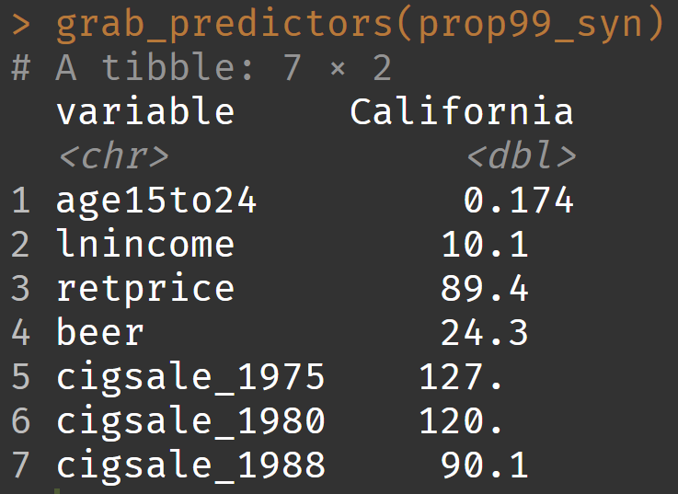
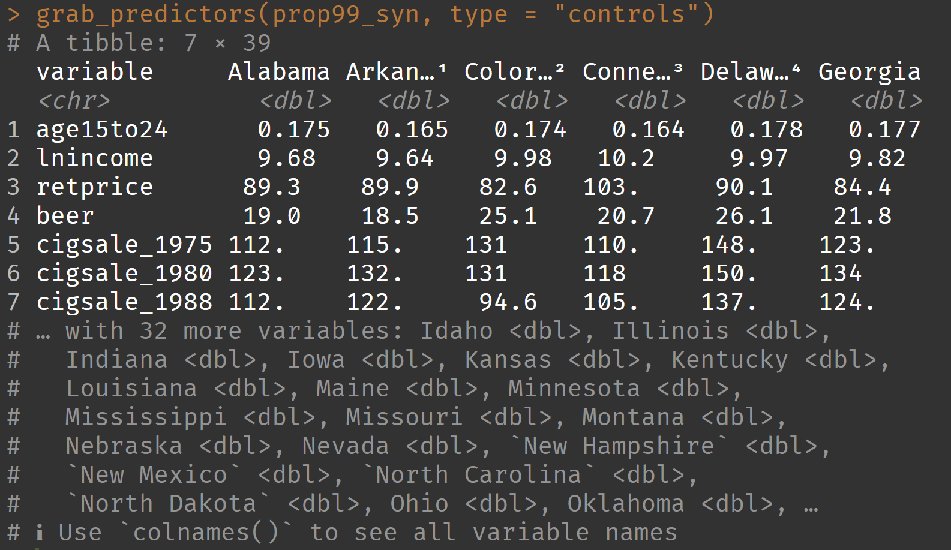
Inspecting predictors

Slide 30
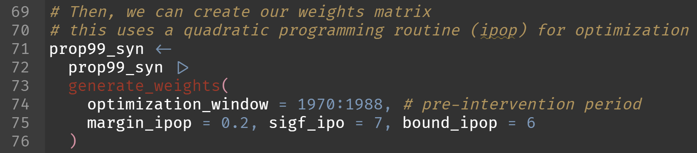
Estimating weights (magic!)

Slide 31
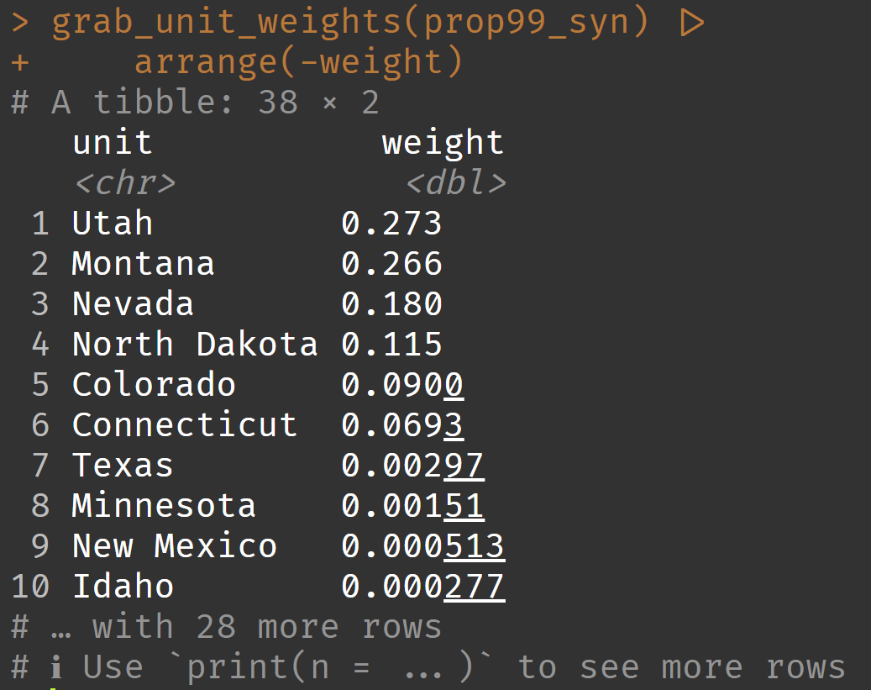
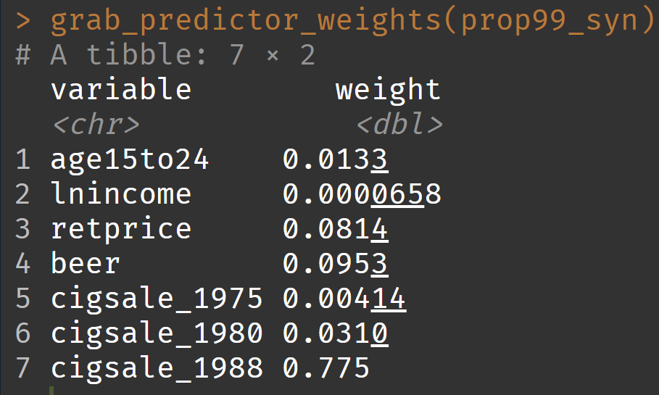
Inspecting weights

Slide 32
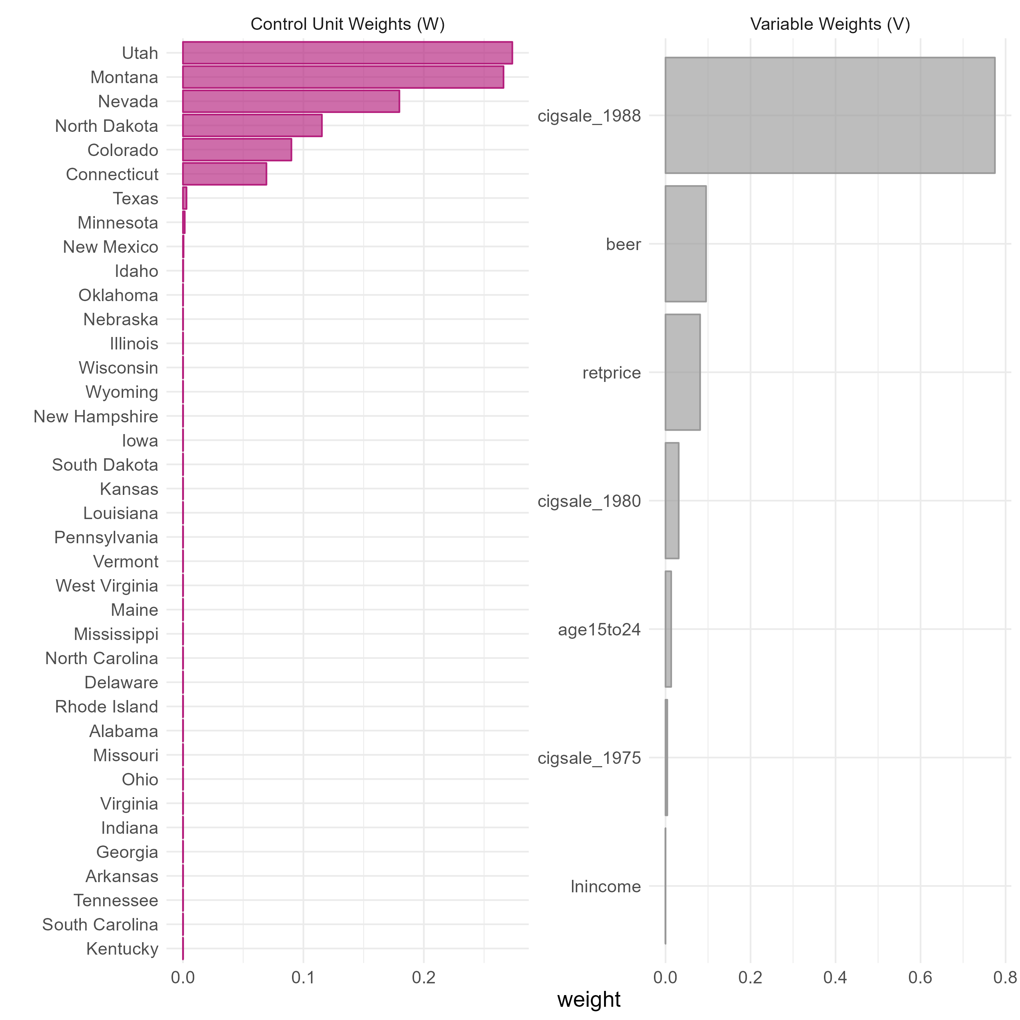

Slide 33
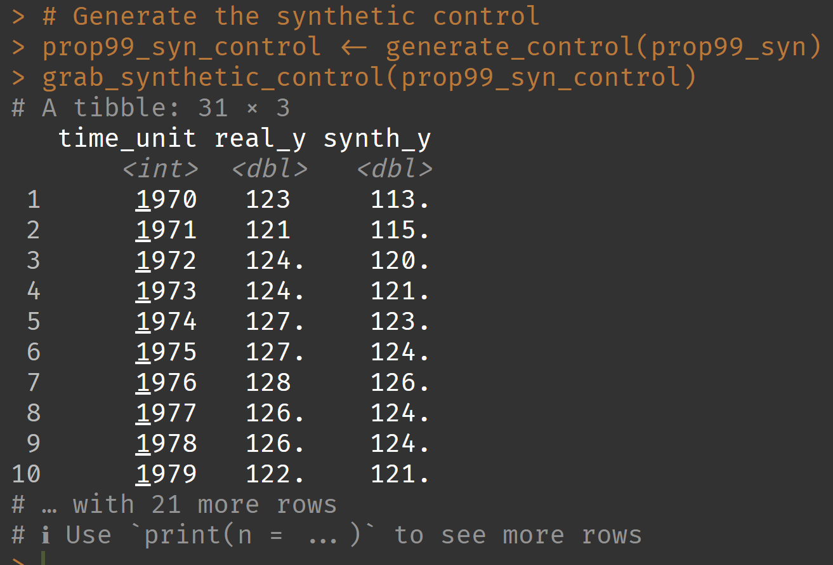
Creating synthetic control

Slide 35
Inference

Slide 37
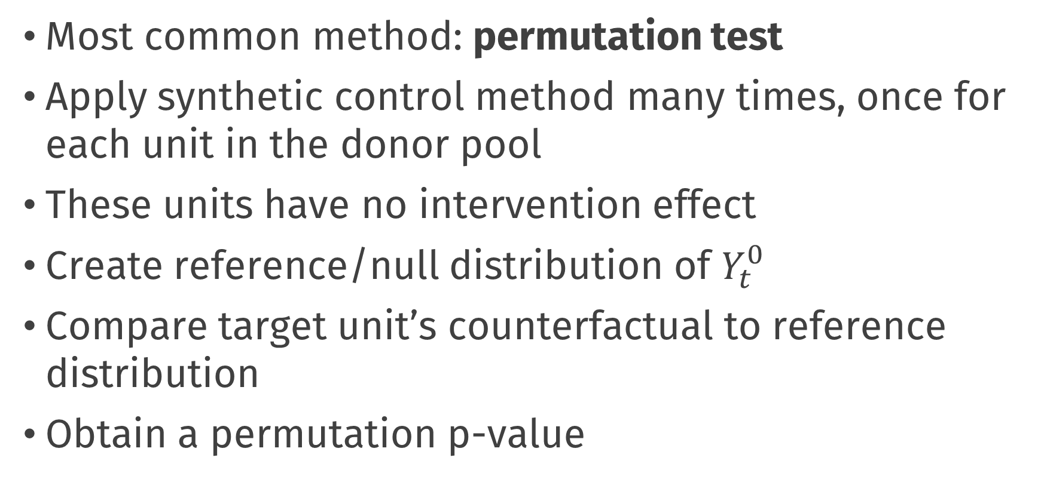
How to quantify uncertainty?
Most common method: permutation test
Apply synthetic control method many times, once for each unit in the donor pool
These units have no intervention effect
Create reference/null distribution of $Y_{t}^{0}$
Compare target unit’s counterfactual to reference distribution
Obtain a permutation p-value

Slide 38
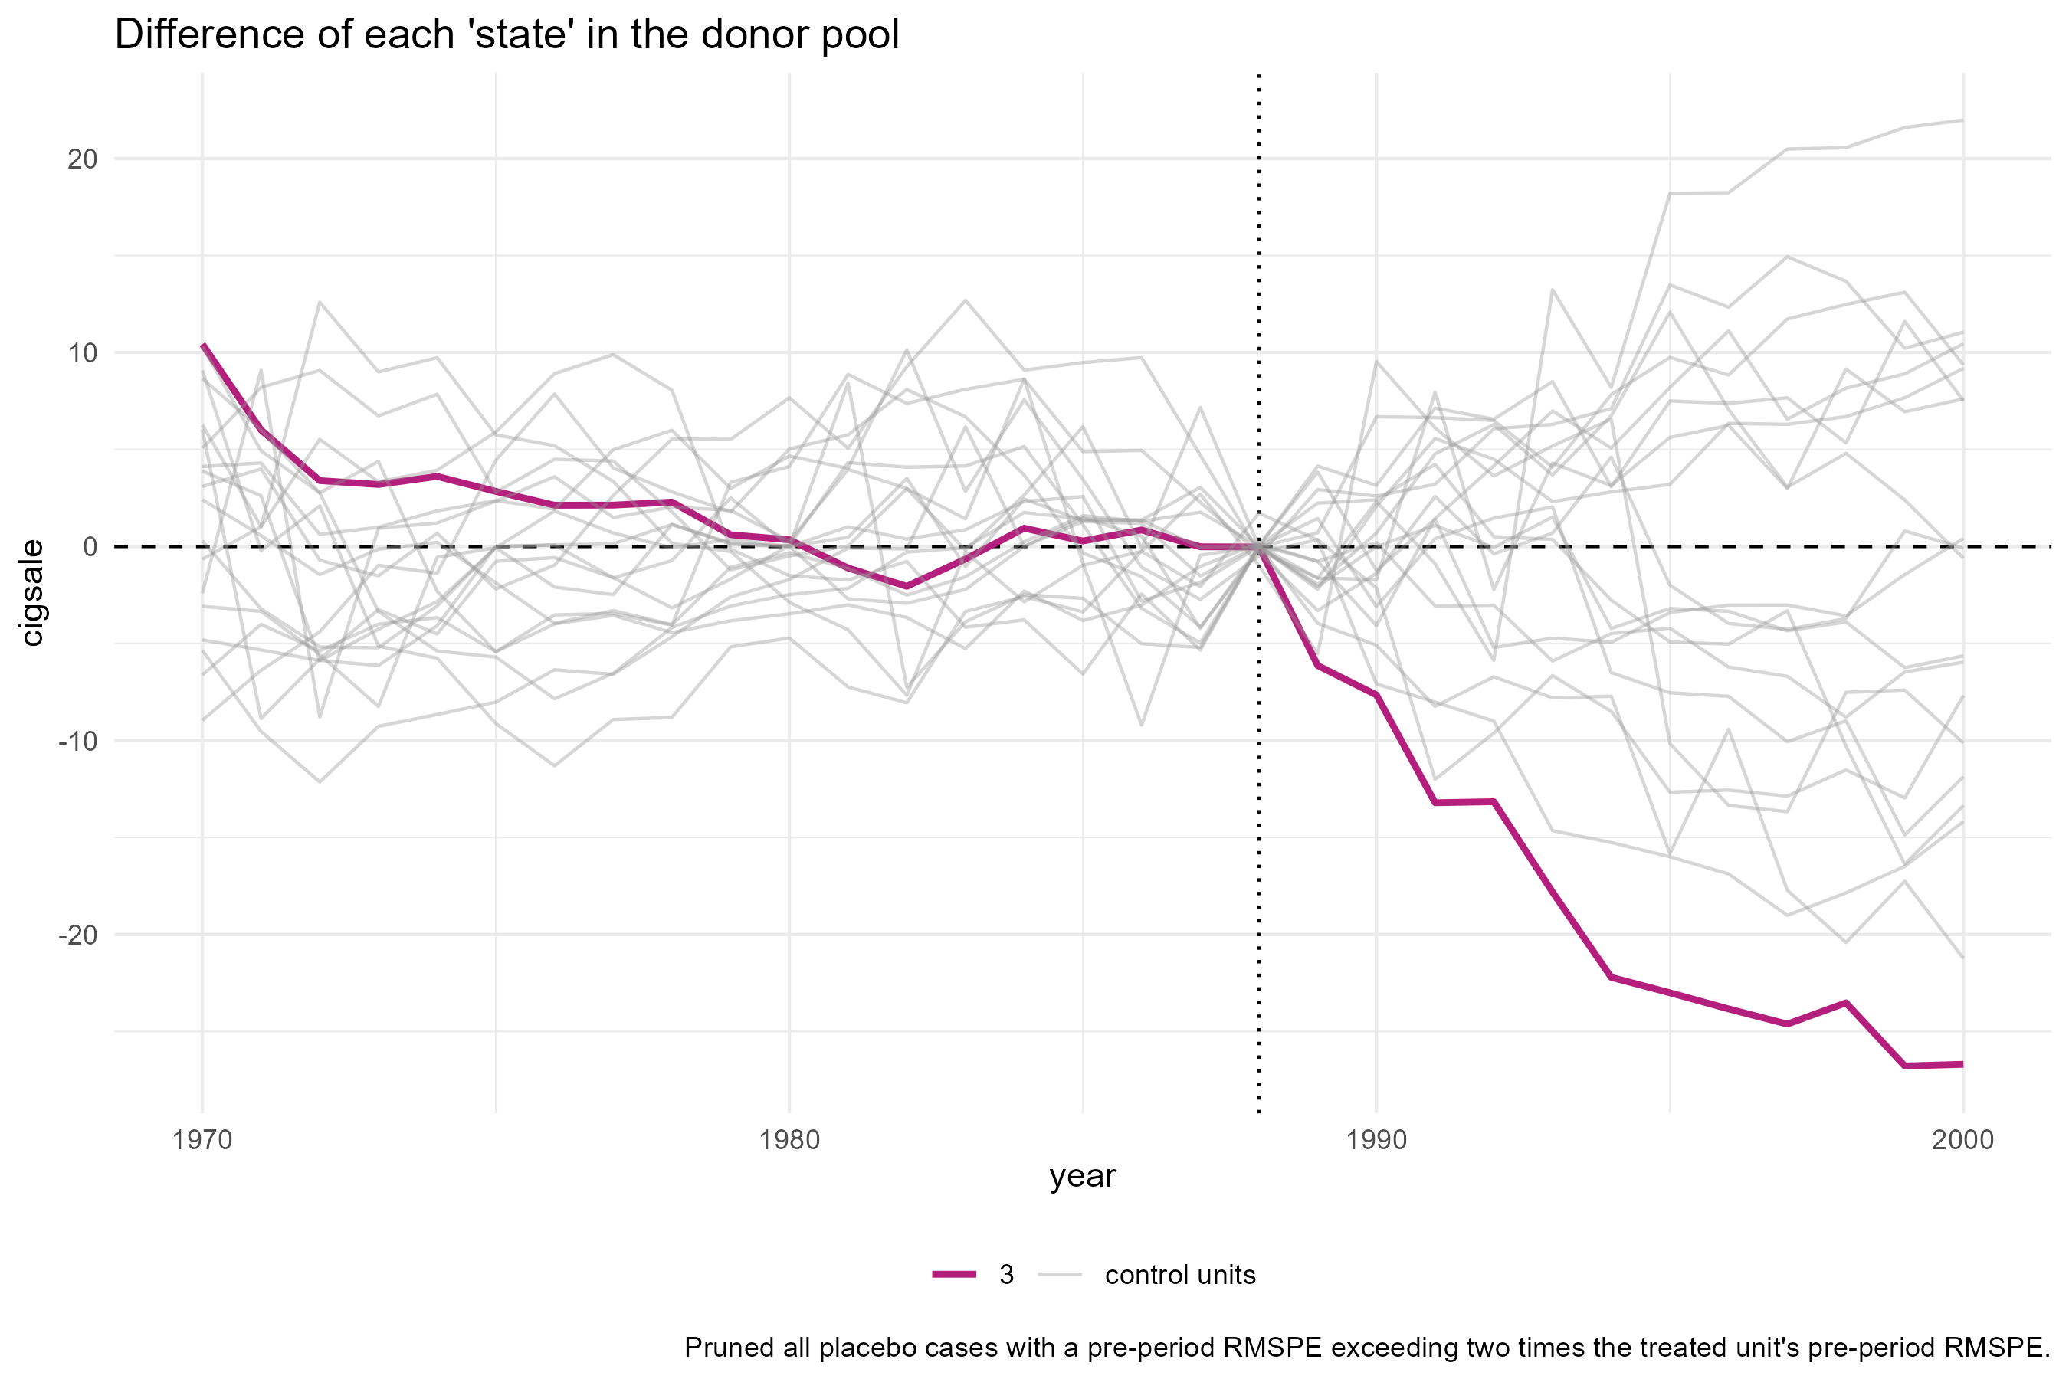

Slide 39
Choices, choices …

Slide 40
There are many choices
Which units in the donor pool?
Which control variables?
What should my weights optimize?
How many nonzero unit weights should I get?
What settings do I give to the nonlinear optimizer?
“researcher degrees of freedom”

Slide 41
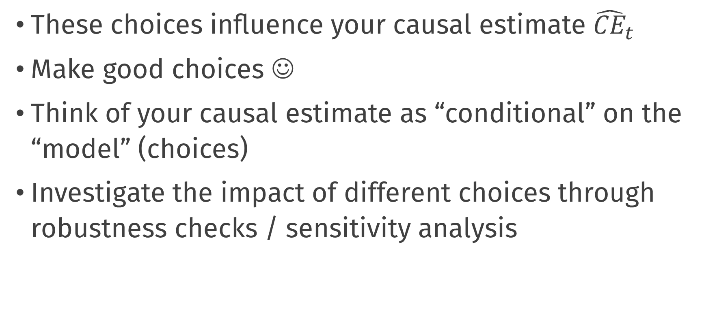
There are many choices
These choices influence your causal estimate ${\hat{CE}}_{t}$
Make good choices ☺
Think of your causal estimate as “conditional” on the “model” (choices)
Investigate the impact of different choices through robustness checks / sensitivity analysis

Slide 42
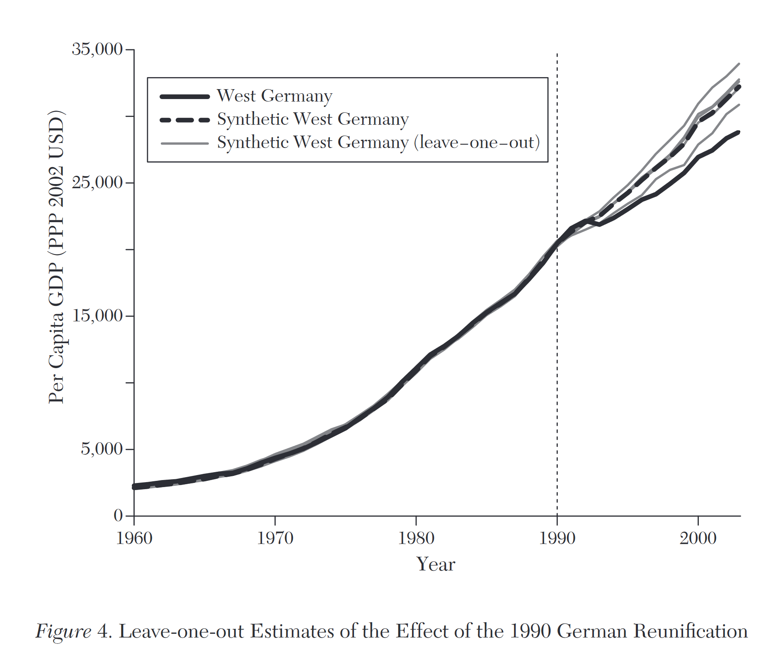
Leave-one-unit-out validation

Slide 43
More of this in the practical

Slide 44
Practical: tidysynth, inference, robustness
Work in your groups!
Take a break from 14:30 to 14:45

Slide 45
Break

Slide 46
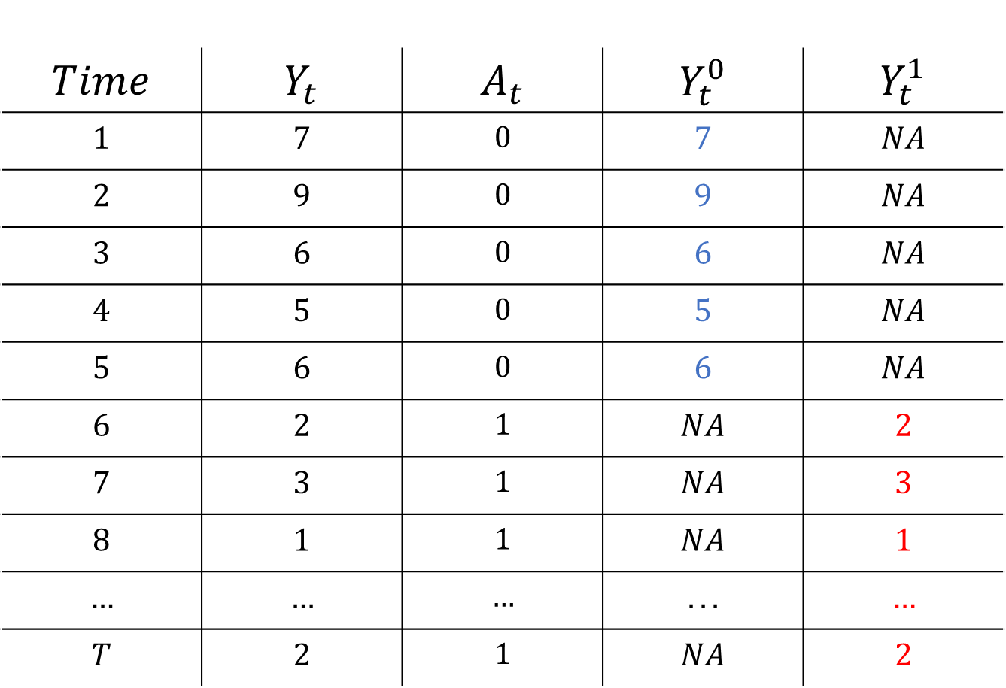
$$Time$$ | $$Y_{t}$$ | $$A_{t}$$ | $$Y_{t}^{0}$$ | $$Y_{t}^{1}$$
$$1$$ | $$7$$ | $$0$$ | $$7$$ | $$NA$$
$$2$$ | $$9$$ | $$0$$ | $$9$$ | $$NA$$
$$3$$ | $$6$$ | $$0$$ | $$6$$ | $$NA$$
$$4$$ | $$5$$ | $$0$$ | $$5$$ | $$NA$$
$$5$$ | $$6$$ | $$0$$ | $$6$$ | $$NA$$
$$6$$ | $$2$$ | $$1$$ | $$NA$$ | $$2$$
$$7$$ | $$3$$ | $$1$$ | $$NA$$ | $$3$$
$$8$$ | $$1$$ | $$1$$ | $$NA$$ | $$1$$
$$…$$ | $$…$$ | $$…$$ | $$...$$ | $$…$$
$$T$$ | $$2$$ | $$1$$ | $$NA$$ | $$2$$

Slide 47
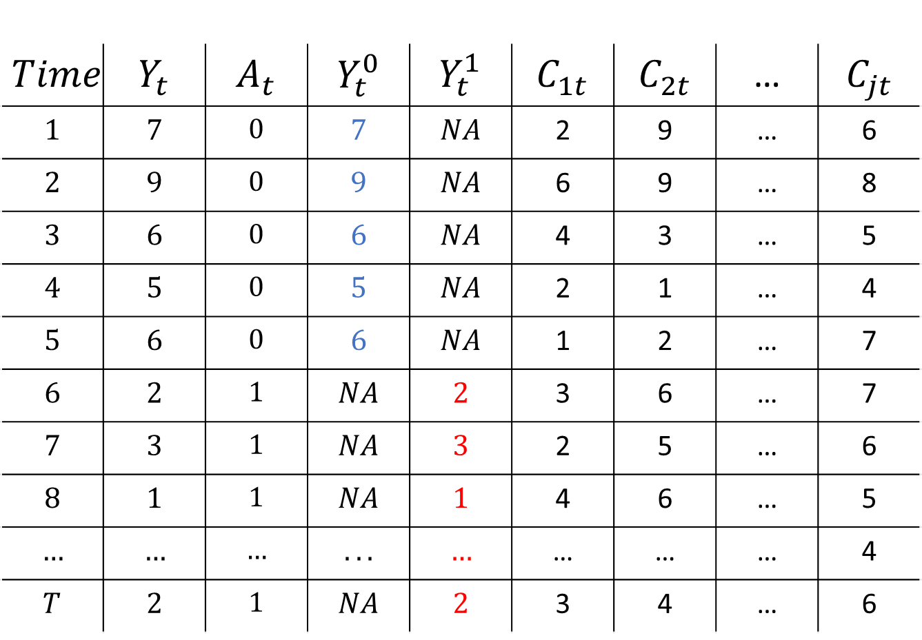
$$Time$$ | $$Y_{t}$$ | $$A_{t}$$ | $$Y_{t}^{0}$$ | $$Y_{t}^{1}$$ | $$C_{1t}$$ | $$C_{2t}$$ | … | $$C_{jt}$$
$$1$$ | $$7$$ | $$0$$ | $$7$$ | $$NA$$ | 2 | 9 | … | 6
$$2$$ | $$9$$ | $$0$$ | $$9$$ | $$NA$$ | 6 | 9 | … | 8
$$3$$ | $$6$$ | $$0$$ | $$6$$ | $$NA$$ | 4 | 3 | … | 5
$$4$$ | $$5$$ | $$0$$ | $$5$$ | $$NA$$ | 2 | 1 | … | 4
$$5$$ | $$6$$ | $$0$$ | $$6$$ | $$NA$$ | 1 | 2 | … | 7
$$6$$ | $$2$$ | $$1$$ | $$NA$$ | $$2$$ | 3 | 6 | … | 7
$$7$$ | $$3$$ | $$1$$ | $$NA$$ | $$3$$ | 2 | 5 | … | 6
$$8$$ | $$1$$ | $$1$$ | $$NA$$ | $$1$$ | 4 | 6 | … | 5
$$…$$ | $$…$$ | $$…$$ | $$...$$ | $$…$$ | … | … | … | 4
$$T$$ | $$2$$ | $$1$$ | $$NA$$ | $$2$$ | 3 | 4 | … | 6

Slide 48
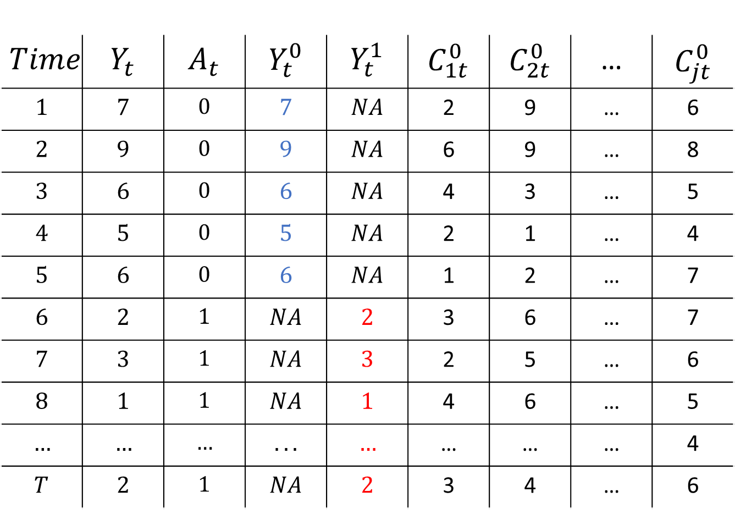
$$Time$$ | $$Y_{t}$$ | $$A_{t}$$ | $$Y_{t}^{0}$$ | $$Y_{t}^{1}$$ | $$C_{1t}^{0}$$ | $$C_{2t}^{0}$$ | … | $$C_{jt}^{0}$$
$$1$$ | $$7$$ | $$0$$ | $$7$$ | $$NA$$ | 2 | 9 | … | 6
$$2$$ | $$9$$ | $$0$$ | $$9$$ | $$NA$$ | 6 | 9 | … | 8
$$3$$ | $$6$$ | $$0$$ | $$6$$ | $$NA$$ | 4 | 3 | … | 5
$$4$$ | $$5$$ | $$0$$ | $$5$$ | $$NA$$ | 2 | 1 | … | 4
$$5$$ | $$6$$ | $$0$$ | $$6$$ | $$NA$$ | 1 | 2 | … | 7
$$6$$ | $$2$$ | $$1$$ | $$NA$$ | $$2$$ | 3 | 6 | … | 7
$$7$$ | $$3$$ | $$1$$ | $$NA$$ | $$3$$ | 2 | 5 | … | 6
$$8$$ | $$1$$ | $$1$$ | $$NA$$ | $$1$$ | 4 | 6 | … | 5
$$…$$ | $$…$$ | $$…$$ | $$...$$ | $$…$$ | … | … | … | 4
$$T$$ | $$2$$ | $$1$$ | $$NA$$ | $$2$$ | 3 | 4 | … | 6

Slide 49

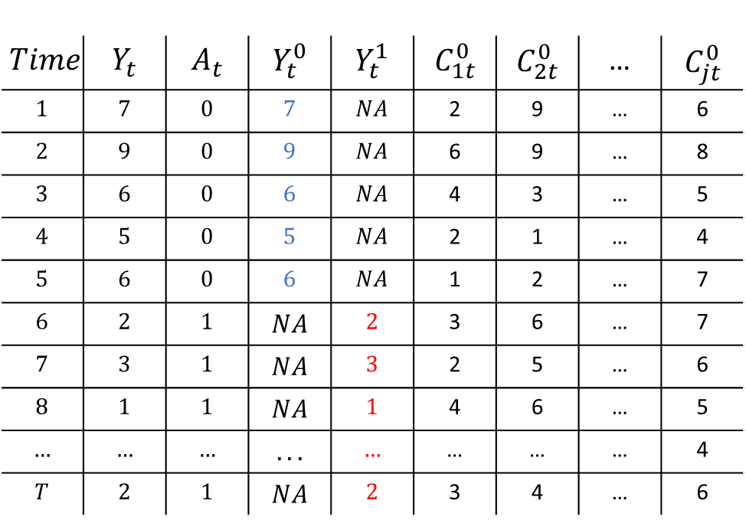
Synthetic Control
$$Time$$ | $$Y_{t}$$ | $$A_{t}$$ | $$Y_{t}^{0}$$ | $$Y_{t}^{1}$$ | $$C_{1t}^{0}$$ | $$C_{2t}^{0}$$ | … | $$C_{jt}^{0}$$
$$1$$ | $$7$$ | $$0$$ | $$7$$ | $$NA$$ | 2 | 9 | … | 6
$$2$$ | $$9$$ | $$0$$ | $$9$$ | $$NA$$ | 6 | 9 | … | 8
$$3$$ | $$6$$ | $$0$$ | $$6$$ | $$NA$$ | 4 | 3 | … | 5
$$4$$ | $$5$$ | $$0$$ | $$5$$ | $$NA$$ | 2 | 1 | … | 4
$$5$$ | $$6$$ | $$0$$ | $$6$$ | $$NA$$ | 1 | 2 | … | 7
$$6$$ | $$2$$ | $$1$$ | $$NA$$ | $$2$$ | 3 | 6 | … | 7
$$7$$ | $$3$$ | $$1$$ | $$NA$$ | $$3$$ | 2 | 5 | … | 6
$$8$$ | $$1$$ | $$1$$ | $$NA$$ | $$1$$ | 4 | 6 | … | 5
$$…$$ | $$…$$ | $$…$$ | $$...$$ | $$…$$ | … | … | … | 4
$$T$$ | $$2$$ | $$1$$ | $$NA$$ | $$2$$ | 3 | 4 | … | 6
Estimate Weights
$$Y_{t}= \sum_{j=1}^{J}{\hat{w_{j}}C_{jt}}$$
t < s

Slide 50
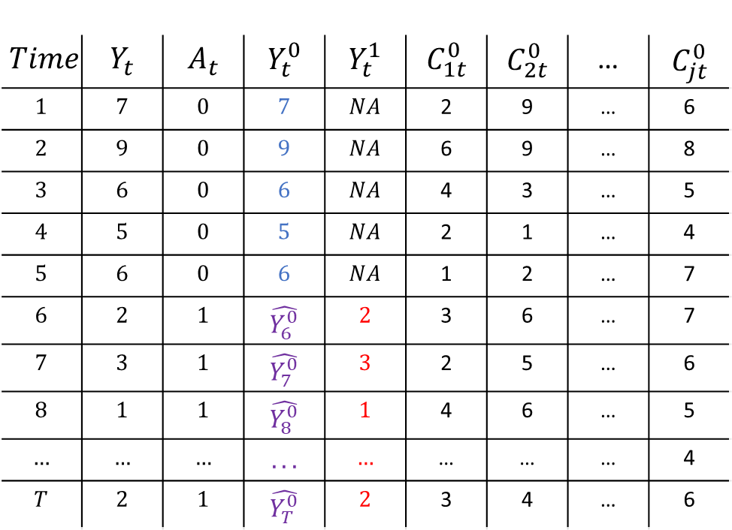


Synthetic Control
$$Time$$ | $$Y_{t}$$ | $$A_{t}$$ | $$Y_{t}^{0}$$ | $$Y_{t}^{1}$$ | $$C_{1t}^{0}$$ | $$C_{2t}^{0}$$ | … | $$C_{jt}^{0}$$
$$1$$ | $$7$$ | $$0$$ | $$7$$ | $$NA$$ | 2 | 9 | … | 6
$$2$$ | $$9$$ | $$0$$ | $$9$$ | $$NA$$ | 6 | 9 | … | 8
$$3$$ | $$6$$ | $$0$$ | $$6$$ | $$NA$$ | 4 | 3 | … | 5
$$4$$ | $$5$$ | $$0$$ | $$5$$ | $$NA$$ | 2 | 1 | … | 4
$$5$$ | $$6$$ | $$0$$ | $$6$$ | $$NA$$ | 1 | 2 | … | 7
$$6$$ | $$2$$ | $$1$$ | $$\hat{Y_{6}^{0}}$$ | $$2$$ | 3 | 6 | … | 7
$$7$$ | $$3$$ | $$1$$ | $$\hat{Y_{7}^{0}}$$ | $$3$$ | 2 | 5 | … | 6
$$8$$ | $$1$$ | $$1$$ | $$\hat{Y_{8}^{0}}$$ | $$1$$ | 4 | 6 | … | 5
$$…$$ | $$…$$ | $$…$$ | $$...$$ | $$…$$ | … | … | … | 4
$$T$$ | $$2$$ | $$1$$ | $$\hat{Y_{T}^{0}}$$ | $$2$$ | 3 | 4 | … | 6
Estimate Weights
$$Y_{t}= \sum_{j=1}^{J}{\hat{w_{j}}C_{jt}}$$
t < s
$$\hat{Y_{t}^{0}}= \sum_{j=1}^{J}{\hat{w_{j}}C_{jt}}$$
t > s
Impute counterfactual
$$\hat{CE_{t}}=Y_{t}^{1} −\hat{Y_{t}^{0}}$$

Slide 51
Default light slide
Default subheading
This is the body of the text
Default subheading
Note that the text is not black, but “black, text 1, lighter 25%”
Default subheading
This makes things easier on the eyes
Default subheading
This is the body of the text

Slide 52
Default dark slide
Default subheading
The dark slide brings some variation
Default subheading
It can highlight important aspects of the presentation.
Default subheading
This is the body of the text
Default subheading
This is the body of the text

Slide 53
Is this an impact slide?

Slide 54
Here is an impactful slide with a sentence on it.
Here is a topic related to the aforementioned question.

Slide 55
Questions?

