Slide 1

Leveraging register data to estimate causal
effects of policy interventions
Workshop ODISSEI
Oisín Ryan & Erik-Jan van Kesteren

Slide 2


About us
Erik-Jan van Kesteren
Background in statistics / social science
Assistant professor @ methodology & statistics UU
Social Data Science team lead @ ODISSEI (consortium of universities)
Some stuff I work on:
Latent variables, high-dimensional data, optimization, regularization, visualisation, Bayesian statistics, multilevel models, spatial data, generalized linear models, privacy, synthetic data, high-performance computing, software development, open science & reproducibility

Slide 3

About us
Oisín Ryan
Background in statistics / social science
Currently: Postdoc @ methodology & statistics UU
From July: Assistant Professor @ Data Science and Biostatistics, Julius Center, UMC Utrecht
Co-ordinator Special Interest Group in Causal Data Science UU/UMCU
Website: oisinryan.org
Some stuff I work on:
Causal inference, causal discovery, time-series analysis, computational modeling and complex systems, Bayesian statistics, multilevel models, open science & reproducibility, R programming

Slide 4
Today’s Goal
A brief survey and practical introduction to the
Core concepts
Key assumptions
Different statistical methods
used to evaluate the causal effects of policy interventions
Disclaimer:
We take a “wide” instead of “deep” view
Many details / extensions / advanced topics omitted!

Slide 5
causalpolicy.nl

Slide 6
Today’s plan: morning
Introduction + Practical (105 minutes)
Policy Interventions and Causal Inference
Pre-Post Analyses and Difference-in-Difference
Break (15 minutes)
Interrupted Time Series (45 minutes)
Practical (30 minutes)
Lunch around 12:00 ; re-start at 13:00

Slide 7
Today’s plan: afternoon
Synthetic Control Methods (45 minutes)
Practical (45 minutes)
Break (15 minutes)
Controlled ITS and CausalImpact (45 minutes)
Practical (45 minutes)
Break (15 minutes)
Discussion session (30 minutes)
Finish around 17:00

Slide 8
Context: “Policy Evaluations”
Many social science research questions concern evaluating what the effect of implementing a particular policy or intervention was on some outcome of interest
Examples:
- What was the effect of raising the maximum speed limit on road deaths?
What effect did introducing students loans have on post-graduation debt levels?
Did introducing an after-school programme in disadvantaged neighbourhoods lead to improved educational outcomes in children from that neighbourhood?

Slide 9
Context: “Policy Evaluations”
Sometimes referred to as “policy evaluation” research or “comparative case studies”
Basic Structure:
We have some unit (or units) which we observe before and after some intervention or action
Did the intervention produce a change in the outcome for that unit?

Slide 10
Methods for Policy Evaluation
Many different methods have been developed to answer these types of research questions
These methods differ in terms of:
The amount and type of information they use
Amount of time-points and amount of potential “control” units
The specific statistical approach they take
The types of assumptions they make

Slide 11
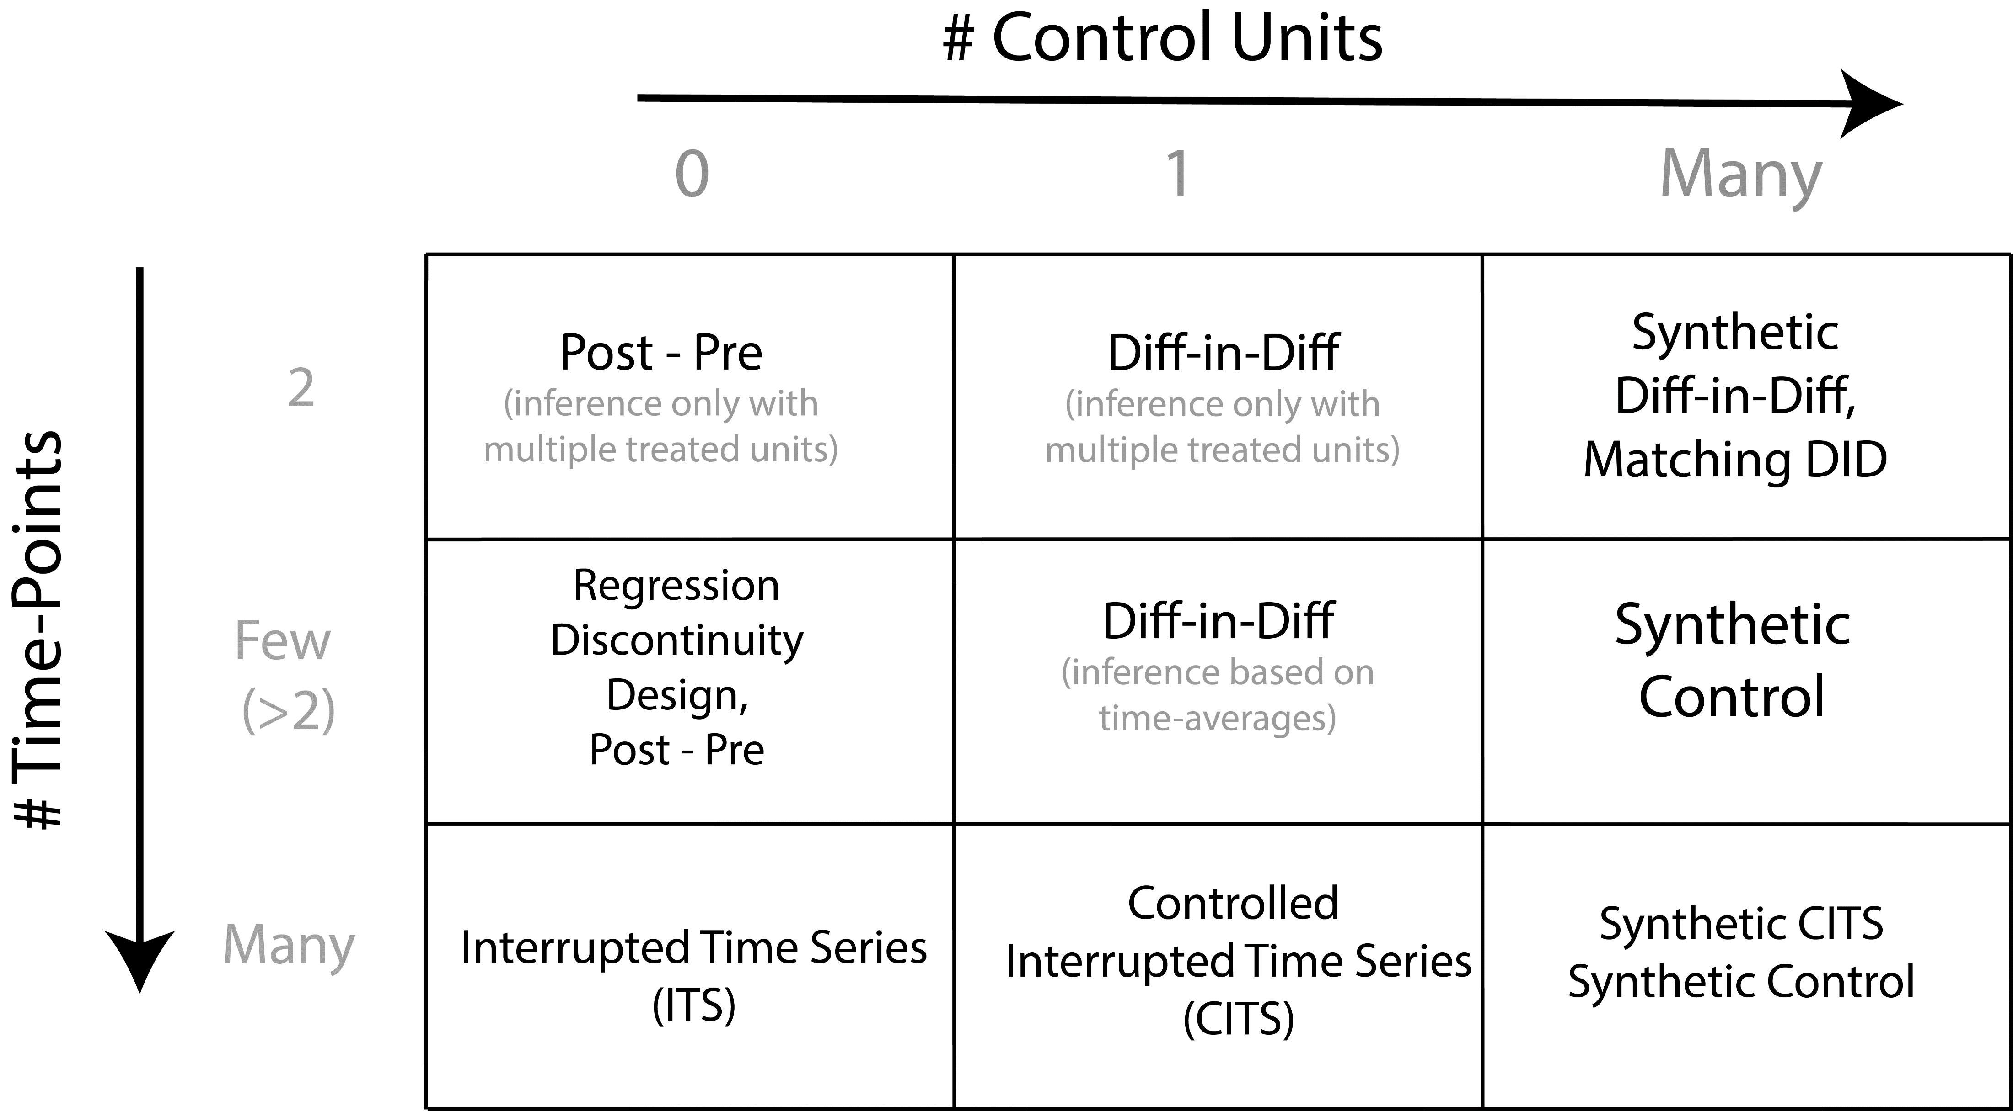

Slide 12
Causal Inference: A primer

Slide 13
Potential Outcomes
Causal Inference is (broadly) concerned with using data to estimate what the effect is of intervening or changing the value of one or more variables.
Using the potential outcomes framework, we can define causal inference as a missing data problem

Slide 14



Slide 15
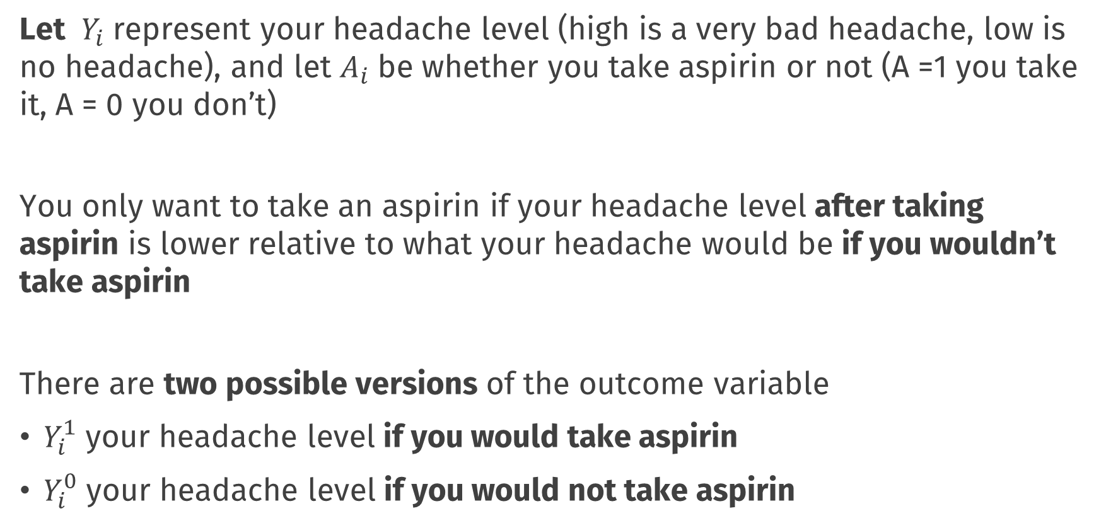
Potential Outcomes
Let $Y_{i}$ represent your headache level (high is a very bad headache, low is no headache), and let $A_{i}$ be whether you take aspirin or not (A =1 you take it, A = 0 you don’t)
You only want to take an aspirin if your headache level after taking aspirin is lower relative to what your headache would be if you wouldn’t take aspirin
There are two possible versions of the outcome variable
$Y_{i}^{1}$ your headache level if you would take aspirin
$Y_{i}^{0}$ your headache level if you would not take aspirin

Slide 16
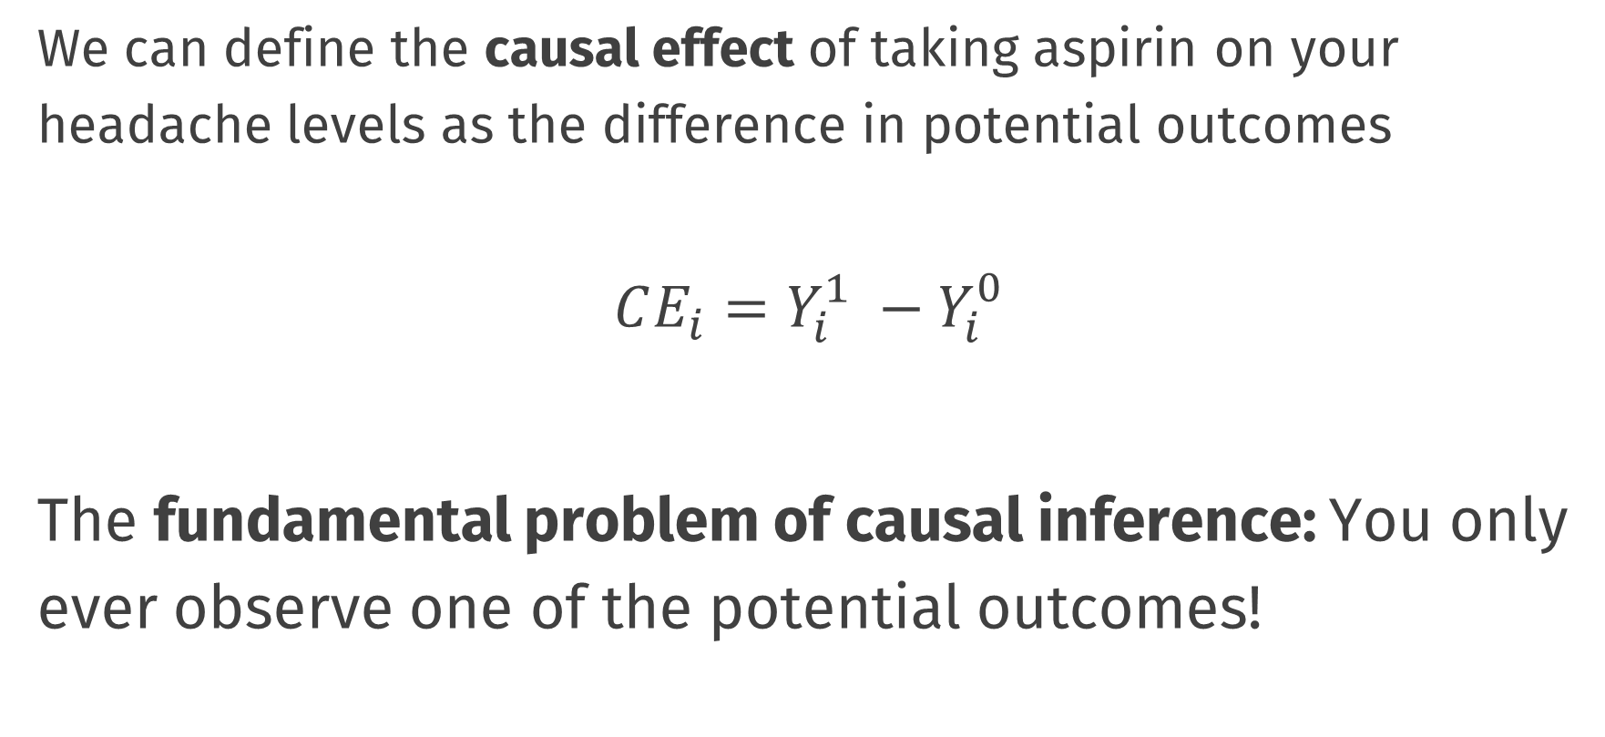
Causal Effects
We can define the causal effect of taking aspirin on your headache levels as the difference in potential outcomes
$$CE_{i}=Y_{i}^{1} −Y_{i}^{0}$$
The fundamental problem of causal inference: You only ever observe one of the potential outcomes!

Slide 17
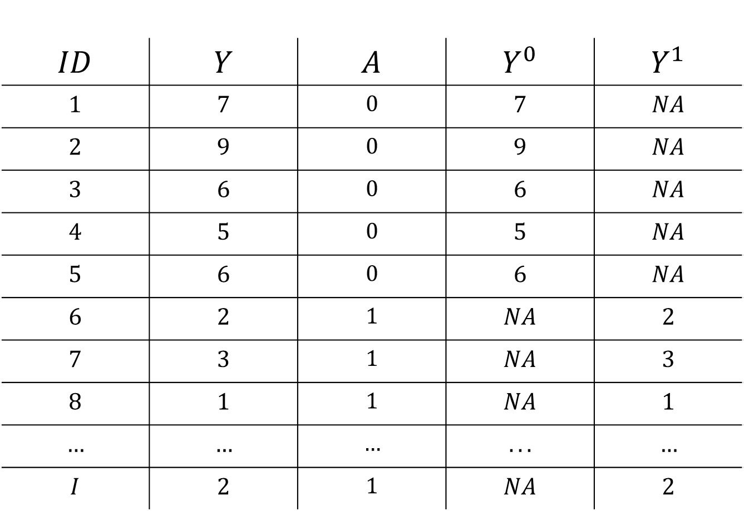
Data and Potential Outcomes
$$ID$$ | $$Y$$ | $$A$$ | $$Y^{0}$$ | $$Y^{1}$$
$$1$$ | $$7$$ | $$0$$ | $$7$$ | $$NA$$
$$2$$ | $$9$$ | $$0$$ | $$9$$ | $$NA$$
$$3$$ | $$6$$ | $$0$$ | $$6$$ | $$NA$$
$$4$$ | $$5$$ | $$0$$ | $$5$$ | $$NA$$
$$5$$ | $$6$$ | $$0$$ | $$6$$ | $$NA$$
$$6$$ | $$2$$ | $$1$$ | $$NA$$ | $$2$$
$$7$$ | $$3$$ | $$1$$ | $$NA$$ | $$3$$
$$8$$ | $$1$$ | $$1$$ | $$NA$$ | $$1$$
$$…$$ | $$…$$ | $$…$$ | $$...$$ | $$…$$
$$I$$ | $$2$$ | $$1$$ | $$NA$$ | $$2$$

Slide 18
Data and Potential Outcomes
$$ID$$ | $$Y$$ | $$A$$ | $$Y^{0}$$ | $$Y^{1}$$
$$1$$ | $$7$$ | $$0$$ | $$7$$ | $$NA$$
$$2$$ | $$9$$ | $$0$$ | $$9$$ | $$NA$$
$$3$$ | $$6$$ | $$0$$ | $$6$$ | $$NA$$
$$4$$ | $$5$$ | $$0$$ | $$5$$ | $$NA$$
$$5$$ | $$6$$ | $$0$$ | $$6$$ | $$NA$$
$$6$$ | $$2$$ | $$1$$ | $$NA$$ | $$2$$
$$7$$ | $$3$$ | $$1$$ | $$NA$$ | $$3$$
$$8$$ | $$1$$ | $$1$$ | $$NA$$ | $$1$$
$$…$$ | $$…$$ | $$…$$ | $$...$$ | $$…$$
$$I$$ | $$2$$ | $$1$$ | $$NA$$ | $$2$$

Slide 19
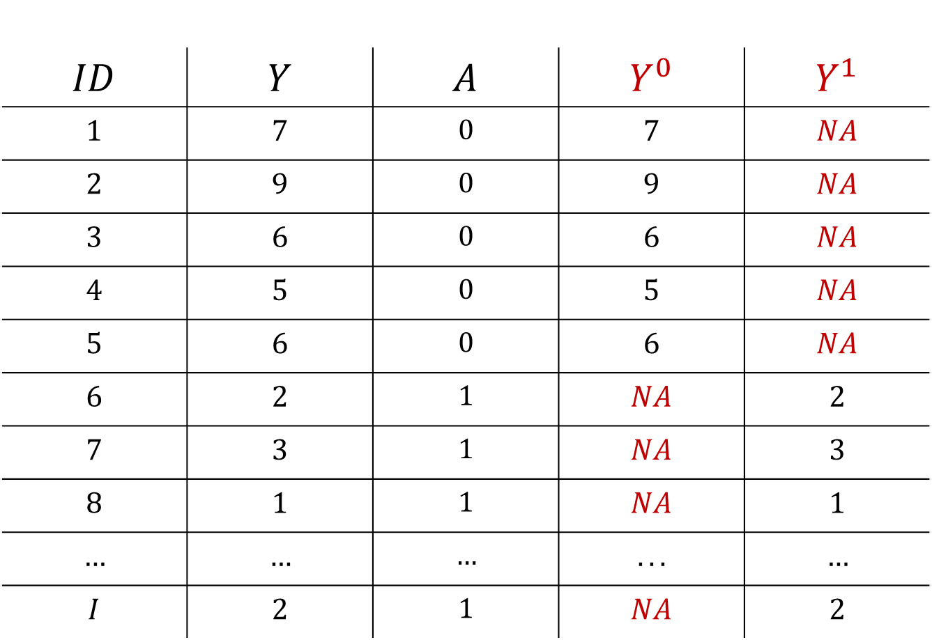
Data and Potential Outcomes
$$ID$$ | $$Y$$ | $$A$$ | $$Y^{0}$$ | $$Y^{1}$$
$$1$$ | $$7$$ | $$0$$ | $$7$$ | $$NA$$
$$2$$ | $$9$$ | $$0$$ | $$9$$ | $$NA$$
$$3$$ | $$6$$ | $$0$$ | $$6$$ | $$NA$$
$$4$$ | $$5$$ | $$0$$ | $$5$$ | $$NA$$
$$5$$ | $$6$$ | $$0$$ | $$6$$ | $$NA$$
$$6$$ | $$2$$ | $$1$$ | $$NA$$ | $$2$$
$$7$$ | $$3$$ | $$1$$ | $$NA$$ | $$3$$
$$8$$ | $$1$$ | $$1$$ | $$NA$$ | $$1$$
$$…$$ | $$…$$ | $$…$$ | $$...$$ | $$…$$
$$I$$ | $$2$$ | $$1$$ | $$NA$$ | $$2$$

Slide 20
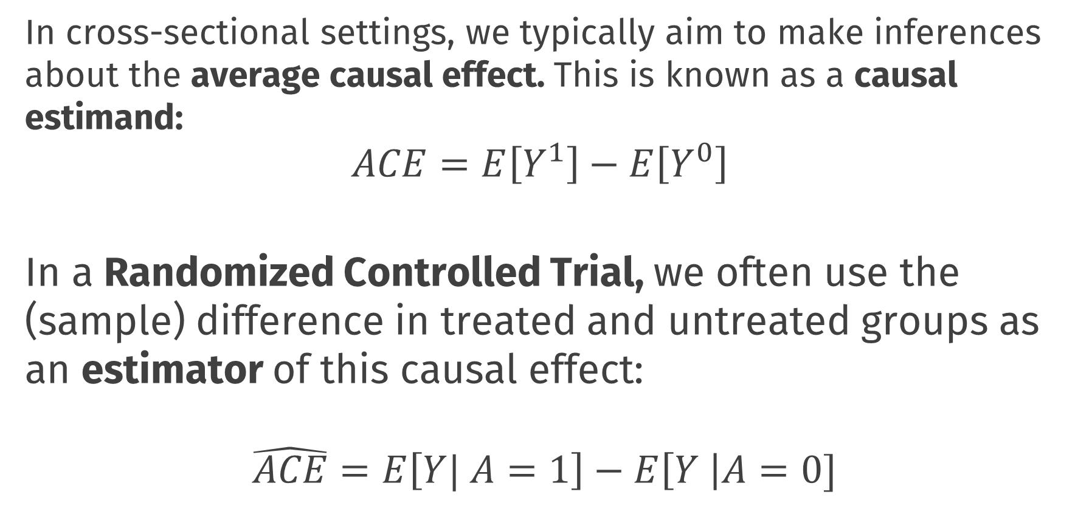
Causal Inference
In cross-sectional settings, we typically aim to make inferences about the average causal effect. This is known as a causal estimand:
$$ACE=E\left[Y^{1}\right]−E\left[Y^{0}\right]$$ In a Randomized Controlled Trial, we often use the (sample) difference in treated and untreated groups as an estimator of this causal effect:
$$\hat{ACE}=E\left[Y| A=1\right]−E\left[Y \right|A=0]$$
Notes:
Even though we can’t directly observe both $Y_{i}^{1}$ and $Y_{i}^{0}$ for the same individuals, under certain conditions, we can make inferences about these potential outcome variables

Slide 21
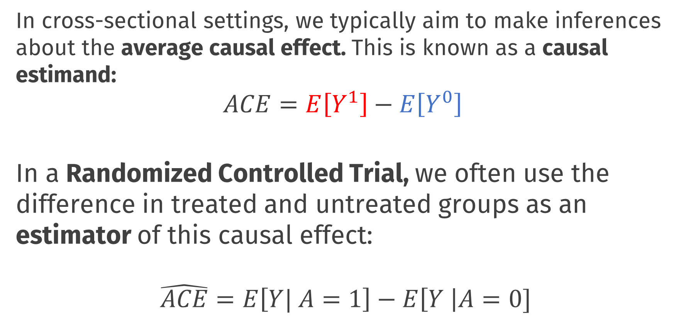
Causal Inference
In cross-sectional settings, we typically aim to make inferences about the average causal effect. This is known as a causal estimand:
$$ACE=E\left[Y^{1}\right]−E\left[Y^{0}\right]$$ In a Randomized Controlled Trial, we often use the difference in treated and untreated groups as an estimator of this causal effect:
$$\hat{ACE}=E\left[Y| A=1\right]−E\left[Y \right|A=0]$$
Notes:
Even though we can’t directly observe both $Y_{i}^{1}$ and $Y_{i}^{0}$ for the same individuals, under certain conditions, we can make inferences about these potential outcome variables

Slide 22
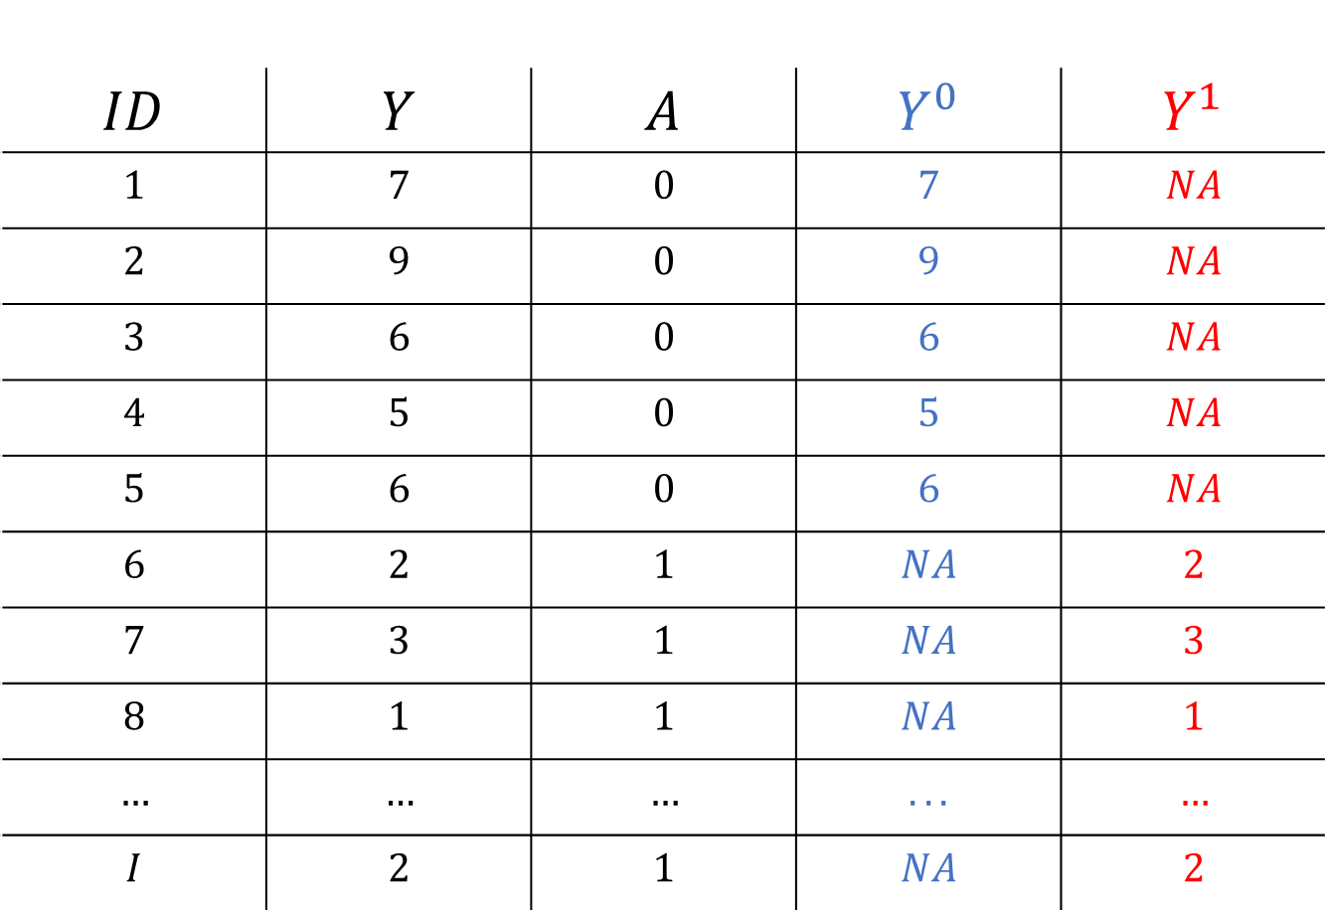
Causal Inference
$$ID$$ | $$Y$$ | $$A$$ | $$Y^{0}$$ | $$Y^{1}$$
$$1$$ | $$7$$ | $$0$$ | $$7$$ | $$NA$$
$$2$$ | $$9$$ | $$0$$ | $$9$$ | $$NA$$
$$3$$ | $$6$$ | $$0$$ | $$6$$ | $$NA$$
$$4$$ | $$5$$ | $$0$$ | $$5$$ | $$NA$$
$$5$$ | $$6$$ | $$0$$ | $$6$$ | $$NA$$
$$6$$ | $$2$$ | $$1$$ | $$NA$$ | $$2$$
$$7$$ | $$3$$ | $$1$$ | $$NA$$ | $$3$$
$$8$$ | $$1$$ | $$1$$ | $$NA$$ | $$1$$
$$…$$ | $$…$$ | $$…$$ | $$...$$ | $$…$$
$$I$$ | $$2$$ | $$1$$ | $$NA$$ | $$2$$

Slide 23
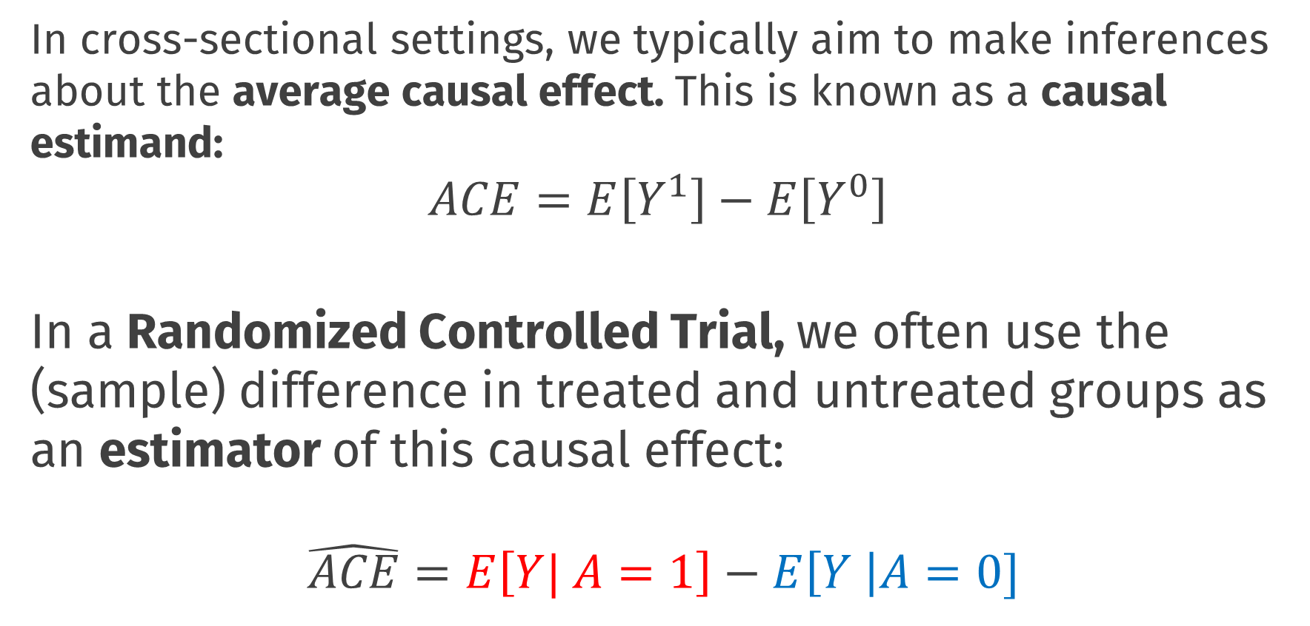
Causal Inference
In cross-sectional settings, we typically aim to make inferences about the average causal effect. This is known as a causal estimand:
$$ACE=E\left[Y^{1}\right]−E\left[Y^{0}\right]$$ In a Randomized Controlled Trial, we often use the (sample) difference in treated and untreated groups as an estimator of this causal effect:
$$\hat{ACE}=E\left[Y| A=1\right]−E\left[Y \right|A=0]$$
Notes:
Even though we can’t directly observe both $Y_{i}^{1}$ and $Y_{i}^{0}$ for the same individuals, under certain conditions, we can make inferences about these potential outcome variables

Slide 24
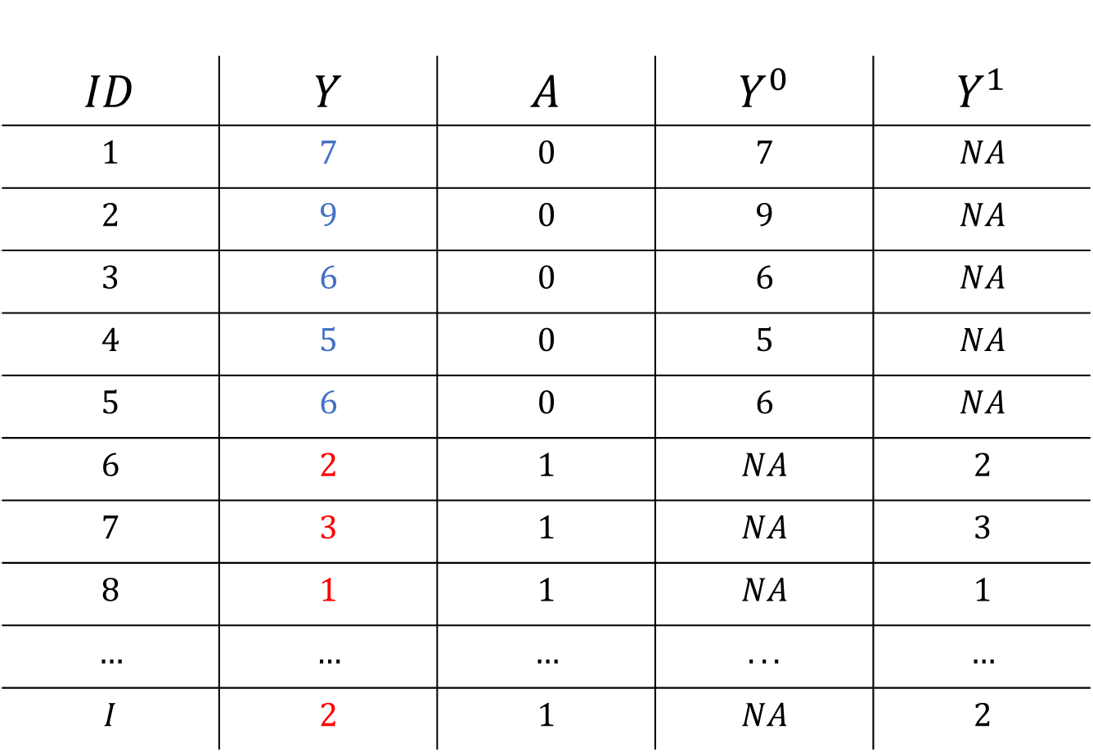
Causal Inference
$$ID$$ | $$Y$$ | $$A$$ | $$Y^{0}$$ | $$Y^{1}$$
$$1$$ | $$7$$ | $$0$$ | $$7$$ | $$NA$$
$$2$$ | $$9$$ | $$0$$ | $$9$$ | $$NA$$
$$3$$ | $$6$$ | $$0$$ | $$6$$ | $$NA$$
$$4$$ | $$5$$ | $$0$$ | $$5$$ | $$NA$$
$$5$$ | $$6$$ | $$0$$ | $$6$$ | $$NA$$
$$6$$ | $$2$$ | $$1$$ | $$NA$$ | $$2$$
$$7$$ | $$3$$ | $$1$$ | $$NA$$ | $$3$$
$$8$$ | $$1$$ | $$1$$ | $$NA$$ | $$1$$
$$…$$ | $$…$$ | $$…$$ | $$...$$ | $$…$$
$$I$$ | $$2$$ | $$1$$ | $$NA$$ | $$2$$

Slide 25
Causal Inference Assumptions
This type of inference about causal effects from observed data is only possible under certain conditions or assumptions
Exchangeability
If we were to reverse treatment assignment we would observe the same group differences. Information is exchangeable between groups
Basically: absence of confounder variables
E.g. People who have bad headaches choose to take the aspirin
RCTs are powerful because randomization ensures exchangeability. But in principle this kind of inference is possible from non-RCT designs
In practice we need conditional exchangeability; to control for confounders!
Notes:
Even though we can’t directly observe both $Y_{i}^{1}$ and $Y_{i}^{0}$ for the same individuals, under certain conditions, we can make inferences about these potential outcome variables

Slide 26
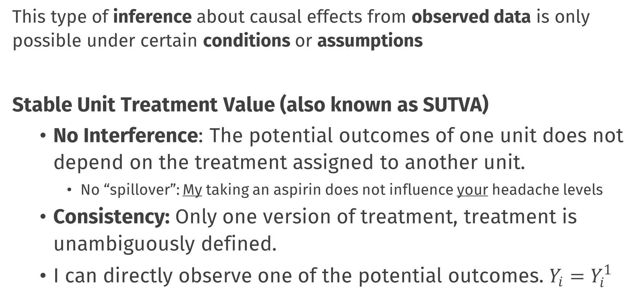
Causal Inference Assumptions
This type of inference about causal effects from observed data is only possible under certain conditions or assumptions
Stable Unit Treatment Value (also known as SUTVA)
No Interference: The potential outcomes of one unit does not depend on the treatment assigned to another unit.
No “spillover”: My taking an aspirin does not influence your headache levels
Consistency: Only one version of treatment, treatment is unambiguously defined.
I can directly observe one of the potential outcomes. $Y_{i}=Y_{i}^{1}$
Notes:
Even though we can’t directly observe both $Y_{i}^{1}$ and $Y_{i}^{0}$ for the same individuals, under certain conditions, we can make inferences about these potential outcome variables
E.g.: If I want to make inferences about the effect of losing weight on heart health, my inferences will be different if I study people who gradually lost weight due to diet and exercise vs those who are lighter due to liposuction!

Slide 27
Causal Inference Assumptions
These two generic assumptions essentially always appear in causal inference problems, and as we will see, we will have to deal with concerns around confounders and no interference repeatedly today
Other assumptions or conditions may also be needed depending on the specific design and analytic approach you take
Notes:
Here; I could show the derivation of how you get from estimand to estimator using those assumptions, but I think it’s good to leave this out

Slide 28
Causal Inference and Policy Evaluations

Slide 29
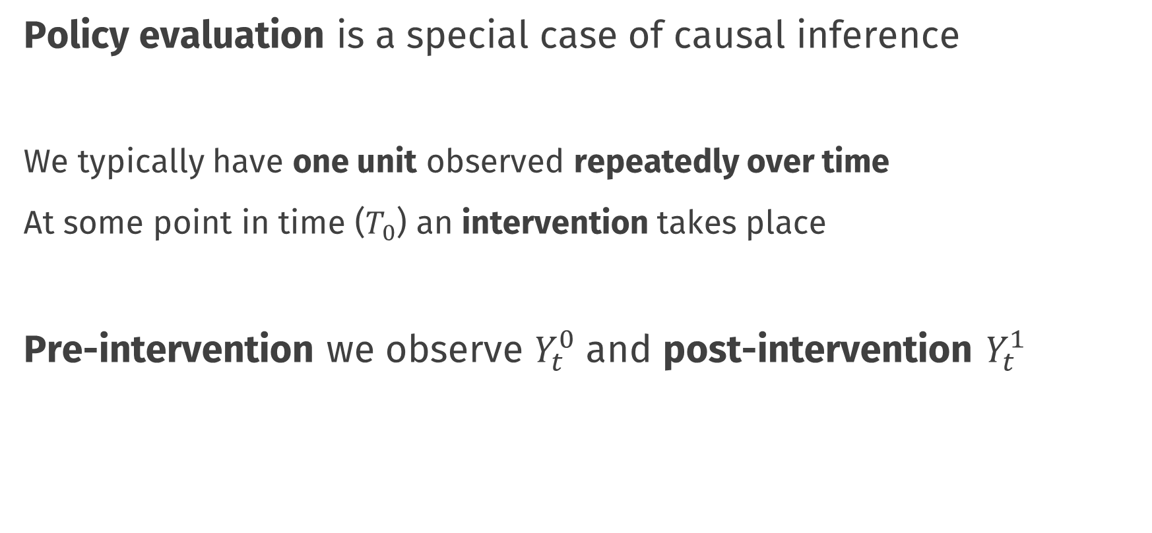
Todays Topic
Policy evaluation is a special case of causal inference
We typically have one unit observed repeatedly over time
At some point in time ($T_{0}$) an intervention takes place
Pre-intervention we observe $Y_{t}^{0}$ and post-intervention $Y_{t}^{1}$
Notes:
Even though we can’t directly observe both $Y_{i}^{1}$ and $Y_{i}^{0}$ for the same individuals, under certain conditions, we can make inferences about these potential outcome variables

Slide 30
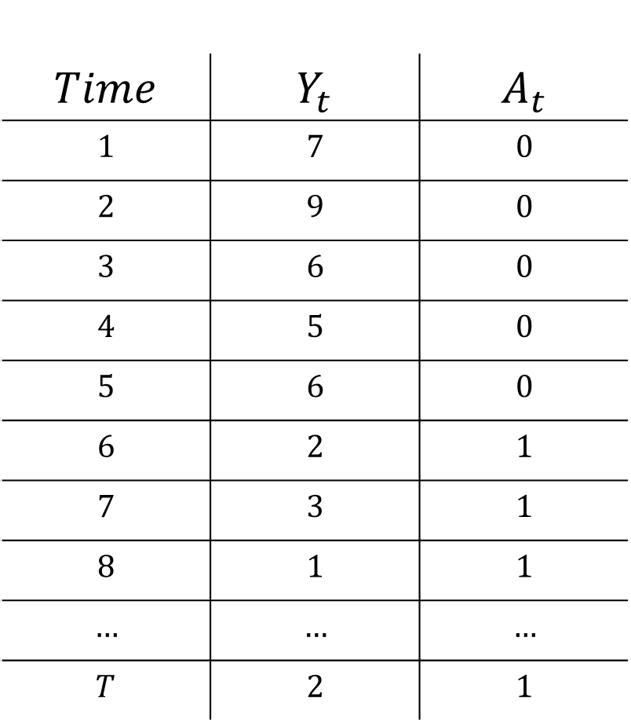
$$Time$$ | $$Y_{t}$$ | $$A_{t}$$
$$1$$ | $$7$$ | $$0$$
$$2$$ | $$9$$ | $$0$$
$$3$$ | $$6$$ | $$0$$
$$4$$ | $$5$$ | $$0$$
$$5$$ | $$6$$ | $$0$$
$$6$$ | $$2$$ | $$1$$
$$7$$ | $$3$$ | $$1$$
$$8$$ | $$1$$ | $$1$$
$$…$$ | $$…$$ | $$…$$
$$T$$ | $$2$$ | $$1$$

Slide 31
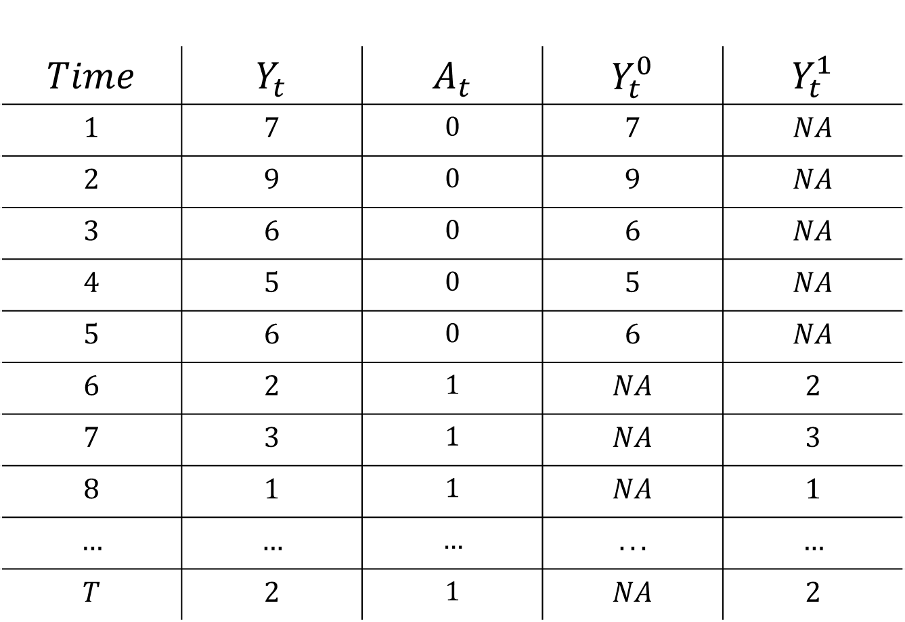
$$Time$$ | $$Y_{t}$$ | $$A_{t}$$ | $$Y_{t}^{0}$$ | $$Y_{t}^{1}$$
$$1$$ | $$7$$ | $$0$$ | $$7$$ | $$NA$$
$$2$$ | $$9$$ | $$0$$ | $$9$$ | $$NA$$
$$3$$ | $$6$$ | $$0$$ | $$6$$ | $$NA$$
$$4$$ | $$5$$ | $$0$$ | $$5$$ | $$NA$$
$$5$$ | $$6$$ | $$0$$ | $$6$$ | $$NA$$
$$6$$ | $$2$$ | $$1$$ | $$NA$$ | $$2$$
$$7$$ | $$3$$ | $$1$$ | $$NA$$ | $$3$$
$$8$$ | $$1$$ | $$1$$ | $$NA$$ | $$1$$
$$…$$ | $$…$$ | $$…$$ | $$...$$ | $$…$$
$$T$$ | $$2$$ | $$1$$ | $$NA$$ | $$2$$

Slide 32
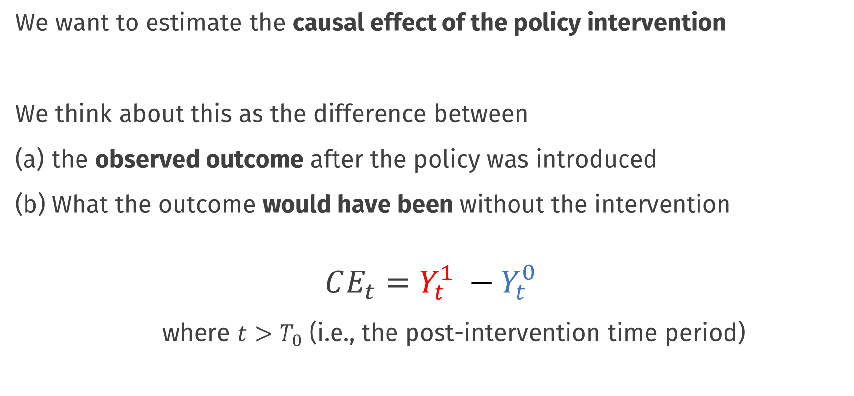
Causal Effects of Policies
We want to estimate the causal effect of the policy intervention
We think about this as the difference between
the observed outcome after the policy was introduced
What the outcome would have been without the intervention
$$CE_{t}=Y_{t}^{1} −Y_{t}^{0}$$
where $t>T_{0}$ (i.e., the post-intervention time period)
Notes:
Even though we can’t directly observe both $Y_{i}^{1}$ and $Y_{i}^{0}$ for the same individuals, under certain conditions, we can make inferences about these potential outcome variables

Slide 33
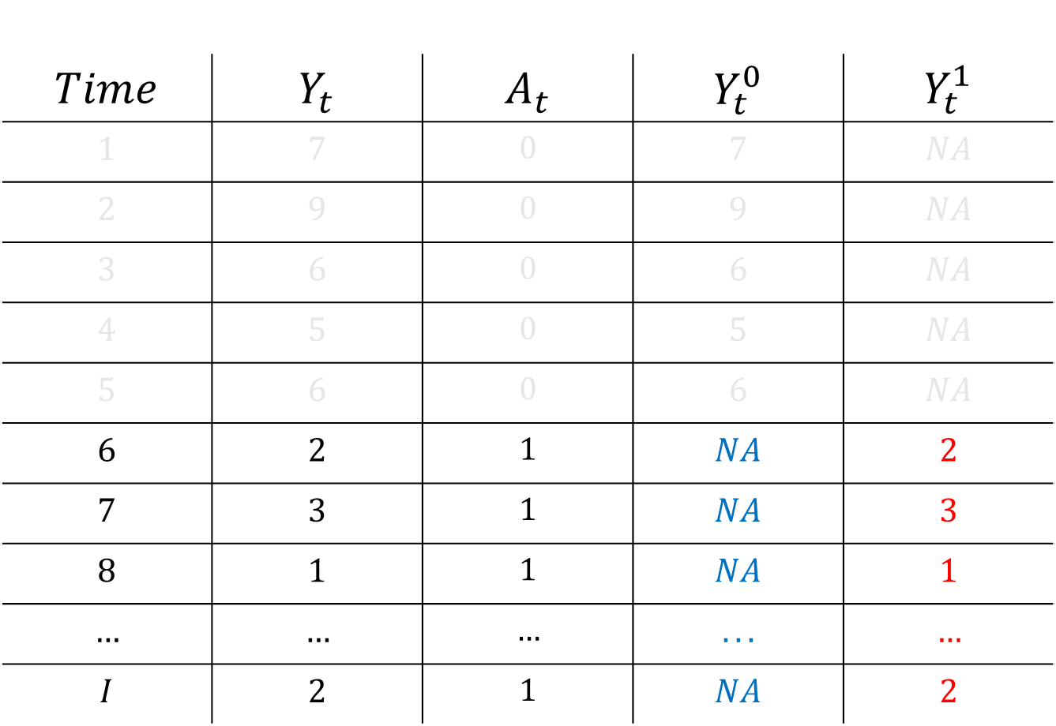
$$Time$$ | $$Y_{t}$$ | $$A_{t}$$ | $$Y_{t}^{0}$$ | $$Y_{t}^{1}$$
$$1$$ | $$7$$ | $$0$$ | $$7$$ | $$NA$$
$$2$$ | $$9$$ | $$0$$ | $$9$$ | $$NA$$
$$3$$ | $$6$$ | $$0$$ | $$6$$ | $$NA$$
$$4$$ | $$5$$ | $$0$$ | $$5$$ | $$NA$$
$$5$$ | $$6$$ | $$0$$ | $$6$$ | $$NA$$
$$6$$ | $$2$$ | $$1$$ | $$NA$$ | $$2$$
$$7$$ | $$3$$ | $$1$$ | $$NA$$ | $$3$$
$$8$$ | $$1$$ | $$1$$ | $$NA$$ | $$1$$
$$…$$ | $$…$$ | $$…$$ | $$...$$ | $$…$$
$$I$$ | $$2$$ | $$1$$ | $$NA$$ | $$2$$

Slide 34
Running Example: Proposition 99

Slide 35
Proposition 99
A famous example in causal inference literature
In 1988, the state of California imposed a 25% tax on tobacco cigarettes
Total savings in personal health care expenditure until 2004 is $86 billion (Lightwood et al., 2008)
Abadie, A., Diamond, A., & Hainmueller, J. (2010). Synthetic control methods for comparative case studies: Estimating the effect of California’s tobacco control program. Journal of the American statistical Association, 105(490), 493-505.

Slide 36
Proposition 99
We prepared a dataset for this workshop:
proposition99.rds
Panel (i.e. longitudinal) dataset
Can be downloaded from the website
Let’s explore!

Slide 37
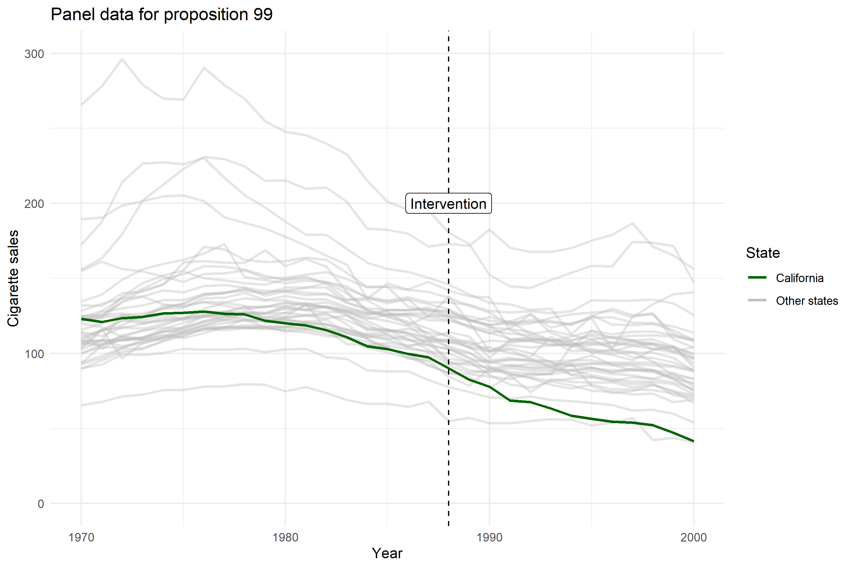

Slide 38
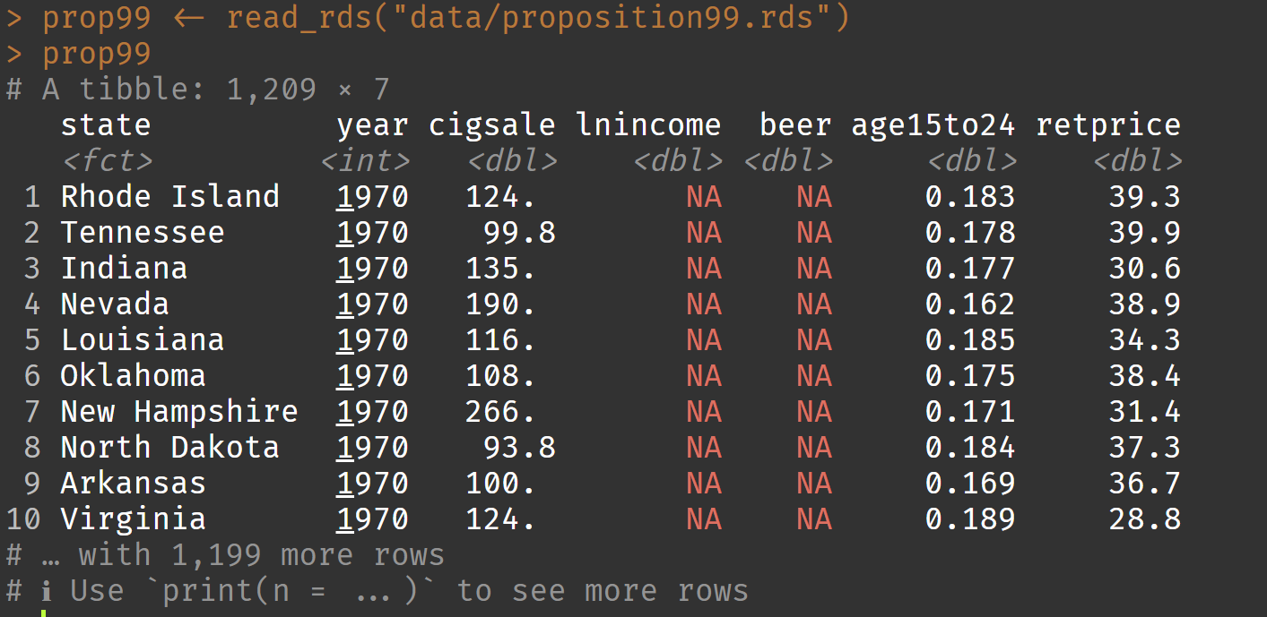
Proposition 99

Slide 39
Proposition 99
state: 39 different states, used in Abadie et al. (2010)
year: 1970 until 2000
cigsale: packs of cigarettes per 100 000 people
lnincome: natural log of mean income
beer: beer sales per 100 000 people
age15to24: proportion of people between 15 & 24
retprice: retail price of a box of cigarettes

Slide 40
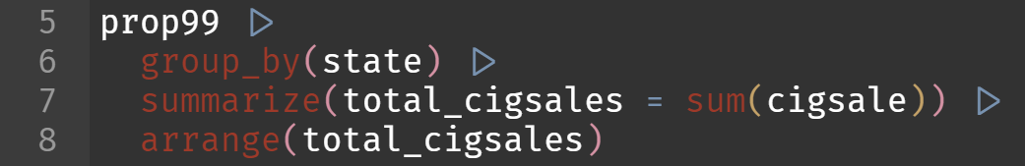
Proposition 99
Which state sold the least cigarettes per capita?
We make use of tidyverse:
This works well with our prepared dataset

Slide 41
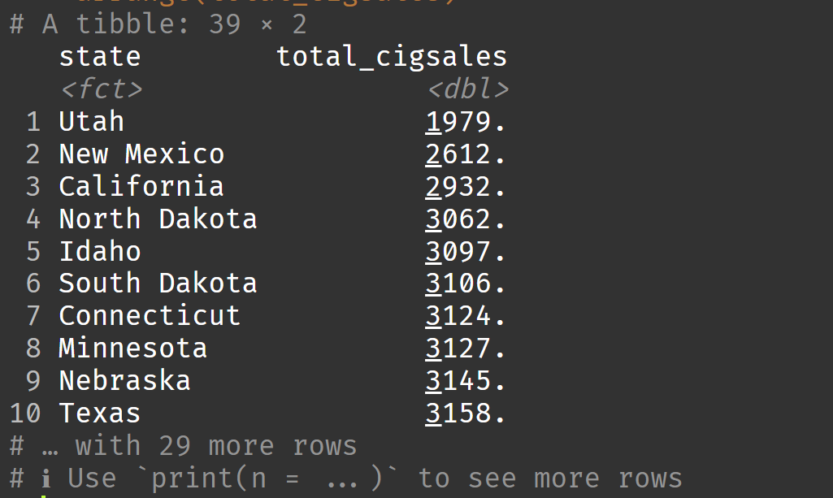
Proposition 99

Slide 42
Practical: set-up and data
Work in pairs!
Exercises 1 – 3

Slide 43
Estimating the causal effect
Basic methods

Slide 46
Pre-Post Estimator

Slide 47
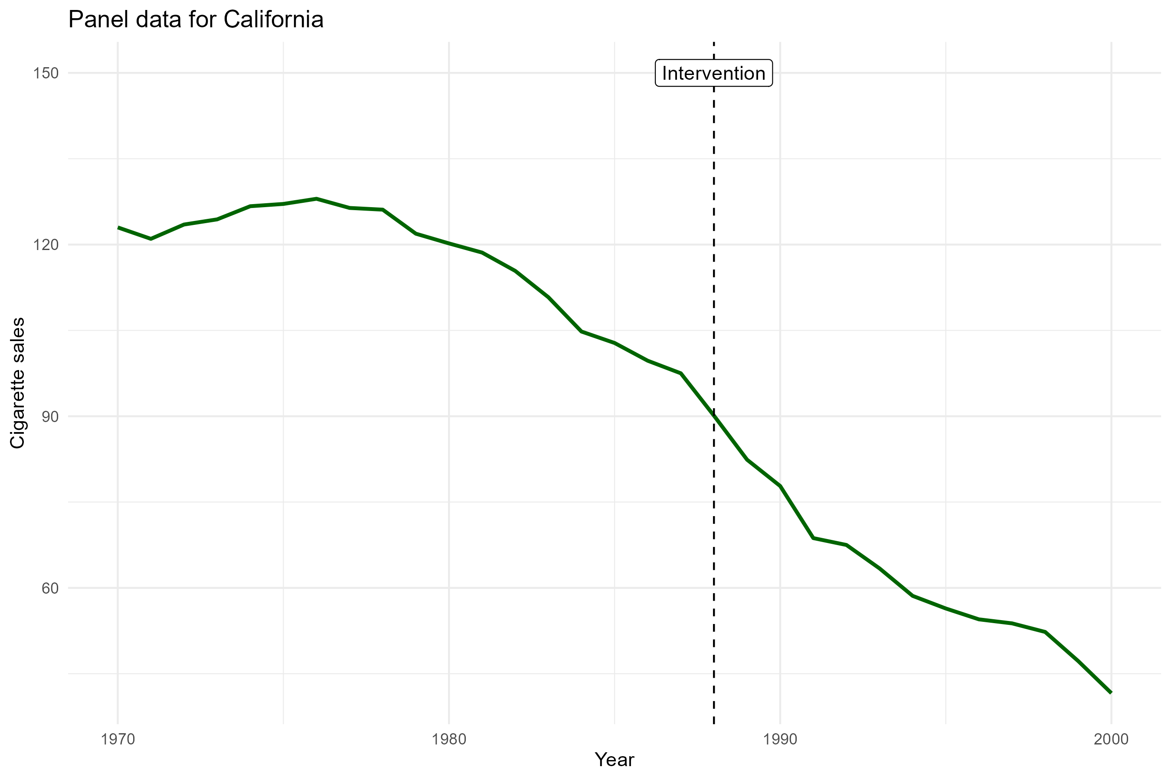
Pre-post estimator
We use only the cigarette sales time series for California

Slide 48
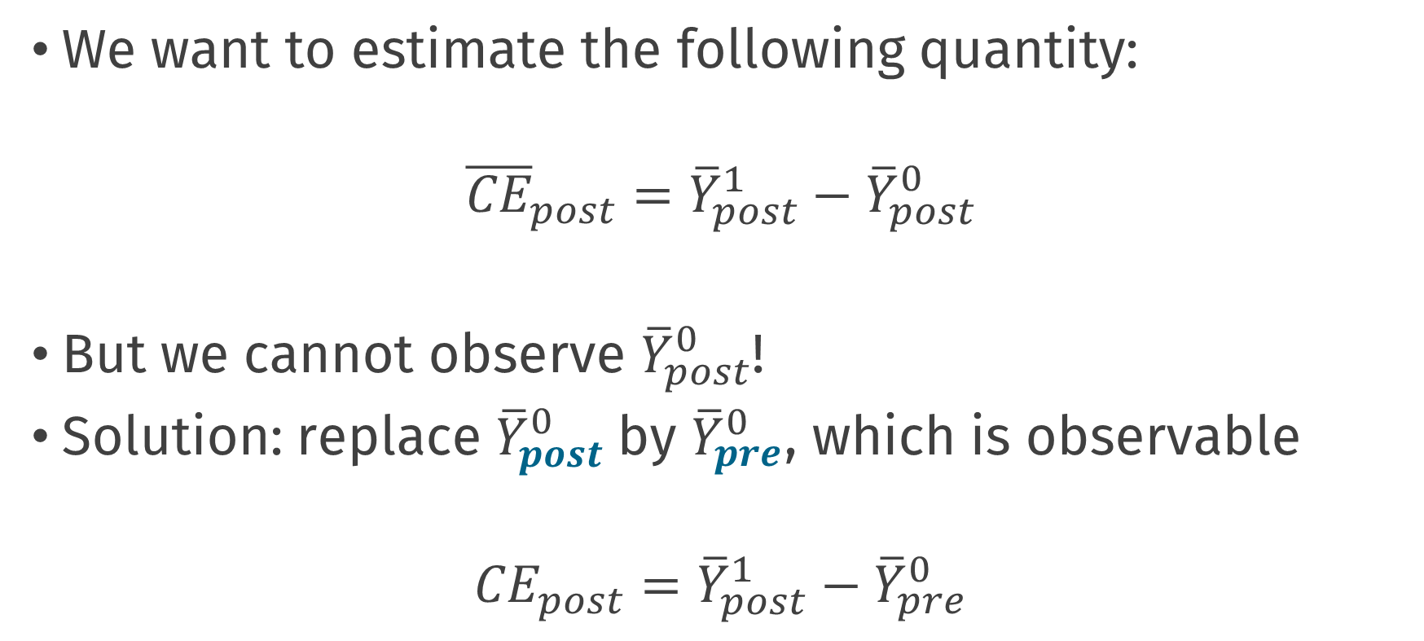
Pre-post estimator
We want to estimate the following quantity:
$${\overline{CE}}_{post}={\overline{Y}}_{post}^{1}−{\overline{Y}}_{post}^{0}$$
But we cannot observe ${\overline{Y}}_{post}^{0}$!
Solution: replace ${\overline{Y}}_{post}^{0}$by ${\overline{Y}}_{pre}^{0}$, which is observable
$${CE}_{post}={\overline{Y}}_{post}^{1}−{\overline{Y}}_{pre}^{0}$$
Notes:
OR note: Should we define this in words? Change in the average number of cigarette sales in the years that follow the intervention, relative to what we would have expected average cigarette sales to be in the absence of an intervention
Also, note here, no “bar” over the latter quantity, maybe just also remove it from the first?; we also use different notation (Expected values, post and pre vs t, s)

Slide 49
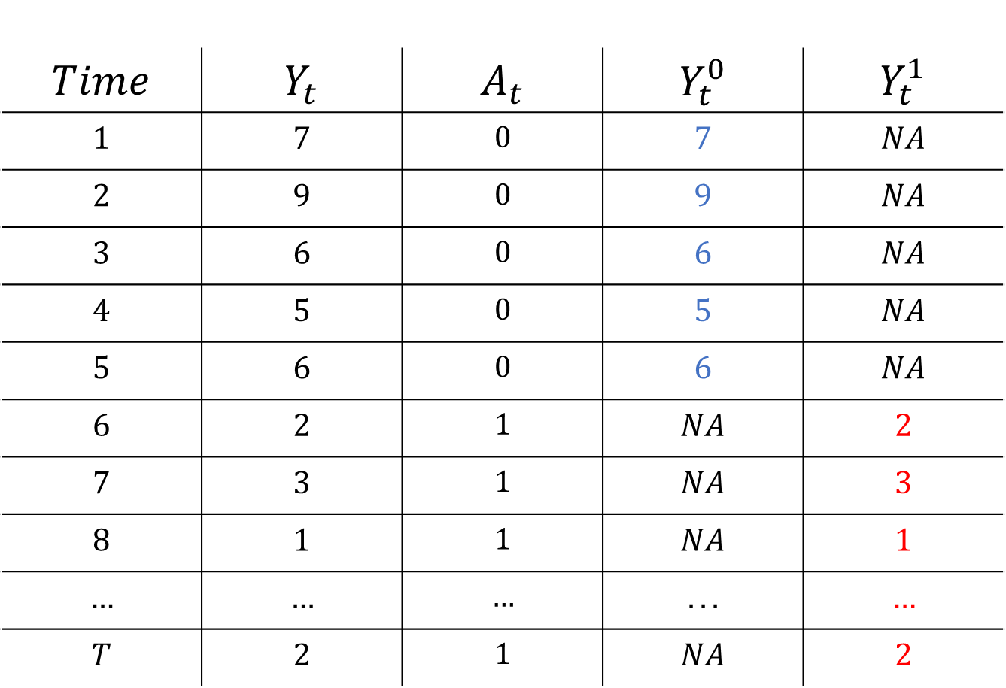
$$Time$$ | $$Y_{t}$$ | $$A_{t}$$ | $$Y_{t}^{0}$$ | $$Y_{t}^{1}$$
$$1$$ | $$7$$ | $$0$$ | $$7$$ | $$NA$$
$$2$$ | $$9$$ | $$0$$ | $$9$$ | $$NA$$
$$3$$ | $$6$$ | $$0$$ | $$6$$ | $$NA$$
$$4$$ | $$5$$ | $$0$$ | $$5$$ | $$NA$$
$$5$$ | $$6$$ | $$0$$ | $$6$$ | $$NA$$
$$6$$ | $$2$$ | $$1$$ | $$NA$$ | $$2$$
$$7$$ | $$3$$ | $$1$$ | $$NA$$ | $$3$$
$$8$$ | $$1$$ | $$1$$ | $$NA$$ | $$1$$
$$…$$ | $$…$$ | $$…$$ | $$...$$ | $$…$$
$$T$$ | $$2$$ | $$1$$ | $$NA$$ | $$2$$

Slide 50
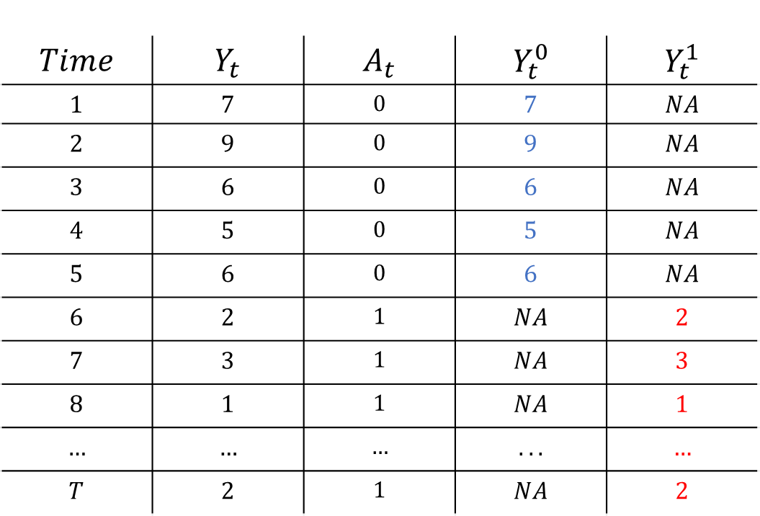
Pre – Post analysis
$$Time$$ | $$Y_{t}$$ | $$A_{t}$$ | $$Y_{t}^{0}$$ | $$Y_{t}^{1}$$
$$1$$ | $$7$$ | $$0$$ | $$7$$ | $$NA$$
$$2$$ | $$9$$ | $$0$$ | $$9$$ | $$NA$$
$$3$$ | $$6$$ | $$0$$ | $$6$$ | $$NA$$
$$4$$ | $$5$$ | $$0$$ | $$5$$ | $$NA$$
$$5$$ | $$6$$ | $$0$$ | $$6$$ | $$NA$$
$$6$$ | $$2$$ | $$1$$ | $$NA$$ | $$2$$
$$7$$ | $$3$$ | $$1$$ | $$NA$$ | $$3$$
$$8$$ | $$1$$ | $$1$$ | $$NA$$ | $$1$$
$$…$$ | $$…$$ | $$…$$ | $$...$$ | $$…$$
$$T$$ | $$2$$ | $$1$$ | $$NA$$ | $$2$$
$${\overline{Y}}_{pre}^{0}$$
$${\overline{Y}}_{post}^{1}$$

Slide 51

Pre – Post analysis
$$Time$$ | $$Y_{t}$$ | $$A_{t}$$ | $$Y_{t}^{0}$$ | $$Y_{t}^{1}$$
$$1$$ | $$7$$ | $$0$$ | $$7$$ | $$NA$$
$$2$$ | $$9$$ | $$0$$ | $$9$$ | $$NA$$
$$3$$ | $$6$$ | $$0$$ | $$6$$ | $$NA$$
$$4$$ | $$5$$ | $$0$$ | $$5$$ | $$NA$$
$$5$$ | $$6$$ | $$0$$ | $$6$$ | $$NA$$
$$6$$ | $$2$$ | $$1$$ | $$NA$$ | $$2$$
$$7$$ | $$3$$ | $$1$$ | $$NA$$ | $$3$$
$$8$$ | $$1$$ | $$1$$ | $$NA$$ | $$1$$
$$…$$ | $$…$$ | $$…$$ | $$...$$ | $$…$$
$$T$$ | $$2$$ | $$1$$ | $$NA$$ | $$2$$
$${\overline{Y}}_{pre}^{0}$$
Assume equal to
$${\overline{Y}}_{post}^{1}$$
$${ − \overline{Y}}_{post}^{0}$$
$${\overline{CE}}_{post}={\overline{Y}}_{post}^{1}−{\overline{Y}}_{post}^{0}$$

Slide 52
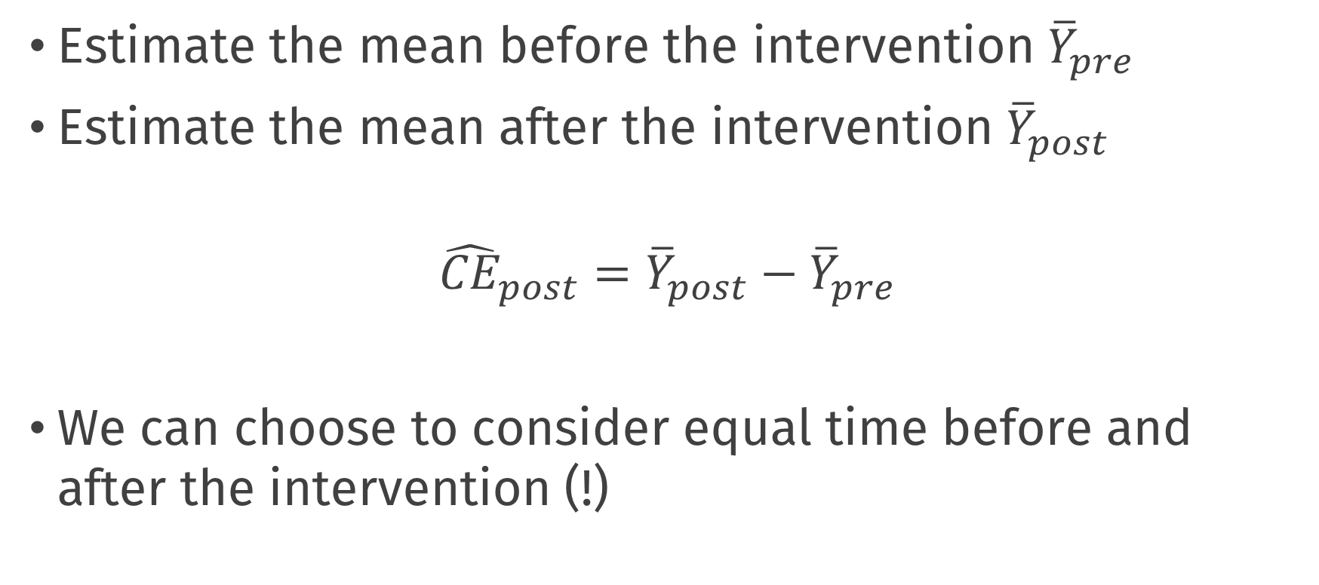
Pre-post estimator
Estimate the mean before the intervention ${\overline{Y}}_{pre}$
Estimate the mean after the intervention ${\overline{Y}}_{post}$
$${\hat{CE}}_{post}={\overline{Y}}_{post}−{\overline{Y}}_{pre}$$
We can choose to consider equal time before and after the intervention (!)

Slide 53
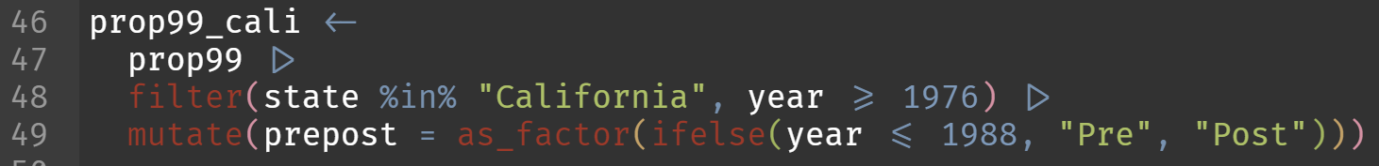
Pre-post estimator
Filter & compute pre-post factor variable
Compute the pre-post difference

Slide 54
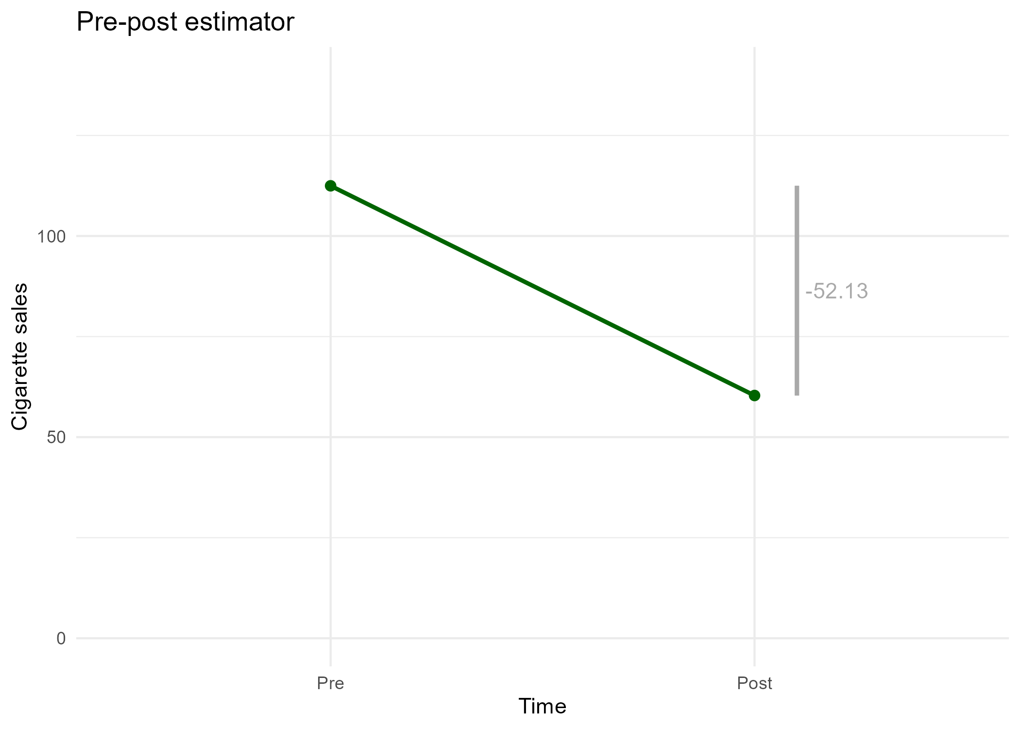
Pre-post estimator

Slide 55

Pre-post estimator
But what about uncertainty?
Use linear regression / OLS to compute $\hat{CE}$

Slide 56

$$Time$$ | $$Y_{t}$$ | $$A_{t}$$ | $$Y_{t}^{0}$$ | $$Y_{t}^{1}$$
$$1$$ | $$7$$ | $$0$$ | $$7$$ | $$NA$$
$$2$$ | $$9$$ | $$0$$ | $$9$$ | $$NA$$
$$3$$ | $$6$$ | $$0$$ | $$6$$ | $$NA$$
$$4$$ | $$5$$ | $$0$$ | $$5$$ | $$NA$$
$$5$$ | $$6$$ | $$0$$ | $$6$$ | $$NA$$
$$6$$ | $$2$$ | $$1$$ | $$NA$$ | $$2$$
$$7$$ | $$3$$ | $$1$$ | $$NA$$ | $$3$$
$$8$$ | $$1$$ | $$1$$ | $$NA$$ | $$1$$
$$…$$ | $$…$$ | $$…$$ | $$...$$ | $$…$$
$$T$$ | $$2$$ | $$1$$ | $$NA$$ | $$2$$

Slide 57
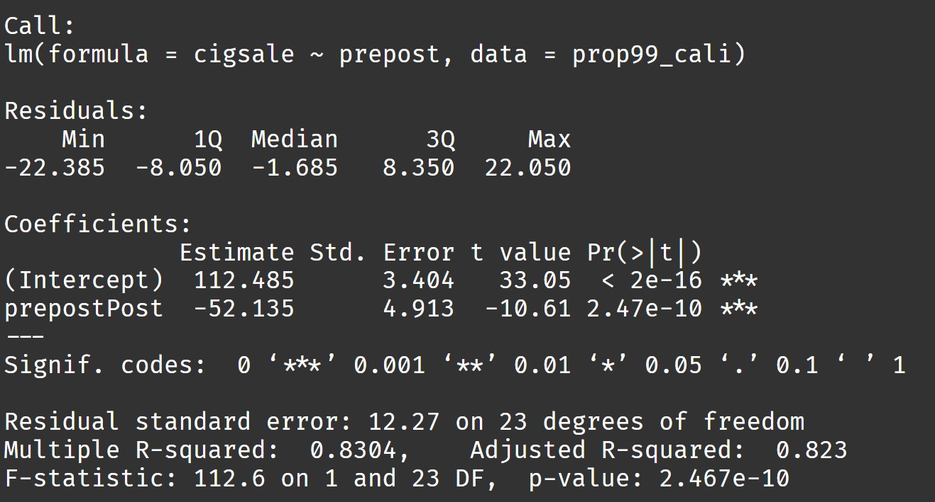
Pre-post estimator
Result:
Standard errors
assume no
autocorrelation
(!)
Notes:
OR: Here the variance is coming from the fact that you don’t feed the means in, but instead the raw data, which are now treated as observations from two groups

Slide 58
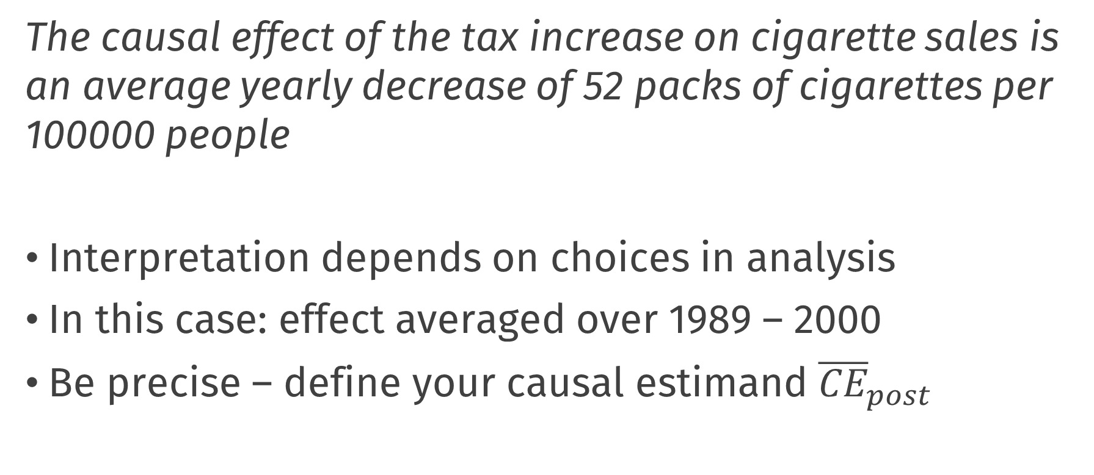
Pre-post estimator
The causal effect of the tax increase on cigarette sales is an average yearly decrease of 52 packs of cigarettes per 100000 people
Interpretation depends on choices in analysis
In this case: effect averaged over 1989 – 2000
Be precise – define your causal estimand ${\overline{CE}}_{post}$

Slide 59
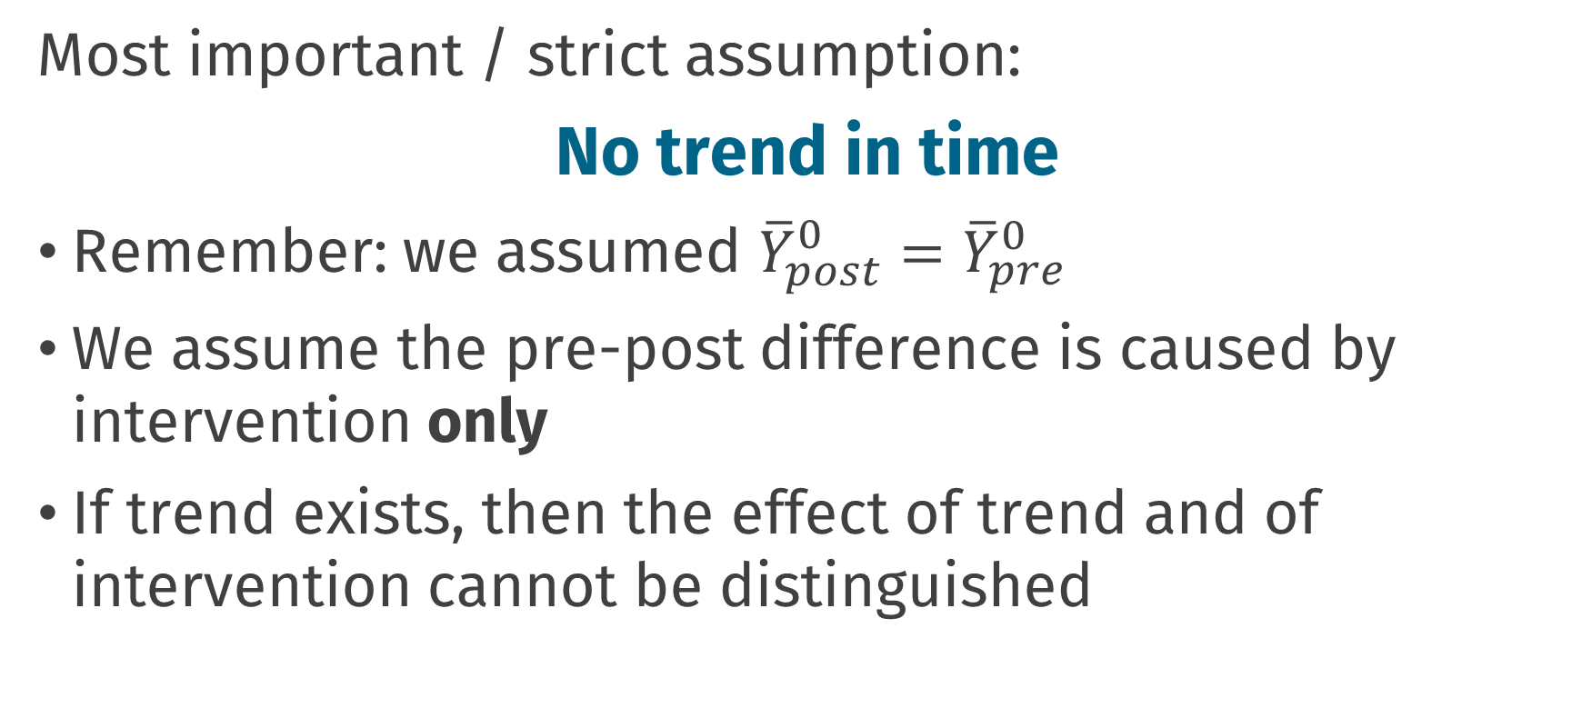
Pre-post estimator
Most important / strict assumption:
No trend in time
Remember: we assumed ${\overline{Y}}_{post}^{0}={\overline{Y}}_{pre}^{0}$
We assume the pre-post difference is caused by intervention only
If trend exists, then the effect of trend and of intervention cannot be distinguished

Slide 60
Pre-post estimator
Is there a trend in time, independent of the intervention?
How much of pre-post difference is caused by intervention?

Slide 61
Difference-in-Differences

Slide 62
Difference-in-differences
,,transparent and often at least superficially plausible”
Used a lot in economics
There is a lot of discussion around this topic
We will explain the basic method here
There are a lot of possible extensions!
Angrist, J. D. and Krueger, A. B. (1999). Empirical strategies in labor economics. In Handbook of labor economics, volume 3, pages 1277–1366. Elsevier.

Slide 63
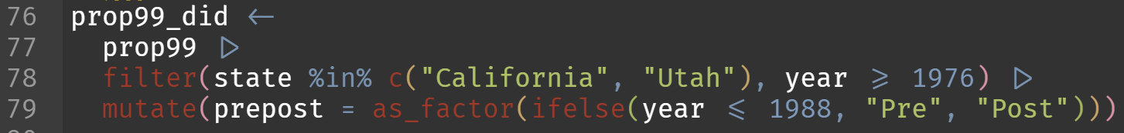
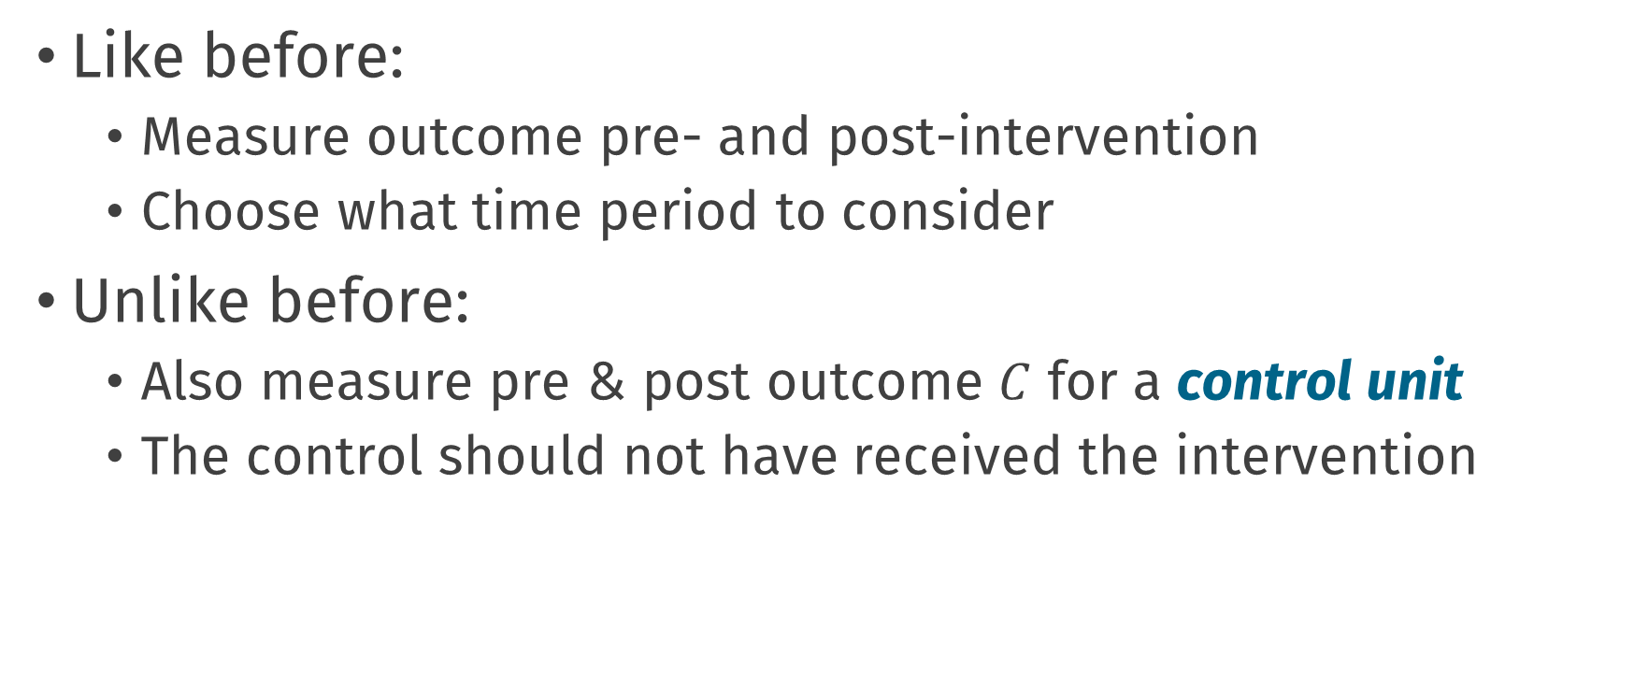
Difference-in-differences
Like before:
Measure outcome pre- and post-intervention
Choose what time period to consider
Unlike before:
Also measure pre & post outcome $C$ for a control unit
The control should not have received the intervention

Slide 64
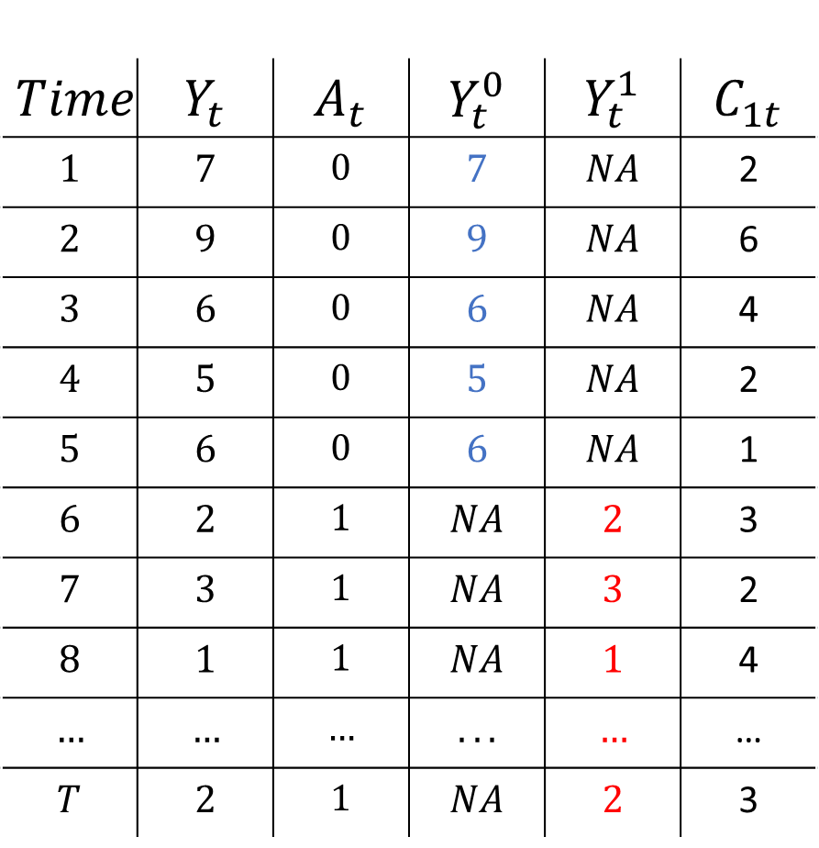
$$Time$$ | $$Y_{t}$$ | $$A_{t}$$ | $$Y_{t}^{0}$$ | $$Y_{t}^{1}$$ | $$C_{1t}$$
$$1$$ | $$7$$ | $$0$$ | $$7$$ | $$NA$$ | 2
$$2$$ | $$9$$ | $$0$$ | $$9$$ | $$NA$$ | 6
$$3$$ | $$6$$ | $$0$$ | $$6$$ | $$NA$$ | 4
$$4$$ | $$5$$ | $$0$$ | $$5$$ | $$NA$$ | 2
$$5$$ | $$6$$ | $$0$$ | $$6$$ | $$NA$$ | 1
$$6$$ | $$2$$ | $$1$$ | $$NA$$ | $$2$$ | 3
$$7$$ | $$3$$ | $$1$$ | $$NA$$ | $$3$$ | 2
$$8$$ | $$1$$ | $$1$$ | $$NA$$ | $$1$$ | 4
$$…$$ | $$…$$ | $$…$$ | $$...$$ | $$…$$ | …
$$T$$ | $$2$$ | $$1$$ | $$NA$$ | $$2$$ | 3

Slide 65
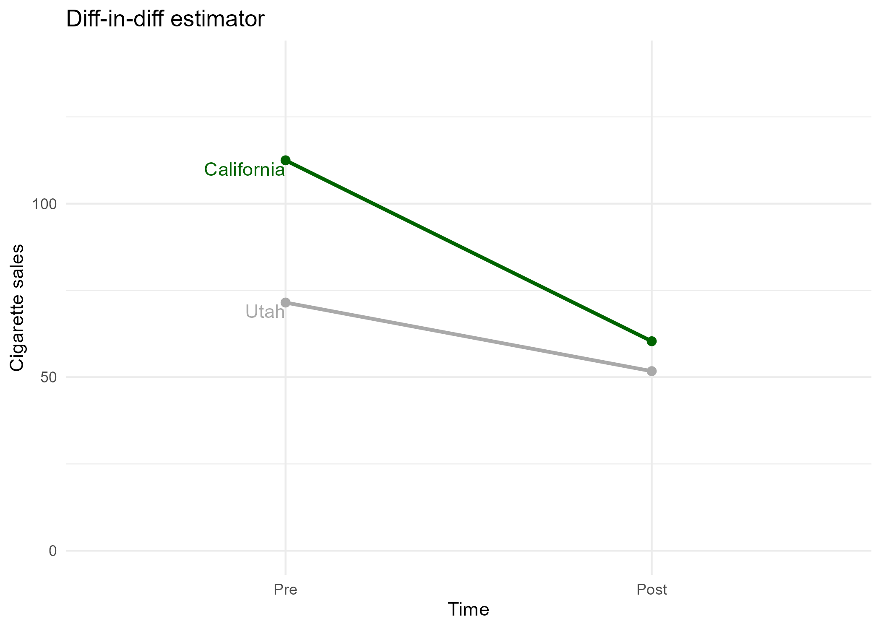
Difference-in-differences

Slide 66
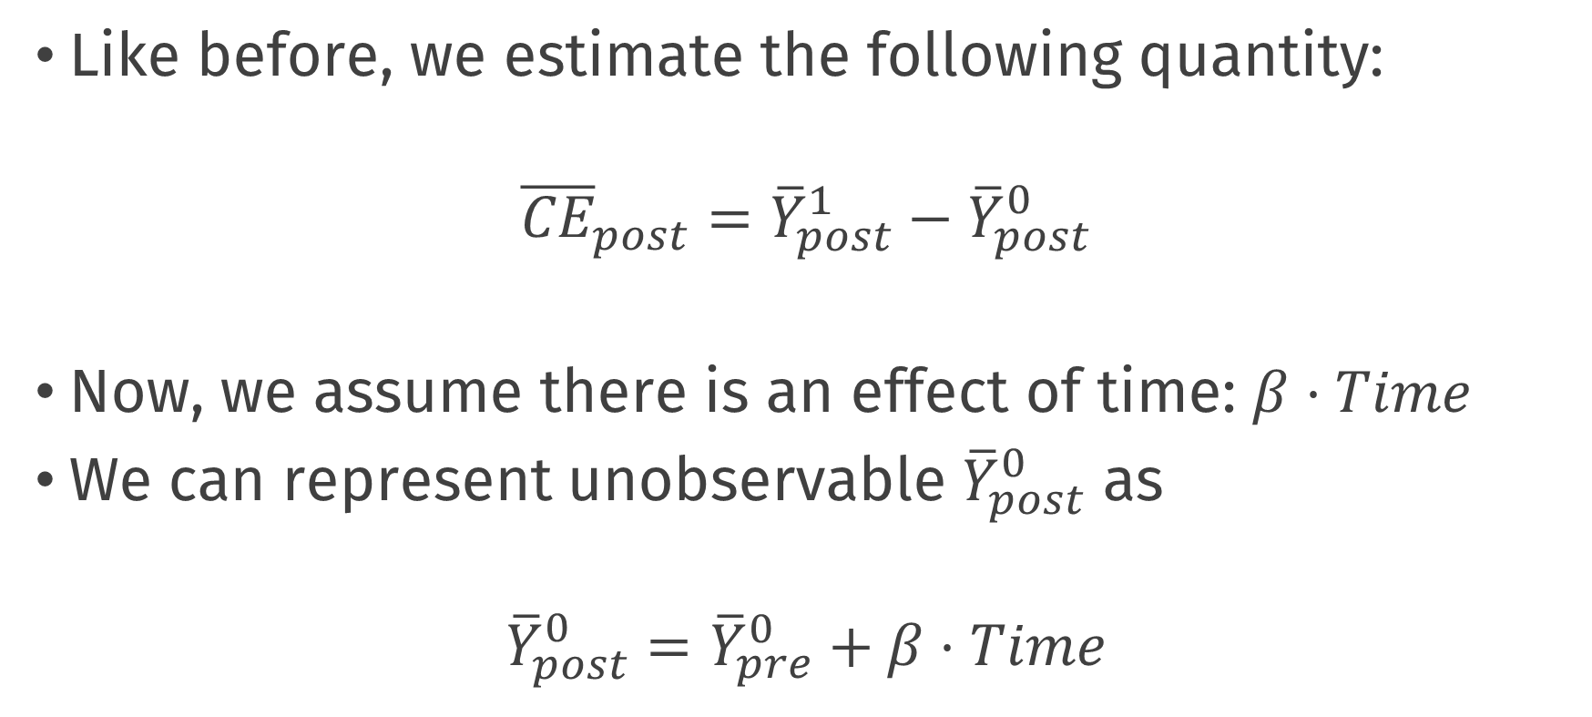
Pre-post estimator
Like before, we estimate the following quantity:
$${\overline{CE}}_{post}={\overline{Y}}_{post}^{1}−{\overline{Y}}_{post}^{0}$$
Now, we assume there is an effect of time: $β⋅Time$
We can represent unobservable ${\overline{Y}}_{post}^{0}$ as
$${\overline{Y}}_{post}^{0}={\overline{Y}}_{pre}^{0}+β⋅Time$$

Slide 67
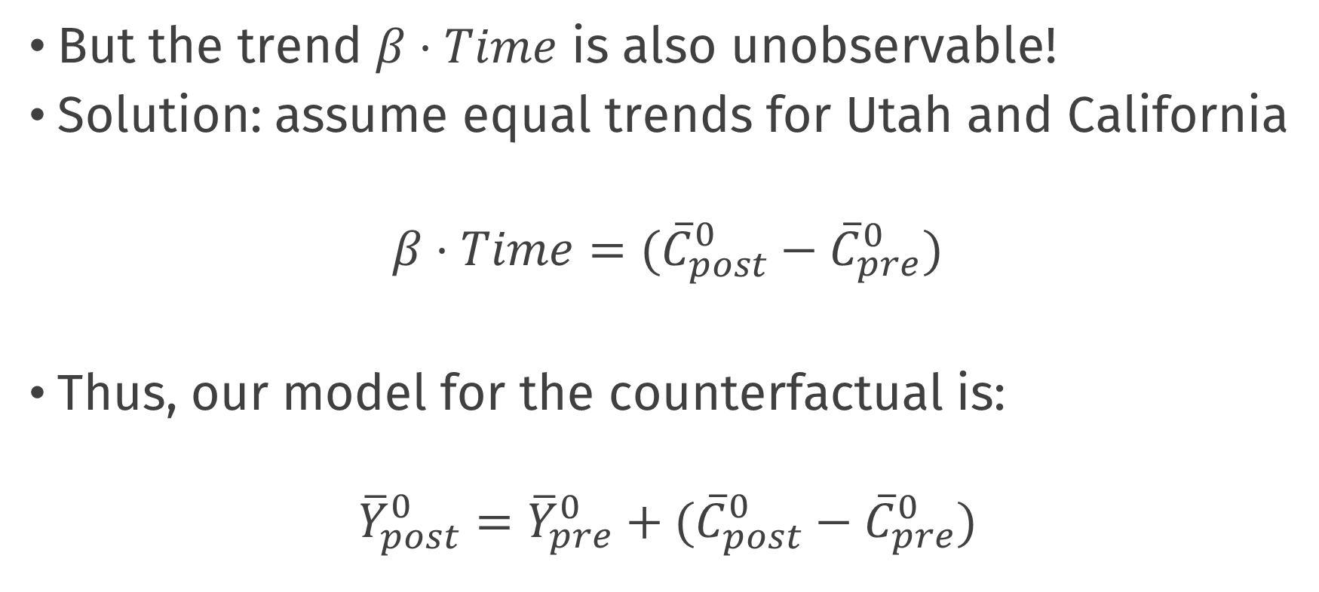
Pre-post estimator
But the trend $β⋅Time$ is also unobservable!
Solution: assume equal trends for Utah and California
$$β⋅Time=({\overline{C}}_{post}^{0}−{\overline{C}}_{pre}^{0})$$
Thus, our model for the counterfactual is:
$${\overline{Y}}_{post}^{0}={\overline{Y}}_{pre}^{0}+({\overline{C}}_{post}^{0}−{\overline{C}}_{pre}^{0})$$

Slide 68
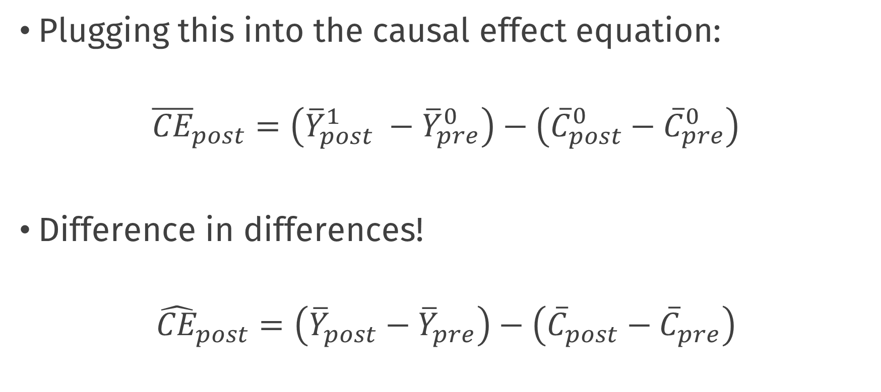
Pre-post estimator
Plugging this into the causal effect equation:
$${\overline{CE}}_{post}=\left({\overline{Y}}_{post}^{1} −{\overline{Y}}_{pre}^{0}\right)−\left({\overline{C}}_{post}^{0}−{\overline{C}}_{pre}^{0}\right)$$
Difference in differences!
$${\hat{CE}}_{post}=\left({\overline{Y}}_{post}−{\overline{Y}}_{pre}\right)−\left({\overline{C}}_{post}−{\overline{C}}_{pre}\right)$$

Slide 69
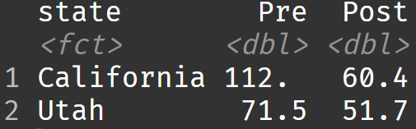
Difference-in-differences
CE = (Cali_post – Cali_pre) – (Utah_post – Utah_pre)
(60.4 - 112)-(51.7 - 71.5) = -32.3

Slide 70
Difference-in-differences

Slide 71




Difference-in-differences
$${\overline{Y}}_{pre}^{0}$$
$${\overline{Y}}_{post}^{1}$$
$${\overline{C}}_{pre}^{0}$$
$${\overline{C}}_{post}^{0}$$

Slide 72
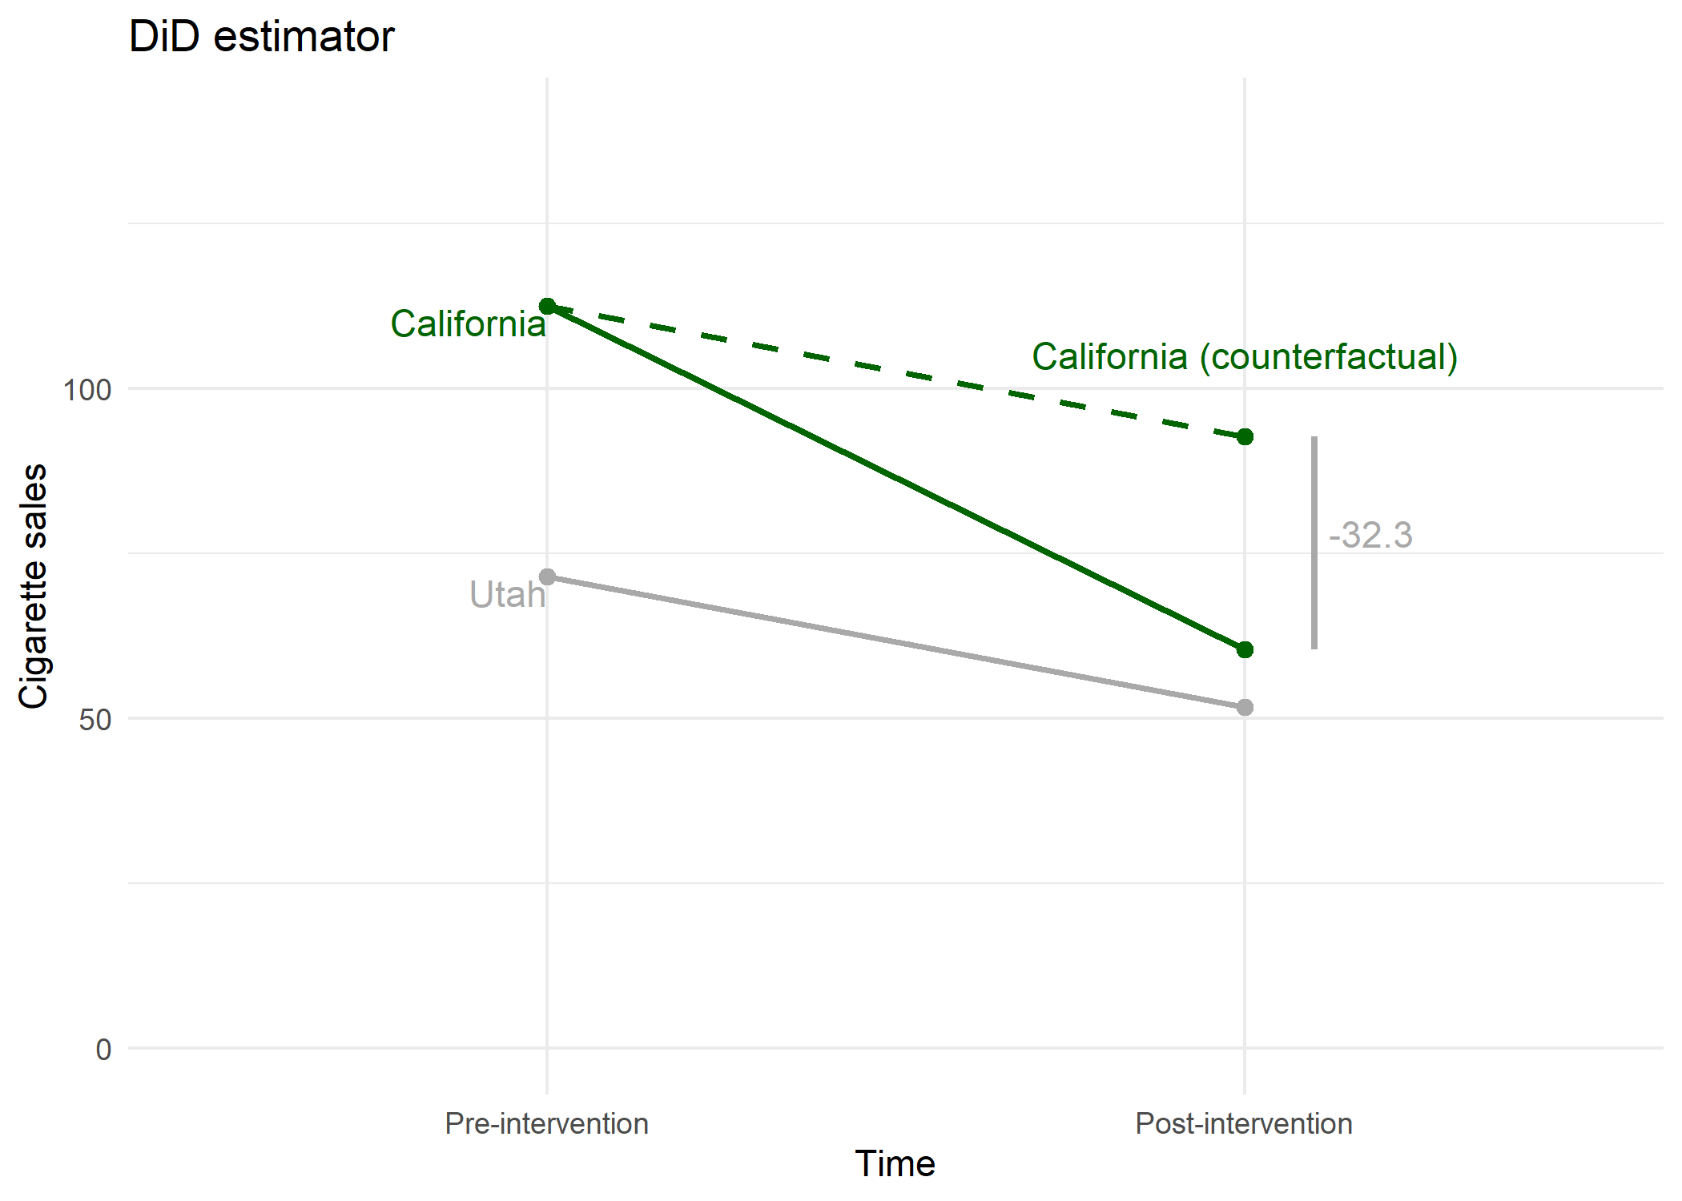

Difference-in-differences
$${\overline{Y}}_{pre}^{0}$$
$${\overline{Y}}_{post}^{0}$$
$${\overline{Y}}_{post}^{1}$$
$${\overline{C}}_{pre}^{0}$$
$${\overline{C}}_{post}^{0}$$

Slide 73
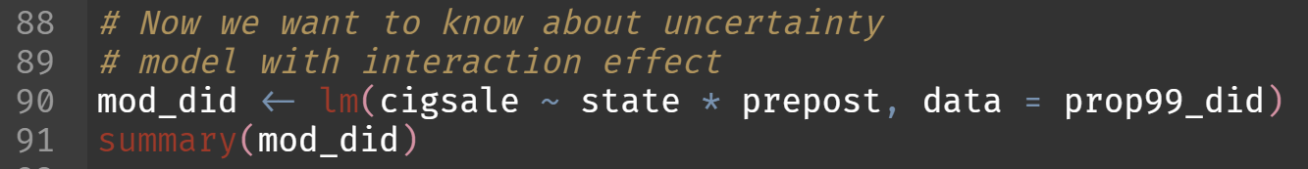
Difference-in-differences
But what about uncertainty?
Use linear regression / OLS to compute $\hat{CE}$

Slide 74
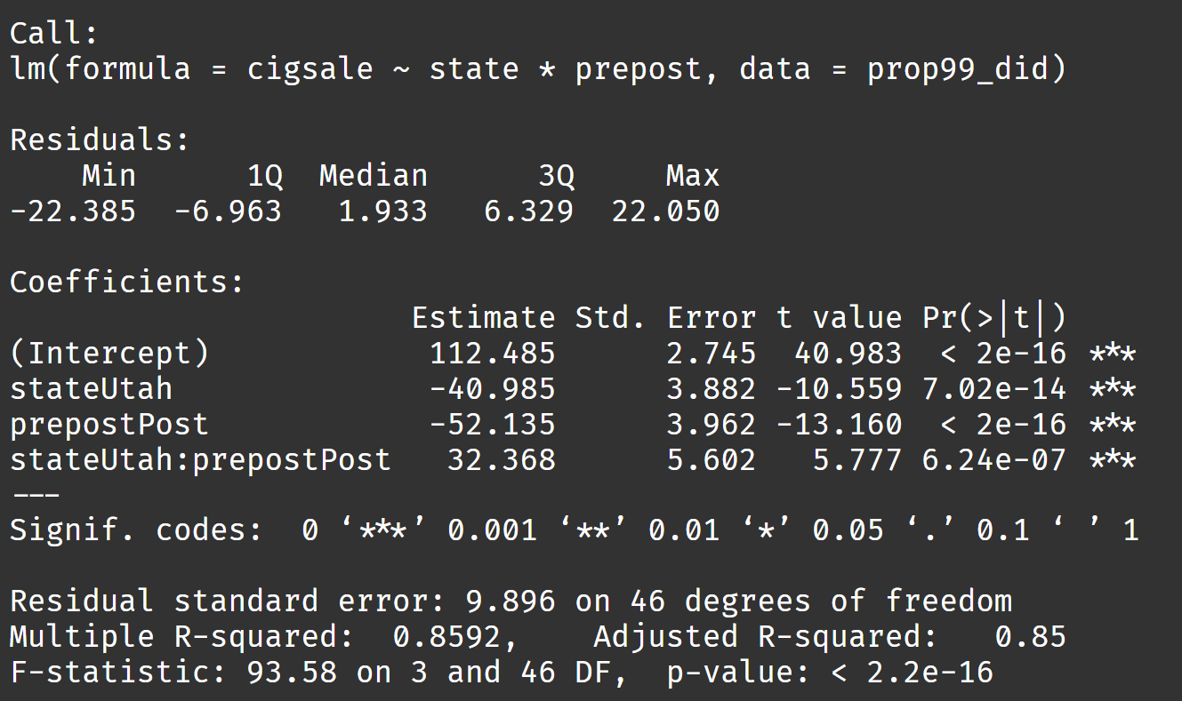
Difference-in-differences
Standard errors
assume no
autocorrelation
(!)

Slide 75
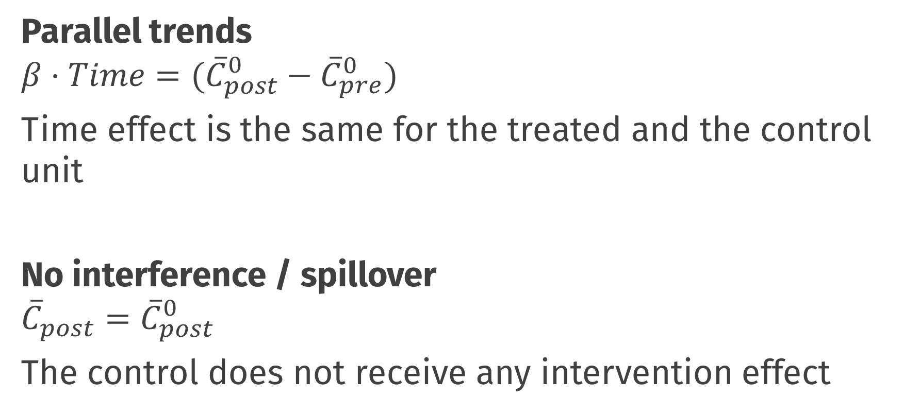
Most important assumptions
Parallel trends
$$β⋅Time=({\overline{C}}_{post}^{0}−{\overline{C}}_{pre}^{0})$$
Time effect is the same for the treated and the control unit
No interference / spillover
$${{\overline{C}}_{post}=\overline{C}}_{post}^{0}$$
The control does not receive any intervention effect
Notes:
OR: No interference; the fact that California has a smoking ban has no effect on cigarette sales in Utah (cig sales Utah is the same as it would be if California had no cigarette ban). Can we think of any problems with this? For example, Utah might also follow suit to the nearby state and not allow smoking… people living in Utah might work in California, etc… bias in either direction possible

Slide 76
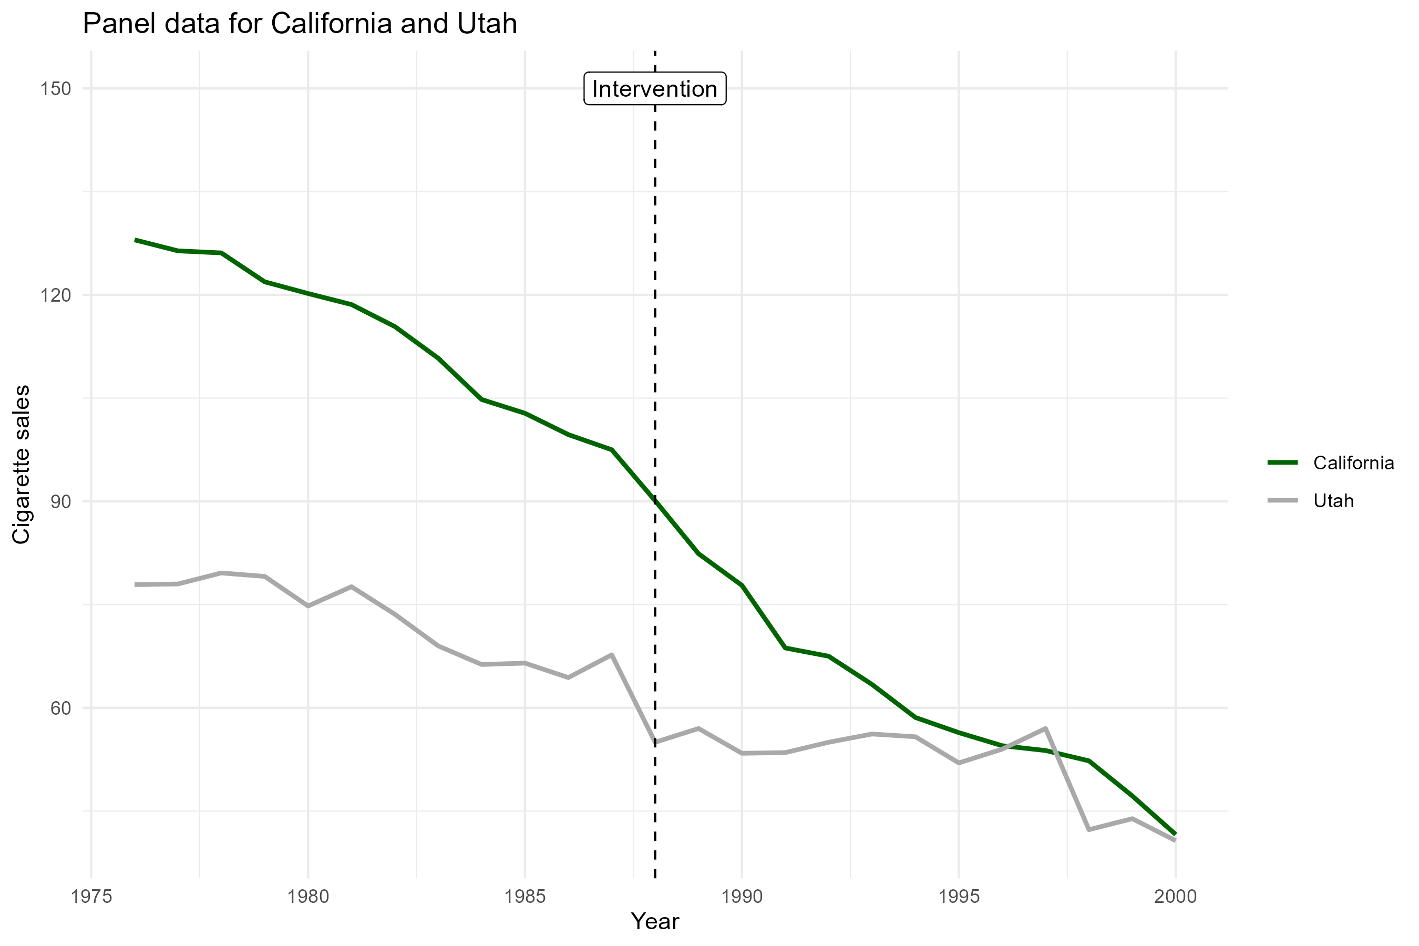
Most important assumptions
Can we assume parallel trends?
At least superficially plausible ☺

Slide 77
Practical: pre-post & DiD
Work in pairs!
Take a break from 10:45 to 11:00

Slide 78
Break

