Slide 1

Leveraging register data to estimate causal
effects of policy interventions
Workshop ODISSEI
Oisín Ryan & Erik-Jan van Kesteren

Slide 2


About us
Erik-Jan van Kesteren
Background in statistics / social science
Assistant professor @ methodology & statistics UU
Social Data Science team lead @ ODISSEI (consortium of universities)
Some stuff I work on:
Latent variables, high-dimensional data, optimization, regularization, visualisation, Bayesian statistics, multilevel models, spatial data, generalized linear models, privacy, synthetic data, high-performance computing, software development, open science & reproducibility

Slide 3

About us
Oisín Ryan
Background in statistics / social science
Currently: Postdoc @ methodology & statistics UU
From July: Assistant Professor @ Data Science and Biostatistics, Julius Center, UMC Utrecht
Website: oisinryan.org
Some stuff I work on:
Causal inference, causal discovery, time-series analysis, computational modeling, visualisation, Bayesian statistics, multilevel models, open science & reproducibility

Slide 4
github.com/sodascience/workshop_causal_impact_assessment

Slide 5
Today’s plan: morning
Introduction (60 minutes)
Policy Interventions and Causal Inference
Pre-Post Analyses and Difference-in-Difference
Practical (30 minutes)
Break (15 minutes)
Interrupted Time Series (45 minutes)
Practical (30 minutes)
Lunch around 12:00 ; re-start at 13:00

Slide 6
Today’s plan: afternoon
Synthetic Control Methods (45 minutes)
Practical (45 minutes)
Break (15 minutes)
Synthetic CITS an CausalImpact (45 minutes)
Practical (45 minutes)
Break (15 minutes)
Discussion session (30 minutes)
Finish around 17:00

Slide 7
Context: “Policy Evaluations”
Many social science research questions concern evaluating what the effect of implementing a particular policy or intervention was on some outcome of interest
Examples:
- What was the effect of raising the maximum speed limit on road deaths?
What effect did introducing students loans have on post-graduation debt levels?
Did introducing an after-school programme in disadvantaged neighbourhoods lead to improved educational outcomes in children from that neighbourhood?

Slide 8
Context: “Policy Evaluations”
Sometimes referred to as “policy evaluation” research or “comparative case studies”
Basic Structure:
We have some unit (or units) which we observe before and after some intervention or action
Did the intervention produces changes in the outcome for that unit?

Slide 9
Methods for Policy Evaluation
Many different methods have been developed to answer these types of research questions
These methods differ in terms of:
The amount and type of information they use
Amount of time-points and amount of potential “control” units
The specific statistical approach they take
The types of assumptions they make
Today we aim to give you a brief introduction to many of these different methods!

Slide 10
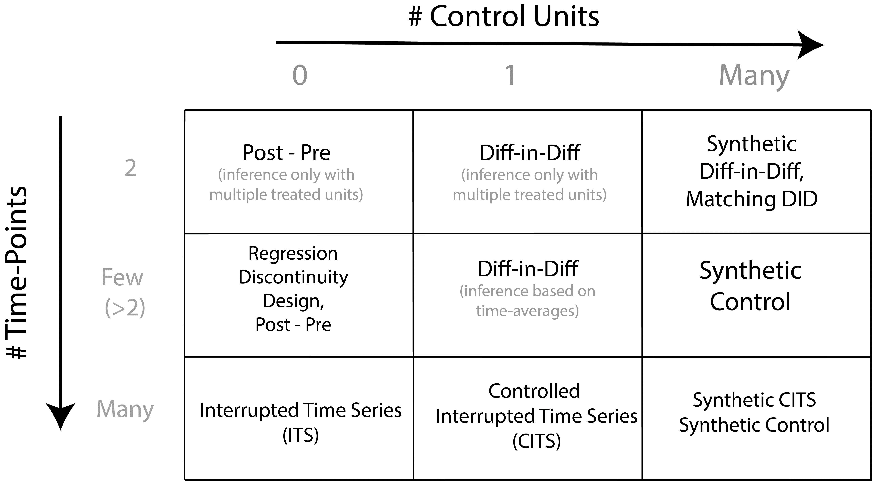

Slide 11
Causal Inference: A primer

Slide 12
Potential Outcomes
Causal Inference is (broadly) concerned with using data to estimate what the effect is of intervening or changing the value of one or more variables.
Using the potential outcomes framework, we can define causal inference as a missing data problem

Slide 13



Slide 14
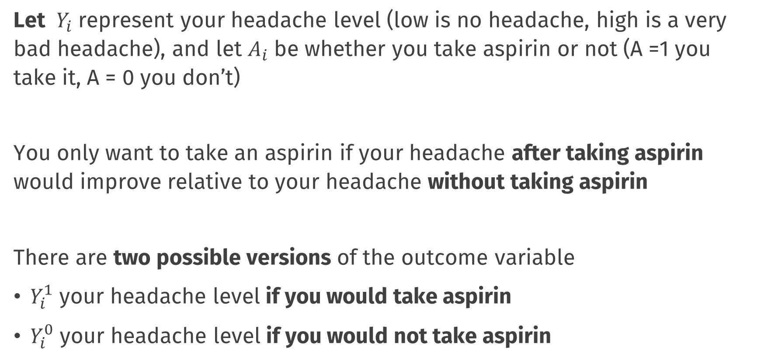
Potential Outcomes
Let $Y_{i}$ represent your headache level (low is no headache, high is a very bad headache), and let $A_{i}$ be whether you take aspirin or not (A =1 you take it, A = 0 you don’t)
You only want to take an aspirin if your headache after taking aspirin would improve relative to your headache without taking aspirin
There are two possible versions of the outcome variable
$Y_{i}^{1}$ your headache level if you would take aspirin
$Y_{i}^{0}$ your headache level if you would not take aspirin

Slide 15
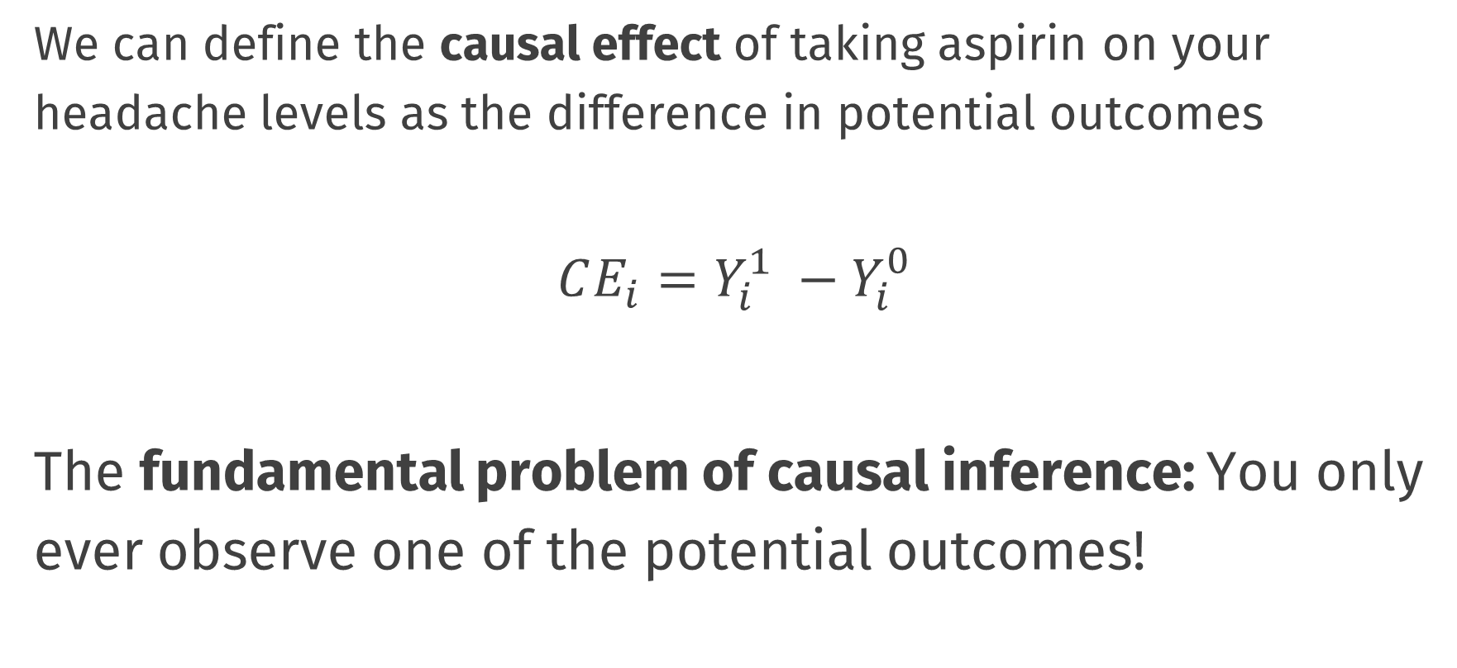
Causal Effects
We can define the causal effect of taking aspirin on your headache levels as the difference in potential outcomes
$$CE_{i}=Y_{i}^{1} −Y_{i}^{0}$$
The fundamental problem of causal inference: You only ever observe one of the potential outcomes!

Slide 16
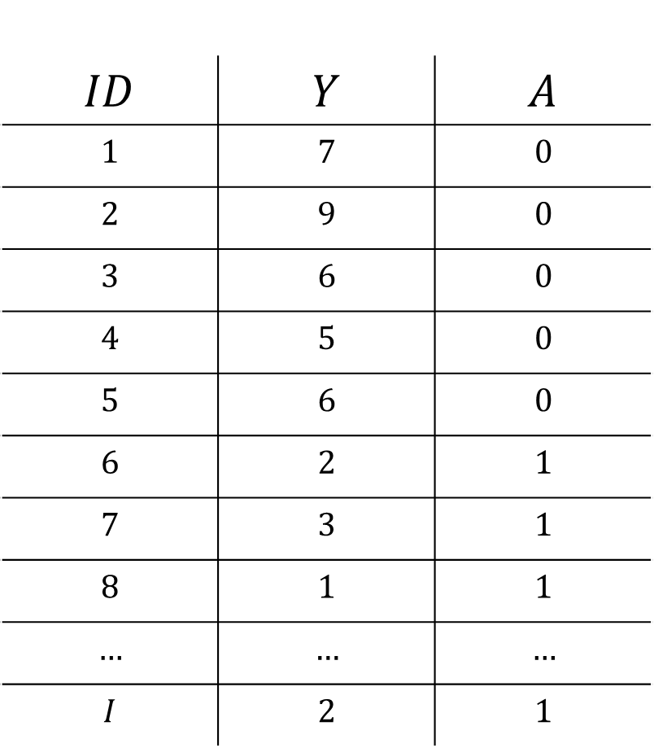
Data and Potential Outcomes
$$ID$$ | $$Y$$ | $$A$$
$$1$$ | $$7$$ | $$0$$
$$2$$ | $$9$$ | $$0$$
$$3$$ | $$6$$ | $$0$$
$$4$$ | $$5$$ | $$0$$
$$5$$ | $$6$$ | $$0$$
$$6$$ | $$2$$ | $$1$$
$$7$$ | $$3$$ | $$1$$
$$8$$ | $$1$$ | $$1$$
$$…$$ | $$…$$ | $$…$$
$$I$$ | $$2$$ | $$1$$

Slide 17
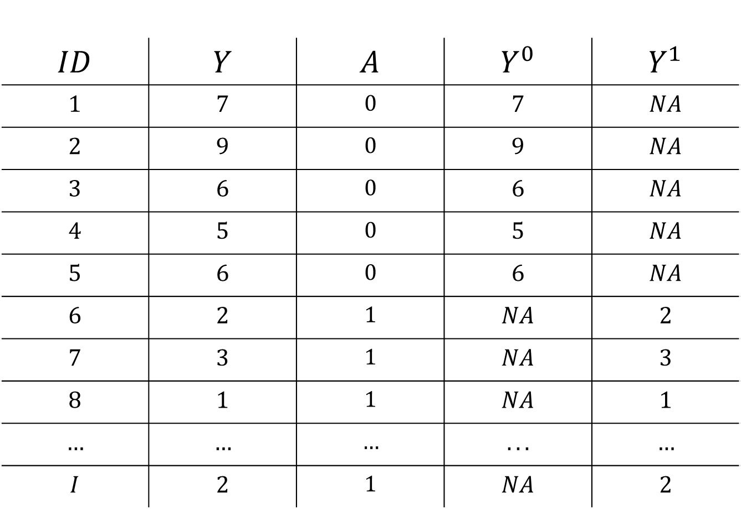
Data and Potential Outcomes
$$ID$$ | $$Y$$ | $$A$$ | $$Y^{0}$$ | $$Y^{1}$$
$$1$$ | $$7$$ | $$0$$ | $$7$$ | $$NA$$
$$2$$ | $$9$$ | $$0$$ | $$9$$ | $$NA$$
$$3$$ | $$6$$ | $$0$$ | $$6$$ | $$NA$$
$$4$$ | $$5$$ | $$0$$ | $$5$$ | $$NA$$
$$5$$ | $$6$$ | $$0$$ | $$6$$ | $$NA$$
$$6$$ | $$2$$ | $$1$$ | $$NA$$ | $$2$$
$$7$$ | $$3$$ | $$1$$ | $$NA$$ | $$3$$
$$8$$ | $$1$$ | $$1$$ | $$NA$$ | $$1$$
$$…$$ | $$…$$ | $$…$$ | $$...$$ | $$…$$
$$I$$ | $$2$$ | $$1$$ | $$NA$$ | $$2$$

Slide 18
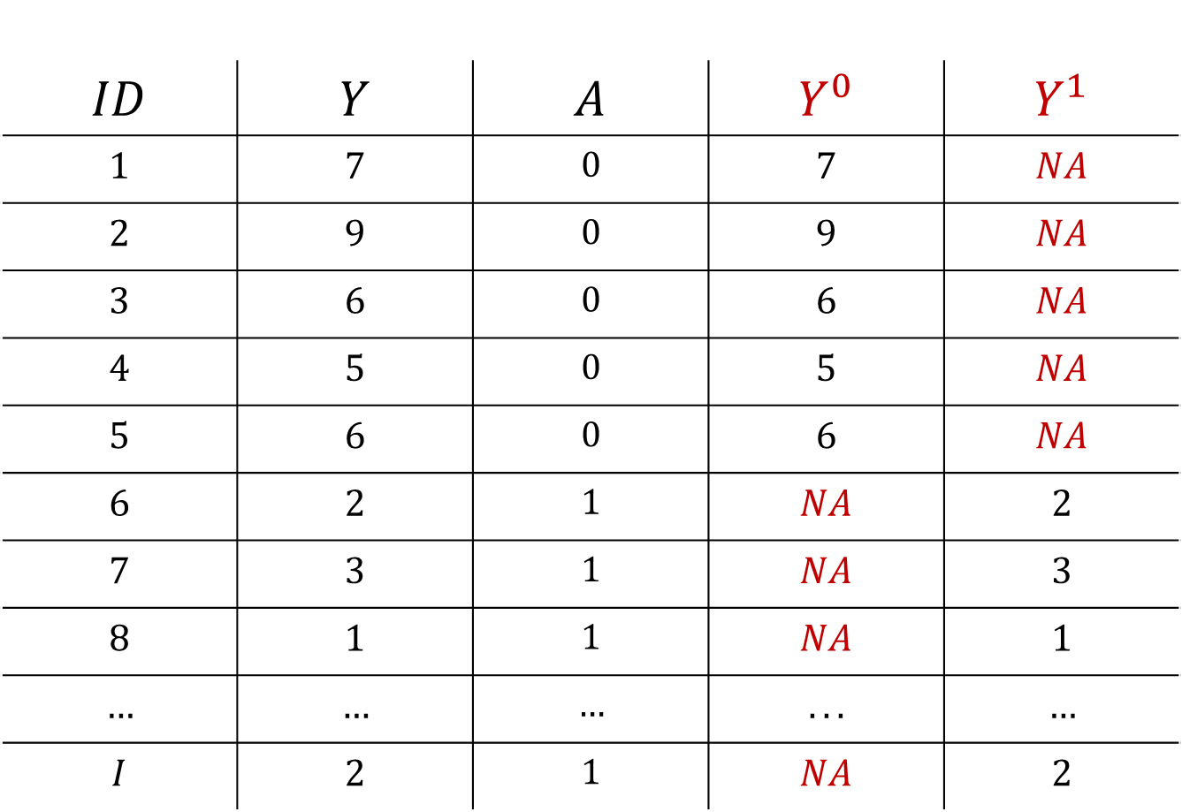
Data and Potential Outcomes
$$ID$$ | $$Y$$ | $$A$$ | $$Y^{0}$$ | $$Y^{1}$$
$$1$$ | $$7$$ | $$0$$ | $$7$$ | $$NA$$
$$2$$ | $$9$$ | $$0$$ | $$9$$ | $$NA$$
$$3$$ | $$6$$ | $$0$$ | $$6$$ | $$NA$$
$$4$$ | $$5$$ | $$0$$ | $$5$$ | $$NA$$
$$5$$ | $$6$$ | $$0$$ | $$6$$ | $$NA$$
$$6$$ | $$2$$ | $$1$$ | $$NA$$ | $$2$$
$$7$$ | $$3$$ | $$1$$ | $$NA$$ | $$3$$
$$8$$ | $$1$$ | $$1$$ | $$NA$$ | $$1$$
$$…$$ | $$…$$ | $$…$$ | $$...$$ | $$…$$
$$I$$ | $$2$$ | $$1$$ | $$NA$$ | $$2$$

Slide 19
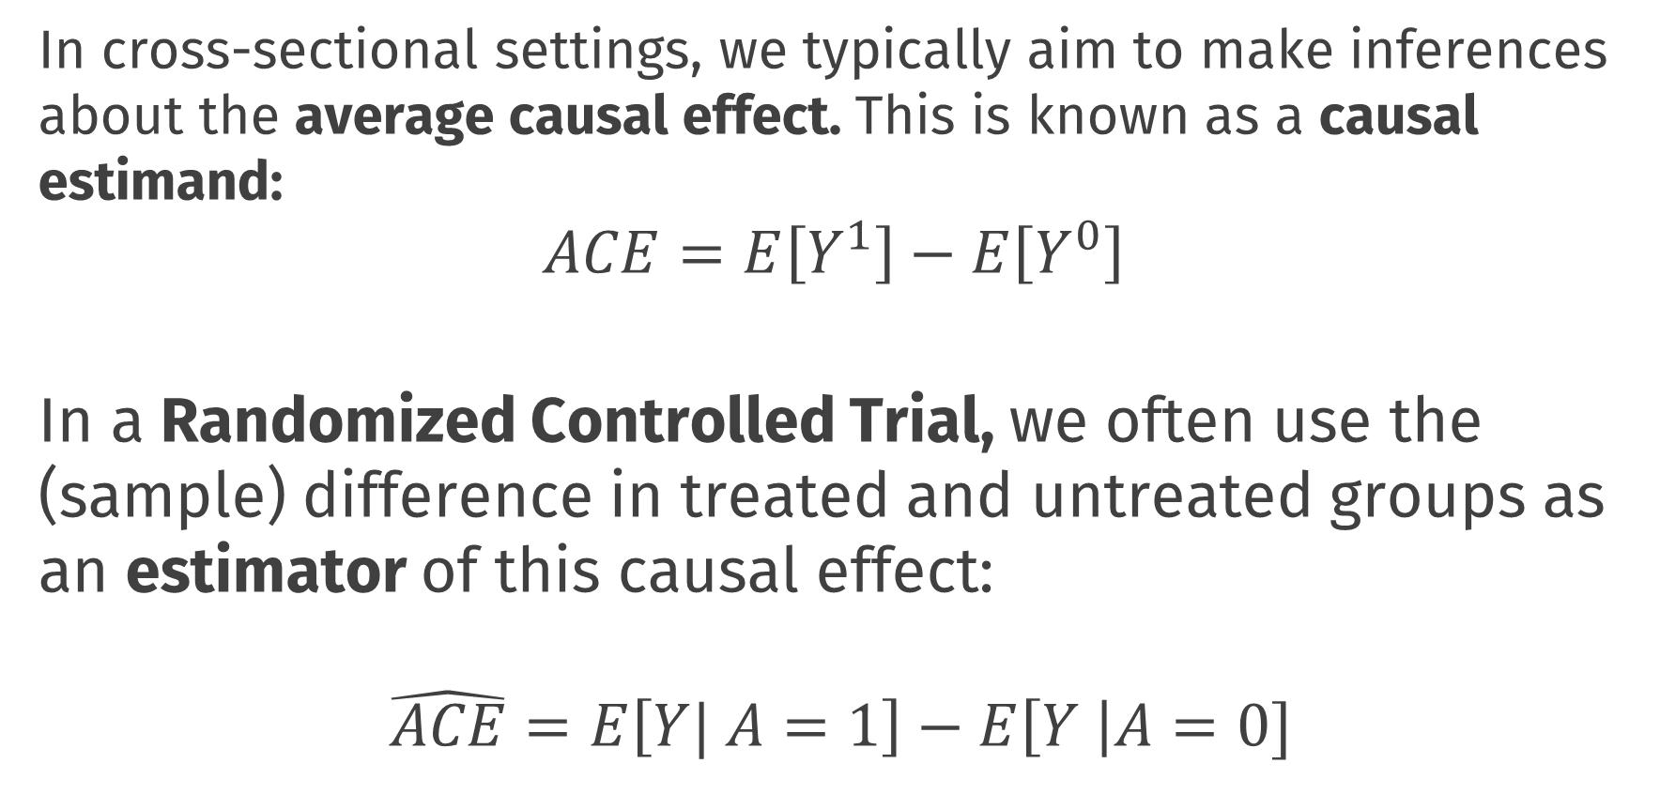
Causal Inference
In cross-sectional settings, we typically aim to make inferences about the average causal effect. This is known as a causal estimand:
$$ACE=E\left[Y^{1}\right]−E\left[Y^{0}\right]$$ In a Randomized Controlled Trial, we often use the (sample) difference in treated and untreated groups as an estimator of this causal effect:
$$\hat{ACE}=E\left[Y| A=1\right]−E\left[Y \right|A=0]$$
Notes:
Even though we can’t directly observe both $Y_{i}^{1}$ and $Y_{i}^{0}$ for the same individuals, under certain conditions, we can make inferences about these potential outcome variables

Slide 20
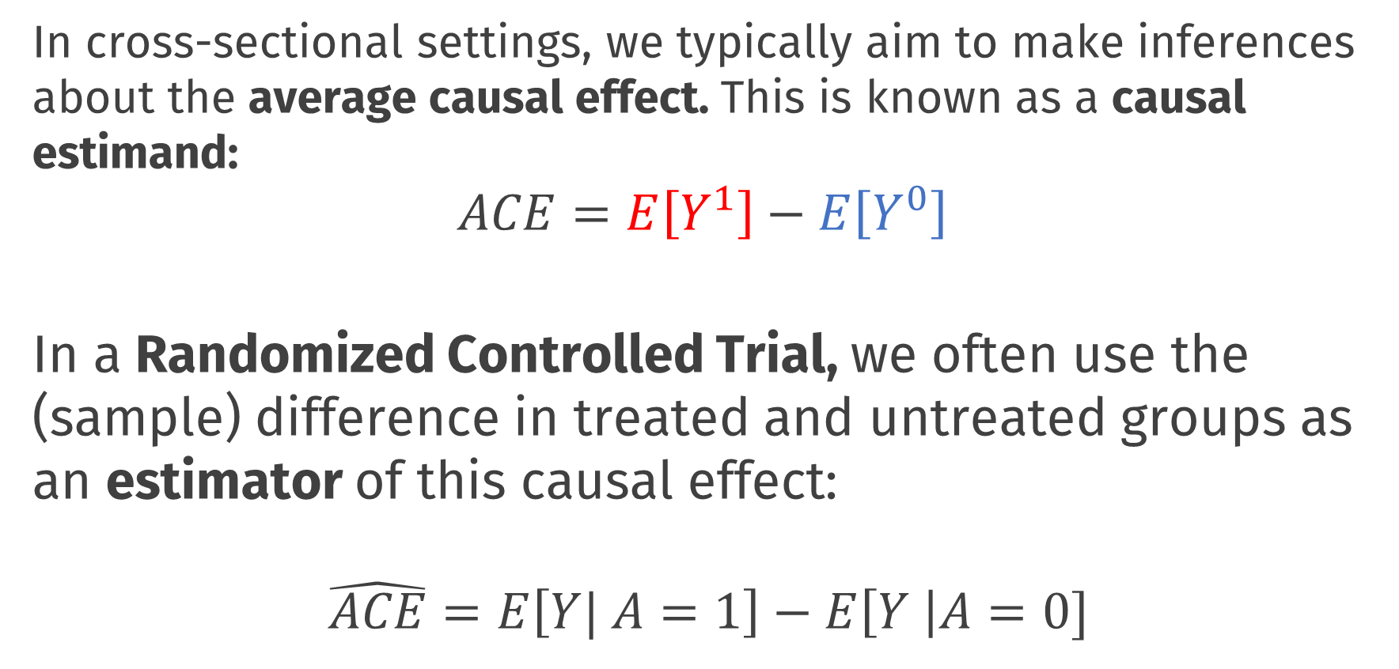
Causal Inference
In cross-sectional settings, we typically aim to make inferences about the average causal effect. This is known as a causal estimand:
$$ACE=E\left[Y^{1}\right]−E\left[Y^{0}\right]$$ In a Randomized Controlled Trial, we often use the (sample) difference in treated and untreated groups as an estimator of this causal effect:
$$\hat{ACE}=E\left[Y| A=1\right]−E\left[Y \right|A=0]$$
Notes:
Even though we can’t directly observe both $Y_{i}^{1}$ and $Y_{i}^{0}$ for the same individuals, under certain conditions, we can make inferences about these potential outcome variables

Slide 21
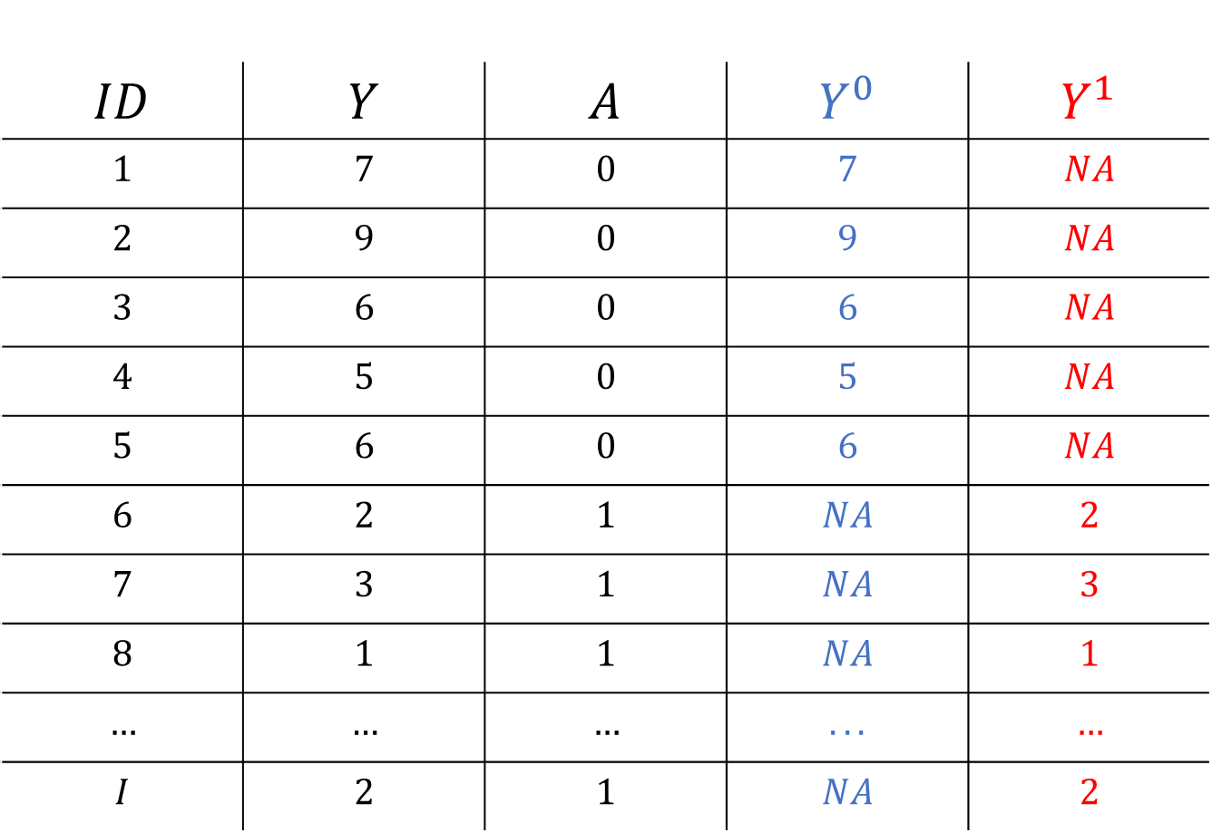
Causal Inference
$$ID$$ | $$Y$$ | $$A$$ | $$Y^{0}$$ | $$Y^{1}$$
$$1$$ | $$7$$ | $$0$$ | $$7$$ | $$NA$$
$$2$$ | $$9$$ | $$0$$ | $$9$$ | $$NA$$
$$3$$ | $$6$$ | $$0$$ | $$6$$ | $$NA$$
$$4$$ | $$5$$ | $$0$$ | $$5$$ | $$NA$$
$$5$$ | $$6$$ | $$0$$ | $$6$$ | $$NA$$
$$6$$ | $$2$$ | $$1$$ | $$NA$$ | $$2$$
$$7$$ | $$3$$ | $$1$$ | $$NA$$ | $$3$$
$$8$$ | $$1$$ | $$1$$ | $$NA$$ | $$1$$
$$…$$ | $$…$$ | $$…$$ | $$...$$ | $$…$$
$$I$$ | $$2$$ | $$1$$ | $$NA$$ | $$2$$

Slide 22
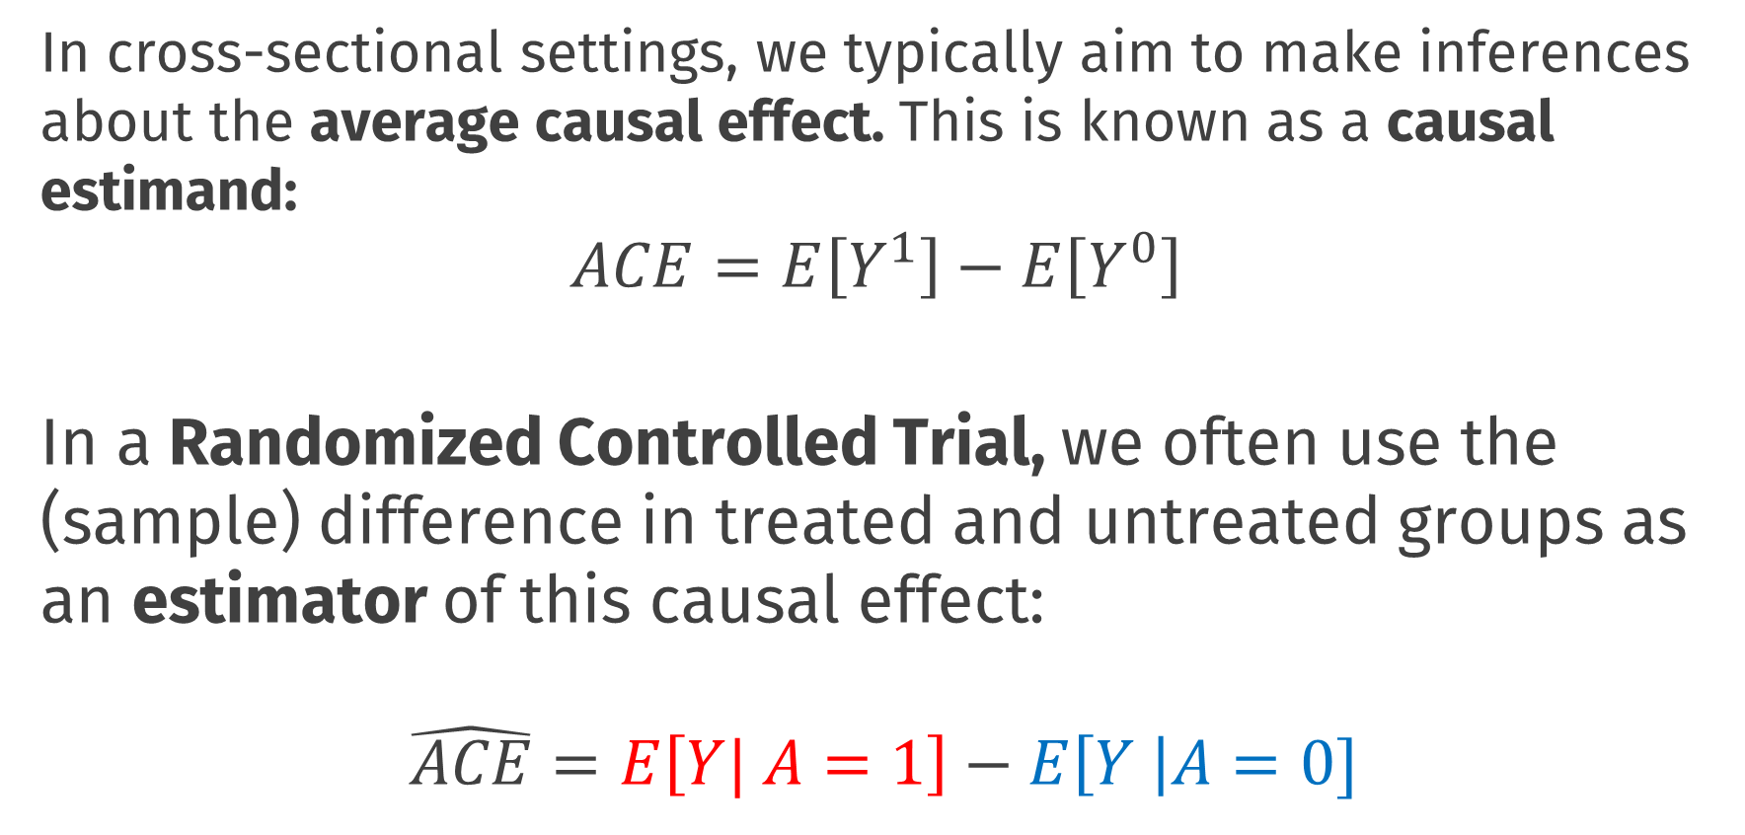
Causal Inference
In cross-sectional settings, we typically aim to make inferences about the average causal effect. This is known as a causal estimand:
$$ACE=E\left[Y^{1}\right]−E\left[Y^{0}\right]$$ In a Randomized Controlled Trial, we often use the (sample) difference in treated and untreated groups as an estimator of this causal effect:
$$\hat{ACE}=E\left[Y| A=1\right]−E\left[Y \right|A=0]$$
Notes:
Even though we can’t directly observe both $Y_{i}^{1}$ and $Y_{i}^{0}$ for the same individuals, under certain conditions, we can make inferences about these potential outcome variables

Slide 23
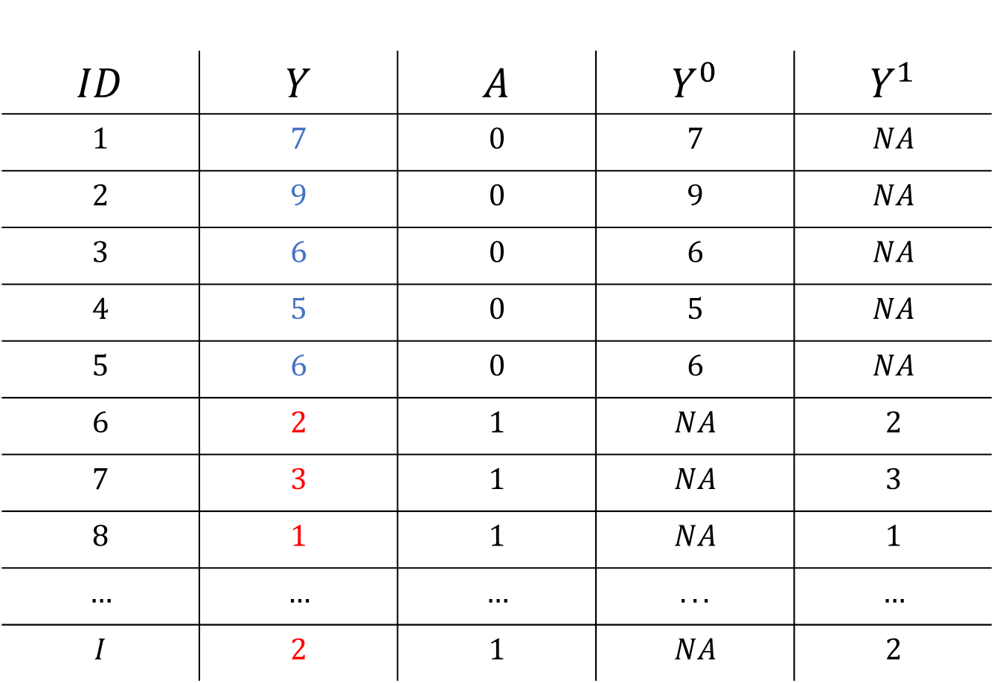
Causal Inference
$$ID$$ | $$Y$$ | $$A$$ | $$Y^{0}$$ | $$Y^{1}$$
$$1$$ | $$7$$ | $$0$$ | $$7$$ | $$NA$$
$$2$$ | $$9$$ | $$0$$ | $$9$$ | $$NA$$
$$3$$ | $$6$$ | $$0$$ | $$6$$ | $$NA$$
$$4$$ | $$5$$ | $$0$$ | $$5$$ | $$NA$$
$$5$$ | $$6$$ | $$0$$ | $$6$$ | $$NA$$
$$6$$ | $$2$$ | $$1$$ | $$NA$$ | $$2$$
$$7$$ | $$3$$ | $$1$$ | $$NA$$ | $$3$$
$$8$$ | $$1$$ | $$1$$ | $$NA$$ | $$1$$
$$…$$ | $$…$$ | $$…$$ | $$...$$ | $$…$$
$$I$$ | $$2$$ | $$1$$ | $$NA$$ | $$2$$

Slide 24
Causal Inference Assumptions
This type of inference about causal effects from observed data is only possible under certain conditions or assumptions
Exchangeability
Essentially relates to the absence of (unaccounted for) confounder variables
If we were to reverse treatment assignment we would observe the same group differences. Information is exchangeable between groups
RCTs are powerful because randomization ensures exchangeability. But in principle this kind of inference is possible from non-RCT designs
In practice we need conditional exchangeability; to control for confounders!
Notes:
Even though we can’t directly observe both $Y_{i}^{1}$ and $Y_{i}^{0}$ for the same individuals, under certain conditions, we can make inferences about these potential outcome variables

Slide 25
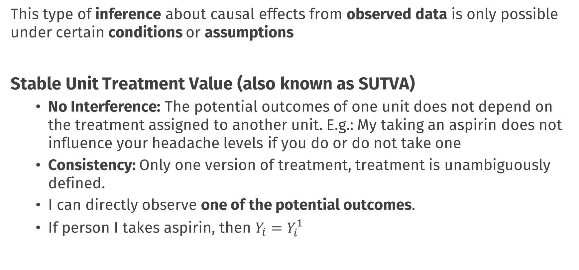
Causal Inference Assumptions
This type of inference about causal effects from observed data is only possible under certain conditions or assumptions
Stable Unit Treatment Value (also known as SUTVA)
No Interference: The potential outcomes of one unit does not depend on the treatment assigned to another unit. E.g.: My taking an aspirin does not influence your headache levels if you do or do not take one
Consistency: Only one version of treatment, treatment is unambiguously defined.
I can directly observe one of the potential outcomes.
If person I takes aspirin, then $Y_{i}=Y_{i}^{1}$
Notes:
Even though we can’t directly observe both $Y_{i}^{1}$ and $Y_{i}^{0}$ for the same individuals, under certain conditions, we can make inferences about these potential outcome variables
E.g.: If I want to make inferences about the effect of losing weight on heart health, my inferences will be different if I study people who gradually lost weight due to diet and exercise vs those who are lighter due to liposuction!

Slide 26
Causal Inference Assumptions
These two generic assumptions essentially always appear in causal inference problems, and as we will see, we will have to deal with concerns around confounders and no interference repeatedly today
Other assumptions or conditions may also be needed depending on the specific design and analytic approach you take
Notes:
Here; I could show the derivation of how you get from estimand to estimator using those assumptions, but I think it’s good to leave this out

Slide 27
Causal Inference and Policy Evaluations

Slide 28
Todays Topic
Policy evaluation is a special case of causal inference
We typically have one unit observed repeatedly over time
At some point in time an intervention takes place
Notes:
Even though we can’t directly observe both $Y_{i}^{1}$ and $Y_{i}^{0}$ for the same individuals, under certain conditions, we can make inferences about these potential outcome variables

Slide 29

$$Time$$ | $$Y_{t}$$ | $$A_{t}$$
$$1$$ | $$7$$ | $$0$$
$$2$$ | $$9$$ | $$0$$
$$3$$ | $$6$$ | $$0$$
$$4$$ | $$5$$ | $$0$$
$$5$$ | $$6$$ | $$0$$
$$6$$ | $$2$$ | $$1$$
$$7$$ | $$3$$ | $$1$$
$$8$$ | $$1$$ | $$1$$
$$…$$ | $$…$$ | $$…$$
$$T$$ | $$2$$ | $$1$$

Slide 30
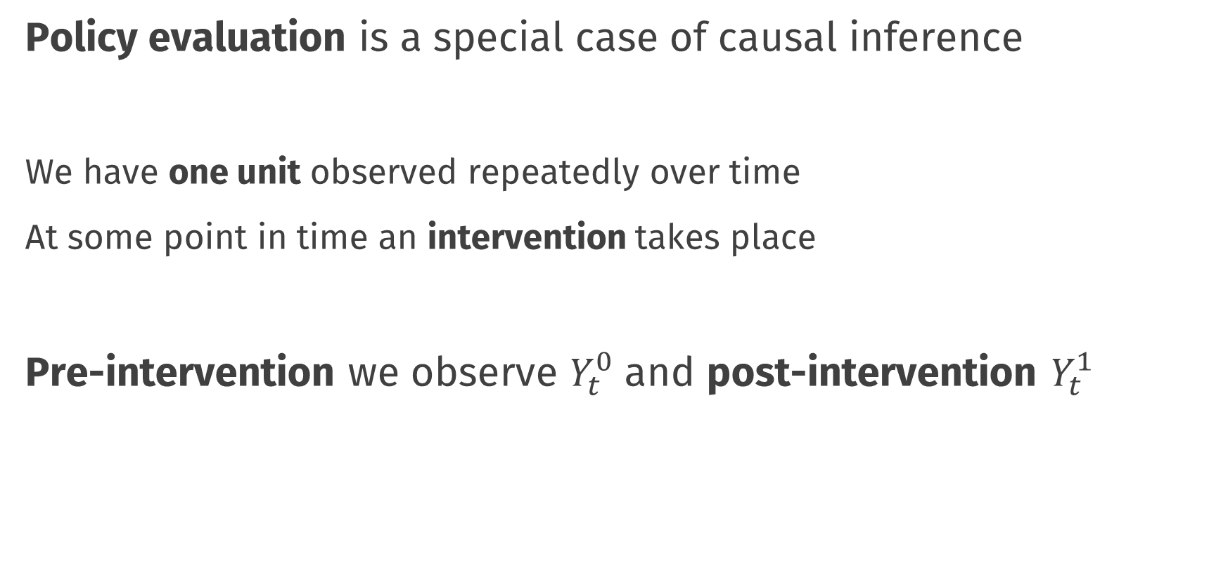
Todays Topic
Policy evaluation is a special case of causal inference
We have one unit observed repeatedly over time
At some point in time an intervention takes place
Pre-intervention we observe $Y_{t}^{0}$ and post-intervention $Y_{t}^{1}$
Notes:
Even though we can’t directly observe both $Y_{i}^{1}$ and $Y_{i}^{0}$ for the same individuals, under certain conditions, we can make inferences about these potential outcome variables

Slide 31
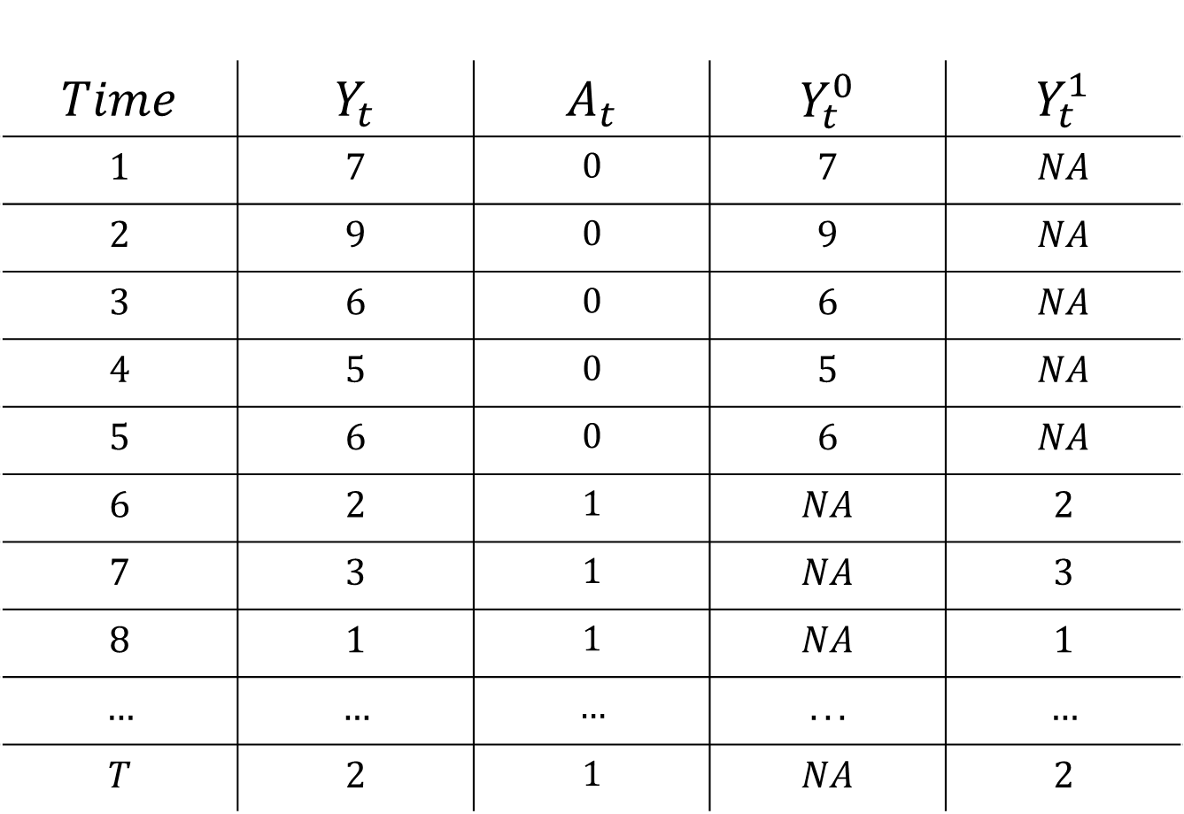
$$Time$$ | $$Y_{t}$$ | $$A_{t}$$ | $$Y_{t}^{0}$$ | $$Y_{t}^{1}$$
$$1$$ | $$7$$ | $$0$$ | $$7$$ | $$NA$$
$$2$$ | $$9$$ | $$0$$ | $$9$$ | $$NA$$
$$3$$ | $$6$$ | $$0$$ | $$6$$ | $$NA$$
$$4$$ | $$5$$ | $$0$$ | $$5$$ | $$NA$$
$$5$$ | $$6$$ | $$0$$ | $$6$$ | $$NA$$
$$6$$ | $$2$$ | $$1$$ | $$NA$$ | $$2$$
$$7$$ | $$3$$ | $$1$$ | $$NA$$ | $$3$$
$$8$$ | $$1$$ | $$1$$ | $$NA$$ | $$1$$
$$…$$ | $$…$$ | $$…$$ | $$...$$ | $$…$$
$$T$$ | $$2$$ | $$1$$ | $$NA$$ | $$2$$

Slide 32
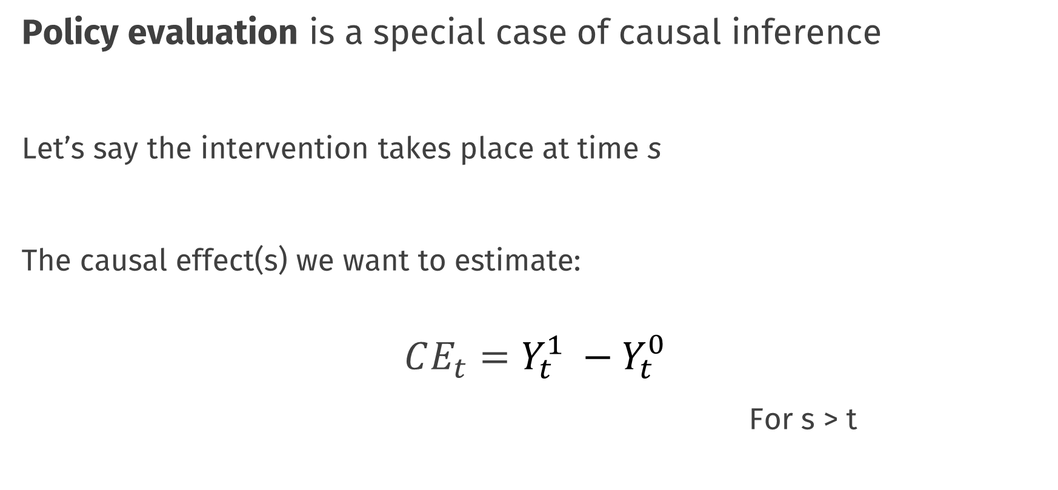
Todays Topic
Policy evaluation is a special case of causal inference
Let’s say the intervention takes place at time s
The causal effect(s) we want to estimate:
$$CE_{t}=Y_{t}^{1} −Y_{t}^{0}$$
For s > t
Notes:
Even though we can’t directly observe both $Y_{i}^{1}$ and $Y_{i}^{0}$ for the same individuals, under certain conditions, we can make inferences about these potential outcome variables

Slide 33
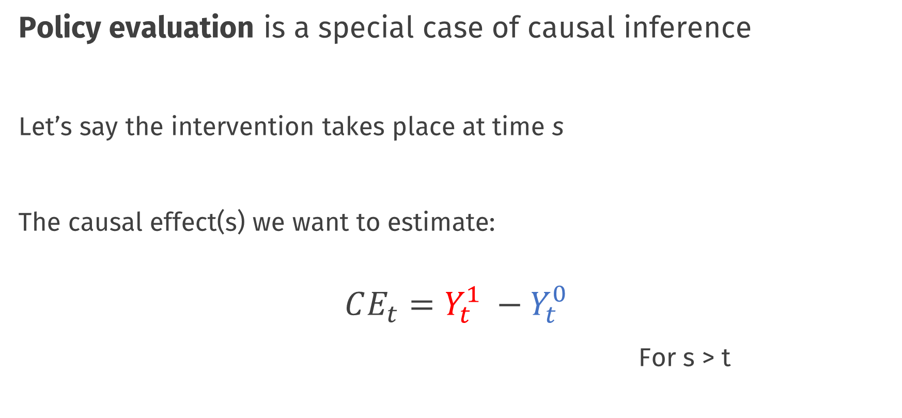
Todays Topic
Policy evaluation is a special case of causal inference
Let’s say the intervention takes place at time s
The causal effect(s) we want to estimate:
$$CE_{t}=Y_{t}^{1} −Y_{t}^{0}$$
For s > t
Notes:
Even though we can’t directly observe both $Y_{i}^{1}$ and $Y_{i}^{0}$ for the same individuals, under certain conditions, we can make inferences about these potential outcome variables

Slide 34
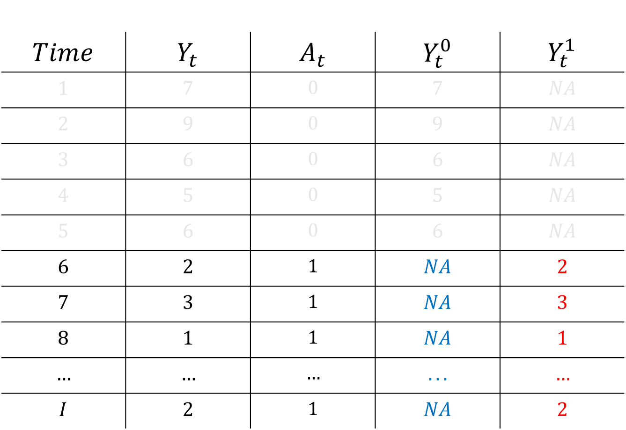
$$Time$$ | $$Y_{t}$$ | $$A_{t}$$ | $$Y_{t}^{0}$$ | $$Y_{t}^{1}$$
$$1$$ | $$7$$ | $$0$$ | $$7$$ | $$NA$$
$$2$$ | $$9$$ | $$0$$ | $$9$$ | $$NA$$
$$3$$ | $$6$$ | $$0$$ | $$6$$ | $$NA$$
$$4$$ | $$5$$ | $$0$$ | $$5$$ | $$NA$$
$$5$$ | $$6$$ | $$0$$ | $$6$$ | $$NA$$
$$6$$ | $$2$$ | $$1$$ | $$NA$$ | $$2$$
$$7$$ | $$3$$ | $$1$$ | $$NA$$ | $$3$$
$$8$$ | $$1$$ | $$1$$ | $$NA$$ | $$1$$
$$…$$ | $$…$$ | $$…$$ | $$...$$ | $$…$$
$$I$$ | $$2$$ | $$1$$ | $$NA$$ | $$2$$

Slide 35
Methods for Policy Evaluation
So how can we estimate these types of causal effects in practice?
Today we aim to give you a brief introduction to a number of different methods that have been developed for this purpose
Which method is best will depend on:
The amount and type of information available
Amount of time-points and amount of potential “control” units
Which assumptions are reasonable in a given setting

Slide 37
Pre-Post Analysis

Slide 38
Break

Slide 39
Default light slide
Default subheading
This is the body of the text
Default subheading
Note that the text is not black, but “black, text 1, lighter 25%”
Default subheading
This makes things easier on the eyes
Default subheading
This is the body of the text

Slide 40
Default dark slide
Default subheading
The dark slide brings some variation
Default subheading
It can highlight important aspects of the presentation.
Default subheading
This is the body of the text
Default subheading
This is the body of the text

Slide 41
Here is an impactful slide with a sentence on it.
Here is a topic related to the aforementioned question.

Slide 42
Questions?

