Slide 1
Discussion

Slide 2
Today’s Goal
A brief survey and practical introduction to the
Core concepts
Key assumptions
Different statistical methods
used to evaluate the causal effects of policy interventions
Disclaimer:
We took a “wide” instead of “deep” view
Many details / extensions / advanced topics omitted!

Slide 3
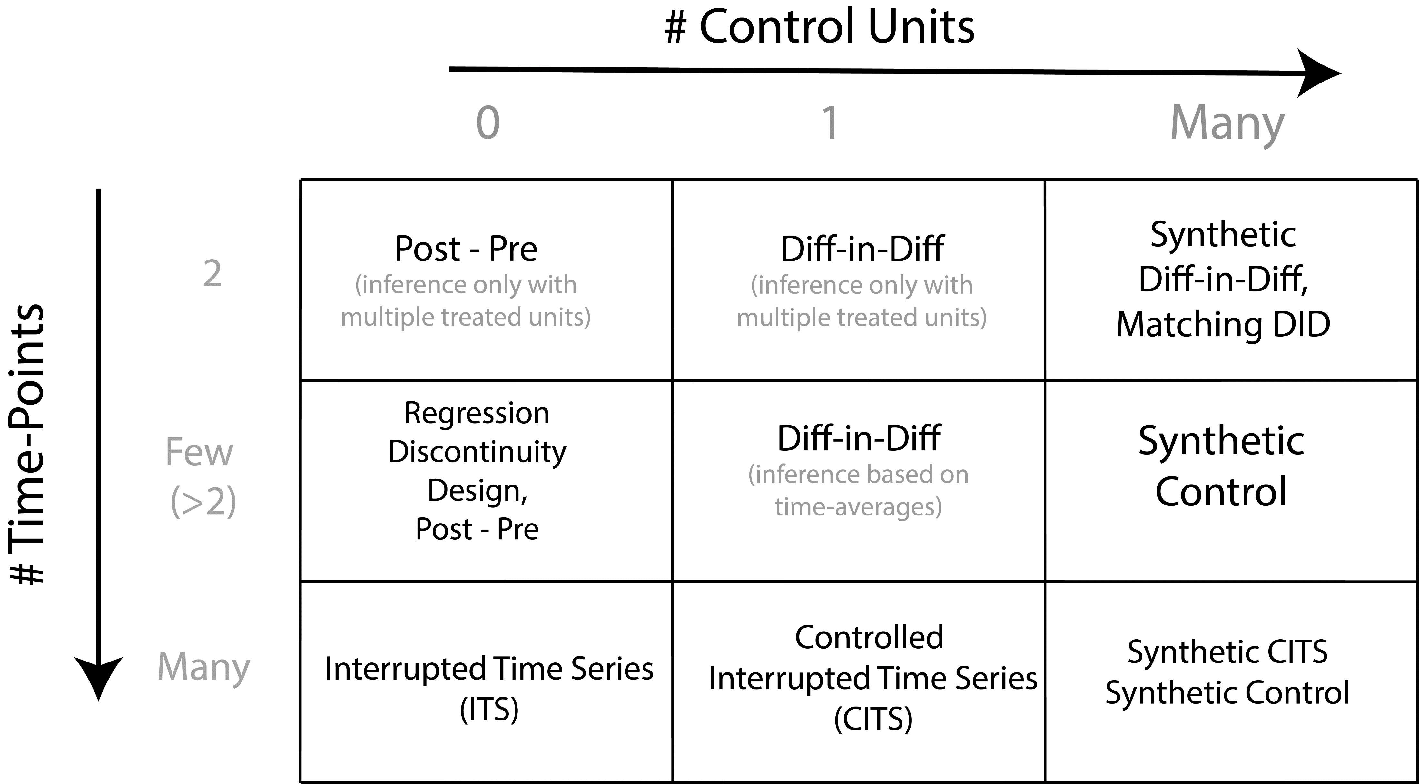

Slide 4
Connections to other methods
Synthetic Control type methods are conceptually and practically similar to “matching” techniques
Often used in causal inference; match similar treated and untreated units
DiD analysis often applied with multiple treated units (averages)
Synthetic Diff-in-Diff (Arkhangelsky et al. 2021)
- combines DiD and Synthetic Control

Slide 5
Advanced Topics
How to deal with interventions which are not “sharp”?
- Outcome may be affected by anticipation

Slide 6
Summary
Many different methods have been developed to answer these types of research questions
These methods differ in terms of:
The amount and type of information they use
Amount of time-points and amount of potential “control” units
The specific statistical approach they take
The types of assumptions they make

Slide 7
Common Themes
Evaluation of assumptions crucial for plausibility of causal effect estimates
- In, time trend

Slide 8
Useful References
Difference in Differences
Interrupted Time Series
Synthetic Control
CausalImpact

Slide 9
Useful References
Synthetic DiD
More on Causal Policy Evaluation
Free online course materials made by Andrew Heiss
https://evalsp23.classes.andrewheiss.com/

Slide 11
Summary
A brief survey and practical introduction to the
Core concepts
Key assumptions
Different statistical methods
used to evaluate the causal effects of policy interventions
Disclaimer:
We took a “wide” instead of “deep” view
Many details / extensions / advanced topics omitted!

Slide 12


About me
Erik-Jan van Kesteren
Background in statistics / social science
Assistant professor @ methodology & statistics UU
Social Data Science team lead @ ODISSEI (consortium of universities)
Some stuff I work on:
Latent variables, high-dimensional data, optimization, regularization, visualisation, Bayesian statistics, multilevel models, spatial data, generalized linear models, privacy, synthetic data, high-performance computing, software development, open science & reproducibility

Slide 13
Today’s plan: morning
Introduction & Recap (60 minutes)
Short break (10 minutes)
Supervised learning: bias/variance (80 minutes)
Supervised learning: classification (40 minutes)
Lunch around 12:40

Slide 14
Today’s plan: afternoon
Prediction competition in groups (90 minutes)
Short break (10 minutes)
Intermezzo: fairness & feedback loops in prediction (30 minutes)
Unsupervised learning (45 minutes)
Finish around 16:30

Slide 15
Data wrangling, visualisation
A short recap
Erik-Jan van Kesteren

Slide 16
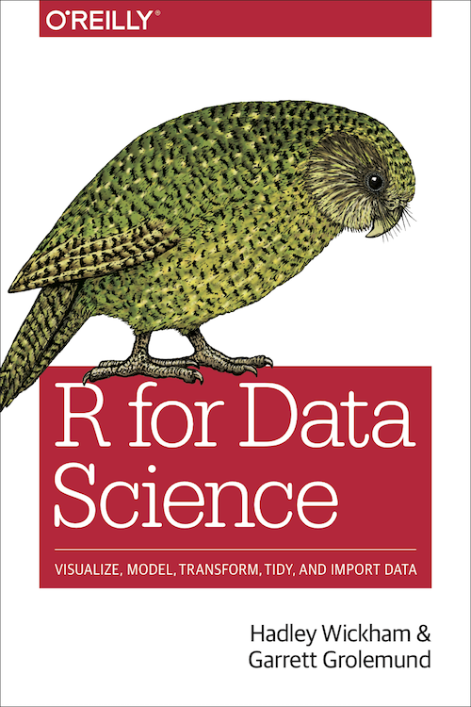
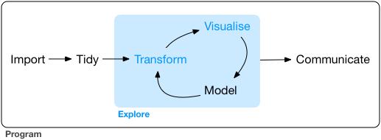
Exploratory data analysis
The goal of data exploration is to generate many promising leads that you can later explore in more depth.
https://r4ds.had.co.nz/

Slide 17
Data wrangling with dplyr
filter
Get only rows that satisfy a condition
select
Select columns from a dataset
mutate
Compute new columns / change existing columns
arrange
Sort/reorder the dataset based on a column

Slide 18
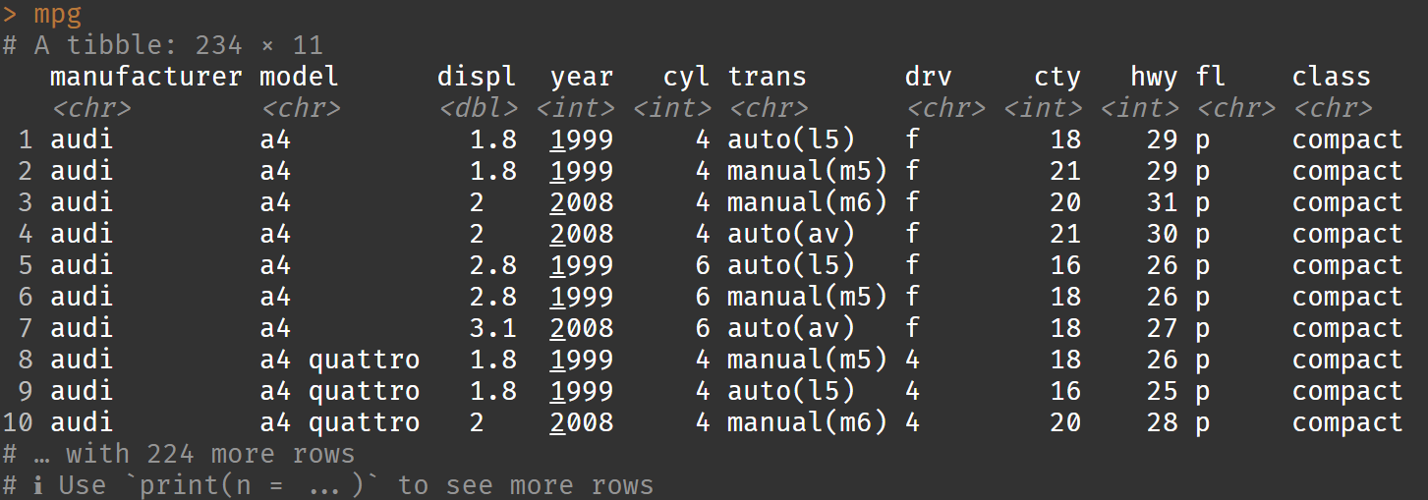
Example dataset: cars

Slide 19
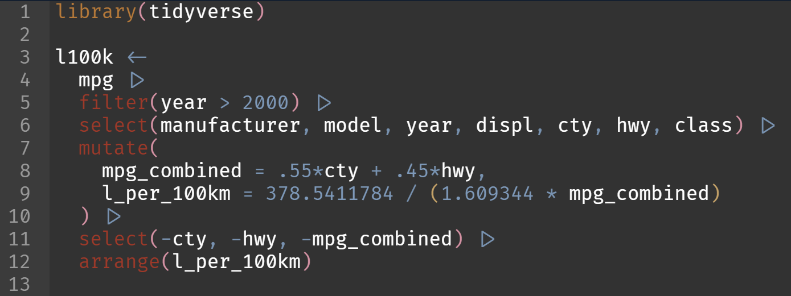
Data wrangling with dplyr
Which are the most efficient (combined city-highway) cars after 2000 in terms of litres / 100km?

Slide 20
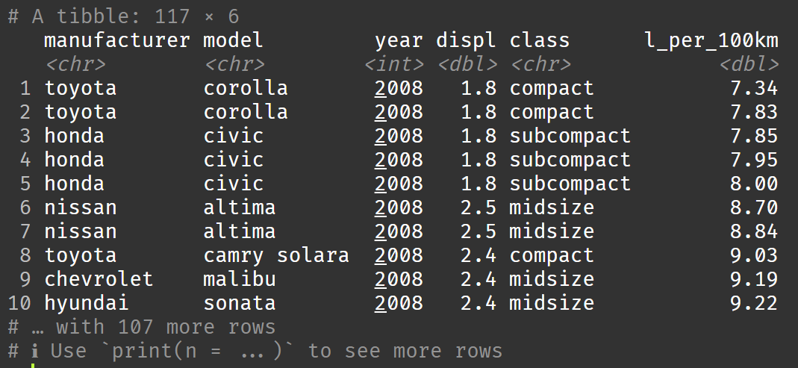
Data wrangling with dplyr

Slide 21
Data visualisation with ggplot2
https://r4ds.had.co.nz/data-visualisation.html
Raw data maps to:
Aesthetics: data-bound properties of the picture (position, shape, colour, …)
Geometric objects, or geom: visual objects on the plot (points, lines, bars, polygons …)
Scales: how data values map to aesthetic values (continuous or discrete)
Facets: subplots / small multiples
Additionally, can apply:
Statistical transformations: transform data before mapping
Alternative coordinate system (cartesian, polar, …)

Slide 22
Example dataset: l100k

Slide 23
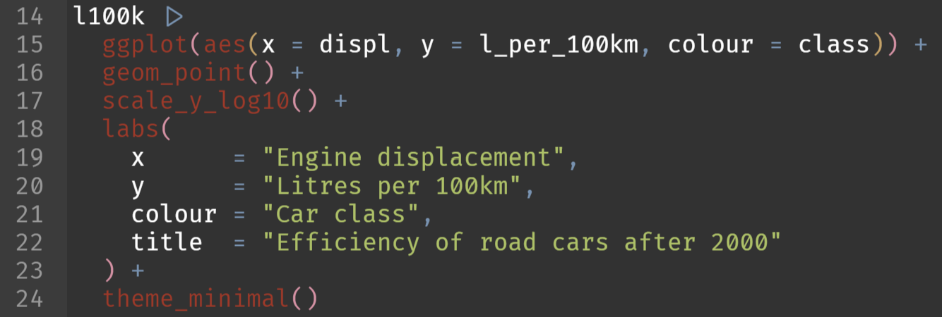
Data visualisation with ggplot2
Display a scatter plot with on the x axis the engine displacement and on the y-axis the efficiency. Colour the points by the car class

Slide 24
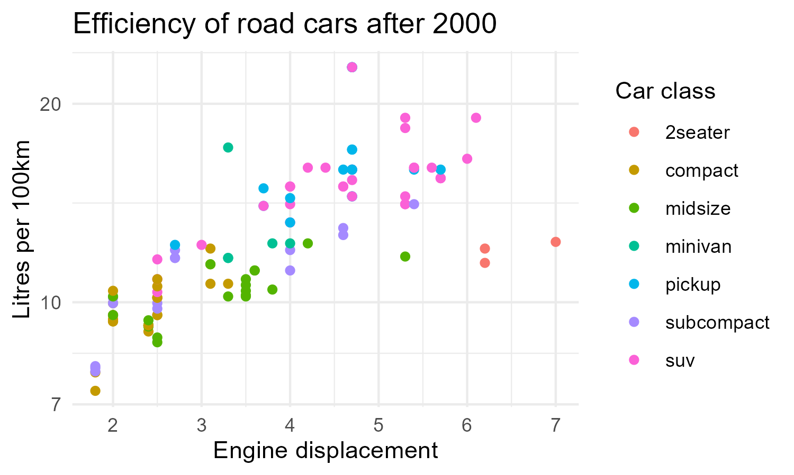
Data visualisation with ggplot2

Slide 25
More data wrangling with dplyr
group by
Registers groups by which to perform further operations (usually mutate, summarise)
summarise
Create summaries based on a function applied to each group

Slide 26
Example dataset: l100k

Slide 27
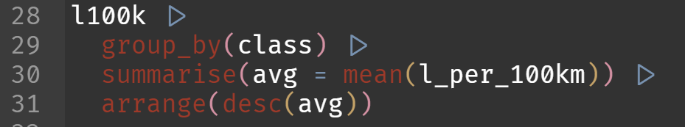
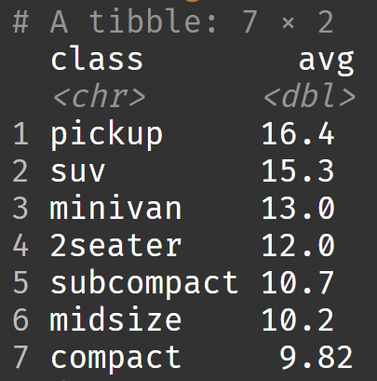
More data wrangling with dplyr
Which type of car should I buy to be the least efficient?

Slide 28
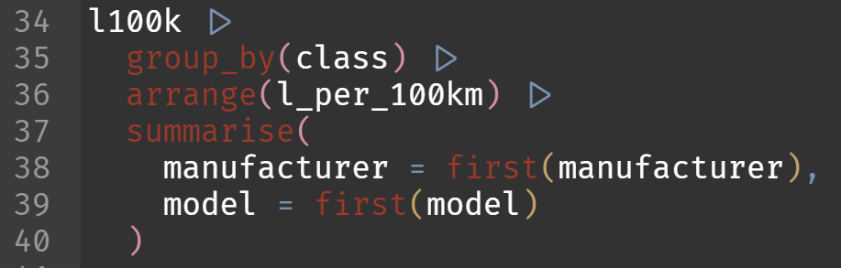
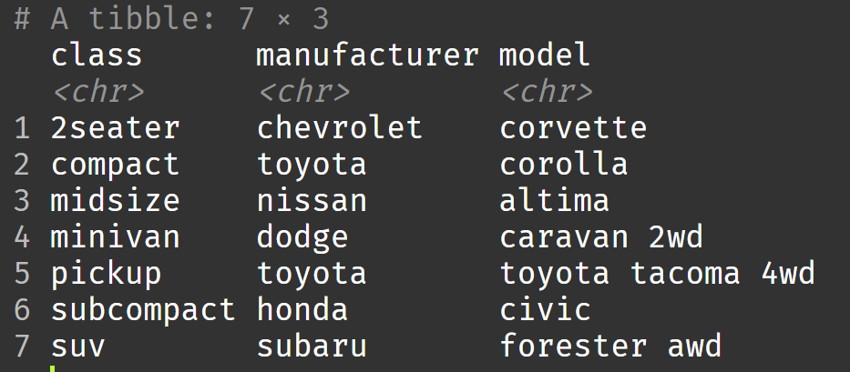
More data wrangling with dplyr
What is the most efficient car within each class?

Slide 29
Pivoting with tidyr
pivot_longer
Combines various columns into a single “value” column with an additional “name” column to indicate where the value came from
pivot_wider
The opposite: puts rows of different categories in separate columns

Slide 30
Example dataset: l100k

Slide 31
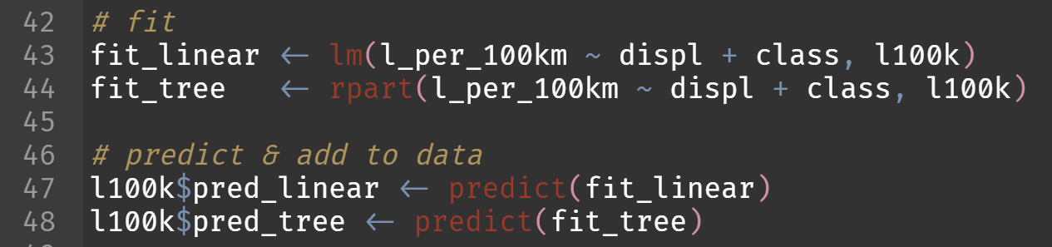
Pivoting with tidyr
Let’s generate predictions for efficiency using two models: a linear regression and a regression tree

Slide 32
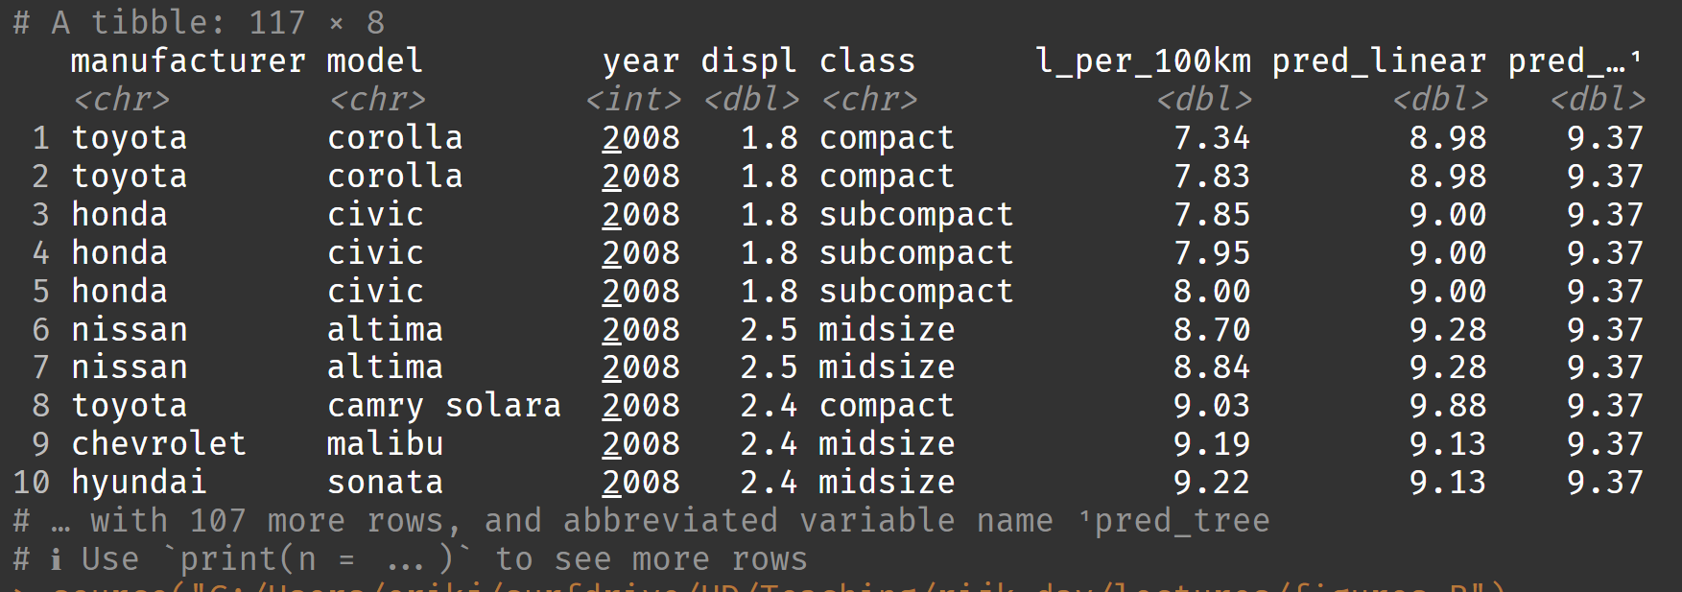
Pivoting with tidyr

Slide 33
Pivoting with tidyr
Let’s plot these predictions with the following mapped aesthetics:
x: engine size
y: predicted efficiency
colour: model type
???

Slide 34
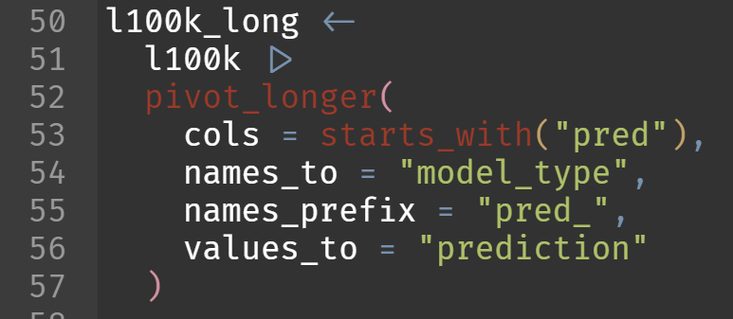
Pivoting with tidyr
ggplot wants tidy data. Let’s pivot our data so that model type becomes a column.

Slide 35
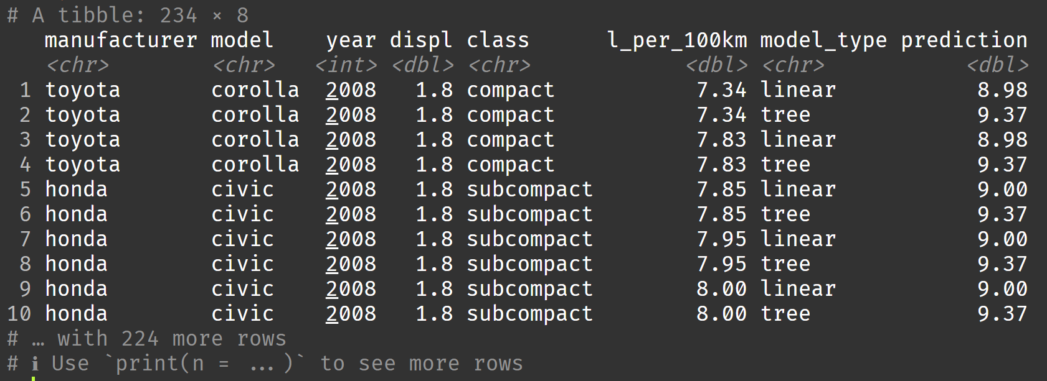
Pivoting with tidyr

Slide 36
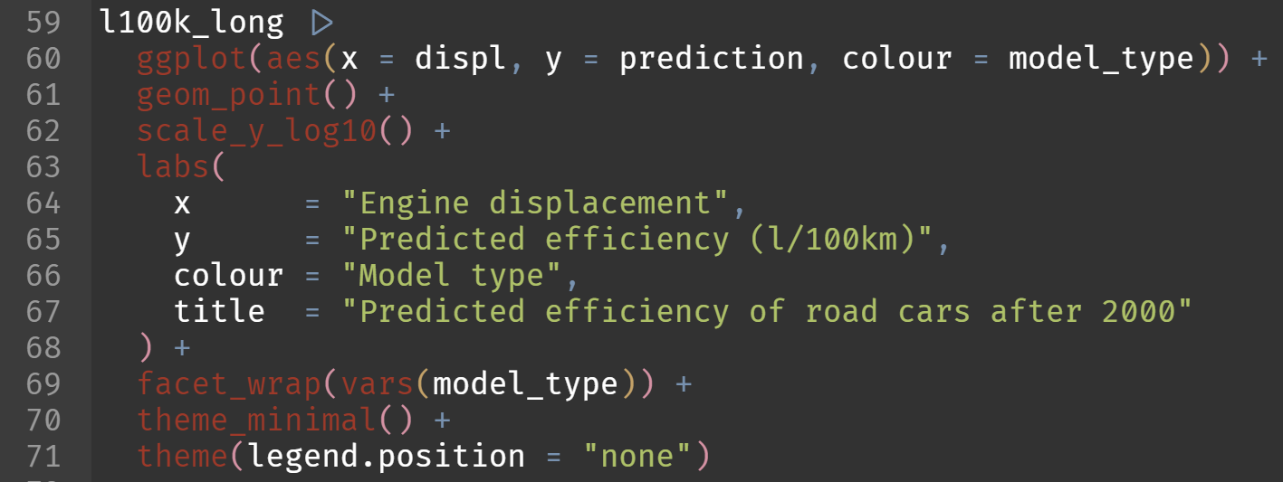
Pivoting with tidyr
Let’s plot these predictions!

Slide 37
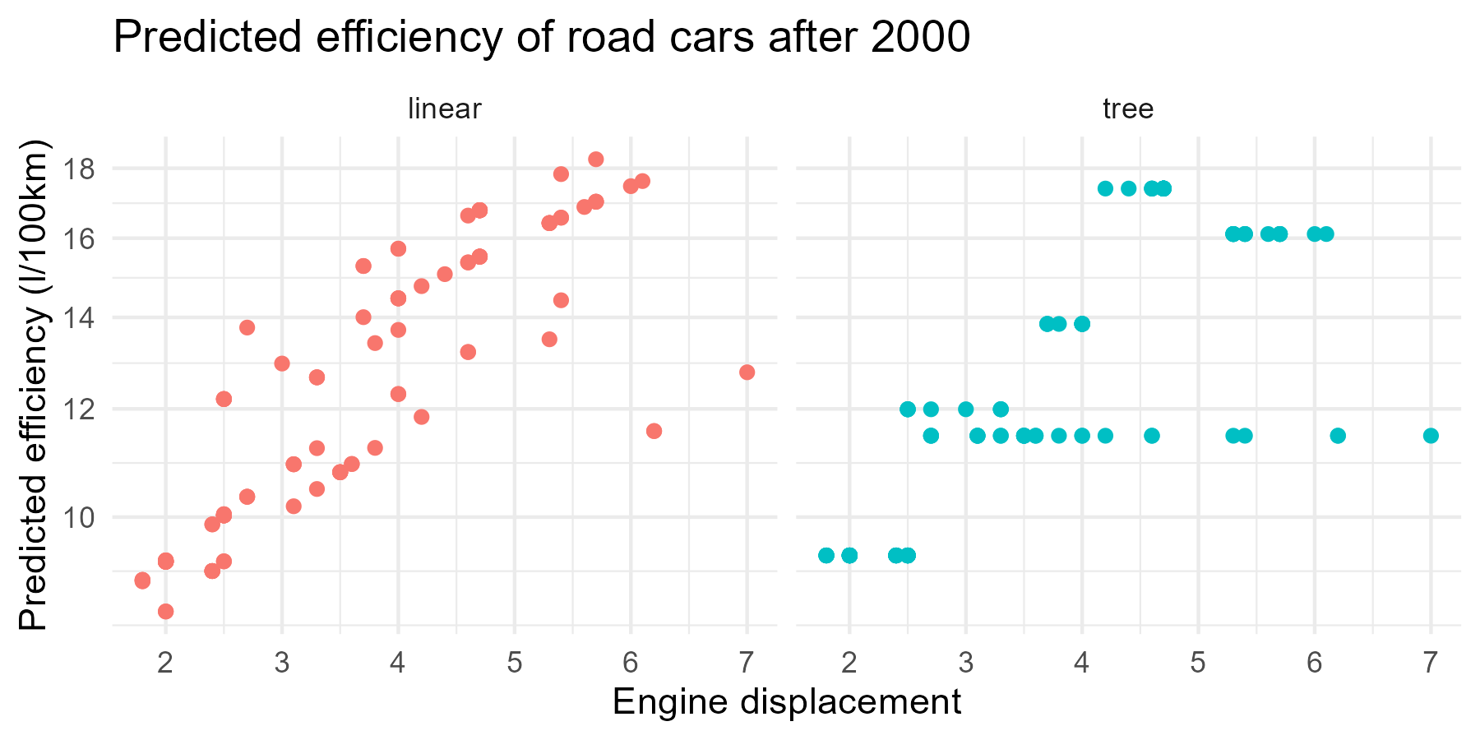
Pivoting with tidyr

Slide 38
Practical: dplyr, ggplot, tidyr
Work in your groups!
Take a break from 10:30 to 10:40

Slide 39
Break

Slide 40
Default light slide
Default subheading
This is the body of the text
Default subheading
Note that the text is not black, but “black, text 1, lighter 25%”
Default subheading
This makes things easier on the eyes
Default subheading
This is the body of the text

Slide 41
Default dark slide
Default subheading
The dark slide brings some variation
Default subheading
It can highlight important aspects of the presentation.
Default subheading
This is the body of the text
Default subheading
This is the body of the text

Slide 42
Is this an impact slide?

Slide 43
Here is an impactful slide with a sentence on it.
Here is a topic related to the aforementioned question.

Slide 44
Questions?

