Slide 1
Discussion

Slide 2
Today’s Goal
A brief survey and practical introduction to the
Core concepts
Key assumptions
Different statistical methods
used to evaluate the causal effects of policy interventions
Disclaimer:
We took a “wide” instead of “deep” view
Many details / extensions / advanced topics omitted!

Slide 3
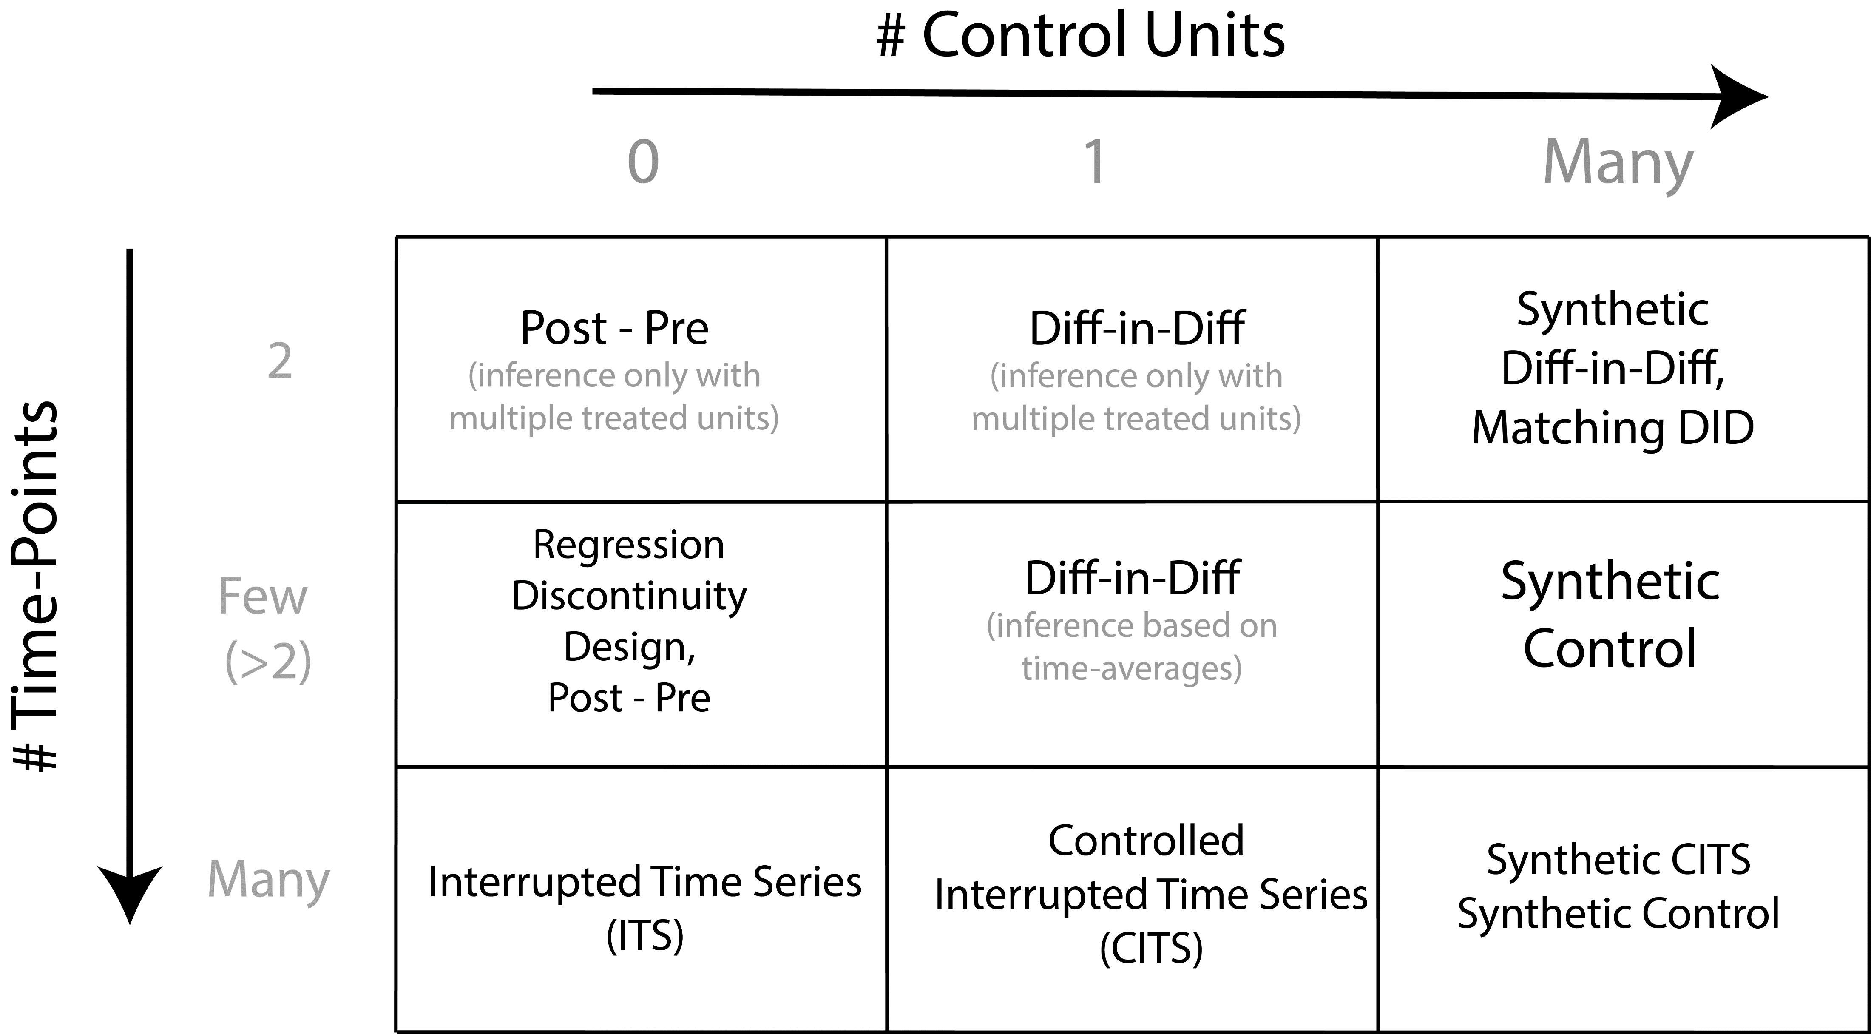

Slide 4
Connections to other methods
Synthetic Control type methods are conceptually and practically similar to matching techniques
Often used in causal inference; match similar treated and untreated units
DiD analysis often applied with multiple treated units (averages)
Synthetic Diff-in-Diff (Arkhangelsky et al. 2021)
- combines DiD and Synthetic Control

Slide 5
Advanced Topics / Open Questions
How to deal with interventions which are not “sharp”?
- E.g. policy may be gradually introduced / rolled out
- Some policies may have an “anticipatory” effect; people stop smoking because cigarettes are about to get more expensive
- Here fuzzy-RDD type analyses may be helpful. OR explicit modelling of intervention effect.
How to deal with multiple treated units?
Aggregating vs not-aggregating
Classic approach is to take means, estimate ACEs. Less data + assumption “hungry” but information is lost
If you have enough data to perform, e.g., synthetic control analysis, may be better to first estimate unit-level effects, then summarize

Slide 6
Advanced Topics / Open Questions
What questions / problems do you run into, that we didn’t manage to cover in class?
https://app.wooclap.com/ZHSIPT

Slide 7
Summary
Many different methods have been developed to answer these types of research questions
These methods differ in terms of:
The amount and type of information they use
Amount of time-points and amount of potential “control” units
The specific statistical approach they take
The types of assumptions they make

Slide 8
So, which method should I use?

Slide 9
So which method should I use?
In this workshop we took a rather statistical view of this question
The answer in part depends on what type and amount of data you have
But this is the easy part
The answer in practice depends on domain knowledge
The hard part is to figure out which assumptions you need for causal inference and whether they are reasonable in your particular use case
It may simply not be possible in some cases!
E.g. DiD won’t work if trends are not parallel; synthetic control won’t work if there is interference between units (no matter how much data you have!)
Often, methods which are “data hungry” can relax some assumptions, but:
There is no free lunch!

Slide 10
Other dimensions to keep in mind
Interpretability of the model
Nice to know/ understand where inferences are coming from
Some methods better than others (e.g. synthetic control more understandable than CausalImpact)
Sensitivity / Robustness / Researcher Degrees of Freedom
How many arbitrary choices do you have to make?
How much do the results change if you make a different choice?
In practice, perform sensitivity checks whenever you can

Slide 11
Useful References
Difference in Differences
Angrist, J. D., & Krueger, A. B. (1999). Empirical strategies in labor economics. In Handbook of labor economics (Vol. 3, pp. 1277-1366). Elsevier.
Angrist, J. D., & Pischke, J. S. (2009). Mostly harmless econometrics: An empiricist's companion. Princeton university press.
Caniglia, E. C., & Murray, E. J. (2020). Difference-in-difference in the time of cholera: a gentle introduction for epidemiologists. Current epidemiology reports, 7, 203-211.
Interrupted Time Series
Bernal, J. L., Cummins, S., & Gasparrini, A. (2017). Interrupted time series regression for the evaluation of public health interventions: a tutorial. International journal of epidemiology, 46(1), 348-355.
Bernal, J.L, Cummins, S., & Gasparrini, A. (2019). Difference in difference, controlled interrupted time series and synthetic controls. International journal of epidemiology, 48(6), 2062-2063.

Slide 12
Useful References
Synthetic Control
Abadie, A., Diamond, A., & Hainmueller, J. (2010). Synthetic control methods for comparative case studies: Estimating the effect of California’s tobacco control program. Journal of the American Statistical Association, 105(490), 493-505.
Abadie, A. (2021). Using synthetic controls: Feasibility, data requirements, and methodological aspects. Journal of Economic Literature, 59(2), 391-425.
CausalImpact
Brodersen, K. H., Gallusser, F., Koehler, J., Remy, N., & Scott, S. L. (2015). Inferring causal impact using Bayesian structural time-series models. The Annals of Applied Statistics, 247-274.
Linden, A. (2018). Combining synthetic controls and interrupted time series analysis to improve causal inference in program evaluation. Journal of evaluation in clinical practice, 24(2), 447-453.
http://google.github.io/CausalImpact/CausalImpact.html

Slide 13
Useful References
Synthetic DiD
Arkhangelsky, D., Athey, S., Hirshberg, D. A., Imbens, G. W., & Wager, S. (2021). Synthetic difference-in-differences. American Economic Review, 111(12), 4088-4118.
More on Causal Policy Evaluation
Free online course materials made by Andrew Heiss
Program Evaluation for Public Service
https://evalf22.classes.andrewheiss.com/content/

Slide 14
Thanks! Get in touch: ryanoisin@gmail.com e.j.vankesteren@uu.nl

Slide 15
Default light slide
Default subheading
This is the body of the text
Default subheading
Note that the text is not black, but “black, text 1, lighter 25%”
Default subheading
This makes things easier on the eyes
Default subheading
This is the body of the text

Slide 16
Default dark slide
Default subheading
The dark slide brings some variation
Default subheading
It can highlight important aspects of the presentation.
Default subheading
This is the body of the text
Default subheading
This is the body of the text

Slide 17
Is this an impact slide?

Slide 18
Here is an impactful slide with a sentence on it.
Here is a topic related to the aforementioned question.

Slide 19
Questions?

