Slide 1

Data analysis & visualisation
Workshop rijksoverheid
Erik-Jan van Kesteren

Slide 2


About me
Erik-Jan van Kesteren
Background in statistics / social science
Assistant professor @ methodology & statistics UU
Social Data Science team lead @ ODISSEI (consortium of universities)
Some stuff I work on:
Latent variables, high-dimensional data, optimization, regularization, visualisation, Bayesian statistics, multilevel models, spatial data, generalized linear models, privacy, synthetic data, high-performance computing, software development, open science & reproducibility

Slide 3
vankesteren.github.io/rijk_dav

Slide 4
Today’s plan: morning
Introduction & Recap (60 minutes)
Short break (10 minutes)
Supervised learning: bias/variance (80 minutes)
Supervised learning: classification (40 minutes)
Lunch around 12:40

Slide 5
Today’s plan: afternoon
Prediction competition in groups (90 minutes)
Short break (10 minutes)
Intermezzo: fairness & feedback loops in prediction (30 minutes)
Unsupervised learning (45 minutes)
Finish around 16:30

Slide 6
Data wrangling, visualisation
A short recap
Erik-Jan van Kesteren

Slide 7
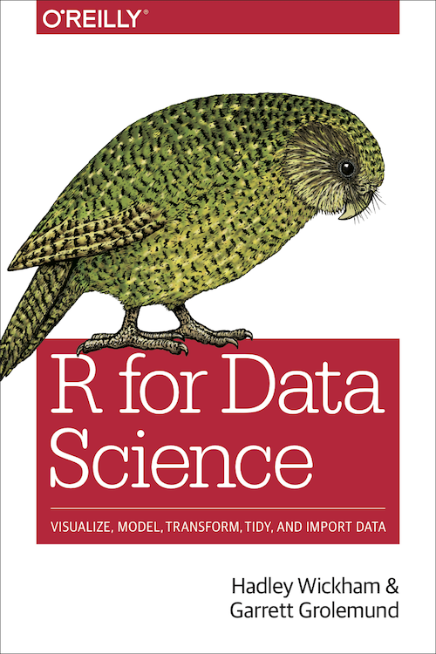
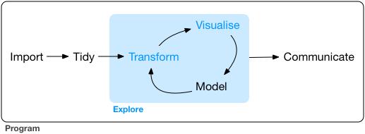
Exploratory data analysis
The goal of data exploration is to generate many promising leads that you can later explore in more depth.
https://r4ds.had.co.nz/

Slide 8
Data wrangling with dplyr
filter
Get only rows that satisfy a condition
select
Select columns from a dataset
mutate
Compute new columns / change existing columns
arrange
Sort/reorder the dataset based on a column

Slide 9
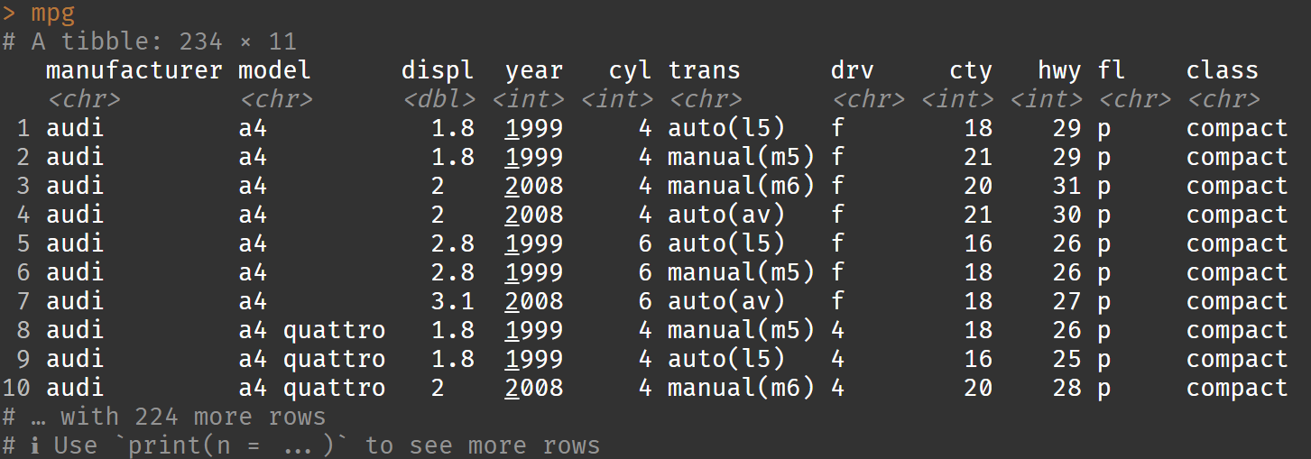
Example dataset: cars

Slide 10
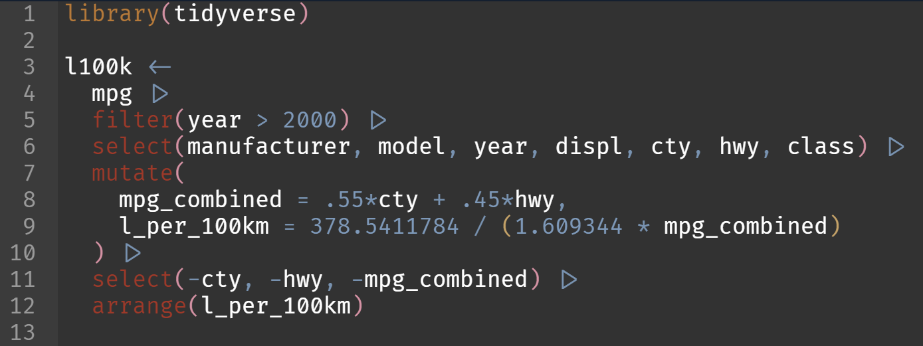
Data wrangling with dplyr
Which are the most efficient (combined city-highway) cars after 2000 in terms of litres / 100km?

Slide 11
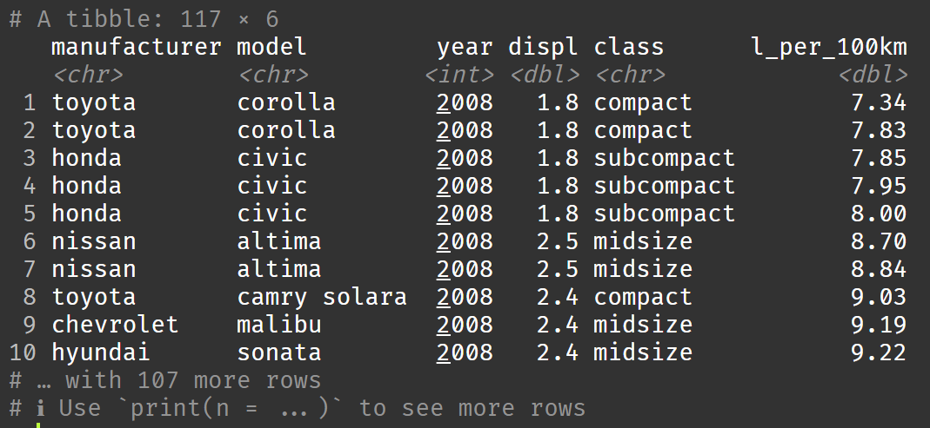
Data wrangling with dplyr

Slide 12
Data visualisation with ggplot2
https://r4ds.had.co.nz/data-visualisation.html
Raw data maps to:
Aesthetics: data-bound properties of the picture (position, shape, colour, …)
Geometric objects, or geom: visual objects on the plot (points, lines, bars, polygons …)
Scales: how data values map to aesthetic values (continuous or discrete)
Facets: subplots / small multiples
Additionally, can apply:
Statistical transformations: transform data before mapping
Alternative coordinate system (cartesian, polar, …)

Slide 13
Example dataset: l100k

Slide 14
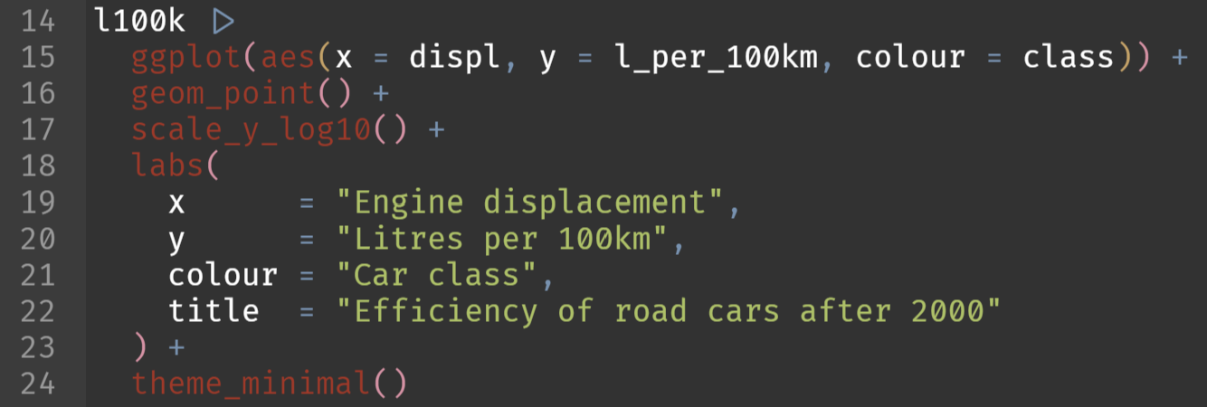
Data visualisation with ggplot2
Display a scatter plot with on the x axis the engine displacement and on the y-axis the efficiency. Colour the points by the car class

Slide 15
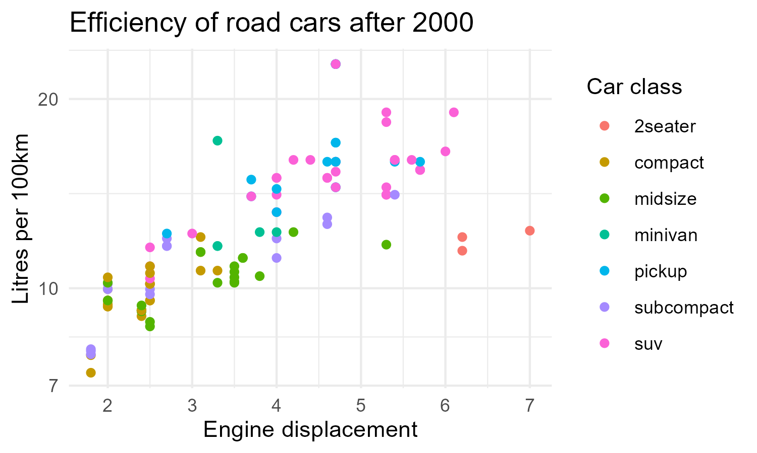
Data visualisation with ggplot2

Slide 16
More data wrangling with dplyr
group by
Registers groups by which to perform further operations (usually mutate, summarise)
summarise
Create summaries based on a function applied to each group

Slide 17
Example dataset: l100k

Slide 18
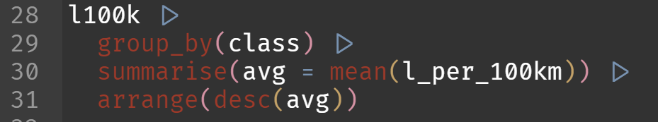
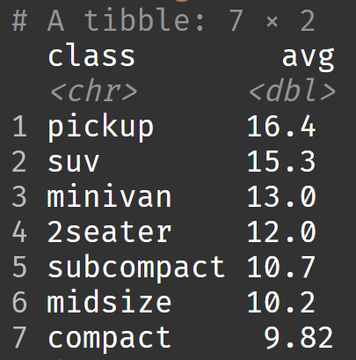
More data wrangling with dplyr
Which type of car should I buy to be the least efficient?

Slide 19
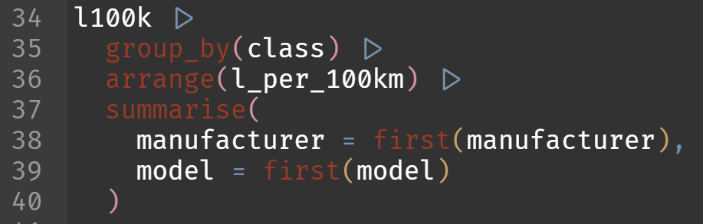
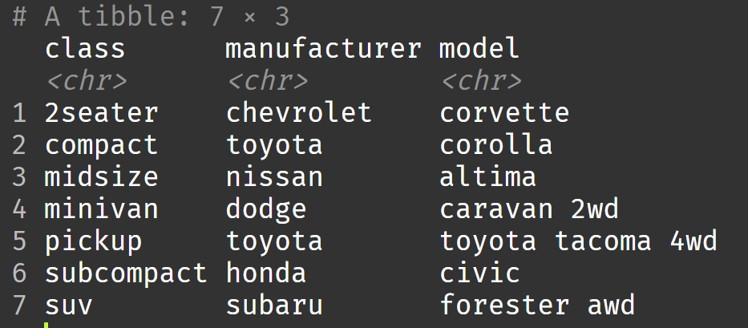
More data wrangling with dplyr
What is the most efficient car within each class?

Slide 20
Pivoting with tidyr
pivot_longer
Combines various columns into a single “value” column with an additional “name” column to indicate where the value came from
pivot_wider
The opposite: puts rows of different categories in separate columns

Slide 21
Example dataset: l100k

Slide 22
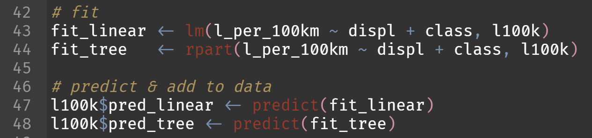
Pivoting with tidyr
Let’s generate predictions for efficiency using two models: a linear regression and a regression tree

Slide 23
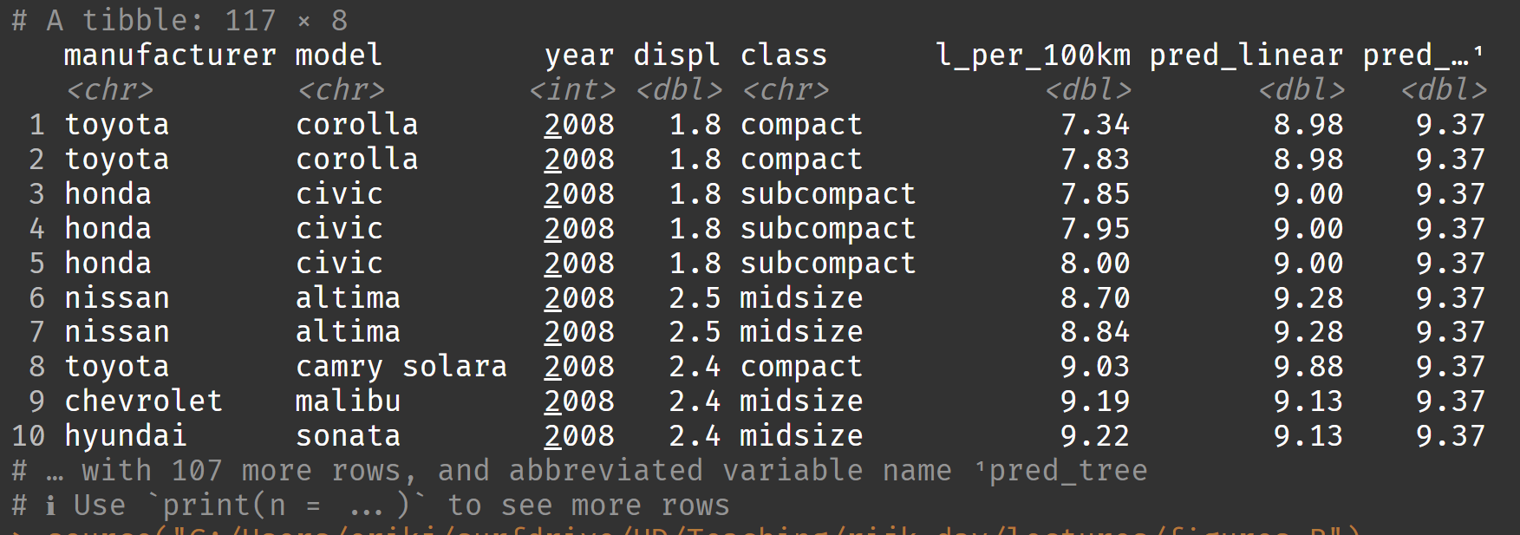
Pivoting with tidyr

Slide 24
Pivoting with tidyr
Let’s plot these predictions with the following mapped aesthetics:
x: engine size
y: predicted efficiency
colour: model type
???

Slide 25
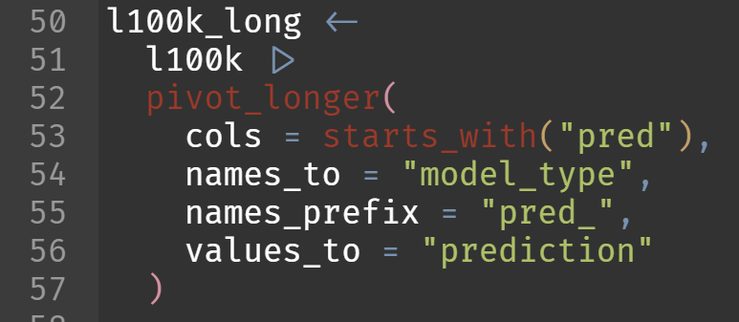
Pivoting with tidyr
ggplot wants tidy data. Let’s pivot our data so that model type becomes a column.

Slide 26
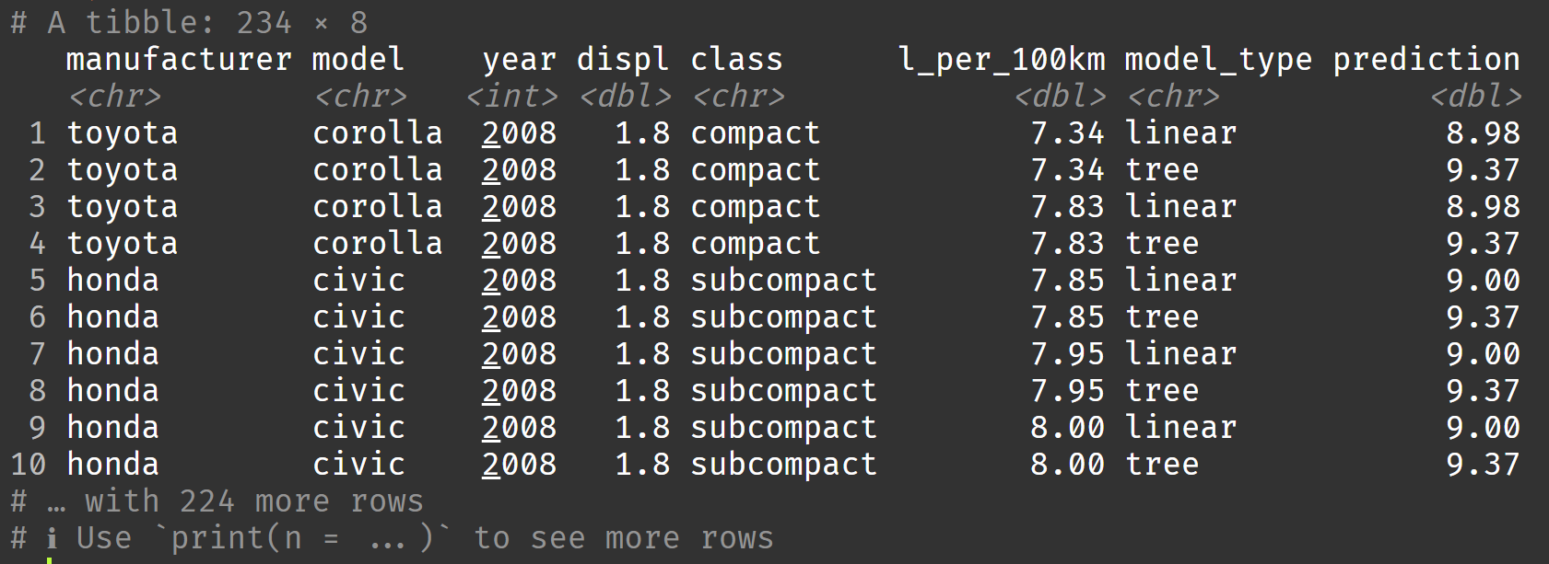
Pivoting with tidyr

Slide 27
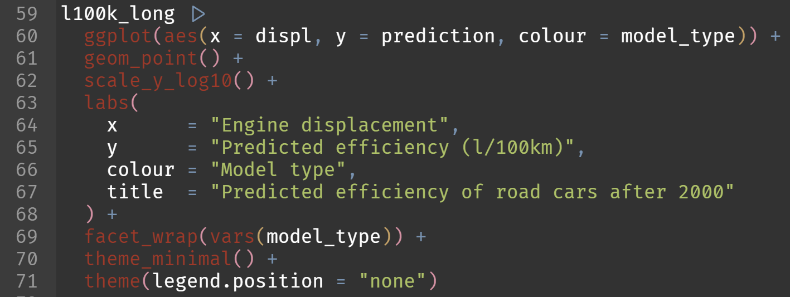
Pivoting with tidyr
Let’s plot these predictions!

Slide 28
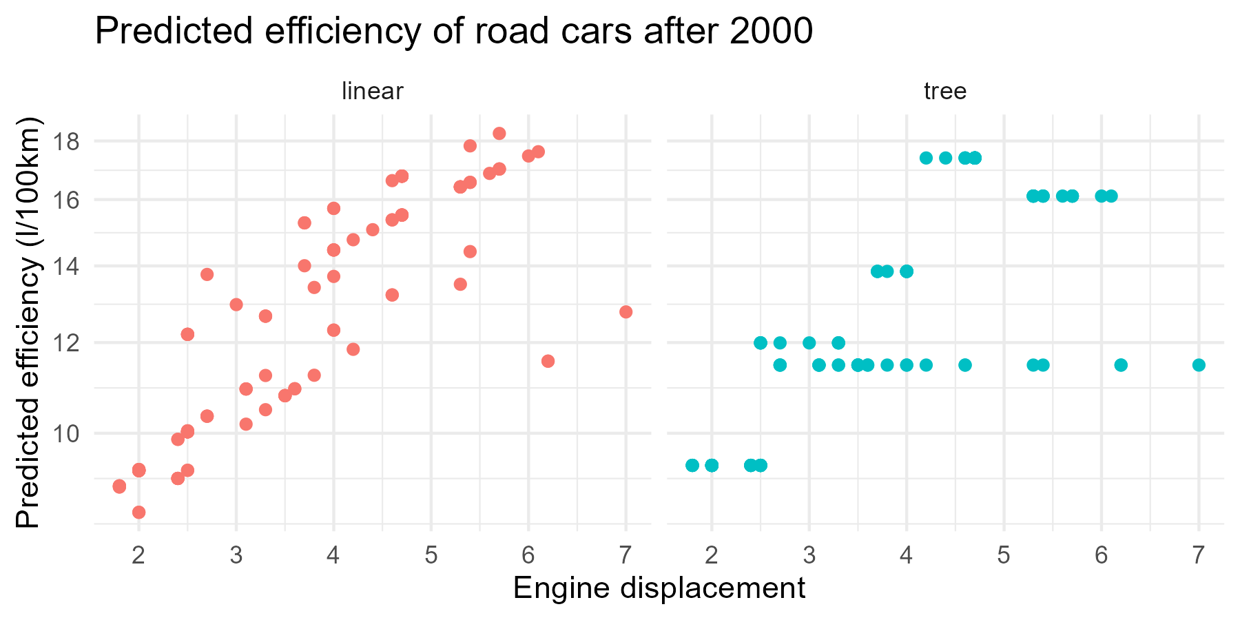
Pivoting with tidyr

Slide 29
Practical: dplyr, ggplot, tidyr
Work in your groups!
Take a break from 10:30 to 10:40

Slide 30
Break

Slide 31
Default light slide
Default subheading
This is the body of the text
Default subheading
Note that the text is not black, but “black, text 1, lighter 25%”
Default subheading
This makes things easier on the eyes
Default subheading
This is the body of the text

Slide 32
Default dark slide
Default subheading
The dark slide brings some variation
Default subheading
It can highlight important aspects of the presentation.
Default subheading
This is the body of the text
Default subheading
This is the body of the text

Slide 33
Is this an impact slide?

Slide 34
Here is an impactful slide with a sentence on it.
Here is a topic related to the aforementioned question.

Slide 35
Questions?

