Slide 1

Efficient microdata
Efficient programming on the CBS microdata environment
Erik-Jan van Kesteren

Slide 2
Today
The CBS RA fundamentals
Project structure & reproducibility
Efficient data handling
Storage
Memory
Consultation & exercise!

Slide 3
CBS RA fundamentals

Slide 4
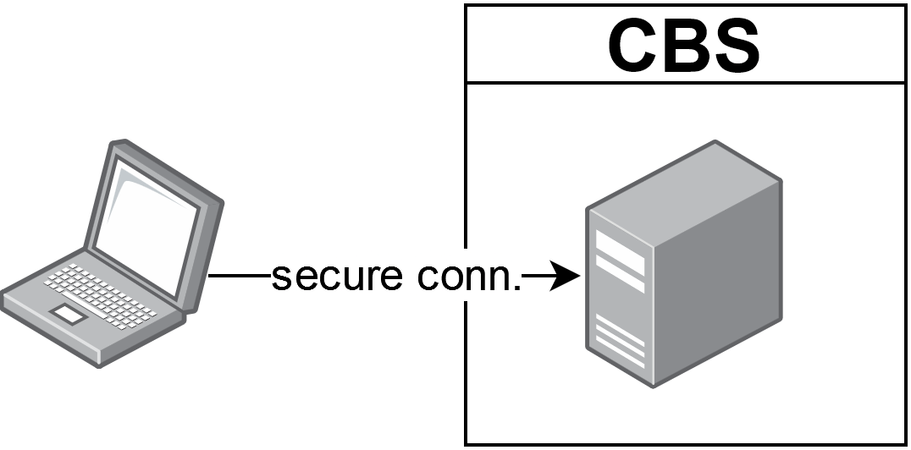
CBS Remote Access environment
A virtual machine on a big server in the internal network
“Normal” windows environment
Data is made available via a drive on a per-project basis G:/microdata
Additional metadata is also available

Slide 5
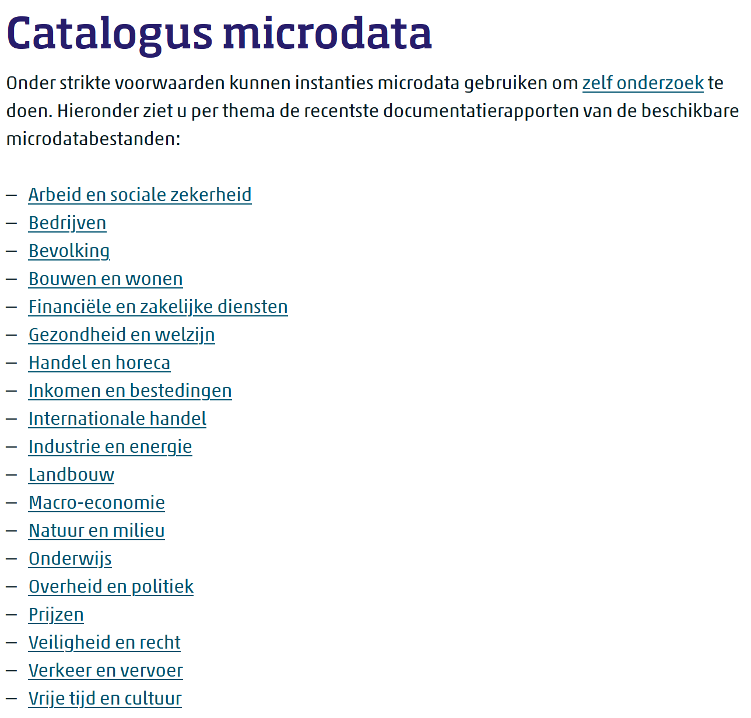
Microdata at CBS
https://www.cbs.nl/nl-nl/onze-diensten/maatwerk-en-microdata/microdata-zelf-onderzoek-doen/catalogus-microdata
Register data and questionnaires
You can (subject to restrictions and costs) also upload your own data
All these tables can be combined to do your research!

Slide 6
Microdata at CBS
https://www.cbs.nl/nl-nl/onze-diensten/maatwerk-en-microdata/microdata-zelf-onderzoek-doen/catalogus-microdata
The tables are made by humans / different departments: manual work
They are (mostly) SPSS .sav files
Some files are huge! (SPOLISBUS)
Their names / versions can change without warning

Slide 7
Additional data
There are additional (meta)data files to help with analysis
Metadata & supplementary data. Translation files, key/value files, lists of existing postal codes, and more.
These reside in a different location (not G:/)
This location has also changed in the past & could change in the future too

Slide 8
Imports/exports
Exporting analysis results is subject to output check
Ensures our privacy
This is manual labour, done by a member of microdata team
Each output costs time and money
You can also import and export code files
This does not cost money!!
More on this later

Slide 9
Any questions?

Slide 10

Structure & reproducibility

Slide 11
Efficient project folder structure
my_project/
├─ raw_data/
│ ├─ questionnaire_data.csv
├─ processed_data/
│ ├─ questionnaire_processed.rds
│ ├─ analysis_object.rds
├─ img/
│ ├─ plot.png
├─ 01_load_and_process_data.R
├─ 02_create_visualisations.R
├─ 03_main_analysis.R
├─ 04_output_results.R
├─ my_project.Rproj
├─ readme.md

Slide 12
Efficient project folder structure
my_project/
├─ raw_data/
│ ├─ questionnaire_data.csv
├─ processed_data/
│ ├─ questionnaire_processed.rds
│ ├─ analysis_object.rds
├─ img/
│ ├─ plot.png
├─ 01_load_and_process_data.R
├─ 02_create_visualisations.R
├─ 03_main_analysis.R
├─ 04_output_results.R
├─ my_project.Rproj
├─ readme.md
At CBS, this is on a different disk (G:/)!
Does not count towards your 100GB quote

Slide 13
Efficient project folder structure
my_project/
├─ raw_data/
│ ├─ questionnaire_data.csv
├─ processed_data/
│ ├─ questionnaire_processed.rds
│ ├─ analysis_object.rds
├─ img/
│ ├─ plot.png
├─ 01_load_and_process_data.R
├─ 02_create_visualisations.R
├─ 03_main_analysis.R
├─ 04_output_results.R
├─ my_project.Rproj
├─ readme.md
At CBS, this is on a different disk (G:/)!
Does not count towards your 100GB quote
Make these objects efficiently stored
Depends on your application

Slide 14
Efficient project folder structure
my_project/
├─ raw_data/
│ ├─ questionnaire_data.csv
├─ processed_data/
│ ├─ questionnaire_processed.rds
│ ├─ analysis_object.rds
├─ img/
│ ├─ plot.png
├─ 01_load_and_process_data.R
├─ 02_create_visualisations.R
├─ 03_main_analysis.R
├─ 04_output_results.R
├─ my_project.Rproj
├─ readme.md
At CBS, this is on a different disk (G:/)!
Does not count towards your 100GB quote
Make these objects efficiently stored
Depends on your application
Clear ordering & separation of tasks
Separating preprocessing & analysis

Slide 15
Efficient project folder structure
my_project/
├─ raw_data/
│ ├─ questionnaire_data.csv
├─ processed_data/
│ ├─ questionnaire_processed.rds
│ ├─ analysis_object.rds
├─ img/
│ ├─ plot.png
├─ 01_load_and_process_data.R
├─ 02_create_visualisations.R
├─ 03_main_analysis.R
├─ 04_output_results.R
├─ my_project.Rproj
├─ readme.md
At CBS, this is on a different disk (G:/)!
Does not count towards your 100GB quote
Make these objects efficiently stored
Binary formats are better later we’ll also see database files
Clear ordering & separation of tasks
Separating preprocessing & analysis
Use .Rproj file for portability

Slide 16
Efficient project folder structure
my_project/
├─ raw_data/
│ ├─ questionnaire_data.csv
├─ processed_data/
│ ├─ questionnaire_processed.rds
│ ├─ analysis_object.rds
├─ img/
│ ├─ plot.png
├─ 01_load_and_process_data.R
├─ 02_create_visualisations.R
├─ 03_main_analysis.R
├─ 04_output_results.R
├─ my_project.Rproj
├─ readme.md
At CBS, this is on a different disk (G:/)!
Does not count towards your 100GB quote
Make these objects efficiently stored
Binary formats are better later we’ll also see database files
Clear ordering & separation of tasks
Separating preprocessing & analysis
Use .Rproj file for portability

Slide 17

Live coding 1: example project

Slide 18
Today
The CBS RA fundamentals
Project structure & reproducibility
Efficient data handling
Storage
Memory
Consultation & exercise!

Slide 19
Efficient data handling

Slide 20




loading
importing
processing
saving
storing

Slide 21

Storage

Slide 22
Geachte relatie,
Uit een meting op maandag 4 april 2022 blijkt dat project 0000, Titel van het project, een ruimtebeslag kent van 133 GB. De limiet voor het project is 100 GB.
Als u de extra capaciteit daadwerkelijk nodig heeft, dan kunt u een verzoek indienen om extra capaciteit bij te kopen. De kosten hiervoor bedragen 25 euro per 50 GB per maand.
Met vriendelijke groet,
Firstname Lastname
DBD Team Dataservices
CBS | Henri Faasdreef 312 | Postbus 24500 | 2490 HA Den Haag
Email: microdata@cbs.nl
Volg statistiekcbs op twitter | facebook | instagram

Slide 23
Efficiently storing large R datasets
Live coding

Slide 24

Memory

Slide 25
Top tip #4
Read your program’s error messages! They give a lot of diagnostic info

Slide 26
In R:
Error: cannot allocate vector of size 745.1 Gb
In Python (numpy)
numpy.core._exceptions._ArrayMemoryError: Unable to allocate 745. GiB for an array with shape (100000000000,) and data type float64
In Stata
(no clue, I really don’t use Stata??)

Slide 27
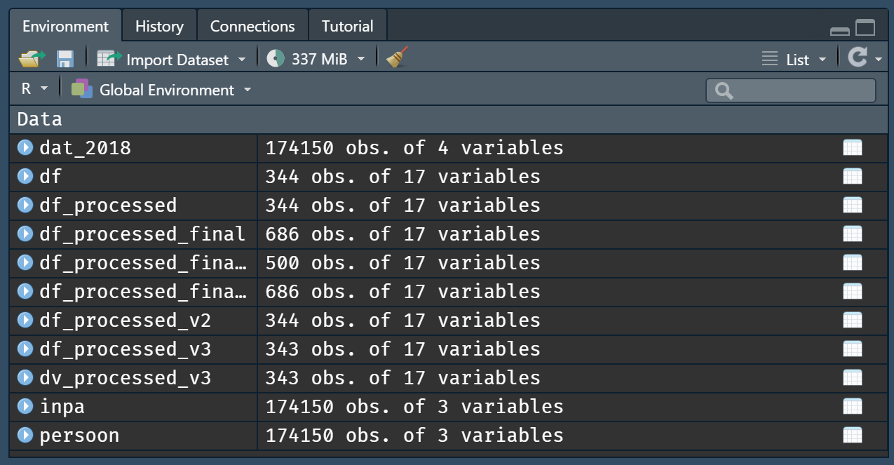
Clean your session / environment

Slide 28
Efficiently processing large datasets
Live coding 2

Slide 29
Larger-than-memory data
Sometimes, your data really is larger-than-memory
It is possible to do analyses on datasets which are on-disk
Two options:
Create chunked data objects
Create a proper database

Slide 30
Top tip #5
Investigate whether the “heavy” RA machine will solve your memory issues

Slide 31
Working with larger-than-memory data
Live coding 3

Slide 32

Compute

Slide 33
Compute-heavy applications
Large simulations, e.g.,
agent-based models
computational models
complex systems stuff
statistical simulations (large power analyses)
Many different conditions
Perform some computation for each neighbourhood in NL
Bayesian estimation with large models (many parameters, many posterior samples)

Slide 34
Speeding up a function with C++
Live coding 4

Slide 35
Embarrassingly parallel
Many independent computations, little or no effort is needed to separate the problem into a number of parallel tasks
Simulations
Applying a function to many conditions
Running a piece of code with many different settings
Bootstrapping

Slide 36
Top tip #6
Is your problem parallelizable? Look into the ODISSEI Secure Supercomputer

Slide 37
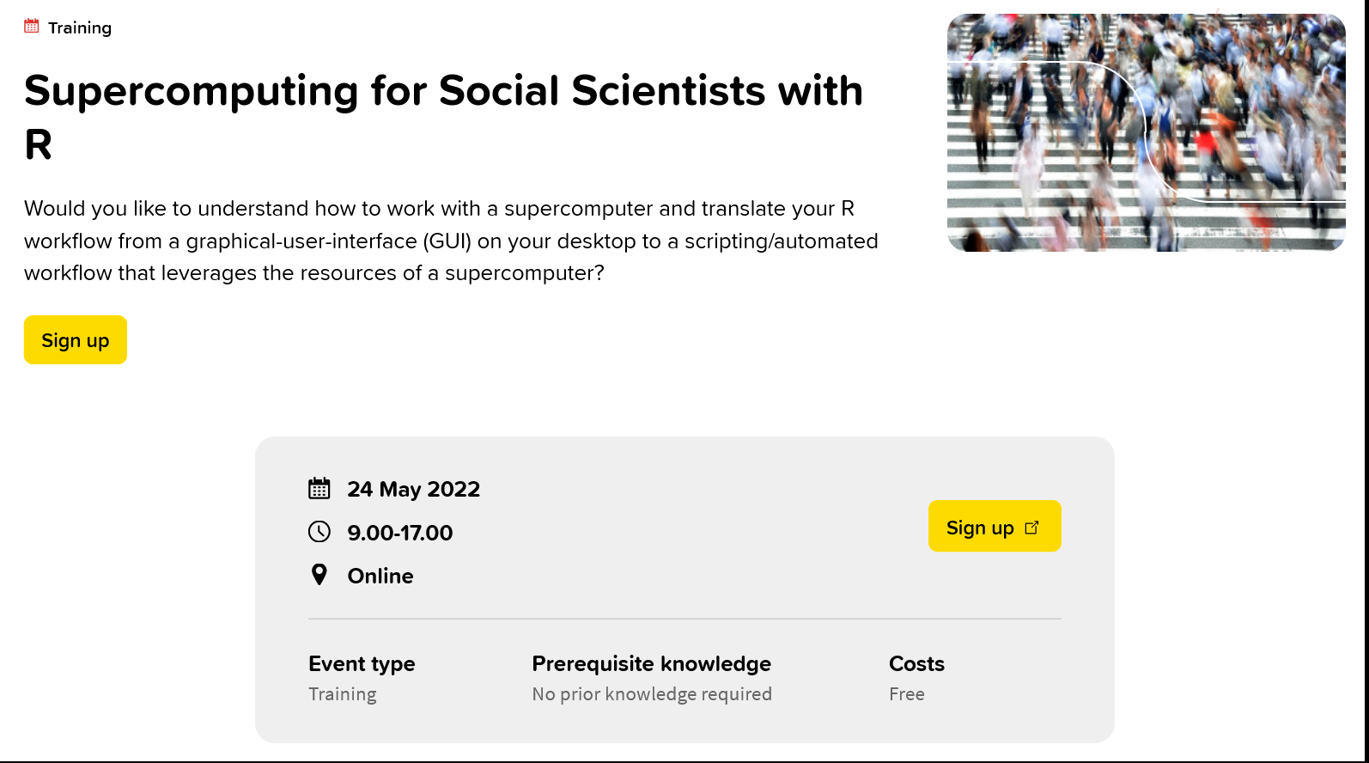

Slide 38
Top tips, collected
Run your heavy tasks during low-intensity hours on the RA environment
If you can afford it, just buy extra storage space for your project ☺
Create a clear code folder, export your code from the RA, and publish it!
Read your program’s error messages! They give a lot of diagnostic info
Investigate whether the “heavy” RA machine will solve your memory issues
Is your problem parallelizable? Look into the ODISSEI Secure Supercomputer
Want to know more? Join the workshop.

Slide 39
Thank you!
https://odissei-data.nl
https://www.surf.nl/en/agenda/supercomputing-for-social-scientists-with-r
https://github.com/sodascience/cbs_microdata_computing
@SoDa_NL

Slide 40
Questions?

Slide 41
Default light slide
Default subheading
This is the body of the text
Default subheading
Note that the text is not black, but “black, text 1, lighter 25%”
Default subheading
This makes things easier on the eyes
Default subheading
This is the body of the text

Slide 42
Default dark slide
Default subheading
The dark slide brings some variation
Default subheading
It can highlight important aspects of the presentation.
Default subheading
This is the body of the text
Default subheading
This is the body of the text

Slide 43
Is this an impact slide?

Slide 44
Here is an impactful slide with a sentence on it.
Here is a topic related to the aforementioned question.

