Slide 1

Efficient microdata
Efficient programming on the CBS microdata environment
Erik-Jan van Kesteren

Slide 2
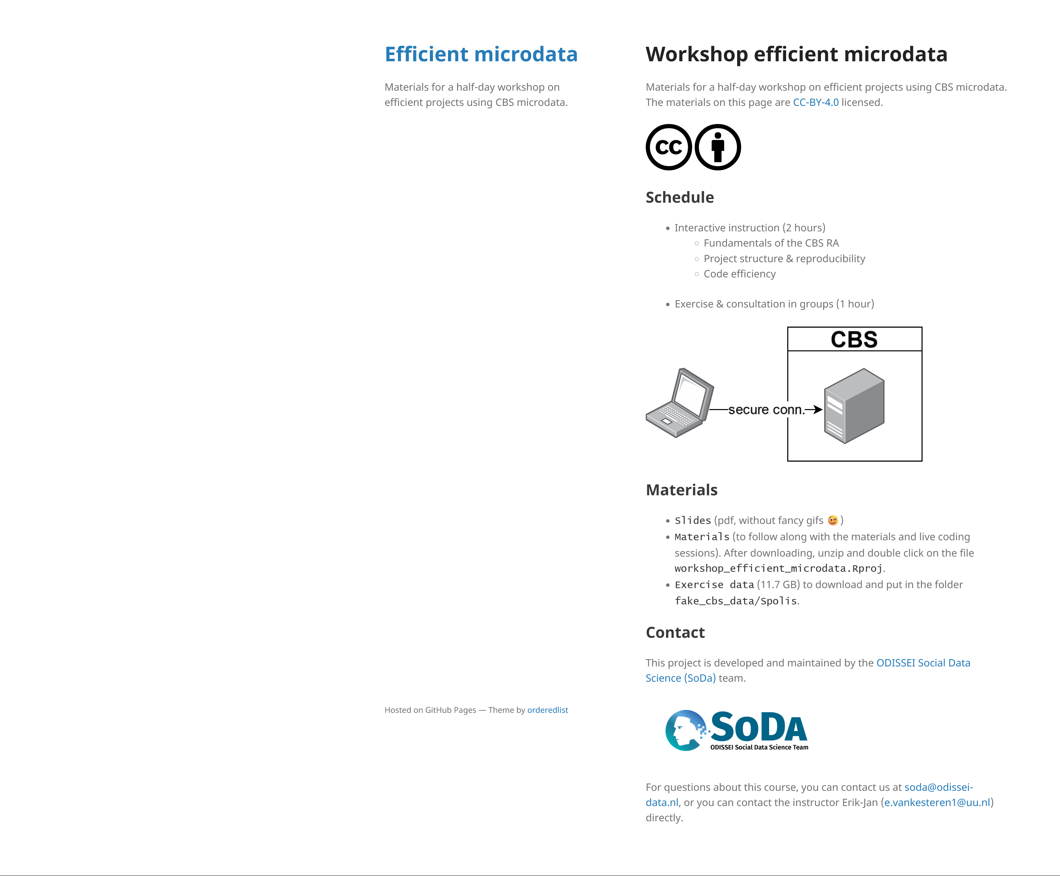
Webpage
https://is.gd/microdataworkshop
Go there now
Download the materials
Download the exercise data
Pray we don’t crash uu wifi

Slide 3

https://odissei-soda.nl/

Slide 4
About me
Erik-Jan van Kesteren
Assistant Professor Data Science / Statistics
Team lead ODISSEI SoDa team
Research topics structural equation modeling, regularization & penalization, Bayesian statistics, multilevel generalized linear models, geospatial data analysis, rank data analysis, visualisation, optimization, federated learning, privacy, fairness, measurement, synthetic data

Slide 5
Today
The CBS RA fundamentals
Project structure & reproducibility
Efficient data handling
Storage
Memory
Consultation & exercise!

Slide 6
CBS RA fundamentals

Slide 7
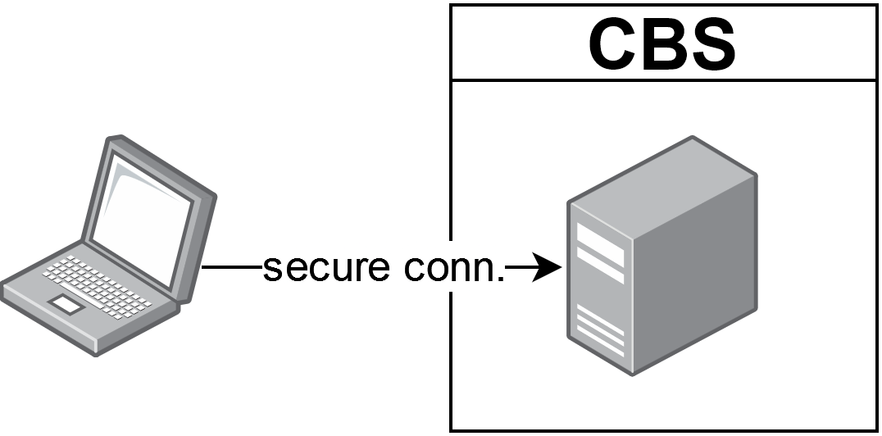
CBS Remote Access environment
A virtual machine on a big server in the internal network
Normal windows OS with 100GB storage
R, python, SPSS, Stata, and more installed by default
If you want specific libraries, ask the microdata team
No fancy environment management

Slide 8
CBS Remote Access environment
Data is made available via a drive on a per-project basis G:/microdata
You can see all tables, but you have access only to those you requested
Additional metadata is also available (for everyone)

Slide 9
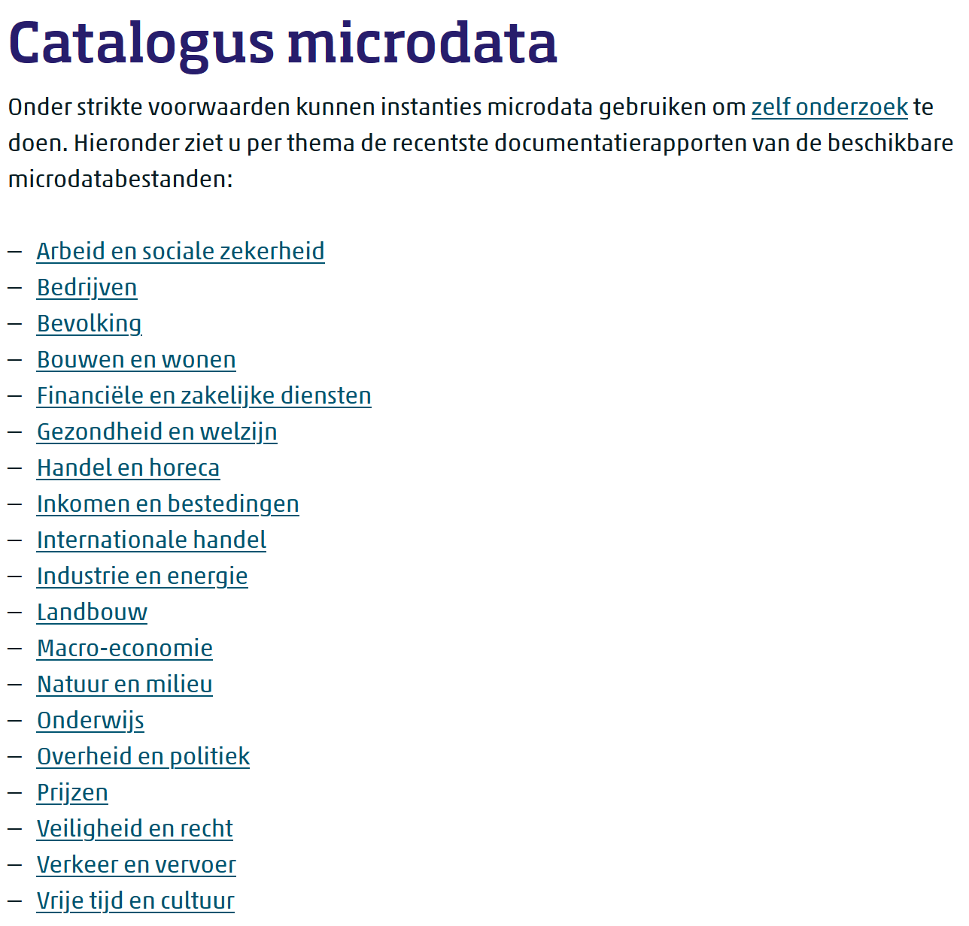
Microdata at CBS
https://www.cbs.nl/nl-nl/onze-diensten/maatwerk-en-microdata/microdata-zelf-onderzoek-doen/catalogus-microdata
Register data and questionnaires
You can (subject to restrictions and costs) also upload your own data & link
All these tables can be combined to do your research!

Slide 10
Microdata at CBS
https://www.cbs.nl/nl-nl/onze-diensten/maatwerk-en-microdata/microdata-zelf-onderzoek-doen/catalogus-microdata
The tables are made by humans / different departments: manual work
They are (mostly) SPSS .sav files
Some files are huge! (SPOLISBUS)
Their names / versions can change without warning

Slide 11
Additional data
There are additional files to help with analysis
Metadata & supplementary data. Translation files, key/value files, lists of existing postal codes, and more.
These reside in a different location (not G:/)
This location has also changed in the past & could change in the future too

Slide 12
Imports/exports
Exporting analysis results is subject to output check
Ensures our privacy
This is manual labour, done by microdata team member
Each output costs time and money
You can also import and export code files
This does not cost money!!
More on this later

Slide 13
Any questions?

Slide 14

Structure

Slide 15
Efficient project folder structure
my_project/
├─ raw_data/
│ ├─ questionnaire_data.csv
├─ processed_data/
│ ├─ questionnaire_processed.rds
│ ├─ analysis_object.rds
├─ img/
│ ├─ plot.png
├─ 01_load_and_process_data.R
├─ 02_create_visualisations.R
├─ 03_main_analysis.R
├─ 04_output_results.R
├─ my_project.Rproj
├─ readme.md

Slide 16
Efficient project folder structure
my_project/
├─ raw_data/
│ ├─ questionnaire_data.csv
├─ processed_data/
│ ├─ questionnaire_processed.rds
│ ├─ analysis_object.rds
├─ img/
│ ├─ plot.png
├─ 01_load_and_process_data.R
├─ 02_create_visualisations.R
├─ 03_main_analysis.R
├─ 04_output_results.R
├─ my_project.Rproj
├─ readme.md
At CBS, this is on a different disk (G:/)!
Does not count towards your 100GB quote

Slide 17
Efficient project folder structure
my_project/
├─ raw_data/
│ ├─ questionnaire_data.csv
├─ processed_data/
│ ├─ questionnaire_processed.rds
│ ├─ analysis_object.rds
├─ img/
│ ├─ plot.png
├─ 01_load_and_process_data.R
├─ 02_create_visualisations.R
├─ 03_main_analysis.R
├─ 04_output_results.R
├─ my_project.Rproj
├─ readme.md
At CBS, this is on a different disk (G:/)!
Does not count towards your 100GB quote
Make these objects efficiently stored
Binary formats are better later we’ll also see database files

Slide 18
Efficient project folder structure
my_project/
├─ raw_data/
│ ├─ questionnaire_data.csv
├─ processed_data/
│ ├─ questionnaire_processed.rds
│ ├─ analysis_object.rds
├─ img/
│ ├─ plot.png
├─ 01_load_and_process_data.R
├─ 02_create_visualisations.R
├─ 03_main_analysis.R
├─ 04_output_results.R
├─ my_project.Rproj
├─ readme.md
At CBS, this is on a different disk (G:/)!
Does not count towards your 100GB quote
Make these objects efficiently stored
Binary formats are better later we’ll also see database files
Clear ordering & separation of tasks
Separating preprocessing & analysis

Slide 19
Efficient project folder structure
my_project/
├─ raw_data/
│ ├─ questionnaire_data.csv
├─ processed_data/
│ ├─ questionnaire_processed.rds
│ ├─ analysis_object.rds
├─ img/
│ ├─ plot.png
├─ 01_load_and_process_data.R
├─ 02_create_visualisations.R
├─ 03_main_analysis.R
├─ 04_output_results.R
├─ my_project.Rproj
├─ readme.md
At CBS, this is on a different disk (G:/)!
Does not count towards your 100GB quote
Make these objects efficiently stored
Binary formats are better later we’ll also see database files
Clear ordering & separation of tasks
Separating preprocessing & analysis
Use .Rproj file for portability

Slide 20

Live coding 1: example project

Slide 21



Reproducibility & offline workflow

Slide 22
Reproducibility
After your project, export your structured code folder!
Double check your documentation
Create a DOI / archived version (OSF, Zenodo)
https://odissei-soda.nl/tutorials/post-1/
This way, others can benefit from your work
Let ODISSEI know ☺
https://odissei-data.github.io/ODISSEI-code-library/

Slide 23
Reproducibility
You cannot export data; create synthetic data
Create “fake” version of input data outside the RA
You can do this with a script
Don’t do this for all input tables (too much work!)
Do this for the intermediate processed table
Computational reproducibility

Slide 24
Offline workflow example
You might want to go a step further with version control
Develop preprocessing & analysis on GitHub
Upload to CBS RA
Do some small code fixes there to make it run
Run once, export results
Export code from CBS, update GitHub repository
Recommended for complex / multi-collaborator projects

Slide 25
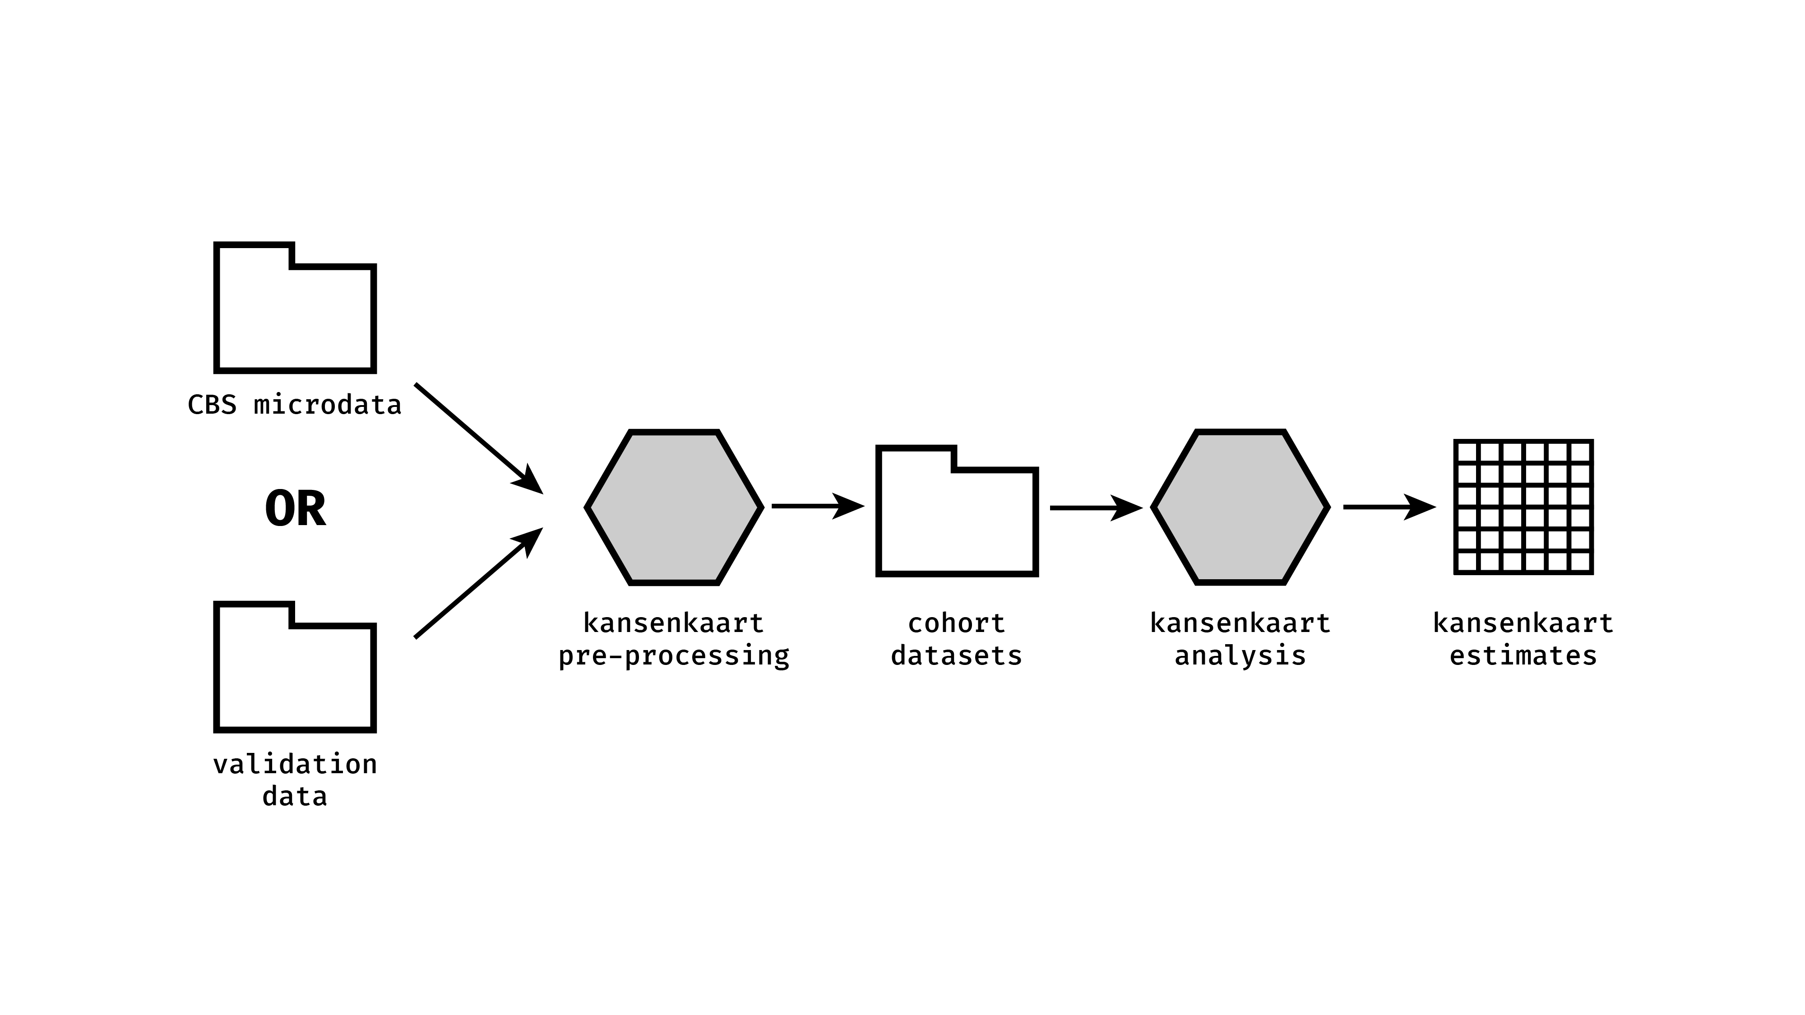

Offline workflow example

Slide 26
Offline workflow example
How far you should go depends a lot on the project
Contact us in consultation time later or schedule a meeting with us

Slide 27
Efficient data handling

Slide 28




CPU / Cores
Disk / storage
loading
importing
processing
saving
storing
Memory / RAM

Slide 29

Storage

Slide 30
Geachte relatie,
Uit een meting op maandag 4 april 2022 blijkt dat project 0000, Titel van het project, een ruimtebeslag kent van 133 GB. De limiet voor het project is 100 GB.
Als u de extra capaciteit daadwerkelijk nodig heeft, dan kunt u een verzoek indienen om extra capaciteit bij te kopen. De kosten hiervoor bedragen 25 euro per 50 GB per maand.
Met vriendelijke groet,
Firstname Lastname
DBD Team Dataservices
CBS | Henri Faasdreef 312 | Postbus 24500 | 2490 HA Den Haag
Email: microdata@cbs.nl
Volg statistiekcbs op twitter | facebook | instagram

Slide 31
Efficiently storing large R datasets
Live coding

Slide 32
Try to create tidy data
Intermediate data should be tidy
Each variable is a column; each column is a variable.
Each observation is a row; each row is an observation.
Each value is a cell; each cell is a single value
https://tidyr.tidyverse.org/articles/tidy-data.html
Make column names legible for humans and machines janitor::clean_names()

Slide 33

Memory

Slide 34
In R:
Error: cannot allocate vector of size 745.1 Gb
In Python (numpy)
numpy.core._exceptions._ArrayMemoryError: Unable to allocate 745. GiB for an array with shape (100000000000,) and data type float64
In Stata
(no clue, I really don’t use Stata??)

Slide 35
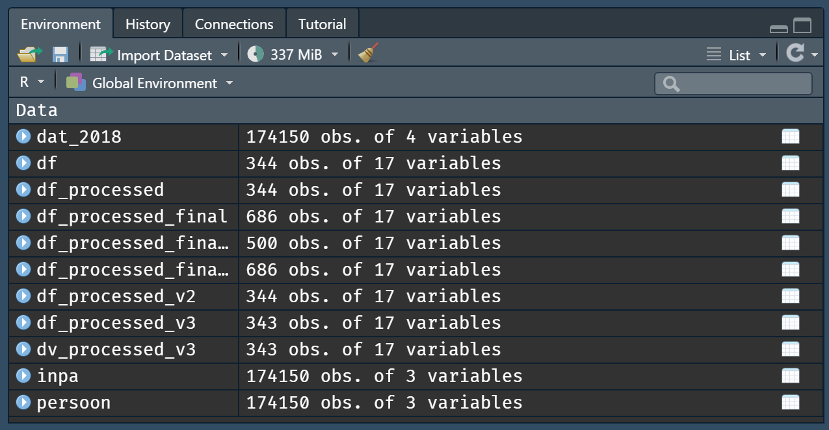
Clean your session / environment

Slide 36
Efficiently processing large datasets
Live coding 2

Slide 37
Larger-than-memory data
Sometimes, your data really is larger-than-memory
It is possible to do analyses on datasets which are on-disk
Two options:
Process data in chunks
Create a proper database

Slide 38
Working with larger-than-memory data
Live coding 3

Slide 39
Questions?

Slide 40
Group consultations / exercise

Slide 41
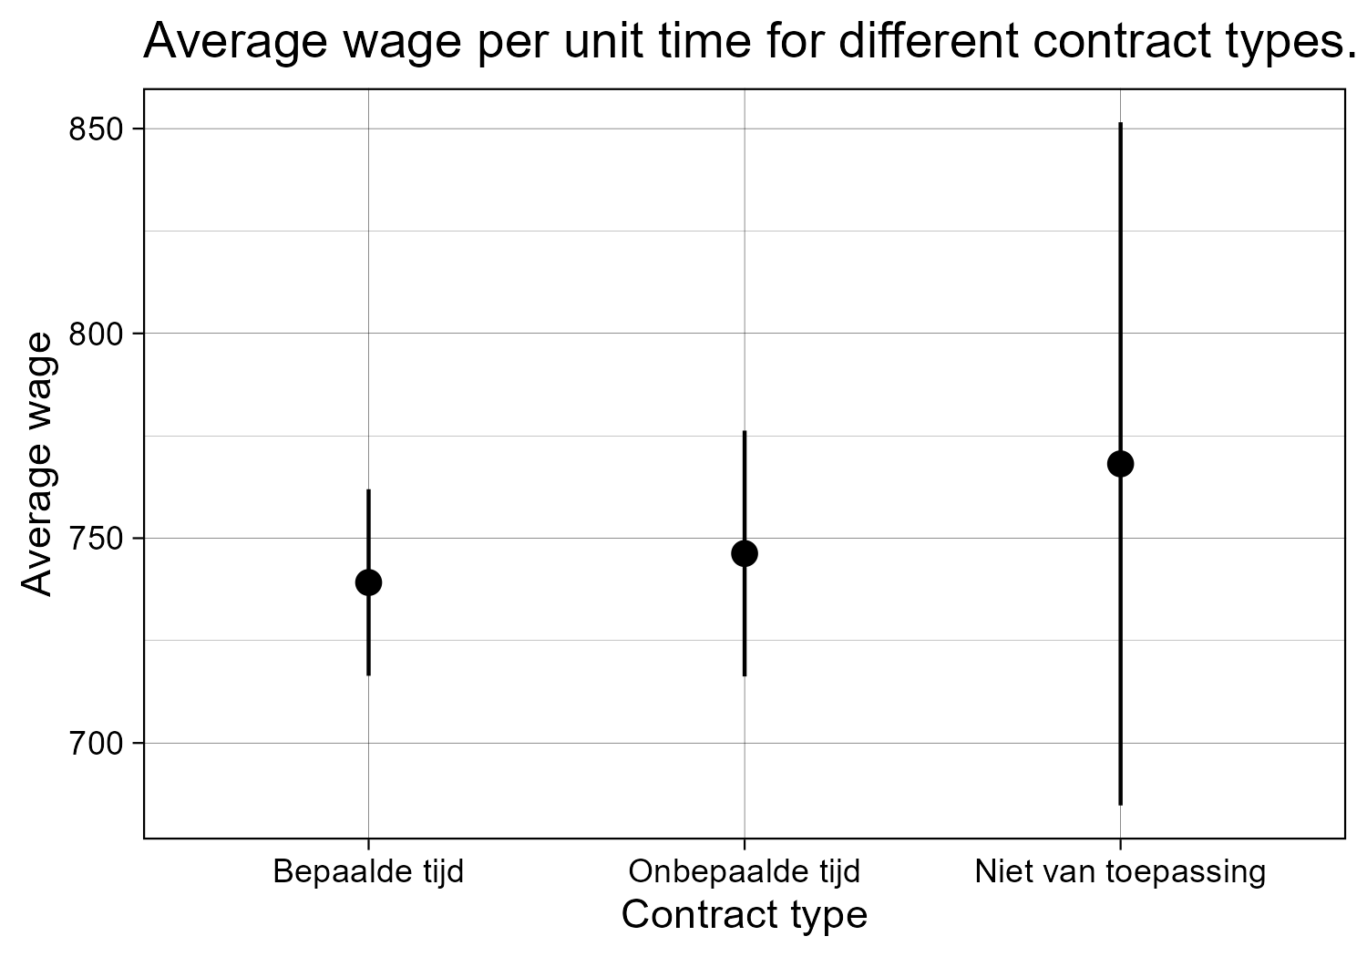
Exercise
Fake SPOLISBUS
Create a “simple” plot
Use the skills from this workshop!
Discuss with your group members!

Slide 42
Groups
First name | Last name | Group
Henry | Abbink | Data handling
Nathalie | Aerts | CBS RA data
Nadya | Ali | Exercise
Stanislav | Avdeev | Data handling
Özgün | Balaban | CBS RA data
Dorien | Beeres | CBS RA data
Cindy | Biesenbeek | Exercise
Clémentine | Cottineau | Advanced computation
Ernst-Jan | de Bruijn | Reproducibility
Niek | de Meijier | CBS RA data
Sreeparna | Deb | CBS RA data
Bob | Driessen | Reproducibility
Federica | Giardina | Data handling
Kyri | Janssen | Big tables
Yuxuan | Jin | Data handling
Steven | Kema | Data handling
Megha | Khosla | Advanced computation
Maša | Krajnc | Big tables
Marie | Labussiere | Reproducibility
Huyen | Nguyen | CBS RA data
Marjanne | Piena | Big tables
Friso | Scheepstra | Version control
Raoul | Schram | CBS RA data
Elizaveta | Sivak | Big tables
Florian | Sniekers | Version control
Pascalle | Spaan | CBS RA data
Lisa | Timm | Version control
Ignacio | Urria | Advanced computation
Mark | van der Meijden | Exercise
Kars | van Oosterhout | Data handling
Michiel | van Rijn | Exercise
Alexandra | Voce | CBS RA data
CBS RA data, data handling, exercise, reproducibility, big tables, advanced computation, version control
Discuss your questions; were they answered? Do you have more questions?
Help each other!
Do the exercise ☺
Members of the SoDa team will walk around

Slide 43
Thank you!
https://odissei-soda.nl

Slide 44
Default light slide
Default subheading
This is the body of the text
Default subheading
Note that the text is not black, but “black, text 1, lighter 25%”
Default subheading
This makes things easier on the eyes
Default subheading
This is the body of the text

Slide 45
Default dark slide
Default subheading
The dark slide brings some variation
Default subheading
It can highlight important aspects of the presentation.
Default subheading
This is the body of the text
Default subheading
This is the body of the text

Slide 46
Is this an impact slide?

Slide 47
Here is an impactful slide with a sentence on it.
Here is a topic related to the aforementioned question.

