Slide 1
Pickle Stability &
Correctness
Test Suite — Final Report
Software Testing Lab

Slide 2
Agenda
01
Introduction — What is pickle?
05
Results — 80/80 Passed
02
Research Question
06
Findings
03
Testing Strategies
07
Limitations
04
Work Distribution
08
Conclusion

Slide 3
01 Introduction
What is pickle?
Research Question
A Python standard-library module that
converts objects into
byte streams (serialization) and back again (deserialization). Pickling → object ➜ bytes Unpickling → bytes ➜ object
Does the same input always produce
the same
hash-identical output? Scenarios to test: • Different operating systems
• Different Python versions
• Floating-point precision
• Recursive data structures

Slide 4
03 Testing Strategies
Equivalence
Partitioning
Boundary
Value Analysis
Fuzzing
White-box
Testing
27 tests
None, bool, int, float,
str, bytes, list, tuple,
dict, set, custom class
25 tests
sys.maxsize, 10^1000,
±0.0, NaN, ±inf,
string 255/256/65535
20 subtests
20 fixed seeds —
random nested objects
(reproducible)
5 tests
Memo dict, reduce_ex,
getstate/setstate,
PROTO opcode
+ Round-trip correctness (9 tests) + Protocol versions 0–5 (8 tests) + dumps vs dump-to-file (1 test)

Slide 5
04 Work Distribution
Member 1
Member 2
CODE:
CODE:
• TestEquivalencePartitioning (27 tests) • TestBoundaryValues (25 tests) • TestRoundTrip (9 tests) • Helper utilities (pickle_sha256, assert_hash_identical)
• TestRecursiveStructures (5 tests) • TestProtocolVersions (8 tests) • TestDumpVsFile (1 test) • TestFuzzing (20 subtests) • TestWhiteBox (5 tests)
REPORT:
REPORT:
Sections 1–3 (Introduction, Test Suite
Overview, Strategies 3.1 & 3.2)
Traceability matrix rows 1–8
Sections 4–7 (Findings, Traceability
rows 9–15, Limitations, Conclusion)
GitHub repository management

Slide 6
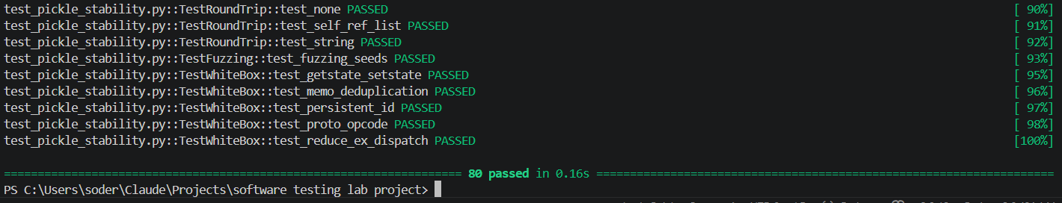
05 Results
80
27
25
20
8
Equivalence
Partitioning
Boundary
Value
Fuzzing
subtests
Protocol
tests
PASSED
0 failed • 0.16 seconds
Python 3.9 / 3.10 • Linux & Windows

Slide 7
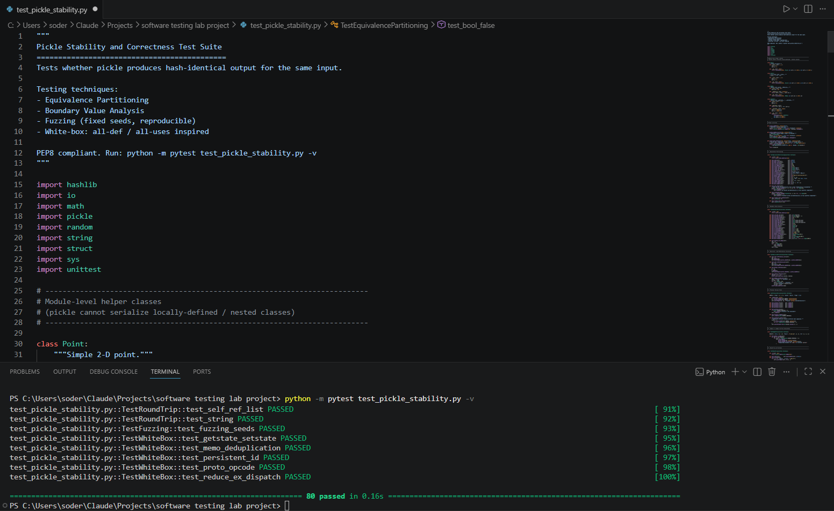
Test File in VS Code
Explanation
This is our main test file written in Python.
It contains 80 test cases organized in 8 classes covering:
• Equivalence Partitioning
• Boundary Value Analysis
• Fuzz Testing
• White-box Testing
We used VS Code as our IDE and the integrated terminal to run pytest.
VS Code IDE

Slide 8
Test Execution Results (Terminal)
Explanation
This terminal output confirms our test suite executed successfully.
Key results:
• 80 tests ran
• 0 failures
• 0 errors
• Completed in 0.16 seconds
Command used:
python -m pytest
test_pickle_stability.py -v
80/80 PASSED ✓

Slide 9
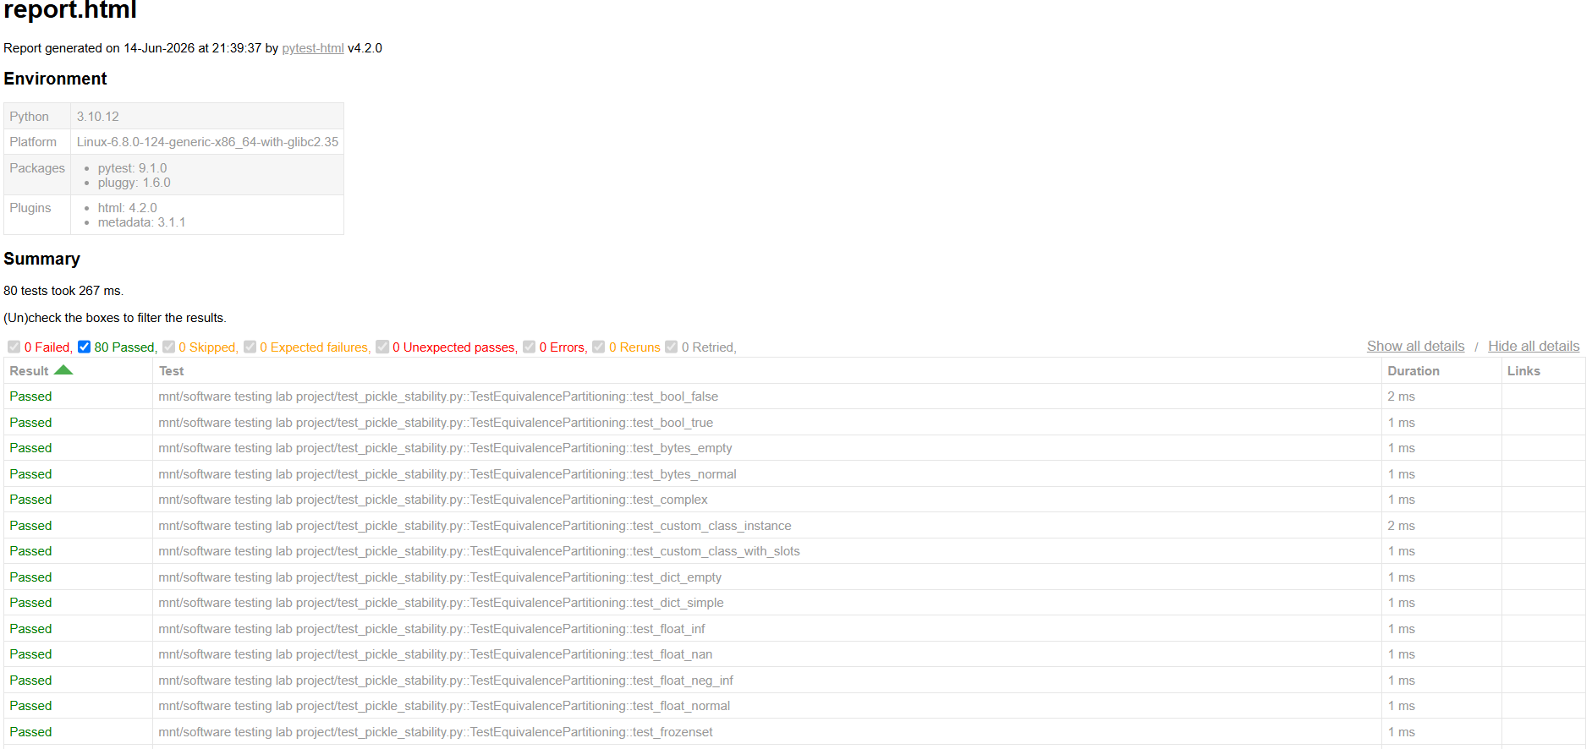
HTML Test Report (pytest-html)
Explanation
This is the HTML report generated automatically by pytest-html.
It provides a detailed visual overview showing:
• Each test name
• Pass / Fail status
• Execution time per test
• Python & pytest version info
Generated with:
--html=test_results.html
--self-contained-html
HTML Report

Slide 10
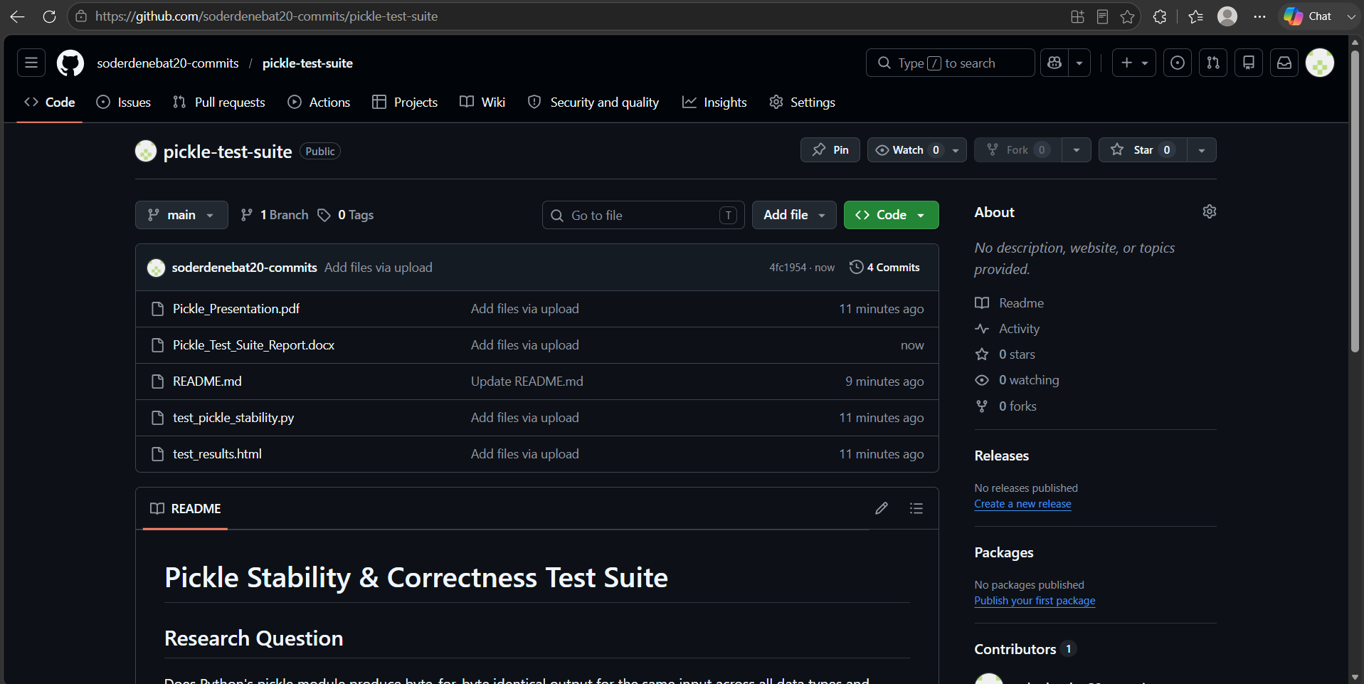
GitHub Repository
Explanation
Our project is publicly available on GitHub.
Repository contains:
• test_pickle_stability.py
• test_results.html
• Pickle_Test_Suite_Report.docx
• Pickle_Presentation.pdf
• README.md
URL:
github.com/soderdenebat20-commits/pickle-test-suite
Public Repository ✓

Slide 11
06 Findings
✅ Stable
⚠️ Note
Primitive types — all deterministic ✓
set / frozenset — may be non-deterministic
due to hash randomisation (PYTHONHASHSEED)
Float specials: NaN, ±∞, −0.0 ✓
Very large integers (10^1000) ✓
Different protocols produce different bytes
(expected and documented behaviour)
Unicode strings up to 65,535 chars ✓
Self-referential list / dict ✓
Custom class (__slots__, __getstate__) ✓
Protocol 0–5 each deterministic ✓
dumps() ≡ dump()-to-BytesIO ✓

Slide 12
07 Limitations
No cross-process stability test
Tests run within a single process. True stability requires comparing pickle files from separate Python invocations on different OSes.
Hash randomisation not toggled
set/frozenset stability requires launching separate processes with fixed vs. random PYTHONHASHSEED.
No cross-version testing
Only tested on Python 3.9 & 3.10. Versions 3.8 and 3.11 require a CI matrix (e.g. GitHub Actions tox).
C extension coverage gap
coverage.py cannot instrument the _pickle C module — branch coverage of the fast path is unknown.
datetime, decimal, enum not tested
These stdlib types have custom __reduce__ implementations that were not included in the current suite.

Slide 13
Conclusion
1
80/80 tests passed — pickle is deterministic within a single process
2
set / frozenset can be non-deterministic due to hash randomisation
3
Different protocol versions produce different byte streams (expected)
4
Future work: cross-process, cross-version, and cross-OS testing via CI
GitHub: https://github.com/YOUR-ORG/pickle-test-suite

