Slide 1
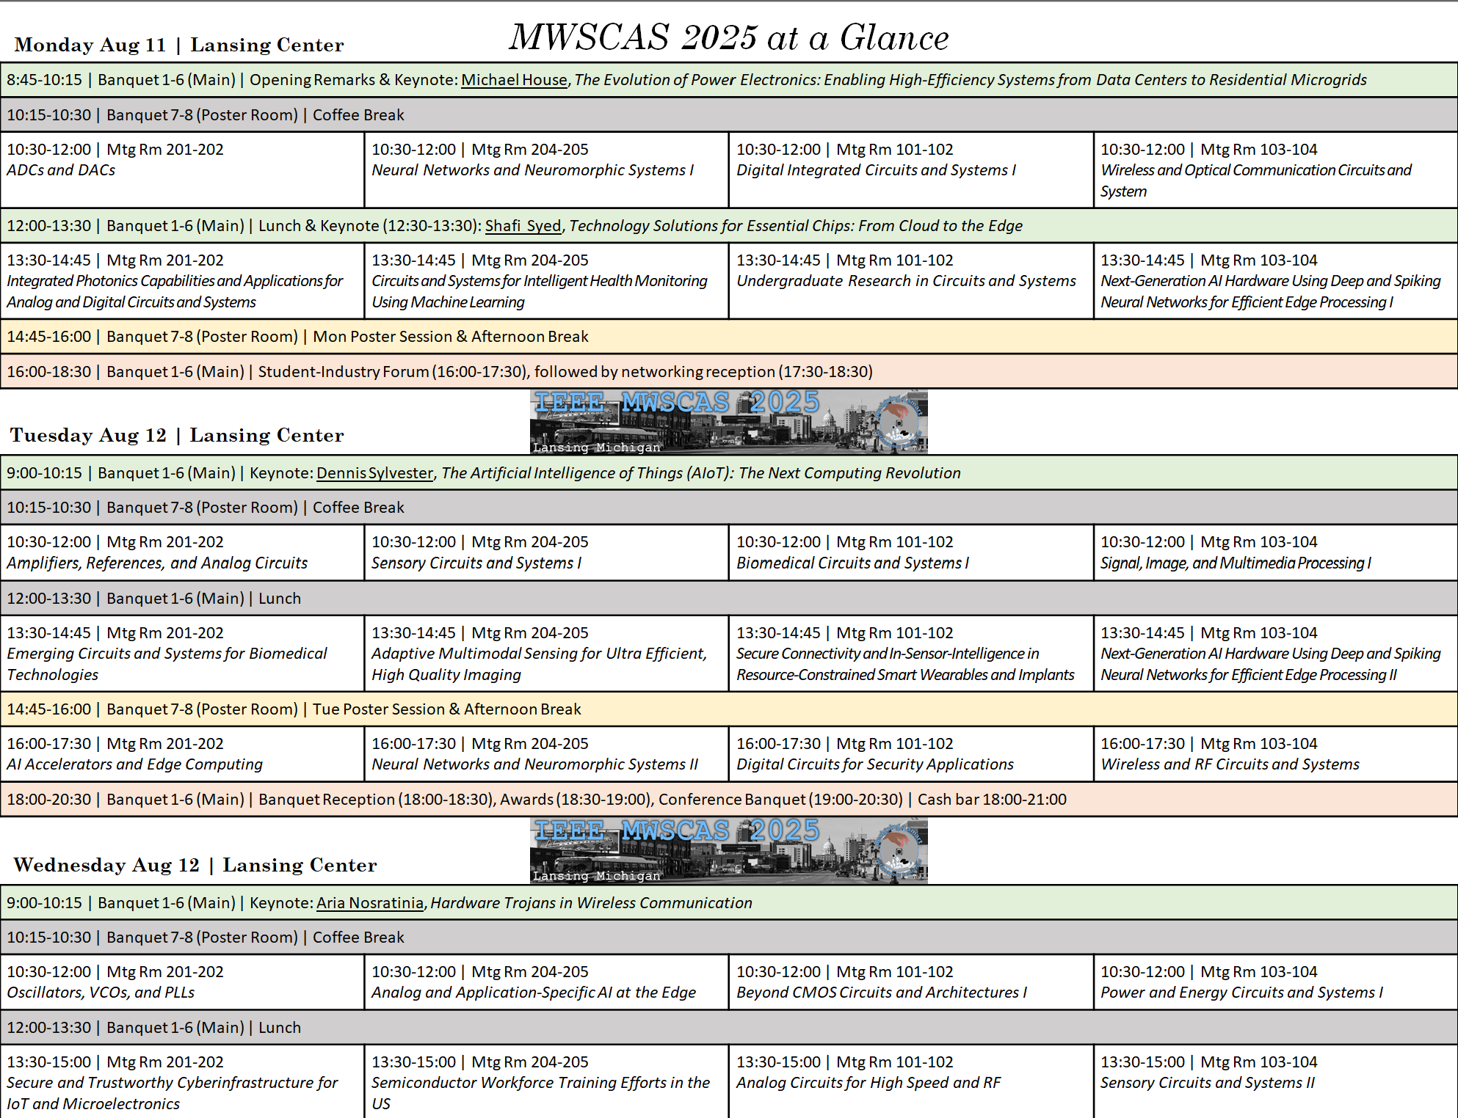

Slide 3
MWSCAS 2024 Myril B. Reed Best Paper Award
Andrew Mason & Navid Yazdi
MWSCAS 2025 General Co-Chairs
Electrical and Computer Engineering
Michigan State University

Slide 4
2024 Myril B. Reed Award
Myril B. Reed was instrumental in establishing the MWSCAS and, along with Ray Wainwright, chaired the first two Midwest Symposiums in 1955 and 1956.
The Myril B. Reed Best Paper Award is given each year for the best paper presented at the previous MWSCAS
The 2024 Myril B. Reed Best Paper Award goes to
<drum roll…..>
Ahmed Benbuk, Diogo Moniz-Garcia, Daniel Gulick, Alfredo Quinones-Hinojosa, and Jennifer Blain, for paper titled “A Miniaturized Wireless Battery Free Implant for in Vivo Musculoskeletal Stimulation”
Each author will receive a plaque and a $100 gift card award at the MWSCAS 2025 conference.

Slide 5
MWSCAS 2025 Best Paper Awards
Andrew Mason & Navid Yazdi
MWSCAS 2025 General Co-Chairs
Electrical and Computer Engineering
Michigan State University

Slide 6
2025 Best Paper Selection Process
Based on paper submission reviews from the MWSCAS 2025 Technical Program Review Committee, the top 11 papers were selected.
These 11 top papers were reviewed again and ranked by an awards committee assigned by the Technical Program Chairs
From this ranking, the top 3 papers were awarded Best Paper Awards
note, all of these were student-authored papers!
The next 3 ranked papers with student authors were awarded Best Student Paper
And the remaining 5 papers were classified as Best Paper Finalist.
The award winners, in reverse order are…

Slide 7
Best Paper Finalist
Let up recognize the papers that made it to the finalists list (in no order) (please stand if you are one of these authors)
Justin London, Tingjun Lei, Chaomin Luo, Yaqun Yuan
Human Activity Recognition and Biomedical Signal Classification Using Multi-Modal Deep Learning
Chao Liu, Yongzhen Chen, Yang Guo, Jiangfeng Wu
A Fully Digital Baseline Wander Compensation Method in ADC-Based High-Speed SerDes Receiver
Cooper Koch, Alexander Burkholder, Ahmed Ammar
Practical Implementation of Distributed Node Selection in Cooperative ARQ-Based Energy Harvesting Wireless Networks
Cheng-Lung Lee, Mark Paulik, Mohan Krishnan
Identification-Based Kinodynamic Trajectory Planning for Reactive Robot Driving
Haotian Zhao, Mohammad Mahdi Ghahramani, Samuel Palermo, Sebastian Hoyos
Multi-Centroid AI-Loops for Autonomous Hyperparameter Search of Non-Linear Time-Variant Systems

Slide 8
Best Student Papers
Best Student Papers are awarded to (in no order):
Jacob O'Donnell, Elaine Greenfield, Hagar Hendy, Karsten Bergthold, Cory Merkel and Tejasvi Das
Evaluating FeFET and Memristor Performance in Time-Domain Computing Applications
Mohamed Saad Aly, Mohamed A. Y. Abdalla, and Mohamed Salah Mobarak
A 24.5-To-40.5 GHz 6-Bit Vector Modulator for Mm-Wave 5G Beamformers
Jongchan Pyeon, Rudra Biswas, Mehdi Kiani, Farnaz Tehranchi
A Deep Learning Framework for Predicting Ultrasound Array Geometry and Skull Shape in Precision Ultrasound Neuromodulation

Slide 9
Best Papers
Best Papers are awarded to (in no order):
Dong-Hyeon Kim, Kihun Kim, Jun-Seo Kim, Jae-Koo Park, Dae-Won Rho, Jae-Ho Lee, Seung-Jae Yang, and Woo-Young Choi
A 40-Gb/s PAM-4 VCSEL Driver with Reconfigurable 3-Tap Fractionally Spaced FFE
Young-Hun Moon, Kun-Woo Park, Kwan-Hoon Song, Kent Edrian Lozada, Min-Jae Seo, and Seung-Tak Ryu
A 184dB-FoMS 25kHz-BW 98.6dB-SNDR Fully Dynamic Discrete-Time Delta-Sigma Modulator with Digital Noise Coupling
Seongwon Yoon, Janak Sharda, Omkar Phadke, and Shimeng Yu
A CMOS Image Sensor Pixel Readout Circuit Design Using Back-End-Of-Line (BEOL)-Compatible Oxide Transistors

Slide 10
Best Posters
Poster awards were judged during live presentations by a committee of reviewers based on technical content, poster quality, and presentation performance
The Winners are…
Monday Poster Session
Graham Buchanan, Sree Nirmillo Biswash Tushar, Hritom Das, and Garrett S. Rose
University of Tennessee, Knoxville and Oklahoma State University
Dynamic Programming Resolution of Memristive Synapse
Tuesday Poster Session
Melania St. Cyr, Sarina Sabouri, Azin Zarrasvand, and Negar Reiskarimian
Massachusetts Institute of Technology and Draper Laboratory
A Feasibility Study on Portable Microwave Tumor Detection

Slide 11
MWSCAS 2025 Special Thanks
Andrew Mason & Navid Yazdi
MWSCAS 2025 General Co-Chairs
Electrical and Computer Engineering
Michigan State University

Slide 12
It Takes a Village…
It really does take a major team effort to pull off a conference like MWSCAS
Without the help of many others, Navid and Andrew would never have been able to bring you a successful conference
Thanks to each of our organizing committee members!
Thanks to our registration & local support team
[all around problem solvers] Sam Lobert, Billur Haskara
[registration desk] Christine & Abi
and a dozen+ student volunteers from MSU and beyond
Very special thanks for amazing insight and advise from past MWSCAS chairs, Randy Geiger and Pamela Abshire

Slide 13

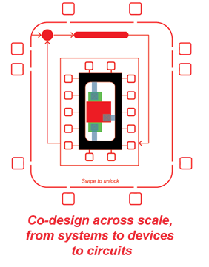
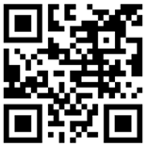
📍 Hilton Netherland Plaza, Cincinnati, OH | 🗓 Aug 9–12, 2026
🎯 Theme: Co-design across scale: from systems to devices to circuits
🗣 Program: Oral & poster sessions, tutorials, special sessions
🎓 Student events: Interactive demos, competitions with prizes
📡 Tracks: Analog/Mixed-Signal, Digital, Power, Sensors, Signal & Image Processing, Communications, Biomedical, AI, Beyond CMOS
📅 Key Dates:
👥 General co-chairs: Soumyajit Mandal (BNL), Rashmi Jha (UC)
🌐 More info: www.mwscas2026.org
Mar 2 – Tutorials/Special Sessions | May 2 – Acceptance
Mar 16 – Regular Papers | Jun 8 – Final Papers
Hoping to see all of you in Cincinnati next year!

