Slide 1
Text Mining: Tools, Techniques and Applications
DS Workshop
Fred N. Kiwanuka

Slide 2
Outline
Text Mining Defined
Foundations of Text Mining
Example Applications
User Interface Challenges
The Future
Notes:
Looking at 5 things
What is text mining?
Easiest to understand by relating it to known technologies
Foundation of text mining
The fundamental theories and technologies that make text mining work.
Application of text mining
General and real world problems that can be solved with text mining
User Interface Challenges
We’ll look at Uis that have been developed for text mining
The Future
Quick glimpse into the potential for text mining in the future

Slide 3
Mining Medical Literature
Medical research
Find causal links between symptoms or diseases and drugs or chemicals.
Notes:
This is all very interesting, but what real-life business problems does this hold promise for?
Let’s consider a specific scenario involving the medical domain, specifically, medical research.
Consider that the medical domain has quite a lot of knowledge captured in the form of unstructured documents: physician reports, medical news articles and reports, etc...

Slide 4
A Real Example
Research objective:
  Follow chains of causal implication to discover a relationship between migraines and biochemical levels.
Data:
  medical research papers, medical news (unstructured text information)
Key concept types:
  symptoms, drugs, diseases, chemicals…
Notes:
The source of information is a collection of medical research papers and news articles.
From this source, we can extract the “dimensions” of the data. Dimensions are the “classes” of information that add substance and some implicit structure to the otherwise unstructured data we’re dealing with.
The goal is to explore the source of migraines by identifying potential causal links to blood chemistry.

Slide 5
Example Application: Medical Research
stress is associated with migraines
stress can lead to loss of magnesium
calcium channel blockers prevent some migraines
magnesium is a natural calcium channel blocker
spreading cortical depression (SCD) is implicated in some migraines
high levels of magnesium inhibit SCD
migraine patients have high platelet aggregability
magnesium can suppress platelet aggregability
  (source: Swanson and Smalheiser, 1994)
Notes:
Here’s what was found.
Note that this is an indication of a “potential” link. It turns out that a follow-up clinical study validated this result.

Slide 6


Text Mining Defined
Discover useful and previously unknown “gems” of information in large text collections
Patterns
Trends
Associations
Notes:
How many people have been involved in a implementation of a so-called Business Intelligence system (Decision Support, Knowledge Discovery, Data Mining System)
How many people have been part of building a text retrieval or information retrieval system (in other words, a “search” application)?
In the loosest definition, text mining attempts to combine the idea of “mining” textual information by employing some of the same technologies used for text retrieval.

Slide 7
“Search” versus “Discover”
Search
(goal-oriented)
Discover
(opportunistic)
Structured
Data
Data
Retrieval
Data
Mining
Unstructured
Data (Text)
Information
Retrieval
Text
Mining

Slide 8
Data Retrieval
Find records within a structured database.
Database Type | Structured
Search Mode | Goal-driven
Atomic entity | Data Record
Example Information Need | “Find a Japanese restaurant in Boston that serves vegetarian food.”
Example Query | “SELECT * FROM restaurants WHERE city = boston AND type = japanese AND has_veg = true”
Notes:
Data Retrieval systems are the ones most people are familiar with. They are the applications provided by behemoths like Oracle and Sybase.
An “information need” is what is the user’s head. The “query” is the user’s articulations of this information need to the system. They are not always the same.

Slide 9
Information Retrieval
Find relevant information in an unstructured information source (usually text)
Database Type | Unstructured
Search Mode | Goal-driven
Atomic entity | Document
Example Information Need | “Find a Japanese restaurant in Boston that serves vegetarian food.”
Example Query | “Japanese restaurant Boston” or Boston->Restaurants->Japanese
Notes:
Most of us are familiar with “search”.
Thanks to the growth of the Web and sites like Google, AltaVista, Excite, etc…, anyone who’s reasonably “Net savvy” has had some exposure to the technology that is IR or information retrieval.
IR systems usually attempt to address one of two modes of searching: goal-driven or opportunistic.
The two modes represent the two types of searches that people typically perform.
How many people still go to their local public library? I maintain that when people use the library they are in one of two modes. Either they are looking for a particular book or books, or they are browsing an area of interest. That is the difference between goal-driven and opportunistic search.

Slide 10
Data Mining
Discover new knowledge through analysis of data
Database Type | Structured
Search Mode | Opportunistic
Atomic entity | Numbers and Dimensions
Example Information Need | “Show trend over time in # of visits to Japanese restaurants in Boston ”
Example Query | “SELECT SUM(visits) FROM restaurants WHERE city = boston AND type = japanese ORDER BY date”
Notes:
Data Mining employs analysis and interpretation of data captured in structured databases to facilitate decision making.
So called “Decision Support” systems usually employ some kind of Data Mining capabilities.

Slide 11
Text Mining
Discover new knowledge through analysis of text
Database Type | Unstructured
Search Mode | Opportunistic
Atomic entity | Language feature or concept
Example Information Need | “Find the types of food poisoning most often associated with Japanese restaurants”
Example Query | Rank diseases found associated with “Japanese restaurants”
Notes:
Text Mining employs the same concepts as Data Mining but against unstructured or semi-structured text information sources.
Text mining aids the opportunistic searcher.
Not only can it help traditional IR by “suggesting” relevant information, it can extract knowledge that is not nicely encapsulated in a single document (or book).

Slide 12
Motivation for Text Mining
Approximately 90% of the world’s data is held in unstructured formats (source: Oracle Corporation)
Information intensive business processes demand that we transcend from simple document retrieval to “knowledge” discovery.
Structured Numerical or Coded
Information
10%
Unstructured or Semi-structured
Information
90%
Notes:
The justification for the interest in text mining is the same as for the interest in knowledge retrieval (search and categorization).
The shear amount of unstructured data (mostly textual) out there calls for more than just document retrieval. Tools and techniques exist to mine this data and realize value in the same way that data mining taps structured data for business intelligence and knowledge discovery.

Slide 13
Challenges of Text Mining
Very high number of possible “dimensions”
  All possible word and phrase types in the language!!
Unlike data mining:
  records (= docs) are not structurally identical
  records are not statistically independent
Complex and subtle relationships between concepts in text
  “AOL merges with Time-Warner”
  “Time-Warner is bought by AOL”
Ambiguity and context sensitivity
  automobile = car = vehicle = Toyota
  Apple (the company) or apple (the fruit)
Notes:
Why aren’t there more products that do text mining?
Because it’s hard!!!
First, there are many possible dimensions of text. Consider just the classes of nouns that might be represented in a text collection. Then, add to that noun phrases (nouns plus adjectives or multi-word concepts).
Second, different documents can look quite different. Never mind issues like formatting differences.
Third, the relationships between words and concepts in text is subtle. Figuring out that a relationship exists is easy, providing the information about the nature of the relationship is tricky.
Finally, the same word can have many meanings (e.g. “interest”), or many words can have the same meaning.

Slide 14
The Emergence of Text Mining
Advances in text processing technology
  Natural Language Processing (NLP)
  Computational Linguistics
Cheap Hardware!
  CPU
  Disk
  Network
Notes:
Why aren’t there more products that do text mining?
Because it’s hard!!!
First, there are many possible dimensions of text. Consider just the classes of nouns that might be represented in a text collection. Then, add to that noun phrases (nouns plus adjectives or multi-word concepts).
Second, different documents can look quite different. Never mind issues like formatting differences.
Third, the relationships between words and concepts in text is subtle. Figuring out that a relationship exists is easy, providing the information about the nature of the relationship is tricky.
Finally, the same word can have many meanings (e.g. “interest”), or many words can have the same meaning.

Slide 15
Text Processing
Statistical Analysis
  Quantify text data
Language or Content Analysis
  Identifying structural elements
  Extracting and codifying meaning
  Reducing the dimensions of text data
Notes:
So, what helps?
Well, the technology to analyze the written word and to address the problems listed in the previous slide has existed for quite some number of years, but only in the last 2 or 3 years have we seen products that are applying this technology to the idea of text mining.
Sometimes called CL, sometimes NLP, but easiest to just refer to it as Text Analysis.

Slide 16
Statistical Analysis
Use statistics to add a numerical dimension to unstructured text
Term frequency
Document frequency
Term proximity
Document length
Notes:
Statistics about text are at the heart of most IR systems. Simple statistics like the number of times a search term occurs in a document can be used to infer the potential relevance of that document.

Slide 17
Content Analysis
Lexical and Syntactic Processing
  Recognizing “tokens” (terms)
  Normalizing words
  Language constructs (parts of speech, sentences, paragraphs)
Semantic Processing
  Extracting meaning
  Named Entity Extraction (People names, Company Names, Locations, etc…)
Extra-semantic features
  Identify feelings or sentiment in text
Goal = Dimension Reduction
Notes:
Content Analysis tries to disambiguate structure and meaning in text.
The three processing “levels” represent three levels of sophistication in this disambiguating.
Ultimately, what were trying to do is reduce the number of dimensions in the text data.

Slide 18
Syntactic Processing
Lexical analysis
  Recognizing word boundaries
  Relatively simple process in English
Syntactic analysis
  Recognizing larger constructs
  Sentence and Paragraph Recognition
  Parts of speech tagging
  Phrase recognition
Notes:
Simple syntactic processing is designed fundamentally to reduce the complexity inherent in text by reducing the possible number of words and phrases to a more manageable number.

Slide 19
Named Entity Extraction
Identify and type language features
Examples:
    People names
    Company names
    Geographic location names
    Dates
    Monetary amount
    Others… (domain specific)
Notes:
Semantic processing aims to “type” language features or concepts so that the information can be mined by these different concept types.

Slide 20
Simple Entity Extraction
“The quick brown fox jumps over the lazy dog”
Noun phrase
Noun phrase
Mammal
Mammal
Canidae
Canidae
Notes:
Here’s a simple example:
Given a sentence, it’s useful to recognize the important concepts present. In this example, we are recognizing noun phrases and then classifying the phrases as particular types.
How concepts are classified depends on the research domain. Here I may have an application intended for a biologist where the kinds of things we might like to know are potential relationships between foxes and dogs. This could easily be factored a different way where dog and fox are not the some concept type.

Slide 21
Entity Extraction in Use
Categorization
  Assign structure to unstructured content to facilitate retrieval
Summarization
  Get the “gist” of a document or document collection
Query expansion
  Expand query terms with related “typed” concepts
Text Mining
  Find patterns, trends, relationships between concepts in text
Notes:
So what is concept extraction good for. Well, it has lot’s of general applications.

Slide 22
Extra-semantic Information
Extracting hidden meaning or sentiment based on use of language.
  Examples:
    “Customer is unhappy with their service!”
    Sentiment = discontent
Sentiment is:
  Emotions: fear, love, hate, sorrow
  Feelings: warmth, excitement
  Mood, disposition, temperament, …
Or even (someday)…
  Lies, sarcasm
Notes:
The ultimate (to date) in language processing is the inference of deep and hidden meaning in unstructured text.
It is inherently subjective, but a standard classification scheme can help in the association of business rules to the inferred affects.

Slide 23
Text Mining:
General Applications
Relationship Analysis
  If A is related to B, and B is related to C, there is potentially a relationship between A and C.
Trend analysis
  Occurrences of A peak in October.
Mixed applications
  Co-occurrence of A together with B peak in November.
Notes:
Some general applications of text mining.

Slide 24
Text Mining:
Business Applications
Ex 1: Decision Support in CRM
  What are customers’ typical complaints?
  What is the trend in the number of satisfied customers in Cleveland?
Ex 2: Knowledge Management
  People Finder
Ex 3: Personalization in eCommerce
  Suggest products that fit a user’s interest profile (even based on personality info).
Notes:
A couple specific business applications of text mining.
Gotta get that “e” in there!

Slide 25
Example 1:
Decision Support using Bank Call Center Data
The Needs:
  Analysis of call records as input into decision-making process of Bank’s management
  Quick answers to important questions
    Which offices receive the most angry calls?
    What products have the fewest satisfied customers?
    (“Angry” and “Satisfied” are recognizable sentiments)
  User friendly interface and visualization tools

Slide 26
Example 1:
Decision Support using Bank Call Center Data
The Information Source:
  Call center records
  Example:
AC2G31, 01, 0101, PCC, 021, 0053352,
NEW YORK, NY, H-SUPRVR8, STMT,
“mr stark has been with the company for
about 20 yrs. He hates his stmt format and
wishes that we would show a daily balance
to help him know when he falls below the
required balance on the account.”
Notes:
Bank call centers thousands of calls a day, mostly in unstructured or semi-structured formats.
This information represents a wealth of knowledge that can be translated into market strategies, etc…

Slide 27
Example 1:
Call Volume by Sentiment

Slide 28
Example 2:
KM People Finder
The Needs:
  Find people as well as documents that can address my information need.
  Promote collaboration and knowledge sharing
  Leverage existing information access system
The Information Sources:
  Email, groupware, online reports, …

Slide 29
Example 2:
Simple KM People Finder
Ranked People Names
Name
Extractor
Authority
List
Query
Search or
Navigation
System
Relevant
Docs

Slide 30
Example 3:
Personalized Movie “Matcher”
The Need:
  Match movies to individuals based on preference profile
The Information:
  Written reviews of movies
  Users’ lists of favorite movies.
Movie
Reviews
Sentiment
Analysis
Typed and
Tagged
Reviews

Slide 31
Sentiment Analysis of Movies: Visualization (after Evans)
absurdity
Action
insecurity
1
conflict
Romance
injustice
crime
0
inferiority
death
deception
immorality
horror
destruction
fear
Notes:
This diagram, created by Dr. David Evans at Clairvoyance, shows a way to visualize the affect of a movie using statistical data and normalization techniques.

Slide 32
Commercial Tools
IBM Intelligent Miner for Text
Semio Map
InXight LinguistX / ThingFinder
LexiQuest
ClearForest
Teragram
SRA NetOwl Extractor
Autonomy

Slide 33
User Interfaces for Text Mining
Need some way to present results of Text Mining in an intuitive, easy to manage form.
Options:
  Conventional text “lists” (1D)
  Charts and graphs (2D)
  Advanced visualization tools (3D+)
    Network maps
    Landscapes
    3d “spaces”

Slide 34
UI Challenges
Simple lists, charts, and graphs not obviously applicable or difficult to work with due to high dimensionality of text
Advanced visualization tools can be intimidating for the general community and are not readily accepted
Notes:
That’s all fine and dandy, but how do we provide this functionality in a mainstream application?

Slide 35
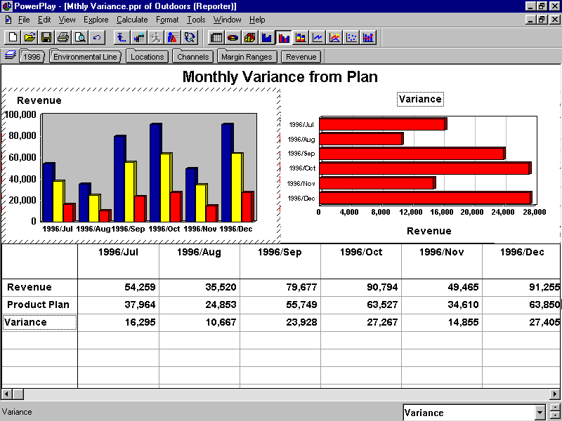
Charts and Graphs
http://www.cognos.com/
Notes:
Here’s a traditional user interface for presenting the results of a data mining operation. In this case, the data is product sales data which is being used to generate a variance report.
It’s a bit harder to see how text information could be presented as a histogram, but, as you’ll see in the demos at the end of this presentation, it can be done.

Slide 36
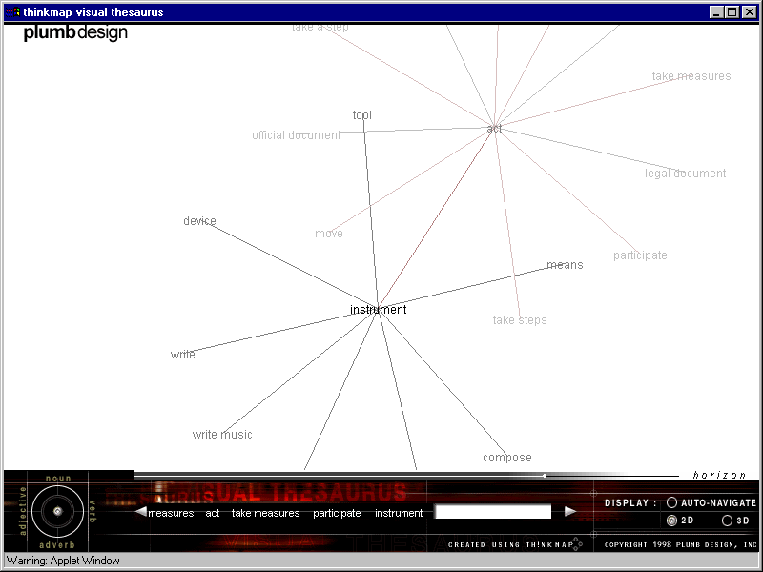
Visualization: Network Maps
http://www.thinkmap.com/
Notes:
Another technique for visualizing relationship information is network maps.
Here’s an example that shows, albeit dimly, how the relationships implied in a thesaurus can be shown in a 2d and pseudo-3d map.
This is a viewer from a company called ThinkMap.

Slide 37
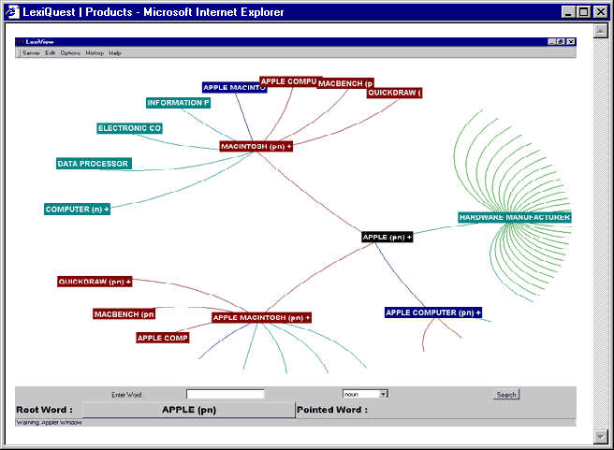
Visualization: Network Maps
http://www.lexiquest.com/
Notes:
Another example from a company called LexiQuest (formerly Erli) which makes language processing technology.

Slide 38
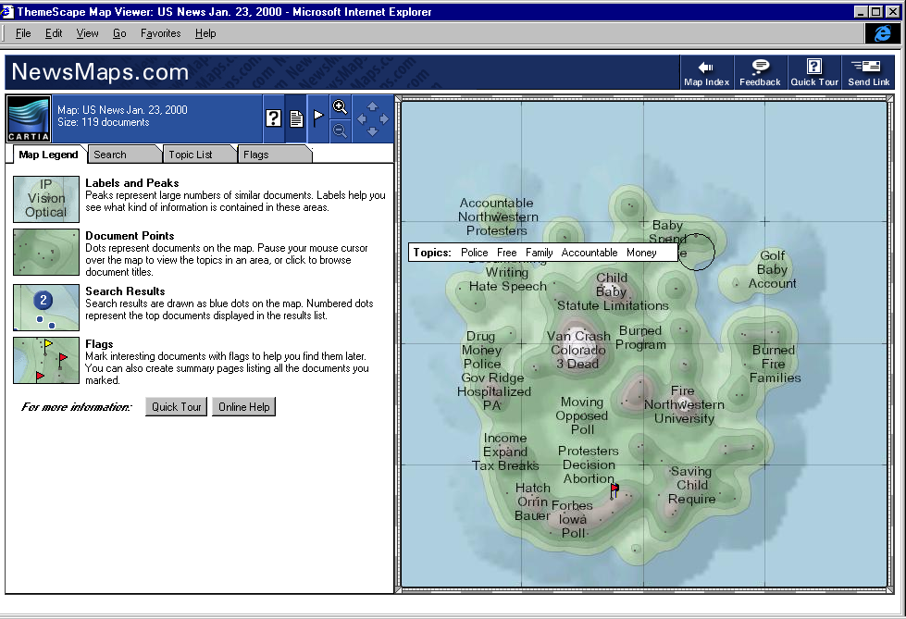
Visualization: Landscapes
http://www.aurigin.com/
Notes:
One of the more interesting approaches to visualizing patterns in text is from a company called Aurigin in their Themescape product.
Now, I have a formal education in geology and geophysics, so I’m comfortable with looking at maps like this, but I have to believe this is also a fairly intuitive interface for most people.
Generally what it tries to do is show thematic clusters as peaks in the map. By clicking on a peak, you can “drill down” into that cluster.
This example shows “whole collection” analysis.

Slide 39
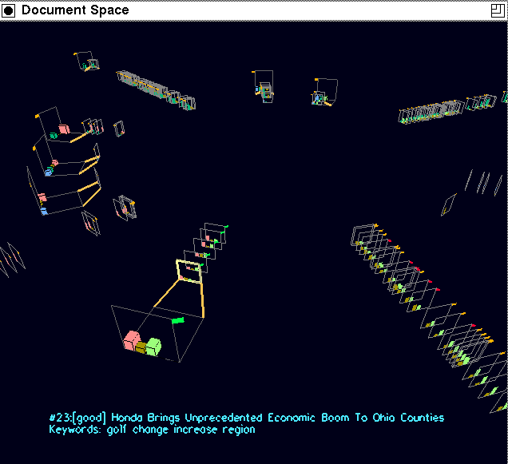
Visualization: 3D Spaces
http://zing.ncsl.nist.gov/~cugini/uicd/cc-paper.html
Notes:
Of course, you can even get more esoteric with 3d spaces. Here’s an example from research being done at the NIST.

Slide 40


The Future
Text
Data
Different tools and data, but common dimensions
Example:
  “Find sales trends by product and correlate with occurrences of company name in business news articles”
  Dimensions: Time, Company names (or stock symbols), Product names, Regions
Notes:
A very interesting future for text mining is integration with traditional data mining concepts and application.
Recent activity in the Information Retrieval space shows promise that this bridge will get crossed in the next several years.

