Slide 1
CSC 390 Final Project
Charles Hildreth, Michael Rivera, Owen Gibson

Slide 2
Side-scrolling shoot ‘em up video game made with Javascript, p5.js, and p5.play

Slide 3
From p5js.org:
p5.js a JS client-side library for creating graphic and interactive experiences, based on the core principles of Processing.
From Wikipedia:
Processing is an open-source graphical library and IDE / playground built for the electronic arts, new media art, and visual design communities with the purpose of teaching non-programmers the fundamentals of computer programming in a visual context.
Processing uses the Java language.
The Processing language and IDE were the precursor to numerous other projects, notably Arduino, Wiring, and p5.js

Slide 4
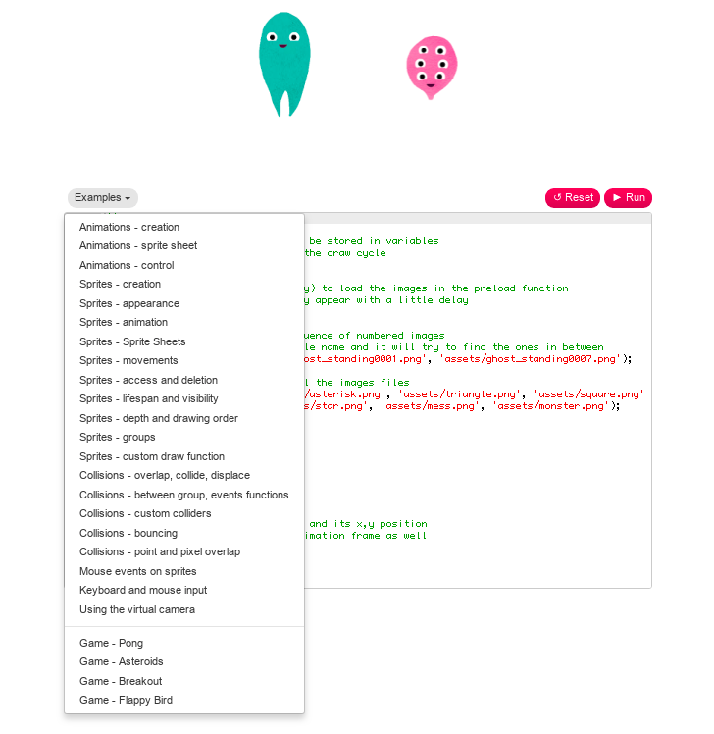

Much of our app is code adapted from example p5.play sketches on their website.

Slide 5
Spaceship Man
Destroy as many cannon turrets as possible, for 50 points each.
Game over after your ship takes 100 hit points
Concept was originally a two-player version of the one player Neo Geo game Lords of Thunder, where player one controls a ship and player two controls the weapons on the level.
Ran out of time, two player functionality will have to be added later.
The video game!

Slide 6
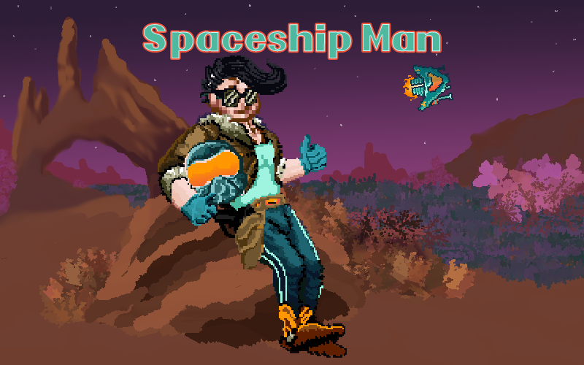
Try it out! Mobile or desktop.
https://sodua.github.io

Slide 7
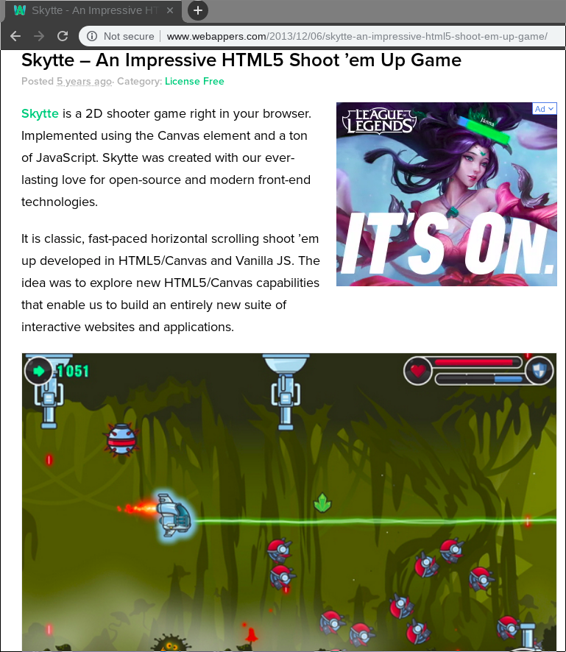
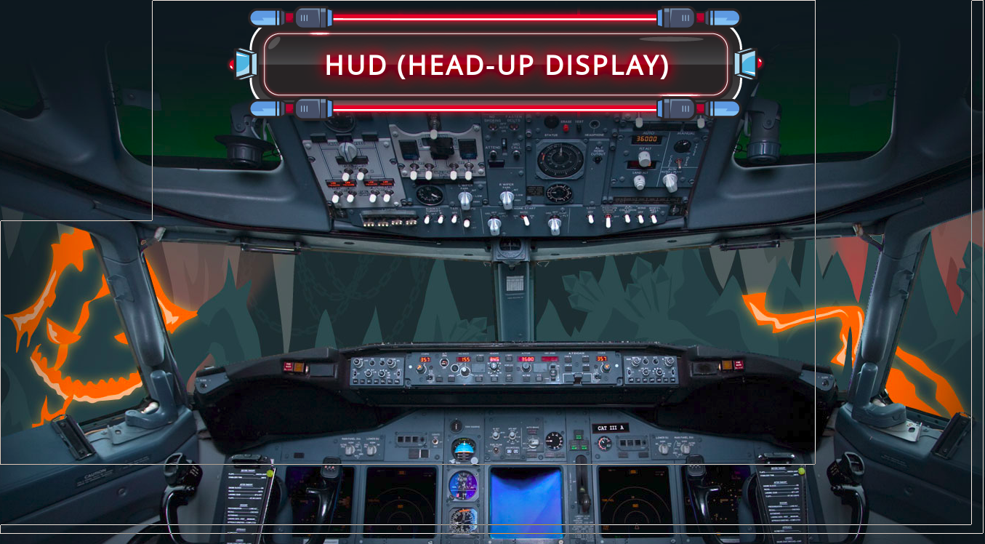
While googling about Javascript we found…
Someone already did a similar game!
(and it looks like they did it better)

Slide 8

We used github.com for collaboration and version control.
We used github.io for staging and testing.
We used both git on the command line and github.com’s web interface to make changes.

Slide 9
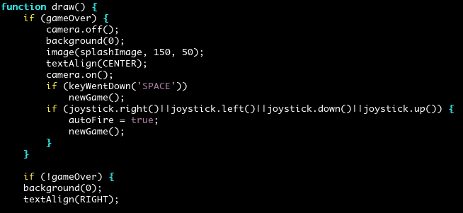
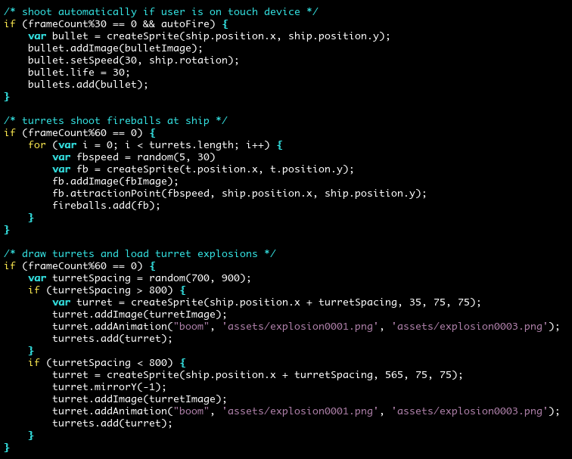
p5.js draw() loop function and animations

Slide 10
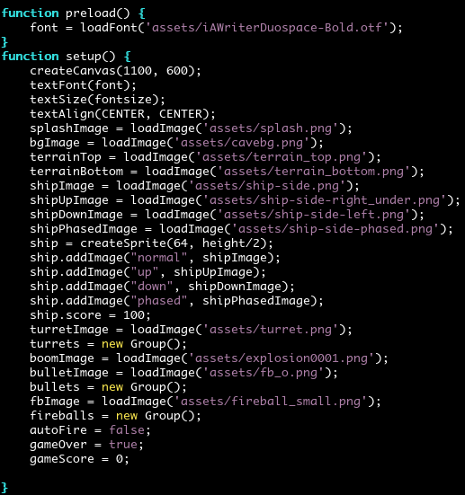
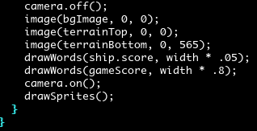
Loading assets and setting variables
Camera on/camera off at end of draw loop

Slide 11


Touch screen joystick library

Slide 12
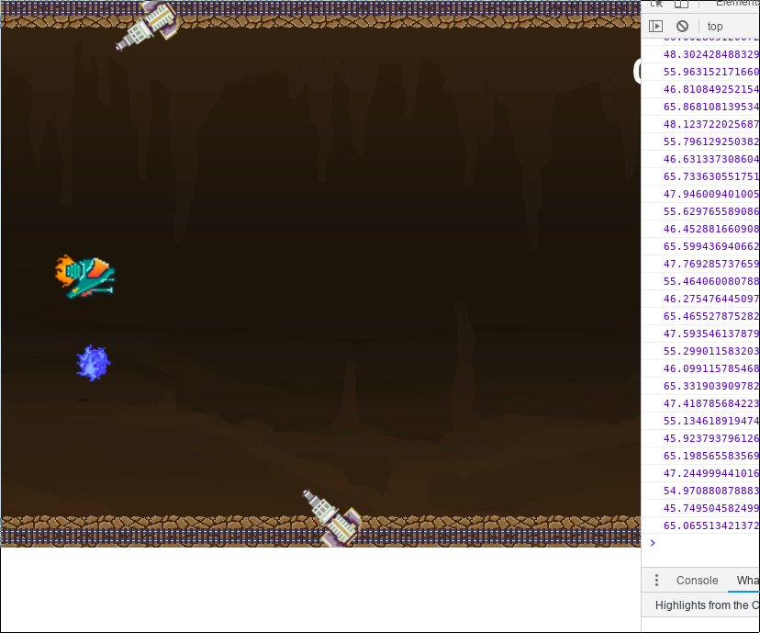
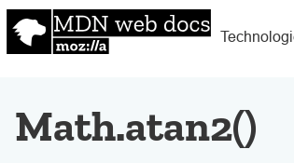
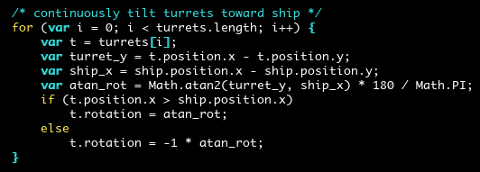
Trigonometry was attempted!

Slide 13
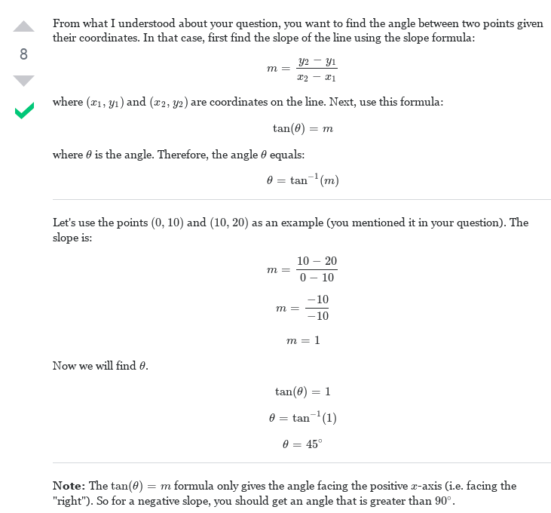

Slide 14
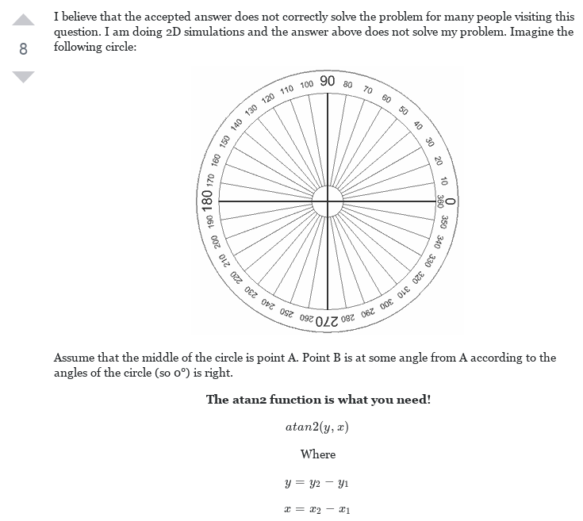

Slide 15
Features still missing...
Two player mode (node.js and WebSockets?)
iOS/Android standalone app (Adobe PhoneGap?)
High scores saved with Javascript localstorage
Ship should explode in event of game over
Turret explosion animations should disappear after a second or two

