Slide 1

Generative AI Assignment 2 - NLP and CV
By Soeb Hussain
002747200

Slide 2
Measuring Text Similarity using NLP Techniques
The Challenge:
Given two paragraphs and calculate how similar they are. This problem has significant implications in various NLP applications, including search engines, recommendation systems, and information retrieval.
The quick brown fox jumps over the lazy dog. The sun is shining brightly in the clear blue sky.
A lazy dog is jumped over by a quick brown fox. The sky is clear, and the sun shines brightly.

Slide 3
Approach to Calculating Text Similarity
Tokenization and Stemming:
Breaking down the paragraphs into individual words, a process known as tokenization. Additionally, I applied stemming to reduce words to their root form.
TF-IDF Vectorization:
I employed the TF-IDF (Term Frequency-Inverse Document Frequency) method to vectorize the paragraphs
Spacy Vectorization:
I used spaCy, a powerful NLP library, to vectorize the paragraphs.
Word2Vec Pretrained Model:
I introduced Word2Vec, a word embedding technique, and generated embeddings using a pretrained model from gensim.
BERT Embedding:
Finally, we explored BERT embeddings, a state-of-the-art technique for capturing context.

Slide 4
Results
Approach | Similarity Score (paragraphs1) | Similarity Score (paragraphs2)
TF-IDF | 66 % | 15.5%
Spacy model | 76 % | 54%
Word2Vec Embeddings | 87.9% | 68%
Bert Embeddings | 92.2 | 91.8%
TF-IDF with stemming and tokenization | 97.8 % | 82%
paragraphs1 = ["The quick brown fox jumps over the lazy dog. The sun is shining brightly in the clear blue sky.",
"A lazy dog is jumped over by a quick brown fox. The sky is clear, and the sun shines brightly."]
paragraphs2 =["The forest was sparsely populated with trees.",
"The woodland had only a sparse number of trees."]

Slide 5

Identifying Color proportion in Image
Primary goal is to tackle the challenge of identifying the main colors within an image. In fields like design, image compression, and data visualization, understanding the dominant colors can be crucial for making informed decisions and enhancing visual appeal.

Slide 6
Method
Approximate RGB Values: For each pixel in the image, I approximated the RGB (Red, Green, Blue) values to the nearest tenth. This step simplified the color data for further analysis.
Create a Color Dictionary: I created a color dictionary that captured all the different variations of color present in the image. This dictionary contained RGB values as keys and the number of occurrences of each color as values.
Implement K-means Clustering: I applied the K-means clustering algorithm to the keys of the color dictionary. K-means grouped similar colors together into a specified number of clusters (in this case, 7 clusters).
Assign Pixels to Clusters: After training the K-means model, I looped over each pixel in the image, assigning each pixel's color to one of the 7 clusters based on the nearest cluster center.
Calculate Cluster Counts: I calculated the count of pixels in each of the 7 clusters. This step allowed me to determine how many pixels belonged to each of the main colors identified by the clustering algorithm.

Slide 7
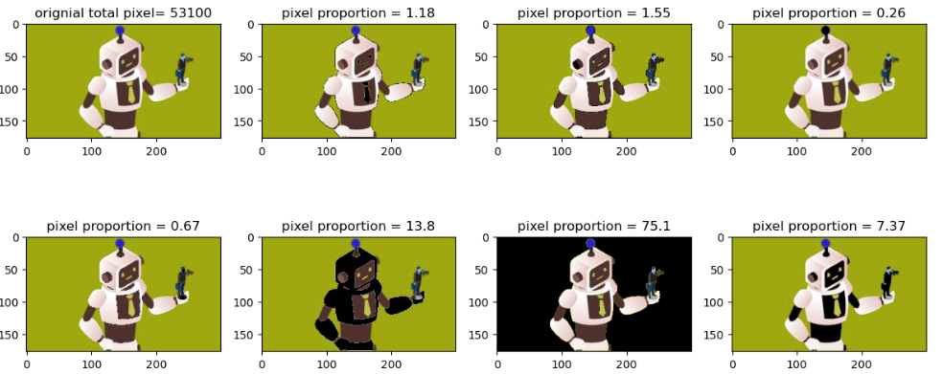
Results

