Slide 1
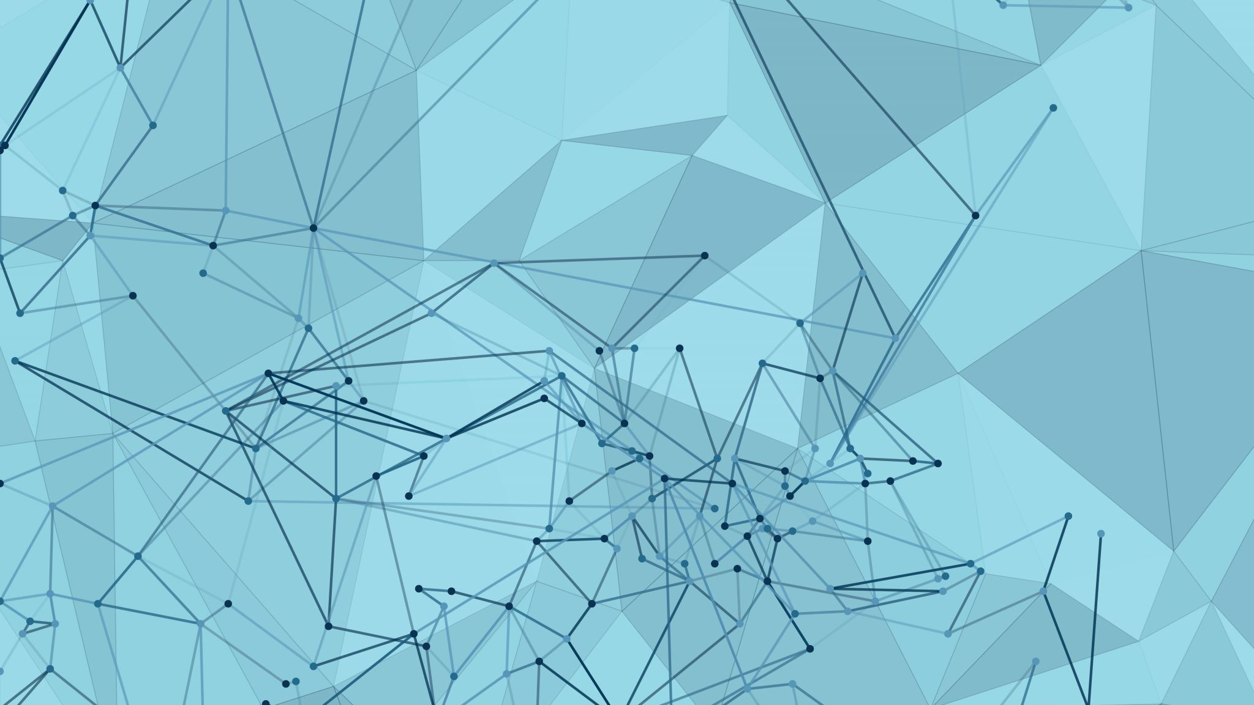
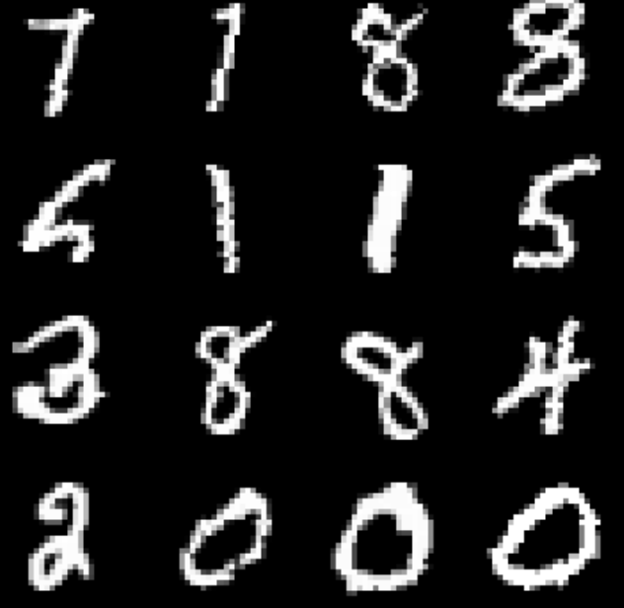
Generative AI Assignment 4 – Generative Adversarial Network on MNIST using pytorch
Study of Modelling Aspects in CIFAR-10 Image for following
The CIFAR-10 dataset consists of 60000 image
of 32x32x 3 size
in 10 classes
with 6000 images per class.
By Soeb Hussain
002747200

Slide 2
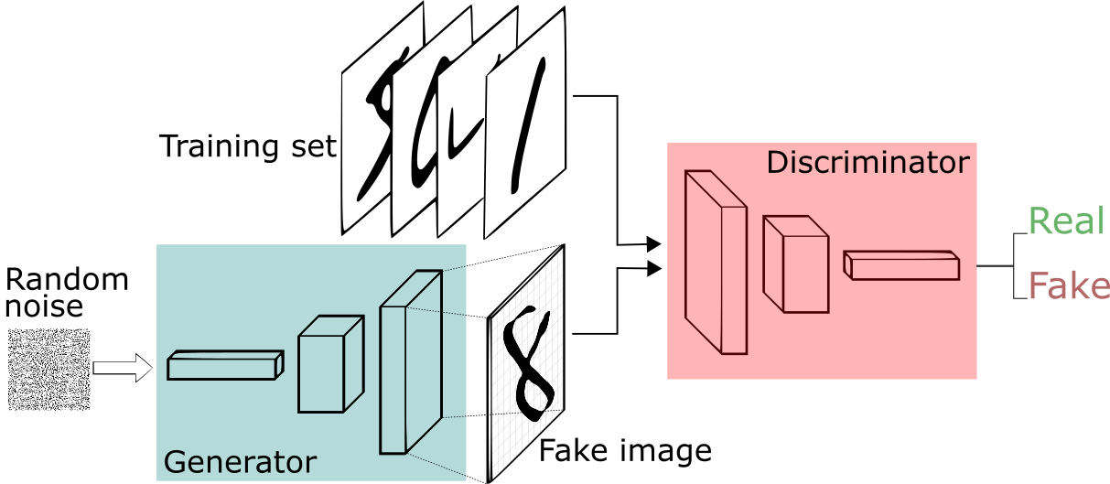
Training a GAN
Initialization:
Initialize the generator and discriminator networks with random weights.
Training Loop:
Train the discriminator to distinguish real data from fake data.
Feed real data and compute the discriminator's loss.
Generate fake data and compute the loss for fake data.
Update discriminator weights to improve its classification.
Train the generator to produce data that fools the discriminator.
Generate fake data and compute the loss from the discriminator's perspective.
Update generator weights to generate more convincing data.
Repeat these steps alternately until convergence or a set number of iterations.
Convergence:
Continue training until the generator produces data that's indistinguishable from real data, and the discriminator can't reliably tell the difference.
image generation or data augmentation.

Slide 3
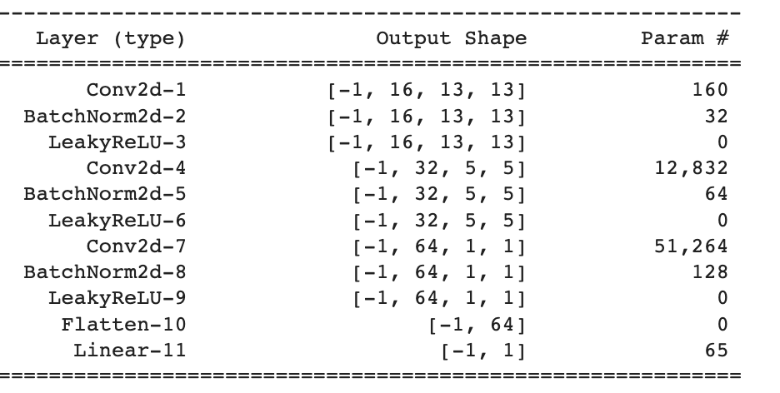
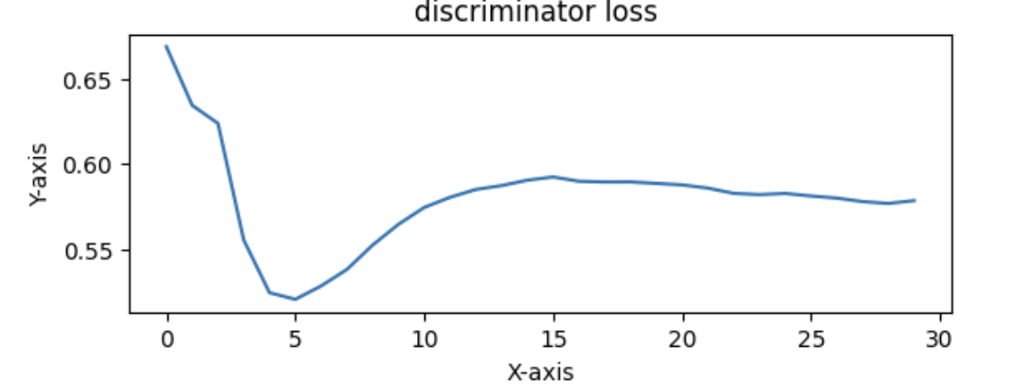
Discriminator Architecture and Loss

Slide 4
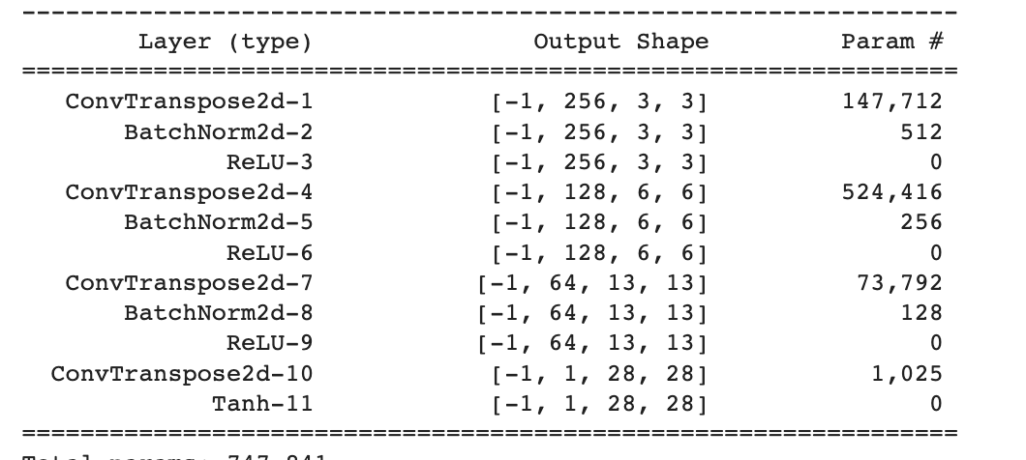
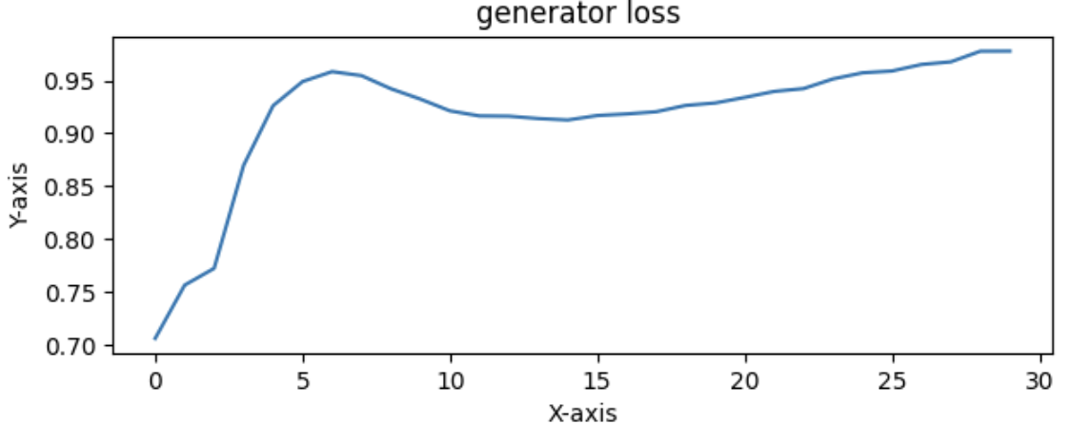
Generator Architecture and Loss

Slide 5
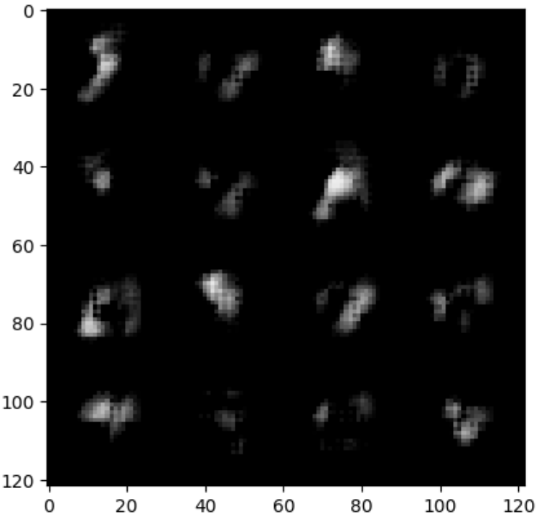
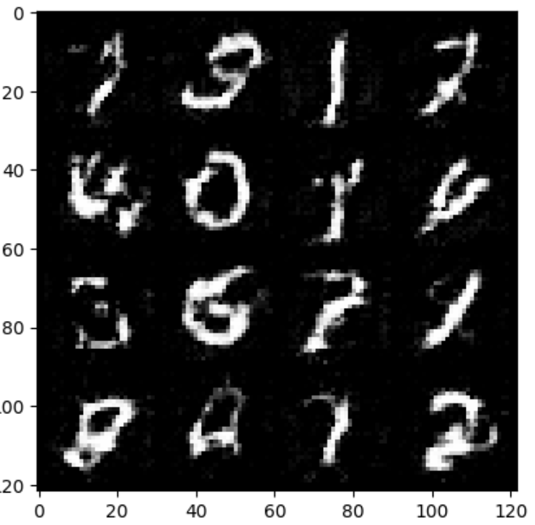
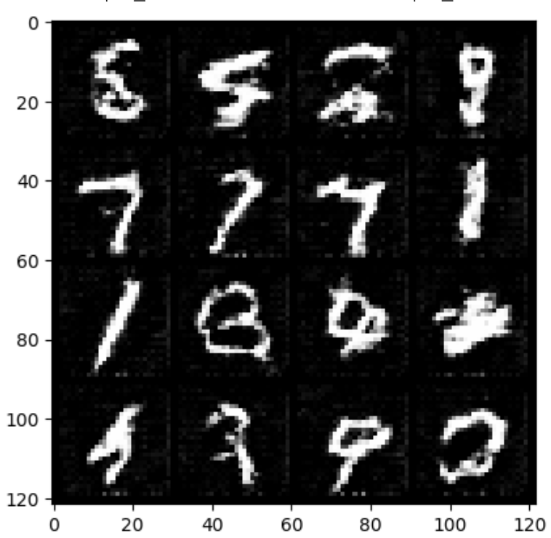
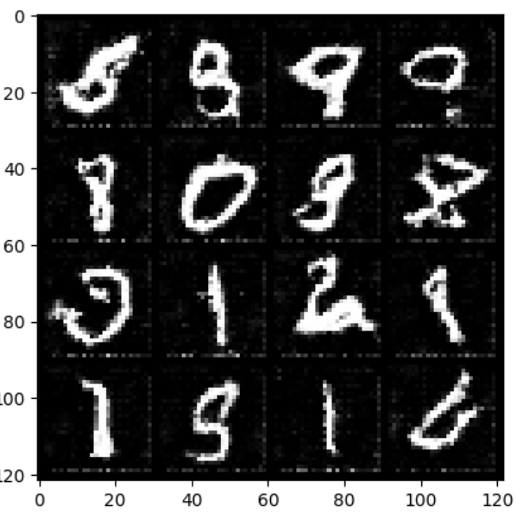
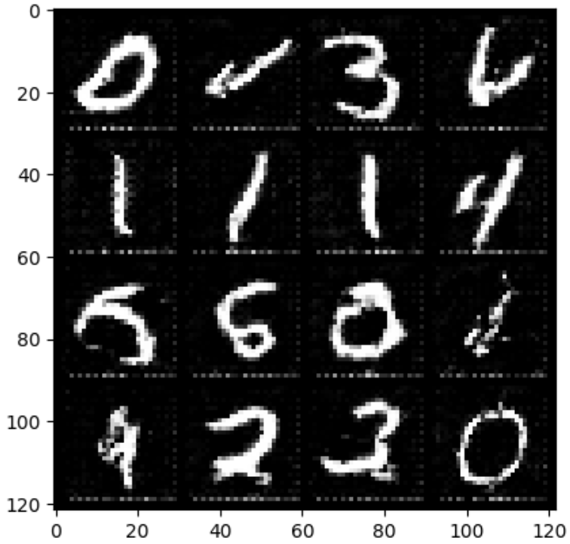
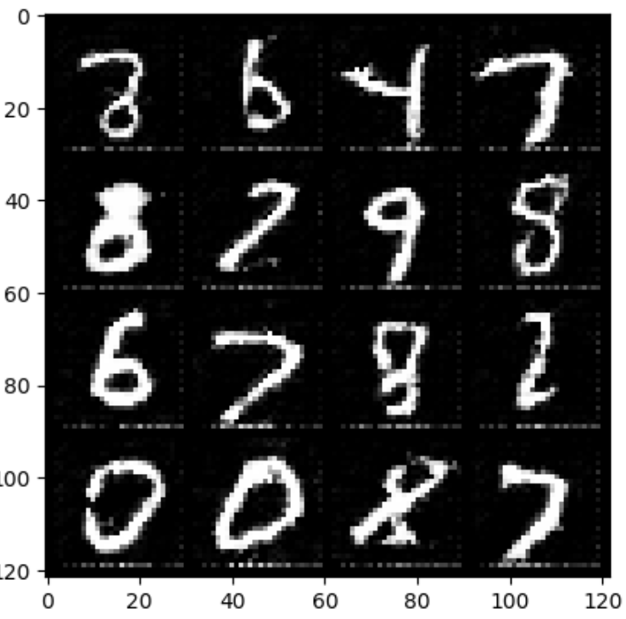
Model Output for different iterators
Epoch 1
Epoch 5
Epoch 10
Epoch 15
Epoch 20
Epoch 30

Slide 6
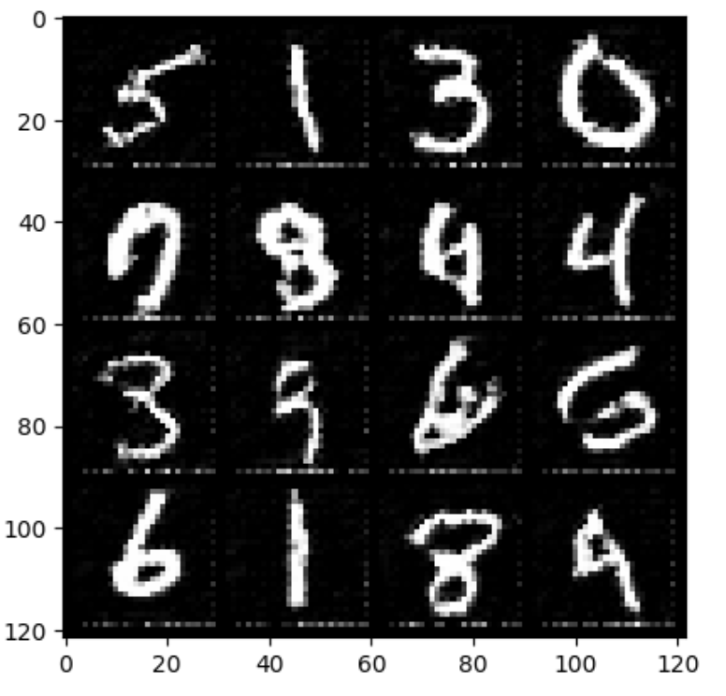
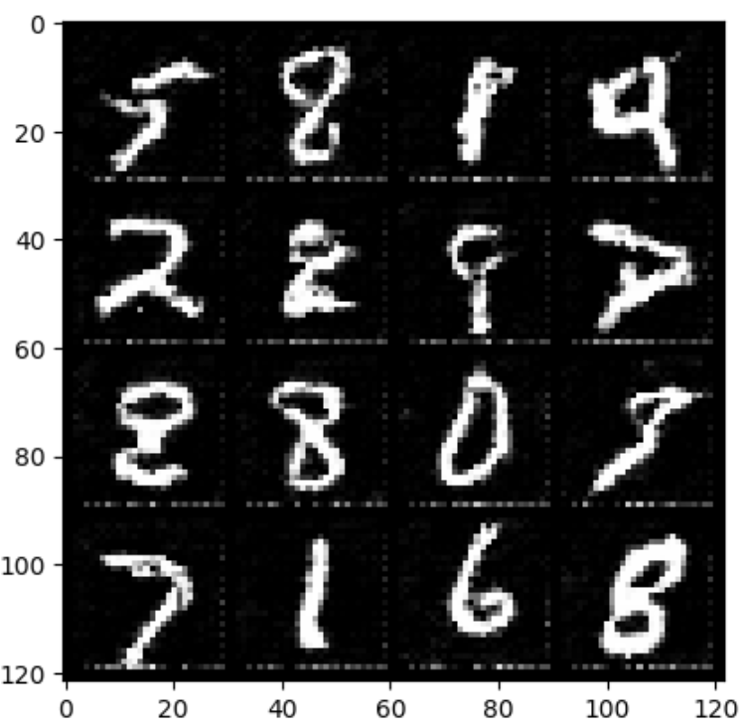
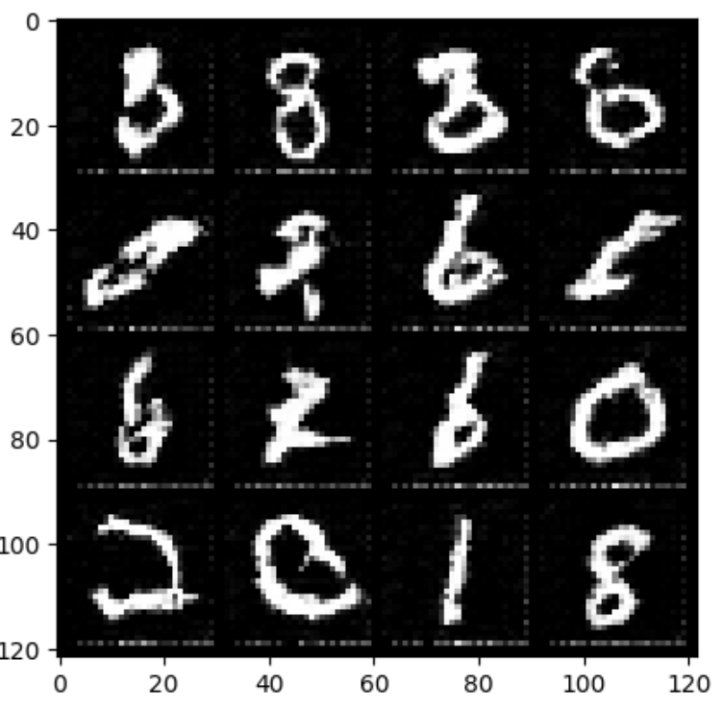
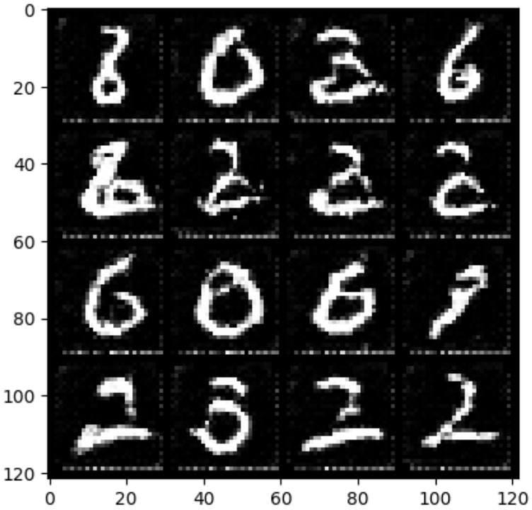
Noise Vector vs Output
Uniform
Distribution
Normal
Distribution
Bernoulli
Distribution
poisson
Distribution

