Slide 1



An Analysis of Patch Plausibility and Correctness for Generate-and-Validate Patch Generation Systems
Paper Authors: Zichao Qi, Fan Long, Sara Achour, and Martin Rinard
Paper Presentation by:
Pulkit Bansal - 40321488

Slide 2


Introduction
What is Automatic Patch Generation?
Generate-and-validate patch repair systems (GenProg, RSRepair, AE) attempt automatic patch generation.
Challenge:
Many patches fail to produce correct outputs due to weak acceptance and validation criteria.
Existing systems generate incorrect or misleading patches, making debugging harder.
Solution:
Traditional generate-and-validate methods struggle with complex patches.
Functionality deletion is a simpler, more focused approach.
Objective of the Paper:
Introduce Kali, a patch generation system that removes functionality instead of modifying code.

Slide 3
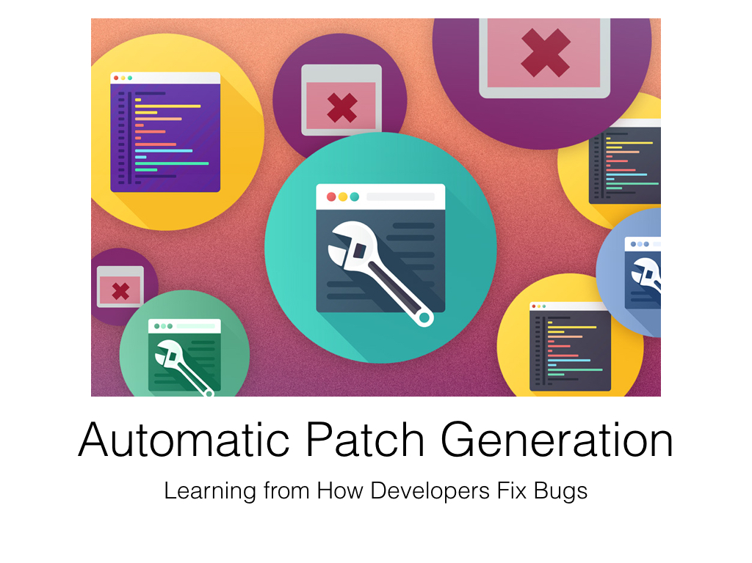

Motivation
Time-Consuming Debugging:
Debugging inefficiencies arise due to weak test suites in GenProg, RSRepair, and AE.
Most patches require manual inspection, as only 2/105 (1.9%) of GenProg patches were correct. (Figure 1, Page 30)
Inefficiency of Flat Delta Debugging:
104/110 (94.5%) of GenProg’s plausible patches were just functionality deletions. (Section 5, Page 29)
Weak validation methods allow incorrect patches to pass test cases, misleading debugging efforts.
Real-World Problems:
Systems generate patches for large real-world projects, but many introduce security vulnerabilities by removing key checks. (Section 5.2, Page 29)
Need for a Structured Approach:
Kali, a functionality deletion-based system, achieves similar or better correctness rates than complex systems. (Figure 1, Page 30)

Slide 4

Problem Statement
Incorrect Patch Generation:
GenProg, RSRepair, and AE generate patches that fail correctness checks.
Only 5/414 GenProg patches (1.2%) were correct. (Section 3, Page 28)
Weak Validation Mechanisms:
Many patches pass test cases but remain incorrect due to weak test suites.
Example: 37/55 (67%) GenProg patches produced incorrect outputs despite validation. (Page 25, Section 1.1)
Security and Reliability Risks:
104/110 GenProg patches (94.5%) only deleted functionality. (Section 5, Page 29)
Functionality deletion leads to buffer overflows, security flaws, and logic failures. (Page 29, Section 5.2)

Slide 5
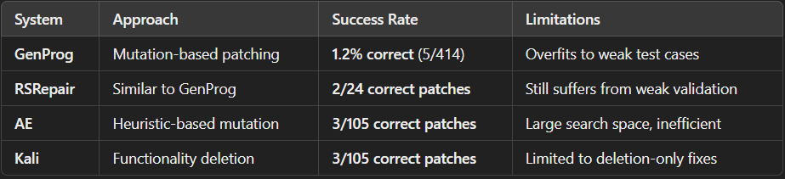
Related Work
GenProg, RSRepair, AE:
Modify program structures via mutation-based genetic algorithms.
Flaw: Relies on weak test cases, leading to incorrect patches. (Section 1.1, Page 25)
ClearView (Binary Patching System):
Uses learned invariants to generate patches that help systems survive defects.
Flaw: Limited correctness; only 4/10 ClearView patches were correct. (Section 7, Page 31)
Key Issue:
Test suite limitations prevent automated repair systems from ensuring patch correctness. (Section 3, Page 28)

Slide 6
Proposed Solution – Kali
What is Kali?
A functionality deletion-based patch generation system. (Section 1.4, Page 26)
Removes code instead of modifying logic, making patch generation simpler and more transparent.
Key Findings:
Kali generates at least as many correct patches as GenProg, RSRepair, and AE. (Section 1.8, Page 27)
More effective in identifying defective functionality than traditional systems.
Efficiency:
Kali’s search space is ≤1700 patches per defect, while GenProg’s is tens of thousands. (Page 30, Figure 1)

Slide 7
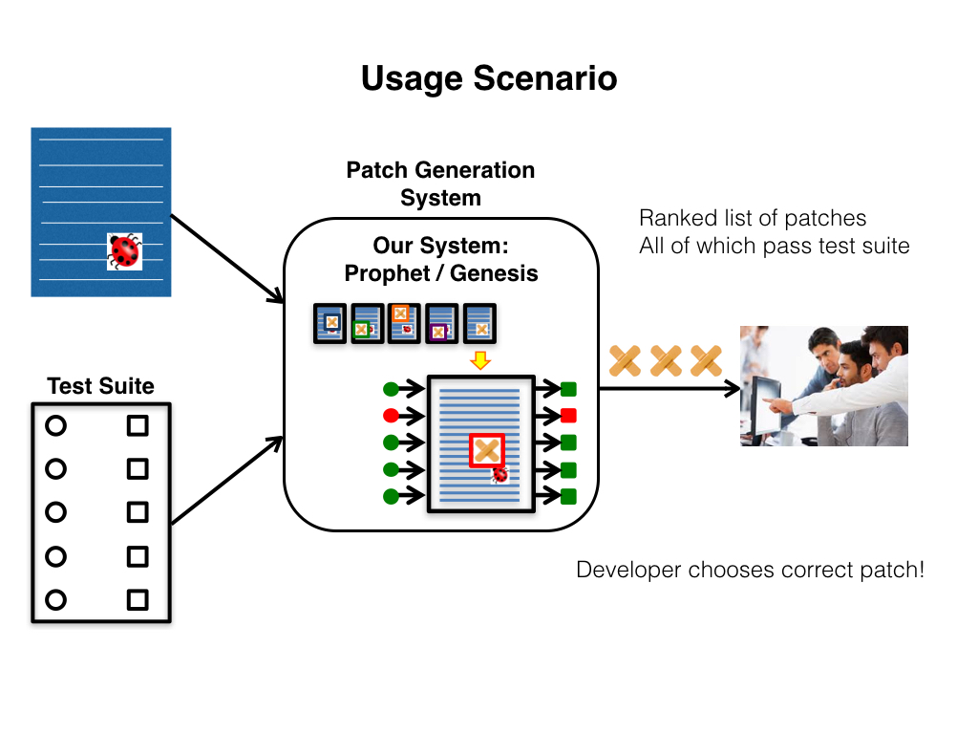
Plausible Patches Vs Correct Patches
🔹 Plausible Patches – Patches that pass test cases but are not necessarily correct. 🔹 Correct Patches – Patches that truly fix the defect and maintain program functionality.
📌 High Plausibility, Low Correctness:
Most patches generated by GenProg, RSRepair, and AE were plausible but incorrect.
Example: GenProg produced 104 plausible patches, but only 2 were actually correct.
📌 Kali’s Functionality Deletion Approach:
Kali matched or outperformed all systems in correct patches.
Kali's plausible patches were ALL correct (27/27), unlike GenProg and RSRepair.
📌 Security Risks of Plausible Patches:
Many plausible patches introduced security vulnerabilities, such as buffer overflows. (Page 29, Section 5.2)

Slide 8
Weak Proxies
🔹 Weak proxies refer to flawed validation methods that assume a patch is correct if it passes test cases, rather than verifying if it truly fixes the defect.
🔹 Weak Proxies are a problem because a patch might pass existing test cases but still be semantically incorrect.
Overfitting to Incomplete Test Suites
Many test suites do not cover all edge cases, allowing incorrect patches to pass validation.
Result: False positives, where bad patches are accepted as fixes.
Security Risks of Weak Proxies
Functionality deletion patches often pass tests because removing code prevents failures.
Example: A libtiff patch removed a crucial check, reintroducing buffer overflow vulnerability CVE-2006-2025.
Impact on Automated Patch Generation
Incorrect patches still make it to production due to weak validation methods. Most "plausible patches" are not actually fixes but just remove failing functionality to pass tests. Need for stronger validation techniques

Slide 9
Evaluation & Experimental Results
Dataset Used:
105 real-world defects from the GenProg benchmark set. (Section 6.1, Page 30)
Key Results:
Correct Patches:
Kali: 3/105 defects
GenProg: 2/105 defects
AE: 3/105 defects
RSRepair: 2/24 defects (Page 30, Figure 1)
Plausible Patches (Functionality Deletion-Based):
GenProg: 104/110
RSRepair: 37/44
AE: 22/27
Kali: 27/27 (Page 29, Section 5.2)
Performance:
Kali finds patches in tens of minutes, GenProg takes hours. (Section 6.2, Page 30)

Slide 10
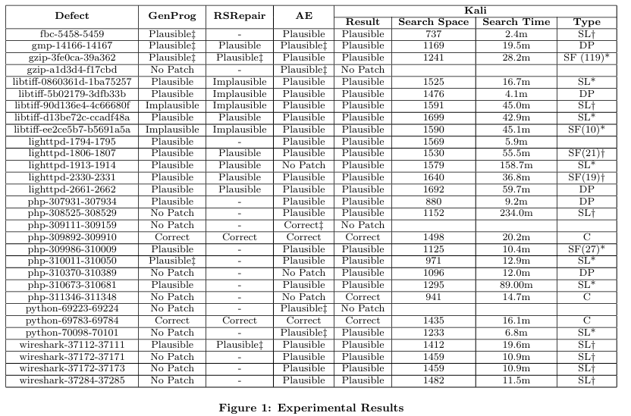
Evaluation & Experimental Results

Slide 11
Limitations & Technical Insights
Functionality Deletion is a Limited Strategy – Kali is effective only when removing code is a viable solution; it cannot modify or rewrite logic, making it unsuitable for many real-world defects. (Page 27, Section 1.8)
Dependence on Existing Test Suites – If the test suite is incomplete or weak, incorrect patches may still pass validation, leading to false positives. (Page 28, Section 3)
Not Ideal for Complex or Semantic Bugs – Bugs requiring logical restructuring, variable modifications, or algorithmic corrections cannot be fixed with Kali’s deletion-based approach. (Page 26, Section 1.8)
Potential for Security Vulnerabilities – If Kali removes critical checks or error-handling mechanisms, it may unintentionally introduce security risks instead of fixing defects. (Page 29, Section 5.2)
Lack of Generalization to All Programming Languages – Kali has been primarily evaluated on C programs, and its effectiveness on other languages (e.g., Java, Python) remains unclear. (Page 27, Section 1.8)
Weak Proxies Mislead Patch Evaluation – Many generate-and-validate systems consider a patch valid if it passes test cases, but this approach is flawed as it does not ensure actual correctness.
Correctness vs. Plausibility – The study differentiates between plausible patches (which pass test cases) and correct patches (which fix the defect correctly), emphasizing that many existing methods fail to ensure correctness.
Scalability Advantage of Kali – Since Kali removes functionality instead of modifying code, its search space is significantly smaller and more efficient compared to GenProg and RSRepair.
Challenge in Handling Multi-Line or Structural Changes – Kali operates at a fine-grained level, meaning it struggles with multi-line modifications or cases where restructuring is necessary.

Slide 12
Conclusion & Future Work
Summary & Impact
Most patches from GenProg, RSRepair, and AE were incorrect due to weak validation criteria. (Page 25, Section 1.1)
Kali matches or outperforms existing systems by focusing on functionality deletion. (Page 30, Figure 1)
Stronger validation mechanisms are needed to ensure patches do not introduce new vulnerabilities. (Page 28, Section 3)
Future Work
Integrating Semantic Analysis – Improve patch correctness by understanding code logic. (Page 27, Section 1.8)
Enhancing Test Suites – Strengthen validation mechanisms to prevent incorrect patches from passing. (Page 28, Section 3)
Expanding Kali's Scope – Apply Kali to Java, Python, and binary patching for broader impact. (Page 27, Section 1.8)

Slide 13

Thank You

