Slide 1


jGenProg – Java Automatic Program Repair using Genetic Programming
Paper: Martinez et al., "Astor: A Program Repair Library for Java" (2016)
Tool Demo Presentation By: Pulkit Bansal - 40321488

Slide 2


Overview
Introduction
Motivation
Tool Installation
Usage
Working & Impact
Demo
Future Improvements & limitations
Conclusion and Future Scope

Slide 3

INTRODUCTION
Automatic Program Repair (APR)
Software systems frequently contain bugs, which are costly and time-consuming to fix manually.
Automatic Program Repair (APR) aims to generate patches automatically by analyzing code and test outcomes.
Why jGenProg is Valuable
jGenProg is a tool for automatically repairing Java programs using Genetic Programming (GP).
Part of the Astor framework, which supports multiple APR strategies.
Reduces debugging time by automating the patch generation process.
Provides a research platform for experimenting with bug repair strategies.
Useful in Continuous Integration (CI) pipelines to auto-repair regressions or recurring issues.

Slide 4

MOTIVATION
Why jGenProg?
Manual debugging is labor-intensive and error-prone.
Many bugs follow repeatable patterns.
Inspired by human-written patches, it evolves solutions automatically.
What Makes jGenProg Stand Out?
One of the earliest GP-based APR systems for Java.
Works at source code level with real-world Java bugs.
Reproduces results from the GenProg C-based tool but for Java.
Modular and extensible via the Astor framework.

Slide 5

WORKING & IMPACT
┌─────────────────────────────┐
│ Buggy Java Program │
└────────────┬───────────────┘
│
▼
┌─────────────────────────────┐
│ Fault Localization Tool │
│ (e.g., Flacoco) │
└────────────┬───────────────┘
│
▼
┌─────────────────────────────────────┐
│ Generate Candidate Patches Using │
│ Genetic Operators (Mutation, etc.) │
└────────────┬────────────────────────┘
│
▼
┌─────────────────────────────┐
│ Run Project Test Suite │
│ (Fitness Evaluation) │
└────────────┬───────────────┘
│
▼
┌─────────────────────────────┐
│ Select & Evolve Patches │
│ (Based on Test Performance) │
└────────────┬───────────────┘
│
▼
┌─────────────────────────────┐
│ Output Valid Patch │
│ (Bug-free Java Program) │
└─────────────────────────────┘
HOW IT WORKS
Uses Genetic Programming (mutation, crossover, selection)
Evolves a population of candidate patches
Evaluates them using fault localization and test execution
Keeps only those that pass tests or improve fitness
IMPACT
Applied to many Defects4J bugs with success
Demonstrates APR is feasible and automatable for real Java projects
Has influenced later tools like Astor4Android, Arja, and more

Slide 6

INSTALLATION AND USAGE
Installation
Clone Astor repo:
git clone https://github.com/SpoonLabs/astor.git
Navigate and build with Maven:
cd astor
mvn clean package
mvn clean install -DskipTests
mvn clean install compile
jGenProg is available under the astor modes.
Usage Example
cd ./examples/math_70
mvn clean compile test-compile
Requirements
Java 8+
Maven
Optional: flacoco for fault localization
java -cp target/astor-2.0.0-jar-with-dependencies.jar fr.inria.main.evolution.AstorMain
-mode jgenprog
-location ./examples/math_70
-dependencies ./libs/junit-4.4.jar
-failing org.apache.BisectionSolverTest
-out /tmp/astorDemo -maxtime 60

Slide 7


LIVE DEMO
Youtube Video Link: https://www.youtube.com/watch?v=ovBQyINeUtE&t=635s

Slide 8
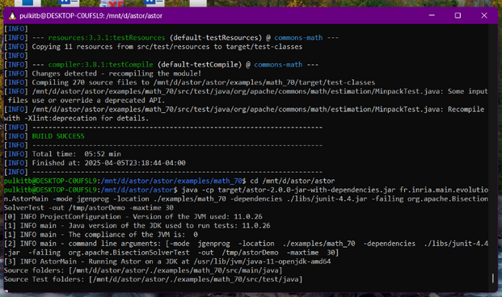
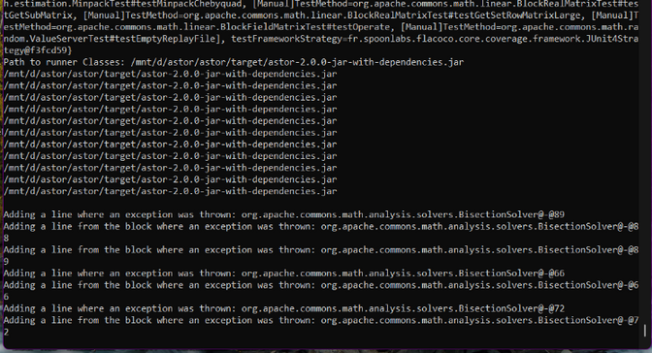
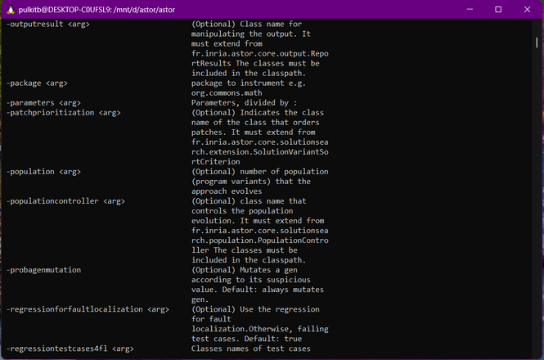
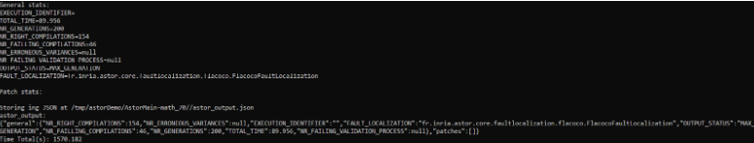
LIVE DEMO
Youtube Video Link: https://www.youtube.com/watch?v=ovBQyINeUtE&t=635s

Slide 9

01
Limited scalability for large codebases
02
Search space can be vast → long repair times
03
Only test-suite based: patch correctness is relative to test coverage
LIMITATIONS & FUTURE IMRPOVEMENTS
04
May generate overfitting or semantically incorrect patches
05
Integrate advanced fault localization (e.g., ML-based)
06
Use semantic or behavioral patch validation
07
Hybrid approaches (combine with symbolic execution, etc.)
08
Patch ranking or filtering based on learned models

Slide 10

CONCLUSION
jGenProg is a foundational tool for Java APR using Genetic Programming
Key Takeaways
Demonstrates how Genetic Programming can be effectively used to repair Java programs automatically.
Reduces manual debugging time and cost.
Provides a modular and extensible foundation through the Astor framework.
Encourages a shift from reactive debugging to proactive, automated repair pipelines.
Empirically validated using real-world bugs from the Defects4J benchmark.
Shows the power of evolutionary algorithms in software engineering.
References
GitHub: https://github.com/SpoonLabs/astor
Paper: Martinez et al., "Astor: A Program Repair Library for Java" (2016)
Defects4J benchmark: https://github.com/rjust/defects4j
jGenProg Demo: https://github.com/SpoonLabs/astor/blob/master/README.md

Slide 11

THANK YOU!

