Slide 1

Refactory: Re-Factoring Based Program Repair Applied to Programming Assignments
Tool Demo Presentation
Prepared by: Priyadarshine Kumar
Date: March 18, 2025

Slide 2

Motivation
1
Automated Program Repair (APR) helps correct buggy student programs.
2
Existing tools require manual effort or large datasets of correct solutions.
3
Student submissions often contain severe errors, making repair challenging.
4
Need an approach that works with fewer correct solutions and scales efficiently.

Slide 3
Limitations of Existing Tools
Clara
Refazer
Requires many correct solutions, suffers from scalability issues.
Relies on learned transformations but lacks accuracy.
Neural-based approaches
Autograder
Suffer from low precision and unpredictable repairs.
Manual effort required for error models in tools like Autograder.

Slide 4





Introduction to Refactory
Fully automated program repair tool.
Works with only one correct solution.
Uses refactoring to generate new correct solutions.
Matches buggy programs with refactored correct programs.
Synthesizes small and efficient patches.

Slide 5

Technical Overview: Three-Phase Approach
3. Block Repair
2. Structure Alignment
Uses variable mapping and synthesis to correct buggy code.
1. Refactoring Correct Solutions
Matches buggy programs with refactored correct solutions.
Generates alternative versions of correct programs.

Slide 6
Phase 1: Refactoring Correct Solutions
1
Apply Refactoring Rules
Applies 10 refactoring rules to generate semantically equivalent correct programs.
2
Modify Control Flow
Modifies control flow by adding/removing branches, loops, and conditions.
3
Improve Alignment
Helps align correct solutions with buggy student submissions.

Slide 7
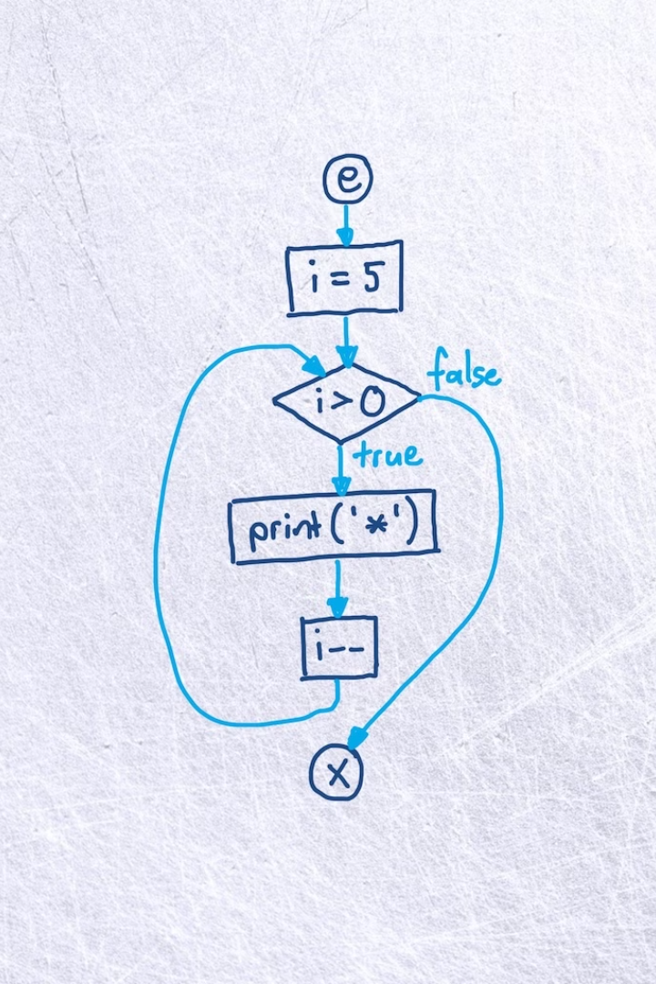



Phase 2: Structure Alignment
Find Closest Match
Finds the closest refactored correct program based on control flow graphs.
Modify If Needed
If no match is found, modifies the buggy program's structure to align it.
Ensure Accuracy
Ensures accurate patch synthesis by improving similarity.

Slide 8



Phase 3: Block Repair
Analyze Equivalence
2
Uses dynamic equivalence analysis for variable mapping.
Map Basic Blocks
1
Maps basic blocks between buggy and correct programs.
Synthesize Expressions
Synthesizes expressions to create minimal and accurate patches.
3

Slide 9

Tool Installation

Slide 10
Conclusion & Future Work
1
Refactory is an effective automated repair tool for student programming assignments.
2
Outperforms Clara in repair accuracy, efficiency, and scalability.
3
Can be extended to professional software repair beyond educational use.
4
Future work includes supporting object-oriented programming and additional Python features.

