Slide 1
AutoCodeRover: Autonomous Program Improvement
Yuntong Zhang, Haifeng Ruan, Zhiyu Fan, Abhik Roychoudhury
Presenter: Nhat Minh Le – 40323412

Slide 2
Motivation
Large Language Models can assist human in solving problems especially in automated program repair and coding.
AutoCodeRover is an open-source project.
Clear setup instructions

Slide 3
Agenda
I. Tool Information
II. Evaluation
III. Limitation
IV. Demo

Slide 4
I. Tool Information
AutoCodeRover: a novel LLM-driven multi-agent framework combining with code search capabilities for automating bug detection, structuring bug reporting, and program repair for Python Projects (SWE-bench).
In February, 2025, It is acquired by Sonar

Slide 5
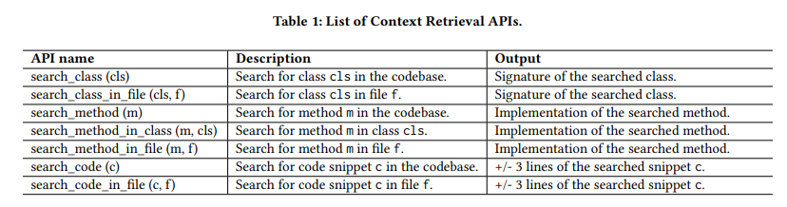
I. Tool Information

Slide 6
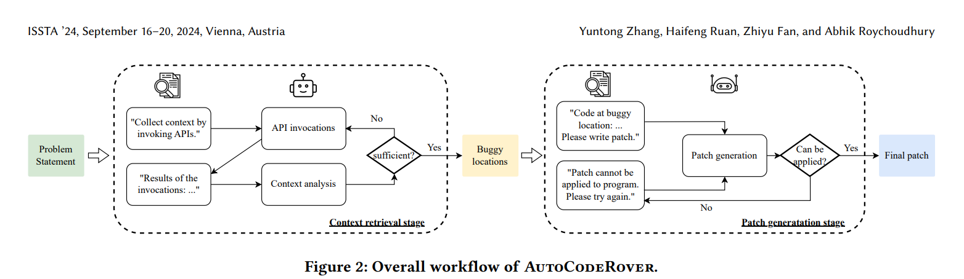
I. Tool Information

Slide 7
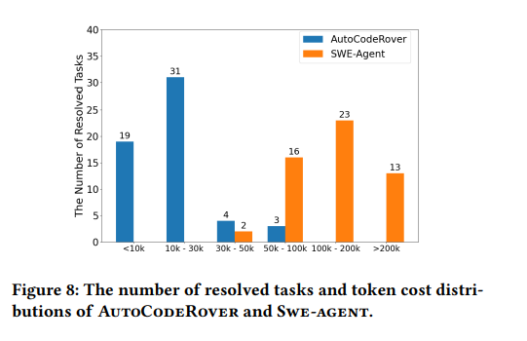
II. Evaluation
AutoCodeRover achieves lower cost (on average $0.43 USD), compared to SWE-Agent
AutoCodeRover can resolve more tasks with less cost (31) compared to SWE-Agent (23)
Limitation: 1. Rely on LLM to decide bug and generate code
2. Overfittting patch

Slide 8
III. Demo
Environment setup
Docker
OPENAI_API_KEY, ANTHROPIC_API_KEY. GROQ_API_KEY
Link setting up AutoCodeRover: https://youtu.be/ZwRGiMduXh4
Link setting up SWE-bench: https://youtu.be/BVswfxKhkO8
Demo for one task
https://youtu.be/Co_TxGwZNrk
Demo for multiple tasks and SWE-bench-Lite (300 tasks)
https://youtu.be/9MoMlz_Vcp0

Slide 9
Thank you!
Questions?

Slide 10
References
AutoCodeRover: https://arxiv.org/abs/2404.05427
AutoCodeRover’s Github: https://github.com/AutoCodeRoverSG/auto-code-rover
SWE-bench: https://www.swebench.com/

