Slide 1
Controlling data flow with redux
IMPACT
ngaarhus / mar. 9, 2017
Notes:
I want to tell you about a little framework called redux, and how you can utilize it to control your application’s dataflow.
First of all, how many of you have ever heard of redux?
How many have used it in their web apps?
The thing I personally find interesting about the framework, is its consistent way of handling state and state changes, and also its way of simplifying dataflow as apps increase in scale

Slide 2
What is redux?
Yet another javascript framework!
A predictable state container
Made by some guy from Eastern Europe
Notes:
Yes, it is yet another javascript framework, but not in the same sense as angular og react, as redux is seperated entirely from the view part of applications.
Bindings for all the major frameworks have been developed which bind the application state to the respective components.
On the website for redux, it describes itself as a predictable state container, which comes from its foundation on functional programming principles such as using immutable data only and keeping functions ”pure”.
Its been written by a guy from eastern europe, and if you decide to watch his tutorials on egghead.io (which are very good btw), you’ll bee greetet by a guy with a heavy accent.

Slide 3
Redux data flow
Notes:
Without further due, this is what a redux-applications data-flow looks like
In this presentation we wont go into the middleware layer of redux, as this is optional and not required to understand to get a sense of what’s going on.
The view corresponds to our application.
This sends actions to the store, typically based on some event your want to react on – like a click on a button.
Actions are sent to the store through its dispatcher. From here it’s run through a set of reducers, which transform the internal state of the store based on the action.
The application updates the view through a subscription to the store, thus updating its interface with the transformed state.

Slide 4
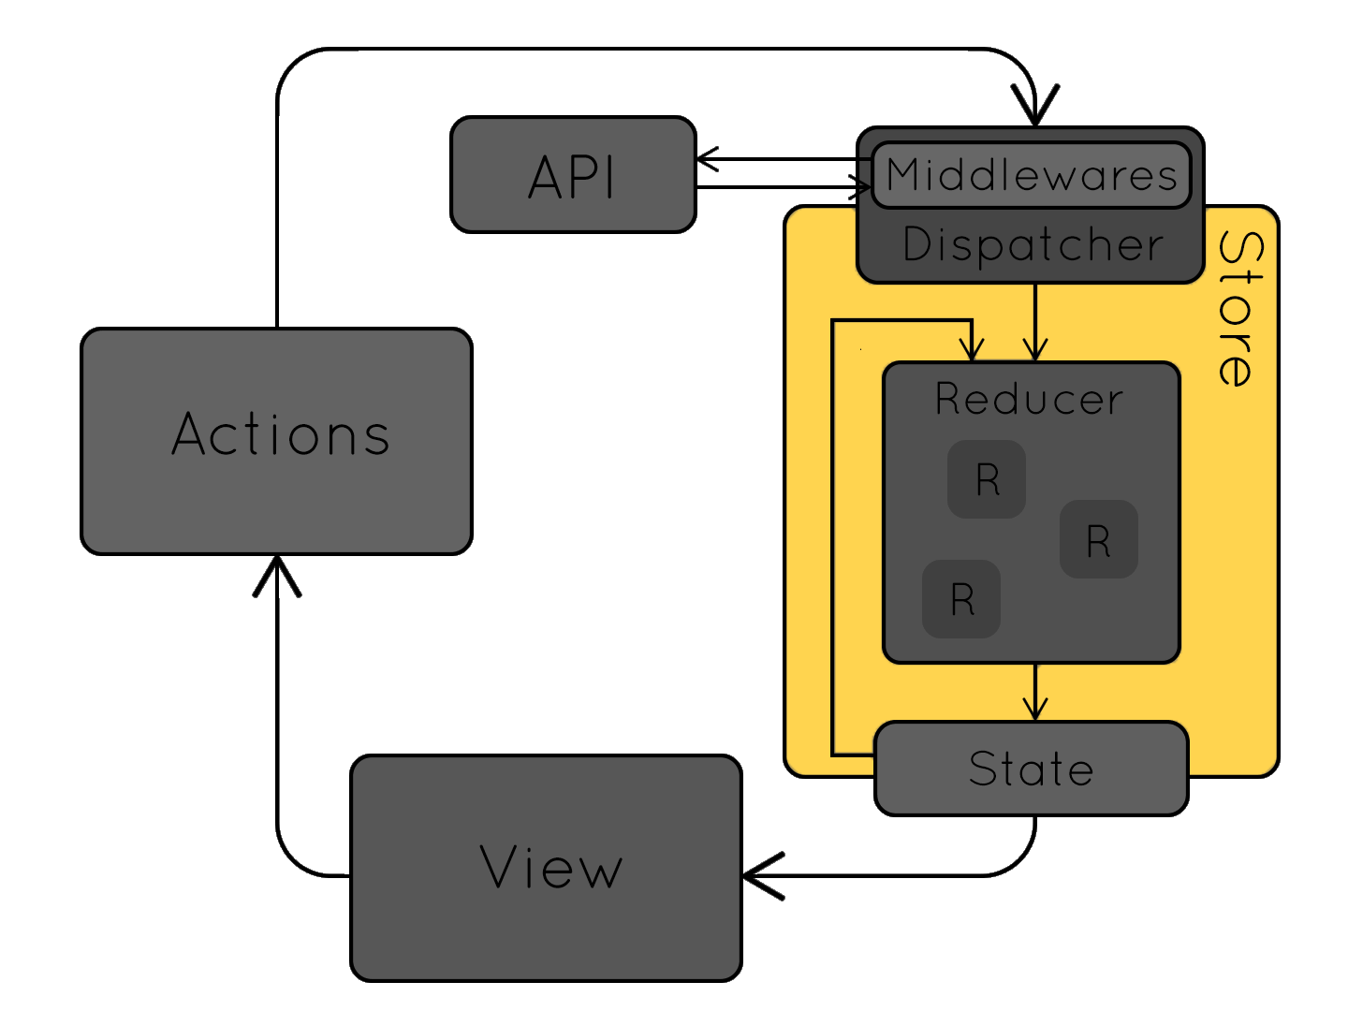
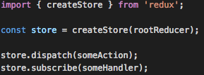
Store
State is kept in the redux “Store”
Is generated from reducers
Dispatches actions
Notifies subscribers
Notes:
”store” is the only variable from redux you interact with throughout your application. This variable is shared between all of the components.
You generate your redux store from a reducer, which i’ll explain more about in a minute, and that’s as complicated as it has to be – though it can (and in many cases will) get a lot more complicated.
The store of the application handles dispatching actions and notifying subscribers when changes occur.
It becomes immediately apparent that redux, as seen from the outside is in its basic sense nothing more than a publish/subscribe pattern.

Slide 5
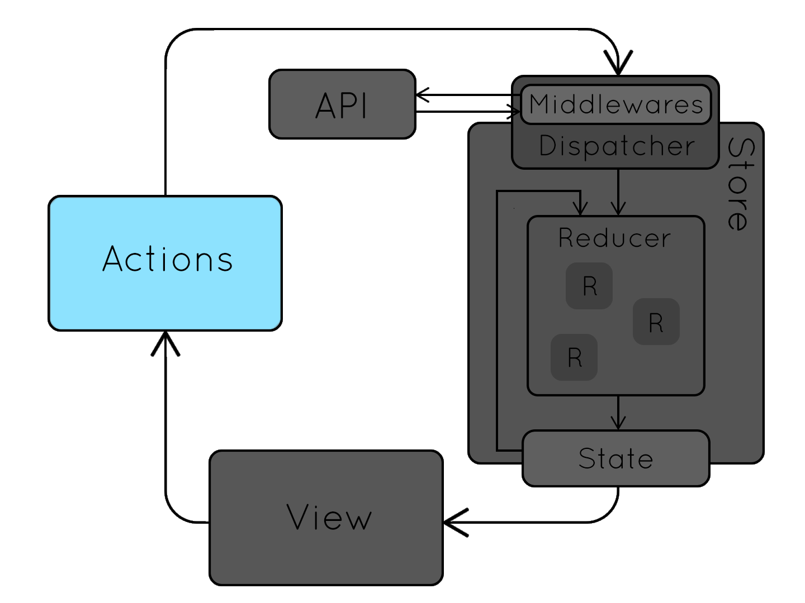
Actions
Objects describing what happens in the application
Add to basket
Can include data
store.dispatch(action)
Notes:
The store knows how to transform its internal state based on incoming actions.
Actions are, in its simplest form, and object describing what happens in the application at a certain time. As an example this could be a click on a button, with the purpose of adding a product to the basket.
Actions can include data, but this is not required.

Slide 6
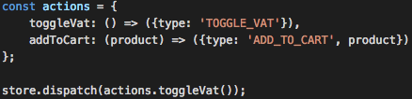
actions
Action “type” Describes the intent of the action
Optional properties can be used to transform state
Notes:
The only required property of an action object, is the action type. The action type is a string, which describes the purpose of the action. It can be accompanied by data, as an example if you add a product to a basket, it would make sense to include the product in the action.
Usually to give structure to action creation, you would define a set of action creators, which are functions with the sole purpose of creating action objects.

Slide 7
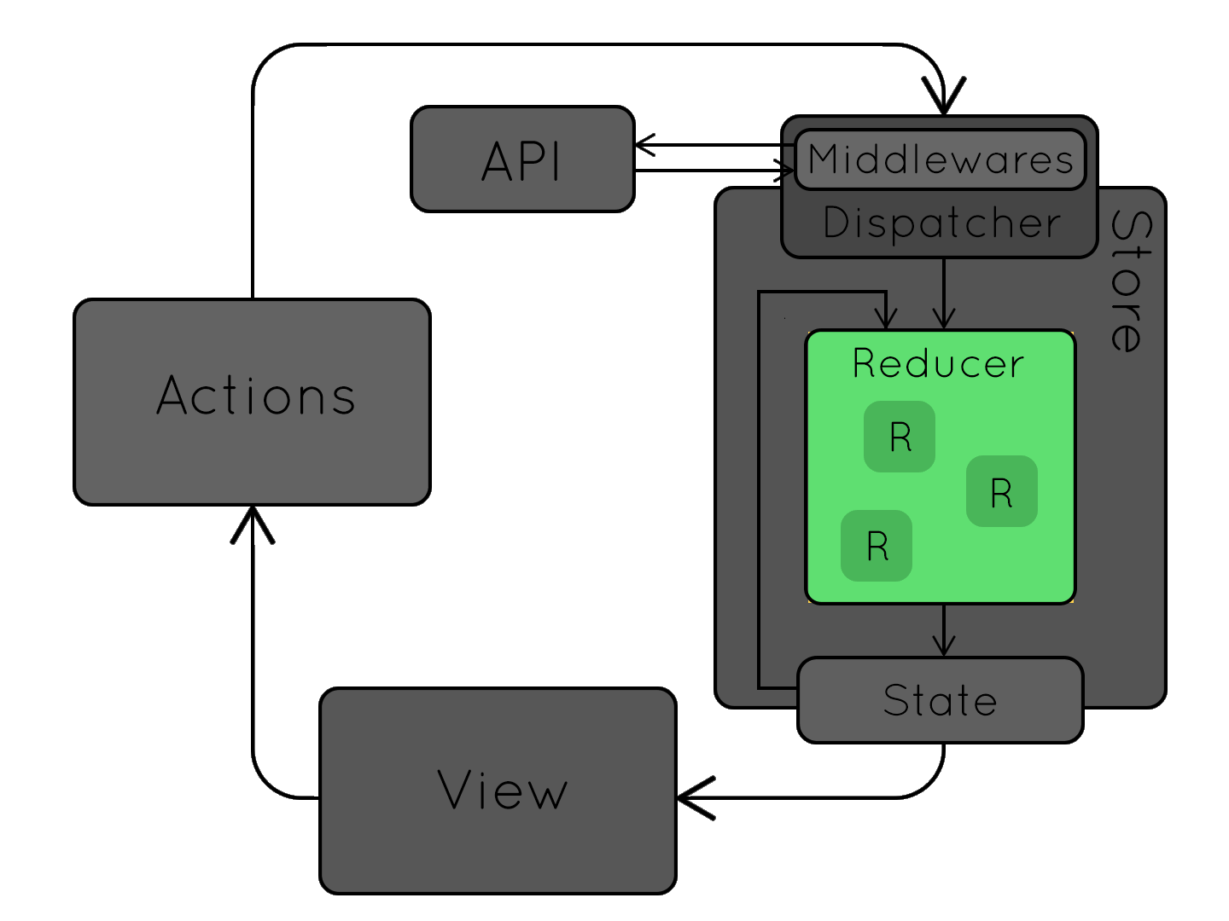
Reducer
Pure functions
Describe state transformations
Handles ”actions” and ALWAYS returns a (new) state
Notes:
The biggest challenge, both conceptually and practically when starting redux, is reducers. In short terms, a reducer is a pure function taking two arguments and always returning a transformed state.
”Pure” means that its output relies solely on its input arguments, and that it produces no side effects, such as mutating a class-wide variable. This is where redux gets its predictability and reliablity.
Reducers describe and define the logic for state transformations. State is transformed according to the nature of incoming actions.

Slide 8
Multiple Reducers
Reducers can be combined to form a global state from multiple sub-states
combineReducers({ key: substate })
Notes:
Unless your application is really simple, you’ll quickly feel the urge to split up your application into multiple components. Redux supports this by making it possible to divide your state into multiple substates and multiple reducers to transform the respective substates.
Imagine an example where you would need to keep state on a user and a shopping basket. In that case you would make a reducer to handle each substate and combine them through a combineReducers function exposed by redux.

Slide 9
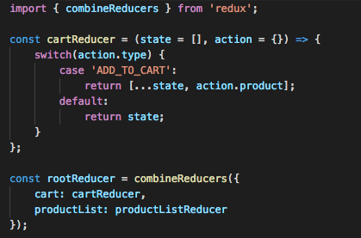
Implementing reducers
Notes:
As previously stated, reducers are pure functions. They are implemted by defining a function which takes two arguments: state, and an action. Every time an action is dispatched to the store, the store calls the defined reducers with its current state and the dispatched action.
In your reducers, you will make different state transformations based on the action type. Typically, you would check this through a switch statement.
As an example, in the case of adding a product to a shopping cart, an action with the type add_to_cart is dispatched, which also holds a product to be added. This is appended to the state, which in this case is an array of products.
Notice how I use the array spread operator which is shorthand for concatenating the existing array with the product to be added. The critical point to doing it this way is, that this operator treats arrays in an immutable fashion, which improves performance with frameworks such as angular and react.

Slide 10
Simple redux app
The good old counter example
Vanilla js

Slide 11
Redux & angular
A todo-list example with sub-states
(JUST) Angular
Notes:
Go through the todo-list application in the browser
Show the app.module file and how redux is implemented through @angular-redux module.
The internal store of ngRedux is configured with a reducer just as we did with vanilla and createStore.
The root reducer used to configure the store, consists of two seperate reducers each defining logic for transforming its own substate. These are combined in an object, thus covering the whole global state.
If we take a look at the todo-list, which is probably the more exiting of the two subcomponents, we can see how we interact with redux through the ngRedux service.
Dispatching is straightforward and just as in vanilla redux. When it comes to subscribing to the state, this is done in a really fancy and clever way through select decorators.
In essense, what these do is they grab the substate defined in the parentheses (through dot notation), and wraps it in an observable. Every time the store is updated, the observables subscribe function is triggered.
We bind the inner data of the observable to the view through the async pipe.
If we take a look at the todo list reducer, we see a lot of code, relatively speaking, compared to our simple counter example. Typescript takes part of the blame for this, as everything obviosuly needs type declarations.
If we look at the reducers we see two of them. This is a common pattern to seperate code by substate and responsibility.
The todo list reducer handles state transformations on the list level, while the todo reducer handles transformations on the single todo level.
If we look closer at the switch case handling adding todos to the list, it simply adds a todo and returns the transformed state, which is propagated to the different views subscribing to it.

Slide 12
Redux challenges
A different way of thinking about state
Requires more setup and strict structure
Integrating plugins (redux-bindings) for frameworks adds even more complexity
Improves readability
Reduces complexity of view components
Notes:
In conclusion, I want to touch upon the different challenges I experienced when first incorporating redux in my development stack.
It is an entirely different way of thinking about state and requires some form of adaptive thinking.
It requires more setup and strict structure – this is also positive if working closely with other people.
Integrating redux bindings, in the case of angular the ngRedux module, adds even more complexity to the app. It comes with added benefit of improving readability and reduces the complexity of view components substantially.

Slide 13
?

