Slide 1

Java Design Patterns
By Gautam Kumar(Soe Win)
G-Tech
MyanmarFullStackDevelopers

Slide 2
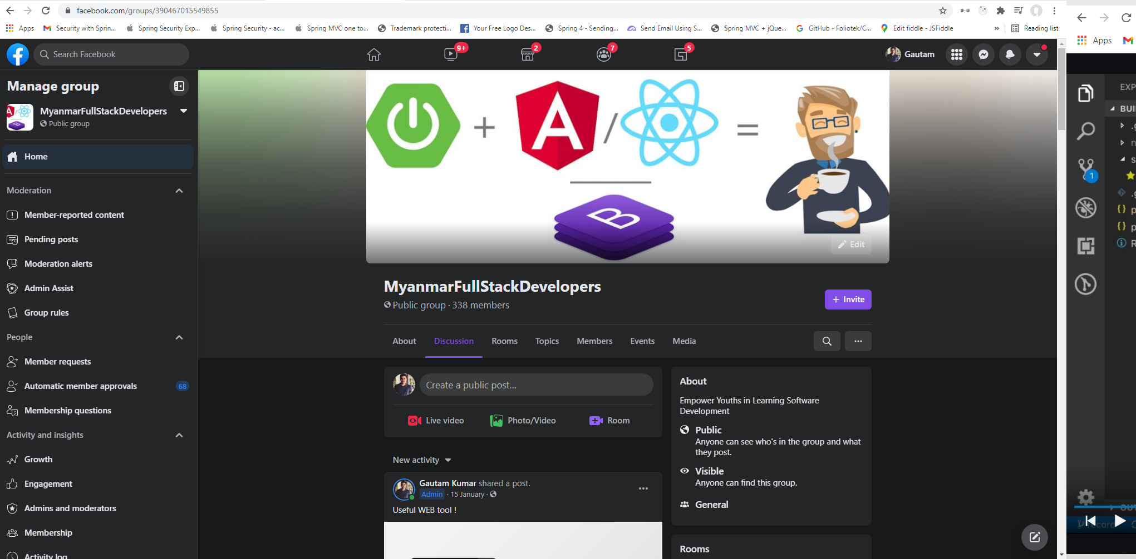

Like & Subscribe my YouTube Channel Please! :D

Slide 3
Can you design patterns which are well-proved solution for solving the specific problem?

Slide 4
Contents
Types of Design Patterns in Java
Creational Design Patterns
Singleton Pattern
Builder Pattern
Prototype Pattern
Factory Pattern
Abstract Factory Pattern

Slide 5
Types of Design Patterns in Java
Creational
Structural
Behavioral
Our Focus

Slide 6
Creational Design Pattern
In software engineering, creational design patterns are design patterns that deal with object creation mechanisms, trying to create objects in a manner suitable to the situation.
The basic form of object creation could result in design problems or in added complexity to the design.
Creational design patterns solve this problem by somehow controlling this object creation.

Slide 7
Types of Creational Design Patterns
1. Singleton Pattern
2. Builder Pattern
3. Prototype Pattern
4. Factory Pattern
5. Abstract Factory Pattern

Slide 8


Slide 9
Singleton Pattern
Guarantees control of a resource (Guarantee one instance)
Lazily loaded
Examples:
Runtimes
Logger (some are Singleton, some are Factory)
Spring Beans (by default)

Slide 10
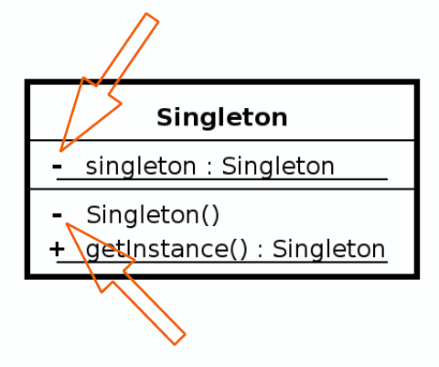
Cont’d
Design
Class is responsible for lifecycle
Static in nature (because we need to create with Class instance)
Needs to be thread-safe
Private constructor
No parameters in constructor otherwise it will be Factory Pattern

Slide 11
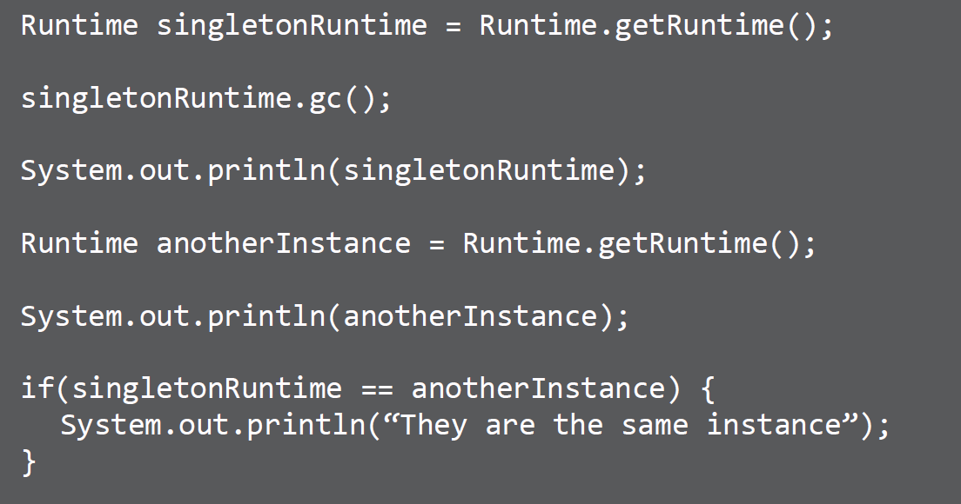
Cont’d
Example

Slide 12
Cont’d
Demo
Create Singleton
Demonstrate only one instance created
Lazy Loaded
Thread safe operation

Slide 13
Cont’d
Pitfalls
Often overused
Difficult to unit test (because we don’t have public constructor)
If not careful, not thread-safe
Sometime confused with Factory Pattern
Often confused that java.util.Calendar is NOT a Singleton, but its Prototype Pattern

Slide 14
Cont’d
Summary
Guarantee one instance
Easy to implement
Solves a well defined problem

Slide 16
Builder Pattern
helps us in creating immutable classes with a large set of state attributes and make object immutable
Handles complex constructors
Large number of parameters
Immutability
Examples:
StringBuilder
DocumentBuilder
Locale.Builder

Slide 17
Cont’d
Design
Flexibility over telescoping constructors
Static inner class
Calls appropriate constructor
Negates the need for exposed setters
Java 1.5+ can take advantage of Generics
Telescoping constructor means many constructors

Slide 18
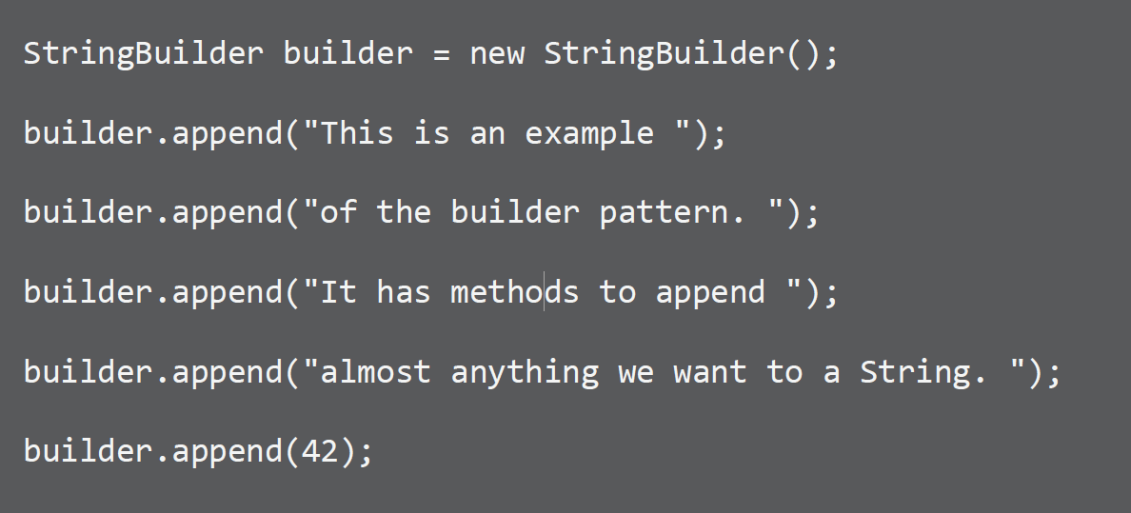
Cont’d
Example

Slide 19
Cont’d
Demo
Demonstrate Exposed Setters
Demonstrate Telescoping Constructors
Create Builder
Build Out Example

Slide 20
Cont’d
Pitfalls
Immutable ( always new object)
Inner static class
Designed first
Complexity – little bit
Method returns object

Slide 21
Cont’d
Contrast
Builder
Handles complex constructors
No interface required
Can be a separate class
Works with legacy code
Prototype
Implemented around a clone
Avoids calling complex
constructors
Difficult to implement in legacy code
Builder try to avoid creating complex constructors whereas prototype tries to avoid to call them again & again.

Slide 22
Cont’d
Summary
Creative way to deal with complexity
Easy to implement
Few drawbacks
Can refactor in with separate class

Slide 24
Prototype Pattern
Avoids costly creation
Avoids subclassing
Typically doesn’t use “new” ( use cloning mechanism )
Often utilizes an Interface
Usually implemented with a Registry
Example:
java.lang.Object#clone()

Slide 25
Cont’d
Design
Clone / Cloneable
Avoids keyword “new”
Although a copy, each instance unique
Costly construction not handled by client
Can still utilize parameters for construction
Shallow VS Deep Copy
Shallow copy often copy immediate properties whereas Deep copy of references

Slide 26
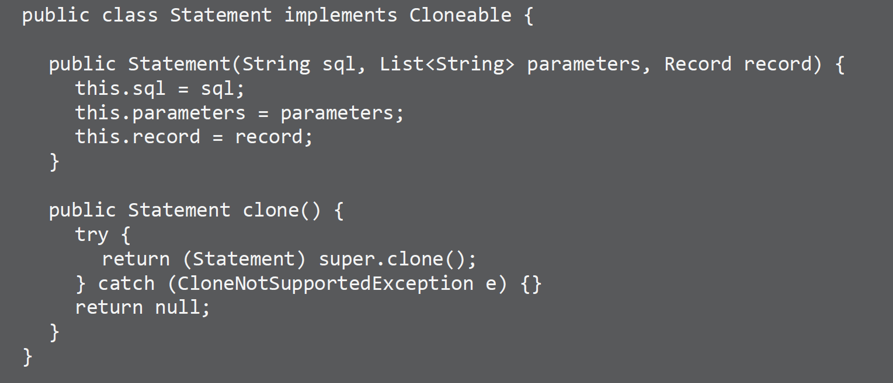
Cont’d
Example

Slide 27
Cont’d
Demo
Create Prototype
Demonstrate shallow copy
Create with a Registry

Slide 28
Cont’d
Pitfalls
Sometimes not clear when to use
Used with other patterns
Registry(helper class)
Shallow VS Deep Copy

Slide 29
Cont’d
Contrast
Prototype
Lighter weight construction
Copy Constructor or Clone
Shallow or Deep
Copy of itself
Factory
Flexible Objects
Multiple constructors
Concrete Instance
Fresh Instance

Slide 30
Cont’d
Summary
Guarantee unique instance
Often refactored in
Can help with performance issues
Don’t always jump to a Factory

Slide 32
Factory Pattern
Doesn’t expose instantiation logic
Defer to subclasses/polymorphsim
Common interface/abstract
Specified by architecture, implemented by user
Examples:
Calendar
ResourceBundle
NumberFormat Often people think Calendar is Singleton but its factory pattern where it initiate instance by calling different-different subclasses

Slide 33
Cont’d
Design
Factory is responsible for lifecycle
Common Interface/Abstract
Concrete Classes
Parameterized create method

Slide 34
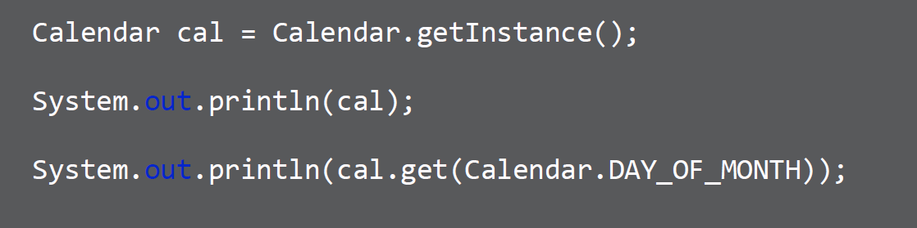
Cont’d
Example

Slide 35
Cont’d
Demo
Create Pages
Create Website
Create Concrete Classes
Create Factory
Enum

Slide 36
Cont’d
Pitfalls
Complexity
Creation in subclass
Refactoring

Slide 37
Cont’d
Contrast
Singleton
Returns same instance
One constructor method – no args
No Interface
No Subclasses
Factory
Returns various instances
Multiple constructors
Interface/abstract driven
Subclasses
Adaptable to environment more easily

Slide 38
Cont’d
Summary
Parameter Driven
Solves complex creation
A little complex
Opposite of a Singleton

Slide 40
Abstract Factory Pattern
Factory of Factories
Factory of related objects
Common Interface/abstract
Defer to Subclasses
Examples:
DocumentBuilder
Frameworks

Slide 41
Cont’d
Design
Groups Factories together
Factory is responsible for lifecycle
Common Interface/Abstract
Concrete Classes
Parameterized create method
Composition

Slide 42
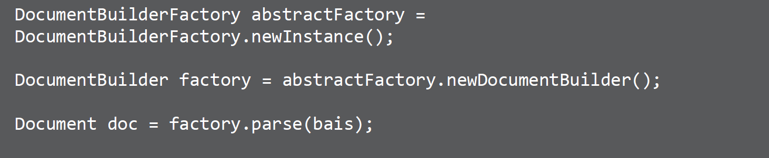
Cont’d
Example

Slide 43
Cont’d
Demo
Code Walkthrough
Abstract Factory
Factory
CredictCard Demo

Slide 44
Cont’d
Pitfalls
Complexity
Runtime switch
Pattern within a pattern
Problem specific
Starts as a Factory

Slide 45
Cont’d
Contrast
Factory
Returns various instances
Multiple constructors
Interface/abstract driven
Adaptable to environment more easily
Abstract Factory
Implemented with a Factory
Hides the Factory
Abstracts Environment
Built through Composition

Slide 46
Cont’d
Summary
Group of similar Factories
Complex
Heavy abstraction
Framework pattern

Slide 47


Slide 48
Conclusion!!!
https://www.facebook.com/groups/390467015549855
https://www.youtube.com/channel/UCdLKiOx6aWZZkQvALP3LiDw

