Slide 1


Overview of SOFA Features
25.6.2008

Slide 2
Force Fields
Francois Faure

Slide 3
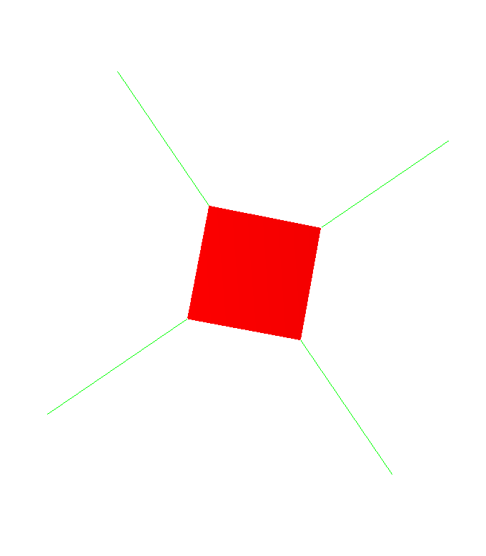
ConstantForceField
Constant forces applied to given degrees of freedom
  scenes/constantForce.scn

Slide 4
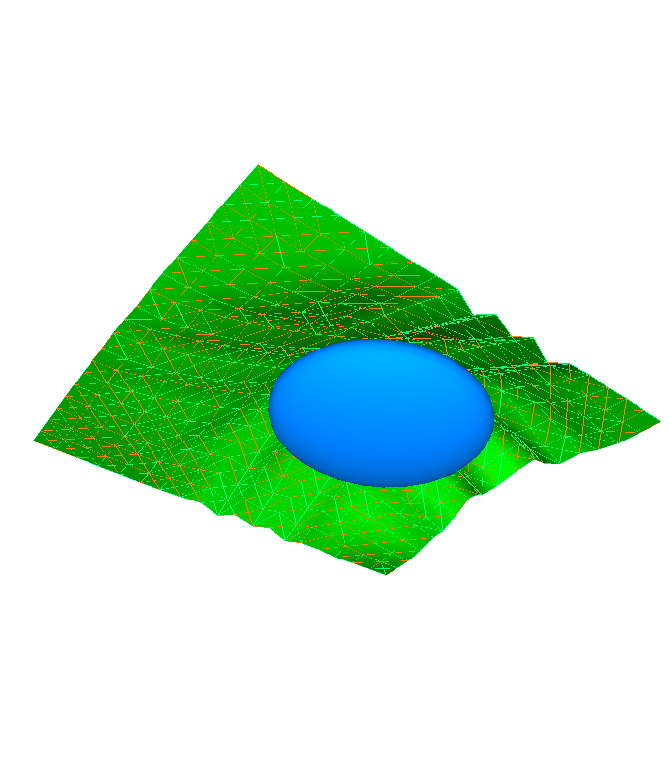
Implicit Force Fields
ConicalForceField
EllipsoidForceField
SphereForceField
  Repulsion applied by a cone/ellipsoid/sphere toward the exterior
  examples/conicalFF.scn
  scenes/Ellipsoid.scn
  scenes/triangleFEMSphere.scn
PlaneForceField
  Repulsion applied by a plane toward the exterior (half-space)
  scenes/2d.scn

Slide 5
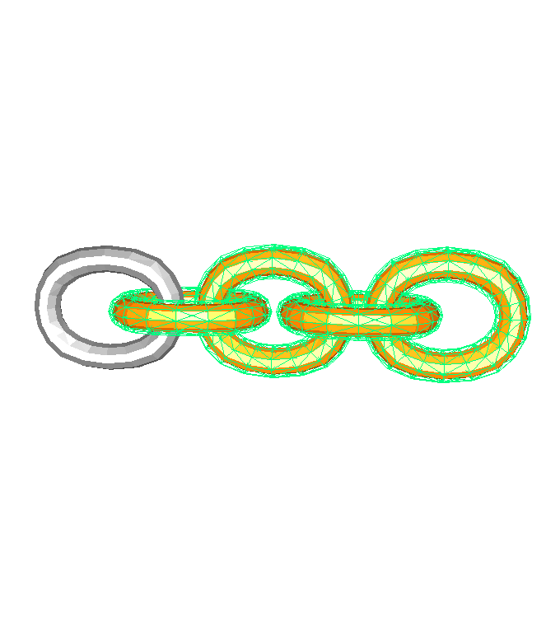
MeshSpringForceField
Spring force eld acting along the edges of a mesh
  scenes/chainSpring.scn

Slide 6
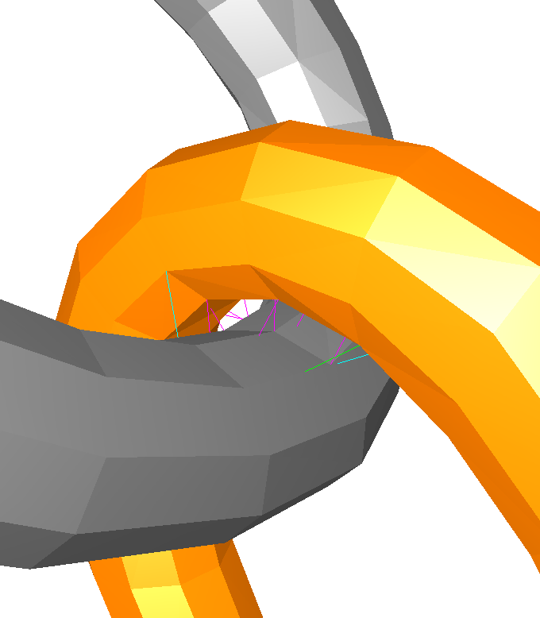
PenalityContactForceField
Contact using repulsive springs: in all our scenes using the proximity method to repulse objects in collision.

Slide 7
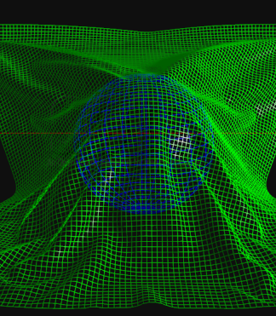
QuadBendingSprings
Springs added to a quad mesh to prevent bending
  scenes/quadSpringSphere.scn

Slide 8
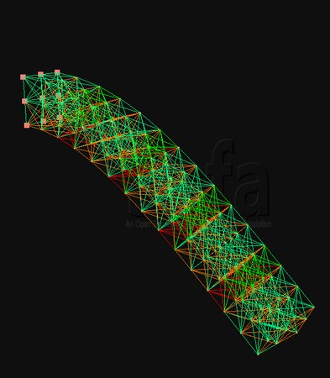
StiffSpringForceField
Stiff springs for implicit integration
  can be used between two objects or between the degrees of freedom of the same object
  examples/massSpring.scn

Slide 9
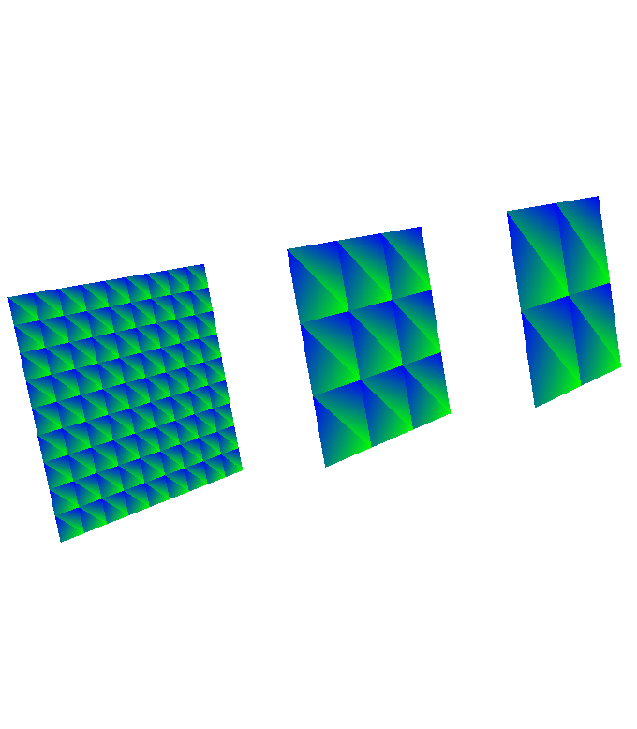
TriangleFEMForceField
Triangular finite elements
  scenes/triangleFEM.scn

Slide 10
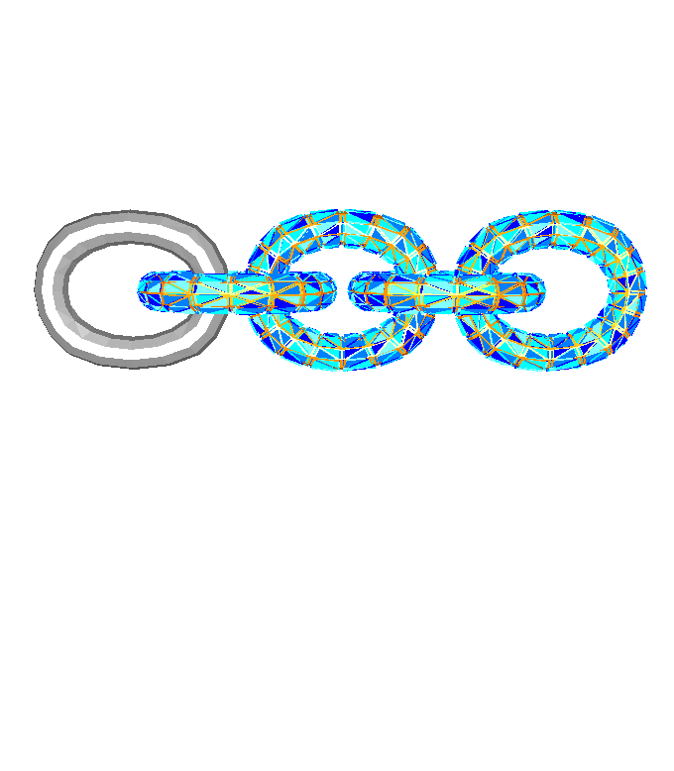
TetrahedronFEMForceField
Tetrahedral finite elements
  scenes/chainFEM.scn

Slide 11
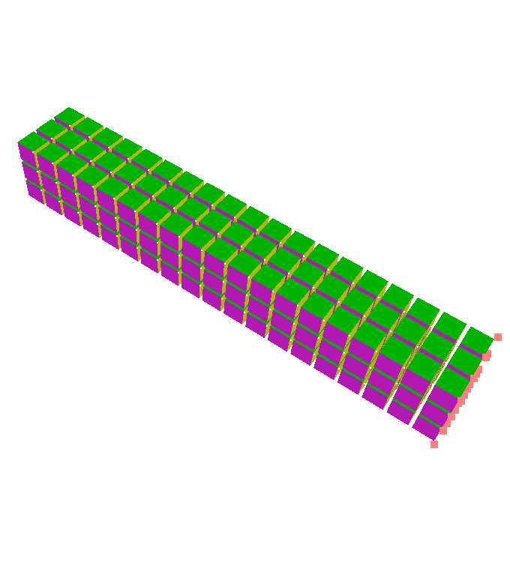
HexahedronFEMForceField
Hexahedral finite elements
  scenes/beamHexahedraFEM.scn

Slide 12
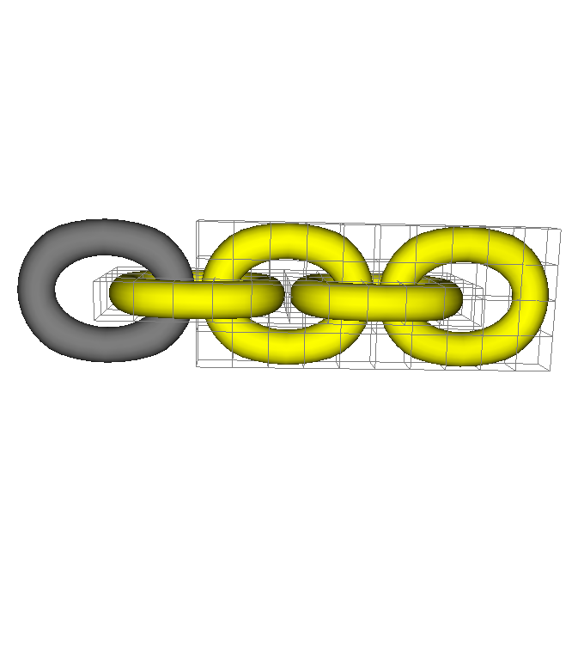
RegularGridSpringForceField
Spring acting on the edges and faces of a regular grid
  scenes/chainFFD.scn

Slide 13
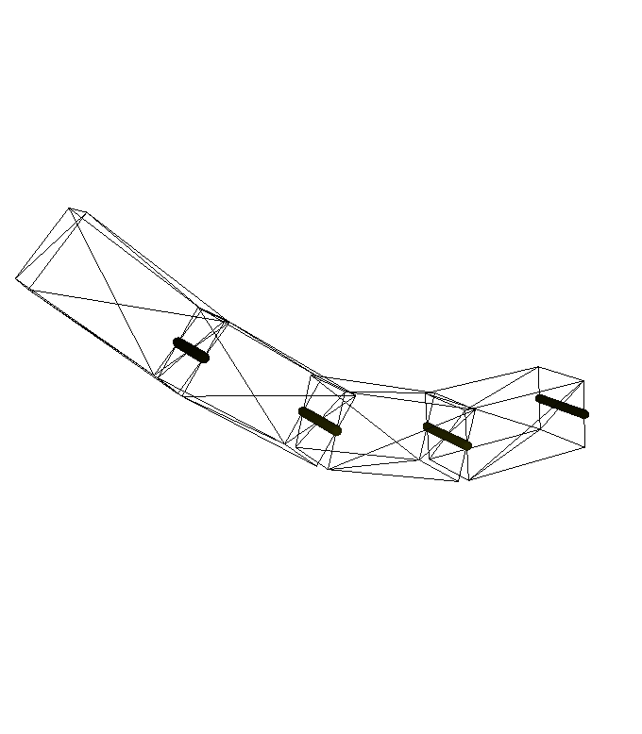
JointSpringForceField
Equivalent of the SpringForceField but for Rigid
  examples/softArticulations.scn

Slide 14
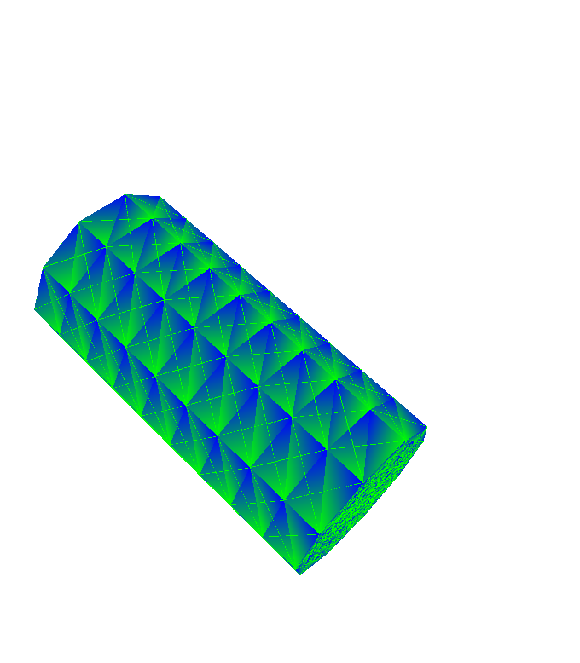
TrianglePressureForceField
Triangle Pressure
  scenes/TopoMap_cylinder3d.scn

Slide 15
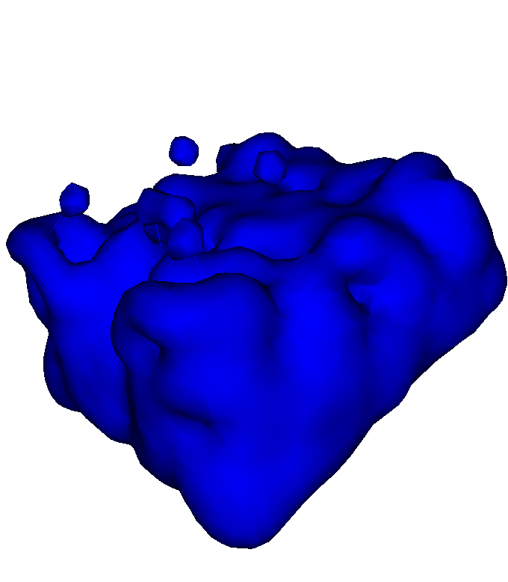
LennardJonesForceField
Lennard-Jones forces for fluid
  examples/fluidLennardJones.scn

Slide 16
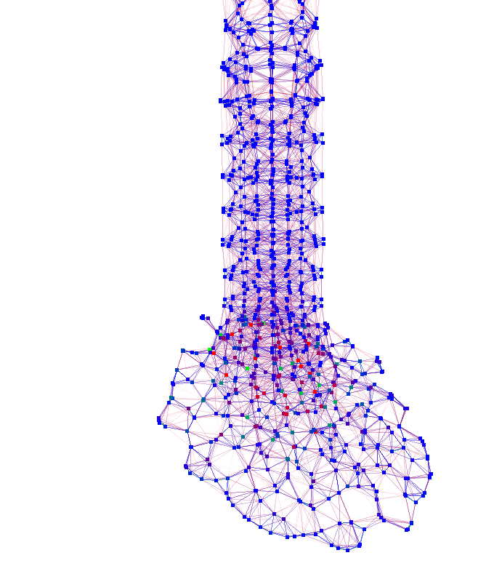
SPHFluidForceField
Smooth Particle Hydrodynamics
  examples/demoSPHFluid.scn

Slide 17
Mappings
Francois Faure

Slide 18
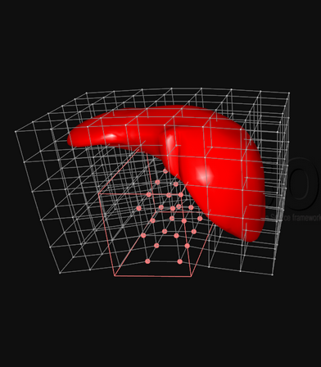
BarycentricMapping
Mapping using barycentric coordinates of the child with respect to the cells of its parent
  the most used mapping in Sofa
  can be found in lots of scenes needing mapping between deformable objects
  scenes/chainFEM.scn

Slide 19
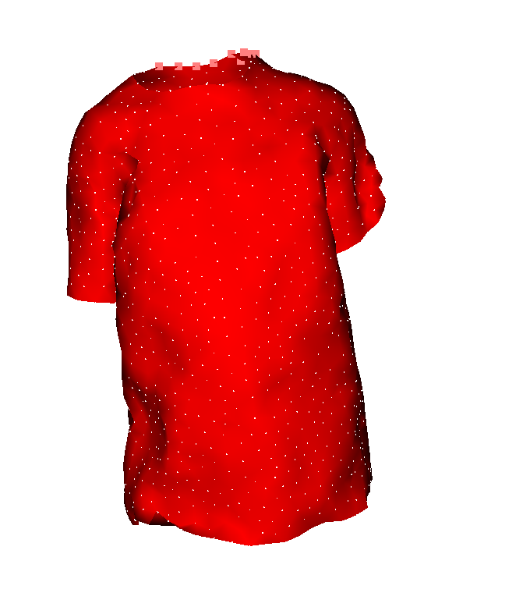
IdentityMapping
Special case of mapping where the child points are the same as the parent points
  can be used, e.g., for data conversion
  examples/demoTshirtFEM.scn

Slide 20
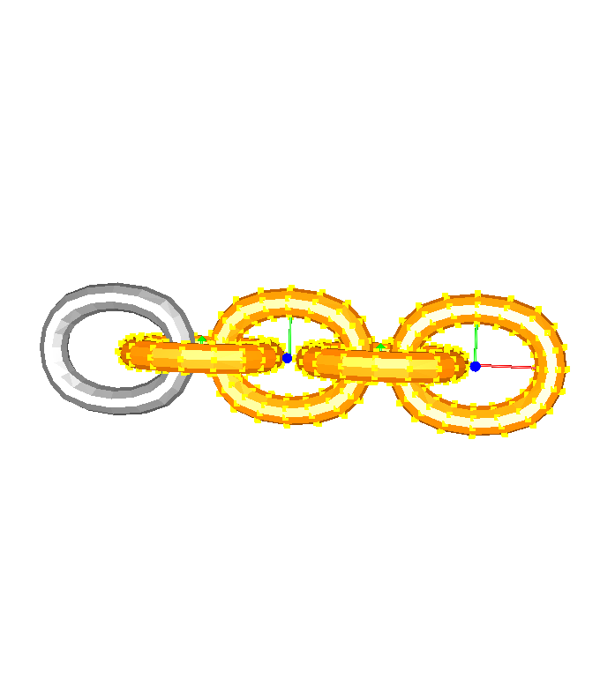
RigidMapping
Set the positions and velocities of points attached to a rigid parent
  scenes/chainRigid.scn

Slide 21
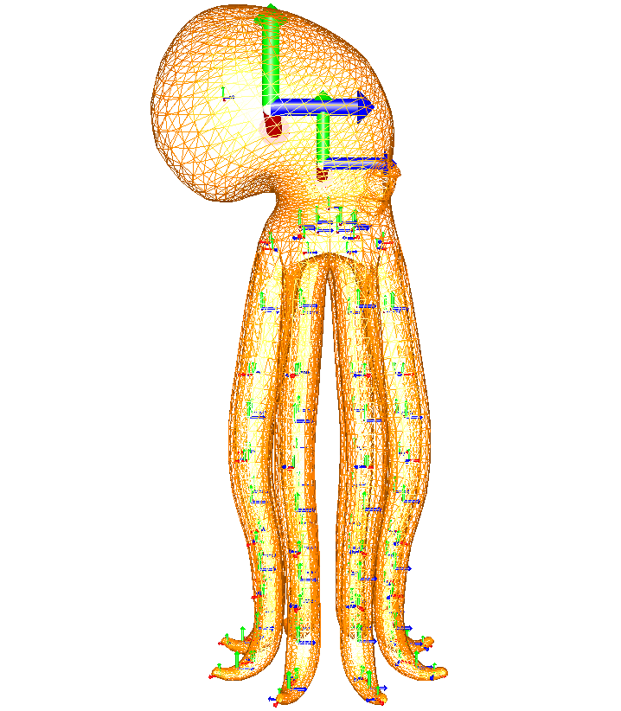
SkinningMapping
  examples/SkinnedRigidPendulum.scn

Slide 22
Constraints
Christian Duriez

Slide 23
Constraints

Slide 24
GUI
Florent Falipou

Slide 25
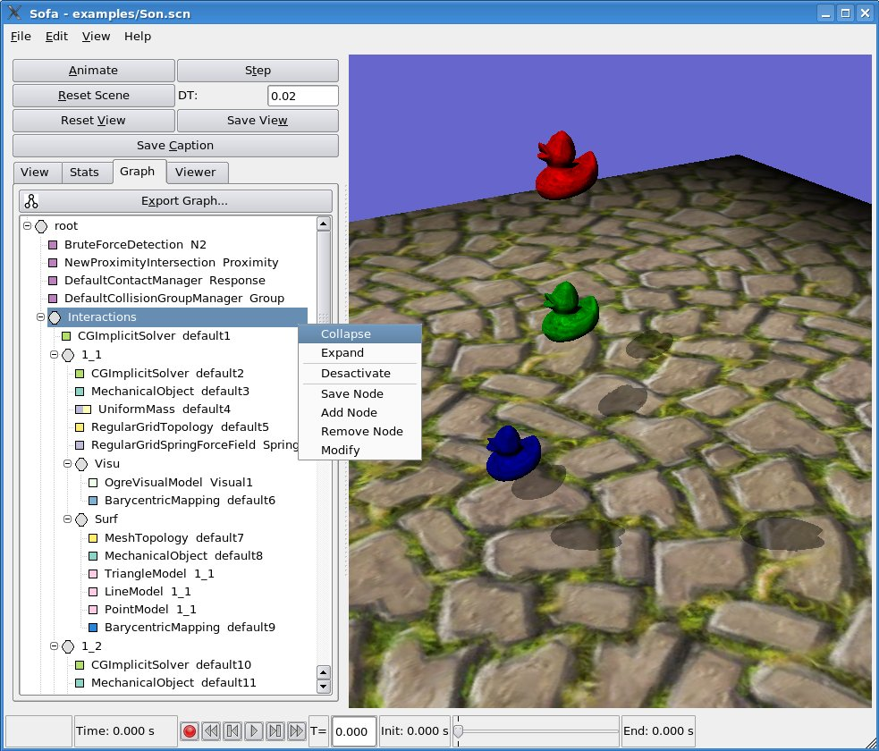
GUI

Slide 26
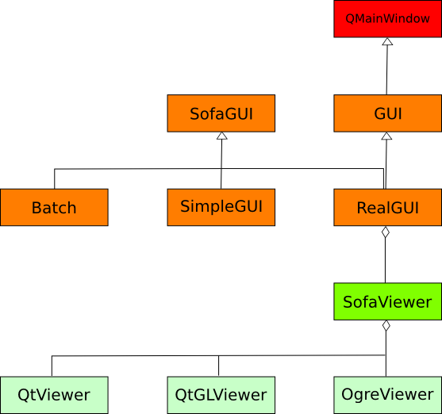
GUI - Architecture

Slide 27
SOFA::MAYA
Michaël Adam

Slide 28
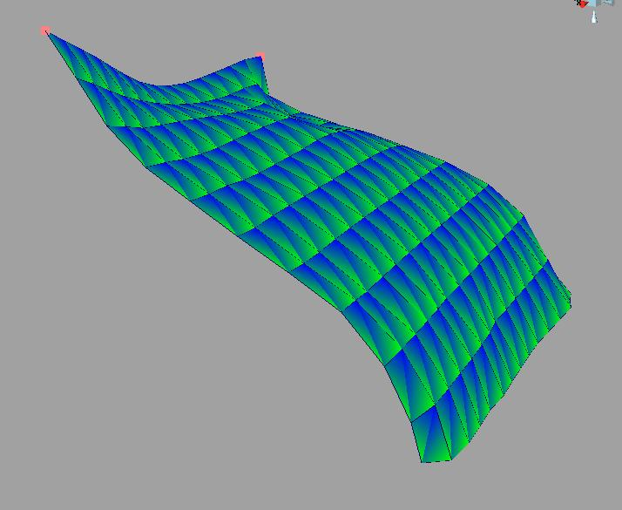
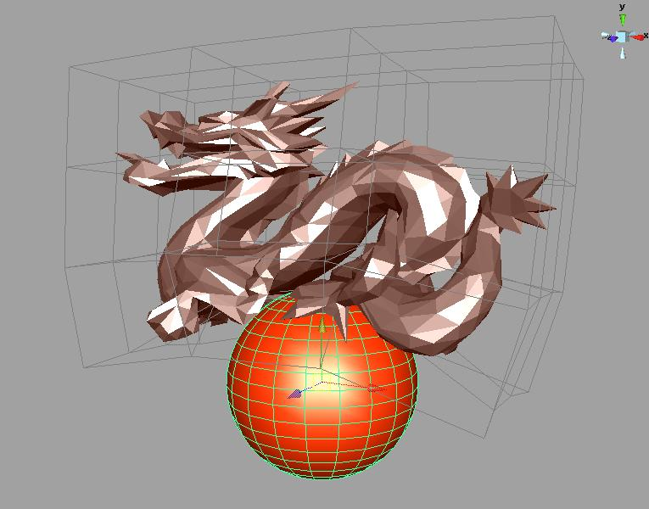
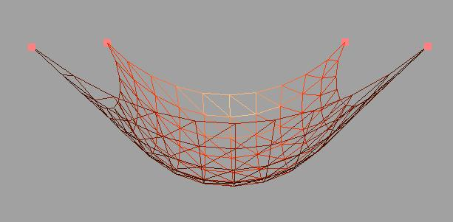
Current Possibilities
Simulate deformable objects with different Sofa models
  FEM
  Stiff Springs
  FFD Grid

Slide 29
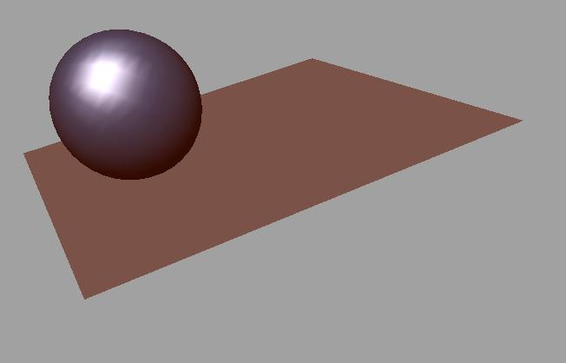
Current Possibilities
Simulate rigid objects
  active
  inactive

Slide 30
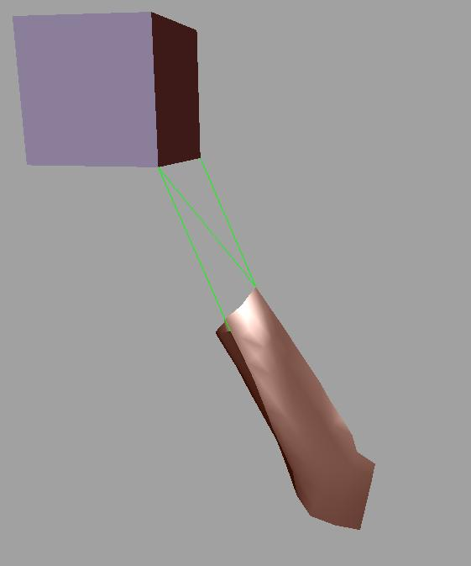
Current Possibilities
Perform collisions
Add constraints
Build interactions

Slide 31
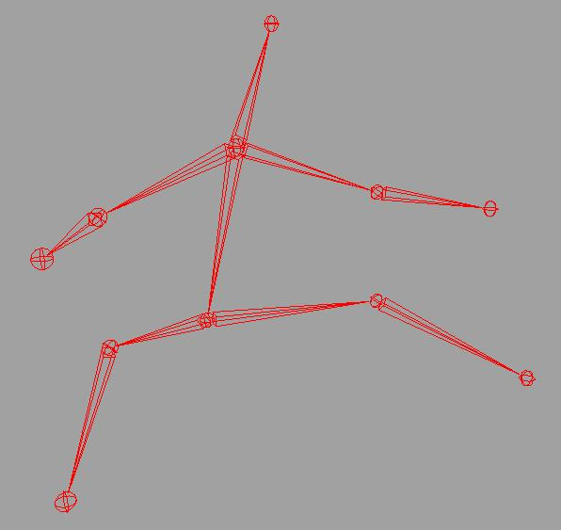
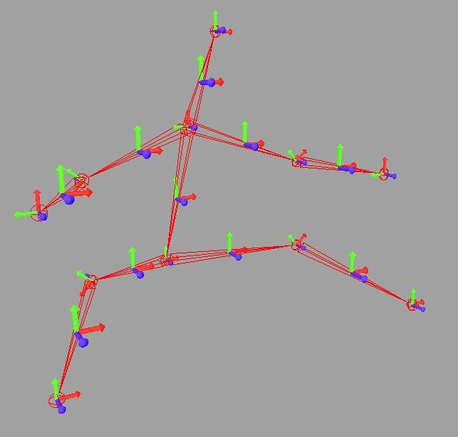
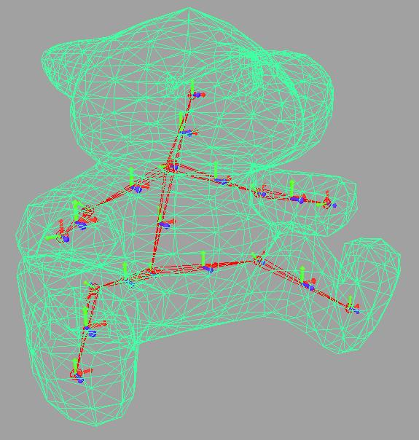
Current Possibilities
Simulate articulated bodies
  Create the Sofa rigid body structure directly from Maya skeleton.
  Create the associated skinning in Sofa from the skinning weights used in Maya.

Slide 32
Current Possibilities
Export sofa scenes
  Save a scene created with Maya to .scn file.
  Then open it directly into Sofa.
Import sofa scene
  Open a .scn file into Maya.
  Modify the scene, play the simulation using Maya interactivity.

Slide 33
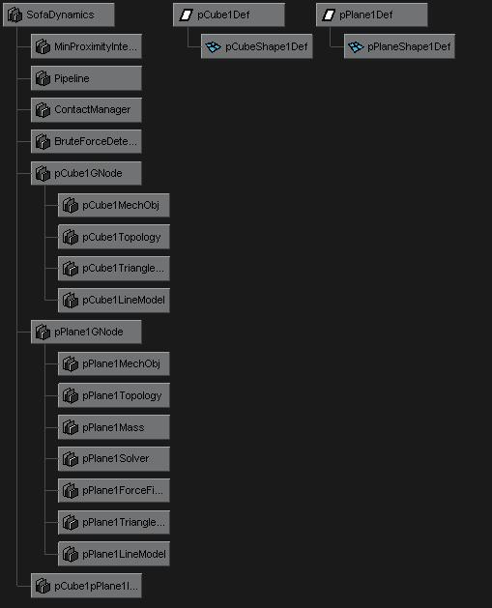
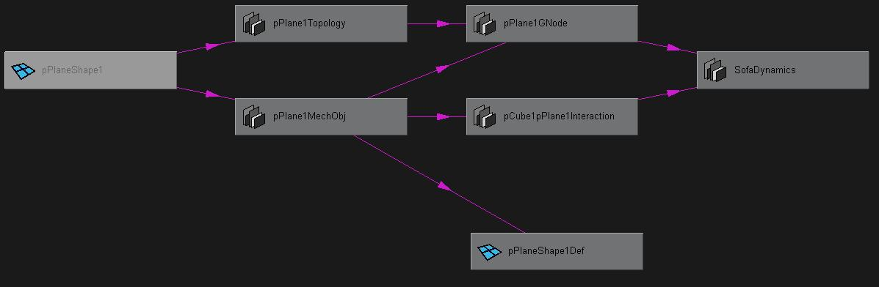
Integration of SOFA
Make Sofa as a Maya plug-in
  Put the Sofa scene graph into the Maya scene graph.
  For each Sofa object, a Maya node is created.

Slide 34
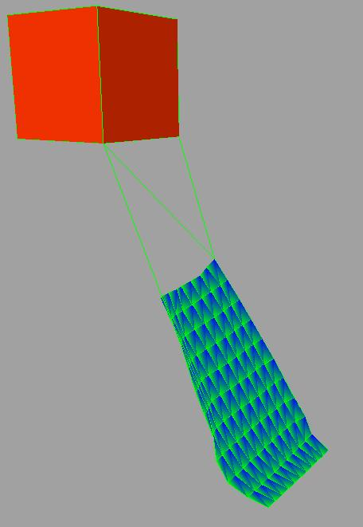
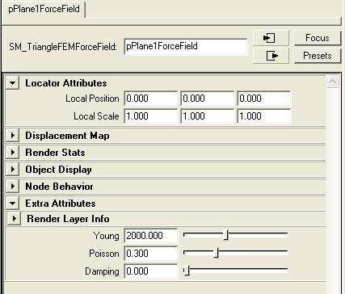
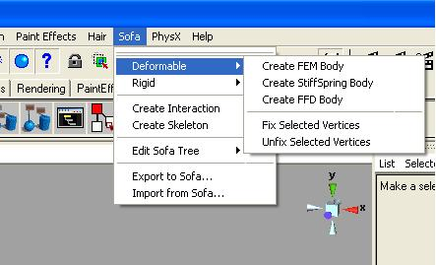
User Interface
A Sofa menu.
Sofa objects parameters can be changed.
Sofa objects display is plugged into the Maya scene.

Slide 35
Using Blender Functionalities with SOFA
Vincent Vansuyt

Slide 36
Blender's imports and exports for SOFA
SOFA
BLENDER
XML SCENE FILE
Import and export
Objects
- meshes
- positions
- colors

Slide 37
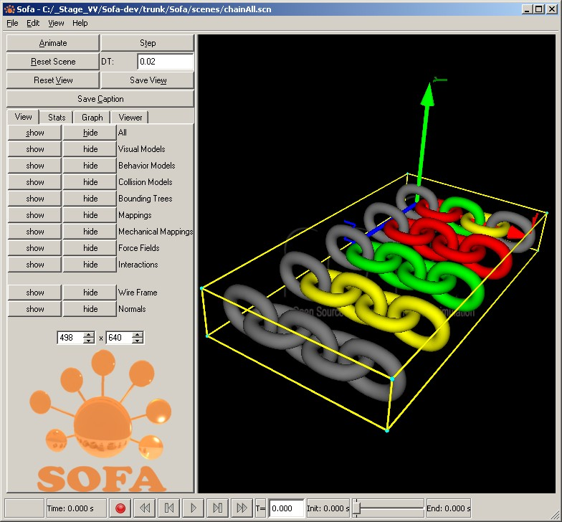
Blender's imports from SOFA (1/5)
XML SOFA scene "ChainAll.scn"

Slide 38
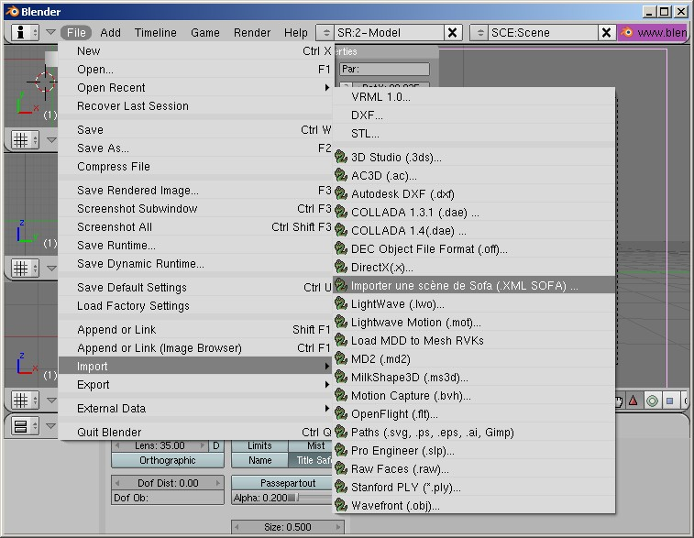
Blender's imports from SOFA (2/5)

Slide 39
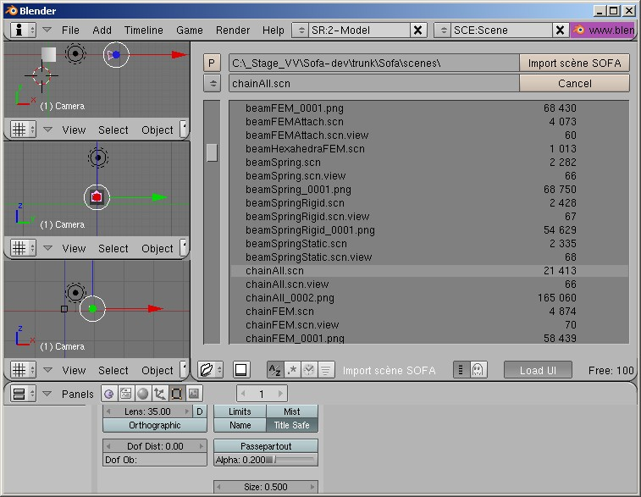
Blender's imports from SOFA (3/5)

Slide 40
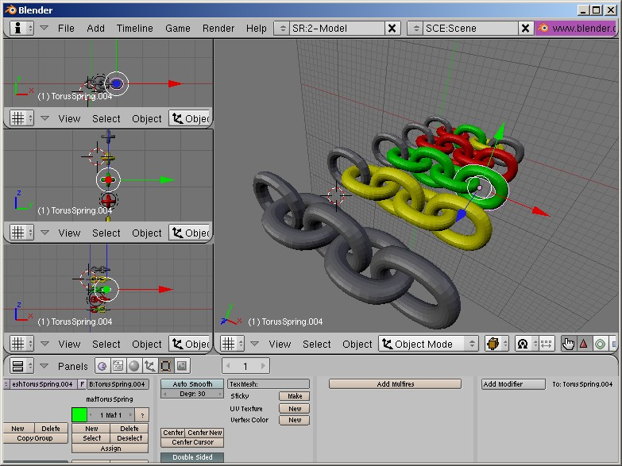
Blender's imports from SOFA (4/5)

Slide 41
Blender's imports from SOFA (5/5)

Slide 42
Blender's exports to SOFA (1/2)

Slide 43
Blender's exports to SOFA (2/2)

Slide 44
Computing mesh center of mass and inertia matrix (1/7)
Brian MIRTICH's C-code transposed into Python-code for Blender

Slide 45
Computing mesh center of mass and inertia matrix (2/7)

Slide 46
Computing mesh center of mass and inertia matrix (3/7)

Slide 47
Computing mesh center of mass and inertia matrix (4/7)

Slide 48
Computing mesh center of mass and inertia matrix (5/7)

Slide 49
Computing mesh center of mass and inertia matrix (6/7)

Slide 50
Computing mesh center of mass and inertia matrix (7/7)

Slide 51
Articulated Bodies
Christian Duriez

Slide 52
Articulated Bodies

Slide 53
Soft Articulations
Michaël Adam

Slide 54
Soft Articulations: Concepts
Objective : simulate articulations using stiff forces (no constraint)‏
  +: More stable, there is always a solution
  - : Not yet optimized for tree structure
Use of 6-DOF springs
  Stiffness on each axis of translation and rotation. Null stiffness in the allowed directions.
  Implemented on standard Sofa rigid types
  Need a specific mapping (rigid to rigid)‏
  - : Currently instabilities in case of large rotations

Slide 55
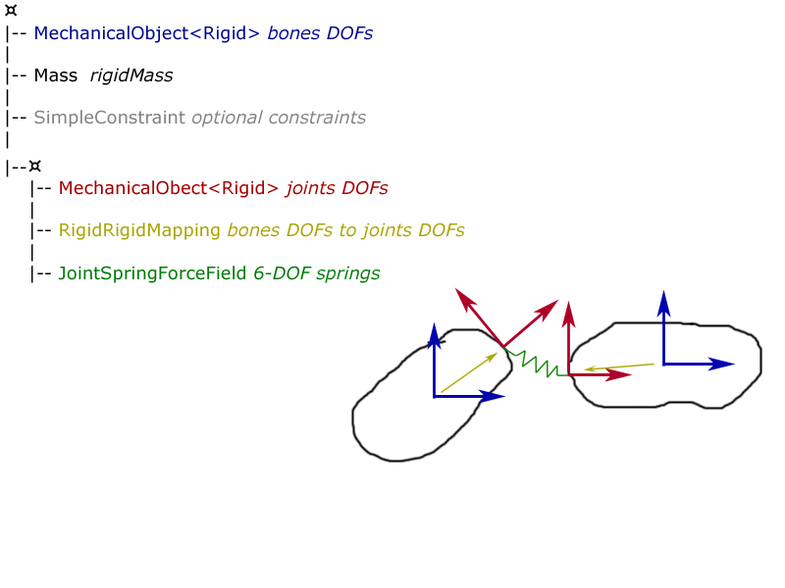
Corresponding scene graph
Corresponding Scene Graph

Slide 56
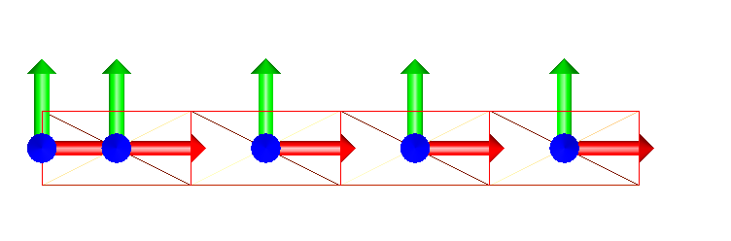
Skinning
A simple skinning mapping is used for now.
  It is possible to give directly the weights list to the mapping.
  Else, user defines a number of references n that will be used for mapped points.
  Then, each mapped point will search its n nearest DOFs, and then compute the skinning weights (w = 1/d²).

Slide 57
Parallelization
Everton Hermann

Slide 58
Parallelization
Extract tasks from the scene graph
Tasks Scheduling and Partitioning
Static and dynamic assignment between sofa objects and processors
Task Graph visualization
Parallel execution of tasks inside an object and between different objects
Implemented using KAAPI/Athapascan

Slide 59
CUDA
Jeremie Allard

Slide 60
CUDA

Slide 61
Fluids
Jeremie Allard

Slide 62
Fluids

Slide 63
Haptics
Christian Duriez

Slide 64
Haptics

