Slide 1

Constraint process in SOFA

Slide 2


An (medical) example
Simulation of a coil embolization
www.sofa-framework.org

Slide 3
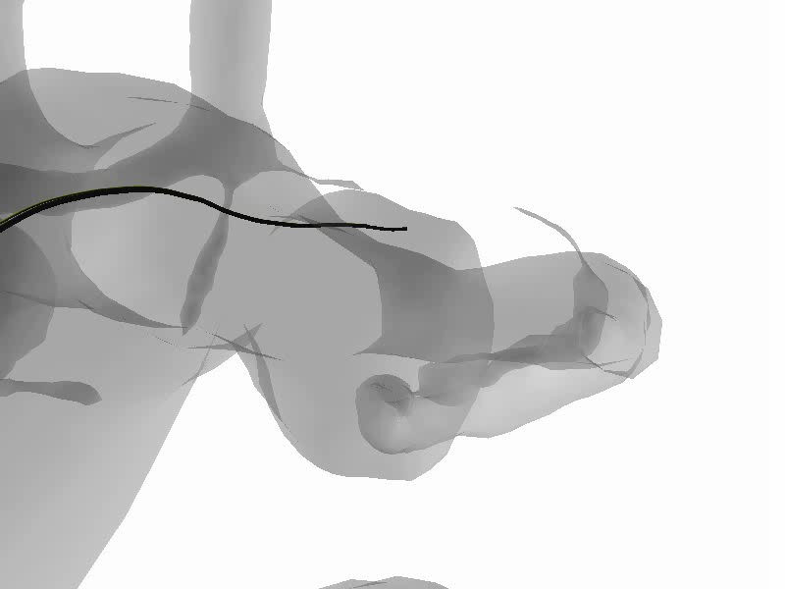
An example
Simulation of a coil embolization
  Bilateral constraints
    Micro-catheter / coil
  Friction contact
    coil / aneurysm wall
www.sofa-framework.org

Slide 4
Type of constraint process available in SOFA
Projection
  Bilateral constraints
Computation by corrective motion
  Unilateral with or without friction
  Bilateral constraints (soon…)
Mapping (DOF reduction : the objects under the mapping are driven by the DOF upper)
  Bilateral constraints
www.sofa-framework.org

Slide 5
Projection
Works with solvers (CG) of SOFA:
  The velocity of the constraint points is projected to a desired value:
  Class:
    FixedConstraint
    BoxConstraint
    AttachConstraint (forces are exchanged and added between the constraint points)
www.sofa-framework.org

Slide 6
Corrective motion
Works with “MasterContactSolver” in SOFA:
  The simulation scheme is modified :
    A « free » motion is performed (without constraints).
    Constraints forces are computed (based on the violation of the constraints during the free motion),
    then a « corrective » motion is performed to correct this violation.
  Class
    UnilateralInteractionConstraint (with an option for friction)
    ConstraintCorrection Class
www.sofa-framework.org

Slide 7
Mapping
DOF reduction:
  Define new parameters using the mapping
    Articulation position (Articulated System Map., Laparoscopic Map.)
    Curve position (Curve Map.)
Filters (?)
=>Constraints are solved somehow “implicitly”
www.sofa-framework.org

Slide 8
Lagrange x
Tentative of using Lagrange multipliers:
  existing class
    LagrangianMultiplierAttachConstraint
    LagrangianMultiplierConstraint
    LagrangianMultiplierContactConstraint
    LagrangianMultiplierFixedConstraint
  problems
    only compatible with the biconjugate-gradient of sofa
    two thinks are mixed : the constraint definition / the way the constraint is solved
    does not work…
www.sofa-framework.org

Slide 9
attempt for a unification
Rq: We just have separate Integration scheme choice from Matrix system solver choice (possibility to use external library)…
It’s time to separate :
  Constraint formulation (Fixed, Attach, Point on a Plane, Point on a Line)
  The way it is solved (Projection, Lagrange x, Corrective Motion)
We keep the solution of the mapping apart
  It is not based on a constraint formulation
www.sofa-framework.org

Slide 10
Issues for a unification
Several issues:
  The constraint could be applied on the position (imposed displacement), on velocity (imposed velocity) or acceleration (imposed acc)
    This will not provide the exact same results
    Can be linked with the Integration scheme (Baumgart scheme)
  Compatibility with CGLinearSolver (and the future BiConjugateGradientLinearSolver)
    With lagrange multiplier
      Each Lagrange multipliers can be considered as a new dof
      These dofs are not part of the constraint object
        case of interaction constraints
        the size of the constraint could be different than the type of the constraint object
    With corrective motion
      Sometimes Split holonomic constraints (free motion) / non honolomic constraints (constraint motion)
www.sofa-framework.org

Slide 11
Issues for a unification
Several issues:
  Compatibility with external solver
    Constraint could be applied under a mapping:
      we need the matrix of the constraint direction on the dof space
      All constraint should be compliant with VecConst
      All “Mechanical Mapping” should implement applyJt (VecConst…)
    Common definition of the constraint
      distinguish the constraint type: bilateral, unilateral, friction
      distinguish what constraint should be handled by the external solver / the one that should be not
Other issues ?
www.sofa-framework.org

Slide 12
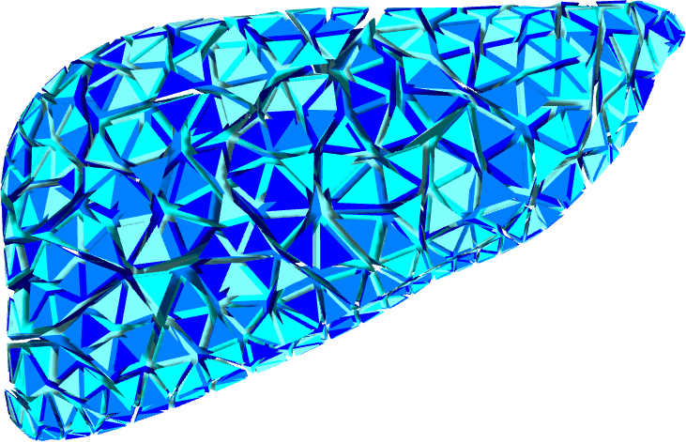
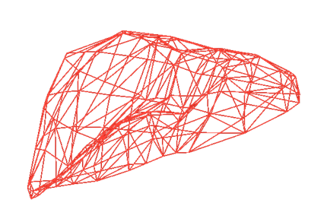
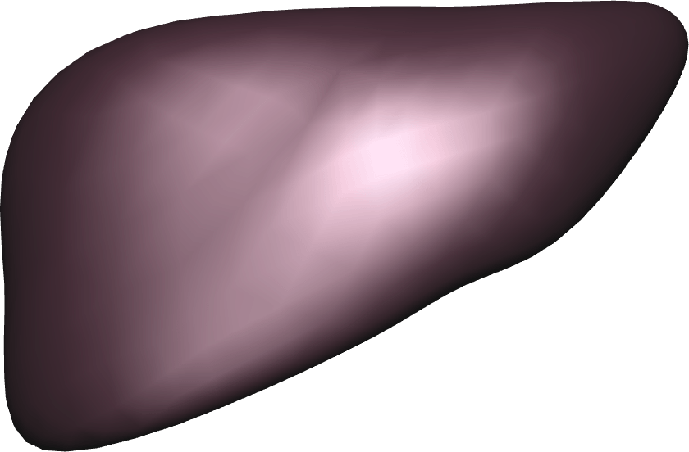
Issues for a unification
(M/dt + B + K dt) v = f_{ext} - f_{int}
A v = b
C v ≥ d
?
?
Mapping
Mapping
Visualization
www.sofa-framework.org

Slide 13
Proposal
New definition of constraints
  Several characteristics:
    A type (Bilateral, Unilateral,…)
    A size, a set of direction, indices of constraints points => VecConst
    Displacement / Velocity / Acceleration
    (optional) corresponding violation when the constraint is created
  No indication on the way it is globally solved :
    local indication… like the way you can project the constraint could be useful
www.sofa-framework.org

Slide 14
Proposal
Lagrange multiplier support
Root
Object1
Object2
Mapping
Constraint
Object1map
www.sofa-framework.org

Slide 15
Proposal
Lagrange multiplier support within SOFA
  A new state is created for Lagrange x
    Its size = the size of the constraints
    It allows for new DOF for the Lagrange x
Root
Object1
Object2
LagrangeX
Mapping
Constraint
Object1map
www.sofa-framework.org

Slide 16
Proposal
Lagrange multiplier support within SOFA
  A new state is created for Lagrange x
    Its size = the size of the constraints
    It allows for new DOF for the Lagrange x
  New “interactioncomponent” (terminology ?)
    Computes the non-diagonal terms
    Specific implementation of type
      « addForce »
      « addDForce »
Root
Object1
Object2
LagrangeX
VecConst = H2
Δv₀ += H1 Δv1
+H2 Δv1
Mapping
f += H2^{T} λ
[ M1 0 H1] [ Δv1 ] =[ f1 ]
[ 0 M2 H2] [ Δv2 ] =[ f2 ]
[ H1^{T} H2^{T} 0 ] [ λ ] [Δv₀ ]
Object1map
Constraint
VecConst = h1
With H1 = J^{T} h1
f += h1^{T} λ
www.sofa-framework.org

Slide 17
Proposal
Lagrange multiplier support with external solver
  VecConst are sent upward through the mapping
  Explicit construction of H1 and H2
  M1 and M2 are constructed as it is done actually
Root
Object1
Object2
VecConst = H1
VecConst = H2
Mapping
[ M1 0 H1] [ Δv1 ] =[ f1 ]
[ 0 M2 H2] [ Δv2 ] =[ f2 ]
[ H1^{T} H2^{T} 0 ] [ λ ] [Δv₀ ]
Object1map
Constraint
VecConst = h1
www.sofa-framework.org

Slide 18
Proposal
Lagrange multiplier support
  Imposed motion (displ, vel, acc ?)
  How to compute the violation ?
Root
Euler Implicit ODE
- I work with velocity
- (optional) Baumgart
Object1
Object2
[ M1 0 H1] [ Δv1 ] =[ f1 ]
[ 0 M2 H2] [ Δv2 ] =[ f2 ]
[ H1^{T} H2^{T} 0 ] [ λ ] [Δv₀ ]
Mapping
Δv₀, Δq₀ ?
Object1map
[ M1/dt 0 H1] [ Δq1 ] =[ f1 ]
[ 0 M2/dt H2] [ Δq2 ] =[ f2 ]
[ H1^{T} H2^{T} 0 ] [ λ ] [Δq₀ ]
Constraint
My violation is defined with Δq
Corresponding Δv₀ is…
www.sofa-framework.org

Slide 19
Open discussion…

