Slide 1


Slide 2
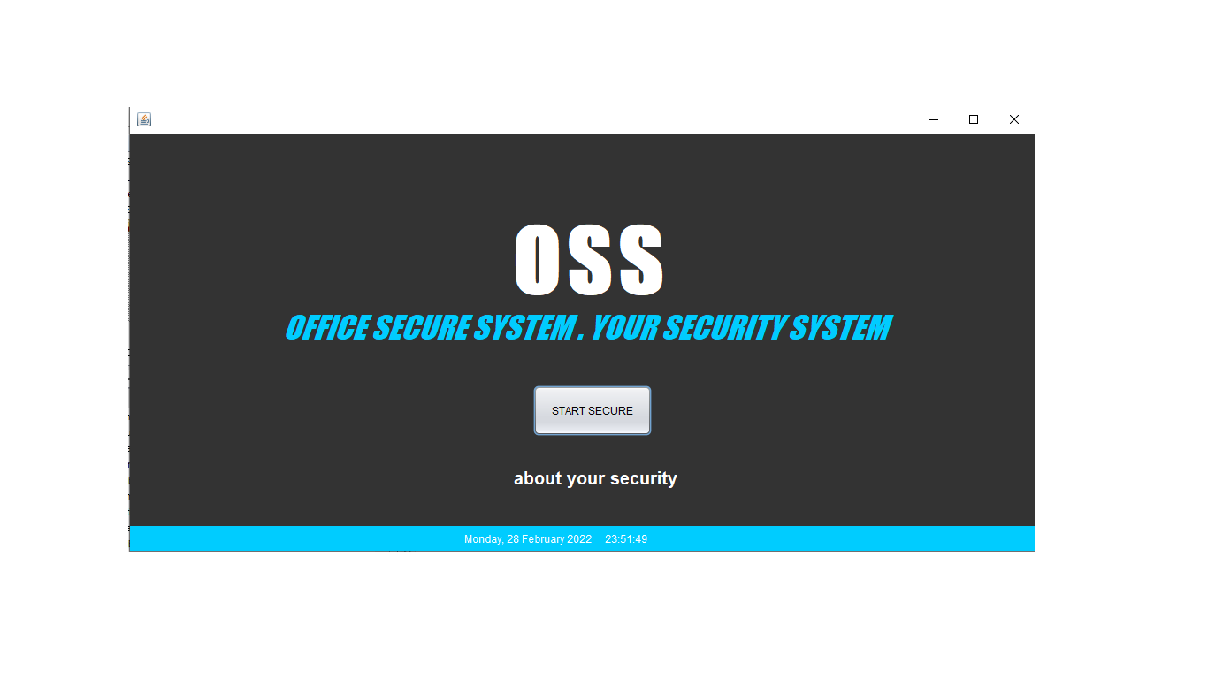
MAIN PAGE

Slide 3
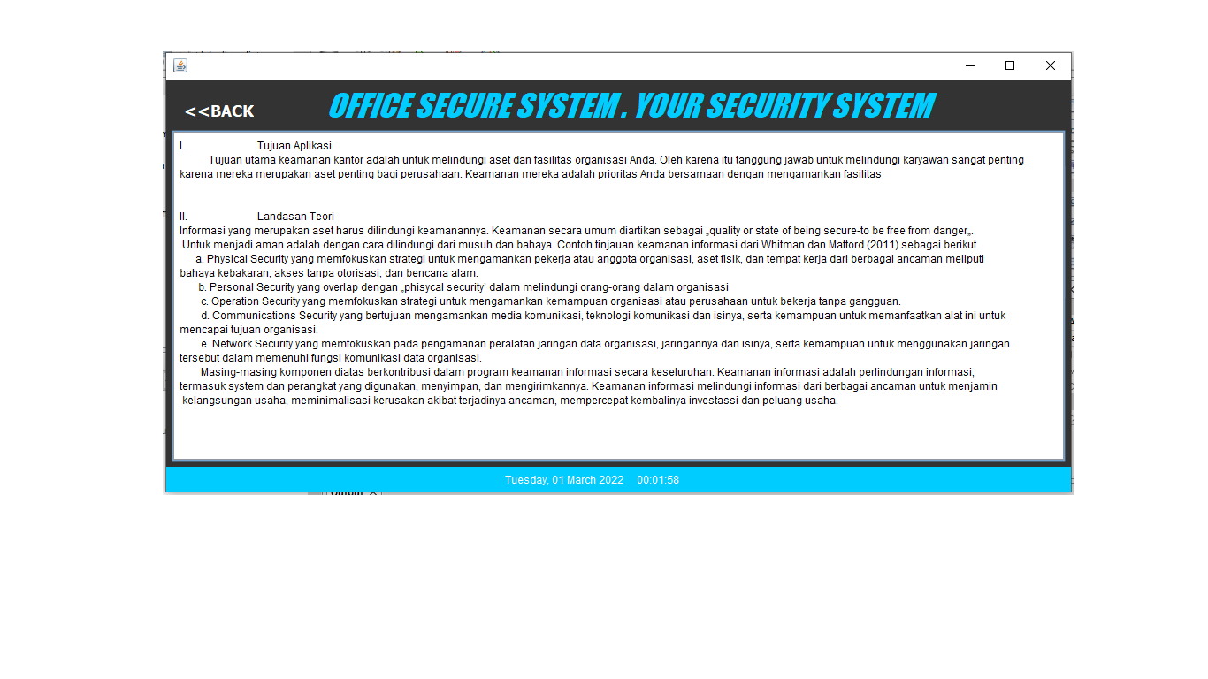
ABOUT PAGE

Slide 4
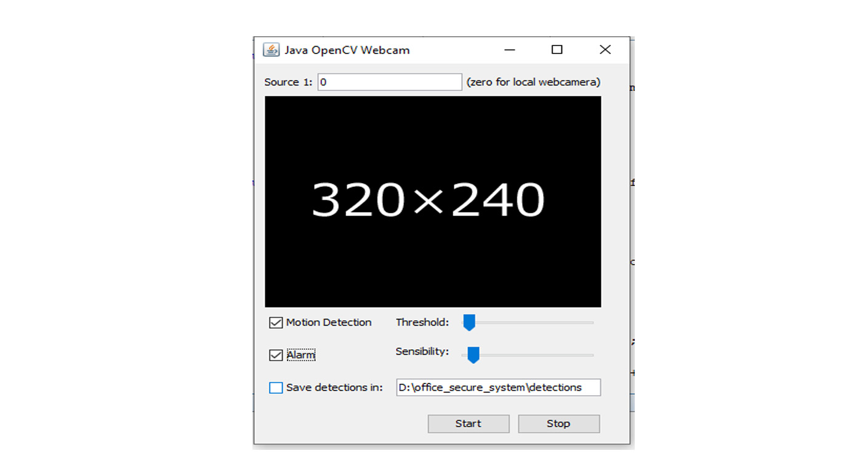
MOTION DETECTOR PAGE STANDBY (WHEN START SECURE BUTTON WAS PUSH)

Slide 5
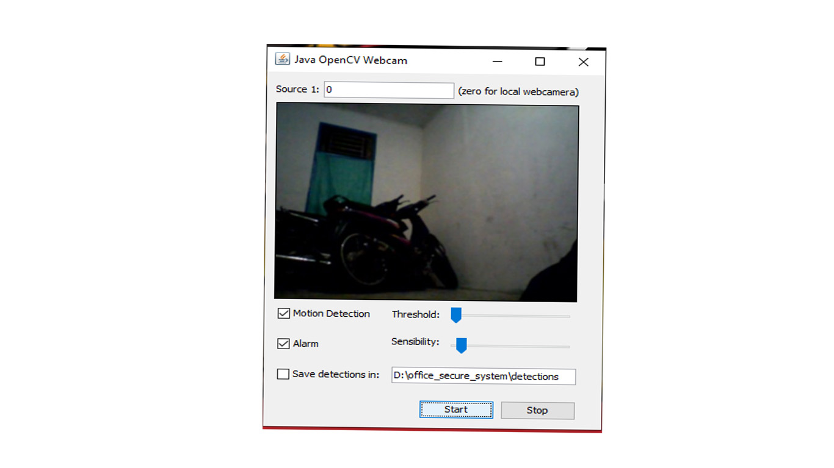
MOTION DETECTOR PAGE RUN (WHEN PUSH START BUTTON)

Slide 6
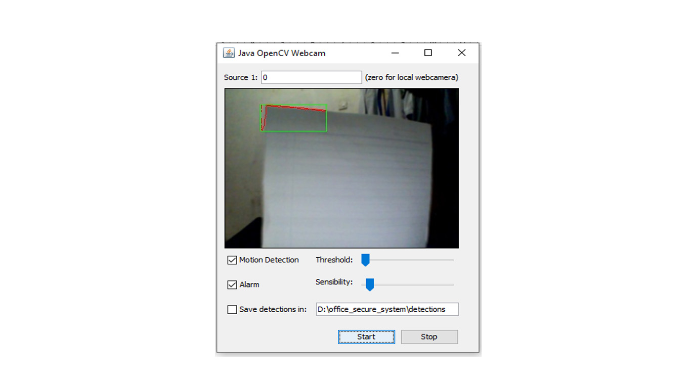
MOTION DETECTOR PAGE RUN (DETECT A MOTION)

Slide 7
MOTION DETECTOR OFF (STOP BUTTON PUSH)

Slide 8
MOTION DETECTOR OFF (STOP BUTTON PUSH)

Slide 9
OFFICE SECURE SYSTEM . YOUR SECURITY SYSTEM

