Slide 1

Rules for Myassist

Slide 2
Why Rules?
Higher level of abstraction than code
Separation of concerns
Can be inspected/defined by non-developers
Faster turnaround/deployment time
Possibilities for optimisation (Rete algorithm)
2
CR/AEX3 | 10/07/2017
© Robert Bosch GmbH 2017. All rights reserved, also regarding any disposal, exploitation, reproduction, editing, distribution, as well as in the event of applications for industrial property rights.

Slide 3
The Rete Algorithm
A naive implementation of an expert system might check each rule against known facts in a knowledge base, firing that rule if necessary, then moving on to the next rule (and looping back to the first rule when finished). For even moderate sized rules and facts knowledge-bases, this naive approach performs far too slowly. The Rete algorithm provides the basis for a more efficient implementation. A Rete-based expert system builds a network of nodes, where each node (except the root) corresponds to a pattern occurring in the left-hand-side (the condition part) of a rule. The path from the root node to a leaf node defines a complete rule left-hand-side. Each node has a memory of facts which satisfy that pattern. This structure is essentially a generalized trie. As new facts are asserted or modified, they propagate along the network, causing nodes to be annotated when that fact matches that pattern. When a fact or combination of facts causes all of the patterns for a given rule to be satisfied, a leaf node is reached and the corresponding rule is triggered.
3
CR/AEX3 | 10/07/2017
© Robert Bosch GmbH 2017. All rights reserved, also regarding any disposal, exploitation, reproduction, editing, distribution, as well as in the event of applications for industrial property rights.

Slide 4
When to use Rules?
Numerical Algorithms
Heavy lifting of classification/identifying patterns
Is this a picture of a cat?
What kind of personality does this person have
What are his musical tastes
Rules:
Ad hoc policy issues and preferences
could vary from product to product or user to user
Smart Preferences
When is a good opportunity …
For which people …
To disturb me with notifications about which kinds of events.
What is good time of day
For which activities that I have planned with no specific time
More use cases ?
4
CR/AEX3 | 10/07/2017
© Robert Bosch GmbH 2017. All rights reserved, also regarding any disposal, exploitation, reproduction, editing, distribution, as well as in the event of applications for industrial property rights.

Slide 5
Does it have to be Javascript?
Industry standards:
Drools: the mainstream Java business solution https://www.drools.org/
Drools is a Business Rules Management System (BRMS) solution. It provides a core Business Rules Engine (BRE), a web authoring and rules management application (Drools Workbench) and an Eclipse IDE plugin for core development.
CLIPS: golden oldie https://sourceforge.net/projects/clipsrules/
CLIPS is probably the most widely used expert system tool.^{[1]} CLIPS incorporates a complete object-oriented language (hence the acronym COOL) for writing expert systems. CLIPS itself is written in C, extensions can be written in C, and CLIPS can be called from C. Its user interface closely resembles that of the programming language Lisp. COOL combines the programming paradigms of procedural, object oriented and logical (theorem proving) languages.
JESS: java implementation of a superset of CLIPS https://herzberg.ca.sandia.gov/
Using Jess, you can build Java software that has the capacity to "reason" using knowledge you supply in the form of declarative rules. Jess is small, light, and one of the fastest rule engines available. Its powerful scripting language gives you access to all of Java's APIs. Jess includes a full-featured development environment based on the award-winning Eclipse platform.
5
CR/AEX3 | 10/07/2017
© Robert Bosch GmbH 2017. All rights reserved, also regarding any disposal, exploitation, reproduction, editing, distribution, as well as in the event of applications for industrial property rights.

Slide 6
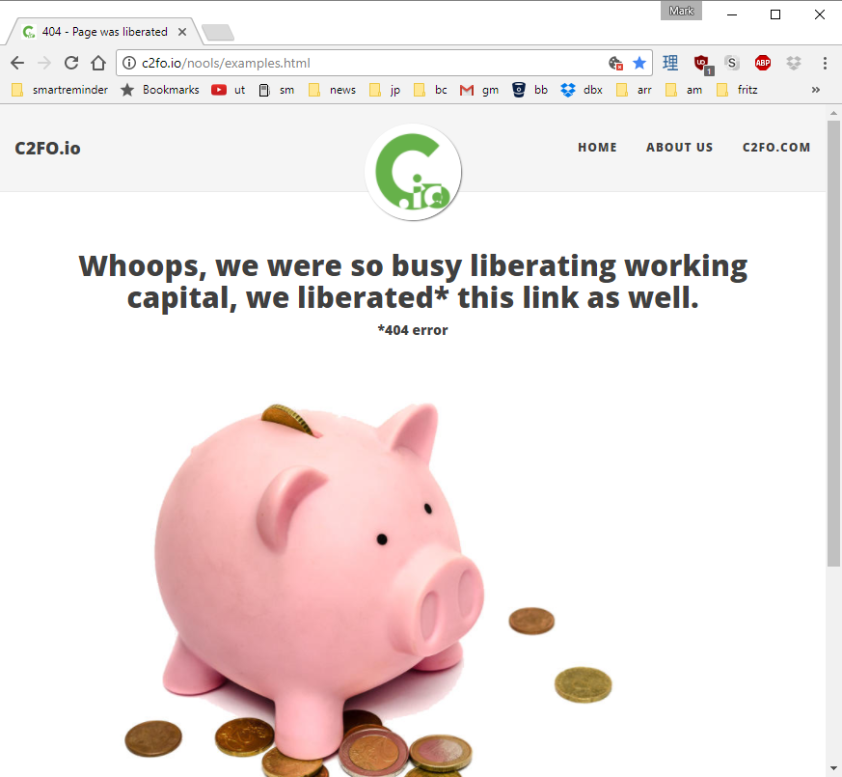
Nools is abandonware
6
CR/AEX3 | 10/07/2017
© Robert Bosch GmbH 2017. All rights reserved, also regarding any disposal, exploitation, reproduction, editing, distribution, as well as in the event of applications for industrial property rights.

Slide 7
If it still has to be Javascript …
https://github.com/jruizgit/rules : still active
https://github.com/cachecontrol/json-rules-engine : supposed to use "simple json structures"
https://github.com/mithunsatheesh/node-rules : older
https://github.com/iannsp/rulezb : A Business Rule Engine for rule them all
https://github.com/atrniv/node-clips : an interface to clips, older (see above)
https://github.com/rsamec/business-rules-engine : older
https://github.com/maxant/rules: somehow useful for both java and node.js
7
CR/AEX3 | 10/07/2017
© Robert Bosch GmbH 2017. All rights reserved, also regarding any disposal, exploitation, reproduction, editing, distribution, as well as in the event of applications for industrial property rights.

Slide 8
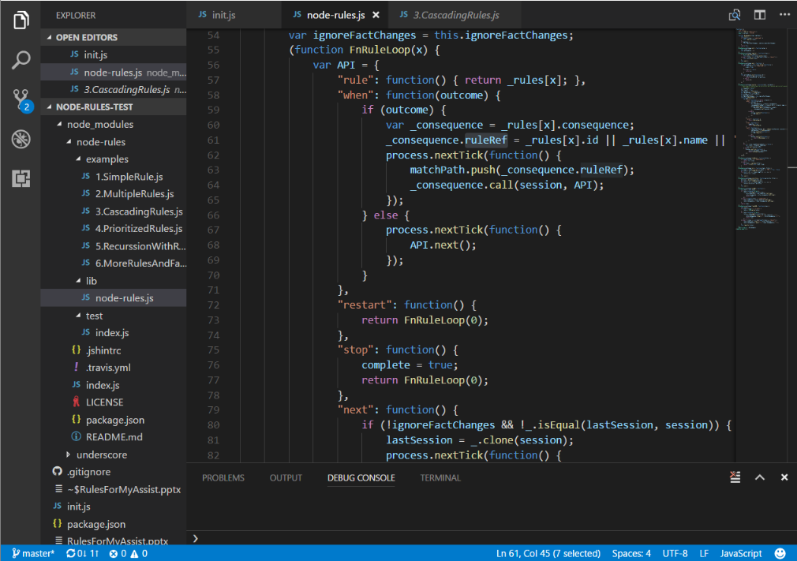
Node-rules is tiny!
8
CR/AEX3 | 10/07/2017
© Robert Bosch GmbH 2017. All rights reserved, also regarding any disposal, exploitation, reproduction, editing, distribution, as well as in the event of applications for industrial property rights.

Slide 9
What’s in a rule?
var rules = [{
"condition": function(R) {
R.when(this.application === "MOB");
},
"consequence": function(R) {
this.isMobile = true;
R.next();//we just set a value on to fact, now lets process rest of rules
}
}, {
"condition": function(R) {
R.when(this.cardType === "Debit");
},
"consequence": function(R) {
this.result = false;
this.reason = "The transaction was blocked as debit cards are not allowed";
R.stop();
}
}];
9
CR/AEX3 | 10/07/2017
© Robert Bosch GmbH 2017. All rights reserved, also regarding any disposal, exploitation, reproduction, editing, distribution, as well as in the event of applications for industrial property rights.

Slide 10
Invocation
Dream:
observe all variables in system and optimally react to changes
Reality:
call rules system explicitly with a given context at a given time
10
CR/AEX3 | 10/07/2017
© Robert Bosch GmbH 2017. All rights reserved, also regarding any disposal, exploitation, reproduction, editing, distribution, as well as in the event of applications for industrial property rights.

Slide 11
Use Cases
When is a good opportunity …
to be disturbed by notifications/reminders …
about which kinds of events …
related to which people.
What is a good time of day …
For which activities that I have planned with no specific time
More Please !!
11
CR/AEX3 | 10/07/2017
© Robert Bosch GmbH 2017. All rights reserved, also regarding any disposal, exploitation, reproduction, editing, distribution, as well as in the event of applications for industrial property rights.

